Slide 1
Three-Tiered Truancy Intervention Plan
Tennessee Data and Attendance Supervisors Conference
September 13, 2018

Slide 2
Pre Tier I – Dyersburg City
Prior to Enacting Tier 1, Dyersburg City Schools
Met with the Juvenile Court Personnel to discuss the new law and talk about options, including incarcerating parents
Met with Dyer County Schools to get similar plans throughout the county
Send Three Day Letters to ALL Parents when a student misses 3 Days, regardless of the Type of Excuse
Set up an Attendance Web Page
Used App to push out Attendance Messages

Slide 3
Tier I—Cocke County
At the fifth unexcused absence, the attendance clerk calls student into office to talk to student about absences and gives them three (3) days to have parent, guardian, or other person in parental relation to contact school to set up a parental conference, or a conference call meeting in which the parent and student are able to meaningfully participate.
A conference with the student and the student’s parent(s)/guardian(s);
An attendance contract, based on the conference, signed by the student, the parent(s)/guardian(s), and an attendance supervisor or designee. The contract shall include:
A specific description of the school’s attendance expectations for the student;
The period for which the contract is effective; and
Penalties for additional absences and alleged school offenses, including additional disciplinary action and potential referral to juvenile court; and
Give parent a copy of the contract and attendance report

Slide 4
Tier I—Cocke County
Regularly scheduled follow-up meetings to discuss the student’s progress.
If a student or parent does not show up for the conference, or conference call meeting:
After at least two attempts to meet with the student or parent the school may document that the student’s parent or guardian is unwilling to cooperate in the truancy intervention plan. The director of schools or designee may report the student’s absences to the appropriate judge

Slide 5
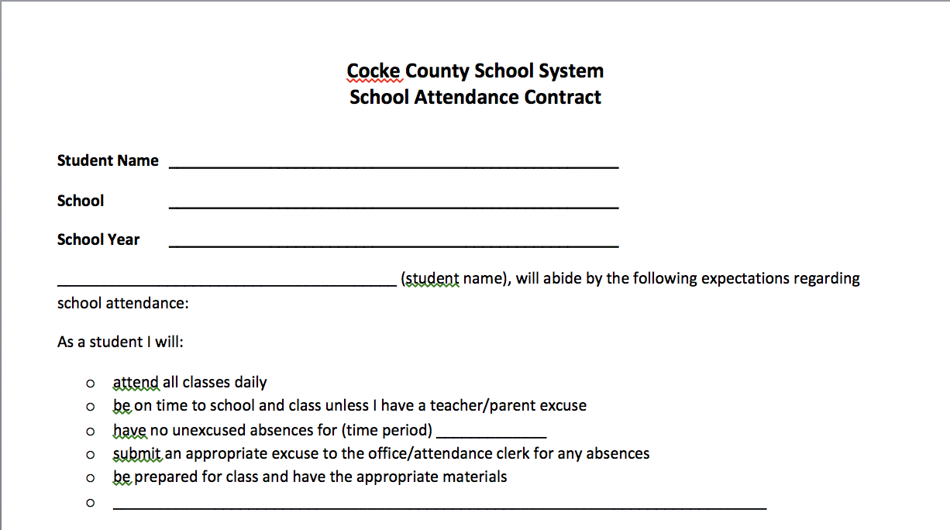

Slide 6
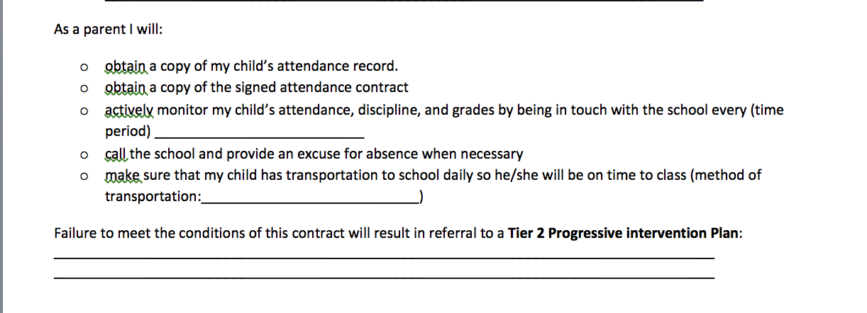

Slide 7
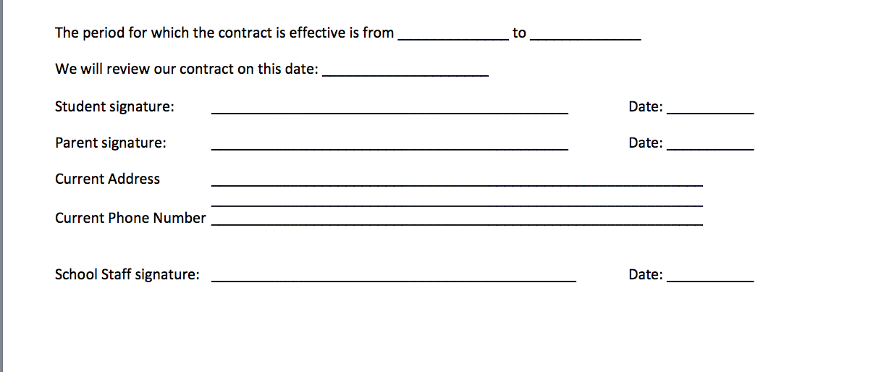

Slide 8
Tier I—Hawkins County
Tier 1 is triggered when a student accumulates 3 unexcused absences. The school will schedule a conference with the parent to formulate a plan in hopes of avoiding any further unexcused absences. Preferably, the conference will be in person. If the parent is not reached on the first attempt, the school shall make at least 2 more documented attempts in the first 10 days of the child accumulating the 3rd unexcused absence. If the school is still unsuccessful at reaching the parent(s), the school shall meet without the parent(s). If the parent(s) does schedule the meeting and does not show, one more attempt at scheduling a conference will be made before meeting without the parent(s).

Slide 9
Tier I—Hawkins County
The principal or his/her designee will conduct the conference with the parent(s) and student if age appropriate. During the conference the Tier 1 Truancy Contract will be completed, and a plan will be developed and implemented for the student. The contract will expire at the end of the current school year. The principal/designee will determine what supports are available for the family, and he/she would discuss the value of education with the family. Any unused parent notes or any doctors’ notes may be accepted at this time, even if it is past the allowable 5 days to turn in a note. The principal or his/her designee will inform parent(s) the next unexcused will trigger Tier 2, and with continued unexcused absences, the child is subject to further truancy interventions.

Slide 10
Tier I—Hawkins County
A review meeting should be set within the next 90 days or end of the semester, whichever occurs first. If the student misses another unexcused day prior to the review meeting, the review meeting will be rescheduled as quickly as possible. If the interventions were successful, the follow up meeting may be conducted over the phone. The parent(s) should be informed that if another unexcused absence does occur, Tier 2 will still be triggered.

Slide 12
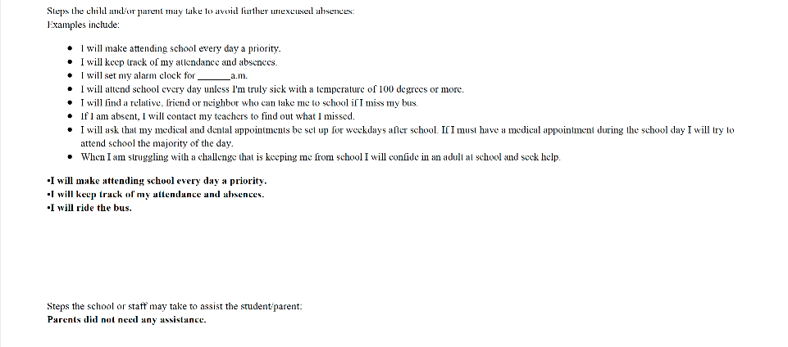

Slide 13
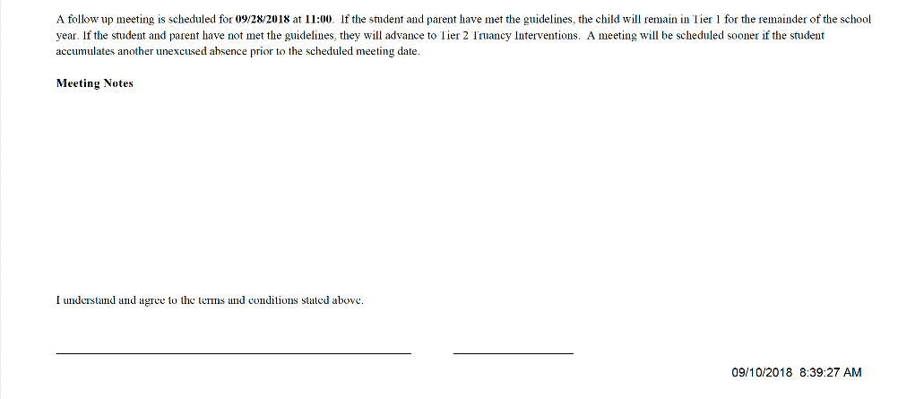

Slide 14
Dyersburg City – Tier I
Triggered at the 5th unexcused day
5 Day Letter
Meeting with the Attendance Support Person
Signed Attendance Contract
“Regular Scheduled Meeting” is triggered at the 7th unexcused absence

Slide 15
Tier II—Cocke County
If a student accumulates additional unexcused absences in violation of the attendance contract in Tier I, the student will be subject to Tier II.
Under this tier, a school employee shall conduct an individualized assessment detailing the reasons a student has been absent from school. The employee may refer the student to counseling, community-based services, or other services to address the student’s attendance problems.
(Family Resource, Coordinated Health School Nurse, RTI, etc.)
If a student does not show up for the conference:
After at least two attempts to meet with the student the student will be subject to Tier III

Slide 16
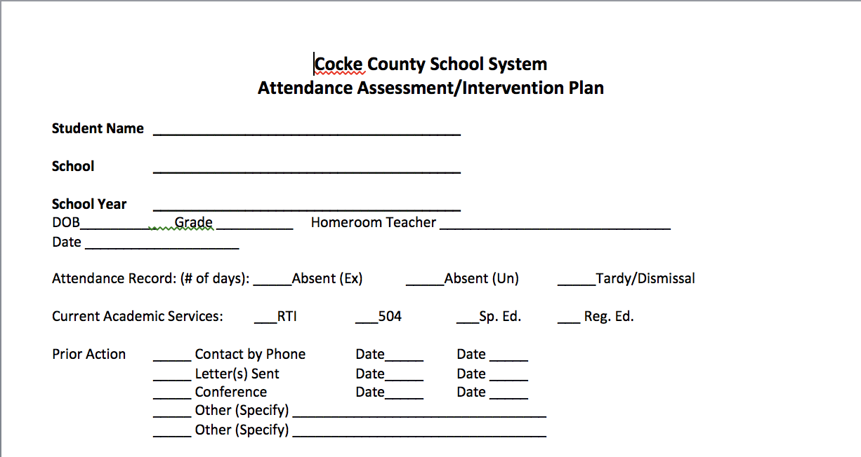

Slide 17
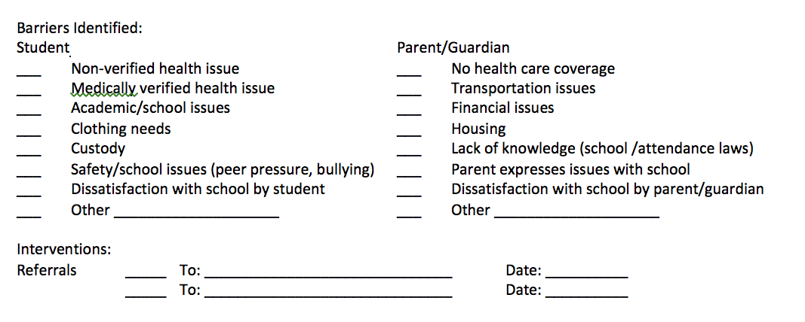

Slide 18
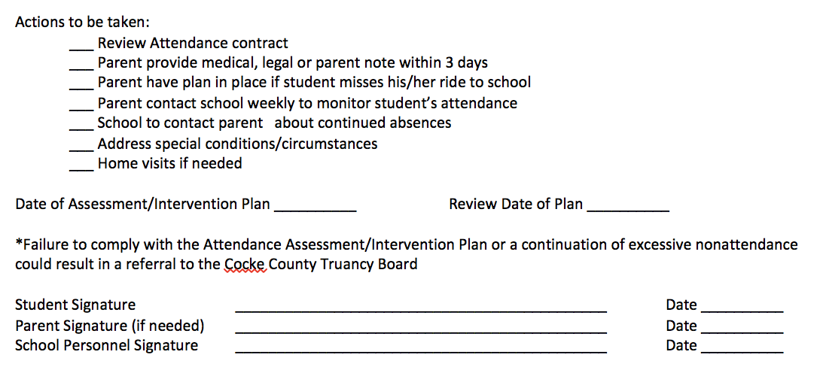

Slide 19
Tier II—Hawkins County
If the Tier 1 Intervention Plan is unsuccessful, Tier 2 is triggered. The same procedures as stated in Tier 1 shall be followed regarding scheduling the conference. An administrator will need to conduct the Tier 2 conference. Additional measures will be added to the plan developed in Tier 1. Additional measures may include conferences with the school counselor and check-in/check-out. The Tier 2 Truancy Contract must be completed. The contract will expire at the end of the current school year. The administrator will inform parent(s) the next unexcused absence will trigger Tier 3, and with continued unexcused absences, the child is subject to further truancy interventions.
A review meeting should be set within the next 90 days or end of the semester, whichever occurs first. If the student misses another unexcused day prior to the review meeting, the review meeting will be rescheduled as quickly as possible. If the interventions were successful, the follow up meeting may be conducted over the phone. The parent(s) should be informed that if another unexcused absence does occur, Tier 3 will still be triggered.

Slide 20
Dyersburg City – Tier II
Triggered at 10th unexcused day
Letter to the Parent
Truancy Prevention does Attendance Assessment
Call/Meeting with Parent

Slide 21
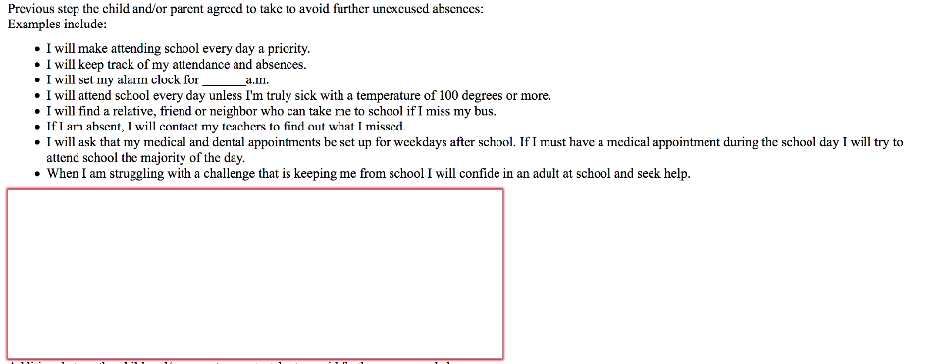

Slide 22
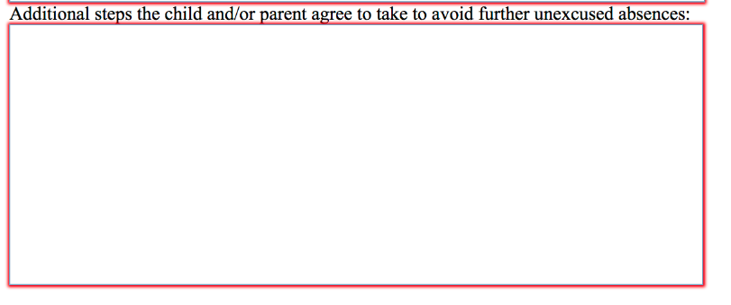
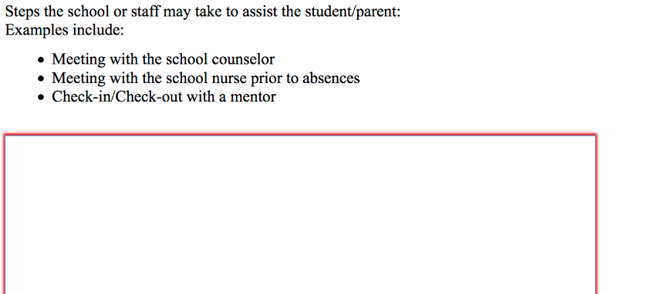

Slide 23
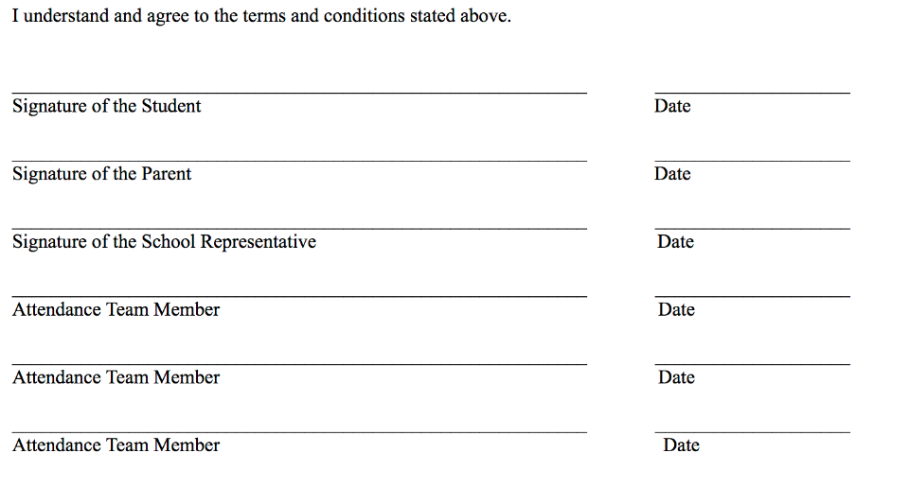

Slide 24
Tier III—Cocke County
Truancy Board referral
These interventions shall be determined by a team,. (Truancy Board) formed by the district. The interventions shall address student needs in an age-appropriate manner. Finalized plans shall be . (Truancy Board). approved by the Director of Schools/designee.
Truancy Board will examine any available information and afford the student and parent/guardian the opportunity to enter an attendance contract with them.
Make referral to TN Dept. of Children’s Services FCIP (if needed).
Make referral to any other community-based services (if needed).
Contract will be aimed at addressing student’s attendance problems.
If a student or parent does not show up for the Truancy Board:
After at least two attempts to meet with the student or parent the school may document that the student’s parent or guardian is unwilling to cooperate in the truancy intervention plan. The director of schools or designee may report the student’s absences to the appropriate judge.

Slide 25
Tier III—Hawkins County
Tier 3 meetings will be conducted by the Hawkins County Schools Attendance Officers and be referred to as meetings of the Attendance Review Committee (ARC). Meetings will be held either at the Juvenile Justice Center in Rogersville or the City Building in Church Hill. If a student from a school is required to attend, a representative from that school should also be in attendance. A representative from community agencies will also be invited to the meetings. Meeting notices requiring the student and parent to appear at the Attendance Review Committee will be mailed ten (10) calendar days prior to said meeting. A parent/guardian failing to attend the Attendance Review Committee hearing or to make other arrangements will be subject to a petition to juvenile court. The attendance policies of the Hawkins County Board of Education and the reasons for the student’s unexcused absenteeism will be discussed at this meeting. Additional resources will be added to the intervention plan.

Slide 26
Tier III—Hawkins County
Students may be placed on ARC probation at the conclusion of the meeting. Students placed on probation by the Attendance Review Committee will automatically be petitioned to juvenile court if they miss additional unexcused absences in the current school year. If a student receives special education or 504 services a manifestation meeting must occur prior to the court date. Students placed on probation by the Attendance Review Committee will automatically be petitioned to juvenile court if they miss additional unexcused absences in the current school year.
Students who are habitually and unlawfully absent from school shall be reported to the appropriate judge having juvenile jurisdiction in that county by the Attendance Supervisor or Attendance Officer, after written notice to the parent or guardian of said child.

Slide 27
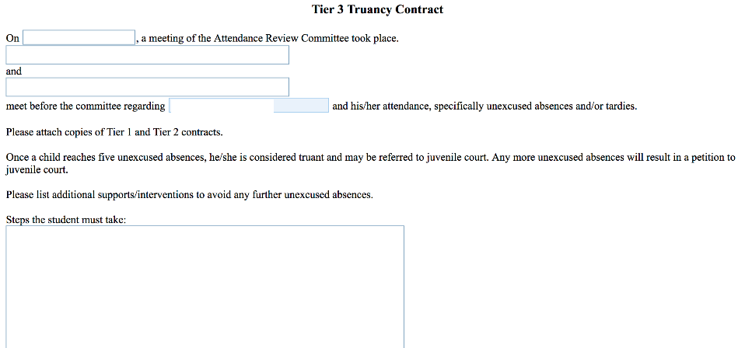

Slide 28
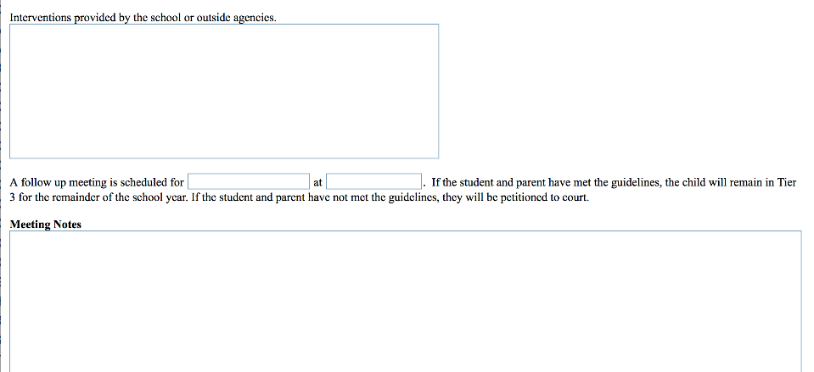

Slide 29
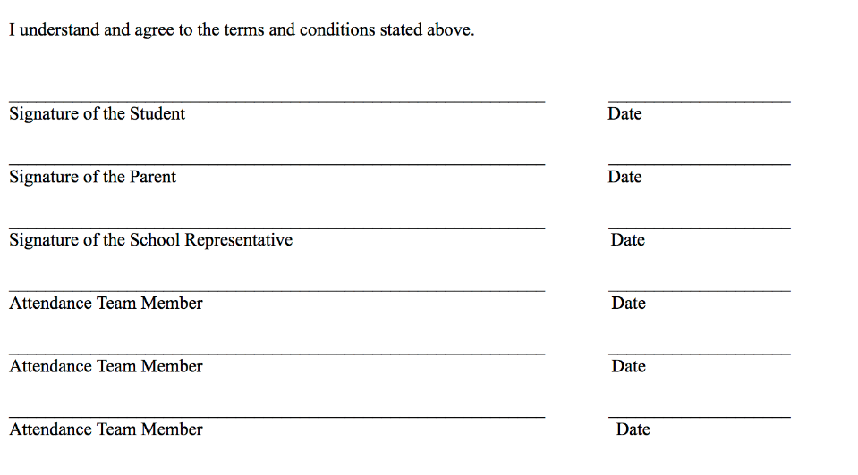

Slide 30
Dyersburg City – Tier III
Triggered at 15 unexcused days
Letter to Parent
Child & Family Team Meeting
Meet with Dyersburg City/Dyer Co. Truancy Board

Slide 31
After Tier III—Cocke County
If student, parent/guardian fails to comply with Tier Three :
Referral to Juvenile court
Accompanied by a statement from the student’s school certifying that
The school applied the progressive truancy interventions adapted to the student, and
The progressive truancy interventions failed to meaningfully address the student’s school attendance.

Slide 32
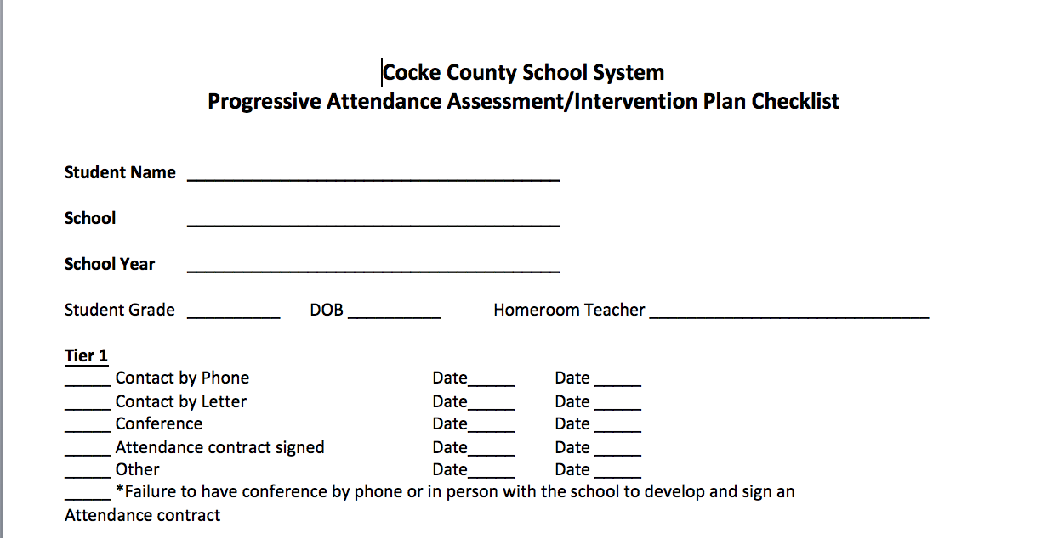

Slide 33
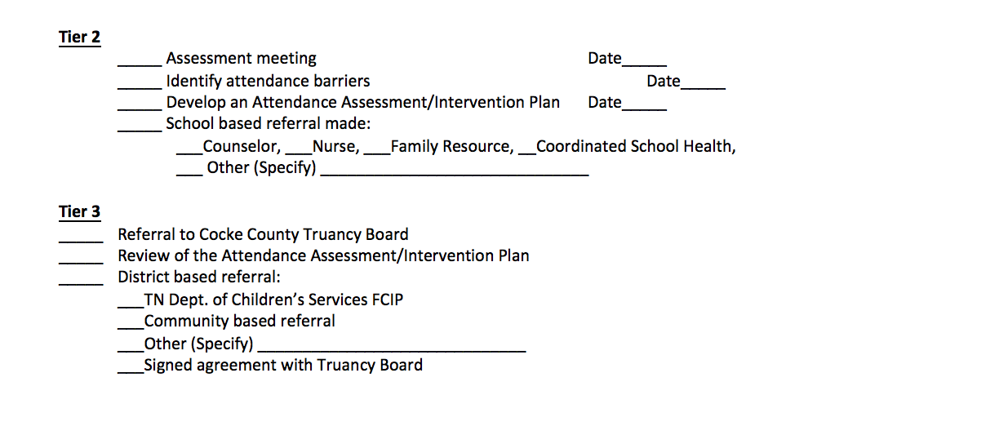

Slide 35
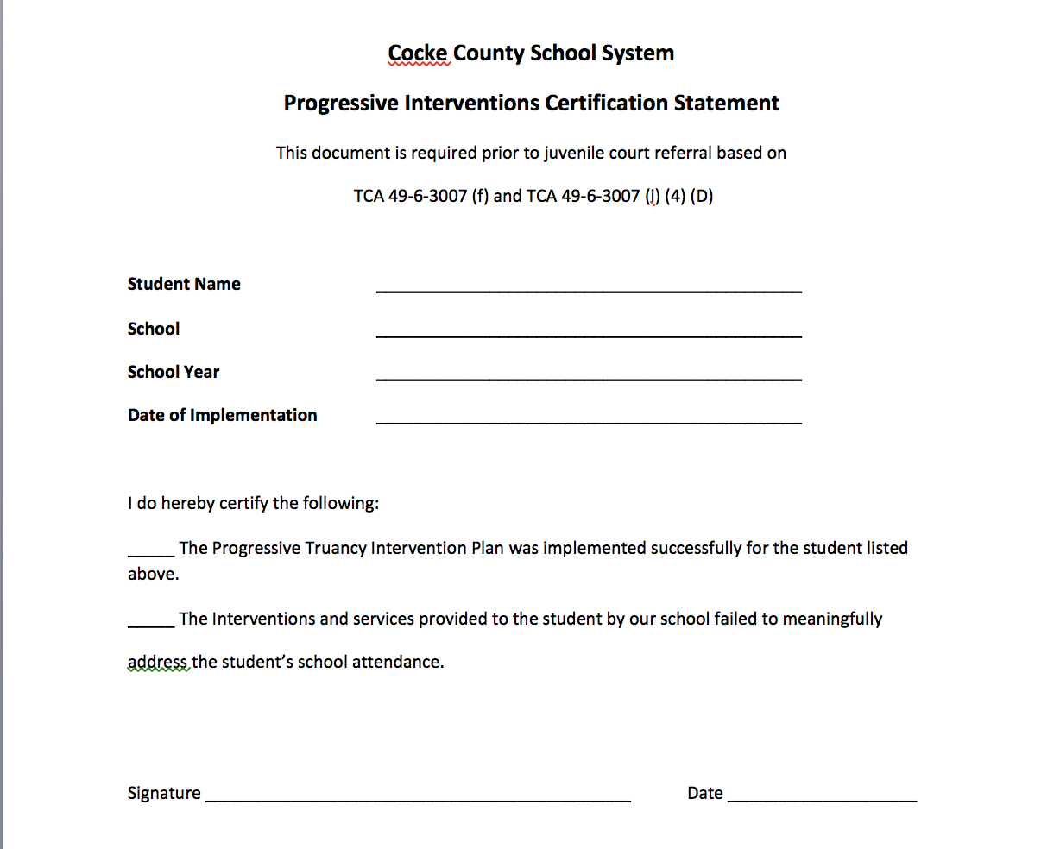

Slide 36
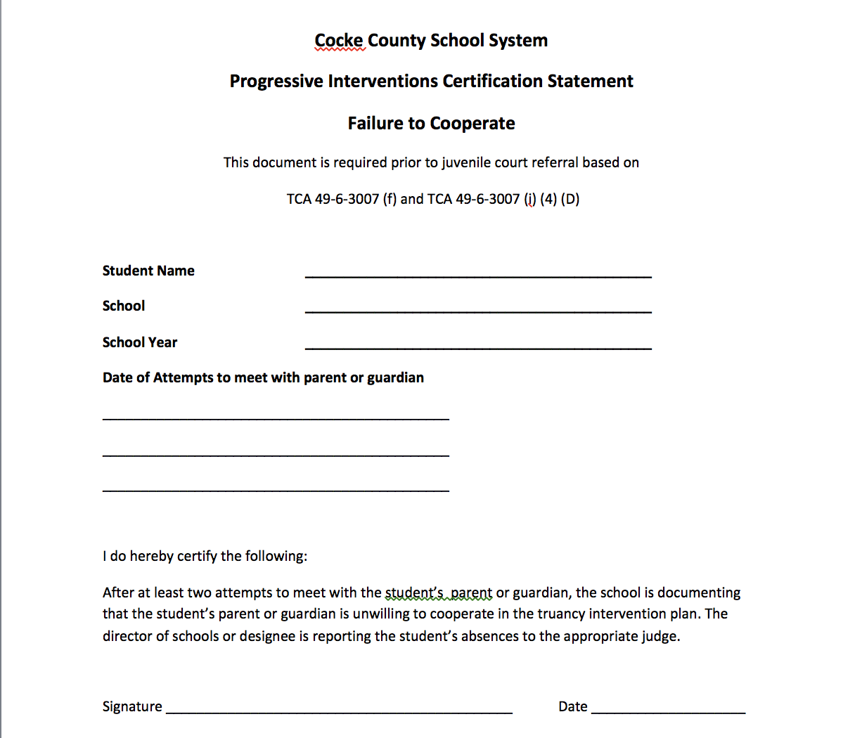

Slide 37
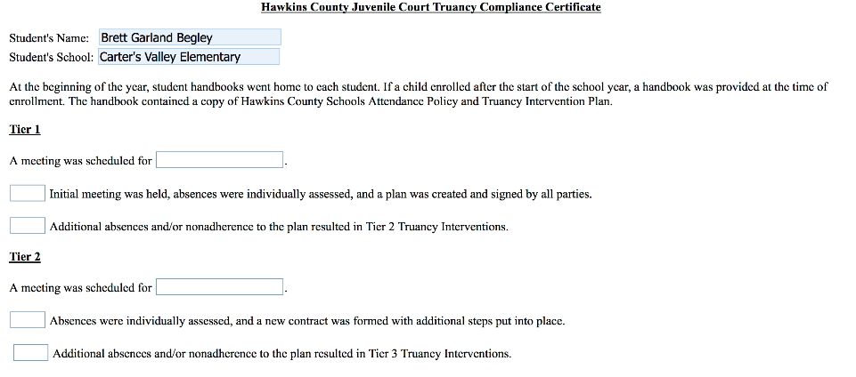
After Tier III—Hawkins County

Slide 38
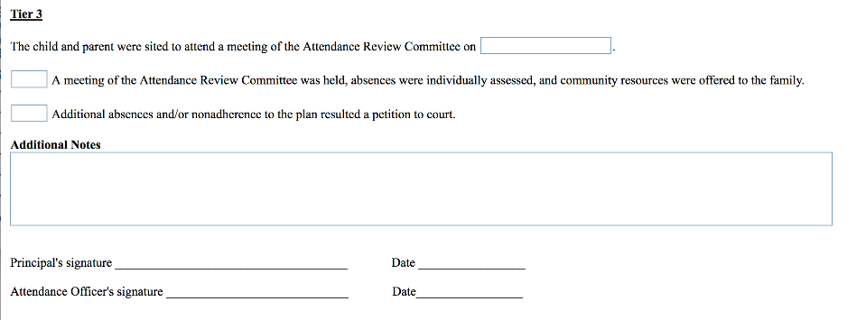

Slide 39
Dyersburg City – After Tier III
After Truancy Board, more unexcused absences may result in going to Juvenile Court
15 Absences, regardless of excuse, lose the privilege of undocumented notes

