Slide 1
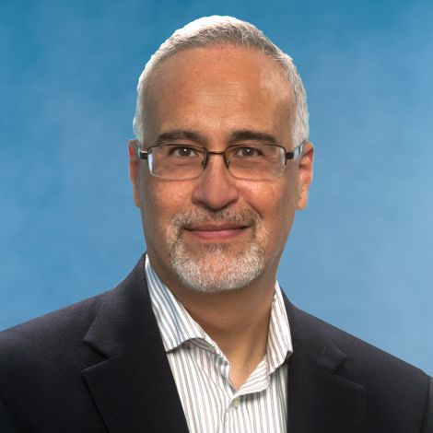
Marketing Elective Courses Fall 2020
BUSI 490 Business Topics: Introduction to Sales MOD 1 (1.5 credits) Section 107 TTH 12:30PM McColl 3600 | BUSI 564 Design Thinking and New Product Development Semester (3 credits) Section 1 TTH 2:00PM McColl 3050 Prerequisite: BUSI 406 with minimum grade of C | BUSI 566 Marketing Strategy Semester (3 credits) Section 1 TTH 12:30PM McColl 3050 Prerequisite: BUSI 406 with minimum grade of “C” | BUSI 590 Customer Relationship Management Semester (3 credits) Section 36 MW 9:30AM Section 37 MW 11:00AM McColl 3000 Prerequisite: BUSI 406 with a minimum grade of “C”
Professor Mark McNeilly | Professor Barry Bayus | Professor William Putsis | Professor Longxiu Tian
No revenue comes into a company until something is sold. Introduction to Sales will give you a practical understanding of this critical function so that you can add value to your company and your company's customers and channel partners. Introduction to Sales will employ lectures, cases, real-world applications, role plays and discussions to answer the critical questions of sales and sales management strategy. The first portion of the class will focus on sales management and strategy with the last half built around specific sales tactics and skills within the sales call. | In this project-based course, student teams will research a new product idea, generate product concepts, develop a product prototype, and participate in a product concept pitch session at the end of semester. Successful product and service innovation puts the consumer at the center of the development process. To do this, traditional marketing research (focus groups, surveys) is being complemented by design thinking and Web 2.0 approaches. | Marketing plays a crucial role in creating and managing market-based customer assets to attain sustainable competitive advantage. Marketing strategy is critical to managing these market-based customer assets. This course reviews and integrates marketing concepts developed in other marketing courses to facilitate learning about creation and management of market-based customer assets. | Customer Relationship Management (CRM) is the marketing “mantra” for today’s businesses. This course focuses on understanding the principles and data-driven tools of customer relationship management where the philosophy is to view customers as assets of the firm and the goal is to use customer information to grow customer loyalty, relationships, and their lifetime value to the firm.

