Slide 1
Math Interventions – Tier 3
ESC 13
October 30, 2018

Slide 2
Contact Information
Sarah Powell, Ph.D
The University of Texas at Austin
srpowell@austin.utexas.edu
@sarahpowellphd
119

Slide 3
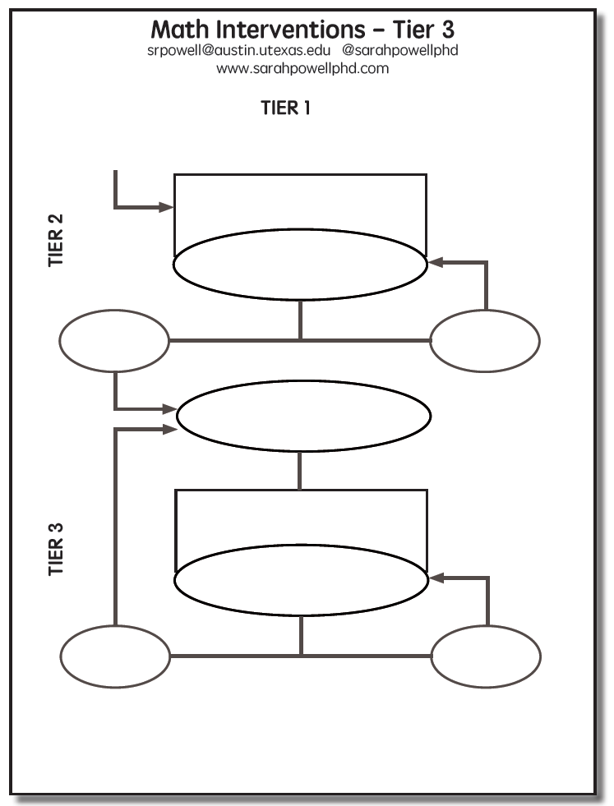

Slide 4
Tier 2
Students are tutored in small groups using evidence-based practices
Tutoring takes place three or four times a week
Each tutoring session lasts 30 to 60 minutes
Tutoring lasts 10 to 20 weeks
Progress monitoring continues weekly

Slide 5
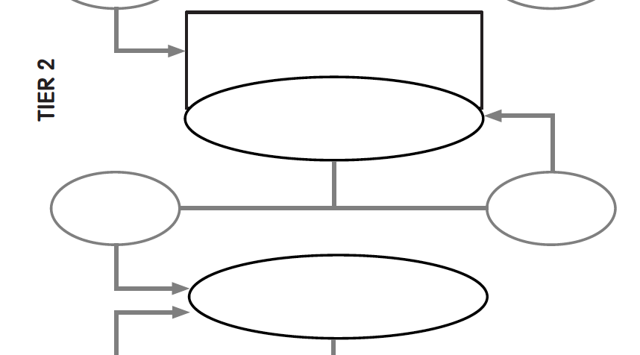
Evidence-based instruction provided in small groups
Progress monitoring for 10-20 weeks
inadequate
response
adequate
response
Diagnostic assessment

Slide 6
Tier 3
Diagnostics are conducted
Adaptations are made to the student’s intervention
Student progress is monitored weekly
With adequate slopes or end levels, students return to secondary or primary prevention

Slide 7
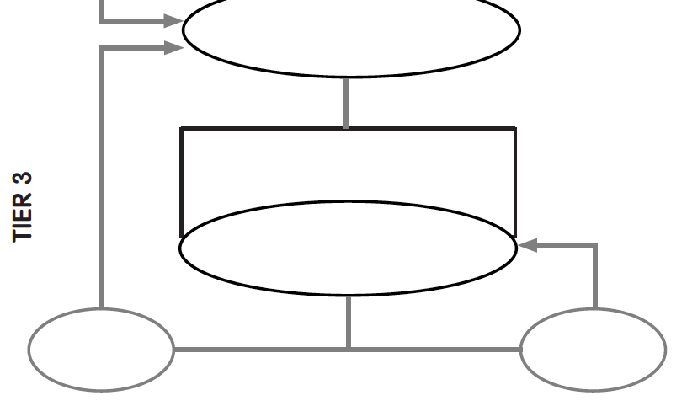
Diagnostic assessment
Evidence-based instruction provided individually or in small groups
Progress monitoring for 10-20 weeks
inadequate
response
adequate
response

Slide 8
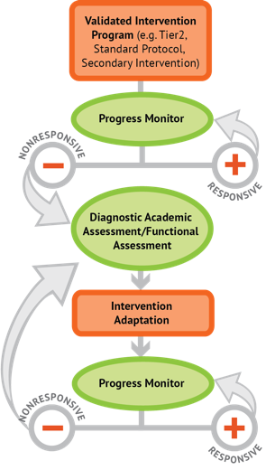
Intervention: Occurs frequently and with intensity
Assessment: Formative
Assessment: Diagnostic
Intervention adaptation: Content, dosage, explicit instruction, attention to transfer
Assessment: Formative

Slide 9
Instructional Platform
INSTRUCTIONAL DELIVERY
Explicit instruction
Precise language
Multiple representations
INSTRUCTIONAL STRATEGIES
Fluency building
Problem solving instruction
Motivation component

Slide 10
Instructional Platform

Slide 11
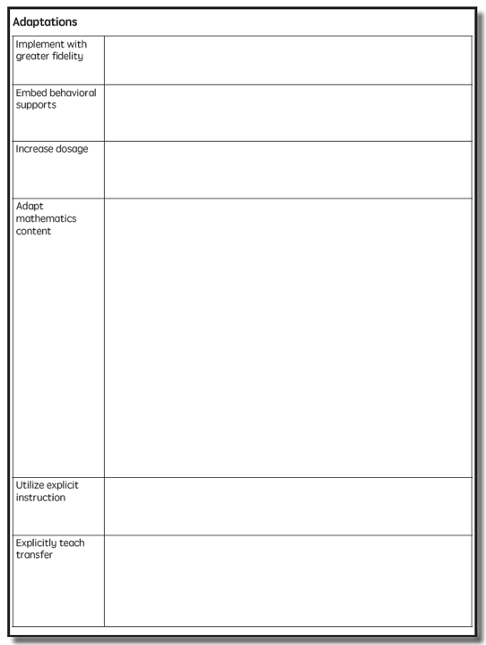

Slide 12
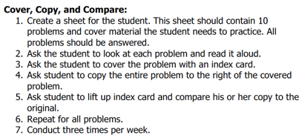
Implement with greater fidelity
Ensure that you are implementing the intervention or strategy with fidelity

Slide 13
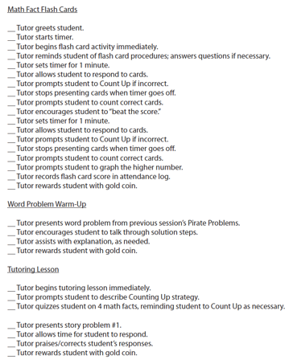
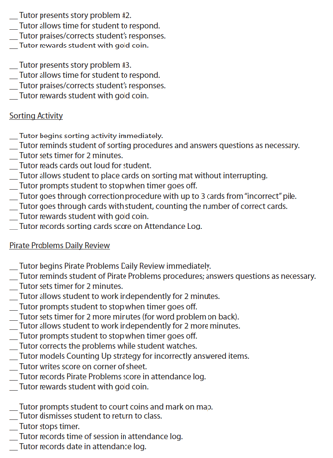
Implement with greater fidelity
Ensure that you are implementing the intervention or strategy with fidelity
Fuchs et al. (2008)

Slide 14
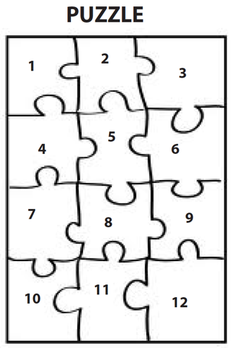
Implement with greater fidelity
Embed behavioral supports
May want to incorporate strategies to improve self-regulation and minimize nonproductive behavior
Powell, Driver, & Julian (2015)

Slide 15
Implement with greater fidelity
Embed behavioral supports
May want to incorporate strategies to improve self-regulation and minimize nonproductive behavior
UPSCheck
Understand
Plan
Solve
Check

Slide 16
Implement with greater fidelity
Embed behavioral supports
Increase dosage
Conduct longer sessions, more sessions per week, or more weeks within DBI

Slide 17
Implement with greater fidelity
Embed behavioral supports
Increase dosage
Conduct longer sessions, more sessions per week, or more weeks within DBI

Slide 18
Implement with greater fidelity
Embed behavioral supports
Increase dosage
Conduct longer sessions, more sessions per week, or more weeks within DBI
Number of weeks left in intervention

Slide 19
Implement with greater fidelity
Embed behavioral supports
Increase dosage
Adapt mathematics content

Slide 20
Implement with greater fidelity
Embed behavioral supports
Increase dosage
Adapt mathematics content
Alter the scope and sequence
Where student IS
Where student NEEDS TO BE
Explain why addition and subtraction strategies work, using place value and the properties of operations.
Use addition and subtraction within 100 to solve one- and two-step word problems…
Fluently add and subtract within 100 using strategies based on place value, properties of operations, and/or relationships.
Apply properties of operations as strategies to multiply and divide….
Fluently multiply and divide within 100, using strategies such as the relationship between multiplication and division…
Fluently add and subtract multi-digit whole numbers using the standard algorithm.
Find whole number quotients and remainders with up to four-digit dividends and one-digit divisors, using strategies based on place value, …
Solve multi-step word problems posed with whole numbers and having whole-number answers using the four operations…
Understand that the two digits of a two-digit number represent amounts of tens and ones.
Use multiplication and division within 100 to solve word problems…
Understand that the three digits of a three-digit number represent amounts of hundreds, tens, and ones.
Fluently multiply multi-digit whole numbers using the standard algorithm.

Slide 21
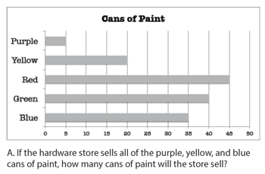
Implement with greater fidelity
Embed behavioral supports
Increase dosage
Solve
Adapt mathematics content
Write equation
Break down problems into smaller steps
Draw picture
Identify schema
Label graph
Underline labels
Read the problem

Slide 22
Implement with greater fidelity
Embed behavioral supports
Increase dosage
Adapt mathematics content
precise
Focus on the language of mathematics
concise

Slide 23
Technical terms
Subtechnical terms
Symbolic terms
General terms
trapezoid
rhombus
numerator
addend
subtract
base
degrees
cube
plane
arc
plus
zero
twelve
dollars
and
above
measure
answer
longest
outside

Slide 24
Implement with greater fidelity
Embed behavioral supports
Increase dosage
MATH JOURNAL
Adapt mathematics content
Focus on the language of mathematics
Define: | Characteristics:
Example: | Non-example:

Slide 25
Implement with greater fidelity
Embed behavioral supports
“Tell me how you solved this problem.”
Increase dosage
Adapt mathematics content
“What were you thinking about when you regrouped?”
Engage student in more discourse
“How would you teach this problem to another student?”
“Describe the word problem in 10 words or less.”

Slide 26
Implement with greater fidelity
Embed behavioral supports
Increase dosage
Adapt mathematics content
“Talk through this problem with me.”
Provide worked examples
405
+ 16
405
+ 16
411
421

Slide 27
Implement with greater fidelity
Abstract
Pictorial
Concrete
Embed behavioral supports
Increase dosage
Adapt mathematics content
Utilize more three-dimensional representations

Slide 28
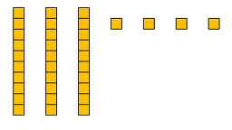
Implement with greater fidelity
Abstract
Pictorial
Concrete
Embed behavioral supports
Increase dosage
Adapt mathematics content
Utilize more two-dimensional representations

Slide 29
Implement with greater fidelity
Abstract
Pictorial
Concrete
Embed behavioral supports
Increase dosage
Adapt mathematics content
Ensure students understand the abstract
34 = 3 tens and 4 ones
2 + 8 = 10
4,179
+ 569
x – 6 = 8

Slide 30
Implement with greater fidelity
Embed behavioral supports
Increase dosage
Adapt mathematics content
Focus on fact fluency
Addition
Subtraction
Multiplication
Division

Slide 31
Implement with greater fidelity
Embed behavioral supports
Increase dosage
Adapt mathematics content
Focus on fact fluency

Slide 32
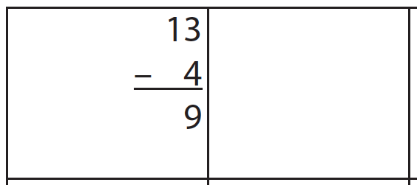
Cover, Copy, Compare
13
- 4
9

Slide 33
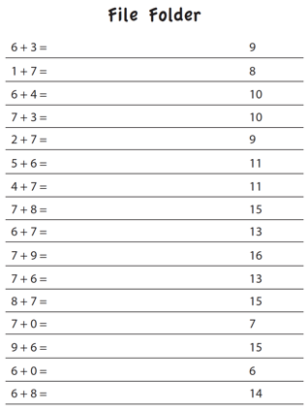
File Folders
9
8
10
10
9
11

Slide 34
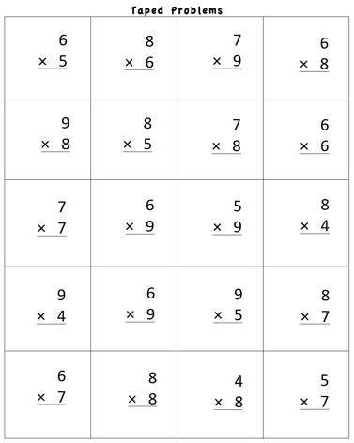
Taped Problems

Slide 35
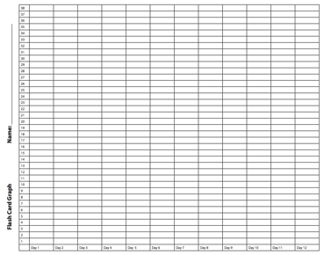
Flash Cards

Slide 36
Magic Squares
4
5
12
8
6
1
3
3
6

Slide 37
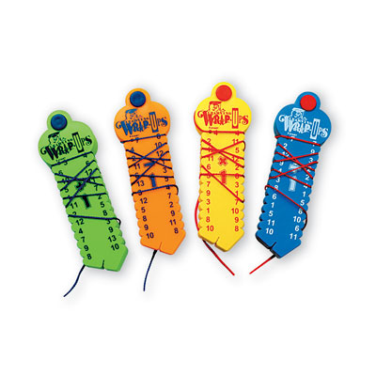
Wrap-Ups

Slide 38
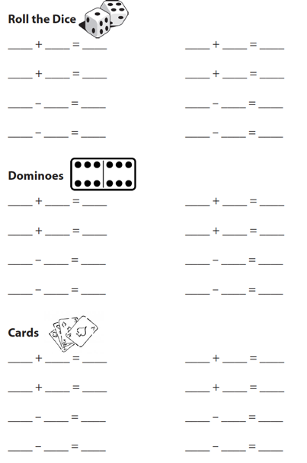
Cards, Dice, Dominoes

Slide 39
Games

Slide 40
Technology

Slide 41
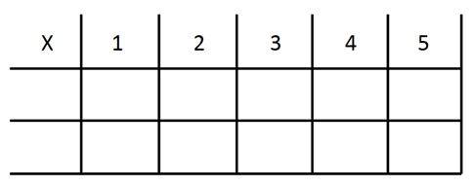
Implement with greater fidelity
Embed behavioral supports
Increase dosage
Adapt mathematics content
-3 + (-4) = ___ 5 – (-6) = ___

Slide 42
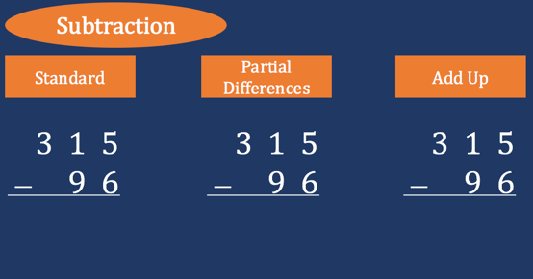
Implement with greater fidelity
Embed behavioral supports
Increase dosage
Adapt mathematics content
Teach alternate algorithms

Slide 43
Implement with greater fidelity
Embed behavioral supports
Increase dosage
Adapt mathematics content
405
+ 16
405
+ 16
Encourage alternate methods and solutions
400
10
11
421
421
+

Slide 44
Implement with greater fidelity
Embed behavioral supports
Don’t tie key words to operations
Teach word-problem schemas
Have an attack strategy
Increase dosage
Adapt mathematics content
Explicitly teach problem solving

Slide 45
Implement with greater fidelity
Additive
Embed behavioral supports
Total
Increase dosage
Adapt mathematics content
Difference
Explicitly teach problem solving
Change
Multiplicative
Equal Groups
Comparison
Ratios/
Proportions

Slide 46
Implement with greater fidelity
Embed behavioral supports
Increase dosage
Adapt mathematics content
Modeling
Practice
Utilize explicit instruction
Clear Explanation
Guided
Practice
Make sure you’re doing it! And do it well!
Planned
Examples
Independent Practice
Supporting Practices
Asking the right questions
Eliciting frequent responses
Providing immediate specific feedback
Maintaining a brisk pace

Slide 47
Modeling
Practice
Clear Explanation
Guided
Practice
Planned
Examples
Independent Practice
Supporting Practices
Asking the right questions
Eliciting frequent responses
Providing immediate specific feedback
Maintaining a brisk pace

Slide 48
Goal and importance
Modeling
Clear Explanation
“Today, we are learning about division. This is important because sometimes you have to share objects or things with your friends.”
Planned
Examples
“Let’s continue working with our three-dimensional shapes and volume. Understanding volume and calculating volume helps with measuring capacity.”

Slide 49
Goal and importance
Modeling
Clear Explanation
Model steps
Planned
Examples
“To solve 26 plus 79, I first decide about the operation. Do I add, subtract, multiply or divide?”
“The plus sign tells me to add. So, I’ll add 26 plus 79. I’ll use the partial sums strategy. First, I add 20 plus 70. What’s 20 plus 70?”
“20 plus 70 is 90. I write 90 right here.”
“Then I add 6 plus 9. What’s 6 plus 9?”
“6 plus 9 is 15. So, I write 15 here.”
“Finally, we add the partial sums. What do we add?”
”So, we add the partial sums of 90 and 15. 90 plus 15 is 105. So, 26 plus 79 equals 105.”

Slide 50
Goal and importance
Modeling
Clear Explanation
Model steps
Planned
Examples
Concise language
“To solve 26 plus 79, I first decide about the operation. Do I add, subtract, multiply, or divide?”
“The plus sign tells me to add. So, I’ll add 26 plus 79. I’ll use the partial sums strategy. First, I add 20 plus 70. What’s 20 plus 70?”
“20 plus 70 is 90. I write 90 right here.”
“Then I add 6 plus 9. What’s 6 plus 9?”
“6 plus 9 is 15. So, I write 15 here.”
“Finally, we add the partial sums. Why do we add the partial sums?”

Slide 51
Goal and importance
Modeling
Clear Explanation
Model steps
Planned
Examples
Concise language
Examples
“Today, we are learning about division. This is important because sometimes you have to share objects or things with your friends.”
24 / 6
28 $÷$ 7
35 $)$ 5

Slide 52
Goal and importance
Modeling
Clear Explanation
Model steps
Planned
Examples
Concise language
Examples
With non-examples
32 $÷$ 8
42 $÷$ 7
25 $−$ 5

Slide 53
Modeling
Practice
Clear Explanation
Guided
Practice
Planned
Examples
Independent Practice
Supporting Practices
Asking the right questions
Eliciting frequent responses
Providing immediate specific feedback
Maintaining a brisk pace

Slide 54
Practice
Teacher and student practice together
Guided
Practice
Independent Practice

Slide 55
Practice
Teacher and student practice together
Guided
Practice
Independent Practice
Student practices with teacher support

Slide 56
Modeling
Practice
Clear Explanation
Guided
Practice
Planned
Examples
Independent Practice
Supporting Practices
Asking the right questions
Eliciting frequent responses
Providing immediate specific feedback
Maintaining a brisk pace

Slide 57
Low-level and high-level
“What is 7 times 9?”
“Which shape has 6 sides?”
“What do you do when you see a word problem?”
Supporting Practices
“Why do you have to regroup?”
Asking the right questions
Eliciting frequent responses
Providing immediate specific feedback
Maintaining a brisk pace
“How would you solve this problem?”
“Why do you have to use zero pairs?”

Slide 58
Low-level and high-level
Classwide, individual, partner, write on paper, write on whiteboard, thumbs up, etc.
Supporting Practices
Asking the right questions
Eliciting frequent responses
Providing immediate specific feedback
Maintaining a brisk pace
“Turn and discuss the formula for perimeter with your partner.”
“Write the multiplication problem on your whiteboard.”
“In your math journal, draw a picture to help you remember to term parallelogram.”

Slide 59
Low-level and high-level
Classwide, individual, partner, write on paper, write on whiteboard, thumbs up, etc.
Supporting Practices
Asking the right questions
Eliciting frequent responses
Providing immediate specific feedback
Maintaining a brisk pace
Affirmative and corrective
“Good work using your word-problem attack strategy.”
“Let’s look at that again. Tell me how you added in the hundreds column.”

Slide 60
Low-level and high-level
Classwide, individual, partner, write on paper, write on whiteboard, thumbs up, etc.
Supporting Practices
Asking the right questions
Eliciting frequent responses
Providing immediate specific feedback
Maintaining a brisk pace
Affirmative and corrective
Planned and organized

Slide 61
Modeling
Practice
Supporting Practices
Introduction of material
Review of material
Modeling
Practice
Modeling
Practice
Supporting Practices
Supporting Practices

Slide 62
Implement with greater fidelity
Embed behavioral supports
405
+ 16
4305
+ 216
Increase dosage
Adapt mathematics content
Utilize explicit instruction
Explicitly teach transfer
Marney baked 89 cookies and sold 40 cookies at the bake sale. How many cookies does Marney have left?
Explicitly teach how current learning relates to other learning
Marney had $89 and spent $40 on shoes. How many much does Marney have left?
Marney had $89 and spent $40 on shoes. How much money will Marney have after buying the shoes?

Slide 63
Implement with greater fidelity
Embed behavioral supports
Increase dosage
Adapt mathematics content
Utilize explicit instruction
Explicitly teach transfer

Slide 64
Instructional Platform
INSTRUCTIONAL DELIVERY
Explicit instruction
Precise language
Multiple representations
INSTRUCTIONAL STRATEGIES
Fluency building
Problem solving instruction
Motivation component

Slide 65
Implement with greater fidelity
Embed behavioral supports
Increase dosage
Adapt mathematics content
Utilize explicit instruction
Explicitly teach transfer

Slide 66
Intervention: Occurs frequently and with intensity
Assessment: Formative
Assessment: Diagnostic
Intervention adaptation: Content, dosage, explicit instruction, attention to transfer
Assessment: Formative

Slide 67
Contact Information
Sarah Powell, Ph.D.
The University of Texas at Austin
srpowell@austin.utexas.edu
@sarahpowellphd
119

