Slide 1

Immunization Update
Immunizing Adolescents
March 2019
Notes:
Educating Physicians In their Communities is:
A peer-to-peer immunization education program presented in the practice setting for practitioners and staff or in a classroom for students.
Presented by a team of 2 professionals: physician or other primary care provider (nurse practitioner, physician's assistant) and a nurse or office manager.
Our Beginnings…
EPIC is in its 16th year of immunization education. The first EPIC Immunization Education program was developed and implemented in Pennsylvania (a joint venture between public health and the PA chapter of the American Academy of Pediatrics). The program has been replicated in several states - Georgia most closely resembling the Pennsylvania program. Georgia was first to add adult vaccines to the program. In 2009 the Georgia Chapter created a separate Women’s Health Immunization Education program for obstetricians and gynecologists. Presentations are also available for students in healthcare training. Presentation on Coding are available to members of the Georgia Chapter of AAP
EPIC programs are designed to meet Standard #10 of the Standards for Child and Adolescent Immunization Practices:
"Persons who administer vaccines and staff who manage or support vaccine administration are knowledgeable and receive on-going education"
And
Standard #8 of the Standards for Adult Immunization Practices: “Persons who administer vaccines are properly trained."

Slide 2
EPIC® is presented by:
Georgia Chapter - American Academy of Pediatrics
Ga. Dept. of Public Health/Immunization Program
In Cooperation with:
Georgia Academy of Family Physicians
Georgia Chapter - American College of Physicians
Georgia OB/Gyn Society
EPIC® (Educating Physicians & Practices In their Communities) is a registered trademark of the Georgia Chapter of the American Academy of Pediatrics. All rights reserved.
Notes:
The EPIC immunization education program is developed and updated annually, and more frequently when necessary, by the Georgia Chapter of the American Academy of Pediatrics in partnership with the Georgia Immunization Program and in cooperation with the Georgia Academy of Family Physicians, the Georgia Chapter of the American College of Physicians/American Society of Internal Medicine, and the Georgia OB/GYN Society.
EPIC education programs utilize information from the Centers for Disease Control and Prevention, ACIP Recommendations, The Immunization Action Coalition and other reliable resources. When there is more than one vaccine manufacturer for a specific type of vaccine the presenter utilizes the generic name (i.e. Tdap, hepatitis b etc.)

Slide 3
Faculty Disclosure Information
In accordance with ACCME* and ANCC-COA* Standards, all faculty members are required to disclose to the program audience any real or apparent conflict of interest to the content of their presentation.
This presentation will include the most current ACIP recommendations for frequently used vaccines but is not a comprehensive review of all available vaccines.
Some ACIP recommendations for the use of vaccines have not currently been approved by the FDA.
Detailed information regarding all ACIP Recommendations is available at www.cdc.gov/vaccines/acip/recs/index.html
*Accreditation Council for Continuing Medical Education
*American Nurses Credentialing Center Commission on Accreditation
Notes:
Presenters for the EPIC program do not discuss vaccines that are not licensed by the FDA or any pending vaccines that are still undergoing clinical trials. Sometimes an ACIP recommendation may not be listed as an indication for a specific vaccine or a specific age group on the manufacturers package insert. Therefore, the recommendation is considered “off label” use of the vaccine. The presenters will discuss the most recent ACIP recommendations during this presentation. All new ACIP Recommendations discussed have been published in MMWR.

Slide 4
Objectives
At the end of this presentation, you will be able to:
Name four vaccines recommended for adolescents
Explain the importance of preventing these diseases in adolescents
Discuss strategies practitioners can use to increase immunization rates in adolescents
Examine parental hesitation regarding HPV vaccine for young adolescents
List at least 2 reliable sources for immunization information
Notes:
These are the objectives for this EPIC presentation.

Slide 5

Advisory Committee on
Immunization Practices (ACIP)
15 voting members with expertise in one or more of the following:
Vaccinology
Immunology
Infectious diseases
Pediatrics
Internal Medicine
Preventive medicine
Public health
Consumer perspectives and/or social and community aspects of
immunization programs
ACIP develops recommendations and schedules for the use of
licensed vaccines
Notes:
The dramatic reduction of vaccine preventable diseases in the United States can be attributed to the availability of vaccines, as well as recommendations and an organized vaccine schedule developed by the Advisory Committee on Immunization Practices (ACIP).
The overall goals of the ACIP are to provide advice which will assist the Department and the Nation in reducing the incidence of vaccine preventable diseases and to increase the safe usage of vaccines and related biological products.
For more information: http://www.cdc.gov/vaccines/acip/index.html
For more details about all the vaccine preventable diseases reviewed in this presentation, refer to: Epidemiology and Prevention of Vaccine-Preventable Diseases (The Pink Book), 13th edition. 2015. HHS, CDC.

Slide 6
Four Vaccines Are Recommended for
ALL Adolescents
Tetanus-diphtheria-acellular pertussis vaccine (Tdap)
Influenza (flu) vaccine---every year
Meningococcal conjugate vaccine (MCV4)
Human papillomavirus vaccine (HPV)
Notes:
Before 2006 the only vaccine routinely recommended for US adolescents was a Tetanus and diphtheria booster. A decade later vaccines have been added to the immunization schedule to protect the adolescent population against meningococcal disease, human papillomavirus (HPV), influenza and pertussis (whooping cough).
Resource: Call to Action: Addressing New and Ongoing Adolescent Vaccination Challenges. National Foundation for Infectious Diseases, 2016 accessed from http://www.adolescentvaccination.org/resources/call-to-action-adolescent-vaccination-challenges.pdf on May 2, 2016.

Slide 7

Estimated Vaccination Coverage Among
Adolescents Aged 13 – 17 Years - 2017
The red arrow represents a major missed opportunity.
National Immunization Survey-Teen (NIS-Teen), United States, 2017. MMWR/August 24, 2018/ Vol.67/No. 33
Notes:
For 2017 coverage rates among adolescents aged 13-17 in the U.S. increased slightly for all vaccines indicated. With the exception of having received at least 1 dose of HPV vaccine, GA rates are at or above the national average.
Even with these gains HPV vaccination coverage remained lower that MenACWY and Tdap coverage rates which give the indication that providers are continuing to miss opportunities for HPV vaccination.
Reference:
National Immunization Survey-Teen (NIS-Teen), United States, 2016. MMWR/August 25. 2017/ Vol.66/No. 33

Slide 8
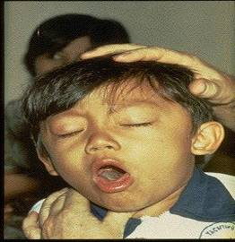
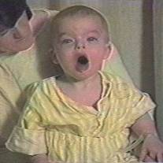

Diphtheria
©AAP
Tetanus
Pertussis
Notes:
Diphtheria, Tetanus and Pertussis (Whooping Cough) are all toxin mediated diseases. This means that the toxin or toxins produced by the bacteria are responsible for the symptoms of the disease.
DIPHTHERIA
Slide shows a child with diphtheria membrane in nasopharynx
Diphtheria is caused by a bacteria (Corynebacterium diphtheriae) that produces a toxin.
The bacterial growth and toxin cause local tissue destruction & membrane formation in nasopharynx & larynx & possible obstruction of respiratory tract. Most common complications are myocarditis & neuritis (motor nerves).
TETANUS
Slide shows a child with muscle rigidity from tetanus.
Tetanus spores that are found everywhere in soil usually enter body through contaminated puncture wounds, lacerations or abrasions. Spores germinate and bacteria (Clostridium tetani) begin to multiply and produce an exotoxin. Toxin affects the neuromuscular junction and produces generalized rigidity and convulsive spasms of skeletal muscles, starting with the jaw and muscles of swallowing (lockjaw).
PERTUSSIS
Slide shows two children with pertussis (whooping cough) with paroxysmal coughing. (Sound is the typical pertussis cough and whoop. Pertussis, caused by a bacterium (Bordetella pertussis), produces multiple antigens and biologically active components that cause inflammation of the respiratory tract, paralysis of the cilia of the respiratory tract and lung damage resulting in pooling of secretions and characteristic cough lasting up to 12 weeks. Humans are the only reservoir. Transmission is by direct contact with respiratory droplets.
For more details about these 3 diseases refer to: Epidemiology and Prevention of Vaccine-Preventable Diseases, 13th edition. 2015 HHS, CDC.

Slide 9
Pertussis in Adolescents
Prolonged cough (3 months or longer)
    Complications (pneumonia, rib fractures)
    Hospitalization
    Missed school and work
    Impact on public health system
Vomiting after prolonged coughing
Weight loss
Multiple medical visits and extensive
medical evaluations
Loss of sleep
Transmission to infants
Ohio Chapter, American Academy of Pediatrics. TIES: Teen Education Immunization Sessions
Notes:
Whooping cough can present differently in adolescents and adults.
Pertussis among adolescents and adults is often milder than in infants and children. The infection may be asymptomatic, or may present as classic pertussis with paroxysmal cough or a whoop.
Pertussis may not be considered by the person’s clinician. Some of the ways pertussis can manifest in adolescents is as a prolonged cough lasting 3 months or more, sometimes associated with vomiting after coughing.
Patients may also experience weight loss. This can prompt a clinician to diagnose other potential causes such as pneumonia, sinusitis or even more serious diagnoses.
Pertussis is not usually thought of right away. This can lead to multiple medical visits and costly and extensive evaluations.
Patients may not get adequate sleep which can affect their school work, leading to poor or failing grades.
Adolescents and adults with pertussis are often the source of infection for susceptible infants and children.

Slide 10
Why Do Adolescents Need Pertussis Vaccine?
Pertussis is endemic in the United States
  Reported cases: in U.S.
  2011: 18,719 – 179 in Georgia
  2012: 48,277 – 318 in Georgia
  2013: 28,639 – 317 in Georgia
  2014: 32,118 – 407 in Georgia
  2015: 20,762 -- 244 in Georgia
  2016: 15, 737 – 170 in Georgia
  2017: 15,808 -- 163 in Georgia
Protection provided by the DTaP vaccine series wanes, so
adolescents need Tdap as a booster
Increasing Tdap immunization rates among adolescents is
an important strategy for reducing pertussis among
adolescents and infants too young to be fully immunized
Summary of Notifiable Infectious Diseases
http://www.cdc.gov/mmwr/mmwr_nd/index.html https://www.cdc.gov/mmwr/volumes/65/wr/mm6552md.htm?s_cid=mm6552md_w
Notes:
Immunity to pertussis following Tdap administered to pre-teens and teens declines by half within 4 years after the booster dose. This waning is contributing to the increase in pertussis among adolescents. This resurgence of cases has been connected to the switch from whole-cell pertussis vaccines to acellular products. Currently we are in need of a vaccine that effectively limits infection and transmission to help reduce the burden of disease.
References:
Mechcatie, E., Haelle, T. Tdap during pregnancy optimal strategy for Protecting infants. Pediatric News: Pediatric Vaccines, 2015; 22-23.

Slide 11
Diphtheria, Tetanus and Pertussis Vaccine for Adolescents
ACIP recommends:
One dose of Tdap:
  For children and adolescents starting at 11 or 12 years of age
  For all adults aged 19 years and older who have not had Tdap previously
  Follow every 10 yrs. with Td vaccine
Boostrix™ licensed for ages 10 and older
Adacel™ licensed for ages 10 through 64 years
  There is no minimum interval between the last dose of Td and Tdap.
2017 Childhood Schedule: Children 7-10 years of age who receive Tdap as part of the catch-up series can be given Tdap again at ages 11-12 years
MMWR, September 23, 2011, Vol 60, #37 MMWR, January 14, 2011, Vol 60, #01 MMWR, June 29, 2012 Vol 61, #25
MMWR, February 7, 2017, Vol. 66
Notes:
A single dose of Tdap is recommended for adolescents 11 through 18 years of age who have completed the recommended childhood diphtheria and tetanus toxoids and pertussis.
Tdap is recommended only for a single dose across all age groups.
Tdap can be administered regardless of interval since the last tetanus-or diphtheria-toxoid containing vaccine. Td should be given as a routine booster every 10 years.
Reference: Epidemiology and Prevention of Vaccine-Preventable Diseases, 13th edition. 2015 HHS, CDC

Slide 12
Tdap for Pregnant Women
ACIP recommends:
One dose of Tdap during each pregnancy, irrespective of a prior history of receiving Tdap.
Optimal timing for Tdap administration is between 27 and 36 weeks gestation. ACIP guidance and current data suggest that vaccinating earlier in the 27 through 36 week window will maximize passive antibody transfer to the infant. This has been shown to be 80%-91% effective.*
If Tdap is not given during pregnancy, and has not been given previously, administer Tdap immediately postpartum.
According to ACIP, pregnant women and some
adolescents may receive additional doses of Tdap. (See previous slide or consult appropriate 2019 Immunization Schedule.)
Ref: Advisory Committee on Immunization Practices. Updated ACIP statement for pertussis, tetanus and diphtheria vaccines presented by Jennifer L. Liang, October 19, 2016.
*MMWR, Recommendation and Reports/Vol. 67/No. 2
MMWR, February 7, 2017, Vol. 66
Notes:
Guidance on use of Tdap products for pregnant women:
All pregnant women should receive a dose of Tdap during each pregnancy, irrespective of prior history of receiving Tdap. Optimal timing for administration is between 27 and 36 weeks gestation. If a dose is given early in that same pregnancy, do NOT repeat it at 27-36 weeks. If not given during pregnancy, give Tdap immediately postpartum³.
References:
1.MMWR, February 22, 2013, Vol 62, #7
2. www.immunize.org, Ask the Experts, Tetanus section, IAC, Sept. 2013
3. MMWR, February 7, 2017, Vol. 66

Slide 13
Influenza and Adolescents
Flu spreads when infected people cough or sneeze. Flu can cause mild to severe illness, and in some cases it can cause death.
Most preteens and teens who get sick with the flu recover within a couple of weeks, some will get complications like sinus infections, or pneumonia.
Preteens and teens who have chronic health problems like diabetes (type 1 and 2) or asthma, are at a greater risk for complications from the flu, but even healthy adolescents can get very sick from the flu.
U.S. Department of Health and Human Services Centers for Disease Control and Prevention: Flu Vaccines for Preteens and Teens
Notes:
Preteens and teens should get the flu vaccine every year, ideally by October. ACIP recommendations urge all United States based providers to recommend and offer yearly influenza immunization to all adolescent and young adult patients before and throughout the influenza season.
Most adolescents with influenza experience a self-limited illness characterized by fever, cough, headache, sore throat, and body aches. However, adolescents who are morbidly obese, are pregnant or who have a chronic medical condition may have a more severe illness due to influenza infection.
School-aged children and adolescents serve as reservoirs for spreading influenza within their communities. The economic burden of influenza infection (during pandemic and non-pandemic years) has been substantial owing to days missed from school, parental absenteeism from work, and costs associated with over-the-counter medications, clinician visits, and hospitalizations
Society for Adolescent Health and Medicine. Influenza Vaccine: An Updated Position Statement of the Society for Adolescent Health and Medicine. Journal of Adolescent Health, 54 (2014) 241-242.

Slide 14
Influenza Vaccine Coverage
2017-2018 Season
Influenza vaccine coverage among children and adolescents 6 months through 17 years decreased with increasing age:
U.S.
6 - 4 years 67.8%
5 -12 years 59.5%
13-17 years 47.4%
Overall Coverage in U.S. 57.9
Overall Coverage in Georgia 51.3
https://www.cdc.gov/flu/fluvaxview/coverage-1718estimates-children.htm#figure2

Slide 15
FDA Recommended Influenza Antigens
for 2018-2019 Season in the U.S.
Trivalent Vaccines (IIV3):
A/Michigan/45/2015 (H1N1)
A/Singapore/INFIMH-16-0019/2016 (H3N2)
B/Colorado/06/2017
Information below pertains to children 6 mos. through 8 yrs. of age
Quadrivalent Vaccines (IIV4 & LAIV4) also include:
B/Phuket/3073/2013-like virus
ACIP recommends annual influenza vaccine for all persons 6 months of age and older who do not have contraindications.
If the child has received a total of 2 doses of vaccine in any prior flu season(s), even if not consecutive:
Give 1 dose this season
If they have not or it’s not known:
Give 2 doses, administered
≥ 4 wks. apart
MMWR Recommendations and Reports Vol. 67 / No. 3
August 24, 2018
Notes:
The Food and Drug Administration's Vaccines and Related Biologics Advisory Committee (VRBPAC) endorsed the WHO-recommended vaccine viruses for use in all U.S. seasonal flu vaccines for the 2018-2019 flu season.
Centers for Disease Control and Prevention, National Center for Immunization and Respiratory Diseases (NCIRD)

Slide 16
Influenza Vaccines for 2018-2019 Season
≥ 6 months | ≥ 3 years | ≥ 4 years | ≥ 5 years | ≥ 18 years | ≥ 65 years
Fluzone (IIV4) 6-35 mos.--2 doses, either 0.25 ml. or 0.5 ml. The schedule can be completed as: (1) two 0.25 ml. doses ≥4 wks. apart (2) two 0.5 ml. doses ≥4 wks. apart OR (3) any combination of 2 doses of either 0.25 ml. or 0.5 ml given ≥4 wks. apart. | Fluzone (IIV4) 36 mos. And older---0.5 ml | Fluvirin (IIV3) | Afluria (IIV3) | FluBlok (RIV3 & RIV4) ** | Fluzone High-Dose (IIV3)
FluLaval (IIV4) 0.5 ml dose |  | Flucelvax (ccIIV4)* |  | Afluria (IIV4) | Fluad (aIIV3)
Fluarix (IIV4) 0.5 ml. dose |  |  |  | Fluzone Intradermal (IIV4) Ages 18-64 yrs. (Not available in 2018-2019)
*Cell-cultured **Recombinant
Ref: (1)Centers for Disease Control and Prevention, (NCIRD). (2) https://www.cdc.gov/mmwr/volumes/66/rr/rr6602a1.htm
(3) https://www.vaccineshoppe.com/image.cfm?doc_id=14051&image_type=product_pdf
Notes:
Flu vaccines for 2018-2019.
Text in red on the table indicates changes in dosages for infants >6 months of age; also that intradermal is not available for the 2018-2019 flu season.

Slide 17
Live, Attenuated Influenza Vaccine (LAIV4)
  FluMist® MedImmune (Nasal Spray)
  Licensed for healthy persons 2 through 49 years of age
ACIP recommendation
LAIV4 MAY be used in the 2018-2019 season.
Contraindications to LAIV:
  Children 2-4 yrs. of age with a diagnosis of asthma
  Persons who are immunocompromised, by medication or disease, have a CSF leak or cochlear implant, or asplenia
  Close contacts and caregivers of severely immunosuppressed persons
  Pregnant women
  Persons who have received influenza antiviral medications within the previous 48 hrs.
MMWR Recommendations & Reports/Vol. 67/No. 3 August 24, 2018
Notes:
Studies demonstrated that LAIV did not work in the 2013-'14 influenza season when the primary strain was the 2009 pandemic influenza A(H1N1) strain, in 2014-'15 when the primary circulating strain was a drifted A(H3N2) virus, or the 2015-'16 season when the primary circulating strain was again the 2009 pandemic influenza A(H1N1) strain. With knowledge that LAIV had no protective benefit during three previous influenza seasons, ACIP does now state that LAIV may be used in the 2018-2019 season.

Slide 18
Influenza Vaccination of Persons with a History of Egg Allergy
Persons with a history of egg allergy of any severity may receive any licensed, recommended, and age-appropriate influenza vaccine (IIV, RIV4, or LAIV4). IIV and RIV4 have been previously recommended.
A previous severe allergic reaction to influenza vaccine is a contraindication to future receipt of the vaccine.
MMWR Recommendations and Reports / Vol. 67 / No. 3 August 24, 2018
Notes:
Recent studies with IIV and LAIV have indicated that a severe allergic reaction to egg-based influenza vaccine in a person with an egg allergy is very unlikely. Numerous studies have looked at egg-allergic patients receiving IIV3, LAIV in which mild allergic reactions occur and no anaphylactic reaction occurrences.
EPIC 2018

Slide 19
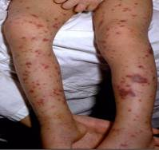
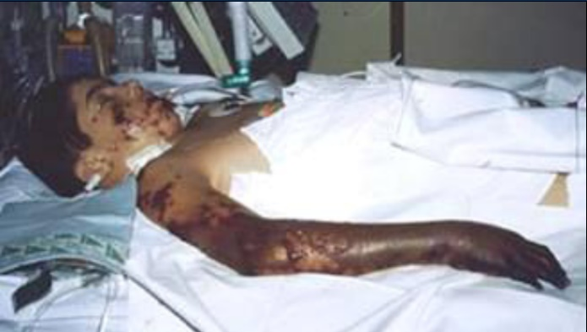
Meningococcal Disease
(caused by Neisseria meningitidis)
Meningitis
~50% of cases 9-10% fatality rate
Meningococcemia
5%-20% of cases Up to 40% fatality rate
Rash
Vascular damage
Disseminated intravascular coagulation
Multi-organ failure
Shock
Death can occur in 24 hours
Photo courtesy CDC: Dr. Brodsky & Mr. Gust
11-19% of survivors have permanent sequelae
Ref: 1. Epidemiology and Prevention of Vaccine-Preventable Diseases. 13th Edition, 2015.
2. AAP Red Book 2015
Notes:
The most common clinical presentations of meningococcal disease are meningitis and meningococcemia.
Neisseria meningitides contains 13 serogroups, the most common being A, B, C, W-135, and Y. About 5-10% of adults are asymptomatic nasopharyngeal carriers of this organism.
Individuals with meningococcemia may die within 24 hours of the onset of symptoms even with prompt treatment with appropriate antimicrobials and supportive care in an intensive care unit.
Reference:
1. Epidemiology and Prevention of Vaccine-Preventable Diseases, 13th edition. 2015 HHS, CDC.
2. AAP Redbook 2015
3. Meningococcal Disease. About the Disease. http://www.cdc.gov/meningococcal/about/index.html

Slide 20
Meningococcal Disease:
Adolescents and Young Adults Are Most at Risk
Age-specific Fatalities, US, 1999-2010¹⁻¹²
Notes:
Meningococcal Disease: Adolescents and Young Adults Are Most
at Risk¹⁻¹²
Although rare, meningococcal disease can be fatal. Deaths occur across all age groups in the US, as shown on this graph covering the years 1999 through 2010. Persons 15-24 years of age accounted for more than 1 in 5 deaths during this period and experienced substantially more deaths than any other decade of age.
References: 1. Hoyert DL, Arias E, Smith BL, et al. Deaths: final data for 1999. Natl Vital Stat Rep. 2001;49(8):1-116. 2. Miniño AM, Arias E, Kochanek KD, et al. Deaths: final data for 2000. Natl Vital Stat Rep. 2002;50(15):1-120. 3. Arias E, Anderson RN, Kung H-C, et al. Deaths: final data for 2001. Nat Vital Stat Rep. 2003;52(3):1-116. 4. Kochanek KD, Murphy SL, Anderson RN, Scott C. Deaths: final data for 2002. Natl Vital Stat Rep. 2004;53(5):1-116. 5. Hoyert DL, Heron MP, Murphy SL, Kung H-C. Deaths: final data for 2003. Natl Vital Stat Rep. 2006;54(13):1-120. 6. Miniño AM, Heron MP, Murphy SL, Kochanek KD. Deaths: final data for 2004. Natl Vital Stat Rep. 2007;55(19):1-120. 7. Kung H-C, Hoyert DL, Xu J, Murphy SL. Deaths: final data for 2005. Natl Vital Stat Rep. 2008;56(10):1-124. 8. Heron M, Hoyert DL, Murphy SL, et al. Deaths: final data for 2006. Natl Vital Stat Rep. 2009;57(14):1-136. 9. Xu J, Kochanek KD, Murphy SL, Tejada-Vera B. Deaths: final data for 2007. Natl Vital Stat Rep. 2010;58(19):1-136. 10. Miniño AM, Murphy SL, Xu J, Kochanek KD. Deaths: final data for 2008. Natl Vital Stat Rep. 2011;59(10):1-126. 11. Kochanek KD, Xu J, Murphy SL, et al. Deaths: final data for 2009. Natl Vital Stat Rep. 2011;60(3):1-166. 12. Murphy SL, Xu J, Kochanek KD. Deaths: final data for 2010. Natl Vital Stat Rep. 2013;61(4):1-117.

Slide 21
Neisseria meningitidis
Risk Factors for Invasive Disease
Immunodeficient persons (e.g., no spleen)
HIV infection
Family members of an infected person
Smoking
Passive exposure to smoke
Upper respiratory tract infection
Crowding
College students (living in dormitories)
Epidemiology and Prevention of Vaccine-Preventable Diseases (The Pink Book), 13th Edition, (2015)
Notes:
Risk factors for the development of meningococcal disease includes deficiencies in the terminal common complement pathway, functional or anatomic asplenia and other underlying chronic diseases. Persons with HIV infection are at increased risk for meningococcal disease.
Household crowding, active and passive smoking are associated with increased risk as well.
Epidemiology and Prevention of Vaccine-Preventable Diseases, 13th edition. 2015 HHS, CDC

Slide 22
Vulnerability of Adolescents and Young Adults to Meningococcal Disease
Spread through respiratory and throat secretions
  Coughing, sneezing
  Kissing
  Sharing eating utensils, water bottles, etc.
Crowded settings facilitate transmission
  College dormitory
  Crowded household
  Military barracks
  Nightclubs, bars
Give2MCV4 project: www.Give2MCV4.org
Notes:
They may not know it, but teenagers and young adults are at increased risk of getting meningococcal disease
About 10% to 15% of the 800 to 1200 Americans who contract meningococcal meningitis each year will die.
Lifestyle
Certain lifestyle factors and behaviors are thought to put healthy preteens and teens at greater risk of meningitis infection, including:
Sharing drinking glasses, sharing eating utensils, or water bottles
Kissing
Smoking (or being exposed to smoke)
Living in close quarters (i.e., dormitories)
CDC. Prevention and Control of Meningococcal Disease. Recommendations of the ACIP. MMWR. 2013;62(2):6.
EPIC 2018

Slide 23
Meningococcal Vaccines Recommended for Adolescents and Young Adults in the U.S.
 | Quadrivalent meningococcal conjugate (MCV4) | Meningococcal B (MenB)
Year first licensed | 2005 | 2014
Serogroup(s) | A, C, W, Y | B
Recommendations | Recommended for routine use in adolescents | Recommended, based on individual clinical decision making, for adolescents and young adults 16−23 years of age
Give2MCV4 project: www.Give2MCV4.org

Slide 24
Meningococcal Conjugate Vaccine (MCV4)
(Men A,C,Y, W-135)
Menactra™ licensed for 9 mos. through 55 years
Menveo® licensed for ages 2 mos. through 55 years
ACIP recommends:
  First dose at age 11 or 12 years and a booster dose at 16 years.
  If first dose is at 13-15 years, give booster dose 5 years after the first dose or sooner, but after age 16 if entering college or technical school.
  If first dose is received ≥ 16 years of age, a 2nd dose is not needed.
  Persons aged 21 years or younger attending school or college should have documentation of one dose of MVC4 not more than 5 years before enrollment.
Notes:
Recommendation for Routine Vaccination of Persons Aged 11 Through 18 Years
After a booster dose of meningococcal conjugate vaccine, antibody titers are higher than after the first dose and are expected to protect adolescents through the period of increased risk through age 21 years. Persons who receive their first dose of meningococcal conjugate vaccine at or after age 16 years do not need a booster dose. Routine vaccination of healthy persons who are not at increased risk for exposure to N. meningitidis is not recommended after age 21 years.
CDC Guidance for Transition to an Adolescent Booster Dose
Some schools, colleges, and universities have policies requiring vaccination against meningococcal disease as a condition of enrollment. For ease of program implementation, persons aged 21 years or younger should have documentation of receipt of a dose of meningococcal conjugate vaccine not more than 5 years before enrollment. If the primary dose was administered before the 16th birthday, a booster dose should be administered before enrollment in college. The booster dose can be administered anytime after the 16th birthday to ensure that the booster is provided. The minimum interval between doses of meningococcal conjugate vaccine is 8 weeks.
No data are available on the interchangeability of vaccine products. Whenever feasible, the same brand of vaccine should be used for all doses of the vaccination series. If vaccination providers do not know or have available the type of vaccine product previously administered, any product should be used to continue or complete the series.
Recommendations for Adults 56 years and older
MPSV4 is the only licensed meningococcal vaccine for adults aged ≥56 years and is immunogenic in older adults. For adults who have received MenACWY previously, limited data demonstrate a higher antibody response after a subsequent dose of MenACWY compared with a subsequent dose of MPSV4. For meningococcal vaccine-naïve persons aged ≥56 years who anticipate requiring a single dose of meningococcal vaccine (e.g., travelers and persons at risk as a result of a community outbreak), MPSV4 is preferred. For persons now aged ≥56 years who were vaccinated previously with MenACWY and are recommended for revaccination or for whom multiple doses are anticipated (e.g., persons with asplenia and microbiologists), MenACWY is preferred.
Ref. 1. Prevention and Control of Meningococcal Disease - Recommendations of the Advisory Committee on Immunization Practices (ACIP) MMWR / March 22, 2013 / Vol. 62 / No. 2
2. Recommendation of the ACIP for Use of Quadrivalent Meningococcal Conjugate Vaccine (MenACWY-D) Among Children Aged 9 Through 23 Months at Increased Risk for Invasive Meningococcal Disease MMWR; October 14, 2011 / 60(40);1391-1392

Slide 25
Why Boost at 16 Years of Age?
Studies indicate that protective levels of circulating antibody decline 3 to 5 years after a single MCV4 dose.
Vaccine effectiveness case−control study suggests that many adolescents are not protected 5 years after vaccination.
According to ACIP a single dose of meningococcal conjugate vaccine administered at age 11 or 12 years is unlikely to protect most adolescents through the period of increased risk at ages 16 through 21 years.
Notes:
CDC recommends that a child receive one dose of MCV4 vaccine at age 11 or 12 years, followed by a second (or booster) vaccination at age 16 to help boost their protection against this devastating illness at a time in life when they are at greatest risk for meningococcal disease, as the protection provided by the first dose wanes within five years in many teens.

Slide 26
Meningococcal Conjugate Vaccine (MCV4)
For Adolescents with Certain Medical Conditions
Two-dose primary series in adolescents with
  HIV infection
  Asplenia
  Complement component deficiency
  Minimal interval of 8 weeks between Dose 1 and 2
Persons Who Have Persistent Complement Component Deficiencies (C3, C5-9, Properdin, Factor D, and Factor H) and Anatomic or Functional Asplenia should receive a booster dose every 5 years.
MMWR / March 22, 2013 / Vol. 62 / No. 2
Notes:
In 2010, ACIP updated recommendations for persons with functional or anatomic asplenia, complement deficiency and/or HIV. Booster doses for these populations help to ensure high levels of SBA (Serum Bacterial Antibody) are maintained over time. Serogroups C, W or Y cause 73% of all cases of meningococcal disease among persons 11 years and older.
Reference:
Epidemiology and Prevention of Vaccine-Preventable Diseases, 13th edition. 2015 HHS, CDC.

Slide 27
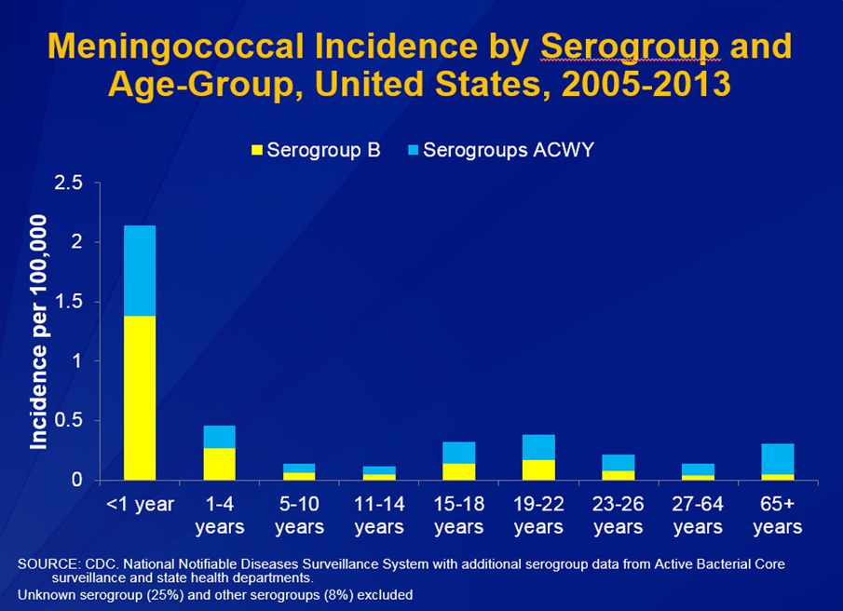
Notes:
This graph shows by age group the incidence per 100,000 of meningococcal disease by serogroup in the United States. Age groups with the highest incidence are infants/toddlers then adolescents and young adults and the elderly population 65 and older.

Slide 28
Serogroup B Meningococcal Vaccine
Bexsero® licensed for ages 10 through 25 years (2 dose)
Trumenba® licensed for ages 10 through 25 years (2 or 3 dose)
ACIP recommends serogroup B meningococcal vaccine for:
Persons with persistent complement component deficiencies
Persons with anatomic or functional asplenia
Microbiologists routinely exposed to isolates of Neisseria meningitidis
Persons identified to be at increased risk because of a serogroup B meningococcal disease outbreak
The 2 vaccine products are not interchangeable.
(Category B – Permissive recommendation)#
A Men B vaccine series may be administered to adolescents and young adults 16 through 23 years of age to provide short-term protection against most strains of Men B. Preferred age is 16-18 years.
MMWR; June 12, 2015 ,Vol. 64 #22; 608-611
# MMWR; October 23, 2015, Vol .64 #41; 1171-1176
Notes:
“MenB vaccine should be administered as either a 2-dose series of MenB-4C or a 3-dose series of MenB-FHbp. The same vaccine product should be used for all doses.“
On February 26, 2015 the ACIP approved for MenB vaccines be recommended for the use among persons aged >10 years at increased risk for serogroup B meningococcal disease. This recommendation was designated a Category A (recommended for all persons in the age-based risk factor group).
The ACIP determined that insufficient evidence existed to routinely recommend that all adolescents be vaccinated with MenB vaccines. ACIP agreed that the information provided would allow each individual health care professional to use clinical decision making when recommending the vaccine. A Category B recommendation was made. MenB vaccine series may be administered to young adults 16-23 years of age to provide short-term protection against most strains of MenB.
, 2015, Vol .64 #41; 1171-1176.
MMWR: June 12, 2015, Vol. 64 #22; 608-611.

Slide 29
Serogroup B Meningococcal
Vaccine Administration
Bexsero® licensed for ages 10 through 25 years (2 dose)
Trumenba® licensed for ages 10 through 25 years (2 dose or 3 dose)
MenB-FHbp (Trumenba®)
  2 dose schedule – administered at 0, 6 months
  Given to healthy adolescents who are not at increased risk for meningococcal disease
  3 dose schedule – administered at 0, 1-2, 6 months
  Given to persons at increased risk for meningococcal disease and for use during serogroup B outbreaks
MenB-4C (Bexsero®)
  2 dose schedule – 0, 1-2 months

Slide 30
Meningitis B Vaccine
Since licensed and designated a “permissive” recommendation for healthy adolescents and adults, some colleges and universities have added this vaccine to their list of optional vaccines. Families may inquire about this vaccine.
KEY POINTS
It is not a replacement for the meningococcal conjugate vaccine.
Insurance coverage has improved since the permissive designation and most plans that cover vaccines will cover this one.
Consider discussing with your vaccine representative about purchasing requirements (ex. number of doses to be purchased).
Notes:
This slide discusses some key points to remember about the Meningococcal B vaccine.

Slide 31
Types of Human Papilloma Virus (HPV)
(More Than 200 Types Identified)
Mucosal/Genital
~40 types
Cutaneous
High risk types
16, 18, 31, 33, 45, 52, 58
(and others)
Low risk types
6, 11 and others
Cervical cancer
Anogenital cancer
Oropharyngeal Cancer
Cancer precursors
Low grade cervical disease
Genital Warts
Laryngeal Papillomas
Low grade cervical disease
Skin warts
Hands and Feet
Ref: 1. Epidemiology and Prevention of Vaccine Preventable Diseases 13th Edition, 2015
2. Red Book – AAP 2015 Report of the Committee on Infectious Diseases
3. MMWR, August 29, 2014, RR Vol. 63, No. 5
Notes:
HPV is a small DNA virus with over 150 types identified. Most HPV types infect the cutaneous epithelium and cause skin warts. There are 40 types that infect the mucosal area and are associated with cervical, anogenital, and oropharyngeal cancers.
Several strains are known to cause tens of thousands of cancer cases in men and women each year, while others can lead to genital warts. Some HPV infections will go away on their own, but there is no way to tell which infections will resolve without symptoms and which will progress to these conditions. The Centers for Disease Control and Prevention (CDC) Advisory Committee on Immunization Practices (ACIP) added HPV vaccines to the list of routinely recommended vaccines for adolescent girls in 2006, and for boys in 2011.
Reference:
Marshall, Gary S. The Vaccine Handbook: A Practical Guide for Clinicians, 5th edition, 2015.
More than 200 types have now been identified.
Virtually all cases of cervical cancer are caused by HPV viruses
Cervical cancer is the 2nd leading cause of cancer death in women in the world.
Reference: cancer.gov (accessed 2-17-18)

Slide 32
HPV Vaccine
Gardasil 9® (9vHPV) HPV types 6, 11, 16, 18, 31, 33, 45, 52, 58
ACIP recommends HPV vaccine starting at age 11 or 12 years for:
  All females through 26 years of age
  All males through 21 years of age
  Men 22 through 26 years who have sex with men or have an immunocompromising condition.
  All other males 22 through 26 years.
Series can be completed with 9vHPV if started with 2v or 4v.
Gardasil 9 is now also licensed for all persons 9 through 45 yrs. of age, using the 3-dose schedule for ages 15 – 45.*
ACIP recommendations forthcoming.
MMWR, March 27, 2015, Vo1 64, No. 11
MMWR, December 16, 2016, Vol 65, No. 49 *https://www.merck.com/product/usa/pi_circulars/g/gardasil_9/gardasil_9_pi.pdf
Notes:
Recommendations for Use of HPV Vaccines
ACIP recommends that routine HPV vaccination be initiated at age 11 or 12 years. The vaccination series can be started beginning at age 9 years.
† Vaccination is also recommended through age 26 years for men who have sex with men and for immunocompromised persons (including those with HIV infection) if not vaccinated previously.
References:
2017 Supplement to Epidemiology and Prevention of Vaccine-Preventable Diseases, 13th Edition (the Pink Book)
MMWR, December 16, 2016, Vol 65, No. 49 https://www.merck.com/product/usa/pi_circulars/g/gardasil_9/gardasil_9_pi.pdf

Slide 33
2 Dose Schedule:
HPV vaccine initiated between 9-14 years can be given in two doses: 0, 6-12 months.
(If the 2nd dose is administered at least 5 months after 1st dose, it can be counted).
3 Dose Schedule:
HPV vaccine initiated after the 15th birthday or certain immunocompromising conditions should be vaccinated with the 3 dose schedule: 0, 1-2, 6 months
Dose 2 should be given at least 1 to 2 months after first dose
(1 month minimum)
Dose 3 should be given at least 6 months after the first dose
(minimum of 3 months between dose 2 and 3)
ACIP Recommendations and Schedule
Reference: 2017 Supplement to Epidemiology and Prevention of Vaccine-Preventable Diseases, 13th Edition (the Pink Book)
Notes:
The ACIP meeting October 2016, approved the recommendation for a 2 dose vaccination schedule for HPV. The 2 dose schedule is only for adolescents that initiate the vaccine before the 15th birthday. If one-dose of the vaccine is administered before the 15th birthday and they turn 15 before receiving their 2nd dose, the two dose series can still be applied.
References:
2017 Supplement to Epidemiology and Prevention of Vaccine-Preventable Diseases, 13th Edition (the Pink Book)
EPIC 2018

Slide 34
Evidence of Reduction in HPV Prevalence
National Health and Nutrition Examination Survey (NHANES) Data
Prevalence of HPV 6,11,16,18 in U.S. girls age 14-19
  2003-2006: 11.5%
  HPV Vaccine
  Licensed in 2006
  2011-2014: 3.3%
Sources: (1) Markowitz et al J Infectious Dis. 2013: 208: 385, Ohio Chapter, American Academy of Pediatrics. TIES: Teen Education Immunization Sessions (2) Markowitz, L. MD. Division of Viral Diseases. ACIP, June, 23,2016.
(3) https:// www.ncbi.nim.nih.gov/pubmed/28931217
Notes:
Even with low HPV vaccination rates in the United States, there is evidence of sharp reduction in the prevalence of HPV among 14-19 year old girls in a nationally representative sample after the introduction of the HPV vaccine in 2006. Although there has been a decrease in the prevalence of high-risk types with the low vaccination rate cross protection and herd immunity remain low.
The immunization rates for Tdap and Meningococcal vaccines that are required at 11 and 12 years of age are around 80% and higher while HPV rates remain for males and females. According to a CDC survey, after the HPV vaccine was recommended for girls in 2006 they looked at females between 2009 and 2012 in the same age group. They were able to see that the prevalence of the strains covered by the vaccine had decreased by 64% in females in the 14 to 19 age group. This showed great effectiveness of the vaccine.
Reference: Hoffman, J. HPV Sharply Reduced in Teenage Girls Following Vaccine, Study Says. The New York Times. Feb 22, 2016.

Slide 35
Reasons to Immunize Against HPV at 11-12 Years of Age
Higher antibody level attained when given to pre-teens rather than to older adolescents or women
At this age, more likely to be administered before onset of sexual activity
HPV can be transmitted by other skin-to-skin contact, not just sexual intercourse
There is no link between vaccine and riskier sexual behavior
Even those who abstain from sex until marriage can be infected by their marital partner
Individuals need all three doses for full protection
This is an anti-cancer vaccine
Presentation by Anne Schuchat, MD, RADM US Public Health Service, Assistant Surgeon General, Director National Center for Immunization and Respiratory Diseases at Immunize Georgia Conference, Atlanta, GA September 11, 2014
Gable, J.,Eder, J., Noonan, K. and Feemstar, K. Increasing HPV Vaccination Rates Among Adolescents: Challenges and Opportunities. PolicyLab: The Children’s Hospital of Philadelphia, 2016.
Notes:
Providers are less likely to recommend the HPV vaccine to their younger adolescent patients. They may be more comfortable reserving their recommendation for older teens, rather than for 11- and 12-year-olds. Providing clinicians with information about vaccine safety and efficacy to share with parents may increase endorsement of current HPV vaccine recommendations.
HPV vaccine should be recommended the same way other vaccines (Tdap, influenza and meningococcal) are recommended.
Provide information about giving vaccine at a young age to increase immune response and protect before sexual activity begins
Reference: Gable, J.,Eder, J., Noonan, K. and Feemstar, K. Increasing HPV Vaccination Rates Among Adolescents: Challenges and Opportunities. PolicyLab: The Children’s Hospital of Philadelphia, 2016.

Slide 36
HPV Vaccine: Special Situations
Vaccine can still be given, even if
  History of genital warts
  History of abnormal Pap test result
  Patient is immunocompromised
  Female patient is breastfeeding
Ohio Chapter, American Academy of Pediatrics. TIES: Teen Education Immunization Sessions
Notes:
The following are special situations when HPV vaccine can still be given. Persons with a history of genital warts can receive the vaccine but there is no evidence that the HPV vaccine will have any therapeutic effect. Immune response and vaccine efficacy might be less for immunocompromised persons but they should still receive the vaccination. Women who are breastfeeding can receive the vaccine but not pregnant women.
Reference:
Epidemiology and Prevention of Vaccine-Preventable Diseases, 13th edition. 2015 HHS, CDC.

Slide 37
Types of Vaccine-Hesitant Parents
Uninformed but educable
  Want education to counter anti-vaccine information
Misinformed but correctable
  Need information about vaccine benefits
Well-read and open-minded
  Want to intelligently discuss pros and cons
Strongly vaccine-hesitant
  Willing to listen but not likely to change their mind right away
Strong-willed and committed against vaccines
  Want to sway the health care provider to their line of thinking
References: 1. Halperin SA. Canadian J CME. 2000;12(1):62-74. 2. Harrington JW. Consultant Ped. 2011;10(11):S17-S21.
Notes:
Types of Vaccine-Hesitant Parents
Generally speaking, vaccine-hesitant parents fall into 1 of 5 categories.^{1,2}
In most cases, a conversation with the 2 types at the top of the list—parents who are uninformed but educable or misinformed but correctable—is likely to be productive and need not be lengthy. Such parents will appreciate the opportunity to have their questions answered (eg, is there preservative in this vaccine and, if so, why) and to engage in a dialogue. Taking the time to listen to those parents’ concerns and dispel any myths they might have heard is worth your while because it increases the likelihood that those parents will consent to immunization of their children.³
The 2 types in the middle of the list—the well-read and open-minded parents and the strongly vaccine-hesitant parents—can be challenging and time-consuming, particularly the latter. A single conversation may not be enough to ease their concerns and get them to trust your recommendation to vaccinate.³
Health care providers will find the last category of parents—strong-willed and committed against vaccines—the most difficult to deal with. These parents may refuse to discuss the reasons for their position and may even try to sway the provider to their point of view.¹⁻³ When dealing with such parents, it is often best to open and close the conversation as quickly and masterfully as possible, as your time may be better spent talking with the other 4 types of parents. That said, remember that you always have the option of revisiting the topic of immunization with vaccine-hesitant parents at a later date.
References: 1. Halperin SA. How to manage parents unsure about immunization. Canadian J CME. 2000;12(1):62-74. 2. Harrington JW. Vaccination refusal: how to counsel the vaccine-hesitant parent. Consultant Ped. 2011;10(11):S17-S21. 3. Domachowske JB, Suryadevara M. Practical approaches to vaccine hesitancy issues in the United States 2013. Hum Vaccin Immunother. 2013;9(12):2654-2657.

Slide 38
Talking with Parents about Vaccines
Use language and examples parents can understand
Give written information (VIS) prior to the immunization visit so parent can review benefits and risks
Draw upon your experiences as a health care provider
Solicit and welcome questions
Recognize that some parents may be more interested in discussing vaccines than others
Immunization education should include:
  Benefits of and risks associated with the vaccines
  After care instructions for managing side effects
Adapted from Glen Nowak, PhD. CDC
Notes:
A provider’s recommendation is one of the strongest predictors of vaccine acceptance. Therefore, it is important that clinicians make strong and timely recommendations about vaccines and are able to confidently address parental concerns.
Key talking points are ways for clinicians to address parental concerns effectively and make sure they are providing a strong provider recommendation. HPV’s association with sexual activity can be a hard concept for parents of young teens to accept.
Reference: Gable, J.,Eder, J., Noonan, K. and Feemstar, K. Increasing HPV Vaccination Rates Among Adolescents: Challenges and Opportunities. PolicyLab: The Children’s Hospital of Philadelphia, 2016.

Slide 39
Addressing Parents’ Top Questions about HPV Vaccine
Why does my child need the HPV vaccine? | HPV Vaccine is important because it prevents cancer. This is why I recommend that your son/daughter be vaccinated today.
What diseases are caused by HPV? | Certain HPV types can cause cancer of the cervix, vagina, and vulva in females, cancer of the penis in men, and in both females and males, cancers of the anus and the throat. We can help prevent infection starting the HPV vaccine series for your child today.
Is my child really at risk for HPV? | HPV is a very common and widespread virus that infects both females and males. We can help protect your child from the cancers and diseases caused by the virus by starting HPV vaccination today.
Why do they need HPV vaccine at such a young age? | HPV vaccination works best at the recommended ages of 11 or 12 years.
Why do boys need HPV vaccine? | HPV infection can cause cancers of the penis, anus, and throat in men and it can also cause genital warts. HPV vaccine can help prevent the infection that lead to these diseases.
Notes:
The CDC’s Tips and TimeSavers document about HPV Vaccine addresses parents concerns about getting their child vaccinated. Here we have listed some of the common questions that parents have. CDC encourages providers to recommend the HPV vaccine the same way other adolescent vaccines are recommended.
Ex. “Your child is due for vaccination today to help protect against meningitis, HPV cancers and pertussis. We’ll give those at the end of the visit.”
Reference: Centers for Disease Control and Prevention. Retrieved from http://www.cdc.gov/vaccines/who/teens/for-hcp-tipsheet-hpv.pdf on April 25, 2016.
EPIC 2018

Slide 40
Adolescent Vaccine Safety
Fainting—or syncope—can occur after any medical procedure, including vaccination
  Adolescents should be seated or lying
  down during vaccination
  Providers should consider observing
  patients in seated or lying positions for
  15 minutes after vaccination
  Concern: risk for serious secondary injuries
Notes:
Fainting, or syncope, after vaccination occurs most often in adolescents and young adults. It can result in serious injury, usually from falling and the resulting injuries such as skull fractures and cerebral hemorrhage. Syncope most often occurs within 15 minutes of vaccination.
Physicians should take appropriate measures to prevent injuries if a patient becomes weak or dizzy or loses consciousness.
Adolescents and adults should be seated or lying down during vaccination.
Vaccine providers, particularly when vaccinating adolescents, should consider observing patients (with patients seated or lying down) for 15–20 minutes after vaccination to decrease the risk for injury should they faint. If syncope develops, patients should be observed until the symptoms resolve.
Doctors and other health care professionals are encouraged to report any adverse events following administration of vaccines to the Vaccine Adverse Event Reporting System (VAERS), which is jointly administered by CDC and the U.S. Food and Drug Administration. Visit http://vaers.hhs.gov for more information or to file a report.
References:
General Recommendations on Immunization Practice Recommendations of the Advisory Committee on Immunization Practices (ACIP): www.cdc.gov/mmwr/pdf/rr/rr6002.pdf
AAP Redbook 2015
Huang WT, Suh C, Campagna E, et al. Adherence to the Advisory Committee on Immunization Practices recommendation to prevent injuries from postvaccination syncope: a national physician survey. Am J Prev Med 2011;41(3):317–21.

Slide 41
Examples of Effective Messaging
For Providers
CDC Research shows: The “HPV vaccination is cancer prevention” message resonates strongly with parents. Studies show that a strong provider recommendation is the best predictor of vaccination.
Sample Dialogue: HPV vaccination is very important because it prevents cancer. I want your child to be protected. That is why I am recommending that your son/daughter receive their first HPV vaccine today.
Notes:
Reference: Gable, J.,Eder, J., Noonan, K. and Feemstar, K. Increasing HPV Vaccination Rates Among Adolescents: Challenges and Opportunities. PolicyLab: The Children’s Hospital of Philadelphia, 2016.

Slide 42
Examples of Effective Messaging
For Providers
CDC Research Shows: Providers who emphasize their personal belief in the importance of HPV vaccines help parents feel secure in their decision.
Sample Dialogue: I strongly believe in the importance of this cancer-preventing vaccine. My son/daughter has received it. Experts agree that this vaccine is very important for your child.
Notes:
Reference: Gable, J.,Eder, J., Noonan, K. and Feemstar, K. Increasing HPV Vaccination Rates Among Adolescents: Challenges and Opportunities. PolicyLab: The Children’s Hospital of Philadelphia, 2016.
EPIC 2018

Slide 43
Strategies to Avoid Missed Opportunities
Provider Prompts
  Automatic pop-up alerts through your EHR system
  These can sometimes be pre-installed and then customized in your office
Family-friendly office hours
  Occasional evening or Saturday hours
  “No-appointment-required” if needing immunizations only
Immunization Champion in your practice
  Manage vaccine supply and schedule periodic updates
  Any member of the staff could fill this role
Source: https://www.aap.org/en-us/advocacy-and-policy/aap--health-initiatives/immunizations/Practice- Management/Pages/office- strategies.aspx

Slide 44
Strategies (cont’d)
Include all recommended vaccines at each visit
Schedule periodic team meetings with all personnel to:
  Improve patient flow
  Improve quality of care
  Discuss problems within the framework of the practice
Bottom line: NOT receiving a healthcare provider’s recommendation for HPV vaccine was one of the main reasons parents reported for not vaccinating their adolescent children.
Sources: https://www.aap.org/en-us/advocacy-and-policy/aap--health-initiatives/immunizations/Practice-Management/Pages/office-
strategies.aspx
http://www.immunize.org/askexperts/experts_hpv.asp
www.immunize.org/catg.d/p3090.pdf

Slide 45

Critical Elements for
Immunization Services
Celebrating 16 years
Notes:
46
EPIC 2018

Slide 46
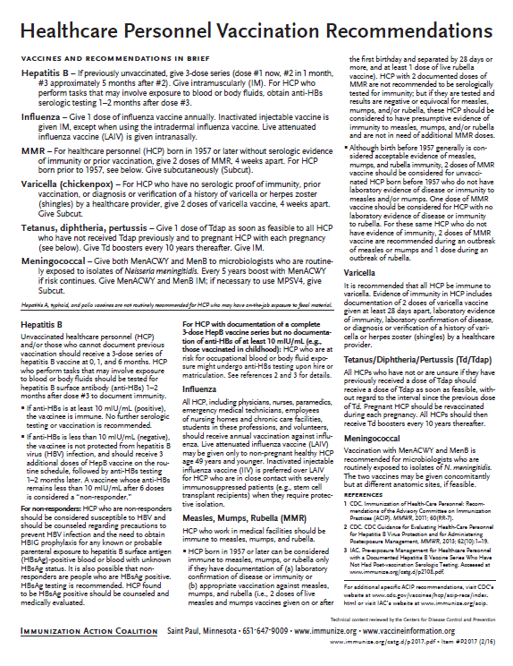
Recommended Healthcare Personnel Vaccinations
Hepatitis B
Influenza
Measles, Mumps, Rubella (MMR)
Varicella (Chickenpox)
Tetanus, Diphtheria, Pertussis (Tdap)
Meningococcal (recommended for microbiologists who are routinely exposed to isolates of N. meningitidis).
Are YOU up to date?
Available at www.immunize.org, P#2017
Notes:
Un-immunized HCP
Un-immunized healthcare workers are at risk of infecting patients, family members and community contacts
Immunized HCP
Protect patients from VPD’s
Help offices avoid potential liability cases. (The practice can be liable if an unimmunized HCP becomes infected with a vaccine preventable disease and infects a patient.)
Maintain productivity
Reduce illness and illness-related absenteeism
Evidence of Immunity to MMR
Documented administration of two doses of measles and mumps vaccine and one dose of rubella vaccine OR
Laboratory evidence of immunity or laboratory confirmation of disease (measles, mumps and rubella) OR
Born before 1957 (measles, mumps and rubella)
Because of their contact with patients or infective material from patients, many HCP are at risk for exposure to (and possible transmission of) vaccine-preventable diseases. Employers and HCP have a shared responsibility to prevent occupationally acquired infections and avoid causing harm to patients by taking reasonable precautions to prevent transmission of vaccine-preventable diseases.
Optimal use of recommended vaccines helps maintain immunity and safeguard HCP from infection, thereby helping protect patients from becoming infected. The recommendations for vaccination of HCP are presented in two categories: 1) those diseases for which routine vaccination or documentation of immunity is recommended for HCP because of risks to HCP in their work settings and, should HCP become infected, to the patients they serve and 2) those diseases for which vaccination of HCP might be indicated in certain circumstances. Vaccines recommended in the first category are hepatitis B, seasonal influenza, measles, mumps, and rubella, pertussis, and varicella vaccines. Vaccines in the second category are meningococcal, typhoid, and polio vaccines.
1. General Recommendations on Immunization, Recommendations of the Advisory Committee on Immunization Practices (ACIP). MMWR (RR-2); January 28, 2011
MMWR; November 25, 2011 / 60(RR07);1-45

Slide 47
PRE-EXPOSURE EVALUATION FOR HEALTH-CARE PERSONNEL
PREVIOUSLY VACCINATED WITH COMPLETE, 2 or 3 DOSE HEP B VACCINE
SERIES WHO HAVE NOT HAD POSTVACCINATION SEROLOGIC TESTING
Measure antibody to hepatitis B surface antigen (anti-HBs) anti-HBs ≥10 mIU/mL
Below adequate level
anti-HBs ≥10mIU/mL
1 dose of HepB vaccine,
4-6 wks.--- serologic testing
No Action for
Hepatitis B prophylaxis
(regardless of source patient hepatitis B surface antigen status)
Below adequate level
At or above adequate level
1 or 2 more doses of HepB vaccine, depending on brand
4-6 wks.--- serologic testing
Vaccinated HCP whose anti-HBs remains <10 mIU/mL after revaccination (i.e., after receiving a total of 2 complete series) should be tested for HBsAg and anti-HBc to determine infection status.
Below adequate level
At or above adequate level
HCP need to receive hepatitis B evaluation for all exposures
MMWR, April 20, 2018/ Vol 67/No. 15
Notes:
Postvaccination Serologic Testing
HCP who can’t provide documentation of 3 doses of HepB vaccine should be considered unvaccinated and should complete the vaccine series. If inadvertently tested before receiving the 3 doses and anti-HBs ≥10 mIU/mL, they should NOT be considered immune. The test level is based on receipt of a documented 3 dose series.
Testing unvaccinated HCP for HBV infection is not generally indicated for persons being evaluated for hepatitis B protection because of occupational risk.
Prevaccination serologic testing is indicated for:
all persons born in geographic regions with HBsAg prevalence of ≥2% (e.g., much of Eastern Europe, Asia, Africa, the Middle East, and the Pacific Islands)
certain indigenous populations from countries with overall low HBV endemicity (<2%)
persons with behavioral exposures to HBV (e.g., men who have sex with men and past or current injection drug users)
persons receiving cytotoxic or immunosuppressive therapy
persons with liver disease of unknown etiology.
Testing HCP at risk for HBV infection should consist of a serologic assay for HBsAg, in addition to either anti-HBc or anti-HBs. For unvaccinated HCP at risk for previous HBV infection, blood should be drawn for testing before the first dose of vaccine is administered.
HCP who have written documentation of a complete, ≥3-dose HepB vaccine series and subsequent postvaccination anti-HBs ≥10 mIU/mL are considered hepatitis B immune. Immunocompetent persons have long-term protection against HBV and do not need further periodic testing to assess anti-HBs levels.
All HCP recently vaccinated or recently completing HepB vaccination who are at risk for occupational blood or body fluid exposure should undergo anti-HBs testing. Anti-HBs testing should be performed 1–2 months after administration of the last dose of the vaccine series when possible. HCP with documentation of a complete ≥3-dose HepB vaccine series but no documentation of anti-HBs ≥10 mIU/mL who are at risk for occupational blood or body fluid exposure might undergo anti-HBs testing upon hire or matriculation. Testing should use a quantitative method that allows detection of the protective concentration of anti-HBs (≥10 mIU/mL) (e.g., enzyme-linked immunosorbent assay [ELISA]).
Completely vaccinated HCP with anti-HBs ≥10 mIU/mL are considered hepatitis B immune. Immunocompetent persons have long-term protection and do not need further periodic testing to assess anti-HBs levels.
Completely vaccinated HCP with anti-HBs <10 mIU/mL should receive an additional dose of HepB vaccine, followed by anti-HBs testing 1–2 months later. HCP whose anti-HBs remains <10 mIU/mL should receive 2 additional
vaccine doses (usually 6 doses total), followed by repeat anti-HBs testing 1–2 months after the last dose. Alternatively, it might be more practical for very recently vaccinated HCP with anti-HBs <10 mIU/mL to receive 3 consecutive additional doses of HepB vaccine (usually 6 doses total), followed by anti-HBs testing 1–2 months after the last dose.
Ref: (1) CDC Guidance for Evaluating Health-Care Personnel for Hepatitis B Virus Protection and for Administering Post Exposure Management MMWR Recommendations and Reports /Vol. 62/No. 10 December 20, 2013 (2) MMWR, Recommendations & Reports/Vol.67/No.1, January 12,2018

Slide 48
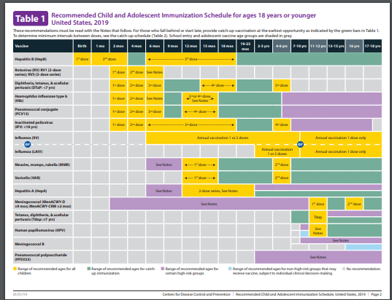
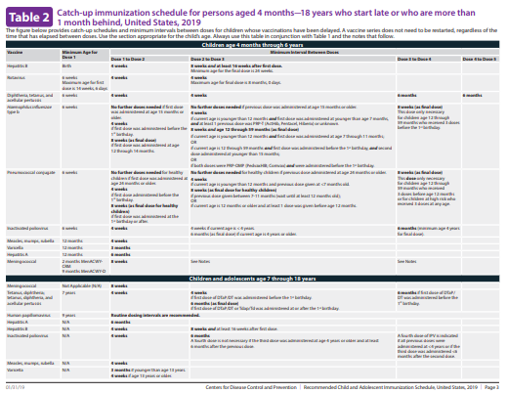
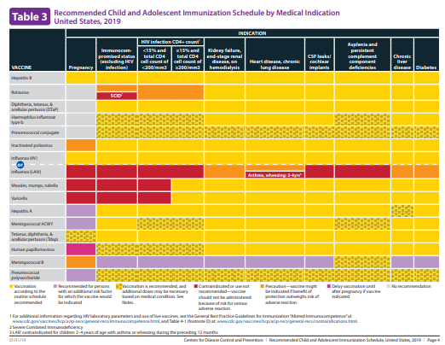
2019 Childhood and Adolescent Immunization Schedules
Recommended Schedule for Children Ages 0-18 Years
Catch-up Schedule
Vaccines that might be indicated for children and adolescents aged 18 years or younger based on medical indications
Changes
Instructions on how to use schedule, plus standardized abbrev. and trade names
Table distinguishes between precautions, necessary delays, and contraindications
Footnotes have been reordered alphabetically
READ THE FOOTNOTES!
CDC Bulletin, February 5, 2019
Notes:
Persons previously vaccinated with 2 doses of a mumps virus-containing vaccine who are identified by public health authorities as being part of a group or population at increased risk for acquiring mumps because of an outbreak should receive a third dose of a mumps virus-containing vaccine to improve protection against mumps disease and related complications.
MMWR, Recommendation of the Advisory Committee on Immunization Practices for Use of a Third Dose of Mumps Virus–Containing Vaccine in Persons at Increased Risk for Mumps During an Outbreak
Weekly / January 12, 2018 / 67(1);33–38

Slide 49
Indications
Recommendations
Requirements
Indication
  Information about the appropriate use of the vaccine
Recommendation
  ACIP statement that broadens and further delineates the Indication found in the package insert
  Basis for standards for best practice
Requirement
  Mandate by a state that a particular vaccine must be administered and documented before entrance to child care and/or school
Notes:
EXAMPLES OF AN INDICATION
ADACEL vaccine is indicated for active booster immunization for the prevention of tetanus, diphtheria and pertussis as a single dose in persons 11 through 64 years of age.
EXAMPLE OF A RECOMMENDATION
Recommendations by ACIP for the routine administration of vaccines. May include other information and guidance on epidemiology of the disease, appropriate timing, dosage, contraindications to the vaccine and guidance for use in special populations.
EXAMPLE OF VACCINE REQUIREMENTS FOR ENTRY INTO CHILD CARE FACILITIES IN GEORGIA
Consistent with the Recommended Childhood and Adolescent Immunization Schedule
Children are required to be age appropriately immunized against each of these diseases: Hepatitis B, Diphtheria, Tetanus, Pertussis, Polio, Hib, Pneumococcus, Measles, Mumps, Rubella, Varicella, Hepatitis A, and meningococcal disease.

Slide 50


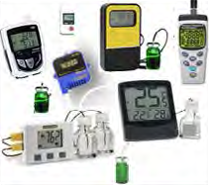
Updated Vaccine Storage and Handling Recommendations
Use stand-alone refrigerator and stand-alone
freezer units. If combined, use only refrigerator part.
Do not store any vaccine in a dormitory-style or
bar-style combined refrigerator/freezer unit.
Use a bio-safe glycol-encased probe
or a similar temperature buffered probe.
Use digital data loggers.
Do not store ANYTHING ELSE in refrigerator.
Review vaccine expiration dates and rotate
vaccine stock weekly.
Ref: Vaccine Storage and Handling Toolkit, JANUARY, 2018
Notes:
It is estimated that 17-37% of immunization providers expose vaccines to improper storage temperatures. More commonly, refrigerators are kept too cold rather than too warm. The potency of vaccines stored at incorrect temperatures may be irreversibly reduced. A physical change in the vaccine may not be apparent.
https://www.cdc.gov/vaccines/hcp/admin/storage/toolkit/index.html to view and print:
-Vaccine Storage and Handling Toolkit
-Vaccine Storage and Handling Guide
-Interim Storage and Handling Guidance
Remember: if you find temperatures out of range, TAKE ACTION, DO SOMETHING ABOUT IT!

Slide 51
Maintaining Appropriate
Vaccine Storage & Handling
Assign a primary and alternate vaccine coordinator.
Store all vaccines as recommended by manufacturer and IN ORIGINAL PACKAGING.
Monitor and record temperatures of refrigerator and freezer twice daily.
Maintain temperature log records for 3 years.
Take immediate action for all out-of-range temps.
Implement a vaccine emergency system.
If it is necessary to transport vaccine, do NOT use dry ice.
Ref: Vaccine Storage and Handling Toolkit, June, 2016
Notes:
Remember: if you find temperatures out of range, TAKE ACTION, DO SOMETHING ABOUT IT!
The June 2016 toolkit reflects an adjustment to the Fahrenheit temperature range for storing refrigerated vaccines. The new recommended range is between 36 and 46 degrees F (previously between 35 and 46 degrees F).

Slide 52
Check Expiration Date of Vaccines and Diluents
Vaccine Expiration Date is 12/10/19
Use through December 10, 2019
Do NOT use on or after December 11, 2019.
Vaccine Expiration Date is 12/19
Use through December 31, 2019
Do NOT use on or after January 1, 2020.
12/19
12/10/19
Note: Some multidose vials have a specified time frame for use once the vial is entered with a needle. This may vary from the expiration date printed on the vial.
Notes:
Ref: Vaccine Storage and Handling Toolkit, June, 2016.

Slide 53
General Best Practice Guidelines for Immunization
(formerly General Recommendations on Immunization)
Timing and Spacing
Contraindications and Precautions
Prevention and Management of Adverse Reactions
Vaccine Administration
Storage and Handling of Immunobiologics
Altered Immunocompetence
Special Situations
Vaccination Records
Vaccination Programs
Vaccine Information Sources
Errata available at https://www.cdc.gov/vaccines/hcp/acip-recs/general-recs/general-recs-errata.html
Kroger AT, Duchin J, Vázquez M. General Best Practice Guidelines for Immunization. Best Practices Guidance of the Advisory Committee on Immunization Practices (ACIP). [www.cdc.gov/vaccines/hcp/acip-recs/general-recs/downloads/general-recs.pdf].
Notes:
Specific administration guidelines have been established for each vaccine. Minimum age and intervals for vaccines are set by manufacturers during clinical trials; too young an age or too close together may alter effectiveness of a vaccine.
There is a 4-day grace period – vaccines given during the 4-day window before the recommended age/interval may be counted as valid. It is suggested that MMR and Varicella, not be given before one year of age. GRITS tables have been set up to calculate this correctly when a vaccine history is entered.
The updated version is entitled General Best Practice Guidelines for Immunization. It will not be available to order but can be accessed on the ACIP Recommendations pg. or downloaded. The bullets list the chapters in the document, plus the location of the errata for this document.
EPIC 2018

Slide 54
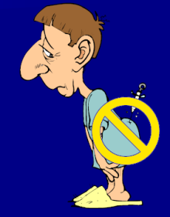
The 7 Rights of Vaccine Administration
Right Patient
Right Vaccine or Diluent
Right Time*
Right Dosage
Right Route, Needle Length, Technique
Right Site for route indicated
Right Documentation
* Correct age, appropriate interval, and administer before vaccine or diluent expires
Ref: Epidemiology and Prevention of Vaccine-Preventable Diseases. 13th Edition, 2015.
Notes:
Be sure to check package insert for correct route, correct sites for the route and correct needle length.
Much of this information is available in the ACIP General Recommendations document.
*Make a chart of this information for use in your office*. Or have a VACS FACS available in your office.
Ref: General Recommendations on Immunization MMWR 2011; 60 (No. RR-2) Jan 28, 2011
REMINDER:
Vaccines should never be given in the gluteus muscle.
If it is discovered that Hepatitis B or rabies vaccine has been given there, all such doses must be repeated at appropriate sites.

Slide 55
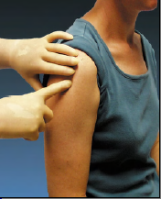
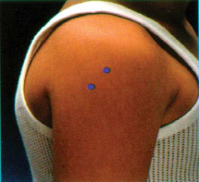
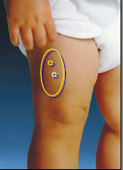
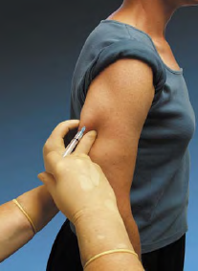
Sites for Vaccine Administration
Intramuscular (IM)
  DTaP, Tdap, Hib, Td, Hep A, Hep B, PCV13, IIV, MCV4, HPV , Herpes Zoster (2-dose vaccine)
Subcutaneous (SQ, SC, or sub-Q)
  MMR, MMRV, Varicella, MPSV4,
  Herpes Zoster (1 dose vaccine)
Either intramuscular or subcutaneous
  IPV, PPSV23
Intranasal
LAIV
Intradermal
IIV3, IIV4 (Fluzone)
(not available for 2018-2019 flu season)
Orally (PO)
Rotavirus
Notes:
Be sure to check package insert for correct route and then make a chart for use in your office.
Revaccination is recommended if:
hepatitis B vaccine is administered by any route other than IM or in any site of an adult other than deltoid or anterolateral thigh
rabies vaccine is administered in gluteal site
if a partial dose of a parenteral vaccine is administered because the syringe or needle leaks or the patient jerks away
Ref: Epidemiology and Prevention of Vaccine-Preventable Diseases. 13th Edition, 2015

Slide 56
Improper Immunization Administration Practices
DO NOT re-use needles or syringes. This has resulted in:
  Transmission of blood-borne viruses (HCV, HBV, HIV)
  Referral of providers to licensing boards for disciplinary action
  Malpractice suits filed by patients
You MAY use the same needle to withdraw a diluent, inject this into a lyophilized vaccine vial, and then administer to a patient, providing the needle or syringe has not otherwise been contaminated.
Types of Vaccine Errors:
Wrong vaccine (23%) Wrong dose (19%)
Expired or contaminated vaccine (19%) Wrong age (17%)
Wrong interval (8%) Diluent errors (4%)
Wrong route (2%)
Wrong patient (1%)
Ref: 1.Epidemiology and Prevention of Vaccine Preventable Diseases 13th Edition, 2015
2. CDC, NCEZIZ, DHQP. Injection Safety Information for Providers: www.cdc.gov/injectionsafety/providers.html
3. http://www.immunize.org/askexperts/administering-vaccines.asp
4. ISMP National Vaccine Error Reporting Program, June 14, 2018, Volume 23, Issue 12
Notes:
Changing needles between drawing vaccine from a vial and injecting it into a recipient is not necessary unless the needle has been damaged or contaminated.
General Best Practice Guidelines for Immunization: Best Practices Guidance of the Advisory Committee on Immunization Practices (ACIP), Vaccine Administration chapter. Published 4-20-17.
EPIC 2018

Slide 57
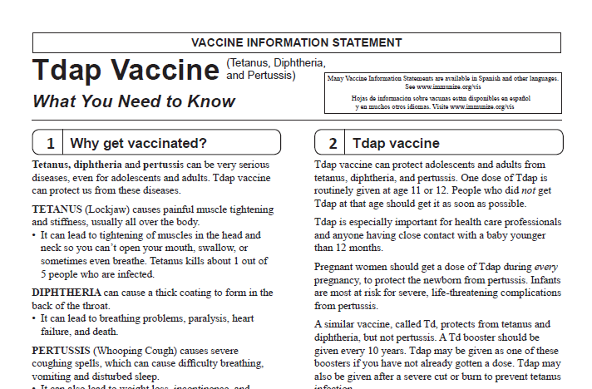
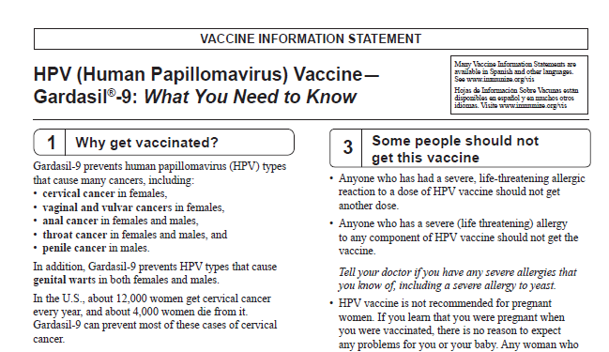
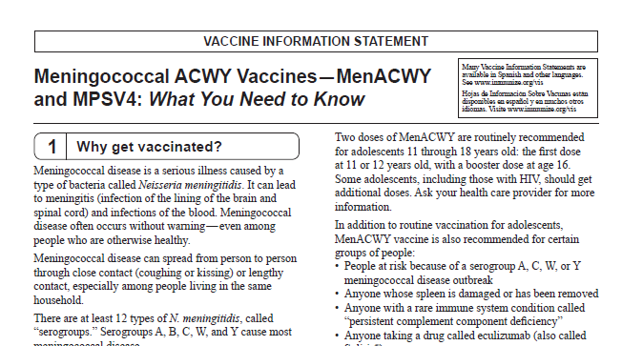
Always Document…
Accept only written documentation of prior immunizations
Provide VIS prior to administration of vaccine
After vaccine administration, document:
  Publication date of VIS & date VIS given
  Date, site, route, antigen(s), manufacturer, lot #
  Person administering vaccine, practice name and address
  Vaccine refusals with a signed “Refusal to Vaccinate Form”
  GA law does not require signed consent for immunizations
Notes:
Vaccine Information Sheets
VIS are required by law for each vaccine given and each time that vaccine is given. The most current VIS must be used. For VIS statements in English and many other languages: www.immunize.org; www.cdc.gov/vaccines/ or call the National Immunization Program Information Hotline at 800-CDC-INFO (800-232-2522).
VIS can be provided at the same time or prior to allow time for questions and educate the parent/client about the vaccine.
Document all information listed on slide. Information will also be helpful if a specific lot of vaccine is recalled in the future.
Refusal to consent for an immunization should be documented for liability purposes and chart completeness. There is no way to document this in GRITS.
Georgia recognizes only medical and religious exemptions.
Medical exemptions must be documented in GRITS and be re-evaluated every year.
Georgia law does not require signed consent for immunization. Patients, parents or legal guardians may verbally consent to immunization. However, some practices may require written consent for all medical care.

Slide 58

A ‘Birth to Death’ Immunization Registry
Providers administering vaccines in Georgia must provide appropriate information to GRITS.
GRITS personnel can work with your EHR/EMR vendor to create an interface between your system and GRITS that will drastically decrease data entry time for your practice.
Contact the GRITS Training Coordinator at (404) 463-0807 or e-mail : dph-immreg@dph.ga.gov
Notes:
In 2004, House Bill 1526 was passed making the Georgia Immunization Registry a birth to death registry mandating that providers of immunizations in Georgia report those immunizations into the registry database. Immunization data may now be shared by all providers of immunizations to Georgians of any age, and to schools, daycares, colleges and universities, and long term care facilities. The patient (age 18 or older) or parent or legal guardian may OPT-OUT of the registry.
Contact GRITS to enroll: 1-888-223-8644
Benefits of GRITS include: accurate immunization records, inventory tracking, reduction in missed opportunities or over-immunization, generation of school entrance forms/college immunization forms, reminder/recall notices for parents, assistance in generating reporting of immunizations to HEDIS/COCASA, and elimination of phone calls to providers for immunization records. The GRITS program is web-based. New users to the system will have to attend a training session and receive a password.
Advantages of a statewide registry are as follows:
Benefits to the Community
Enhance the overall health status by facilitating identification of inadequately immunized segments of the population
Decrease occurrence of over-immunization due to inability to locate past records
Assist in issuing reminders to patients for pending and overdue immunizations
Benefits to Healthcare Providers
Reduce staff time needed to obtain complete immunization history of patients
Provide printouts of school certificates
Provide vaccine information and simplify complex and dynamic immunization schedules
Streamline vaccine inventory process
Generate HEDIS and other reports
Reinforce the concept of a medical home
Benefits to Public Health Officials
Provide an accurate measure of immunization rates for districts, counties, and the state
Allow Georgia healthcare providers to update and exchange immunization information about their patients in a confidential manner
Facilitate community outreach programs
The Georgia Code 31-12-3.1, which took affect July 1, 1996 and House Bill 1526, which took affect July 1, 2004 states:
Any person who administers a vaccine or vaccines licensed for use by the United States Food and Drug Administration to a person shall, for each such vaccination, provide to the department such data as are deemed by the department to be necessary and appropriate for purposes of the vaccination registry established pursuant to subsection (a) of this Code section…
At the present time the mandatory use of GRITS is not being strictly enforced but will be sometime in the future.

Slide 59
Exemptions From School
Medical Exemption O.C.G.A. §20-2-771(d)
Used when a physical disability or medical
condition contraindicates a particular vaccine.
Requires an annual review.
The medical exemption is documented in GRITS.
Religious Exemption O.C.G.A. §20-2-771(e)
Parent or guardian must be directed to http://dph.georgia.gov/immunization-section to obtain an Affidavit of Religious Objection to Immunization form.
This form must be signed and notarized and provided to the school.
Must be kept on file at school/facility in lieu of an
immunization certificate.
Affidavit does not expire.
Georgia does not have a philosophical exemption
Notes:
Medical exemptions should be entered in GRITS and will be listed on the immunization certificate. Medical exemptions must be reviewed on an annual basis.
Georgia now has an Affidavit of Religious Objection to Immunization form that must be filled out for if the parent is refusing immunizations due to a religious exemption. The form lists all vaccines that are required for admittance into childcare facilities or schools in Georgia. It confirms the safety of vaccines and also states the risks if a child is not vaccinated such as, contracting vaccine preventable diseases and spreading them to others. Lastly the form mentions the exclusion of the child from childcare or school during an epidemic or outbreak of a vaccine preventable disease.
The form must be signed and notarized. It does not expire and must be kept on file at the school or childcare facility.

Slide 60
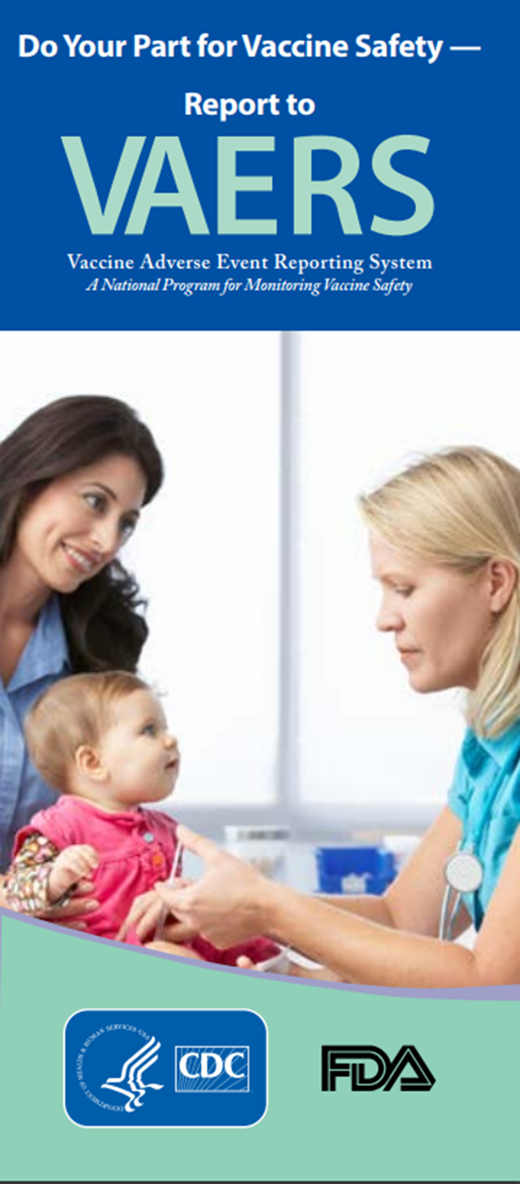
Monitoring Vaccine Safety
VAERS
Option 1 - Report Online to VAERS (Preferred)
Submit a VAERS report online. The report must be completed online and submitted in one sitting and cannot be saved and returned to at a later time. Your information will be erased if you are inactive for 20 minutes; you will receive a warning after 15 minutes.
Option 2 - Report using a Writable PDF Form
Download the Writable PDF Form to a computer. Complete the VAERS report offline if you do not have time to complete it all at once. Return to this page to upload the completed Writable PDF form by clicking here.
If you need further assistance with reporting to VAERS, please email info@VAERS.org or call 1-800-822-7967.
FDA and Vaccine Data Link Safety Project
VERP: VACCINE ERROR REPORTING SYSTEM
  On line reporting at http://verp.ismp.org/
  Report even if no adverse events associated with incident
  Will help identify sources of errors to help develop prevention strategies
Notes:
Nothing is 100% risk free. Most reactions to vaccines are mild with very small risk of severe allergic reactions (anaphylaxis).
Systems in place to monitor safety include the FDA (pre and post licensure monitoring) and the Vaccine Safety Datalink (VSD) Project. This large project links 4 HMO's at 10 sites with the CDC to monitor adverse events possibly caused by vaccines.
FDA monitors vaccines for safety before issuing licenses - very stringent licensing involving laboratory and human testing; vaccine safety is also monitored after licensure to ensure each vaccine lot is effective and pure. Vaccine manufacturers also do post-licensure monitoring.
The Institute of Medicine reviews research related to vaccine safety and publishes a report periodically.
VAERS
Updated system. Two options for reporting are outlined in the gray box.
Passive reporting system to monitor vaccine adverse events established by the National Childhood Vaccine Injury Act 1986
Mandates patients/ parents are educated about risk of vaccines and compensated for any injury caused by vaccine.
Emphasize there is no penalty for reporting an “adverse event”. The healthcare provider is only reporting that a specific event occurred after administration of a specific vaccine and is not claiming that the event was caused by the vaccine.
VERP – There is relatively little data available on why vaccine administration errors occur. The Institute for Safe Medication Practice (ISMP) has launched a national patient safety reporting program to capture the unique causes and consequences of vaccine –related errors. The ISMP National Vaccine Error Reporting Program (ISMP VERP) allows healthcare practitioners to report errors and near misses in confidence.
Sources of Vaccine Safety Information:
https://www.cdc.gov/vaccines/hcp/vis/index.html www.cdc.gov/vaccinesafety/
www.idsociety.org www.vaccinesafety.edu
www.acponline.org www.aap.org
www.aafp.org www.immunize.org
www.vaccine.chop.edu www.vaers.hhs.gov
EPIC 2018

Slide 61

Why do we miss opportunities to immunize?
Physician or patient unaware of the need
Visits for mild illness, injury, or follow-up
Need for multiple vaccines
Invalid contraindications
Inappropriate clinic policies
Reimbursement deficiencies
Notes:
The CDC definition of a missed opportunity is, “A health care encounter in which a person is eligible to receive vaccination but is not vaccinated completely.” (Epidemiology and Prevention of Vaccine-Preventable Diseases, 13th edition. 2015 HHS, CDC.)
Missing an opportunity to immunize may leave you vulnerable to a lawsuit. Patients who developed vaccine-preventable disease after failing to be immunized (missed opportunities) have filed lawsuits. [see Needletips (1), 1,1994]
To avoid missed opportunities:
Vaccination records: Keep accurate immunization records in a prominent location in the chart so immunization status can be easily checked at each visit.
Mild illness/injury visits/follow-up visits: The CDC recommends immunization with all vaccines for patients even those with low-grade fever, mild diarrhea, mild ear infections, mild acute illness, or upper respiratory infections. There is no evidence of increased risk of adverse events associated with immunizations during the course of a minor illness. The decision to defer immunizations results in a missed opportunity. The procedure for assessing immunization status and giving immunizations at follow-up and sick/injury visits may require more time, necessitating change in your office practice.
Multiple vaccinations per visit: More than one vaccine can be administered at one time. There is no limit to the number of vaccines that can be given at one visit.
Know the schedules: Post the current schedule and keep staff updated on any changes.
Know Contraindications: Be aware of the true/valid contraindications, precautions and invalid contraindications. There are few truly valid contraindications to vaccine administration.
Clinic policies: Some clinics might have the policy to not vaccinate clients at any visits except at well-visits.
Adolescents: Adolescents are a large and healthy part of our population who seek medical care infrequently. Immunization status needs to be assessed at each visit.
Adults: Some adults who are healthy may be seen infrequently. Other adults may have multiple medical problems. Immunization status of all adults needs to be assessed at each visit.
Some barriers to be overcome regarding adolescents include:
Parents may be unaware that there are now more vaccines recommended for adolescents
Infrequent medical encounters for adolescent preventive medical services leaves fewer opportunities to immunize
Lack of awareness by both physicians and parents that VFC provides recommended vaccines free for the uninsured and underinsured (in Georgia) through age 18.
Obtaining parental consent for vaccines is a challenge
Failure to vaccinate during sports physicals
Lack of reminder/recall systems for adolescents
Studies have shown that eliminating missed opportunities can help to increase vaccination coverage by 20 percent.

Slide 62
Invalid Contraindications to Vaccine
Mild illness or injury
Antibiotic therapy
Disease exposure or convalescence
Pregnancy or immunosuppression in household
Family history of an adverse event to a vaccine
Breastfeeding
Prematurity
Allergies to products not in vaccine
Need for TB skin testing
Need for multiple vaccines
Ref: General Recommendations on Immunization - MMWR January 28, 2011, Vol 60 # RR02)
Notes:
ANTIBIOTIC THERAPY
Antibiotics do not have an effect on the immune response to a vaccine. [Exception: The growth of the live Ty21, a strain of typhoid vaccine, is inhibited in vitro by various antibacterial agents. Some antibacterial agents may interfere with efficacy of Ty21 vaccine. CDC Yellow Book (Health Information for Travelers) recommends delaying vaccine >72 hours after any antibacterial agent. The Typhoid VIS recommends a delay of >24 hours.]
DISEASE EXPOSURE OR CONVALESCENCE
There is no evidence that either disease exposure or convalescence will affect the response to a vaccine or increase the likelihood of an adverse event.
PREGNANCY OR IMMUNOSUPPRESSION IN THE HOUSEHOLD OR BREASTFEEDING
Most vaccines, including live vaccines (MMR, varicella, and yellow fever) can be given to infants or children with pregnant or immunosuppressed household contacts, as well as to breast-feeding infants. Breastfeeding does not decrease the response to routine childhood vaccines and does not extend or improve passive immunity to vaccine-preventable disease provided by maternal antibody.
PREMATURE BIRTH
Vaccines should be started on schedule based on the child's chronological age. Studies demonstrate that decreased seroconversion rates might occur among certain premature infants with low birth weights (i.e., <2,000 grams) after administration of hepatitis B vaccine at birth. However, by one month chronological age, all premature infants, regardless of initial birthweight or gestational age are as likely to respond as adequately as older and larger infants.
NEED OR REQUIREMENT FOR TUBERCULOSIS SKIN TEST (PPD)
All vaccines, including MMR, can be given on the same day as a TB skin test, or any time after a TB skin test is applied. MMR vaccine may decrease the response to a TB skin test, potentially causing a false negative response in someone who actually has an infection with tuberculosis. If MMR has been given and one or more days have elapsed, in most situations it is recommended to wait 4-6 weeks before giving a routine TB skin test. No information on the effect of varicella vaccine on a TB skin test is available. It is prudent to apply rules for spacing measles vaccine and TB skin testing to varicella vaccine."
ADMINISTERING VACCINES TO HOUSEHOLD MEMBERS OF IMMUNOCOMPROMISED PATIENTS
Immunocompetent individuals who live in a household with immunocompromised patients can safely receive inactivated vaccines. They may also receive live virus vaccines such as MMR, varicella, rotavirus, zoster, yellow fever, and oral typhoid vaccines if indicated. LAIV should be avoided in some instances. (See Footnote 3).
1. General Recommendations on Immunization, Recommendations of the Advisory Committee on Immunization Practices (ACIP). MMWR 2011; 60 (No. RR-2) January 28, 2011
2. Epidemiology and Prevention of Vaccine-Preventable Diseases, 13th edition 2015. HHS, CDC. (Pink Book).
3. IDSA Guidelines, “2013 IDSA Clinical Practice Guideline for Vaccination of the Immunocompromised Host,” Clinical Infectious Diseases Advance Access published December 4, 2013

Slide 63
Vaccine Risk Perception
Many parents are not familiar with vaccine-preventable diseases and perceive the risks of vaccines outweigh the benefits.
Concerns
  Immune system overload
  Children get too many shots at one visit
  Vaccines have side effects (adverse reactions)
  Immunity from the disease is better than immunity from a vaccine (i.e. chicken pox)
  Vaccines cause autism
Notes:
Vaccine Concerns
-One quarter of parents mistakenly believe that vaccines weaken the immune system.
-One quarter of parents believe that children get more immunizations than are good for them.
-On the plus side, the child's health care provider is seen as the most important source for immunization information. (Gellin, B., et.al. "Do parents understand immunizations? A national telephone survey." Pediatrics, 106(5); 1097-1102).
Answers to common concerns about vaccines
Vaccines do not weaken the immune system (we give a small antigen load even at peak times/ages in the vaccine schedule).
Natural immunity is not better than vaccines (ex: shingles in those who have had chicken pox natural illness).
Vaccine-preventable diseases are serious illnesses with the possibility of complications and even death.
Well controlled studies during the past 10 years have failed to show any association between MMR vaccine or thimerosal and autism. However, many anti-vaccine groups continue to promote the association of autism and MMR vaccine and the dangers of thimerosal.
For more information about these topics (and others of concern to parents/patients) visit http://www.cdc.gov/vaccinesafety/

Slide 64
Response to Vaccine Safety Concerns
Vaccines are among the most thoroughly tested and safest things we put into our bodies
Refusing a vaccine means taking the risks of the disease and of spreading the disease to others
“Natural immunity” (from disease) may come with complications, permanent damage, or death
In Georgia, an unimmunized student may be prohibited from attending school during an epidemic*
Consistent reproducible research has shown that autism is NOT caused by:
— Thimerosal
— Multiple vaccines at one time
— MMR vaccine
* State of Georgia -Rules of Department of Human Services: Public Health 290-5-4-.07
Notes:
Studies have found no link between autism and MMR vaccine.
The Story of Dr. Andrew Wakefield and MMR – Autism Link
Original “study”, published in UK medical journal, Lancet, in 1998, proposing MMR - autism link was based on 12 children.
This resulted in decreased use of MMR vaccine and outbreaks of measles in the United Kingdom.
A press investigation revealed that Dr. Wakefield had falsified patient data and relied on laboratory reports that he had been warned were incorrect.
Larger studies, done later by other researchers, failed to establish any link between MMR and autism.
In 2010 Dr. Wakefield was found guilty of “serious professional misconduct” and his medical license was revoked.
The editors of Lancet took the unusual step of retracting his article from the scientific literature on the grounds that it was the product of dishonest and irresponsible research.

Slide 65




Anti-Vaccine Movement
Promotes the idea that there is less evidence of disease today and immunizations are no longer needed
Sends confusing & conflicting information
Uses stories, personal statements, and books to play on the emotional side of concerned parents
Encourage parents/patients to:
  Get the facts
  Consider the source
  Discuss their concerns with you
Notes:
Anti-vaccine issues have been around since the early 1800's.
Most patients/parents haven't seen the diseases so are more concerned about vaccine risk
Media portrays tragedies with emotional appeal
Web sites with anti-immunization information are plentiful with little scientifically-based vaccine information
Address any concerns and questions your patients may have
Anti-Vaccine web sites:
This is just a small list of the many sites available on the internet for anti-vaccine promotion. Please be sure to check some of these locations so that you are aware of the type on information that can be obtained from these sites.
http://www.thinktwice.com/global.htm
http://www.gval.com/
http://www.nvic.org
For “Evaluating Information on the Web”
go to http://www.vaccineinformation.org/internet-immunization-info/

Slide 66










Resources for Factual & Responsible
Vaccine Information
Notes:
These are sources for scientific and credible information
See information sheet in participant packet
https://www.cdc.gov/vaccinesafety/index.html
www.idsociety.org/Immunization/
www.who.int
www.gaaap.org
www.aap.org
www.cispimmunize.org
www.aafp.org
www.acponline.org
www.immunize.org/resources This site is a good resource for healthcare providers and for information written specifically for patient and parents.
www.nfid.org Great resources for immunization for healthcare professionals; Webinars
www.pkids.org (support and counseling for children with infectious diseases)
www.vaccine.org

Slide 67
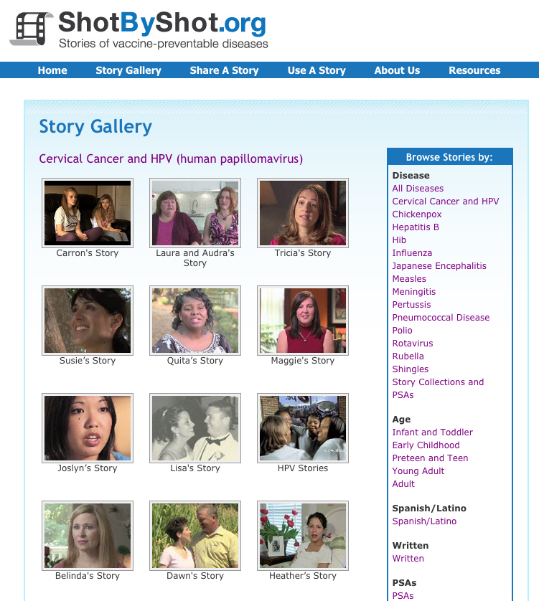
Be sure everyone in the office understands the mission
Human stories often influence people more than statistics
To understand the human stories behind HPV, listen to survivors
  Shot By Shot
  Unprotected People at
  www.immunize.org
Presentation by Jill Roark and Allison Fisher Health Communication Science Office, National Center for Immunization and Respiratory Diseases, Centers for Disease Control and Prevention from GA AAP Webinar, Atlanta, GA March 16, 2016.
Notes:
If you’re recommending the adolescent vaccines, but no one else in the office is enthusiastic, it may be because they don’t understand the importance of these vaccines.
Be sure everyone in the office understands the mission. One great way to get everyone on board is by watching the videos on Shot by Shot or Unprotected People on www.immunize.org
The human stories behind pertussis, meningococcal disease, and HPV cancers – often influence people more than statistics.
EPIC 2018

Slide 68
Important Office Practices
Use reminders on medical records and notify patients when vaccines are needed
Use of automatic text-messaging systems to remind patients of needed or scheduled appointments
Recall patients when vaccine is available after a shortage
Assess your immunization rates using GRITS to improve patient care, HEDIS¹ scores, and identify problem areas
Use current codes for vaccines and vaccine administration
1. Health Plan Employer Data and Information Set®
Notes:
Reminders and Recall
For providers: A reminder communicating to the health care provider that a patient needs an immunization can be as simple as a chart clip, “sticky note” on the immunization record/ patient record, or a flag on the electronic medical record
For patients: A reminder is a message notifying a patient/parent of an upcoming appointment and/or a need for an immunization
A recall is a message notifying a patient that they are past due for an appointment and/or immunization
These can be automated or manual, computerized, telephonic, or written
If one member of a family is scheduled for an appointment, be sure and check all family member records for up to date immunizations and send reminder home at that time!
Reference: General Recommendations on Immunization, Recommendations of the Advisory Committee on Immunization Practices (ACIP). MMWR 60(RR-2); January 28, 2011
The CDC support for CoCasa is “going away,” as they are encouraging use of similar systems available in IIS programs and registries. GRITS has this capability.*
*Per email to NIPINFO@cdc.gov, 2/2/18---“While the tool is still available, it is the intention of CDC to have programs move toward IIS and registries to determine coverage. Support for CoCasa has been going away for a couple of years. I don't know when it will be officially finished.”

Slide 69

Stay Current!
Sign up for listserv sites which provide timely information pertinent to your practice www.immunize.org/resources/emailnews.asp
  AAP Newsletter
  CDC immunization websites (32 in all)
  CHOP Parents Pack Newsletter
  IAC Express, Needle Tips and Vaccinate Adults
  Websites specific to particular vaccines

Slide 70

YOU ARE ALL PART OF THE TEAM THAT CAN
MAKE SURE YOUR PATIENTS RECEIVE THE
IMMUNIZATIONS THEY NEED!
AND REMEMBER………….

Slide 71
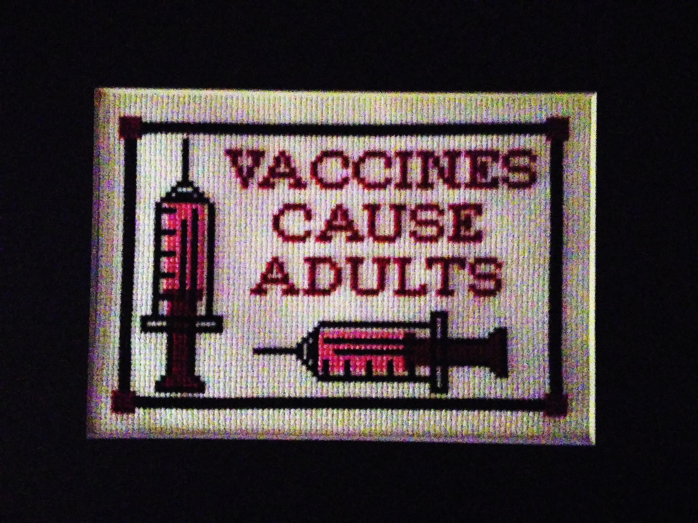

Slide 72
Questions?
Check out these links for more immunization information and resources!
National Immunization Program
E-mail ► NIPInfo@cdc.gov
Hotline 800.CDC.INFO
Website http://www.cdc.gov/vaccines
Georgia Immunization Program
E-mail DPH-Immunization@dph.ga.gov
Hotline 404-657-3158
Website http://dph.georgia.gov/immunization-section
Immunization Action Coalition
E-mail admin@immunize.org
Phone 651.647.9009
Website www.immunize.org
Notes:
With a second click of the mouse presenters can highlight NIPInfo@cdc.gov, an Email site that can provide answers to specific questions about immunizations. Experts from the CDC will respond to questions Monday through Fridays in 24 to 48 hours or sooner. It is not a practical source of information if the practitioner has a patient in an exam room waiting for an immunization. However, it a great source for information you can not find in the Pink Book or on the CDC web site.

Slide 73
Test Your Knowledge!
EPIC 2019

Slide 74
Test Your Knowledge!
Emily is 12 years old and comes to your office for a physical exam. Her immunizations were up-to-date when she started kindergarten.
What vaccines do you recommend for her?
Notes:
74

Slide 75
Test Your Knowledge!
Emily is 12 years old and comes to your office for a physical exam. Her immunizations were up-to-date when she started kindergarten.
What vaccines do you recommend for her?
Tdap, Meningococcal Conjugate, HPV, possibly a 2nd varicella, hepatitis A
Influenza vaccine (in the fall)
Ref: Child and Adolescent Immunization Schedule
Notes:
.
75

Slide 76
Simon received MPSV4 at 5 years of age for international travel and a dose of MCV4 at age 11.
Does he need a booster dose of MCV4 vaccine at age 16?
Test Your Knowledge!
Notes:
76

Slide 77
Simon received MPSV4 at 5 years of age for international travel and a dose of MCV4 at age 11.
Does he need a booster dose of MCV4 vaccine at age 16?
Test Your Knowledge!
Yes. Any meningococcal vaccination given prior to the tenth birthday (either with MCV4 or MPSV4) does NOT count toward routinely recommended doses.
IAC Ask the Experts - Reviewed September 2013
Notes:
77

Slide 78
Test Your Knowledge!
Ethan is 17 years old. After his second DTP vaccine at 4 months of age he cried persistently for 4 hours, had a fever of 104°F, and developed a severe local reaction at the injection site.
His pediatrician subsequently administered DT at 6 months, 18 months and 5 years of age. He received Td when he was 12 years old.
With this history of a severe reaction to pertussis vaccine, should he receive Tdap?
Notes:
78

Slide 79
Test Your Knowledge!
Ethan is 17 years old. After his second DTP vaccine at 4 months of age he cried persistently for 4 hours, had a fever of 104°F, and developed a severe local reaction at the injection site.
His pediatrician subsequently administered DT at 6 months, 18 months and 5 years of age. He received Td when he was 12 years old.
With this history of a severe reaction to pertussis vaccine, should he receive Tdap?
Yes, administer Tdap. These adverse reactions in infancy are not contraindications or precautions for Tdap vaccination in adolescents.
Ref: Preventing Tetanus, Diphtheria, and Pertussis Among Adolescents: Use of Tetanus Toxoid, Reduced Diphtheria Toxoid and Acellular Pertussis Vaccines MMWR Recommendations and Reports March 24, 2006 / Vol. 55 / No. RR-3
Notes:
79

Slide 80
Test Your Knowledge!
Dakota is an 18 year girl who will be starting her first year of college in August. She had her first dose of HPV vaccine on April 5 and her second dose on May 8. She will not be coming home again until late November.
Should you give her the third dose of HPV vaccine before she leaves home in mid August?
Notes:
80

Slide 81
Test Your Knowledge!
Dakota is an 18 year girl who will be starting her first year of college in August. She had her first dose of HPV vaccine on April 5 and her second dose on May 8. She will not be coming home again until late November.
Should you give her the third dose of HPV vaccine before she leaves home in mid August?
No! The minimum interval between the second and third doses of vaccine is 12 weeks. The minimum interval between the first and third doses is 24 weeks.
Ref: Immunization Action Coalition – Ask the Experts April 2012
Notes:
81
EPIC 2018

Slide 82
Test Your Knowledge!
If dose #1 of HPV vaccine was given before the 15th birthday and it has been more than a year since that dose was given, would the series be complete with just one additional dose?
Recommendation?
Notes:
74

Slide 83
Test Your Knowledge!
If dose #1 of HPV vaccine was given before the 15th birthday and it has been more than a year since that dose was given, would the series be complete with just one additional dose?
Recommendation?
Yes. Adolescents and adults who started the HPV vaccine series prior to the 15th birthday and who are not immunocompromised are considered to be adequately vaccinated with just one additional dose of HPV vaccine.
Immunization Action Coalition – Ask the Experts, #1283, January 2017
Notes:
74

Slide 84
Test Your Knowledge!
Which individuals are recommended to be vaccinated against meningococcal serogroup B disease who are not in risk groups?
Recommendation?
Notes:
74

Slide 85
Test Your Knowledge!
Which individuals are recommended to be vaccinated against meningococcal serogroup B disease who are not in risk groups?
Recommendation?
ACIP recommends that a MenB vaccine series (Bexero, MenB-4C, GSK; Trumenba, MenB-FHbp, Pfizer) may be administered to people 16 through 23 years of age with a preferred age of vaccination of 16 through 18 years. This Category B recommendation gives clinicians an opportunity to discuss the value of MenB vaccination with their patients and to make a decision together about the individual’s need or desire for the vaccine based on risks, benefits, and wish for protection from the disease.
Immunization Action Coalition – Ask the Experts, #1283, January 2017
Notes:
74

