Slide 1
Lesson 12: Popular Culture
Robert Wonser
Introduction to Sociology

Slide 2
Some notes about pop culture
Pop culture is never the product of a solitary artist but always emerges from a collective activity generated by interlocking networks of cultural creators.
Popular culture is produced, consumed, and experienced within a context of overlapping sets of social relationships.

Slide 3
What is Popular Culture?
Popular culture refers to the aesthetic products created and sold by profit-seeking firms operating in the global entertainment market.
Designed to be bought and sold
Popular culture = popular + culture
So, what does popular mean?
So, what does culture mean?

Slide 4
Popular
1) culture that is well-liked (demonstrated through sales)
2) icons or media products that are globally ubiquitous and easily recognized the world over
3) commercial media that is thought to be trivial, tacky or lowest common denominator; mass culture
4) belonging to the people; folk culture

Slide 5
The Culture Portion
Culture is richly symbolic, invested with meaning and significance.
The meanings attributed to culture are never simply given but are the product of human invention, socially constructed and agreed upon among a demonstrably large number of society’s members.

Slide 6
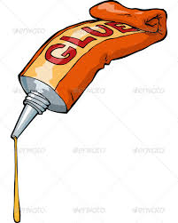
Theoretical takes on Popular Culture
Functionalist: culture “functions” as the social glue that generates solidarity and cohesion within human groups and societies.
Contemporary collective rituals—hs football games, parades, pep rallies—serve to forge emotional bonds of recognition, identity, and trust within communities and social groups
Allows strangers to communicate with each other in public

Slide 7
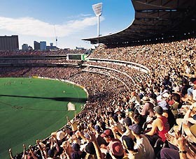
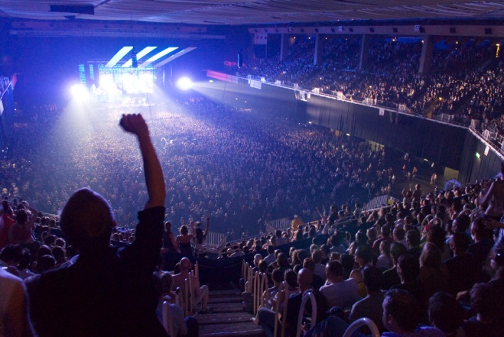
Emotional Energy
A strong benefit of group membership (society, a cultural group, or subcultural group) is the emotional energy one receives from taking part in social gatherings
Durkheim called this “collective effervescence”

Slide 8
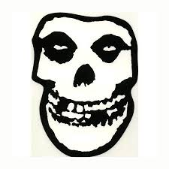
The Importance of Rituals, the Sacred and the Profane
If people share the same sacred emblems and holy names, the same doctrines, they know they belong to the same ritual community.
They can identify with one another as members of a group that has feelings of collective solidarity and strength.
Even short conversations are mini rituals that affirm one’s identity in a select group and boost our emotional energy.
Sacred symbols also tell us who is not a part of our group.

Slide 9
Theoretical takes on Popular Culture
Critical: the ascendance of certain kinds of pop culture can be explained primarily in terms of their ability to reflect and reinforce the enormous economic and cultural power of the mass media industry.
Top down model with pop culture as a form of domination.

Slide 10
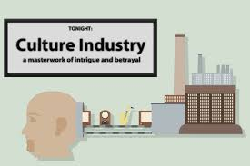
The Culture Industry
Culture Industry - popular culture is akin to a factory producing standardized cultural goods — films, internet, tv, etc. — that are used to manipulate mass society into passivity.
Consumption of the easy pleasures of popular culture, made available by the mass media, renders people docile and content, no matter how difficult their economic circumstances.
Culture Industry cultivates false psychological needs that can only be met and satisfied by the products of capitalism.

Slide 11
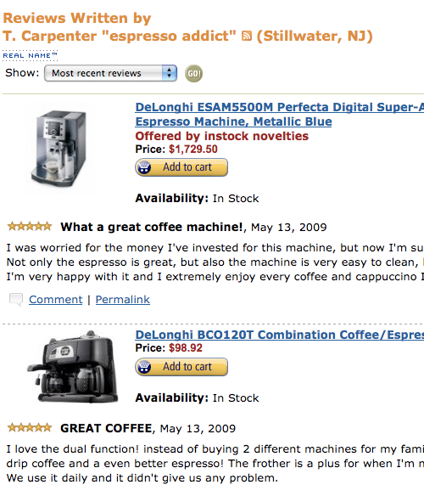
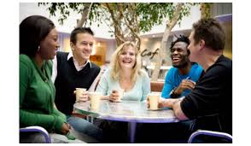
Theoretical takes on Popular Culture
Interaction approach: emphasizes the power that informal processes like word of mouth and peer influence enjoy in the cultural marketplace.
Our consumer tastes are deeply affected by those around us.

Slide 12
So, which opinion is correct?
Meaning, interpretation and value are not ultimately decided by the creators of media and popular culture (though they do have some input), but by its consumers.
Cultural objects are multivocal because they say different things to different people.

Slide 13
Interpretation
Audiences draw on their own social circumstances when attributing meaning and value to popular culture.
These meanings are patterned according to persistent systems of social organization structured by differences in socioeconomic status, nationality, race, ethnicity, gender, sexuality, religion, or age.
These are called interpretive communities

Slide 14
Interpretive Communities: Age
Notes:
http://southpark.cc.com/clips/388728/it-sounds-like-poo

Slide 15
Taste and Consumption
Taste – one’s preference for particular styles of fashion, music, cinema or other kinds of culture
Consumption – the reception, interpretation and experience of culture
Does social class play a role in determining these?

Slide 16
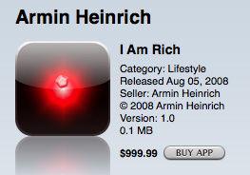
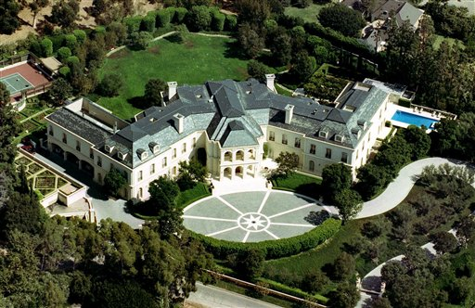
Class Status and Conspicuous Consumption
Conspicuous consumption status displays that show off one’s wealth through the flagrant consumption of goods and services, particularly those considered wasteful or otherwise lacking in obvious utility.
Notes:
Source: http://gizmodo.com/5034701/confirmed-eight-morons-bought-the-999-i-am-rich-iphone-application

Slide 17
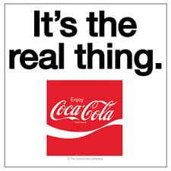
Popular Culture and the Search for Authenticity
Perhaps the biggest motivator to consume popular culture: authenticity
Authenticity can refer to a variety of desirable traits: credibility, originality, sincerity, naturalness, genuineness, innateness, purity, or realness.

Slide 18
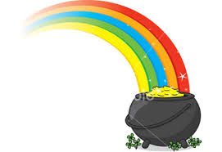
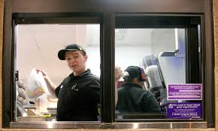
There’s no such thing as authenticity, on consumer products
Can never be truly authentic, instead must always be performed, staged, fabricated, crafted or otherwise imagined.
The performance of authenticity always requires a close conformity to the expectations set by the cultural context in which it is situated.
Why is authenticity so important? Is it lacking in our culture?

Slide 19
The turn to Subcultures
Seeking authenticity, lacking in ‘mainstream consumer culture’
Subcultures offer an alternative identity
How to demonstrate membership? → purchase the appropriate consumer goods (in opposition to mainstream of course!).

Slide 20
Consumerism
Don’t be different, buy the right stuff.
Don’t be a conformist buy different stuff instead!
Consumerism propels the insatiable belief that we need what we do not have and that happiness can be bought with consumer goods.
Modern capitalism
A fundamental frame of reference for relating to oneself, to others, to the environment as a whole
The principle socializing force behind this way of being in the world is television and advertising

Slide 21
I’m Different!
You think this has nothing to do with you.
You go to your closet and you select, I don’t know, that lumpy blue sweater, for instance, because you’re trying to tell the world that you take yourself too seriously to care about what you put on your back.
But what you don’t know is that that sweater is not just blue, it’s not turquoise, it’s not lapis, it’s actually cerulean.
And you’re also blithely unaware of the fact that, in 2002 Oscar de la Renta did a collection of cerulean gowns and then I think it was Yves St. Laurent — wasn’t it? — who showed cerulean military jackets…
And then cerulean quickly showed up in the collections of eight different designers. And then it filtered down through the department stores and then trickled down into some Casual Corner where you, no doubt, fished it out of some clearance bin.
However, that blue represents millions of dollars and countless jobs and it’s sort of comical that you think you’ve made a choice that exempts you from the fashion industry when, in fact, you’re wearing a sweater that was selected for you by the people in this room.

Slide 22
Cultural Hegemony and Consumerism
Ideas propelled by the culture industry:
Last season’s fashions are so last season
planned obsolescence
Shopping completes us
Retail therapy?
This was the only male image for ‘retail therapy’….

Slide 23
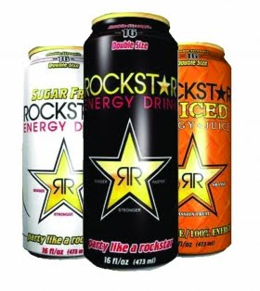
Cultural Hegemony and Consumerism
We can all live like celebrities
No longer the Jones’, we evaluate our consumption relative to reference groups that live financially beyond our own means.
Average household’s credit card debt is $15,950 in 2012.
Ironically, this doesn’t make us any happier by only highlighting existing disparities between the middle and upper classes.
Notes:
Source: http://money.cnn.com/magazines/moneymag/money101/lesson9/
Source: http://www.washingtonpost.com/blogs/wonkblog/wp/2013/08/15/five-facts-about-household-debt-in-the-united-states/

Slide 24
Cultural Hegemony and Consumerism
Our self-worth is determined by our looks and cultural norms of sexual attractiveness
Airbrushed images of perfected bodies normalize an unattainable expectation of beauty.

Slide 25
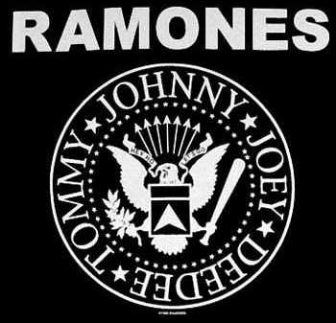
Cultural Hegemony and Consumerism
Brands matter
Connote status
McDonald’s coffee beats Starbuck in unbiased Consumer Reports taste tests.
Ramones t-shirts have outsold their music 10 to 1

Slide 26
The Sleeper Curve
As Steven Johnson claims, video games provide a locus for the same kind of rigorous mental workout required for mathematical theorems and puzzles.
Improve abstract problem-solving skills
‘problem-solving species’
Video games are actually making us sharper and smarter than any other point in the history of civilization.
“The Sleeper Curve” in general applies to pop culture: the most apparently debasing forms of mass diversion turn out to be nutritional after all.

Slide 27
Sleeper Curve
Storyline complexity has increased dramatically and even the best shows from 20 years ago would be regarded as quite primitive were they to air today (compare Dragnet to The Sopranos)
“multiple threading”
Decline in “flashing arrows” - a metaphorical audiovisual cue used in movies to bring some object or situation that will be referred later, or otherwise used in the advancement of plot, to the attention of the viewers.

Slide 28
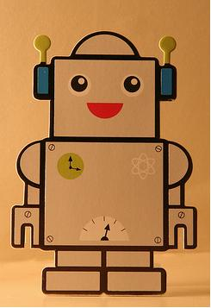
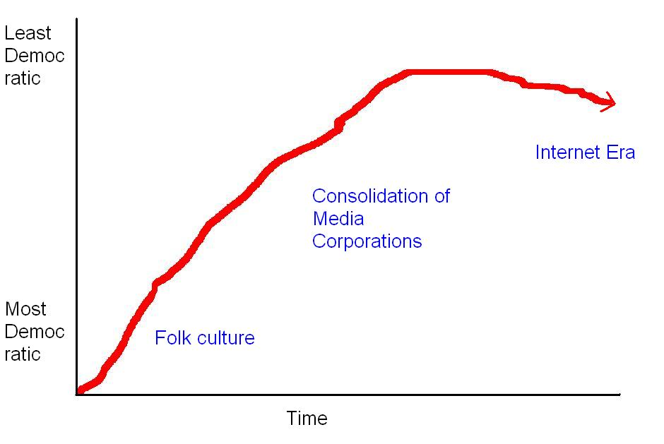
Digital Technology and the Media Industries
The democratization of popular culture
digital divide

Slide 29
The Digital Divide

Slide 30
The Ruling Ideas
“The ideas of the ruling class are in every epoch the ruling ideas, i.e. the class which is the ruling material force of society, is at the same time its ruling intellectual force. The class which has the means of material production at its disposal, has control at the same time over the means of mental production, so that thereby, generally speaking, the ideas of those who lack the means of mental production are subject to it. The ruling ideas are nothing more than the ideal expression of the dominant material relationships, the dominant material relationships grasped as ideas.”
Marx, German Ideology (1845)

Slide 31
Concluding Remarks
Popular culture isn’t ‘good’ or ‘bad’; at least not until it is interpreted.
Pop culture has no inherent meaning.
Popular culture is another vehicle for class reproduction.

Slide 32
Lesson Quiz
1) Which theory emphasizes the importance of rituals in maintaining solidarity between group members?
A) critical
B) conflict
C) functionalist
D) interaction

Slide 33
Lesson Quiz
2) True or False: Meaning comes from the author of a work of popular culture (e.g. the director, singer, etc.).
A) true
B) false

Slide 34
Lesson Quiz
3) ______________ status displays that show off one’s wealth through the flagrant consumption of goods and services, particularly those considered wasteful or otherwise lacking in obvious utility
A) conspicuous consumption
B) critical consumption
C) consumerism
D) inconspicuous production

Slide 35
Lesson Quiz
4) The Sleeper Curve refers to the idea that:
A) pop culture is debased
B) pop culture is meritless
C) pop culture has no redeeming value
D) pop culture is actually making us smarter and hones our problem solving skills

Slide 36
Lesson Quiz
5) The _________ approach sees popular culture as a tool to dominate the masses.
A) functionalist
B) interactionist
C) critical
D) feminist

