Slide 2
SATELLITES FOR HUMANITY
(1/2 CENTURY)

Slide 3
SATELLITE USES
Communications (Fixed and Local)
Telephone / Teletype / Facsimile
Internet / Data
Cellular (Direct and Relay)
Broadcast – Television and Radio
Communications (Mobile) – Ships and Airplanes
Position Determination
Weather
Earth Observation
Government - Comint / Elint / Surveillance / Defense

Slide 4
ORGANIZATIONAL HISTORY
MILITARY – Missiles and Spying
NASA – Science and Commercial
COMSAT
International communications INTELSAT
Maritime Communications INMARSAT
Domestic & Regional Systems COMSTAR
Direct Broadcast DirecTV / Dish / Echostar
PRIVATE
DIRECT CELLULAR SERVICE (Iridium / Globalstar)
SES, ARABSAT, ASIASAT, EUTELSAT, SATELLITE RADIO
GOVERNMENT
POSITION DETERMINATION (GPS / GLONASS / GALILEO)
WEATHER (NOAA)
DOMESTIC (MORELOS, PALAPA, etc.)

Slide 5
BASICS
SATELLITES
EQUIPMENT WEIGHT
(Transmitters, antennas, attitude control, etc.
POWER
(Solar cells & batteries)
LAUNCH VEHICLES
ALL GOVERNMENT
SPACEX
TECHNOLOGY ADVANCES

Slide 6
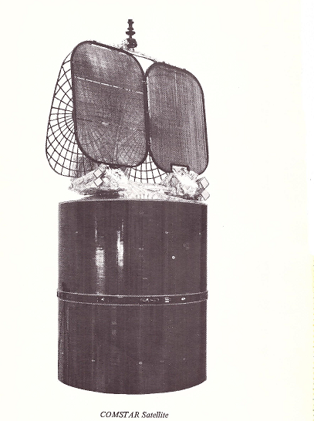
COMSTAR

Slide 7
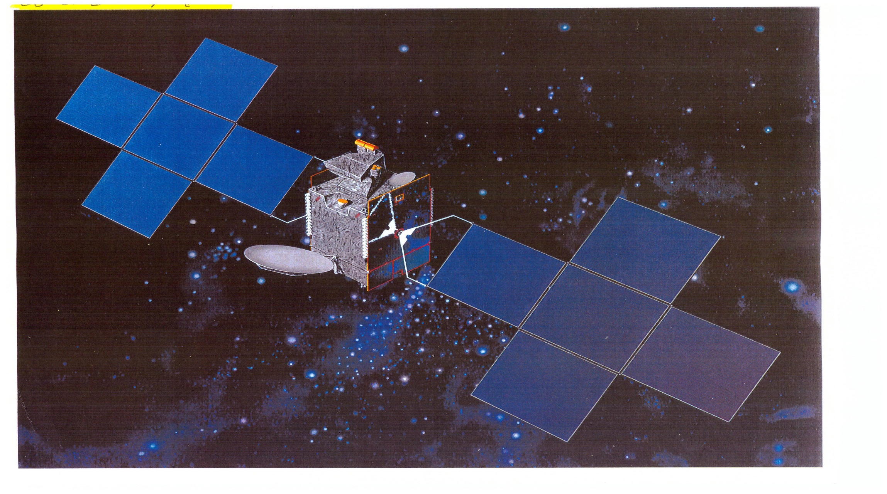
SIRIUS FM 1-4

Slide 8
SIRIUS XM 7/8

Slide 9
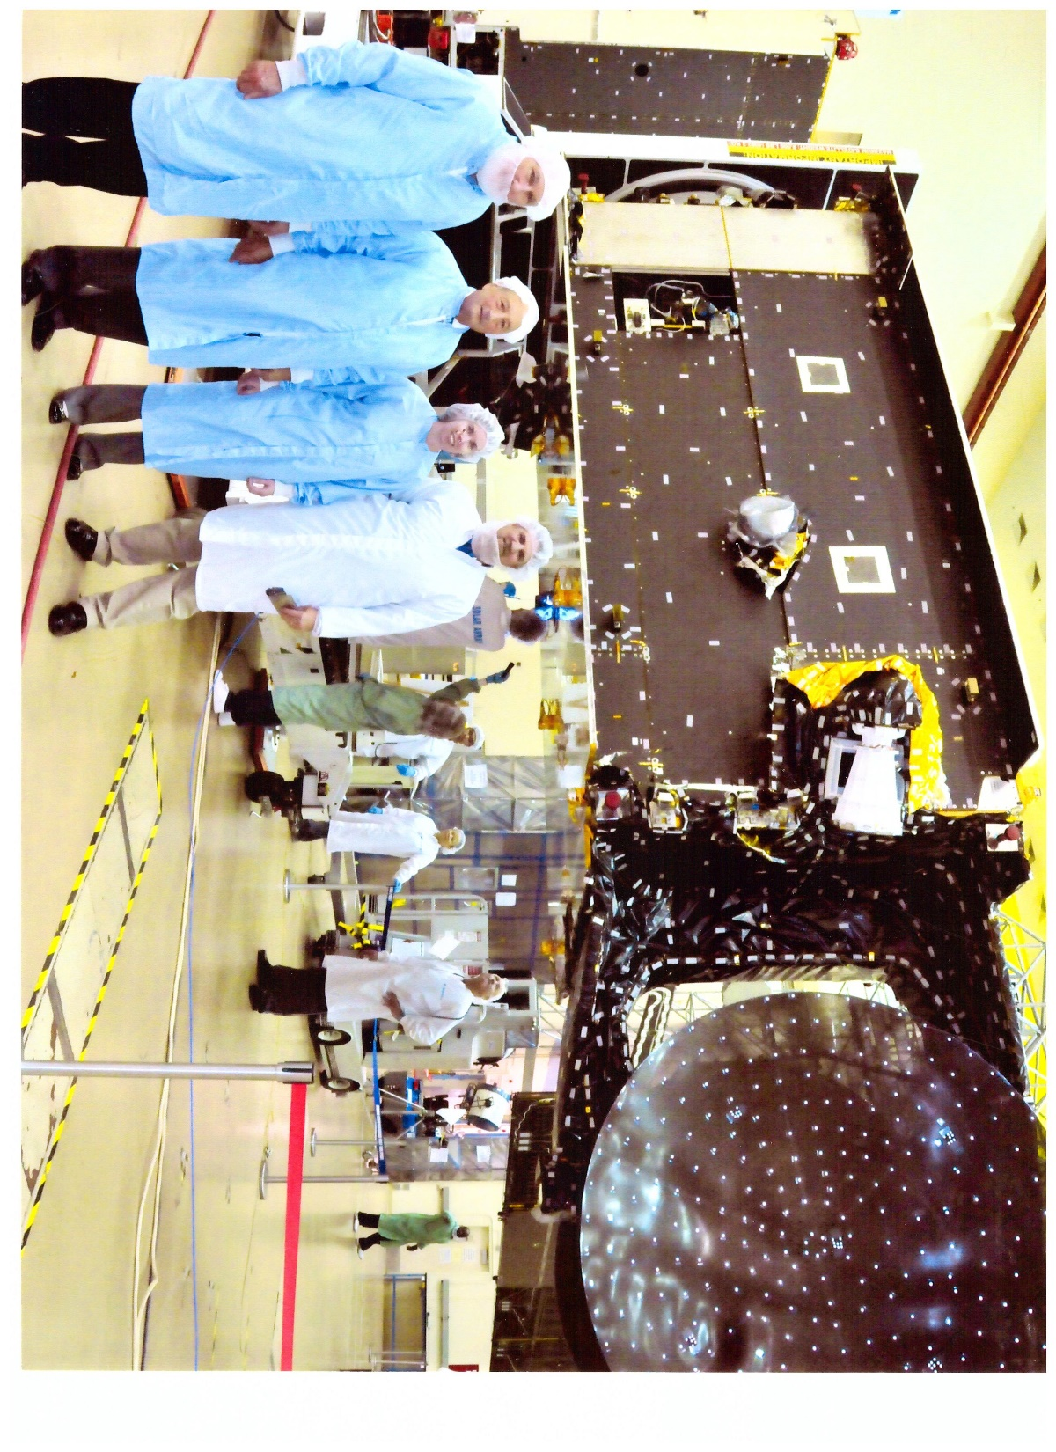

Slide 11
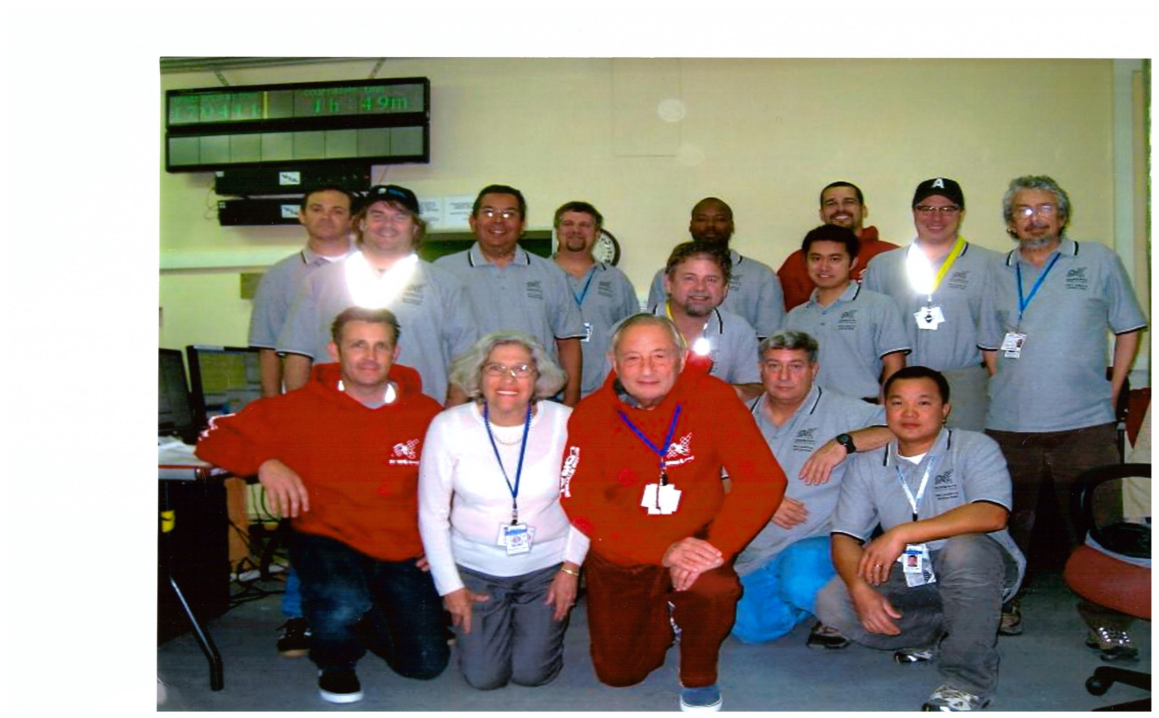

Slide 12
UPCOMING
BETTER AIRPLANE SERVICE
IMPROVED WORLDWIDE INTERNET
ONE WEB (900 SATELLITES)
LOW LATENCY
ACCURATE SHIP TRACKING

