Slide 1
World Peace Project
“LEARN➔DO➔GROW”
LEARN WHAT PEACE-BUILDING IS, AND FACTORS THAT MAKE IT HAPPEN….
DO THOSE THINGS….
GROW IN INNER PEACE.
Notes:
“Learn, Do, Grow” is the 2012-2013 Theme for our Arlington West Rotary Club. “It is interesting that the more you learn, the more you realize how much you don't know.” This is not just about Rotary….it’s also about YOU!
As the saying goes, “Live today like it may be your last.” Our club provides each of us an excellent opportunity: to be philanthropic with our time, our skills, and our financial abilities…to develop new friends…to have fun along the way…and to personally experience the peace and inner satisfaction of helping the world become a better place.

Slide 2
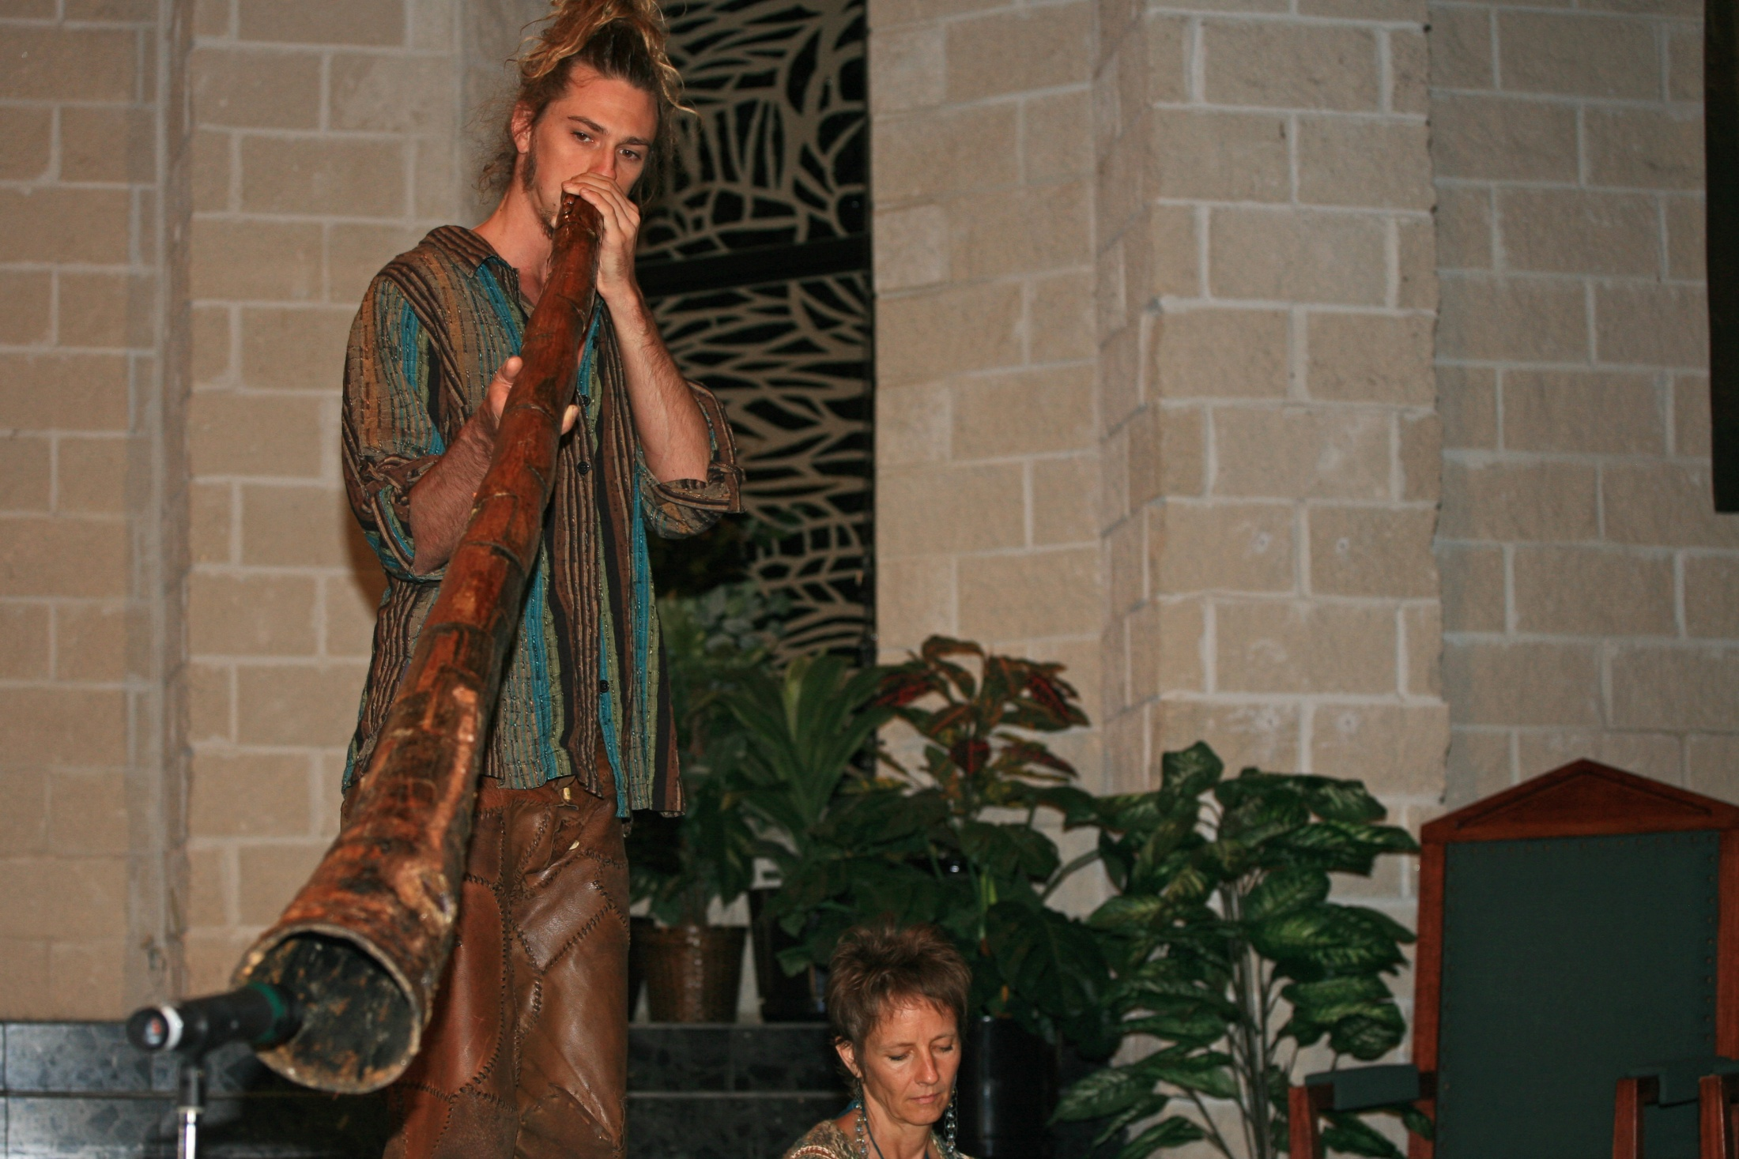
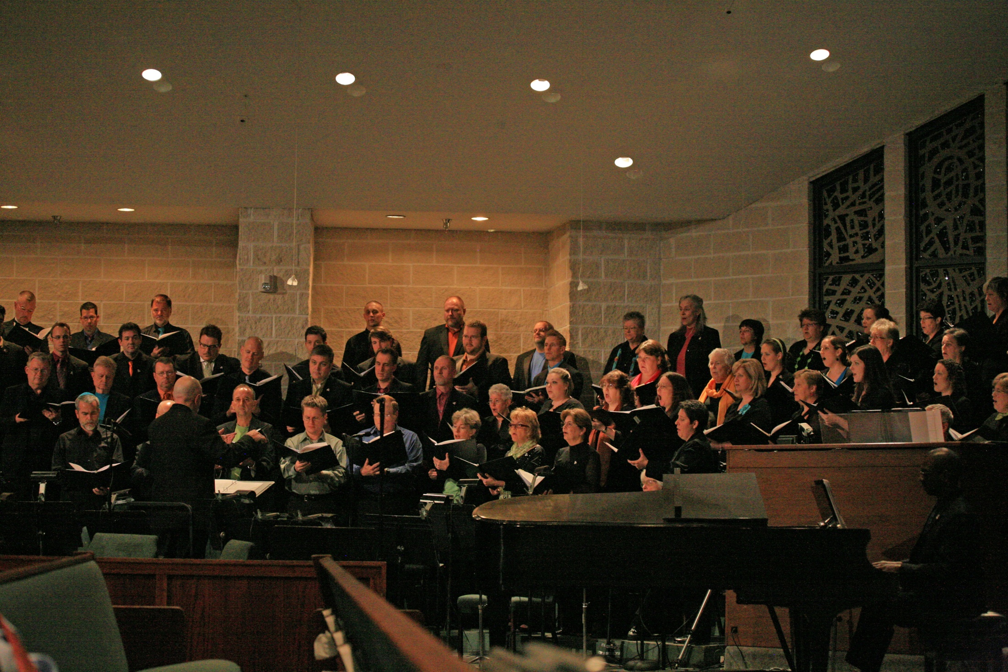
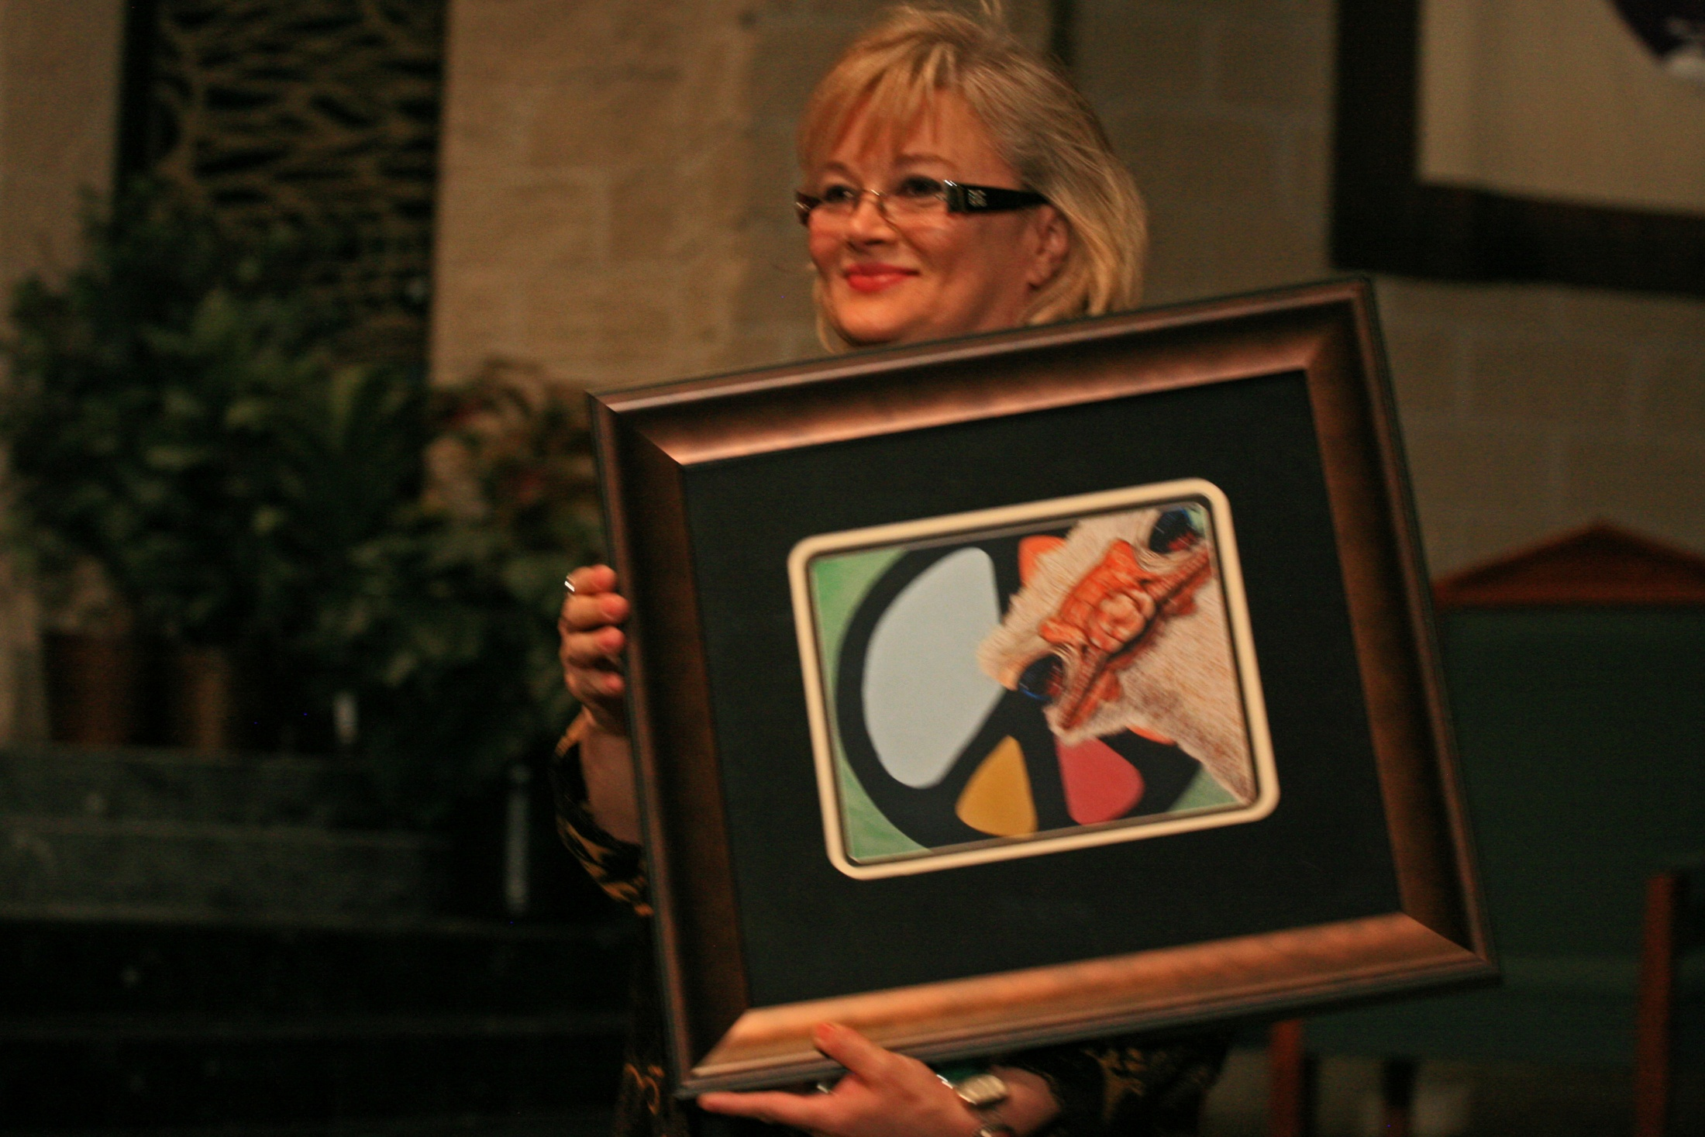
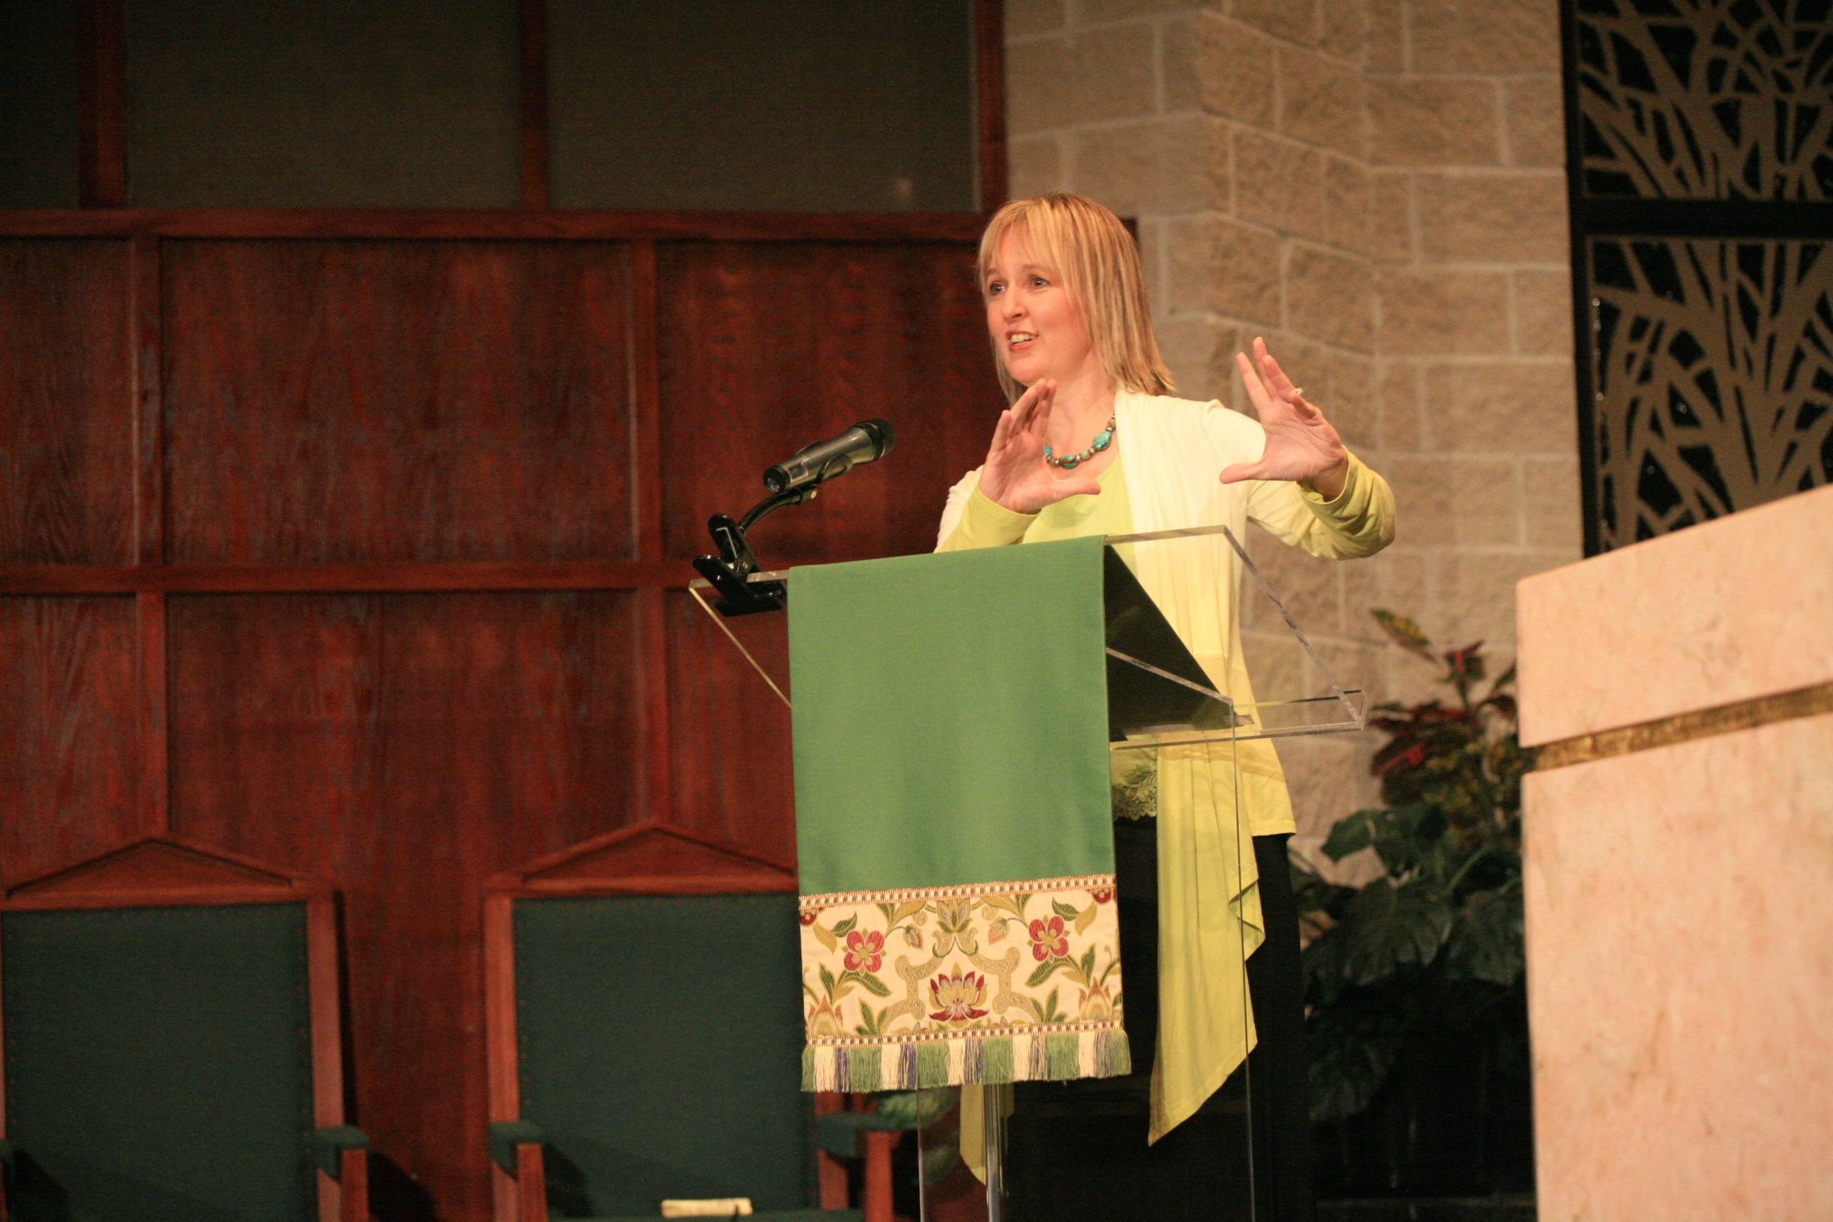
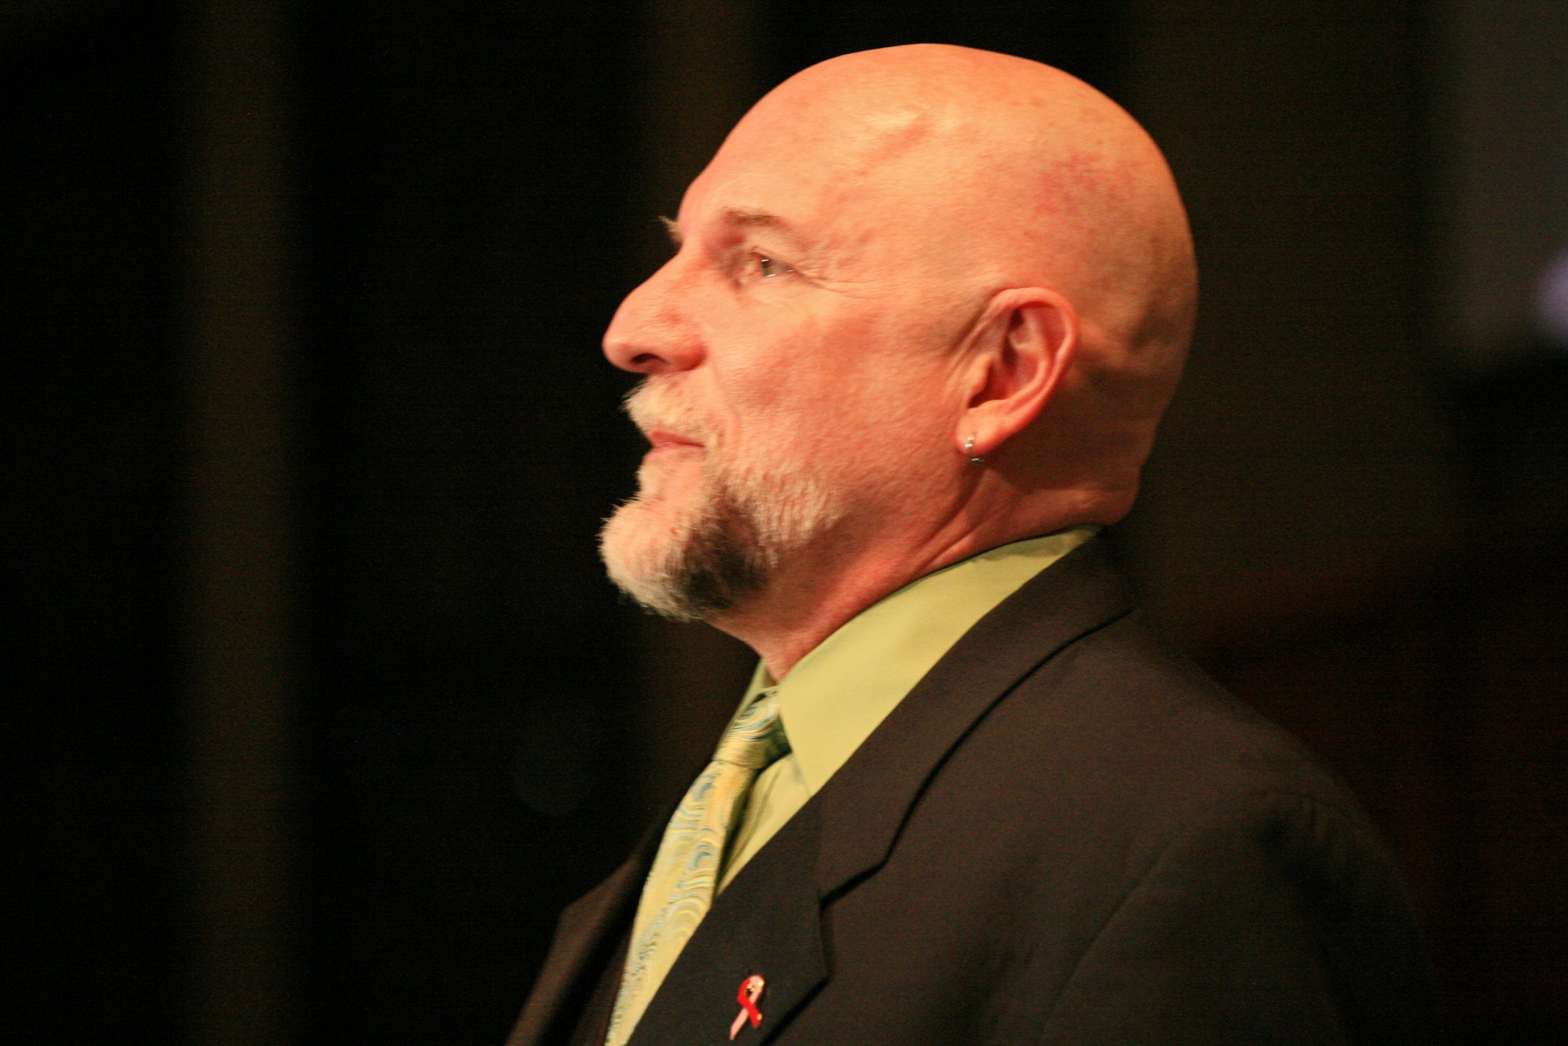
Peace Conclave
Dallas, Texas
Notes:
This was a September 21st International Day of Peace movement in Dallas, attended by Dave Hurt with the Arlington West Club. At the lower left is his daughter, Mindy Audlin, who was the keynote speaker. Receiving a Peace award is Donna Collins, Executive Director of the World Peace Project.

Slide 3
Striving for World Peace
Club Project Goals
1. To Bring more peace in every area of your life.
2. To provide better knowledge, resources, and understanding about peace.
3. To suggest methods of implementation as Rotarians, and as an organization.

Slide 4
Rotarians Striving for World Peace
United Nations (U.N.) Peace Categories
Peace-making….involved with resolving conflict.
Peace-keeping…involved enforcing with treaty resolutions.
Peace-building…creating environments where peace, joy, and abundance can thrive.*
* This peace project will focus on the peace-building process.

Slide 5
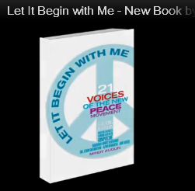
Striving for World Peace
Notes:
The 21 contributors to this book are peace teachers, many of whom are founders of organizations, representing many thousands of members. The book makes it easy to get a handle on what peace is, and how we can strive to promote world peace.

Slide 6
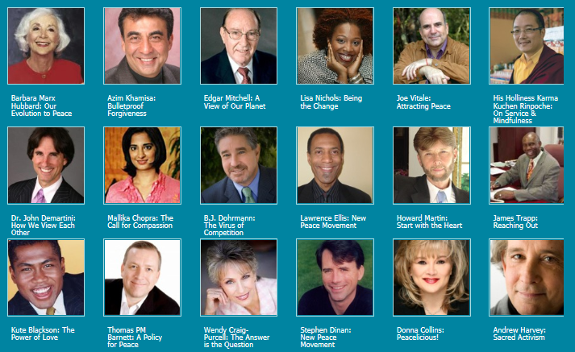
Striving for World Peace

Slide 7
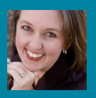
Striving for World Peace
Voices from 21 Peace Teachers

Slide 8
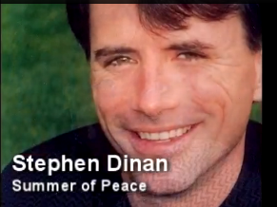
Striving for World Peace
www.stephendinan.com
www.artinactionworld.org
Founder: The Shift Network
The Essential Foundation for Peace
Discipline to deal with conflict.
Social communities based on non-conflict.
Government structures that allow participation
and opportunity.

Slide 9
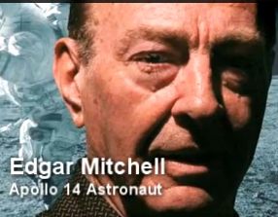
Striving for World Peace
www.edmitchellapollo14.com
www.care2.com/greenliving
Founder Institute of Noetic Sciences (IONS)
PEACE MEANS:
Learning to work with people.
To love nature.
To love our civilization.
To be respectful and caring of all people.

Slide 10
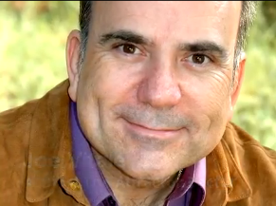
Striving for World Peace
www.joevitale.com
www.operationyes.com
Joe Vitale, Author
Chairman of “Operation Yes”
Ancient Four Phase Mantra: Love, Forgiveness, & Apology
I Love You
I’m Sorry
Please Forgive Me
Thank You

Slide 11
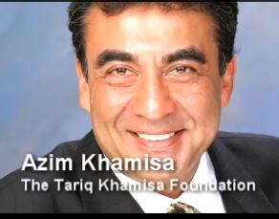
Striving for World Peace
www.azimkhamisa
Path to Peace
Produce Leaders that understand the most difficult step is forgiveness.
Leaders must understand that from conflict can come unity and love.

Slide 12
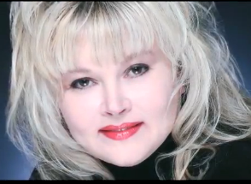
Striving for World Peace
www.theglobalpeaceproject.com
Donna Collins: Executive Director
The Global Peace Project
“If we can come to every meal and take in every morsel with gratitude, there would be a huge shift toward peace.”
Notes:
Donna was the original founder of The World Peace Project in Dallas. She stresses the importance of the family eating together and sources of food..

Slide 13
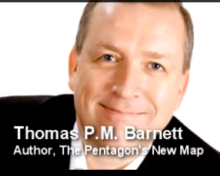
Striving for World Peace
www.thefriendshipforce.org
Professor: Naval War College
Peace is all about creating certainty
The poor want protection from their circumstance.
The middle class wants protection from uncertainty and from the future.
They want to keep what they have achieved, and to pass it on for their children.

Slide 14
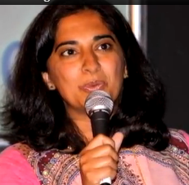
Striving for World Peace
www.intent.com
Mallika Chopra
Founder: Intent.com
I’m a big believer in action. I think the intent is the first step, then you start planning out your path to achieving it.”

Slide 15
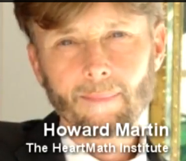
Striving for World Peace
www.glcoherence.org
Executive V.P. Heartmath
“Peace means people cooperating more, working together more. It has less judgment, seeing others for who they are. Peace is a process that has many stepping stones….it takes time, patience, and practical applications from the heart.”

Slide 16
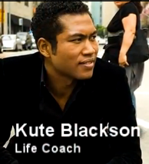
Striving for World Peace
www.kuteblackson.com
From: Ghana, West Africa
Inspirational Leader
Peace-building is really not about settling conflict.
Peace-building is about creating a world of love.
Awareness is the first step, and the most important.
The first place we must start is within ourselves.

Slide 17
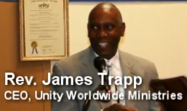
Striving for World Peace
www.academyforpeacecr.org
CEO: Unity Worldwide Ministries
Peace begins by breaking down any seeming barriers between people. Even the great think-tanks on the planet today have said there is no military solution to peace on the planet.
If we have a world where everyone is fed, has clean water and education, then we will be moving toward peace on earth.

Slide 18
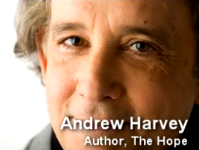
Striving for World Peace
www.tkf.org
Founder: Institute for Sacred Activism
What’s going on in the world demands that everybody wakes up. We’re in a dramatic and potentially destructive, even terminal crisis that we need to respond to from the depths of ourselves.

Slide 19
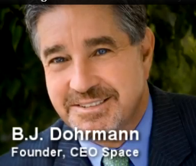
Striving for World Peace
www.ceospace.net
Chairman: CEO Space
If we cooperate, we can have the most exciting exploration that’s ever happened in the history of consciousness.
If we don’t cooperate, we’ll use our weapons and the planet will start again.
Remove the thought of competition. Cooperation is the only way to world peace.

Slide 20
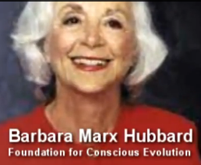
Striving for World Peace
www.barbaramarxhubbard.com
I had a vision for a ‘Peace Room’ that would track and connect what’s working, using emerging technologies and communicating through the social media.
In my daily life, I practice non-judgment, non-attachment, and non-resistance.

Slide 21
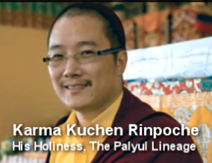
Striving for World Peace
www.palyul.org
Throne Holder: Tibetan Buddhism
Peace is not only concerned with one or two people, it applies to all people on this planet who are concerned and working together to help each other.
We start as an individual, and then as a whole.
Discontentment is the root of all conflict.

Slide 22
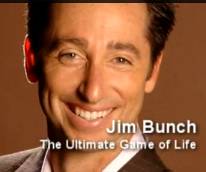
Striving for World Peace
www.theultimategameoflife.com
When you look at global peace, you have to pare it down and simplify it. I call this the three A’s: Awareness, Action, and Accountability.
If everybody on the planet understood each others’ core values, we would start to see how global peace is possible.

Slide 23
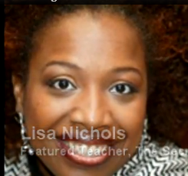
Striving for World Peace
www.lisa-nichols.com
www.motivatingtheteenspirit.com
Author, speaker, teacher
Question: How can we be role models for this emerging generation?
Answer: Peace is a verb, not just a noun. You do peace. You demonstrate it. You live it. You example it.
Take bigger risks with them…let them see you as a person.
Show them unconditional love.
Show no judgment when they make a mistake.

Slide 24
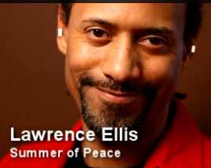
Striving for World Peace
www.LawrenceEllis.org
www.PathstoChange.net
Buddhist Teacher
One thing is critical: Peace begins with me.
We need to look at peace not just in our relationship with everything else, but with relating patterns between individual wholeness and group coherence.

Slide 25
Striving for World Peace
KEY WORDS
INSPIRED ACTION
NON-JUDGMENTAL
ATTITUDE
CONCERN
AWARENESS
CHOICES
FORGIVING
LOVE
MINDSET
OPPORTUNITIES
EMPOWERMENT
PERSONAL WELL BEING
COOPERATION
PASSION

Slide 26
Striving for World Peace
Ideas for Inner Peace
Enjoy life in whatever way you can…observe a sunrise or sunset.
Be thankful for those things that are important like family & friends
Take a walk…slow down to think and to meditate.
Read…both for enjoyment and for the learning process.
Learn to better observe the good that is around you.
Do something nice for someone you do not know well.

Slide 27
Striving for World Peace
Send to another Rotarian, or another Club!
View at www.letitbeginwithmebook.com =====➔

Slide 28
Striving for World Peace Project
District Implementation Options
Club Program Presentation from each District club president.
Presentation to a school, Interact, or Rotoract organization…could serve as a community project and fundraiser…$10.00 per ticket.
District Assembly presentation or workshop by book author.
Handout to all participants a three page World Peace Project article.
Local Newspaper “press release/article” for September 21, International Day of Peace.
Send article to District Newsletter & The Rotarian for worldwide distribution.
Each club purchase a book and send to another club with a peace message (include package consisting of a cd with this PowerPoint Presentation and Article.
Provide this PowerPoint presentation and text support to all who request it.
Provide book & article in an information package in dignitaries hotel room on End Polio Night.

