Slide 1



My Gateway.NET™ – OEM Payments Platform
Simple and Secure
January 2018

Slide 2
Disclaimer
This presentation is confidential and has been prepared exclusively for the benefit and internal use of the Recipient and does not carry any right of publication or disclosure, in whole or in part, to any other party. It has been prepared to the best of the knowledge and belief of My Gateway and its representatives. It comprises statements of intent and opinion, some of which may or may not be realised.
Neither us, our representatives or any other person makes any representation or warranty that any statement, projection or forecast in this presentation is true, complete or accurate. None of the contents of this presentation should be construed as any kind of advice or recommendation.
This presentation may be incomplete without reference to, and should be viewed solely in conjunction with, any further information, oral or written, which may be provided. Neither this presentation nor any of its contents may be used for any other purpose without prior written consent. The submission of this presentation does not create any legal relationship nor constitute an offer to any party.

Slide 3
What Is My-Gateway.NET™?

Slide 4
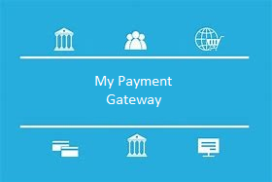


MY GATEWAY - WHO WE ARE
About Us
My-Gateway.NET was developed by an Australian payment technology company, to
Provide a cost effective, easy to implement payment solution for merchants and third party processors
Particularly provide a complete and reliable service covering the China market
Process the major payment brands including new mobile products such as WeChat Pay
Cover ALL UnionPay debit, credit and prepaid cards and Wechat Pay
Provide multiple links to the payment system
Ensure high availability with quality support
Support all payment channels

Slide 5




MY GATEWAY - WHAT WE DO
My-Gateway.NET supports multiple payment channels
E-commerce, POS, M-commerce, IVR
And Wechat Pay and ALL the China issued UnionPay cards
Can also be configured to enable local payment brands
Using unique architecture with multiple links to the payment systems
Ensure the most complete coverage and minimal downtime
Payment Processing
Online
Mobile
In Store

Slide 6

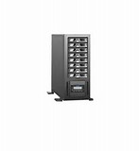

MY GATEWAY - HOW WE DO IT
Merchants
Customers
Issuers &
Service Providers
Merchant Admin System
Link merchants to their customers’ banks

Slide 7

MY GATEWAY - THE OPPORTUNITY
Universal Coverage
Over 1 Billion UnionPay Cardholders
Almost 1 Billion Mastercard & Visa Cardholders
E-commerce Market Expected to be 9% of Global Retail Sales in 2018
China Cardholders Demand for Education, Investment, High-End Goods and Services

Slide 8
What My-Gateway.NET™ Provides

Slide 9
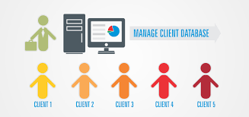

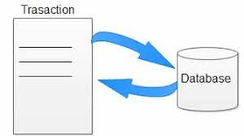
MY GATEWAY - PAYMENT PLUS
3 Components
1. My Gateway-Account Management (MYGN-AM) to help manage merchants’ customers
Provides an optional secure customer account management database – merchants and processors do not need to manage sensitive customer data
2. My Gateway-Payment Management (MYGN-PM) to process payments
Server hosted architecture to securely and simply take payments
3. My Gateway-Merchant Admin (MYGN-MA) to manage your data
Secure browser access to merchant customer and payment information including reports
Merchant and Processor Payment Tools – manually process payments, voids, refunds etc.

Slide 10


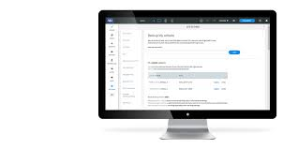
MY GATEWAY - ACCOUNT MANAGEMENT
My Gateway-Account Management interfaces to the merchant or processor
via a set of interface calls from the merchant or processor site
and/or
manually via the merchant admin portal
My Gateway-Account Management functions allow a merchant to create a secure system to manage customers
Add, Retrieve, Update, Delete and Manage customers
Customers can logon to the merchant site and choose to use existing customer information to complete payments
Customers are not required to re-enter card, address or other details
Merchants have access to their customers’ data without the overhead of securely managing sensitive data such as card numbers
Merchants manage customers either via API calls from their website or...
...manually from their My Gateway merchant admin account

Slide 11
MY GATEWAY - PAYMENT MANAGEMENT
My Gateway-Payment Management interfaces to the merchant
via a set of interface calls from the merchant or processor site
and/or
manually via the merchant admin portal
My Gateway-Payment Management functions allow a merchant or processor to process and manage payments
Server hosted architecture relieves the merchant of having to handle payment information
Purchase, Void/Cancel and Refund transactions
Purchase transaction may require the customer to enter their card and other details
Void and Refund transactions do not require any customer input
Void and Refund transactions can be actioned via interface calls from the merchant site or manually via My Gateway-Merchant Admin
Merchants initiate payments via API calls from their website...
...and have the option to manually cancel or refund transactions from their My-Gateway.NET merchant admin account

Slide 12
MY GATEWAY - MERCHANT ADMIN
My Gateway-Merchant Admin interfaces to the merchant
manually via the merchant admin portal
My Gateway-Merchant Admin functions allow a merchant or processor to enquire on and manage their customer database and transactions
Secure browser access to the information stored in the My Gateway central databases
Customers can be added, deleted, updated
Void and Refund transactions can be performed manually
Reports can be viewed and downloaded including transactions by period, payment type, settlement date etc
Operator accounts can be allocated and their privileges managed
Users logon to My-Gateway.NET Merchant Admin to manage their customers and information

Slide 13




MY GATEWAY - SUPPORT FOR IMPLEMENTATION
We support implementation through
Documentation – the My-Gateway.NET Product Services guides
Sample source code – each My-Gateway.NET interface call includes sample source code which can be used to expedite implementation
A test system available to merchants and processors to test their implementation
Access to the merchants transaction, settlement and customer information through the My-Gateway.NET Merchant Admin portal
Support for implementation from multiple offices based in Asia, Australia and Europe

Slide 14
My-Gateway.NET™ Settlement Services

Slide 15




MY GATEWAY – MERCHANT SETTLEMENT
Settlement is simple and transparent
We settle direct to the merchant or processor account at your bank from our banks in HK
Settlement cycle is agreed with the merchant or processor
My-Gateway.NET settles in the currency of your choice - each merchant site and Merchant ID usually transacts in one particular currency
No additional Forex markup when settlement currency is the same as transaction currency – full amount deposited into account less transaction fees
Merchants and processors can download and view their settlement history or pending transactions at any time at the My-Gateway.NET Merchant Admin portal
Customers
Card Issuing Bank
My-Gateway.NET
Merchant’s Bank
Merchants

Slide 16
My-Gateway.NET™ Pricing

Slide 17
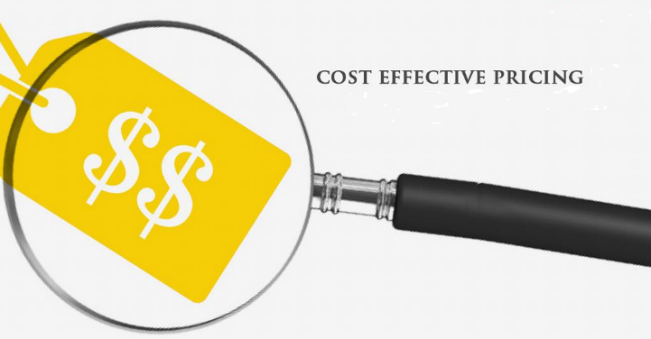

MY GATEWAY – WHAT WE CHARGE
Pricing is transparent and based on
One Time fees to support implementation and access to the My-Gateway.NET modules selected
Monthly software license fees to maintain support for the My-Gateway.NET modules used
Transaction fees based on card type, location and currency used for payment and settlement
My Gateway will provide a complete fee structure based on the modules you select to use. There are no hidden or extra charges once pricing has been agreed.

Slide 18
My-Gateway.NET™ Summary & Next Steps

Slide 19






MY GATEWAY – YOUR PAYMENTS PARTNER
Making Payments Easy
Transparent, cost effective pricing structure
One agreement – PSP deals with My-Gateway.NET directly
Easy, well supported implementation
Secure storage of client and transaction data
Complete coverage of all China UnionPay cards and Wechat Pay
Web access to merchant reports & transaction history

Slide 20

MY GATEWAY – GETTING STARTED
3.
Select My Gateway modules, finalise pricing and sign License Agreement
Next Steps
1.
Download the My Gateway on-boarding guide and complete the My Gateway application form
4.
Implement My Gateway APIs & enable online Merchant Admin system
2.
Download and review the My Gateway technical implementation documentation

Slide 21
Thank You

