Slide 1
Tax
Joseph W. Booth, J.d., M.Div, Faaml, Fiaml
joe@boothfamilylaw.com

Slide 2
Scope
To provide sufficient tax discussion so that a family law practitioner can see potential tax issues and guide their client.

Slide 3
Overview
Marital Residence
filing status
allocation of income
Other deductions
carryover items
Estimated tax payments
Resources
Finding Clues
Kansas issues when calculating child support based on federal tax information

Slide 4
Marital Residence
Ownership
Sale

Slide 5
Home ownership
Deduct certain expenses associated.
Must be a “qualified Residence”.
Principal residence
One other home (cabin, camper, houseboat)
Mortgage and equity line
Cap of $1,000,000 on purchase and $100,000 on equity line.
Cap is reduced to $750,000 for loans incurred after December 15, 2017
Credited to the year paid (13th payment)
HELOCs not deductible unless used to purchase or substantially improve home
Real estate & Property taxes are Deductible, subject to $10,000 SALT cap
Notes:
Interest is deductible under IRC Sec. 163(h)(3)
State and Local Taxes (SALT) is deductible under IRC Sec. 164

Slide 6
Tax consequences of home sale
Losses are not deductible
Exclusion for gain received from sale of personal residence.
$250,000 individually $500,000 for couple
Owned for preceding 5 yrs principal residence 2 yrs.
Safe harbors!
Notes:
IRC Sec. 121

Slide 7
Safe Harbors etc. Sale of home
involuntary Sale, condemnation
Can be “principal residence” depending on fact pattern. Houseboat, cabin, RV, etc.
Must contain facilities for cooking, sleeping, & toilet (IRS Ltr. Ruling 8015017)
Safe Harbors treasury reg. 1.121-4
change in employment
Health problems
unforeseen circumstances (inc. divorce) discretionary on IRS.
Notes:
IRC Sec. 121(d)
Treas. Reg. 1.121-4

Slide 8
Other rules to exclude gain
No other home sale within the 2 year period.
Involuntary conversions treated as home sale
Joint ownership confers benefits to both owners
Transfer incident to divorce, the recipient receives credit for transferor’s occupancy and ownership periods.
If one spouse is out but they still own it, the “out” spouse still keeps the owenership/occupancy period from “in” spouse.
Notes:
Treas. Reg. § 1.121–1
Treas. Reg. 1.1033(a)-1; 1.1033(a)-3
IRC Sec 121(c)

Slide 9
Filing status

Slide 10
Status
Determined Midnight December 31.
A court order of divorce or separate maintenance that specifically states the parties will part.
Simply separated with an agreement “legal separation” is married.
Notes:
IRC Sec. 7703

Slide 11
 |  |  | 2019
 | Single |  |  |  | Married Joint
income | tax | +rate |  | income | tax | +rate
0 |  | 10% |  | 0 |  | 10%
9,701 | 970 | 12% |  | 19,401 | 1,940 | 12%
39,476 | 4,543 | 22% |  | 78,951 | 9,086 | 22%
84,201 | 14,382.50 | 24% |  | 168,401 | 28,765 | 24%
160,726 | 32,748.50 | 32% |  | 321,451 | 65,497 | 32%
204,101 | 46,628.50 | 35% |  | 408,201 | 93,257 | 35%
510,301 | 153,798.50 | 37% |  | 612,351 | 164,709.50 | 37%
 | Head of Household |  |  |  | Married Separate
income | tax | +rate |  | income | tax | +rate
0 |  | 10% |  | 0 |  | 10%
13,851 | 1,385 | 12% |  | 9,701 | 970 | 12%
52,851 | 6,085 | 22% |  | 39,476 | 4,543 | 22%
84,201 | 12,962 | 24% |  | 84,201 | 14,382.50 | 24%
160,701 | 31,322 | 32% |  | 160,726 | 32,748.50 | 32%
204,001 | 45,210 | 33% |  | 204,101 | 46,628.50 | 35%
510,301 | 152,380 | 37% |  | 306,176 | 82,354.75 | 37%
Notes:
IRC Sec. 1

Slide 12
Hypothetical $66,000 taxable income 2019 Amounts

Slide 13
Annulment
A legal finding that the marriage never existed.
Not clear how far back one could go and amend prior years, in that year you are single, but see Rev. Rul. 76-255, which implies every year of marriage should be amended. IRS says AT LEAST last 3 years must be amended.

Slide 14
Head of Household
often calculates same or similar to Married/joint
Qualifications
US citizen
unmarried or abandoned
paying >50% of household expenses.
Live with Qualifying child (dependency does not have to be taken) or other dependent, including paying household for dependent parents.

Slide 15
Qualifying child
Defined in 152(c)in 2005, before then each section had its own definition.
enable a taxpayer to claim several tax benefits, such as
head of household filing status,
the exemption for a dependent,
the child tax credit or additional child tax credit,
the child and dependent care credit and
the earned income tax credit.
Notes:
IRC Sec. 152(c)

Slide 16
Qualifying child requirements
Relationship — the taxpayer’s child or stepchild (whether by blood or adoption), foster child, sibling or stepsibling, or a descendant of one of these.
Residence — has the same principal residence as the taxpayer for more than half the tax year. Exceptions apply, in certain cases, for children of divorced or separated parents, kidnapped children, temporary absences, and for children who were born or died during the year.

Slide 17
Qualifying child, Continued
Age — must be under the age of 19 at the end of the tax year, or under the age of 24 if a full-time student for at least five months of the year, or be permanently and totally disabled at any time during the year.
Support — the child did not provide more than one-half of his/her own support for the year.

Slide 18
Abandoned spouse
File separate returns
Maintain home with qualifying child or dependent
Furnish >50% of household costs
Spouse gone from household > 6 months.
Notes:
IRC Sec. 7703(b)

Slide 19
Married
Includes statutory marriage and common law
Ks common law = capacity + present intent+ public declaration.
Can file joint or married/filing seperate

Slide 20
alimony
such payment is received by (or on behalf of) a spouse under a divorce or separation instrument
The instrument does not exclude the payment as alimony
separate residences
Ends on death of payee
In an divorce instrument
Does not relate to child support
cannot file a joint return.
No longer deductible by payor/reportable by payee if divorce decree after 2018
Notes:
IRC Sec. 71
Treas. Reg. 1.71-1

Slide 21
Alimony recapture 26 USC 71(f)
Repealed effective December 22, 2017
Is a computation about a difference of $15,000 between the first 3 years.
Exceptions
Death
Fluctuating payments not within control of payor spouse
Notes:
Pub.L. 115-97, Title I, § 11051(b)(1)(B)

Slide 22
Regarding Children & Child support
Child support not tax deductible.
Qualifying child as defined earlier
“Custodial Parent” determined by court documents.
Parent with >50% gets deduction (form 8332)
If 50/50 parenting time the deductions need to be clearly articulated in degree or parenting plan.
Since there are an odd number of night in a year, ensure one parent knows they can use HoH status and count child for EITC purposes

Slide 23
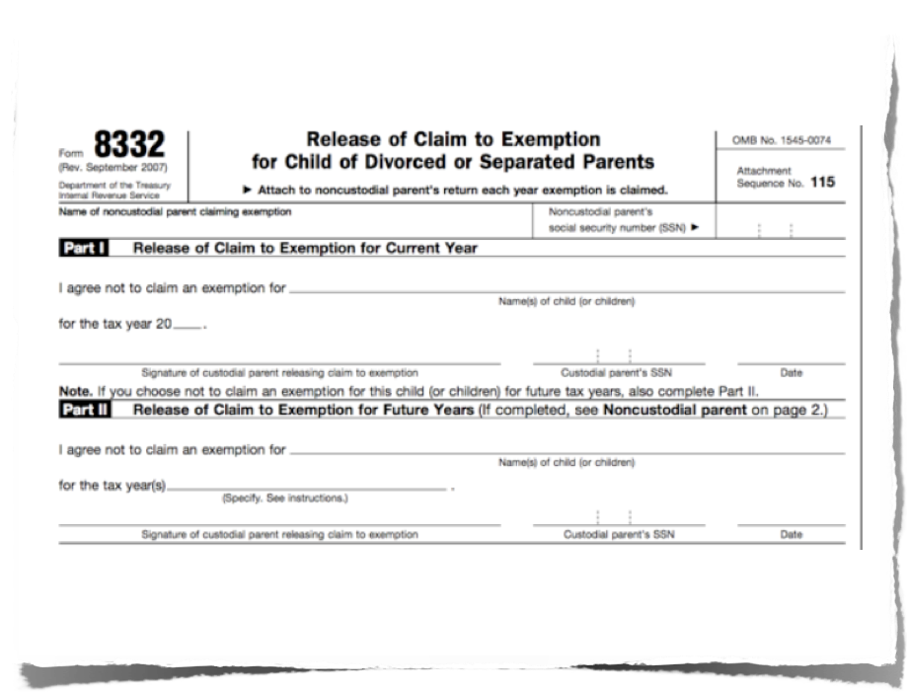
Form 8332

Slide 24
QDRO
Allows for the transfer of ERISA funds to alternate payee
IRC Section 71(t) essentially gives the recipient a 1 time shot to get funds distributed from a "qualified" plan without the 10% penalty.
Can be used on non-ERISA plans per IRC Sec 402(e)(1)(A)

Slide 25
QDRO Requirements
Must cite applicable state law
Responsibility for maintaining tax-advantaged status (i.e. rollover) is on the movant
QDRO must contain all of the following:
Full, formal name of the plan
The full name and mailing address of plan participant and spouse
SSNs of both parties, under separate cover
Participant’s plan ID number (if any)
Fixed amount or percentage of plan benefit or balance to be paid to spouse
If defined benefit/traditional pension, duration benefit is to be paid
Notes:
IRC Sec. 1056(d)(3)(A) et seq.

Slide 26
Carry over items
Review past returns
Capital Losses may be a marital asset to be divided or used by spouse who suffered loss, depending on the state. Kansas treats all investments as common ownership to be divided. (Watson v. Watson)
Net Operating Losses are required to be split as if divorcing spouses had filed separately (Treas. Reg. 1.172-7)
Passive-Activity Loss Carryovers are treated as tax-free gifts where the receiving spouse maintains the basis.
Charitable contribution carryovers are divided according to IRS regulations (Pease limitation repealed after 2017)
AMT carryover credits are generally allocated as if the parties had filed separate return, but there is no formal guidance on this. Note, however, that the AMT credit dies with the holder. Vichich v. Commr. of Internal Revenue, 146 T.C. 186 (T.C.2016)
Carry over basis goes with the asset distributed in divorce. (IRC 1041)

Slide 27
Estimated tax payment
Review the current pay stubs for consistency
under-withholding to create debt shared
Over withholding to reduce income.

Slide 28
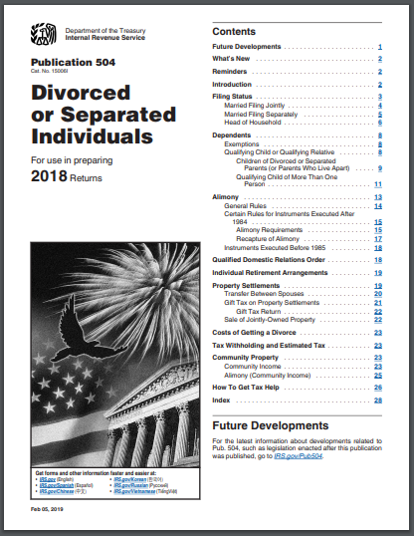
Resources
Pamphlet for divorce issues.

Slide 29
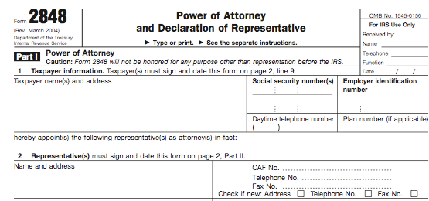
The attorney can get tax info

Slide 30
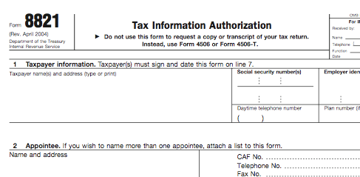
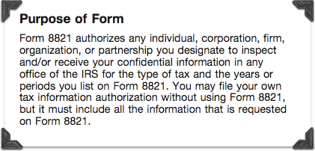

Slide 31
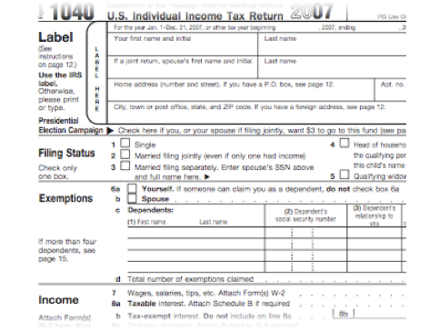
Review old returns.
Records of prior transactions
Sales of property
disposing of retirement
income patterns
Income sources
Ratios of income to assets

Slide 32
Kansas Child Support Considerations
Courts are to split the deductions/credits associated with children so as to maximize benefit.
If custodial parent will not alternate tax benefits, an adjustment is made to child support calculations
Kansas has not updated child support guidelines to account for the TCJA
Custodial parent gets larger standard deduction as HoH (extra 50% fed and state), which results in an adjustment to child support calculations
Calculations relying on old (1984-2017) tax law will be distorted
Exemptions are gone, but KS allows the available exemptions to be split
ACA failure to provide health coverage penalty follows exemption, but enforcement is suspended effective TY2019
Child Tax Credit is larger, but Child Care Tax Credit is ONLY available to parent claiming child for CTC purposes. Both credits are limited by earned income

Slide 33
Joseph W. Booth, J.D., M.Div, Faaml, Fiaml
joe@boothfamilylaw.com
11900 W. 87th St. Pkwy. Ste 225
Lenexa, KS 66215
913.962.7732

