Slide 1
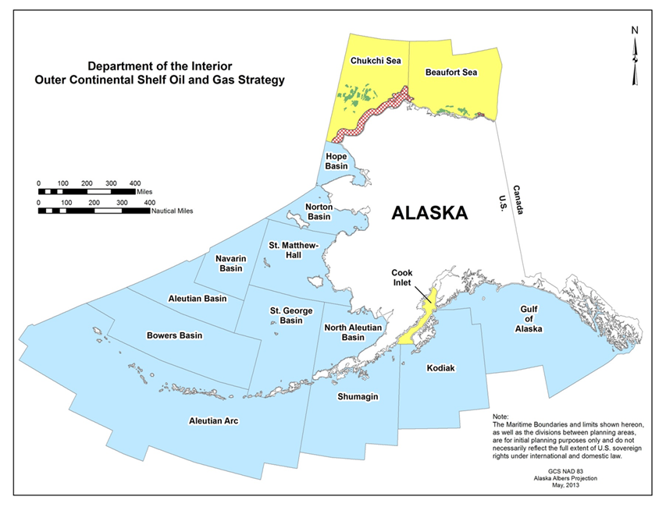
Environmental Studies Program
BOEM Assesses Potential Impacts on the Human, Marine and Coastal Environments that may be Affected by OCS Energy Development Activities
The Studies Program functions to establish information needed for assessment and management of impacts from OCS exploration, development, and production.
Studies are planned and carried out in cooperation with affected States and interested parties, while avoiding duplication.
Studies are designed to predict environmental impacts and to monitor for changes over time.

Slide 2
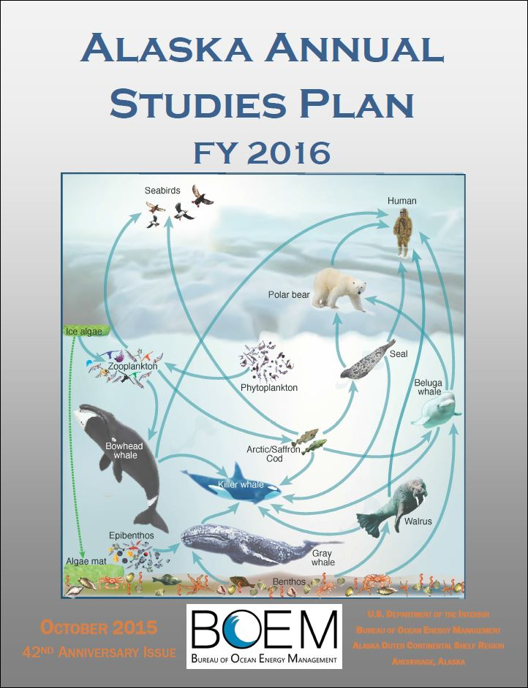
Research Planning Process
ESP process takes ~9 months to complete.
Autumn: ASP distributed to 200+ groups
Winter: Study profiles received and worked into priority shortlist
Spring: Shortlist consolidated and coordinated with other science efforts
Summer: Final priorities reviewed by external NAS Advisory Committee
Notes:
Hold up copy of ASP, say, I hope you are all familiar with this

Slide 3
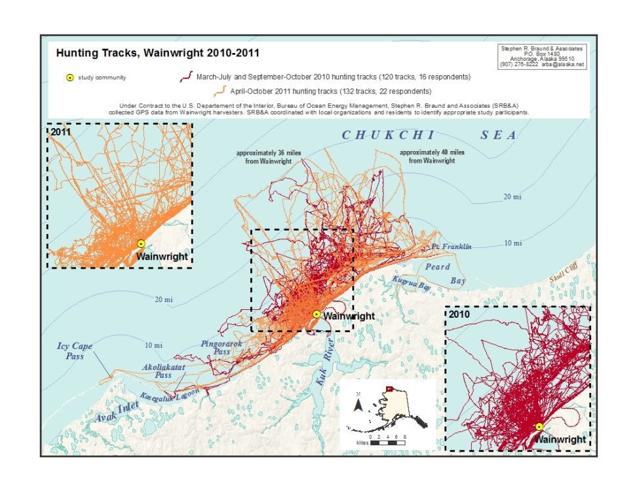
Stakeholder Engagement
Direct input to ASP via profiles
Comments received during scoping/public hearing testimony
Coordination through regular meetings with AEWC, NSSI, IARPC, etc.
Subsistence monitoring: harvest mapping, sharing networks, social indicators
TK integration: whale tagging, seal tagging, Arctic cisco, LEO observations
Notes:
In addition to soliciting stakeholder engagement during the Study Development Process, the Alaska OCS region ensures that stakeholder engagement is secured after a study is contracted. For example, consultants visit the affected communities and work with Tribal offices and other entities to obtain concurrence and engage citizen scientists, local experts who contribute so much to the findings.

Slide 4
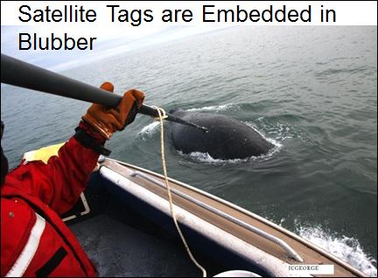
Research Platforms/Sound Sources Include:
ASAMM aerial surveys
UAS experimentation
Shipboard sampling and instrumentation (including auto recorders of ambient noise)
Marine mammal tagging
Research activities most active during open-water season, but occur year round
Notes:
The study subject dictates the season during which field work is conducted. Because so many studies involve surveying migratory sea mammals, surveying for fish, and tagging marine mammals, the majority of the work takes place in the summer and the fall. Fall studies can overlap with Beaufort Sea bowhead whale hunts. Our fisheries biologist and the UAF fisheries biologist worked with the AEWC and local communities to ensure that sampling did not interfere with Kaktovik bowhead whale hunts. This past season, the Alaska ESP ensured that marine mammal work by Wood’s Hole did not interfere with the Kaktovik fall bowhead whale hunt.

Slide 5
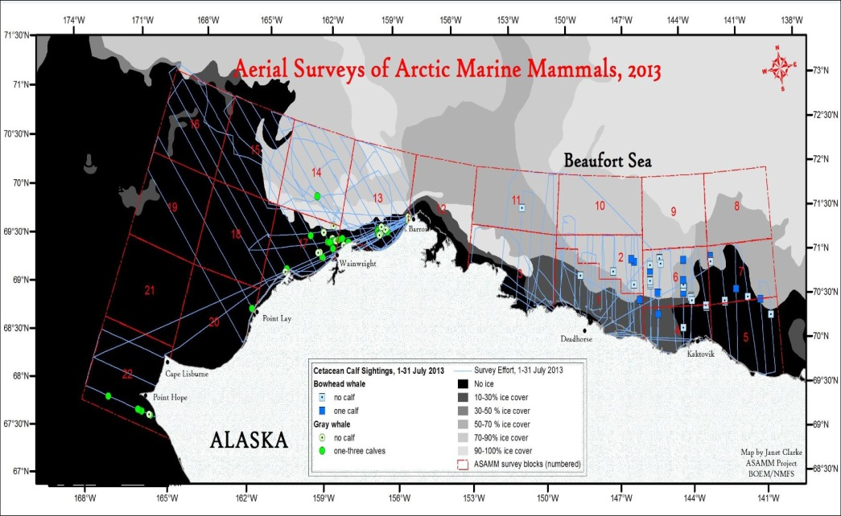
Examples of Routine Mitigation
Aerial surveys coordinate flight plans with FAA and communication centers
Aerial surveys deviate to avoid harassment of marine mammals and maintain altitude of 1000’
Aerial surveys deviate to avoid conflict with subsistence hunters
Shipboard cruises respect time area closures during whaling season
Notes:
Aerial surveys of marine mammals are and have been routine in the Beaufort Sea since 19XX. Because the practice has always been to change flight paths to avoid conflict with subsistence hunters, they have not been a source of conversation.

Slide 6
Cruise Protocols
TRANSBOUNDARY SURVEY. Joint US and Canada.
This was a fish study performed by the UAF and funded by BOEM.
At least 6 mos in advance, the BOEM project manager, ESP studies chief, and the PI presented to AEWC, NSB and other key parties (local whaling representations),

Slide 7
Cruise Protocols
The outcome was for BOEM to follow same protocols as seismic:
Stay out of the Nuiqsut and Kaktovik subsistence areas from Aug. 25 until bowhead whale hunt over.
They stayed west of 150 and checked routinely with the comm center through Alaska Native Liaison on board the vessel.
Notes:
Exception: Lost equipment, pick up of replacement
End of cruise, travel to west dock, stayed off shelf
Flight research; followed safety and altitude restrictions

Slide 8
Cruise Protocols
DYE STUDY: Consultation with AEWC, NSB, and NSB attorney in January
Field work took place in the Chukchi in Sept.
UAF and BOEM
100 km from shore south of Burger between Wainwright and Point Lay
There were no conditions placed on this study.
Notes:
Arctic tracer release study

Slide 9
Cruise Protocols
ANIMIDA III: Offspring of work conducted in Beaufort Sea since 1983
Long term monitoring program of contaminants contracted to Olgoonik? Fairweather.
Boulder patch study at Stefansson Sound east to Camden Bay

Slide 10
Cruise Protocols
PI’s Ken Dunton and John Trefary are well respected seasoned artic hands.
Have performed considerable outreach including developing curriculum for and teaching HS marine bio class at Kaktovik.
To our knowledge, work does not overlap temporally with fall whale hunt.

Slide 11
Cruise Protocol
CHAOZ: Research at Hanna Shoal
Early to mid-August, some runs to Barrow for supplies
Temporal and spatial distance from whale hunt

Slide 12
Questions?
Questions? Comments?
Presenter: Chris Campbell
Sociocultural Specialist
Environmental Studies Program, Alaska OCS Region
(907) 334-5264 or Chris.Campbell@boem.gov

