Slide 1
Mathematics Symbol Knowledge at Grades 1, 3, and 5
MCLS
June 18, 2019

Slide 2
srpowell@austin.utexas.edu
@sarahpowellphd
119

Slide 3
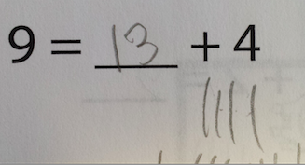

Slide 4
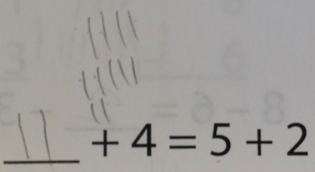

Slide 5
An analysis of elementary mathematics textbooks…

Slide 6
Addition and Subtraction
Comparison
Money

Slide 7
Multiplication and Division
Rational Numbers
Algebra

Slide 8
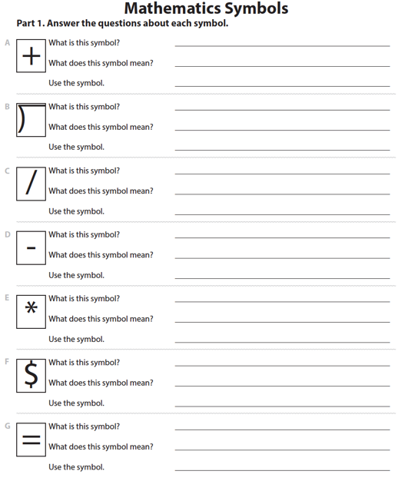
Students identified the symbol, provided the meaning of the symbol, and used the symbol.
Students had 20 minutes to answer as many as possible.

Slide 9
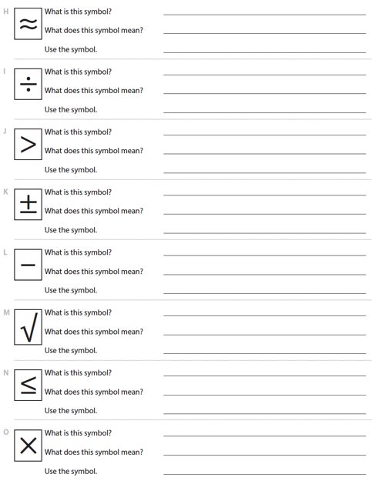

Slide 10
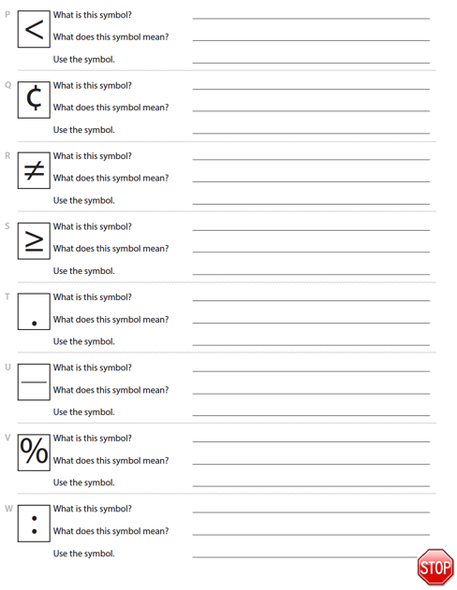

Slide 11
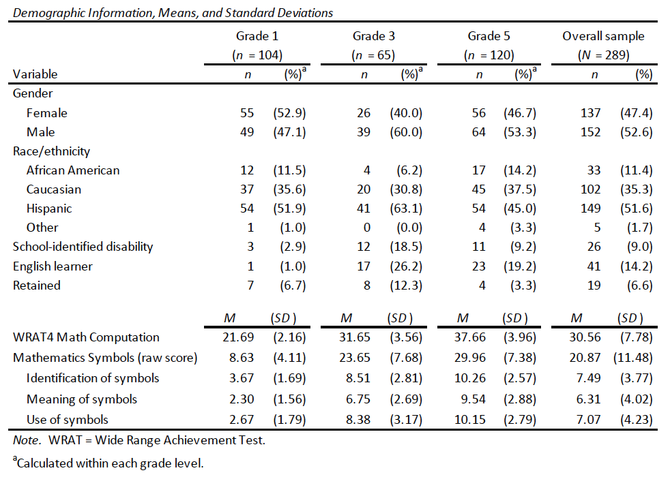

Slide 12
Scoring
Range of acceptable responses:
“minus” or “take away” for identification of the minus sign
“add” or “put together” or “bring some more” for meaning of the plus sign
“4 + 5 = 8” accepted (but not “4 + 5 = 2”) for use of the plus sign
“ad” or “molply” accepted
negative symbol (D), minus sign (L), and fraction bar (U) scored based on student’s first interpretation

Slide 13
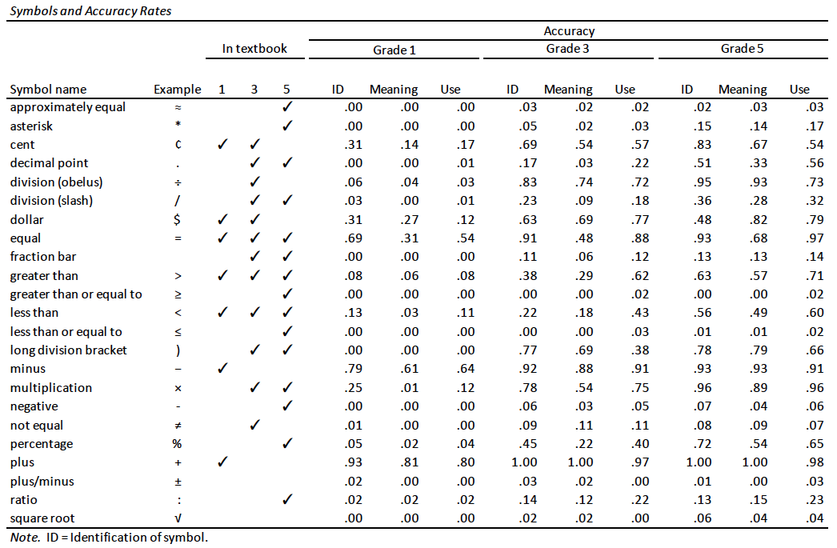

Slide 14
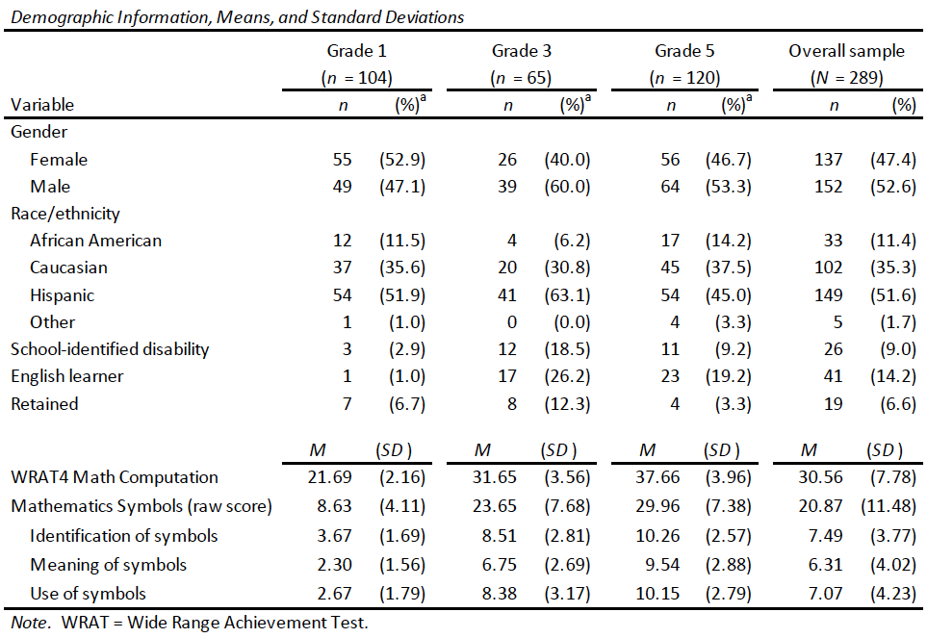
Range of scores: 0 to 21

Slide 15
Range of scores: 3 to 43

Slide 16
Range of scores: 8 to 49

Slide 17
ES = 2.44

Slide 18
ES = 3.57

Slide 19
ES = 0.84

Slide 20
Identification greater than use;
Identification and use greater than meaning

Slide 21
Identification similar to use; Both greater than meaning

Slide 22
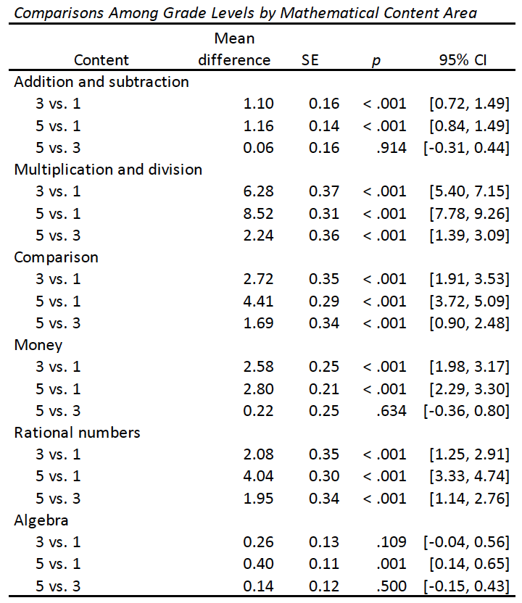
No differences between grades 3 and 5

Slide 23
Differences among all grade levels

Slide 24
Only difference between grades 1 and 5

Slide 25
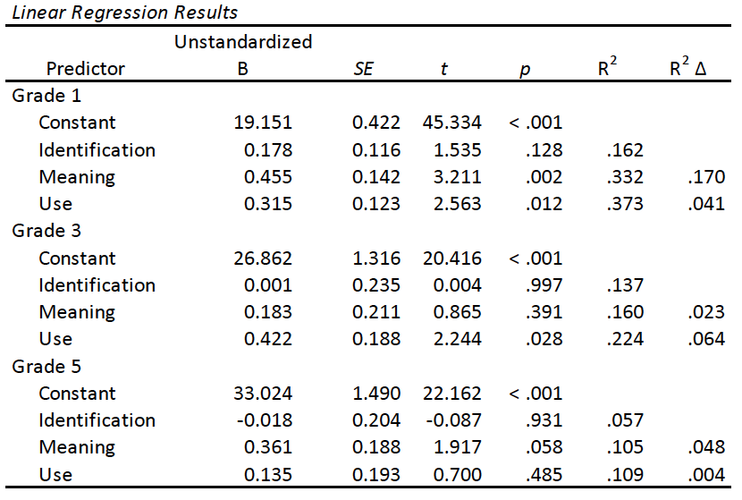
With Computation as outcome

Slide 26
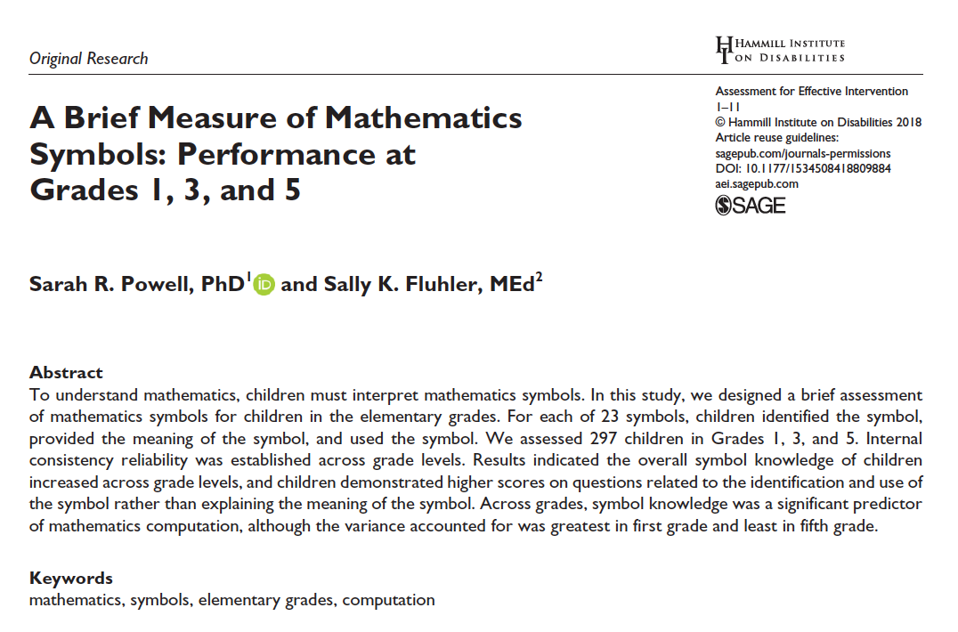

Slide 27
Thank You
Teachers and students in Austin, TX
Research team at the University of Texas at Austin

Slide 28
srpowell@austin.utexas.edu
@sarahpowellphd
119

