Slide 1
EMR Refresher
Module I
Airway/Cardiac/Neuro/Trauma
Ventilation/ Oxygenation/cardiac/neurological emergencies/cns injuries

Slide 2
Module I-Section 1-Ventilation & Oxygenation
Objectives
  Discuss some A & P of the airway system
  Discuss and describe the ventilatory process
    Alveolar ventilation
    Minute ventilation
  Identify adequate vs. inadequate breathing
  Difference between respiratory distress and failure
  Differentiate between the features and indications of oxygen therapy devices including nasal cannula and non-rebreather mask
  Describe ventilatory assist and measurement of adequacy (introduce ETCO2)
    When to oxygenate and when to ventilate
  Describe rescue breathing technique for adults, children and infants
  Describe the indications for oxygen
  Describe safety considerations and hazards of oxygen administration

Slide 3
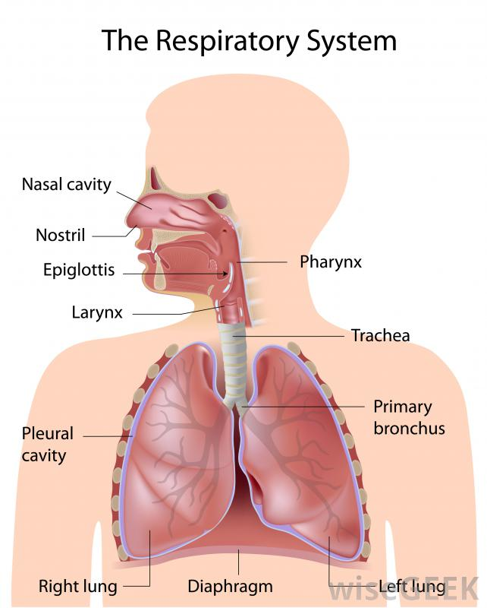
A & P of the Airway System
Oropharynx
Nasopharynx
Pharynx
Trachea
Esophagus
Bronchi
Lungs
Alveoli
Capillaries
Notes:
Describe the area and function of each structure and where it lies and its function.

Slide 4
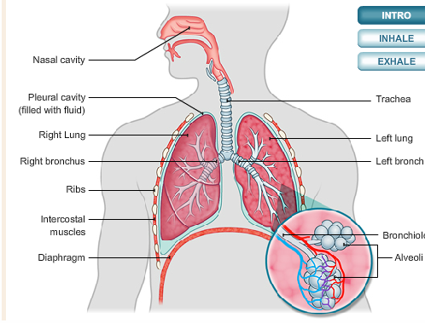
The Ventilatory Process
Alveolar ventilation – the exchange of oxygen and carbon dioxide that occurs in the alveoli
Minute ventilation – the amount of air pulled into the lungs and removed from the lungs in one minute

Slide 5
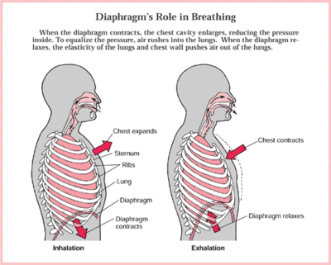
Adequate vs. Inadequate Breathing
Look, Listen, and Feel!
  Looking for rise and fall of the chest for equal expansion and adequate depth
  Listening for air flow and any obstructive sounds
  Feeling the air coming from the patients nose and mouth as well.
  *A normal adult, has a resting breathing rate of about 12-20 breaths per minute.
  Are there noisy respirations, wheezes, gurgling, gasping, any cyanosis, absent, slow or rapid
Notes:
Discuss the causes of inadequate breathing:
Mechanical blockage – tongue
Vomitus
Foreign objects, broken teeth, dentures
Illness or disease
Drug overdose
Poisoning
Severe loss of blood
Electrocution by electrical current or lightening

Slide 6
Difference between respiratory distress and failure
Respiratory Distress
  Retractions
  Two word sentences
  Pursed lips
  Cyanosis
Respiratory Failure
  Decreased consciousness
  Poor chest rise
  Pale, cool, mottled
  Minimal air movement

Slide 7

Indications for different oxygen delivery devices
Nasal cannula
  Fairly stable patients
  Low-flow oxygen from 2-6 L/minute, 35 to 50%
Non-rebreather
  Patients with serious s/s such as severe shortness of breath, severe chest pain, congestive heart failure and carbon monoxide poisoning as well as s/s of shock
  Delivers high flow oxygen at 8-15 L/minute, and concentrations as high as 90% with a reservoir bag
Notes:
Demonstrate with these devices and have an oxygen cylinder on hand for hands-on use as well.

Slide 8
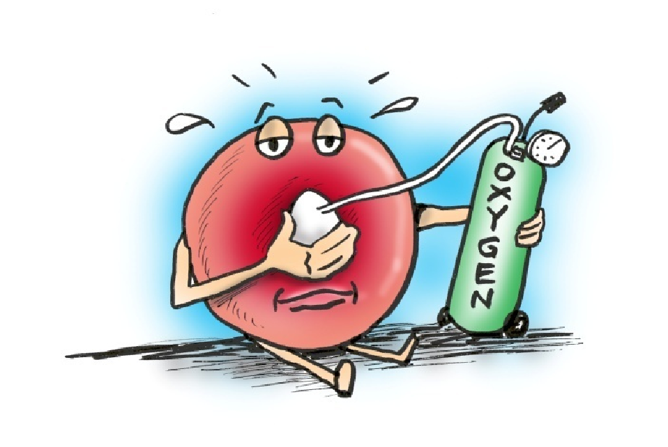
Ventilatory Assist and Measurement of Adequacy
Oxygenate vs. ventilate
  Many patients with respiratory disease need only comfort care
  Some may need minimal oxygen delivery via a nasal cannula or even a mask
  Some may require intervention to the point of BVM ventilation to assist with their breathing inadequacy
  BVM device consists of a reservoir and one way valve. With oxygen attached from 10-15 L/min it can deliver up to a concentration of up to 90%.
  This is more reliably accomplished as a two-person skill, although can be done by one person.
  *Introduce ETCO2(optional)
Notes:
Demonstrate the use of a BVM.
Discuss when would be appropriate scenarios to oxygenate vs. ventilate.
*Introduce ETCO2, optional demonstration

Slide 9
Rescue Breathing: Adults vs. Children
Adult rescue breathing
  Kneel at patients head maintaining an open airway. Assure the mouth is clear of any fluids or foreign bodies
  Select the proper mask size
  Place the mask on the patients face
  Seal the mask, forming an E – C with your fingers around the chin and mask
  Lifting the chin into the mask, then squeeze the bag and visualize chest rise
  Add supplemental oxygen
  Rescue breath once every 5-6 seconds
Child/infant rescue breathing
  Due to the smaller anatomy and airways of children you will not have to use as much of a head tilt. Also, padding under their torso may assist in maintaining an open airway.
  Use a sniffing position in most cases for infants.
  Too much of a tilt and you will close off the airway.
  The rate is also slightly faster with children with a rescue breath given once every 3-5 seconds
Notes:
Demonstration is better with this and much of the oxygenation/ventilation lecture can be hands-on while lecturing.

Slide 10
Indications for oxygen
Don’t deny any patient oxygen with shortness of breath or who is clearly having difficulty breathing.
Oxygen therapy for Acute Coronary syndrome and stroke patients should be guided by measured oxygen levels (SpO2). In the absence of SpO2 measurements, then it is reasonable to give 2 L/min nasal cannula.
A patient presenting with ACS and stroke with signs and symptoms of dyspnea, shock and heart failure, it is also reasonable to administer high flow oxygen via a non-rebreather mask.
Notes:
Discuss AHA guidelines for current recommendations regarding oxygen administration for ACS and stroke.

Slide 11
Safety Considerations & Hazards of Oxygen Administration
Highly pressurized cylinders
Highly combustible with any spark, flame, heat or oily substance
Handle carefully and always turn the tank off when not in use and release the pressure in the regulator, storing the tank in a safe place within a sturdy carrying case to avoid damage.
Pulse oximetry pro’s and wo’s
Supplemental oxygen can be lifesaving but use if carefully and only after you’ve thoroughly assessed your patient for a need
Notes:
Explain the indications and use of pulse oximetry and its limitations.

Slide 12
Summary
Know the difference between respiration and ventilation
Determining whether the patient is breathing adequately vs. inadequately
Knowing how to effectively treat respiratory arrest and failure
Adequately using the different oxygen masks for effective delivery when appropriate
Knowing the hazards of oxygen delivery

Slide 13
Module 1-Section II – Cardiac
(Adult and Pediatric Cardiac Arrest/ROSC)
Objectives
  Discuss some A & P of the cardiovascular system
  State the five links in the Chain of Survival
  Discuss recognition of the critical cardiac patient
  Describe the current techniques of one and two rescuer adult CPR
  Describe the current techniques of one and two rescuer pediatric CPR
  List the signs of effective CPR
  Describe the complications of performing CPR
  Describe the indications and use of an automated external defibrillator
  Identify the signs associated with Return of Spontaneous Circulation

Slide 14
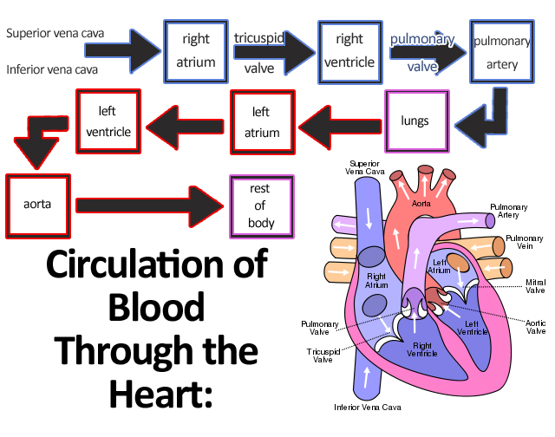
A & P of the Cardiovascular System
The Circulatory System
  Heart
    Atrium
    Ventricle
  Arteries
  Veins
  Capillaries
  Carotid arteries
  Brachial arteries
  Radial arteries
Notes:
Describe the location and function of each.

Slide 15

5 Links in the Chain of Survival
Recognition/Activation of EMS
Immediate high-quality CPR
Rapid defibrillation
Basic and advanced EMS
ALS and post arrest care

Slide 16

Recognition of the Critical Cardiac Patient
Heart Attack (Myocardial Infarct)
  Usually immediate and severe and may not go away with rest or nitroglycerin
Angina Pectoris
  Typically responds to nitroglycerin and goes away with rest
Congestive Heart Failure
  Usually a “pump” issue with fluid back up into the lungs with primarily shortness of breath and typically no chest pain
Notes:
Explain how each patient can be a critical cardiac patient but present similarly but depending upon the age group and sex (female vs. male), health history, diabetics etc. each can show different signs and symptoms and give examples of each.

Slide 17
Current Techniques of One and Two Rescuer Adult CPR
*Most important points to remember during CPR
  Assessing carotid pulse at least 5 but no more than 10 seconds
  Proper hand placement
  Proper depth at least 2 inches
  Allow full chest recoil
  Compress at a rate of 100-120 per minute
  30:2 ratio

Slide 18
Current Techniques of One Rescuer Pediatric CPR
Infant CPR ( under 1 year)
  Assess brachial pulse
  Proper 2-finger placement
  Proper depth 1 ½ inches
  Proper rate 100-120 per minute
  30:2 one person, 15:2 two person
Child CPR ( over 1 year)
  Assess carotid pulse
  Proper 1 hand or 2 hand placement depending on the size of the child
  Proper depth 2 inches
  Proper rate 100-120 per minute
  30:2 one rescuer, 15:2 two rescuer

Slide 19
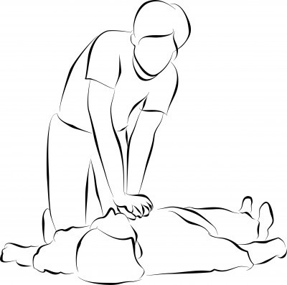
Signs of Effective CPR
Pulse with compression
Skin color improves
Chest visibly rises during ventilation
Compression and ventilations delivered at appropriate rate and depth
Return of spontaneous circulation

Slide 20
Complications of Performing CPR
Broken ribs
Gastric distention
Regurgitation
Notes:
Discuss pros and cons of performing CPR when to perform and when not to perform.

Slide 21
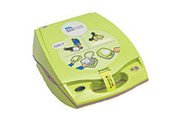
Use of Automated External Defibrillator
70% of all out-of-hospital cardiac arrest patients have irregular heart electrical rhythms
Defibrillator provides the greatest chance of survival when delivered early
The third link in the “chain of survival”
Vary in design, be familiar with your device

Slide 22
Return of Spontaneous Circulation
Signs of life are observed
  Patient breathing
  Patient movement
Assure proper ventilation and oxygenation
  Avoid excessive ventilation (over-bagging)
    Reduces cardiac output
    *Remember most deaths following ROSC occur within the first 24 hours
    - transport to most appropriate facility

Slide 23
Summary
Recite the steps in the chain of survival
Know the s/s of a critical cardiac patient
Know how to perform one and two person adult and pediatric CPR
Knowing how to use the AED
Recognizing signs of effective CPR and the complications of doing CPR
Recognizing “Return of Spontaneous Circulation” signs

Slide 24
Module I – Section III – Neurological Emergencies,
Stroke, CNS Injuries
Objectives
  Define altered mental status
  State common causes of altered mental status
  Define types of seizures
  Explain causes of seizures
  Explain complications associated with seizures
  Discuss signs and symptoms of stroke
  Explain major causes of stroke
  Discuss importance of knowing the timeline of stroke events
  Discuss management of the stroke victim
  Identify the signs and symptoms of a patient with traumatic brain injury (TBI)
  Discuss the current research and practices for the use of selective spinal immobilization

Slide 25
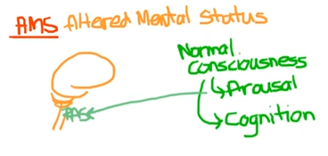
Altered Mental Status
A sudden or gradual decrease in the patient’s level of responsiveness.
A
V
P
U
Notes:
Review the AVPU assessment and how it is used to determine a patient’s level of responsiveness.

Slide 26
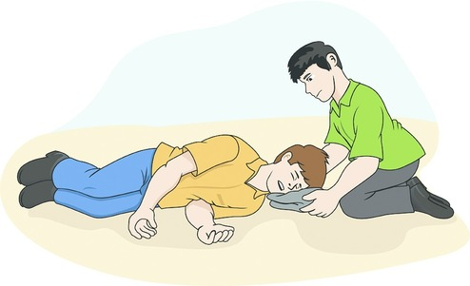
Common Causes of Altered Mental Status
A – alcohol
E - epilepsy
I - infection
O - overdose
U - uremia
T - trauma
I - insulin
P - psychosis
S - stroke
Notes:
Discuss each and how they can cause altered mental states.

Slide 27
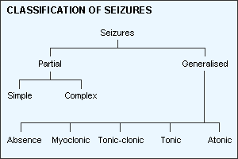
Common Types of Seizures
Generalized
  Grand mal (shaking movements involving the entire body)
Absence
  Brief lapse of consciousness, formerly known as petit mal seizures
Status Epilepticus
Notes:
Discuss the signs and symptoms you may see with each type of these seizures, how long each may last.

Slide 28
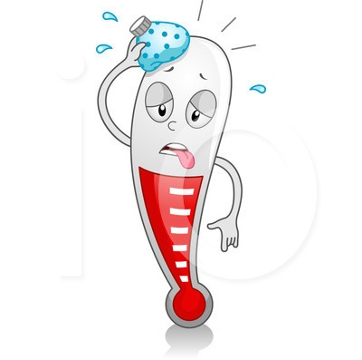
Causes of Seizures
High fever
Trauma
Stroke
Shock
Infection
Poisoning
Diabetic
Overdose

Slide 29
Complications Associated with Seizures
Aspiration
Bone and spine fractures
Brain damage from lack of oxygen and/or depletion of glucose
Dehydration

Slide 30
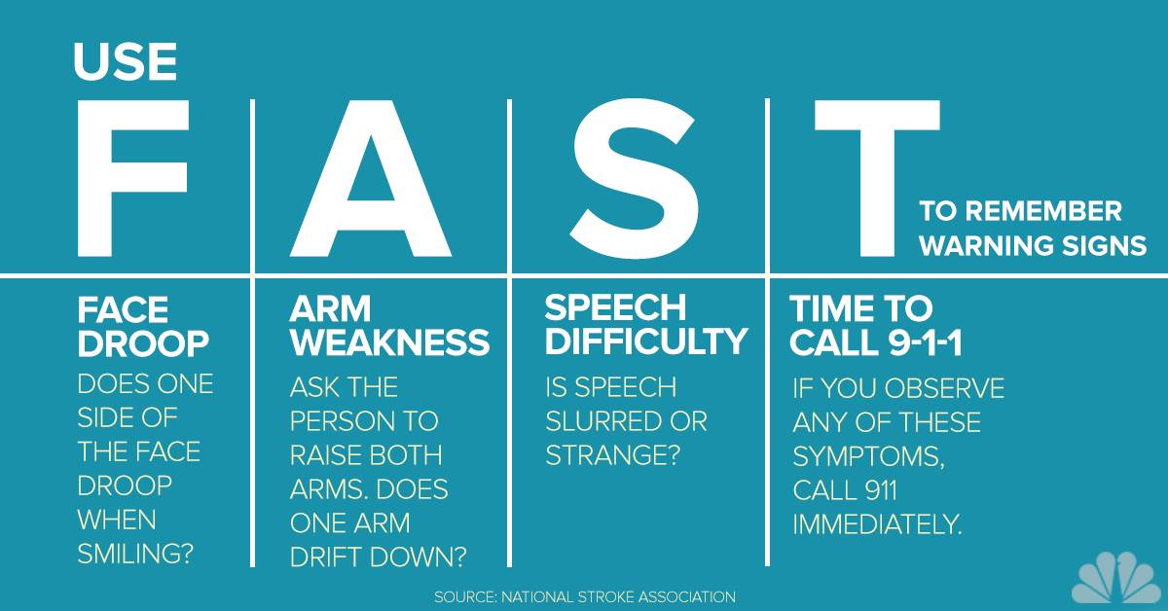
Signs and Symptoms of Stroke
Vary dependent on what part of the brain is affected.
They can be similar to that of a head injury, hypoglycemia or seizures.
The patient can be alert, confused or unresponsive.
They could describe a headache and the “worst headache of their lives”
Facial drooping, one-sided weakness, slurring speech
Notes:
Dizziness
Confusion
Drooling
Difficulty seeing
Unequal pupil size
Respiratory arrest
Incontinence

Slide 31
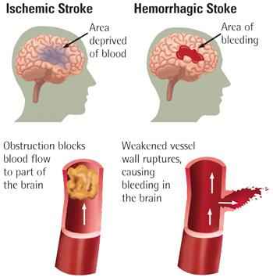
Major causes of stroke
Hypertension
High cholesterol
Heart disease
Diabetes
Smoking

Slide 32
Importance of knowing the timeline of stroke events
Stroke patients can have favorable outcomes if recognized and treated early within a critical time period.
3 hours from the onset of symptoms a “clot-buster” medication can be administered
It’s extremely important to retrieve the timeline from family members or loved ones as to the exact time the patient was “last seen well” or “normal”
Transport to the appropriate facility quickly is also an important factor

Slide 33
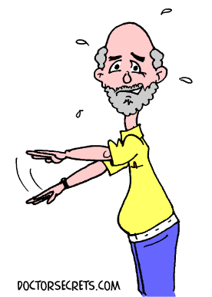
Management of the stroke victim
Manage ABC’s
Recognize S/S’s
Determine “timeline”
Perform CPSS
Place in recovery position

Slide 34
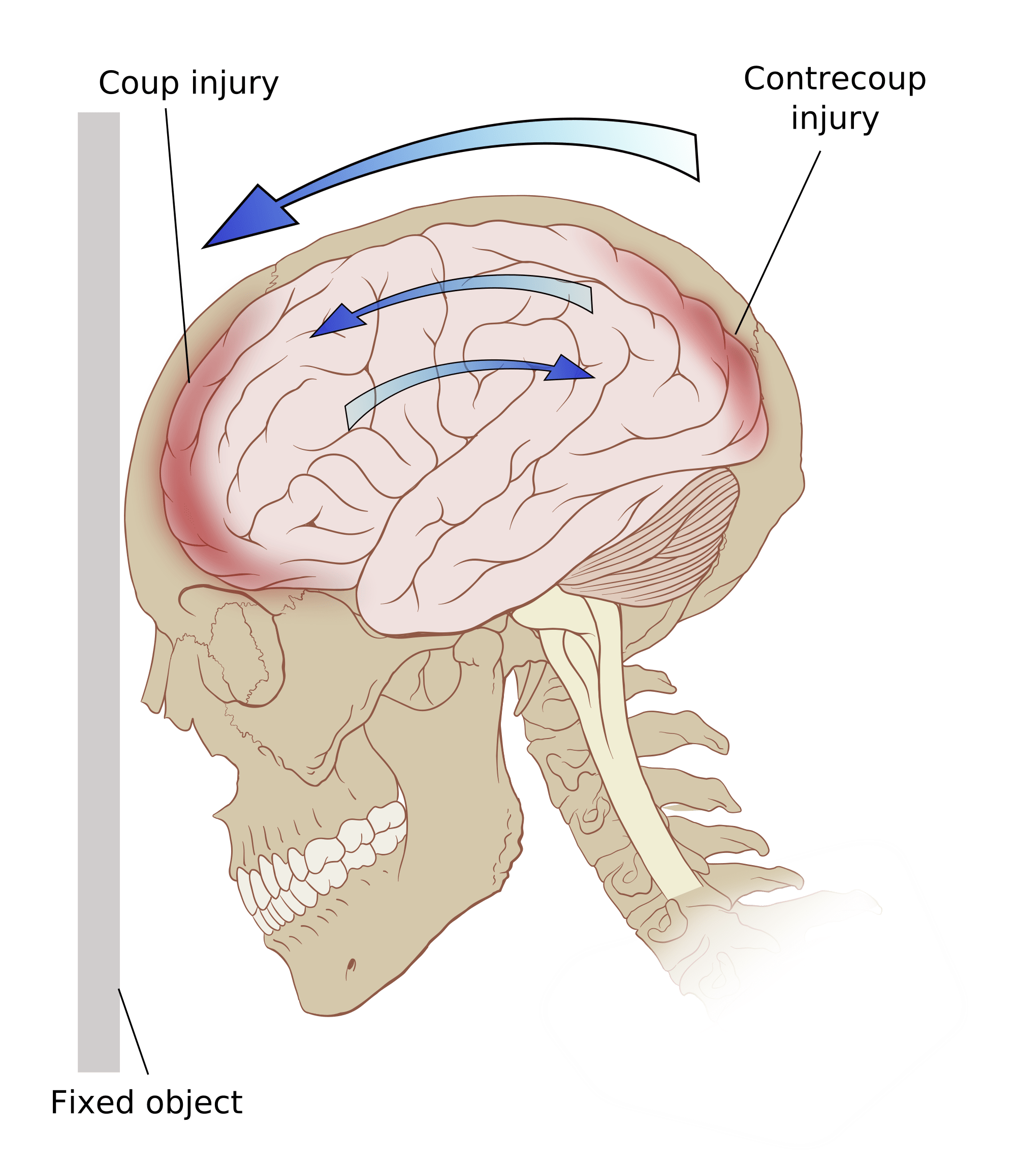
Identify signs and symptoms of traumatic brain injury
Physical
  Headache
  N/V
  Balance problems
  Dizziness
  Visual problems
  Fatigue
  Light sensitivity
  Noise sensitivity
  Numbness/tingling
Cognitive
  Mental fogginess
  Feeling slowed down
  Difficulty concentrating
  Difficulty remembering

Slide 35
Signs and symptoms of traumatic brain injury, cont.
Emotional
  Irritability
  Sadness
  Heightened emotions
  Nervousness
Sleep
  Drowsiness
  Sleepiness less than/more than usual
  Trouble falling sleep

Slide 36
Care and education of the concussion patient
Patient should be transport if a concussion is suspected
If the patient refuses, educate them on the warning s/s and seeking medical attention:
  One pupil larger than the other
  Drowsiness or cannot be awakened
  A headache that gets worse and won’t go away
  Weakness, numbness, or decreased coordination
  Repeated vomiting or nausea
  Slurred speech
  Convulsions or seizures
  Difficulty recognizing people or places
  Increasing confusion, restlessness, unusual behavior or agitation
  Loss of consciousness, even brief

Slide 37
EMS spinal precautions and use of the long backboard
Follow local protocol*
Remember a patient with altered mental status may not be able to accurately relay injury symptoms when you assess, always be cautious with traumatic brain injured patients and factor mechanism of injury in your decision-making process for immobilization.
Notes:
Reference: National EMS Education Standards
Discuss current guidelines and protocol for the emergency responder

Slide 38
Summary
Identifying causes of altered mental status, A-E-I-O-U-T-I-P-S, and the care and treatment of each
Know the different types of seizures and how they present
Describe the s/s of stroke and knowing the importance of having the exact timeline of patient’s last known “normal” state
Identifying traumatic brain injury and the care and treatment for same
Know the current practice for spinal immobilization

Slide 39
EMR
Refresher
Module II
Medical Emergencies/Operations
Endocrine/Behavioral/Immunological/Toxicological/Infectious Disease/OB/Field Triage-Disasters/MCI’s/EMS Provider Hygiene Safety & Vaccine/EMS Culture of Safety

Slide 40
Module II – Section I – Endocrine Emergencies
Objectives
  Explain the role glucose plays on the cells
  Identify symptoms commonly associated with hypoglycemia
  Identify symptoms commonly associated with hyperglycemia/diabetic coma
  Describe interventions for hypo/hyperglycemic patients

Slide 41
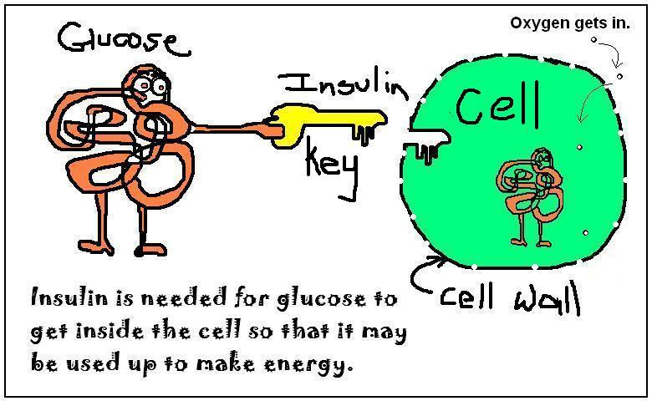
Role glucose plays on the cells
Glucose is an essential nutrient for the cells.
Fuel for cells
Ensures proper brain and cell functioning
Changes in levels may result in altered behavior
Notes:
Explain the role of Insulin
Explain Diabetes and the two types: Type I and Type II

Slide 42
Symptoms associated with Hypoglycemia
Pale, moist, cool skin
Rapid, weak pulse
Dizziness or headache
Confusion or headache
Confusion or unconsciousness
Sweating
Hunger
Rapid onset of symptoms (within minutes)

Slide 43
Symptoms associated with Hyperglycemia
Slow onset and changes in mental status
Rapid breathing, sweet breath odor
Dehydration, pale, warm, dry
Weakness, nausea, vomiting
Weak, rapid pulse
Polyuria, polydipsia, polyphagia

Slide 44
Interventions for Hypo/Hyperglycemia patients
Hypoglycemia
  Ensure open airway, adequate breathing, circulation and ability to swallow
  Check glucose
  If able to swallow and alert can have the patient drink juice
  *Follow local protocol regarding oral glucose administration
Hyperglycemia
  Ensure open airway, adequate breathing, circulation and ability to swallow
  Check glucose
  Supportive care until transport arrives, place in recovery position
Notes:
Review patient’s medical history regarding insulin, food intake, etc.

Slide 45
Summary
Understanding the role that glucose plays on the cells
Recognizing the signs and symptoms of a patient with a glucose emergency whether hypoglycemic or hyperglycemic and treat accordingly

Slide 46
Module II – Section II – Behavioral Emergencies
Objectives
  Define a behavioral crisis
  List factors that contribute to a behavioral emergencies
  Describe the components of a mental status exam
  Recognize signs and symptoms of the abused patient
  Describe assessment and treatment of the violent patient
  State the risk factors for suicide
  Describe care and approach in dealing with the suicidal patient

Slide 47

Behavioral Crisis
What is a behavioral crisis?
  A sudden disruptive event such as a physical illness, a traumatic injury, or the death of a loved one which causes a person to exhibit abnormal behavior that is unacceptable or cannot be tolerated by the patient himself or by friends, family or the community.

Slide 48
Main factors that contribute to Behavioral Emergencies
Medical conditions such as uncontrolled diabetes, stroke, brain injuries, high fevers, infections
Physical trauma
Psychiatric illnesses such as depression, panic disorders
Mind-altering substances such as alcohol and drugs
Situational stresses from emotional traumas such as death of a loved one or serious injury to a loved one

Slide 49
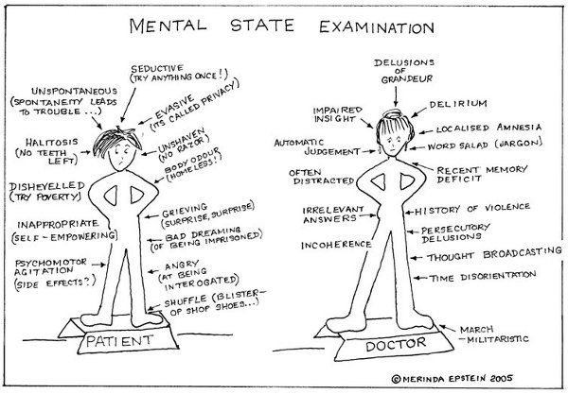
Components of Mental Status Exam
Mechanism of injury or nature of illness?
  Injuries/illnesses can cause altered behavior
  Medication side effects
Mental health history
General appearance
  Dress
  Grooming
  Posture
  Wringing of hands
  Facial grimaces
  Mannerisms
  Actions
  Violence
Notes:
Head injuries, hypoglycemia, hypoxia, stroke, dementia

Slide 50
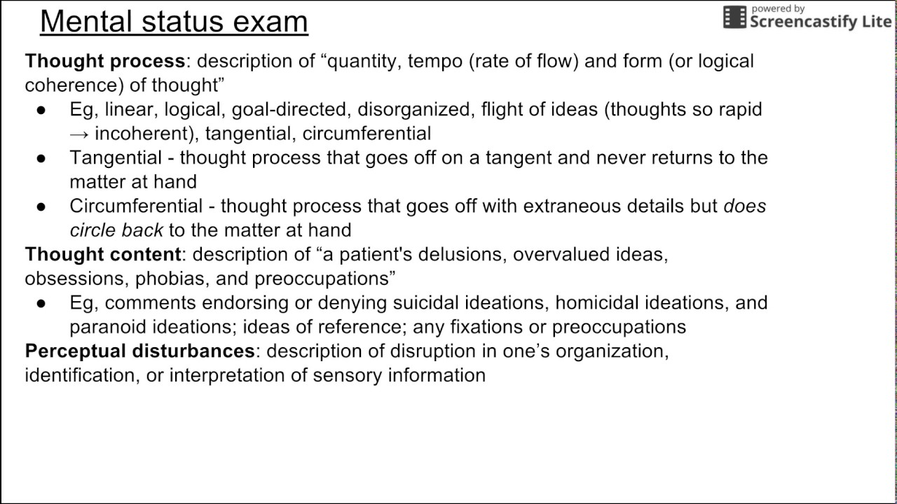
Components of mental status exam, cont.
Speech
  Spontaneous or pressured
  Slow or fast
  Soft or loud
  Understandable or not
  Appropriate or inappropriate
  Mood
  Area of thought
    Racing thoughts
    Hallucinations
    Obsessive
    Delusions
    Suicidal
    Unconnected
    Disturbed or distorted
Notes:
Mood – depressed, euphoric, manic, anxious, angry, agitated, fearful, guilty

Slide 51
Signs and symptoms of the abused patient
Broken bones
Cuts
Head injuries
Bruises of varying stages of healing
Burns (patterned)
Scars from old injuries
Internal injuries may be caused
Person may be withdrawn, underweight or malnourished for age from neglect
Notes:
Discuss the different forms of abuse, physical, sexual, neglect, emotional
Discuss current laws regarding reporting abuse or suspected abuse.

Slide 52
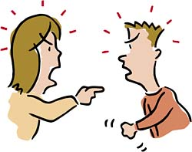
Assessment and treatment of the Violent Patient
Assess the scene and your safety first and foremost, identify the need for law enforcement
Immediately attempt to establish verbal or eye contact with the patient to begin the process of creating a rapport with your patient
Communication is key
Observe the patient’s behavior, mannerisms, speech, is he/she yelling, posture
Is there substance abuse involved?
Have an escape route
Empathy can often defuse tense situations
Notes:
Care and treatment may often times only be supportive with no actual patient care interventions involved.

Slide 53
Risk factors for Suicide
History of depression and other mental disorders
Previous suicidal gestures/attempts
History of family/child abuse (non-accidental trauma)
Feelings of hopelessness
Unwillingness to seek mental health care (stigma attached)
Feeling of being isolated from others
History of impulsive of aggressive behavior
Inability to access mental health
Recent diagnosis of a serious health, especially an illness that signals a loss of independence
Recent loss of a loved one, job, money or social loss
Access to firearms
PTSD
Alcohol or drug abuse
Loss of a relationship
Notes:
Giving away personal belongings/cherished possessions
Physical or mental stress
Major physical stress such as surgery and long periods of sleep deprivation
Expression of a clear plan for committing suicide
Ability of the mechanisms to carry out suicide

Slide 54
Care and approach in dealing with the suicide patient
Protect yourself and others first from further harm
Does the patient still have a weapon or items on their person to do them harm?
Gather the information regarding the episode
Protect ABC’s
Control hemorrhage, treat any injuries
Don’t judge the patient
Listen, be supportive

Slide 55
Dealing with Agitated Delirium/Excited Delirium Patients
Stay calm, and do not cause more harm to the patient
This state is caused by a sudden onset of extreme agitation and extremely irrational or combative behavior
  Bizarreness, aggressiveness, agitation, ranting, hyperactivity, paranoia, panic
  Resulting from substance intoxication, psychiatric illness, alcohol withdrawal, head trauma, or a combination of these
  Patient can have hypertension, tachycardia, diaphoresis, dilated pupils, tachypnea, abnormal tolerance to pain, hyperthermia, noncompliance, and endless endurance and strength
  May lead to respiratory and cardiac arrest
    Restraints may increase the risk

Slide 56
Summary
Describe what a behavioral crisis is and how to deal with a patient having a behavioral crisis.
Define the many forms of abuse
Be able to care for the violent patient
Know the components of the mental status exam
Be able to state the risks for suicide and how to approach the suicidal patient
Know how to approach and care for the patient in a state of agitated delirium

Slide 57
Module II – Section III – Toxicology & Immunological Emergencies
Objectives
  Define poison
  Describe signs and symptoms and how to treat each of the four routes of exposure to a poison
  Discuss the physiology related to allergies and anaphylaxis
  Differentiate between a mild/localized allergic reaction and anaphylaxis
  Explain the actions of medications used to treat anaphylaxis
  Describe signs and symptoms of drug overdose caused by different substances
  Identify common synthetic stimulants and natural or synthetic THC (tetrahydrocannabinol)
    Recognize the effects
  Identify common opioids
    Recognize the effects
  Explain common treatment options for a person experiencing opioid overdose

Slide 58

What is a Poison?
A substance that causes illness or death when eaten, drank, inhaled, injected, or absorbed in not necessarily large quantities.

Slide 59
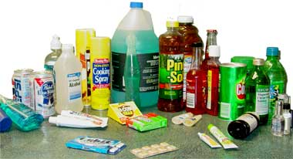
Signs and Symptoms of Ingested Poisons
Ingestion occurs when a poison enters the body through the mouth and is absorbed in the digestive system.
  Nausea
  Vomiting
  Abdominal pain
  Diarrhea
  Chemical burns
  Odors
  Stains around the mouth
  Activated charcoal*
Notes:
*Follow local protocol
Discuss poison control center access 1-800-222-1222

Slide 60

Signs and Symptoms for Inhaled Poisons
Inhalation occurs when a poison enters the body through the mouth or nose and is absorbed by the mucous membranes lining the respiratory system.
  Respiratory distress
  Dizziness
  Cough
  Headache
  Hoarseness
  Confusion
  Chest pain
  Protect yourself, remove patient from the source
  Secure airway, breathing, provide oxygen
Notes:
Carbon monoxide
Ammonia
Chlorine
Discuss each and their effects
Discuss haz mat

Slide 61
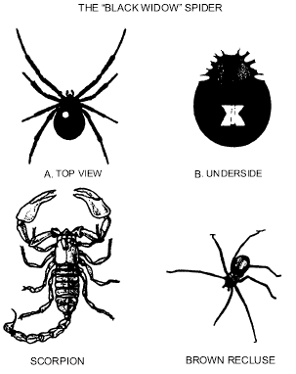
Signs and Symptoms of Injected Poisons
Injection occurs when a poison enters the body through a small opening in the skin and spreads through the circulatory system.
  Tenderness at the site
  Swelling
  Red streaks
  Weakness
  Dizziness
  Localized pain
  Itching
  Hives
  Rapid, weak pulse
  Rapid, shallow breathing
  Identify the source but protect yourself
Notes:
Caused by insects bites or stings or toxic injections
Defer anaphylaxis and epinephrine discussion to later slides

Slide 62
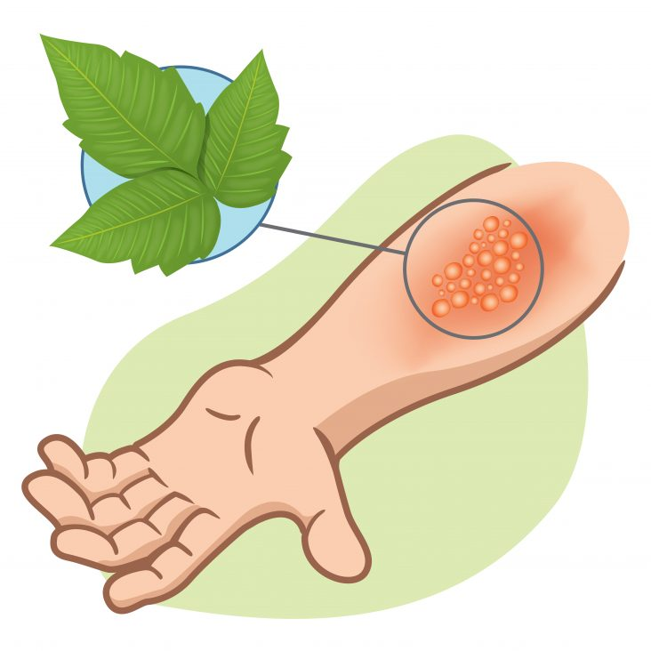
Signs and Symptoms of Absorbed Poisons
Absorption occurs when a poison enters the body through intact skin and spreads through the circulatory system.
  Traces of powder or liquid on the skin
  Inflammation or redness on the skin
  Chemical burns
  Rash
  Burning
  Itching
  Nausea and vomiting
  Dizziness
  Shock
  Protect yourself, obtain haz mat, remove the patient from the source, brush before you flush.
Notes:
Discuss nerve agents

Slide 63
Comparing Allergy to Anaphylaxis
Allergic reaction
  Hyperactive, localized immune response to an allergen
  Some histamine is released
  Localized: redness, swelling, hives, itching
  May cause nausea, vomiting, and/or diarrhea
  Usually requires minimal supportive treatment
Anaphylaxis
  Multiple body systems are affected
  Life threatening reaction of the immune system to an allergen
  Large quantities of histamine are released throughout the body
  Vasodilation and increased capillary permeability
  May lead to shock
  Bronchoconstriction and mucous production
  May lead to respiratory distress
  Swelling of the upper airways

Slide 64
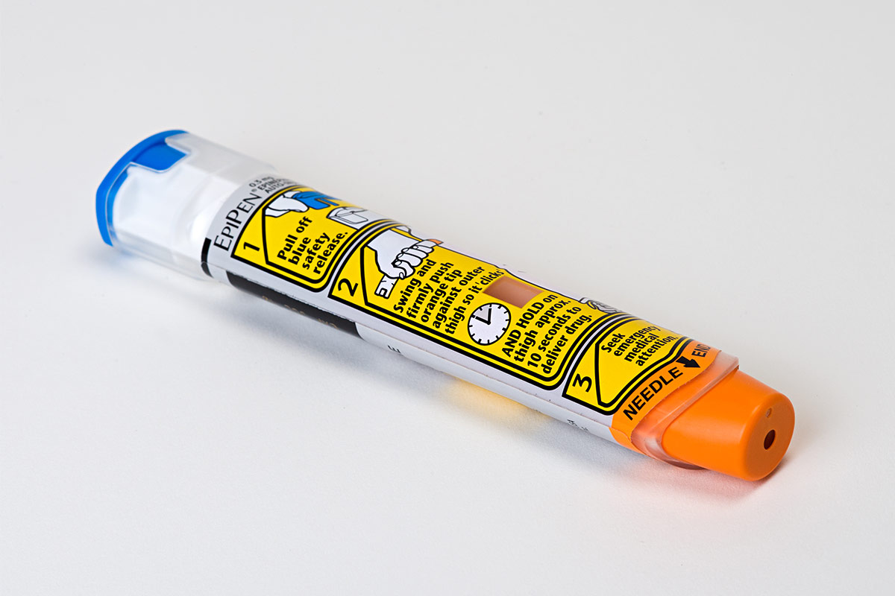
Medication used to treat anaphylaxis
Patient assisted Epi Pens
*Follow local protocol
Ensure adequate airway, ventilation and oxygenation
Assist patient with epinephrine auto-injector if available*
Notes:
Demonstrate the administration of the use of an Epi auto, while this is not an EMR skill to do knowing how and when to assist the patient with self-administration could prove to be a life-saving event.

Slide 65
Signs and symptoms of drug overdose from different substances
Slow, difficult, shallow breathing, or no breathing
Small or pinpoint pupils
Weak pulse
Low blood pressure
Blue nails and lips
Drowsiness
Disorientation
Delirium
Coma
Restlessness
Irritability
Hallucinations
paranoia

Slide 66
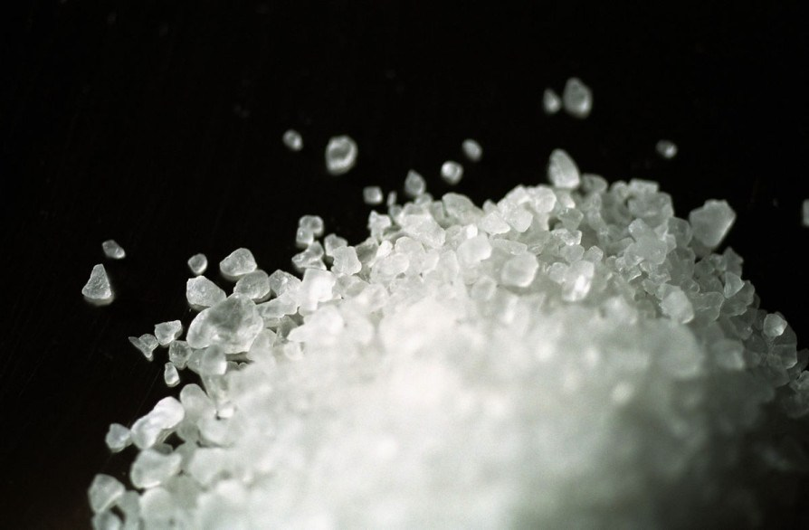
Common synthetic stimulants
Amphetamines
Cocaine
Bath salts
THC (tetrahydrocannabinol)
Notes:
Mind-altering
Swallowed, snorted, smoked or injected
Bath salts-bliss, blue silk, ivory wave, white dove, white knight, white lightning, usually sold as white powder, usually inhaled
MDMA – ecstasy, X, skittles
THC – weed bud, doobie, Mary Jane, pot, blunt, impaired short term memory, impaired balance and coordination, increased appetite

Slide 67
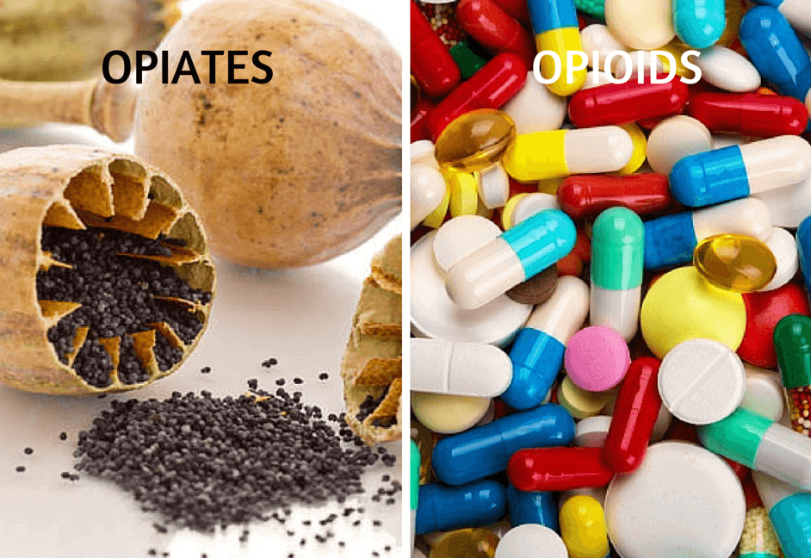
Common Opioids
Heroin
Morphine
Oxycodone
Codeine
Fentanyl
Hydrocodone
Hydromorphone
Methadone
Notes:
Causes respiratory depression
Drowsiness
Constipation
Constricted pupils
Dry mouth
Itching
Nausea and vomiting
Addiction

Slide 68
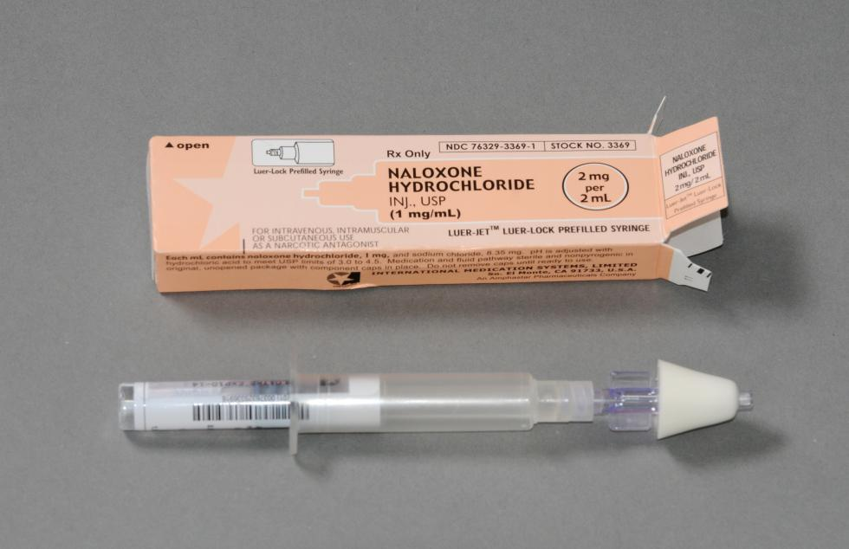
Treatment for opioid overdose
Naloxone (Narcan)
  Opioid antagonist
  Reverses CNS and respiratory depression due to opioid overdose
  NOT effective against non-opioid drugs
  First responders may administer intra-nasally*
  *Follow local protocols
Notes:
Demonstrate the use and dosage of Narcan

Slide 69
Summary
Know the four routes of exposure to a poison, the care and treatment for each and s/s of each
Recognizing a drug overdose, the many substances involved causing overdose, s/s and care for the overdose patient
Differentiate between allergic reaction and anaphylaxis
Describe what THC is.

Slide 70
Module II – Section IV – Infectious Diseases, EMS Provider Hygiene Safety & Vaccine
Objectives
  List common hazards encountered by EMR’s
  Describe three routes of disease transmission
  Describe drug resistant infections
  Describe how the transmission of influenza virus occurs
  Understand the mode of transmission of airborne and bloodborne pathogens
  Assess the differences between sepsis and septic shock
  Describe the standard precautions for preventing infectious diseases
  Identify proper handwashing technique
  Identify appropriate use of alcohol-based hand cleaner
  Discuss the CDC’s recommendations of vaccines for healthcare providers
  Assess eye safety indications and measures

Slide 71
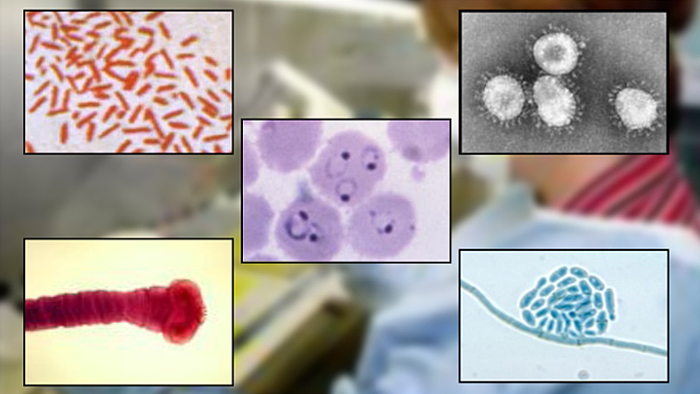
Common Hazards Encountered by EMR’s
Infectious diseases
Traffic
Crime and violence
Crowds
Electrical hazards
Fire
Hazardous materials
Unstable objects
Sharp objects
Animals
Environmental conditions
Special rescue situations

Slide 72
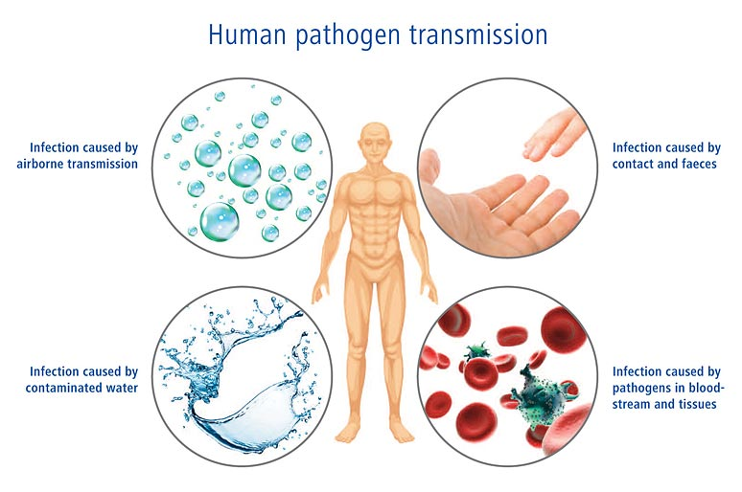
Three routes of disease transmission
Infected blood
Contact with airborne droplets
Direct contact with infectious agents
Notes:
Blood-borne pathogens- HIV, Hepatitis B and C
Airborne – Influenza, TB, SARS
Direct contact - MRSA

Slide 73
Drug resistant infections
Microbes are resistant to the effects of medications/treatments
Difficult to treat
Anyone is susceptible; some must be more cautious
  Weakened immune systems
  Open skin wounds
  Recent surgery
  Invasive procedures (PICC lines, IV’s, in-dwelling catheters, etc.)
Common resistant infections:
  MRSA
  VRE
  VRSA
  TB
  Clostridium difficile (C-Diff)
Notes:
Discuss each infection and how important it is for EMR’s to protect themselves.

Slide 74
How the transmission of influenza virus occurs
Spread from person to person:
  Large particle respiratory droplet transmission
  Contact with droplet contaminated surfaces
  Airborne transmission by small-particle residue of evaporated droplets
Typical incubation period is 1-4 days
Contagiousness begins the day before symptoms start and lasts 5-10 days
Children may be contagious several days before becoming symptomatic, lasting ten or more days after onset
Severely immunocompromised people can shed virus for weeks to months
Notes:
Influenza vaccines – 60% effective (varies with flu strain and vaccine)
Selected based on CDC forecasts
Seasonal flu vaccine is usually trivalent (three component)

Slide 75
Mode of transmission
Bloodborne
  Patient’s blood is splashed or sprayed into your eyes, nose or mouth or into an open sore or cut
  You have blood on your hands and touch your own eyes, nose, mouth, or an open sore or cut
  A needle or sharp object that had a patient’s blood on it stuck or stabbed you
  Broken glass from a motor vehicle crash breaks your skin and has blood on it from the patient.
Airborne
  Patient coughs or sneezes and you inhale these droplets from the air.
  Some droplets remain on surfaces of equipment and if not cleaned or handled properly can transfer to you after it has dried

Slide 76
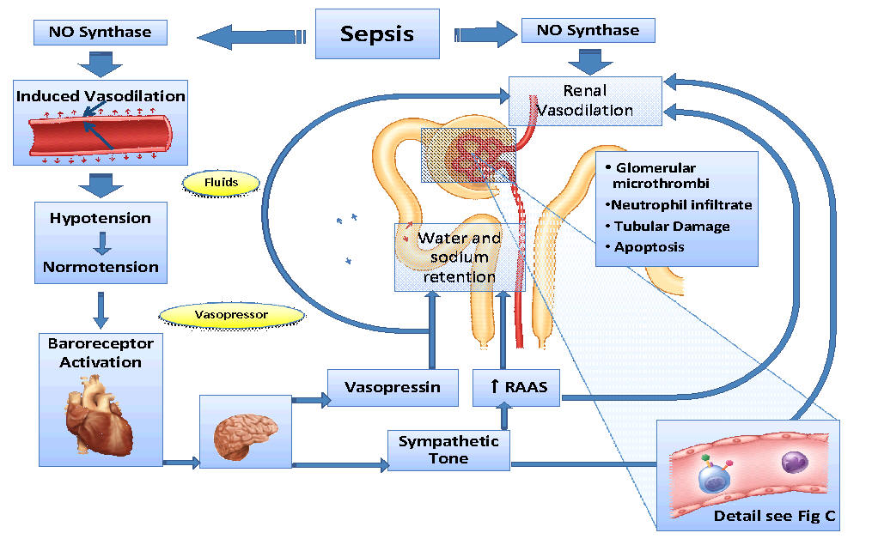
Sepsis and Septic Shock
Body’s response to infection
Most common in older adults
Can be life-threatening
Chemicals released into the bloodstream as a result of an infection, triggering an inflammatory response throughout the body
Eventually if left untreated can develop into shock, in which blood pressure can plummet, mental status will be severely altered, may or may not present with fever
Notes:
Review s/s of Sepsis, etiology, such as pneumonia, UTI’s, abdominal and kidney infections, hypo and hyperthermia.

Slide 77
Standard precautions for preventing infectious disease
Always wear gloves!
Always wear eyewear when appropriate!
Always wash your hands!
Place all sharps into a puncture-resistant container
Even though saliva has not been proven to transmit HIV use a face shield when dealing with a patient’s airway
Notes:
Disinfect your equipment!

Slide 78

Proper Hand-Washing Technique
Wash you hands before and after eating, before and after handling each patient once your gloves are removed.
Wash you hands in clean, warm running water.
Apply soap (does not have to be anti-bacterial), make a good lather
Rub between fingers, around nails, all surfaces for at least 20 seconds, singing “happy birthday”
Thoroughly rinse and dry then turn the faucet off with the used paper towel

Slide 79

Use of alcohol-based hand cleaner
Should contain at least 60% alcohol
Reduces number of germs
Does not eliminate all types of germs
Does not kill viruses
Ineffective when hands are visibly dirty

Slide 80
CDC’s Recommendations of Vaccines for Healthcare Providers
Prevention begins by maintaining your personal health
Recommendations:
  Hepatitis B
  Influenza (annually)
  Measles, mumps, and rubella (MMR) (typically a one-time vaccination)
  Varicella (chickenpox) vaccine or having had chickenpox
  Tetanus, diphtheria, pertussis (Tdap) (every 10 years)
  *Most of these vaccines are given as children, some may need boosters. Keep your vaccines up to date.

Slide 81

Eye and Face Protection
Blood splatters are a significant possibility in most trauma situations and some medical
Goggles
Face Shields
Safety glasses
Full face respirators

Slide 82
Summary
Describe some common hazards encountered by EMR’s
Remember the routes of disease transmission:
Differentiating between airborne and bloodborne pathogens
Know the difference between sepsis and septic shock
Using standard precautions and knowing the proper procedure for hand-washing
Understand your vaccination options and recommendations as an EMR

Slide 83
Module II – Section V – OB Emergencies
Objectives
  Explain the anatomy and function of the female reproductive system
  State the stages of labor
  Explain the procedures for normal child delivery in the field
  Determine the need for neonatal resuscitation during delivery
  Describe the routine care of a newborn not requiring resuscitation
  Describe the care and treatment of some complications that can occur during childbirth

Slide 84
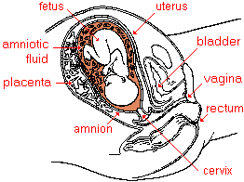
Anatomy and Function of the Female Reproductive System
Uterus
Birth canal
Vagina
fetus
Placenta
Umbilical cord
Notes:
Explain the purpose and function of each

Slide 85
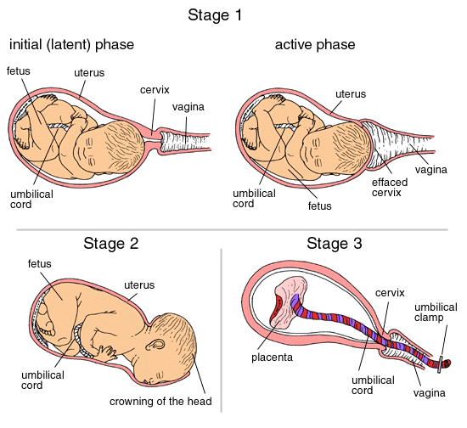
Stages of Labor
First stage
  Contractions start, hopefully the “bag of waters” breaks and the “bloody show” is expelled.
Second stage
  Birth of the newborn
Third stage
  Delivery of the placenta (afterbirth)

Slide 86
Procedures for normal child delivery
REMAIN CALM!
Prepare you equipment
Wash your hands don your gloves and eye protection
Mom will do most of the work you will guide the baby and prevent an explosive delivery.
Support the baby, remember he/she will be slippery when born
Keep the baby’s head at the level of the mother’s vagina
Don’t pull on the newborn, make sure the cord is not around the baby’s neck, if so, gently slip it around
If the bag of waters has not been broken you can tear it open
There is no need for the EMR to cut the cord.

Slide 87
Determine a need for neonatal resuscitation
Most newborns will begin to breath just after birth with minimal stimulation after their airway is cleared.
Some may need a little more assistance.
If the newborn does not cry and breathe on his or her own within the first minute after birth, proceed with the following:
  Tilt the head down to the side to encourage drainage and clear secretions from nose and mouth
  Suction the mouth then nose with a bulb syringe
  Stimulate by flicking the soles of feet or rubbing the baby’s back gently, if no response
  Begin mouth to mouth or nose breathing with gentle puffs just enough for chest rise
  Reassessing every 30 seconds respirations and pulse to assure they reach at least 40 breaths or 100 heart beats before going to the next step
  If not and pulse is not yes increased and is below or at 60 begin chest compressions and make sure oxygen has been added to your ventilations
Notes:
Discuss in more detail the resuscitation process

Slide 88
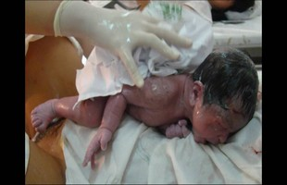
Routine care of newborn not requiring resuscitation
As soon as the newborn is delivered place him/her between mothers legs onto a clean towel at the level of her vagina.
After suctioning and drying assure newborn is breathing adequately
Place the newborn onto mother’s abdomen if both are stable
When umbilical cord stops pulsating clamp or tie it, there is no need to cut it unless you have the sterile equipment to do it.
Note the time of birth
Notes:
Explain the care of the newborn in more detail.

Slide 89
Complications of Pregnancy and Childbirth
Ectopic pregnancy
  Severe abdominal pain, s/s of shock, pale skin, dizziness, rapid pulse
Miscarriage and vaginal bleeding
  Spontaneous abortion, delivery of an incomplete or underdeveloped fetus. A fetus before 20 gestation can’t survive
Premature birth
  Newborn weighing less than 5 pounds or delivered before 36 weeks is considered a preemie, can lose body heat faster, is smaller, skin is thinner, requires prompt transport.
Unbroken bag of waters
  Rare occurrence but needs to be broken before baby can be born, be careful not to injure the newborn when you do break it.
Prolapse of the umbilical cord
  Appears through the vaginal opening before the baby at delivery. Can become compressed by the baby’s head upon delivery, thus cutting of baby’s blood supply which will compromise oxygen delivery. Serious emergency
Notes:
Ectopic pregnancy – a fertilized egg becomes implanted in the fallopian tube instead of in the uterus, can be life-threatening.
Miscarriage – explain how to care for the patient both medically and emotionally
Prolapsed cord – explain patient positioning in a knee to chest and have the mother refrain from pushing.

Slide 90
Summary
Know the anatomy and function of the female reproductive system
Be able to define the stages of labor
Differentiate between a normal newborn delivery and one needing resuscitation
Define the steps of a newborn resuscitation
Describe some complications of pregnancy/delivery

Slide 91
Module II – Section VI – Field Triage--Disasters/MCI
Objectives
  Define a mass-casualty incident
  Describe the EMR’s role in a mass-casualty incident
  Discuss CDC’s field triage decision scheme
  Discuss different triage methods:
  Discuss five components of NIMS/six ICS features
  Discuss terrorism awareness

Slide 92
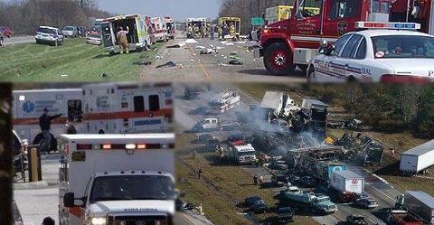
Mass Casualty Incident
Mass Casualty Incident
  (multiple-casualty incidents) more than one sick or injured person, often times more than one jurisdiction can handle alone.
  Can range from a serious motor vehicle accident to a burning building, to an explosion, all involving numerous people.

Slide 93
EMR role in a mass casualty incident
Goal: Doing the greatest good for the greatest number
First surveying the scene, assuring your safety and looking for hazards, doing a size-up, giving an overall estimation of what the situation may be.
Secondly, sending information via radio report:
  Where
  What
  Any hazards
  How many (approximate)
  Type of help needed
Thirdly, sorting begins!

Slide 94
4 Steps of the CDC’s Field Triage Decision Scheme
Step I
  Assess vital signs and level of consciousness
    GCS
    Resp Rate
    Systolic BP (peripheral pulses, perfusion)
Step II
  Assess anatomy of injury
Step III
  Assess mechanism of injury
Step IV
  Assess special patient or system considerations
    Considering priority transport to trauma center for older adults, pediatrics, burns, OB patients, anticoagulant and bleeding disorders

Slide 95
Different triage methods
Salt
  Sort
  Assess
  Lifesaving interventions
  Treatment/transport
Start
  Simple
  Triage
  And
  Rapid
  transport
JumpStart (pediatric version of START)
Notes:
Steps to consider during triage:
Sort: Global sorting
Obvious life threat, purposeful movement, walk
Individual assessment
Perform lifesaving interventions as indicated
Perform ongoing reassessments
Treatment and/or transport
START:
Assess respirations
Assess perfusion
Assess mental status
JumpSTART:
Same as START only the parameters are different review

Slide 96
Five Components NIMS/Six Major Features of ICS
NIMS
  Provides a comprehensive, consistent, and unified approach to handling emergency incidents.
  Preparedness
  Communications and information management
  Resource management
  Command and management
  Ongoing management and maintenance
ICS
  Part of the command and management component of NIMS
  Standardization
  Command
  Planning/Organizational structure
  Facilities and Resources
  Communications Information Management
  Professionalism
Notes:
Briefly discuss each component.

Slide 97
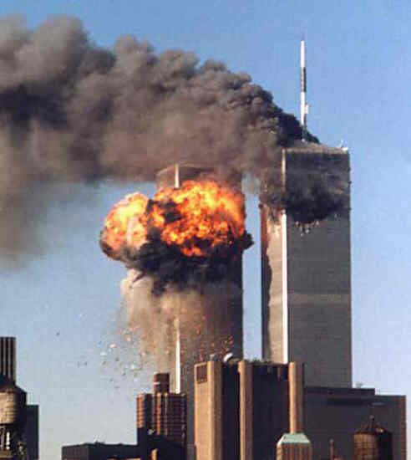
Terrorism Awareness
Terrorism – the systematic use of violence by a group to intimidate a population of government to achieve a political goal.
Weapons of Mass Destruction
Potential Targets and Risks
Agents and Devices
Your response
Notes:
Weapons of mass destruction – any agent designed to bring about mass death, casualties and/or massive damage to property and infrastructure.
Potential targets and Risks:
They need to incite fear, schools, government buildings, shopping centers, sports events, computer networks, food sources.
Agents and devices:
explosives and homemade bombs, chemical agents, insecticides, nerve agents, blister agents, biologic agents.
Your response as an EMR:
Know the limits of your training. Always keep yourself safe and exercise due diligence for the safety of others. Be alert for secondary devices that may be set to detonate after first responders arrive to assist those injured in the primary phase of attack.

Slide 98
Summary
Be able to recognize a mass casualty
Know what your role as an emergency responder is in the event of a mass casualty
Know the START/JumpSTART triaging steps
Be familiar with the NIMS/ICS system
Be aware of a terrorist event and your role in that event

Slide 99
Module II – Section VII – EMS Culture of Safety
Objectives
  Define culture of safety
  Identify and explain the six core elements necessary to advance an EMS culture of safety
  Identify the role of the EMS providers in establishing a culture of safety within EMS organizations

Slide 100
EMS Culture of Safety
The value and priority placed on worker and public safety by everyone in every group at every level of the organization.
The extent to which individuals and groups will commit to personal responsibility for safety; act to preserve
Enhance and communicate safety concerns
Strive to actively learn, adapt and modify behavior based on lessons learned from mistakes

Slide 101
Six Core Elements Necessary to Advance an EMS Culture of Safety
Just Culture
  Development of environments in which EMS personnel are safe to report errors
  Assess risks in order to identify means of overcoming factors that contribute to errors
Coordinated support and resources
  Creation of a guidance and resource coordination body
EMS Safety Data System
  Data driven decisions and policies related to EMS safety can only be made if all data is accessible on a national level
EMS Education Initiatives
  Safety starts with EMS leaders and educators and involves everyone
EMS Safety Standards
  Safety standards for patient and responder safety must be developed using data and evidence
Requirements for reporting and investigation
  Mandates for reporting safety are necessary so a common language and data set can be created to improve responder and patient safety

Slide 102
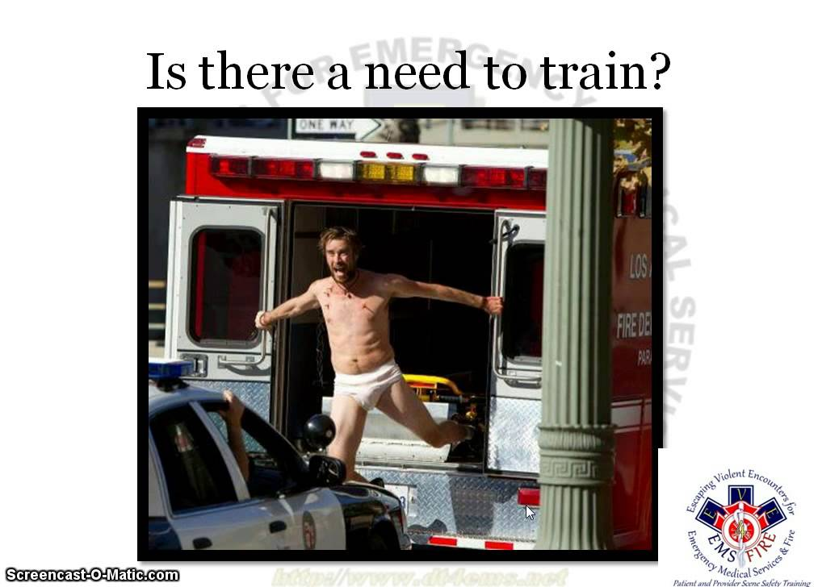
What is your role as an EMS Provider in establishing a Culture of Safety within your organization?
What changes are needed to encourage the development of a culture of safety?
How are mistakes handled if one is made during a patient care encounter?
How should it be handled if applying the concept of Just Culture?
*Blaming or punishing is not an option in Just Culture

Slide 103
Summary
As an EMT it is your responsibility to promote safety in every aspect of your profession:
  Safe transportation of your crew members to and from a scene
  Safe transportation of your patient to the hospital
  Promote safe actions while on the scene
  Promote safety while training
  Assist leadership and following policies and guidelines for the promotion of a culture of safety

Slide 104
EMR Refresher
Module III
Skills
Cardiac Arrest Management/AED/Bleeding Control and Shock Management/Oxygen Administration/Medical Patient Assessment with Baseline Vitals/Trauma Patient Assessment with Baseline Vitals

