Slide 1
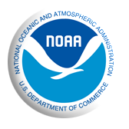
2015 Vessel Activity in the Arctic
Jeffrey D. Adams and Gregory K. Silber
NOAA Fisheries
Office of Protected Resources

Slide 2
Arctic Marine Environment
Increased surface air temperatures
Reduction in sea-ice extent
Increased maritime activity
Increased impacts
Limited vessel activity information
Comprehensive baseline needed

Slide 3
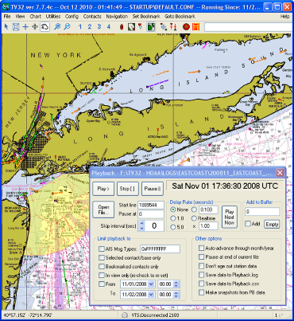
AIS Overview
Automatic Identification System
Maritime Safety Technology
IMO and USCG Mandated
Static Information: vessel name, mmsi, call sign, imo number, type, and length
Dynamic Information: vessel speed, position, heading, and course

Slide 4
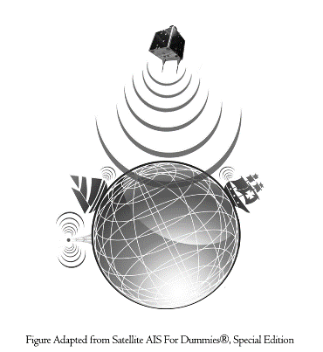
Satellite AIS System
AIS signals detected in space!
Low-orbiting microsatellites
Single satellite has a field of view of 2500 nautical miles
Constellations of microsatellites
Open ocean and coastal areas!
Commercial vendors
Cost effective

Slide 5
Characterizing Vessel Activity
2015 satellite AIS data
ARPA boundary
Vessel activity metrics
Enhanced vessel database
Vessel type and size classes
Annual and monthly activity
Regional and ocean/sea activity

Slide 6
Vessel Activity - Synopses
One-page summary
High-level information
Surface area and sea ice extent
Vessel activity totals and ranges
Relative vessel activity ranks for different oceans and seas

Slide 7
Vessel Activity - Charts
Annual activity by vessel type and size classes
6 vessel type classes (Appendix 1)
7 vessel size classes (GT)
Monthly activity by vessel type class

Slide 8
Vessel Activity - Appendices
Activity metrics by vessel type
Vessel and transit counts by flag country
Transit and sea ice extent maps
Transit density by vessel type class maps

Slide 9
Applications
Identifies areas of highest use
Areas to target for updating bathymetric data
Assist with determining locations for shipping lanes
Determine areas of highest risk to marine mammals (overlay habitat maps with vessel traffic info)

Slide 10
Acknowledgements
Kam Chin and David Phinney of the Department of Transportation VOLPE Data Center
Peter Oppenheimer of the NOAA General Counsel Office
Candace Nachman of NOAA Fisheries Office of Policy

