Slide 1
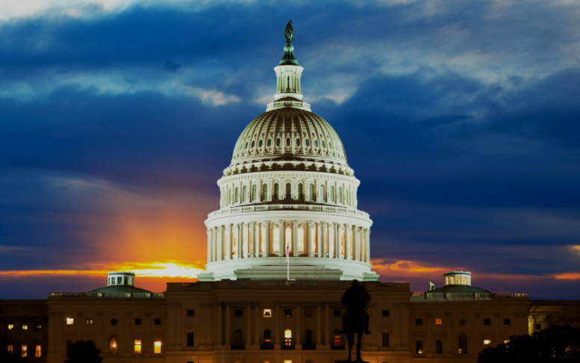
Congress
Josh Lovett, Abi Wakefield, Em Vitale

Slide 2
“If con is the opposite of pro, is congress the opposite of progress?”

Slide 3
The Framers’ View
Congress is meant to be the strongest branch, or “The First Branch.”
Took up four and a half pages of the Constitution (In comparison, the Supreme Court takes up 3/4s of a page)
Meant to sustain federalism with important checks on the other branches, like overriding Presidential Vetoes, and determining the structure and jurisdiction of the Federal Courts (including the Supreme Court).

Slide 4
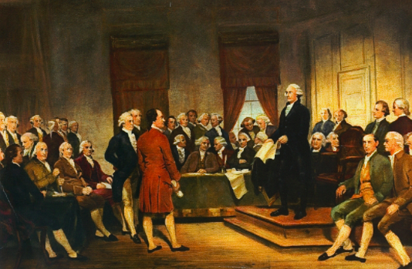
Then:
From 1890 to 1910, 2/3rds of all proposed votes started a party split. However, until the 60’s, bills were more commonly passed on a bipartisan basis. Liberal Republicans and conservative Democrats helped to reach common ground.
Veteran representatives held most leadership positions.
Interparty and interbranch coalitions were used to bargain and compromise in the law making process.

Slide 5
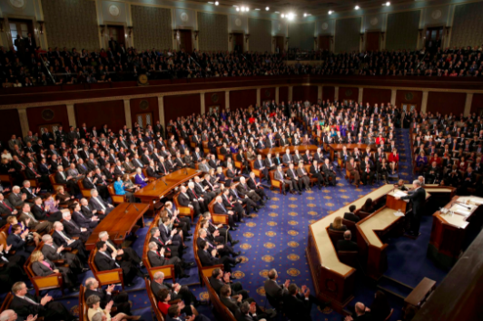
Now:
Congress is the least popular branch of government, and recent public approval ratings have been around a third. Even so, most incumbents get reelected by comfortable margins.
Polarization has increased, and liberal republicans and conservative democrats have become extinct (!!!)
This has lead to gridlock and slow action, further increasing public disapproval.

Slide 6
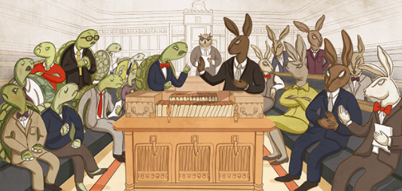
Congress vs. Parliament
Congress members are elected by popular elections, while members of Parliament must persuade their party to put them on the ticket.
Congress is decentralized, with more power vested in individuals. This causes actions to carry out slowly. Parliament is centralized, and members must act in accordance with their party for government to function. This brings the potential for faster action.
Members of Congress make decisions based on the wishes of their constituents, their personal ideology, or party affiliation. Members of Parliament can only choose whether or not to support their government.

Slide 7
The Powers of Congress:
Declare war
Raise and collect taxes
Run Washington DC and all federal property
Regulate interstate commerce
Coin money
Make rules for naturalization and bankruptcy
Establish the post office and roads
Issue patents and copyrights
Create lower courts
Elastic Clause

Slide 8
The Evolution of The House of Representatives
During the first three presidencies, The House was dominant instead of the Senate.
(1820s-1870s) Andrew Jackson began to diminish legislative power. The Civil War left many southern seats vacant and the Radical Republicans took over.
(1889) Thomas B. Reed brought new powers to the Speaker.
(1910-1970s) Starting with Speaker Joseph G. Cannon, leadership powers were gradually stripped away.
(1960s-1970s) In the struggle to pass Civil Rights legislation, individual powers were increased.
(1990s-Present) Starting with Speaker Newt Gingrich, leadership powers were gradually restored.

Slide 9
The Evolution of the Senate
Because of its smaller size (100 senators as opposed to 435 representatives), the Senate had fewer problems concerning power between individuals and leaders than the House.
Around the 1890s, public resentment of candidates buying votes from state legislatures lead to the Senate being termed “The Millionaire's Club.” This gave rise to the desire for popular elections. The Senate resisted until the states threatened to start another constitutional convention.
(1913) The 17th Amendment was passed, though it did not drastically change the composition of the Senate.
In the late 19th century, filibusters became more common (and annoying). During WWI, Rule 22 was adopted to stop filibusters during a wartime crisis. It says that a vote of 60 (orginally 2/3s) can end a filibuster with a “cloture resolution”. Unlimited debate is still a common practice, however.

Slide 10
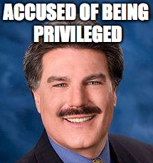
Who is in Congress?
Generally made up of middle-aged, white, male, protestant lawyers.
Recent increase in minorities, first termers (currently one in five), and non-lawyers.
Until the 1950s, most members served only one term. Then federal power increased, higher wages were given, and incumbency began to take hold. Most incumbents who seek reelection win by wide margins, especially in the House.
Between 1933 and 2011, Democrats have been in control of both houses more often than Republicans.
Notes:
Okay, but our dads?

Slide 11
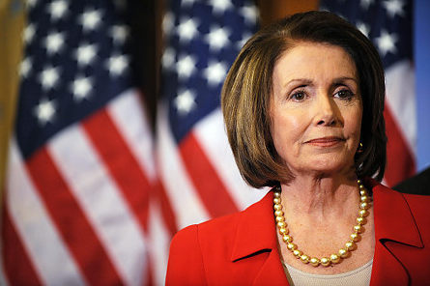
Minority Representation in Congress
Between 1950 and 2011, the number of women in the House increased from nine to 75 and the number of African Americans from two to 42.
There are currently 30 Latino members.

Slide 12
Do Members Represent their Constituents?
There are 3 main main theories concerning how members of Congress behave:
Representational
Organizational
Attitudinal

Slide 13
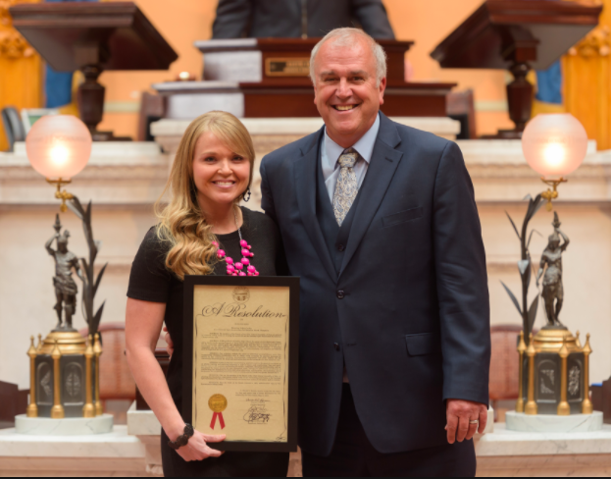
Representational View
Congress members vote to please their constituents in order to get reelected.
Often the case with civil rights laws. Members with a high minority constituency would be unwise to vote against them.
-On the other hand, the public may not have a strong opinion on most issues. In many cases, public opinion is divided and difficult to interpret.

Slide 14
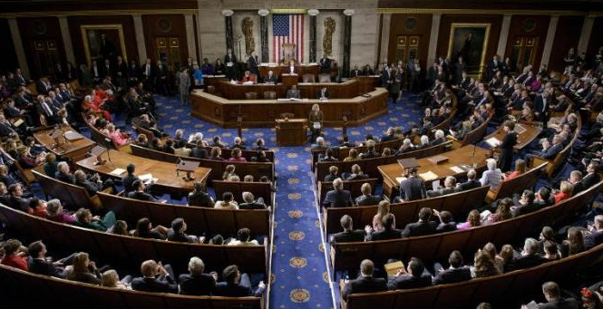
Organizational View
Assumes members of congress vote to please their colleagues.
Organizational cues:
Party
Ideology
The only issue with the organizational view is the unclear stance parties hold on most issues can complicate voting procedures of members of Congress.

Slide 15
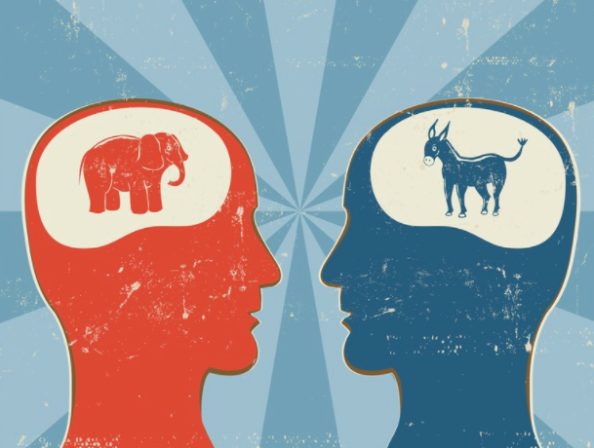
Attitudinal View
Assumes that ideology affects a legislator’s vote.
House Members tend to mirror the beliefs of the people.
1970s Senators more liberal
1980s Senators more conservative
Prior to the 1990s, Southern Democrats aligned with Republicans to create the “conservative coalition.”
The coalition has become obsolete given that most Southern legislators are now Republicans.

Slide 16
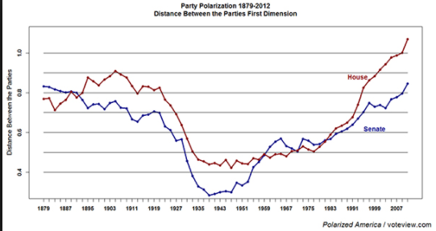
A Polarized Congress

Slide 17
Congressional Organization
Legislative committees are the most important organizational feature of Congress.
Decisions made in committees pass proposals, oversee executive agencies, and conduct investigations.
A healthy Congress generally has about 48 committees and hundreds of additional subcommittees.

Slide 18
Qualifications of HOR Representatives
The founders wanted the House to be the legislative chamber closest to the people, therefore relatively few hurdles were established between ordinary citizens and becoming a Representative.
Representatives serve 2 year terms.
Requirements include:
Must be at least 25 years of age.
Must have been a US citizen for at least 7 years.
Must be a resident in the state in which he/she is chosen.

Slide 19
Qualifications of Senators
The qualifications for the US Senate are greater than those of the House.
Senators serve 6 year terms.
Requirements include:
Must be at least 30 years of age.
Must have been a US citizen for at least 9 years.
Must be a resident in the state in which he/she is chosen.

Slide 20
The Organization of Congress
Party Organization: Senate
President pro tempore presides (member with most seniority in majority party)
Leaders are the majority and minority leaders as elected by their respective parties
Party Whips- Keep leaders informed, round up votes, conduct head counts
Party Organization: House
Speaker of the House is leader of the majority party-presides over house.
Majority leader (floor leader) and minority leader
Party whip
Opinions and interest groups
Committees: Standing, Select, Conference

Slide 21
Standing Committees
A standing committee is a semi-permanent legislative body.
Each member of the House usually serves on two standing committees.
Senators may serve on two major standing committees (i.e. Appropriations, Finance, Foreign Relations, Environment and Public Works, ect.) and one minor standing committee (Veterans’ Affairs, Rules and Administrations, Small Business and Entrepreneurship)

Slide 22
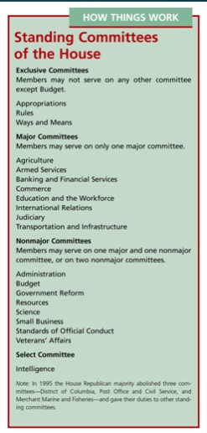
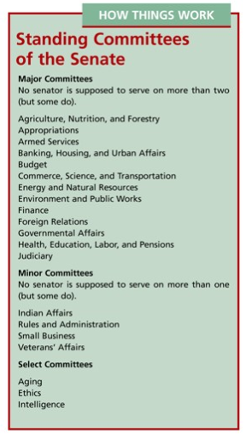

Slide 23
Which committees hold the most power?

Slide 24
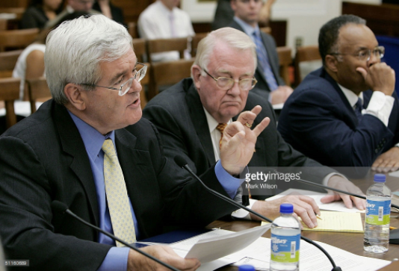
Select Committees
Groups convened for a limited purpose.
Do not produce Legislation
Usually exist for a few years
Examples: Aging, Ethics, Intelligence, Indian Affairs

Slide 25
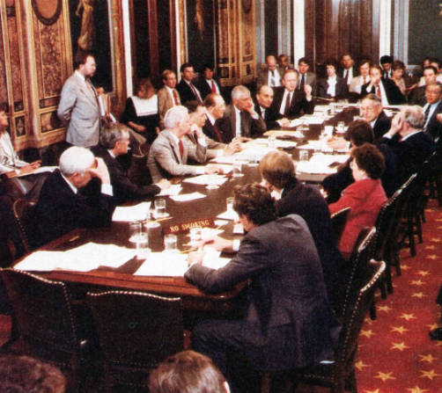
Joint Committees
Members from both the House and the Senate
Can be temporary or permanent
Does not deal directly with bills
Study groups

Slide 26
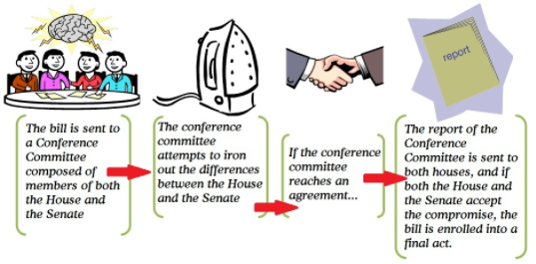
Conference Committees
A temporary committee made up of members from both houses.
Appointed to resolve House and Senate differences about a bill before its final passage.

Slide 27
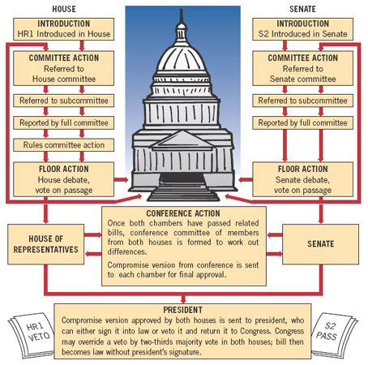
How a Bill Becomes a Law
Can be introduced in either the House or Senate, but all bills that concern revenue legislation must originate in the House.
Next, it is referred to a committee by the Speaker or the Senate’s presiding officer. Committee referrals make it harder to pass complex legislation.

