Slide 1
New Data Boot Camp

Slide 2
EIS/ SIS Manager: Things to Know
Funding is based on data uploaded to EIS per funding period
Students with Block Approval Errors do not count in ADM/ADA
Students with Fatal Errors do not count in ADM/ADA
Expelled students do not receive an ADM or ADA
Suspended students do not receive ADA
Service Only students do not count in ADM/ADA
Students missing a schedule in EIS do not count in ADM/ADA
Student Classifications count toward more/extra funding

Slide 3
EIS Reporting Workflow
Nightly Extract from SIS to EIS
Check Error Reports/Run Data Reports
Make Corrections in SIS

Slide 4
Quick Links EIS- TN Department of Education Student Membership and Attendance Procedures EIS Appendices EIS Data Dictionary EIS Extracts Layout CPM DATA MANUAL

Slide 5
Single Sign-On Dashboard

Slide 6
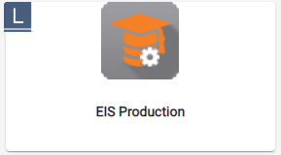
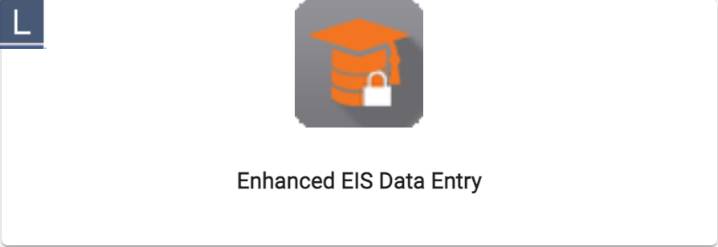
EIS Production Enhanced Data Entry
Education Information System (EIS). Contains selected state wide student, staff, class and calendar information by school year.
Gives districts the ability to track students from school to school across TN
Allows districts to look up staff licensure information
Enables districts to correct school level errors that prevent funding
Supplies districts with a means of contacting other districts

Slide 7
Error Reports on EIS
Select EIS Production on your SSO, Select the District Tab at the top of your screen, Verify your district info, & Go
On the left hand side of your screen you will see Upload Extract File, Error Reports, Block Approval Errors, Report Period Approval and Dynamic Errors.

Slide 8
Block Approval Errors on EIS
Select Block Approval Errors link
Select the School Errors link to see the block approval errors associated with each school (download all school files, calendar errors, teacher errors and student errors are available to view)

Slide 9
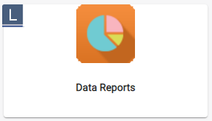
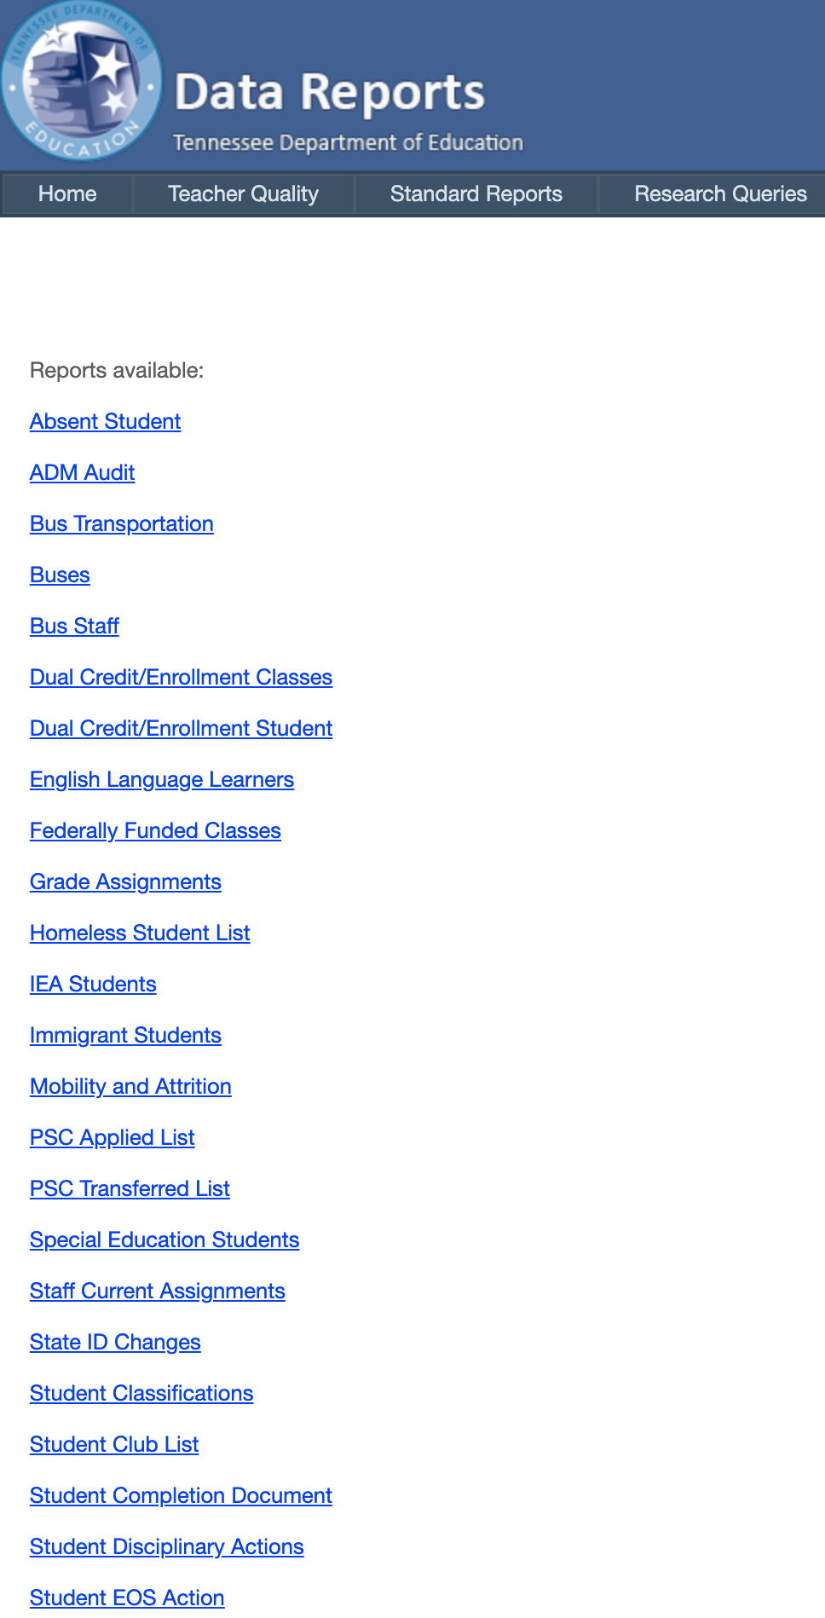
Standard Reports
Research Queries

Slide 10
ADM Audit

Slide 11
Student Membership

Slide 12
Single Sign-On User Report
The SSO User Report will be assigned for users that have an EIS Production security role of DST_AA (District EIS Approval ADM).

Slide 13
Search for Users
Download the list with or without the legacy accounts.
The Status and Login Detected column will be beneficial to District Data personnel as they work locally to confirm that staff members log-in at least one time to their SSO account.

Slide 14
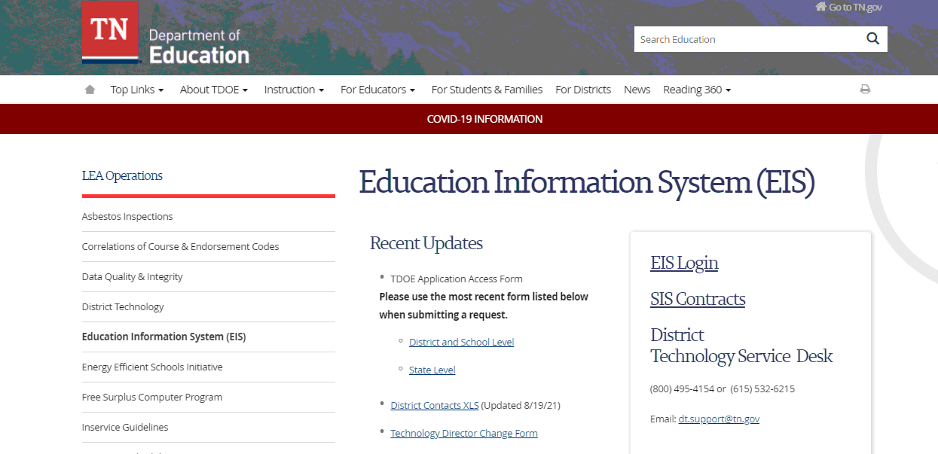
TN Department of Education (EIS)
Review and update EIS contact Information when a staff change is made.
Application Access is used to add new access, modify access and remove access for employees.

Slide 15
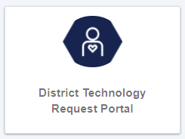
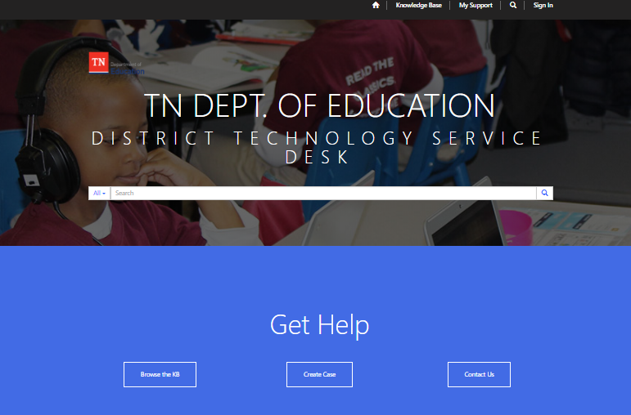
District Technology Request Portal

Slide 16
DT Support Contact Information

