Slide 1
WESTOP CENCAL TRIO DAY 2018
WELCOME TO FRESNO STATE
SATURDAY, FEBRUARY 24TH, 2018

Slide 2
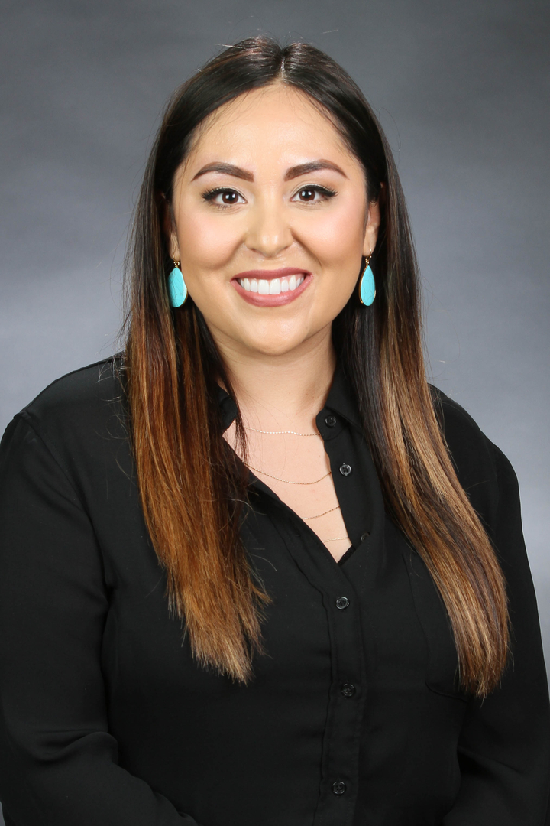
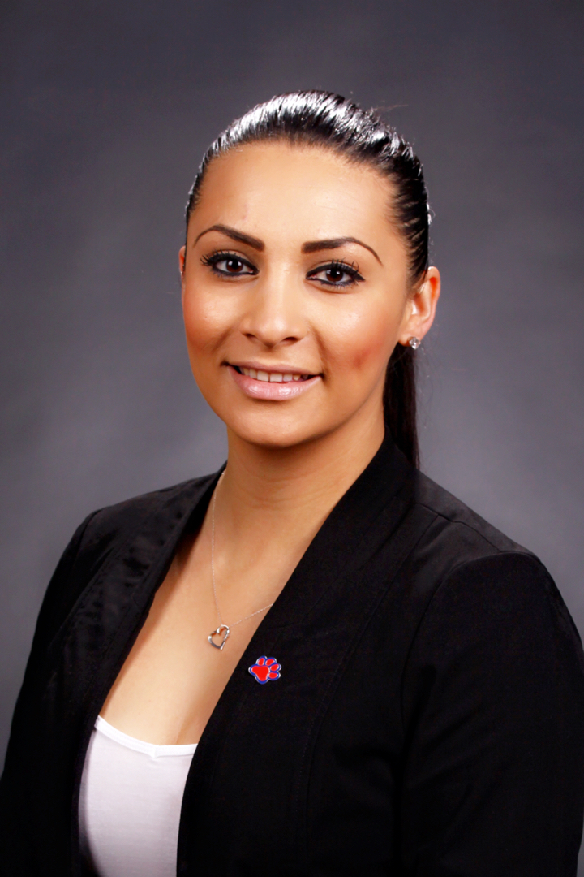
WELCOME – TRIO DAY CHAIR & CENCAL PRESIDENT
Samantha Gonzales, TRiO DAY Chair 2018
Liliana Sanchez, Cencal President 2018

Slide 3
WELCOME
COLLEGE OF THE SEQUOIAS MATH & SCIENCE UPWARD BOUND
REEDLEY COLLEGE UPWARD BOUND (2)
REEDLEY COLLEGE MATH & SCIENCE UPWARD BOUND
FRESNO CITY COLLEGE UPWARD BOUND
UC MERCED UPWARD BOUND (2)
FRESNO STATE EDUCATIONAL TALENT SEARCH (2)
FRESNO STATE UPWARD BOUND (2)
FRESNO STATE SSS & SSS VETERANS
CLOVIS COMMUNITY & MADERA CENTER SSS
UNIVERSITY OF PACIFIC UPWARD BOUND
UNIVERSITY OF PACIFIC SSS

Slide 4
AGENDA
,

Slide 5
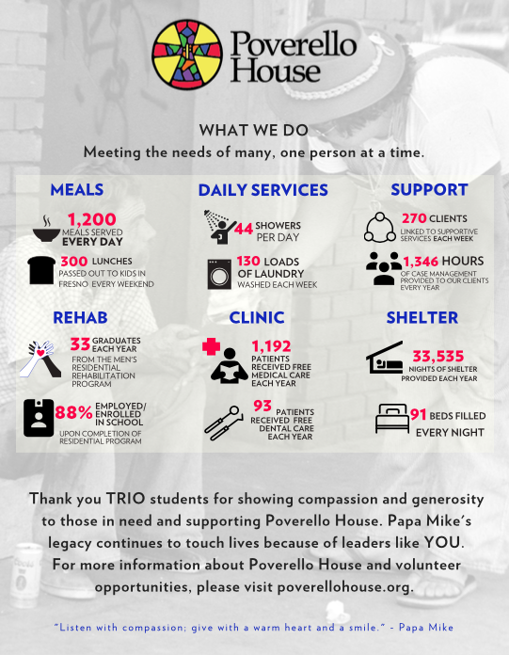
TRIO DAY: DAY OF SERVICE POVERELLO HOUSE
Care Packages & Donations
https://www.youtube.com/watch?v=3U-zrAc1x5E
https://www.youtube.com/watch?v=boGgKVgfybY

Slide 6
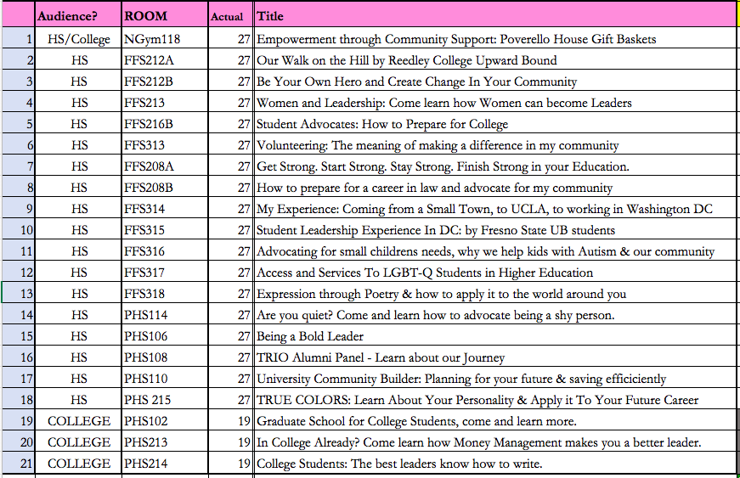
WORKSHOPS
,

Slide 7
MAP

Slide 8
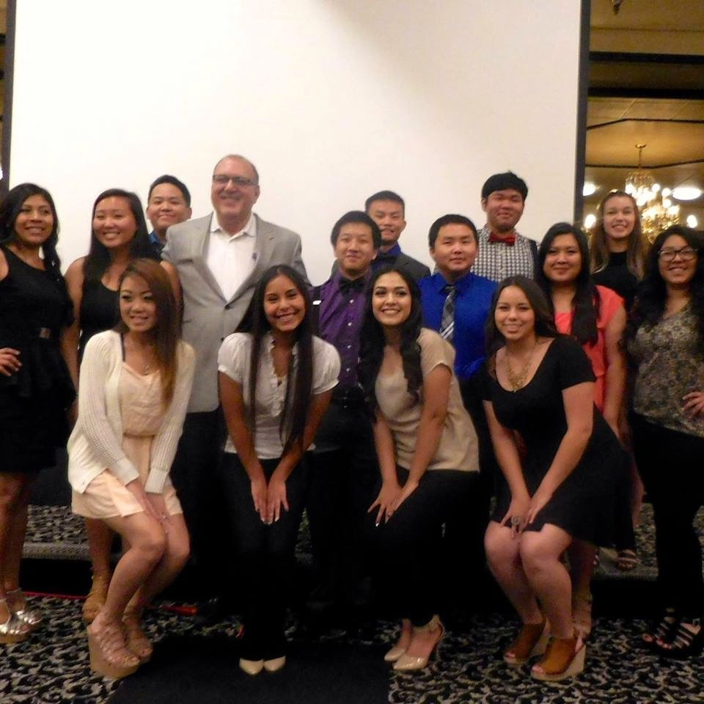
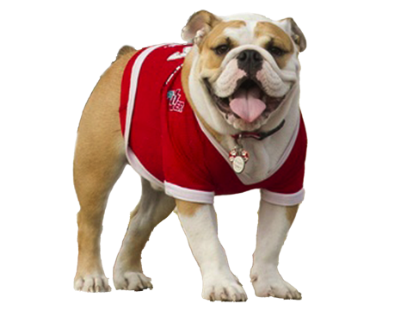
DR. FRANK LAMAS
Vice-President for Student Affairs & Enrollment Management at Fresno State
1st generation to go to college
Advocate for TRIO programs
2018 Fred Turner Award for Outstanding Service to Student Affairs Administrators in Higher Education (NASPA)

Slide 9
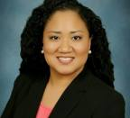
KEYNOTE SPEAKER – DR. DARLENE MURRAY
STUDENT EQUITY COORDINATOR AT REEDLEY COLLEGE
FORMER UPWARD BOUND STUDENT FROM FRESNO STATE
2015 WESTOP TRIO ACHIEVER AWARD

Slide 10
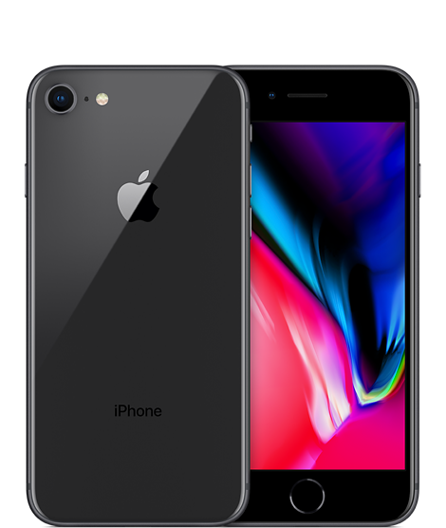
SOCIAL MEDIA & PHONES

Slide 11
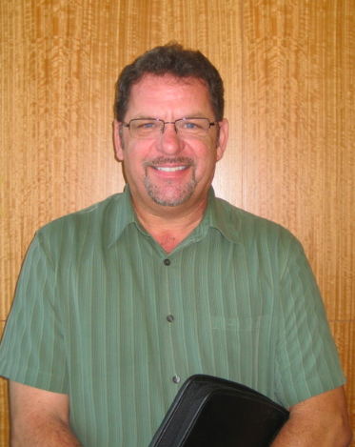
SPECIAL RECOGNITION – PERRY ANGLE
Founding Member or WESTOP Central California’s Chapter.
Helped write one of the first ELL Upward Bound’s in California & retain numerous grants as a TRIO Director
Worked in TRIO at Fresno State, CSU Monterey Bay & Fresno City College

Slide 12
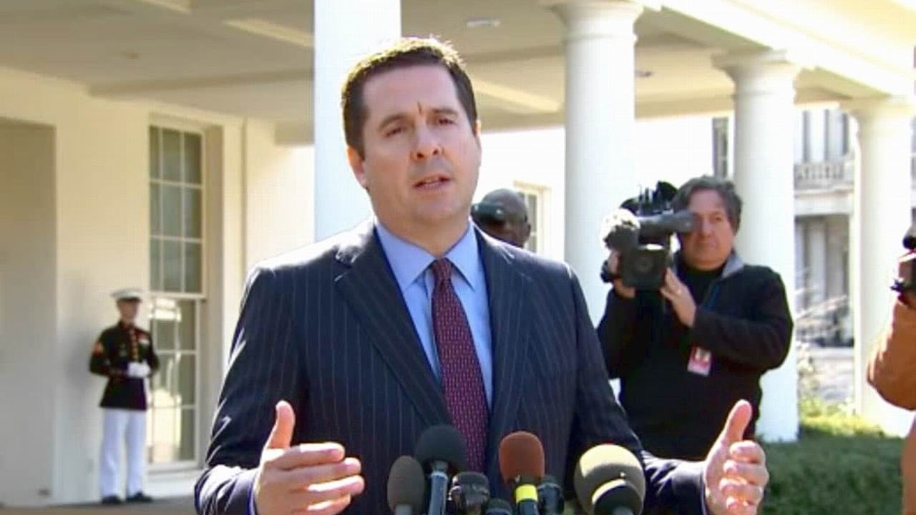
CONGRESSMAN DEVIN NUNES
Represents Fresno & Tulare Counties – 22nd District
Graduated from COS, Cal Poly San Luis Obispo
Voted for a 3% Increase in TRIO funds 2017
Representing Congressman D. Nunes today is rep Mark Blackney.

Slide 13
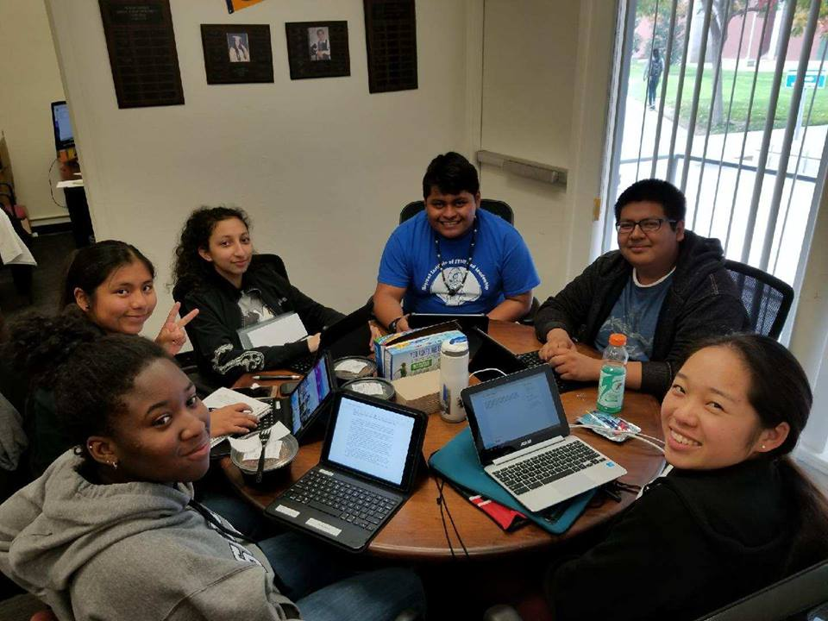
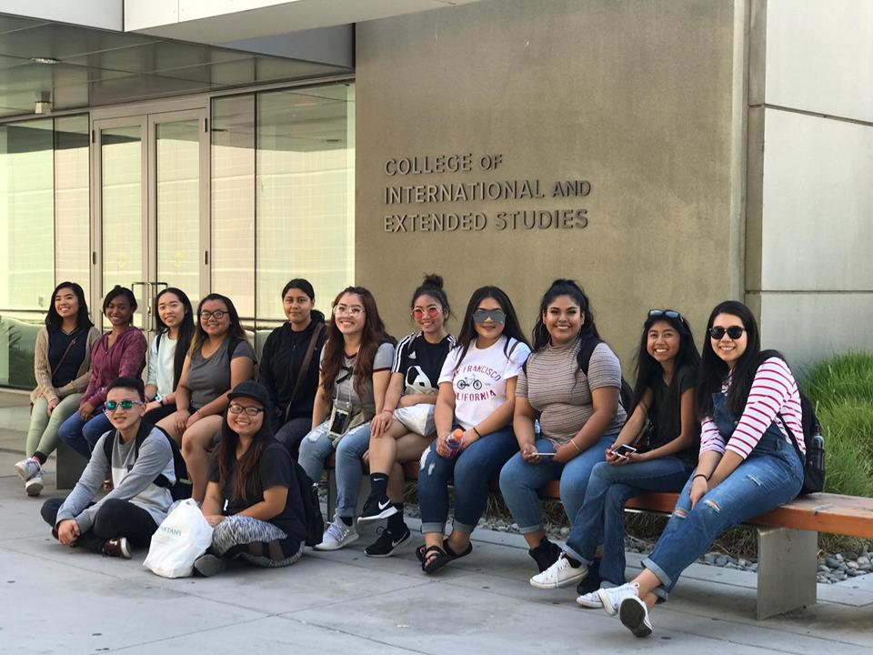
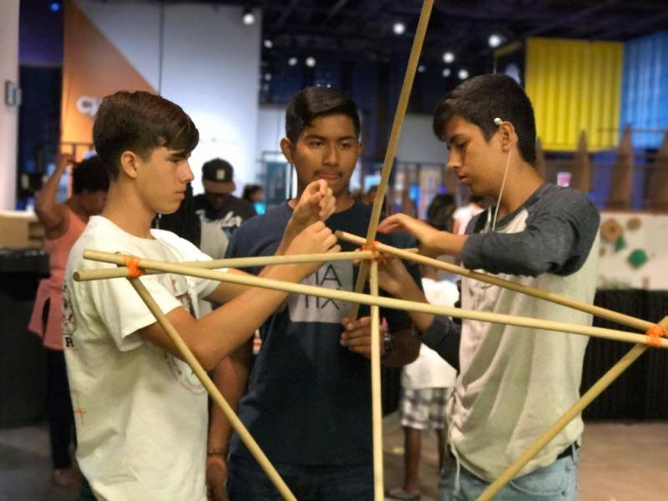
TRIO High School Students Proclamations
Madison Yang, UC Merced Upward Bound
Reedley College, Upward Bound Math & Science
Alicia Aroche, Fresno State, Educational Talent Search

Slide 14
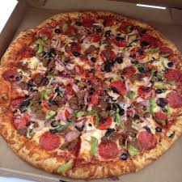
LUNCH 12-12:45 pm
Directions – Outside of North Gym 118

Slide 15
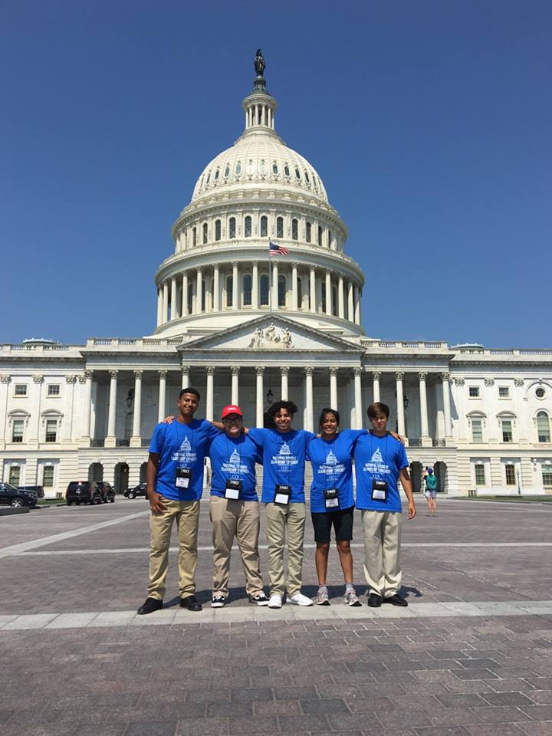
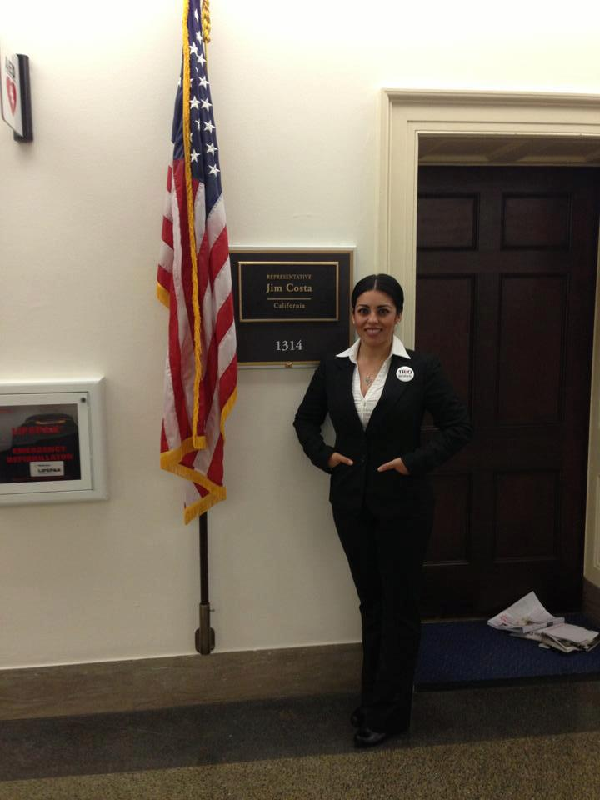
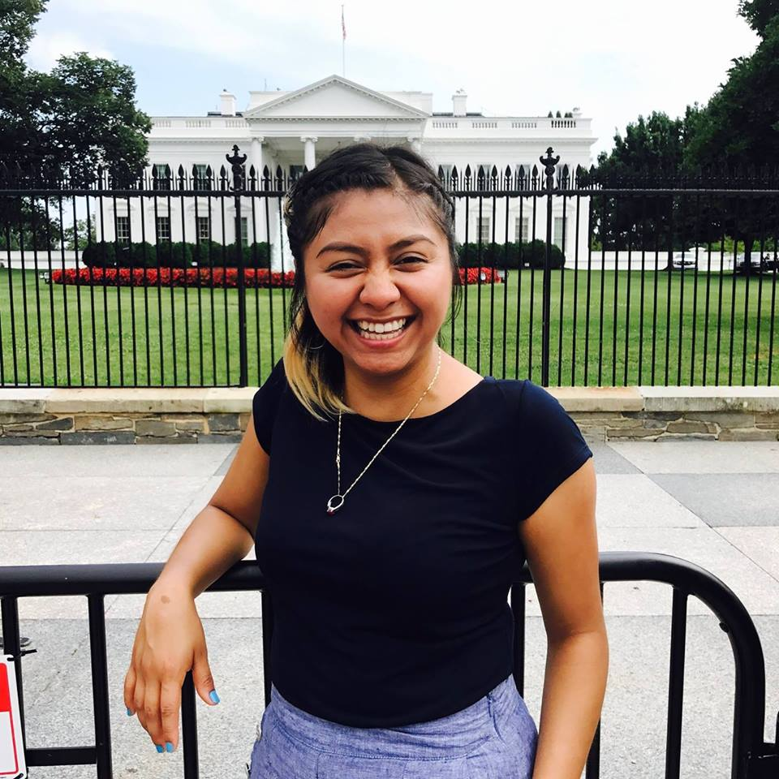
WORKSHOP SESSION II
PROSPER ACT
LETTERS TO CONGRESS –
Walking the Hill
SOCIAL MEDIA ACTIVITIES

Slide 16
What to include in your letter – Dear Congressman, `
Your name.
What program you are in.
Tell me at least 3 ways this program has helped you.
How do you feel about TRIO Programs being eliminated or cut.
How would TRIO going away impact your family, your classmates, your community.
How do you plan to be a great citizen of this nation.
Thank them for their support.

Slide 17
TRIO DAY: DAY OF SERVICE POVERELLO HOUSE
Care Packages & Donations
https://www.youtube.com/watch?v=3U-zrAc1x5E
https://www.youtube.com/watch?v=boGgKVgfybY

Slide 18
2018 CENCAL SCHOLARSHIP RECIPIENTS

Slide 19
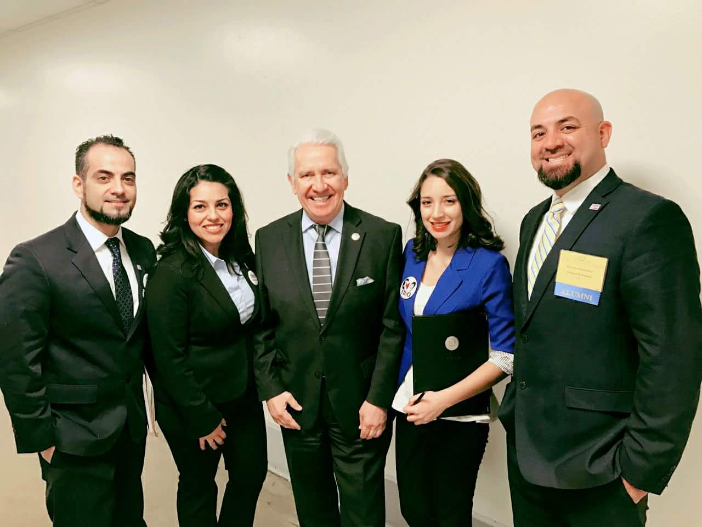
CONGRESSMAN JIM COSTA
Represents Fresno County
Fresno State Alumni
Has served on the TRIO Caucus
Comes from a family of 1st generation
VIDEO

Slide 20
Washington DC Representatives
Estefania Pacheco, Madera High School (internship in DC)
Fernando Cardenas, Alumni Coordinator at COE (Council for Opportunities in Education)
Gaby Romero & Sureima Santillan, Recent Interns at COE

Slide 21
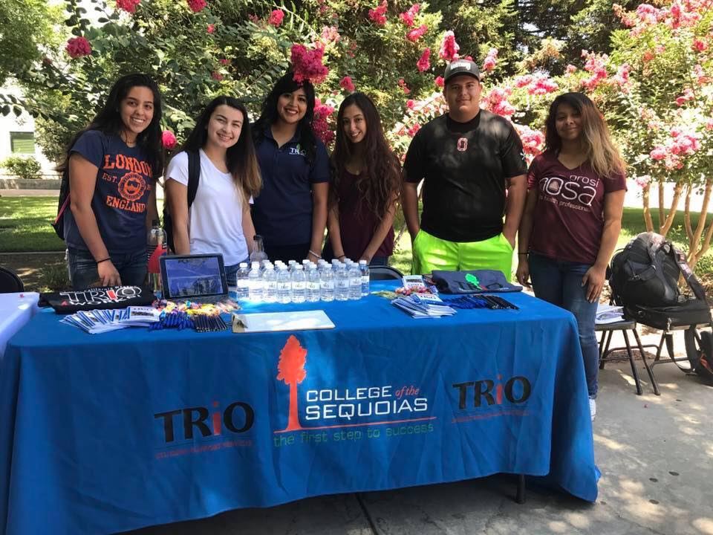
TRIO College Students Proclamations
Karina Arzate-Arenivaz, College of the Sequoias, Student Support Services
Russell Gross, Fresno State, SSS-Veterans

Slide 22
OATH - 1st ANNUAL TRADITION led by R Ricardo Marmolejo
NOW, I, ___________YOUR NAME_______________
do hereby proclaim February 24th, 2018, as National TRIO Day.
I call upon all to observe this day with ceremonies
and activities that celebrate these life- changing programs
as sources of educational access and opportunity
for low-income, first-generation students.
I will graduate.
I will give back.
I will be proud of where I came from.
I am TRIO and TRIO WORKS.
(cheer)

Slide 23
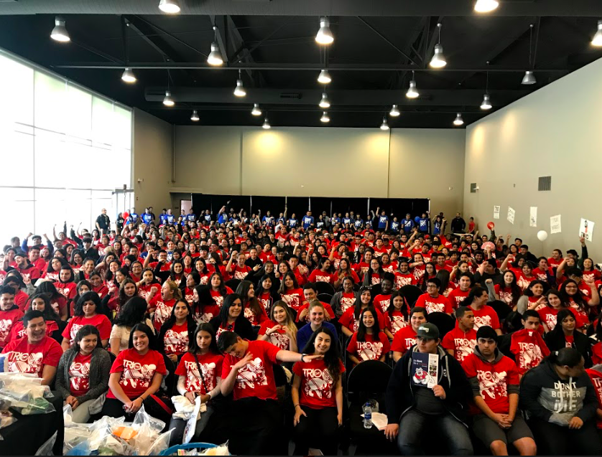
GROUP PHOTO

Slide 24
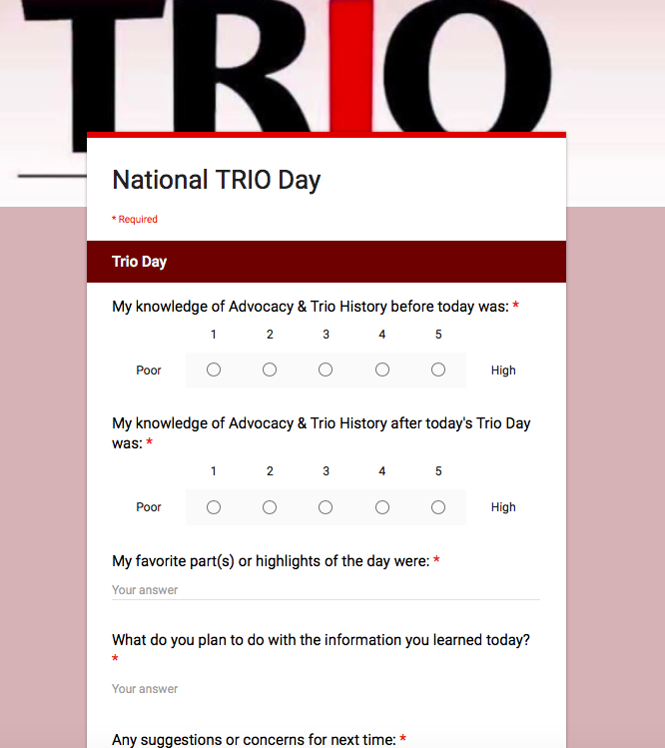
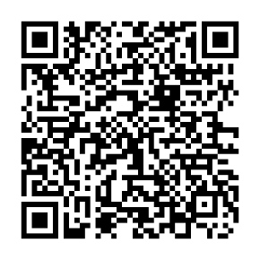
EVALUATION
WESTOPCENCAL.ORG
https://goo.gl/forms/gSLef2W6d59I3IBL2

Slide 25
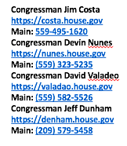
CONTACT YOUR CONGRESSMAN
Call your congressman later if you’d like to share your support for TRIO. Tell them you appreciate their commitment to TRIO programs.
Rep. Costa – Fresno City, Madera, Merced, Fresno (D)
Rep. Nunes – Fresno, Reedley, COS (R)
Rep. Dunham - Univ. of Pacific (R)

Slide 26
THANK YOU FOR ATTENDING TRIO DAY 2018

