Slide 1
2016 UTA Board Goals: Action Item on Tentative Goals
Planning & Development Committee– October 14th 2015
Notes:
Add vanpool and flex vehicles

Slide 2
Outline
Annual Board Retreat Re-Cap
Summary of Morning Session - Issues/Themes
Summary of Afternoon Session – Issues/Themes
Board Goal Setting - Policy Review
2016 Tentative Goal Recommendation from P&D

Slide 3
Old Schedule
X
P&D
FULL
BOARD

Slide 4
New Schedule
P&D
FULL
BOARD

Slide 5
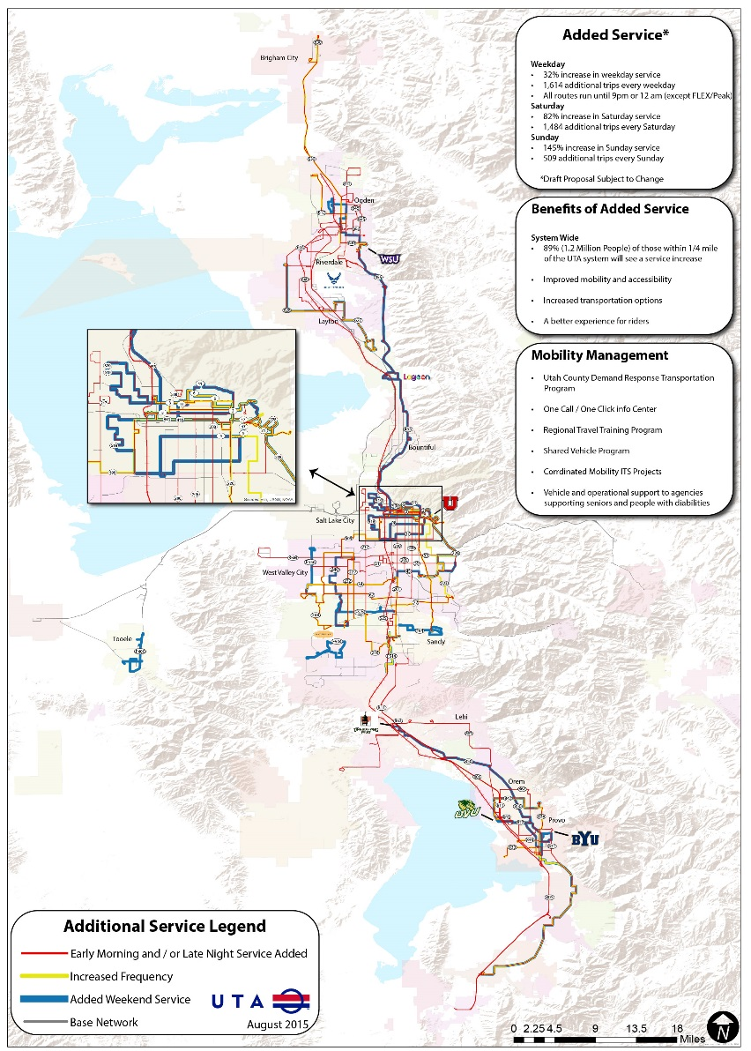
Annual Retreat Re-Cap
Morning Session
New Service Discussion & Map Exercise
Guest Panel Discussion and Q&A
Lunch Break
Executive & Staff Presentations
Afternoon Session
Trust Exercise
2016 Goal Setting Session
Wrap-up & Next Steps

Slide 6
Retreat Re-Cap
Morning Session
“New Service Concepts and Increasing Ridership”
Guest Panel Discussion & Map Exercise
Mayor Bob Stevenson, Layton City
Mayor Tom Dolan, Sandy City
Mayor Norm Searle, Riverdale City
Mayor John Curtis, Provo City
Carlton Christensen, Director of Regional Development Salt Lake County

Slide 7
Board Retreat Summary
Morning Session Issues/Themes
Northern Salt Lake County
Coordinate with Local Road Authorities
Policy Incentives can Support Good Planning
Utah County
Balancing investments with ridership
Balancing density (look for infill opportunities)
Provo-Orem BRT unique fare policy
Transit Utilization May be Improved with
Can Local Funding Come from Sources other than Taxpayers?
Branded Service (i.e. circulators) is Good First Mile/Last Mile Solutions
More Span and Frequency
Davis County
Corridor Preservation/Funding Key to Future Capital Projects
Address Growth Issues, Specifically with Respect to Geography (i.e. West Davis County)
First/Last Mile Solutions are Important
Southern Salt Lake County
Adjust Service to Shifting Job Locations in the Valley (also acknowledge shift work)
Southwestern Cities – “what’s in it for them?”
Support FrontRunner with Better Bus Service
Sandy Circulator is Important Last Mile Solution
Build “Good” Density
Tooele/Weber/Box Elder County
Acknowledge/Design for New Generation of Riders
Mobility is Important
Technology is Important
Trails/bike Paths are Important
More Local Funding is Needed (sales tax)

Slide 8
Board Retreat Summary
Morning Session Issues/Themes (cont.)
General Themes
Focus on First Mile/Last Mile Solutions
Address Changing Geographic Markets, including Job Locations
Encourage More/Better Density & TOD
More Bus Service – Frequency & Span
Look for Different Funding Sources
Address Needs/Desires of New Demographic Markets (i.e. millenials, baby boomers etc.)

Slide 9
Board Retreat Summary
Guest Panel Discussion
“We should market the benefits of working while commuting.”
Mayor Norm Searle, Riverdale City
“Using transit is based on a different ‘mindset’.”
Mayor Bob Stevenson, Layton City
“There is a changing philosophy toward transit.”
Mayor John Curtis, Provo City
“We are all now in the ‘transportation’ business.”
Carlton Christensen, Salt Lake County
“Increased service from UTA is a ‘sellable’ message to voters.”
Mayor Tom Dolan, Sandy City

Slide 10
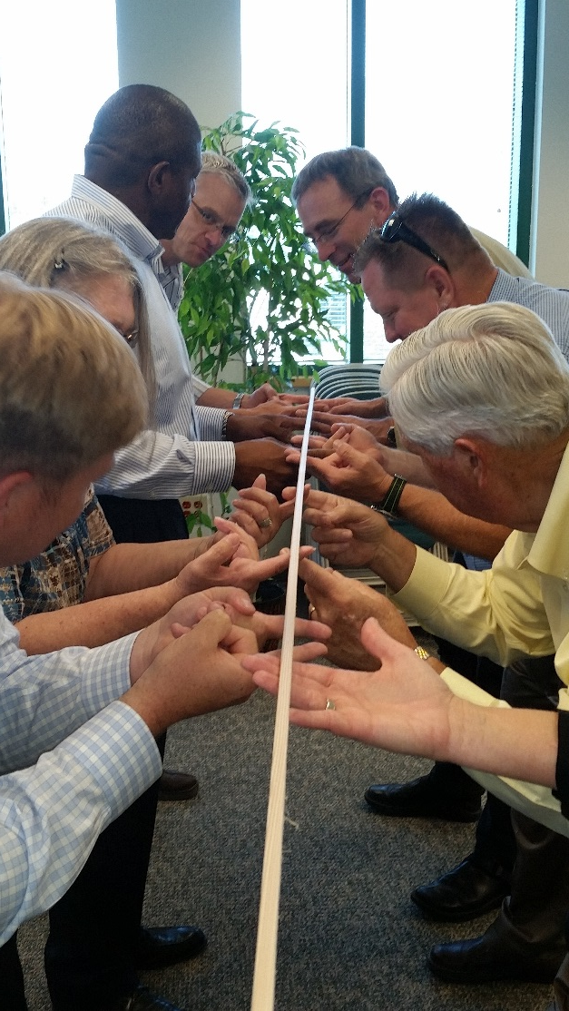
Board Retreat Summary
UTA Executive Staff Presentations
• “Creating Our Next Future”
- Michael Allegra
Staff Presentations
• Equity Analysis Report
- Matt Sibul
• TOD Update
- Steve Meyer
‘UTA Way’ Presentation and Exercise
- Kim Ulibarri

Slide 11
Board Retreat Summary
Afternoon Session – Goal Development
Table ‘A’
Ease of use for customers
Vision/goal for UTA Employees
Table ‘B’
Funding – more creative strategies
Need additional service on all modes
Need First Mile/Last Mile Strategies
Focus on core routes, improve “where they go”
TOD’s – third party transportation?
Social marketing campaign to boost demand/market driven
Accountability for UTA staff
Table ‘C’
Service – focus on reliability, employer locations
“Core/frequent” routes and technology
Accountability - to 1) stakeholders and 2) customers. Gather opinions & give feedback
Fare strategies –“a pass in every pocket”
TOD - UTA should be looking to influence the types of development
Focus on First Mile/Last Mile solutions – especially “complete streets”
Sustainability - SOGR & Safety – keep up the momentum, UTA is in “a good place”
Table ‘A’
Ease of use for customers
Vision/goal for UTA Employees
Leverage technology – make it more intuitive
UTA Mobile App
Understand and integrate other means of mobility (i.e. UBER)
Improve public image of UTA
– all stakeholders, not just customers
New ways to fund transit – be aggressive
Evaluate balance between
ridership and fare box recovery
Go after new, first time riders

Slide 12
Board Retreat Summary
Afternoon Session – Summary of Themes
Improving Public Image of UTA
Customer Focus
Market Driven Focus
Service Levels
First Mile/Last Mile Strategies
TOD
Fares/Technology
Employee Development
Funding/Financial Sustainability
Discussion
Themes
Goals
Core
Strategic
Budget

Slide 13
Retreat Themes & Topics—by Quantity
Themes
Notes:
Discussion on Customer Focus, Public Opinion, Public perception → Use the term “Public Trust and Accountability” – need for discussion

Slide 14
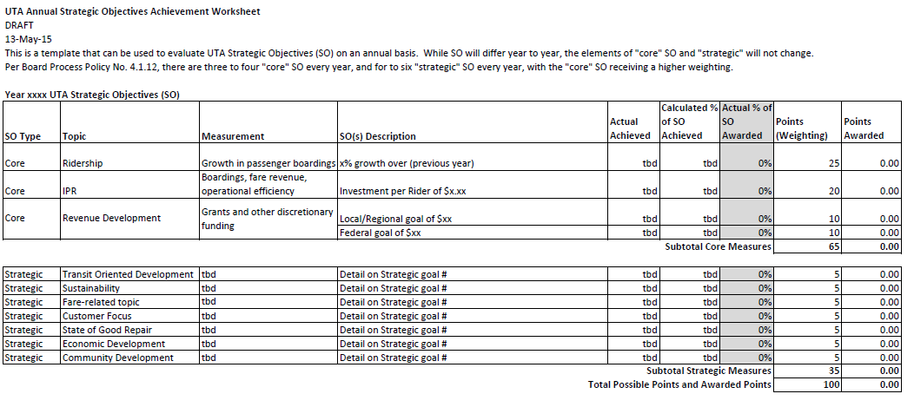
Tie-back to Process Policy
Board Process Policy 4.1.12
TEMPLATE
Strategic Objectives will change over time

Slide 15
Proposed 2016 Goal Areas
Core Goals
Strategic Goal Areas
Improve Public Trust & Accountability
Increase Ridership
Minimize Investment Per Rider (IPR)
Aggressively Pursue Revenue Development
TOD: Think Beyond UTA Property
Leverage Technology in Fares
First/Last Mile Implementation
Notes:
Discussion on Customer Focus, Public Opinion, Public perception → Use the term “Public Trust and Accountability” – need for discussion

Slide 16
Proposed 2016 Goal Areas
Core Goals
Goal | Objective | Measure | Example Strategies
Public Trust & Accountability | Provide a better connection between UTA & the community | Broadened “Companion” Benchmark Survey + Baseline Survey Score Improvement | Revised policies to strengthen and improve transparency and accountability More public involvement with Service Planning
Ridership | Grow ridership in both the short and long term | X% Annual Growth Positive 60 Month Moving Average | New targeted marketing strategy Optimize service changes
Investment per Rider (IPR) | Maximize ridership Maximize passenger revenue Lower operating costs | IPR | Incorporate ridership initiatives Promote the UTA Way across disciplines to increase efficiencies Long-term contracts with Ed/Eco pass customers
Revenue Development | Aggressively pursue outside revenue opportunities | $15.2 Million | CMAQ, TAP, STP, FTA discretionary grants, and other grant opportunities
Notes:
Discussion on Customer Focus, Public Opinion, Public perception → Use the term “Public Trust and Accountability” – need for discussion

Slide 17
Proposed 2016 Goal Areas
Core Goals
Goal | Objective | Measure | Example Strategies
Public Trust & Accountability | Provide a better connection between UTA & the community | Broadened “Companion” Benchmark Survey + Baseline Survey Score Improvement | Revised policies to strengthen and improve transparency and accountability More public involvement with Service Planning
Ridership | Grow ridership in both the short and long term | X% Annual Growth Positive 60 Month Moving Average | New targeted marketing strategy Optimize service changes
Investment per Rider (IPR) | Maximize ridership Maximize passenger revenue Lower operating costs | IPR | Incorporate ridership initiatives Promote the UTA Way across disciplines to increase efficiencies Long-term contracts with Ed/Eco pass customers
Revenue Development | Aggressively pursue outside revenue opportunities | $15.2 Million | CMAQ, TAP, STP, FTA discretionary grants, and other grant opportunities
Notes:
Discussion on Customer Focus, Public Opinion, Public perception → Use the term “Public Trust and Accountability” – need for discussion

Slide 18
Proposed 2016 Goals
Core Goal – Public Trust & Accountability
Expand the annual general public Benchmark Survey effort with a targeted companion survey focused on elected officials and stakeholders designed to probe sentiment about UTA's accountability and engagement.
Show improvement in the existing (baseline) Benchmark Survey score on the following questions:
“Overall, do you have a favorable or unfavorable impression of the Utah Transit Authority?”
“Does UTA makes good use of public funds?”
“Considering the ways public transit has changed over the past several years, are you satisfied or dissatisfied with the direction public transit is going?”

Slide 19
Proposed 2016 Goal Areas
Core Goals
Goal | Objective | Measure | Example Strategies
Public Trust & Accountability | Provide a better connection between UTA & the community | Broadened “Companion” Benchmark Survey + Baseline Survey Score Improvement | Revised policies to strengthen and improve transparency and accountability More public involvement with Service Planning
Ridership | Grow ridership in both the short and long term | X% Annual Growth Positive 60 Month Moving Average | New targeted marketing strategy Optimize service changes
Investment per Rider (IPR) | Maximize ridership Maximize passenger revenue Lower operating costs | IPR | Incorporate ridership initiatives Promote the UTA Way across disciplines to increase efficiencies Long-term contracts with Ed/Eco pass customers
Revenue Development | Aggressively pursue outside revenue opportunities | $15.2 Million | CMAQ, TAP, STP, FTA discretionary grants, and other grant opportunities
Notes:
Discussion on Customer Focus, Public Opinion, Public perception → Use the term “Public Trust and Accountability” – need for discussion

Slide 20
Proposed 2016 Goal Areas
Core Goals
Goal | Objective | Measure | Example Strategies
Public Trust & Accountability | Provide a better connection between UTA & the community | Broadened “Companion” Benchmark Survey + Baseline Survey Score Improvement | Revised policies to strengthen and improve transparency and accountability More public involvement with Service Planning
Ridership | Grow ridership in both the short and long term | X% Annual Growth Positive 60 Month Moving Average | New targeted marketing strategy Optimize service changes
Investment per Rider (IPR) | Maximize ridership Maximize passenger revenue Lower operating costs | IPR | Incorporate ridership initiatives Promote the UTA Way across disciplines to increase efficiencies Long-term contracts with Ed/Eco pass customers
Revenue Development | Aggressively pursue outside revenue opportunities | $15.2 Million | CMAQ, TAP, STP, FTA discretionary grants, and other grant opportunities
Notes:
Discussion on Customer Focus, Public Opinion, Public perception → Use the term “Public Trust and Accountability” – need for discussion

Slide 21
Proposed 2016 Goals
Core Goal – Revenue Development
Actual by Source – Non New/Small Starts
Fed. Legislative Changes – Earmarks, MAP-21
FrontLines 2015 Finished –Sale of assets decline, betterment revenue decreases until Provo-Orem BRT built

Slide 22
Proposed 2016 Goals
Core Goal – Revenue Development
Proposed Goal by Source
Diversification – Actively pursuing more sources even though there are fewer opportunities
Locally Programmed
Federal/Other Grants
$4,415,957
Project Betterments
Pay for Ops, Sponsors
$1,575,000
Federal Discretionary
Grants Directly from Federal Entity
$2,066,043
Joint/Partner Studies
and Project Dev.
$593,000
UTA Gen. Profits
Cap. Gains, Asset Sales
$6,600,000
TOTAL GOAL $15,250,000

Slide 23
Proposed 2016 Goal Areas
Strategic Goals
Goal | Objective | Measure | Example Strategies
TOD: Thinking beyond UTA Property | Help plan for more transit supportive land use at station areas | Completion of two (2) station area plans in coordination with the MPOs | Foster partnerships and jointly fund studies with cities through the MPO’s
Leverage Technology in Fares | Increase EFC use and simplify fare structure | Develop a blueprint for a comprehensive fare policy and products focused on EFC | Migrate paper passes, tokens and punch passes to EFC
First Mile/Last Mile | Implement projects identified in the First and Last Mile Study | Complete three (3) projects | Station Signage Plan Sidewalks leading to a station GREENbike regionalization Bike lane striping leading to a station
Notes:
Discussion on Customer Focus, Public Opinion, Public perception → Use the term “Public Trust and Accountability” – need for discussion

Slide 24
Proposed 2016 Goal Areas
Core Goals
Goal | Objective | Measure | Example Strategies
Public Trust & Accountability | Provide a better connection between UTA & the community | Broadened “Companion” Benchmark Survey + Baseline Survey Score Improvement | Revised policies to strengthen and improve transparency and accountability More public involvement with Service Planning
Ridership | Grow ridership in both the short and long term | X% Annual Growth Positive 60 Month Moving Average | New targeted marketing strategy Optimize service changes
Investment per Rider (IPR) | Maximize ridership Maximize passenger revenue Lower operating costs | IPR | Incorporate ridership initiatives Promote the UTA Way across disciplines to increase efficiencies Long-term contracts with Ed/Eco pass customers
Revenue Development | Aggressively pursue outside revenue opportunities | $15.2 Million | CMAQ, TAP, STP, FTA discretionary grants, and other grant opportunities
Notes:
Discussion on Customer Focus, Public Opinion, Public perception → Use the term “Public Trust and Accountability” – need for discussion

Slide 25
Proposed 2016 Goals
Core Goal - Ridership
Based on current research, staff employed a multivariate regression model and evaluated the following list of factors over the last ten (10) years that affect ridership :
Gasoline Price | Headways
Parking Cost | University Session
Population | Track Miles
Route Miles | Employment
Monthly earnings | Season
Fare Price | Climate
Revenue Miles per 1,000 Population
The model was used to analyze the elasticity of these variables on UTA ridership

Slide 26
Proposed 2016 Goals
Core Goal - Ridership
Considering all of the things that can potentially impact ridership, these factors explain 77% of that impact
Gasoline Price
Parking Cost
Population
Route Miles
Monthly earnings
Fare Price
Headways
University Session
Track Miles
Employment
Season
Climate
Revenue Miles per 1,000 Population
77%

Slide 27
Proposed 2016 Goals
Core Goal - Ridership
The following equation was used to evaluate each of the factors.
Where
€ = elasticity
X = the average of the independent variables
Y = the average of the dependent variable (ridership)
b = the regression coefficient
y = the predicted change in the dependent variable (ridership)
x1.. = the predicted change in the independent variables
Those factors which proved most significant in affecting ridership were:
Gasoline Price | Centerline Track Miles
Population
Employment
Fare Price
Revenue Miles per 1,000 Population
Fare Price
Revenue Miles per 1,000 Population

Slide 28
Proposed 2016 Goals
Core Goal - Ridership
Staff is continuing to evaluate and vet this model, including professional and academic peer reviews.
The output of the model represents a prediction of what ridership would be if NO changes were made to existing service in 2016.
The output of the model predicted a growth rate in 2016 of 1.5%
At the last P&D Committee Meeting, staff left the recommendation at between 1.5% - 2.0%
Targeted improvements were made in August 2015 which should have a positive effect in growing ridership by approximately an additional 0.75% in 2016

Slide 29
Proposed 2016 Goals
Core Goal - Ridership
Therefore, an “actionable and achievable” ridership growth goal for 2016 is:
Forecasted/expected 2016 ridership growth goal - 2.25%
Management challenge growth goal - 0.25% Total - 2.50%

Slide 30
Proposed 2016 Goals
Core Goal - Ridership
Maintain a positive 60 MMA

Slide 31
The UTA Way
Goal Setting and the UTA Way
UTA will create aligned performance goals at the department, team and individual level that support the annual board goals.

Slide 32
Schedule
P&D
FULL
BOARD

Slide 33
Thank You
Thank you.
Questions?

