Slide 1
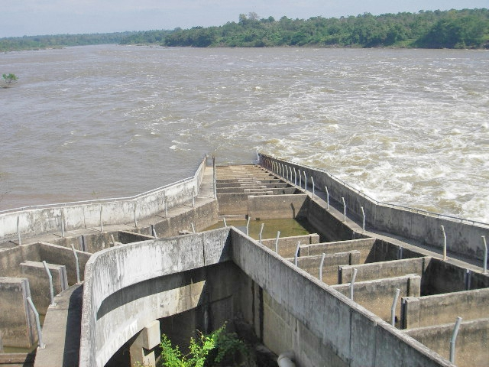
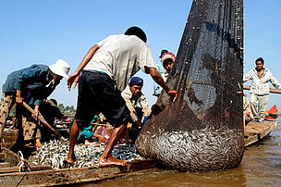
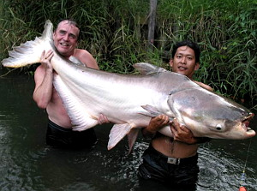
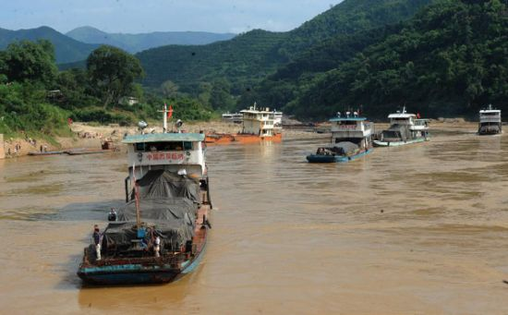
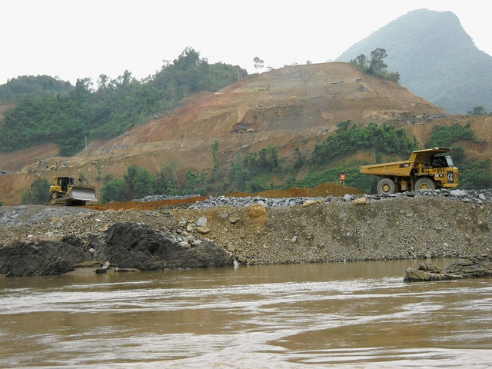
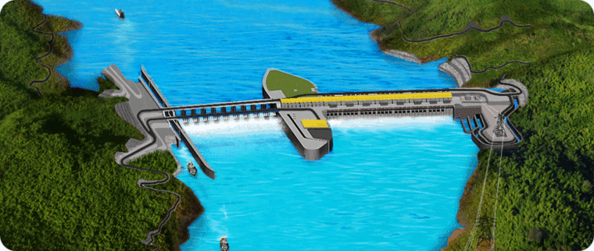
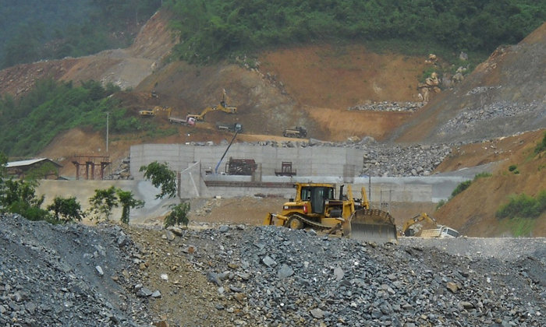
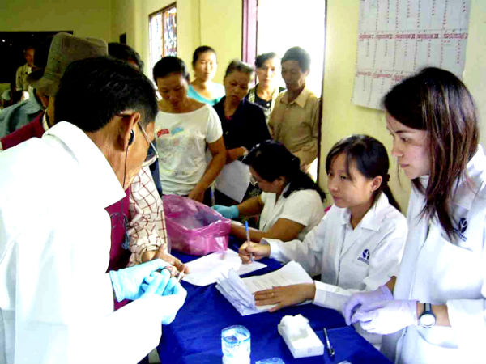
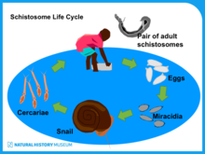
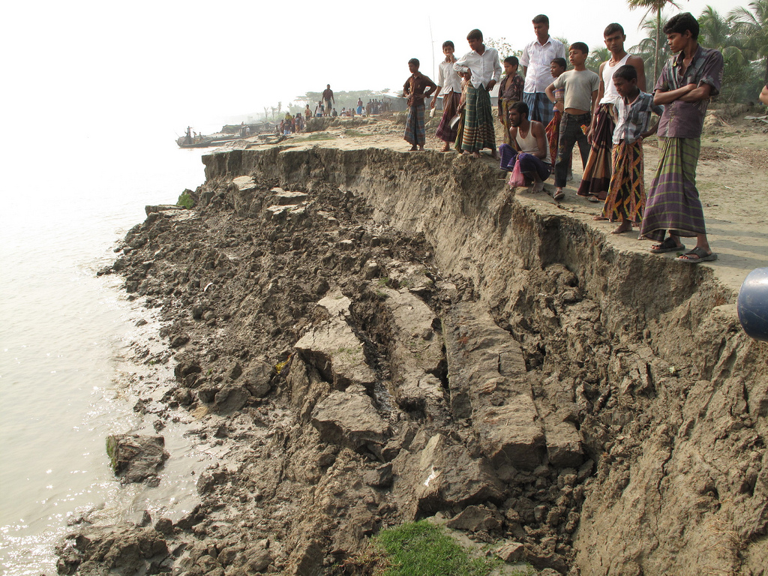
FISHERIES
Dams prevent fish migration and have a negative impact on aquatic ecosystems. Migration is needed for spawning and feeding. If it is prevented then fish stocks decline. This in turn leads to social/economic decline. Fishing tourism which is growing is also under threat.
NEEDS/GUIDANCE : Fish-ways and fish ladders need to be fully integrated into the schemes, to allow fish movement both up and down stream. It is proposed that schemes aim for 95% movement of all fish species
NAVIGATION
Navigation for vessels is needed for trade, economic benefits and development towards MDG,s and the Multiplier Effect.
NEEDS/GUIDANCE : Free navigation. Deeper water in reservoirs allows large vessels, but dams act as barriers.
Locks are needed of sufficient size allow large vessels movement and give economies of scale.
GUIDANCE ON SUSTAINABLE DAMS/HEP
SEE IF IT IS SUSTAINABLE (Social,Economic, Environmental)
XAYABURI DAM LAOS
Proposed 1260 megawatts of electricity
90% of which is expected to be exported to Thailand which gets 80% of its energy from fossil fuels at the moment
MEKONG RIVER COMMISSION
MRC
INTEGRATED MANAGEMENT PLAN
WATER QUALITY/AQUATIC ECOLOGY
Behind the dams is increased water depths, decreased water quality, loss of ecosystems and loss of biodiversity. The slow flow there retains pollution and the stagnant water lowers the oxygen content which impacts on flora and fauna.
NEEDS/GUIDANCE : Downstream flushing of pollutants and monitoring of water and equatic ecosystems. Ecological health monitoring and environmental impact assessments are essential. There may be an increase in water bourn diseases such as schistosomiasis
SEDIMENT
Dams interrupt sediment transfer which affects the downstream channel causing more erosion. Increased sedimentation in the still water of the reservoir shortens the life of the dam.
Erosion will increase in the delta area where 17 million people live and 50% of Vietnams rice is produced
NEEDS/GUIDANCE : Sediment routing, venting of turbidity currents, sediment flushing and sediment by-passes will promote the movement of sediment past the dam.
Sediment traps can be used with mechanical movement of sediment and sediment augmentation downstream

