Slide 1
Secondary Level Interventions at High School: Walking the Continuum
Jessica Swain-Bradway, Ph.D.
University of Oregon
Elizabeth Mitchell,
Springfield High School

Slide 2
Agenda
Entry Task
The need for increased supports at the high school level
School Retention Literature
Secondary Level Supports
Features
High School Considerations
CICO
CICO Plus Academic Support: High School Behavior Education Program (HS-BEP)

Slide 3
Objectives
Attendees will be able to:
Describe secondary supports as an extension of universal school-wide supports
Summarize the basic components of secondary supports
Summarize the basic components of the CICO process
Summarize how the HS-BEP builds on the CICO process
Describe general outcomes associated with CICO and HS-BEP

Slide 4
Entry Task
TRUE FALSE
TRUE? FALSE?

Slide 5
True or False?
A student drops out of high school every 26 minutes.
Family reasons (need a job to take care of family, pregnancy, etc.) are the reasons most often cited by students when asked why they dropped out.
We “know” the single most critical strategy to prevent drop out.
Notes:
Raise your hand for True / False

Slide 6
Drop Out
Approximately 30% of high school students fail to complete high school each year (Alliance for Excellent Education, 2007; Greene, 2002; United States Department of Education, National Center for Educational Statistics, 2007a).
1 student every 26 seconds
Interviews: academic failure, feeling disconnected from schools, content matter not relevant (Alliance for Excellent Education, 2008; Berktold, Geis, & Kaufman, 1998; Markow, & Scheer, 2002).
Academic failure / academic reasons
Notes:
Why do we need an intervention that targets high school students at risk? Silly question.

Slide 7
What Drop Out Costs
$10,000 less in average yearly income for students who drop out of school (HHS, 2006).
Each student who drops out costs the federal government $260,000 over course of lifetime (Rouse, 2005).
A 5% increase in graduation rates of male students alone would equate to savings of $8 billion in crime related costs (Alliance for Excellent Education, 2006).
Notes:
Drop out has individual and societal impact

Slide 8
What Problem Behavior Costs
35% of teachers indicate student misbehavior interferes with teaching (NCES, 2004).
Average “lost” instructional time per ODR:
Student- 20 minutes
Administrators – 10-45 minutes (Scott & Barrett, 2004)
Students with problem behaviors more likely to drop out than peers (Jerald, 2006; McKinney, 1989; Morrison, Anthony, Storino, & Dillon, 2001)
Notes:
I will present on predictors of DO later, as foreshodow, PB related to a strong predictor of dropout, academic failure.

Slide 9
What Problem Behavior costs
Average “lost” instructional time per ODR:
Student- 20 minutes
Administrators – 10-45 minutes (Scott & Barrett, 2004)
Spaulding et al (2009).
N = 1,500 schools
1.3 ODRs per day per 100 students, high school
+ 3,000 ODRs in school year
Lost instruction time for students:
1,000 hours for the year
5.8 in class hours (7 classes)
3,000 office referrals = 172.4 missed schools days
2,000 office referrals = 114.9 missed school days
Notes:
At GP students take 7 classes = 50 minute class periods M, T, Th, F,
W = 42 minute periods

Slide 10
Social Behavior
Academic Behavior

Slide 11
School Retention Literature
Academic and Social Connection
Notes:
Big messages from lit review, note how align with PBIS and how they implicitly and explicitly address the academic social connection

Slide 12
School Retention Literature
Adult feedback or interaction (Croninger & Lee, 2001; Dynarski, 2001; Fashola & Slavin, 1998; Hayward & Tallmadge, 1995; Kerr & Legters; Lee & Burkham, 2003; McPartland, 1994; Schargle & Smink, 2001; Sinclair, Christenson, Lehr, & Anderson, 2003; Thurlow, Christenson, Sinclair, Evelo, & Thornton, 1995)
Increase home / school connection (Dynarski, 2001; Fashol & Slavin, 1998; Sinclair, Christenson, Lehr, & Anderson, 2003; Thurlow, Christenson, Sinclair, Evelo, & Thornton, 1995)
Notes:
Not all empirically tested – suggestions that are in alignment with why students drop out of school.

Slide 13
School Retention Literature
Increase structure and predictability (Dynarski, 2000; Fashola and Slavin, 1998; Hayward and Tallmadge, 1995; Lee and Burkham, 2003; Sinclair, Christenson, Lehr, and Anderson, 2003)
Both academic and social supports (Dynarski, 2001; Fashol & Slavin, 1998; Hayward & Tallmadge, 1995; Kemple, Herlihy, & Smith, 2005; McPartland, 1994; Schargle & Smink, 2001; Thurlow, Christenson, Sinclair, Evelo, & Thornton, 1995).

Slide 14
Secondary Level Interventions
Characteristics and consideration for High Schools
Notes:
Pull out Secondary level supports

Slide 15
Secondary Level Supports
Increase structure and predictability
Increase positive adult feedback
Increase home/school communication
Rapid response/continuously available
Efficient
System for linking academic and social performance
Ongoing data collection for decision making
Notes:
IN general, these are basic characteristics of secondary supports
?? What do we really care about in HS? In 1 word?
: Graduation! Supports should be geared toward graduation.

Slide 16
High School Contexts
Academic success paramount:
Credit accrual
Proficiency tests
Graduation
Targeted systems:
Specific academic supports
Social behaviors that help students access academic success
We must actively address the academic and social connection!

Slide 17
Secondary Supports at the High School Level
Academic success is dependent upon engagement!
Supports must be sufficient to:
1- Maintain engagement
2- Accrue credits
Notes:
Specific to high school
CnC folks document the power of engagement. Mentoring model revolves around increasing engagement 1 student at a time. Time and resource intensive.
Have to be able to reach groups of students.
Supports should be available via that continuum to address all needs.

Slide 18
Maintaining Engagement
Efficiency
Effectiveness
Systems approach
Build capacity
Build on current systems / structures
Attention to function:
Escape
Intensity match
Address ALL needs:
Academic
Social
Emotional / Mental Health

Slide 19
Continuum of Supports
Continuum of Supports
Notes:
Examples of how these messages fit into the continuum in a “typical” HS.

Slide 20
Tiered Intervention Model
Notes:
TALK THROUGH EACH LEVEL
Students in need of supports have access to all supports in a continuum. Not excluded from X to get into Y. If it fits needs, they have access.
At HS can’t wait for semester change. Need mechanism for getting students support as needed: system.

Slide 21
CICO
Secondary tier intervention :
Increases adult feedback and interaction,
Daily in-class check in
Increases home school connection,
CICO card home component
Increases structure and predictability,
Predictable check-in and out
Predictable interactions with teachers
Increases feedback for behaviors
PBS foundations: explicit expectations, frequent reinforcement
Combines academic and social supports.
??
Notes:
ON the continuum…
Aligning with school retention literature

Slide 22
CICO: An exemplar
Elizabeth Mitchell, Springfield High School

Slide 23
About Springfield High
1449 students
Ethnic Diversity:
67% White,
23.5% African American,
2.2% Hispanic,
3.9% Asian,
3.1% Multi-racial,
.3% Native American
31% low income

Slide 24
Classroom Expectations
Respect Self
Bring necessary materials.
Use class time efficiently/ effectively.
Be dressed appropriately.
Respect Others
Speak in appropriate voice.
Be on time.
Allow others to experience class without disruption (including electronic devices).
Respect Property
Keep personal belongings to yourself.
Dispose of trash properly.
Treat school and student property with respect.
Notes:
From Behavior Matrix

Slide 25
Daily Progress Report
Notes:
Used Classroom Expectations to create DPR (added info to second area to account for students who might sleep …)

Slide 26
Systems Meetings
The tier 2 systems team meeting met 2 times a month for 50 minutes.
1 teachers (Tier 2 coach), external coach, pbis/counselor, 2 administrators, Special Needs Dept Chair
Review data for those receiving tier two interventions and review fidelity of implementation.
Notes:
Using Tracking Tool & MAP

Slide 27
Guiding Questions setting up the system

Slide 28
Springfield High Data Decision Rules How Do they get in?
Data-based decision rules for identification:
1) Data source #1: Office Discipline Referrals
Rule for Inclusion in Intervention: 3 ODRs for Disrespect/Flagrant Disrespect
Time frame: school year
2) Data source #2: Grades/Report Cards/Progress Reports
Rule for Inclusion in Intervention: 9th or 10th grade students with 2f’s
Time frame: each quarter
3) Data source #3:
Rule for Inclusion in Intervention: ____________________
Time frame: ____________________
** Teacher or Parent Request for Assistance enters youth : Yes

Slide 29
How does it get started?
How does a simple tier 2 intervention for a student get started?
Conversations with students; letter home & phone call to parents
What is the timeframe for the intervention?
Review every two weeks at BAS meetings
How is a student simple tier two data collected?
Initially on each floor/then on main floor
Check in
Every hour teacher is filling out DPR
Check Out
**THIS IS CHANGING DUE TO HOW STUDENTS ARE ALLOWED INTO THE BUILDING & TO SYSTEMS ISSUES (MORE ON THIS LATER ☺ )
How is a student’s data tracked?
Tracking Tool
Who enters the progress monitoring data?
Elizabeth inputs info into InfoSystem
Notes:
Timeframe…also can be by recommendation of administration and/or parent

Slide 30
How do they get out?
Data-based decision rule for defining “response”
Goal was 80% or better & participate 3 out of the 5 days over a 6 week period of time.
2010-2011
Daily Goal=50/63 points
Weekly Goal=Participate 4/5 days 80% of points
Monthly Goal=16/20 days for 4 weeks with 80% of points

Slide 31
Staff Training
Beginning of year In-Service
What is CICO?
Their role (this year 1st hr teachers-Check In/7th hr teacher-Check Out)
How students could be identified (guiding questions & Request for Assistance)
How to complete the DPR
How to interact with students (give feedback on behavior & focus on the positive)

Slide 32
Daily Progress Report
Notes:
Explain how teachers complete DPR and give feedback

Slide 33
Other info about Daily Progress Report (DPR)
Staff need reminders what an individual student is working to improve
Provides the staff a reminder to prompt the expected behaviors
Provides the staff the opportunity to provide positive feedback.
CICO is about the positive interaction between the staff and the students

Slide 34
START UP
Identified students as well as those who requested to participate and those who were referred met with a member of our Tier 2 team to go through CICO procedures
We focused on the positives of being a part of the program…
“How many of you would like someone to thank you when you do the right thing?”
Notes:
Students met w/Ryog
POSItIVEs..Thanks for doing the right thing and helping you stay on track

Slide 35
CICO Procedures
How students will get the DPR each morning
How to appropriately ask the teacher for feedback for the DPR
How the DPR should be turned in at the end of each day
Where extra DPRs can be obtained
What to do if the student has an early dismissal
Daily, Weekly, & Monthly goals and incentives
Notes:
Go over this info with students
1st hour teacher
End of each hour
7th hour
Self-Serve stations
Red Box
Goals (Daily 50/63 points---Weekly 4 of 5 days at 80%---Monthly 16/20 days 80%)

Slide 36
Parent Consent
Dear Parent/Guardian:
This letter is to inform you that your student, _________________________, has been recommended for the check-in/check-out program at Springfield High School. The check-in/check-out program is a positive intervention that allows students to start their day by checking in with an adult to promote positive behavior throughout the day. Students will also spend a few minutes at the end of each day with an adult reviewing their progress. Progress sheets may be sent home for you to review.
Social and Academic groups (SAIG) serve as a second level of positive intervention. Students will meet once a week for the last twenty minutes of a particular class period.
If you do NOT want your child to be a part of these programs, please sign below and return this paper back to the school with your child. If you have any questions about the check-in/check-out program, please feel free to contact me at XXX-3100, ext 569.
If you have any questions or would like more details regarding groups, please call Robin Y. at XXX-3109, ext. 304.
Thank you for your cooperation,
Elizabeth Mitchell
SHS Check In/Check Out Coordinator
I DO NOT want my child to participate in the check-in/check-out program and/or social and academic groups.
Parent signature:_________________________________________________
Notes:
CICO & SAIG letter of “no consent”

Slide 37
LOGISTICS
Box for kids who left early/self serve envelopes
Started table at multiple locations then moved CICO table outside cafeteria (one person at the table) with check mark on the table
2010-11 Students will Check In with their 1st hour teacher & Check Out with their last hour teacher
Notes:
How the program has evolved…It will keep changing as needed, as more students are added

Slide 38
DATA
How we do it…
What we do with it…
Who enters it…

Slide 39
How do we collect the data?
Notes:
Points for each bullet point & each hour
Box at top to total points
--added some (sleeping students)

Slide 40
What we do with it
Notes:
Monthly add to this document…on PBIS website

Slide 41
Who manages the data?
Tier two internal coach enters data daily or by end of week
Monday morning data is reviewed with the student;
Goal= 80% or better & participate 4 out of the 5 days
Notes:
Considering having data shared with students by 1st hour teacher so the teacher & student can see that taking the time / making the effort to participate is really worth it.
Also, teacher will deliver the SHLotto card ☺

Slide 42
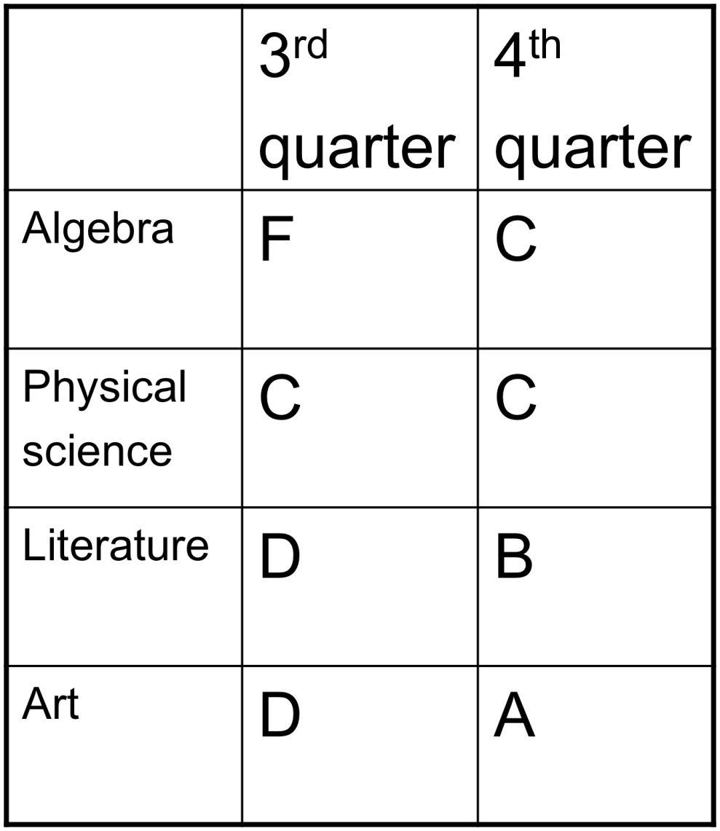
Student Data
10th grade girl
71% participation
Average DPRpoints 94.2%

Slide 43
Practices
How it actually looks
Acknowledging success

Slide 44
A day in the life of student who participates in CICO
A day of check in check out at Springfield High.
Notes:
JUST TAKE THEM THROUGH THE PROCESS OF A STUDENT DOING CICO FROM 1ST-7TH HOUR

Slide 45
Acknowledging SUCCESS
Reward at the end of the week had to have data for 3 out of 5 days (2010-11 participation is 4 out of 5 days)
Weekly Rewards~fruit snacks, chips, suckers (2010-11 SHLotto cards-immediate reward & put into a drawing)
Monthly-drive through pizza; personal pan pizza (vending fund)(2010-11 SHLotto cards-immediate reward & put into a drawing)

Slide 46
SHLotto Cards
Notes:
FREE COOKIE
FREE DRINK
PAPA JOHN’S ON OUR DAY
MONTHLY ITEM (COULD BE FOOD ITEM, COULD BE HOLIDAY ITEM, OR SHS ITEM/TICKETS)
ITEM FROM THE BAS STORE
EARLY DISMISSAL FOR LUNCH

Slide 47
The Difference
Elementary
High School

Slide 48
At high school…
Schedules have more flexibility
Number of students…think 7% of students at any given time as the target.
Don’t get overwhelmed, take baby steps. You have to start somewhere
Notes:
COULD BE BETWEEN 100-200 STUDENTS
*CAN’T LOOK AT THIS AS OUR “TRIAL” YEAR…WE NEED TO REALLY DO THIS…

Slide 49
WHAT WE LEARNED

Slide 50
What we learned
Staff training needs to be early & ongoing
False starts matter
Make decision rules and follow them (and be flexible)
Kids need to be approached positively (not punitive)
High School Kids need self serve stations
If a kid doesn’t participate it was a no-data day
Have the “let’s just try it and see how it works” mindset
If it isn’t working…look at the system

Slide 51
GOALS FOR THIS YEAR

Slide 52
Goals for this year
Staff training at beginning of year
What, why & how
How to refer a student
Other goals
Look at universal screening and be prepared to support students who have needs
Need to find something to increase kids interest at the end of ….the quarter, semester, year… to keep commitment

Slide 53
Other goals continued
Improved communication with student
Post data anonymously, now going to be online
Need to improve parent contact
Parents need to know how to access scores
Need a system of how to transition students out
Need to improve pulling data at the end of six weeks so we can improve transitions.

Slide 54
What is one thing you like about doing Check In/Check Out?: Student Comments
“Getting all three’s in your classes”-Taylor
“I like seeing how my teachers rate me for the day”-Danysiah
“It helps me stay in check. I try so hard now to get to school on time, I dress for PE just so I can get my points”-Keanna
“I like the reward we get at the end of the month”-Donta’Lisa
“Everything about it”-Aaliyha
“Everything”-Nakesha & Breanda
“Having someone wanting you to succeed”-Alischia
“It shows me how good I am doing in class and it helps and when I forget (my sheet) she always sees me in the hallway and I always thank her for one. I am thankful”-Dakota
“Just knowing that I’m dong good in my classes without have to check the school’s website”-Vincent

Slide 55
Student Comments
“I stay out of trouble”-Tommie
“It keeps me motivated to go prepared to class with a good attitude so I can get all of my points”-Mackenzie
“Seeing how good we do in class”-Joe
“I accomplish things for rewards”-Dontrell
“It makes you a heck of a lot responsible, gets you going, and makes you want to do good and to have teachers that care and want you to have check in check out done”-Michaelle
“Accomplishments”-Logan
“The rewards and to see the progress I’m making”-Bre’Ona
“We get rewards for good behavior in class”-Ken
“When I do good I get told positive things and I get rewarded”-Abby
“It feels good to see 3’s and it just makes me do good like that all the time.” –Brittany

Slide 56
EXIT INTERVIEW
Name: ________________________
Grade: ___
Date: _____
CheckIn/CheckOut Exit Survey
Please take a few minutes and answer the following questions…
1. What did you like about doing CICO?
2. Was there anything you did not like about CheckIn/CheckOut?
3. What changes do you suggest we make to the CICO program, if any?
4. How are you going to continue to get successful grades without the CICO program?
5. How will you continue to be successful with positive behavior without the CICO program?
6. What skills did you learn that you plan to use in the future?

Slide 57
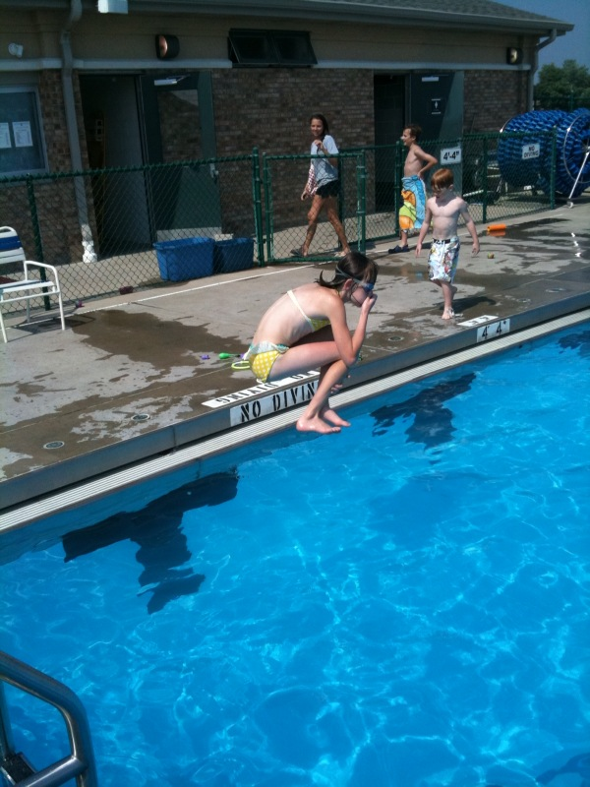
Hold your nose & just jump

Slide 58
Contact information
Elizabeth Mitchell
emitch@springfield.k12.il.us
Springfield High School
101 S. Lewis
Springfield, Illinois 62704
Springfield Public Schools

Slide 59
CICO + School Adjustment Supports

Slide 60
Continuum of Support
Academic Support: skill building / homework
CICO
Additional Check-in (lunch / study hall)
Social Emotional Supports
Academic Support
CICO
Additional Check-in
Academic Support
CICO
Academic Support

Slide 61
High School Behavior Education Program (HS-BEP, Swain-Bradway, 2009)
45 minute class
5 minutes: Entry Task, Check-In
15 minutes skill building: foundational organizational skills
25 minutes supported homework completion: application of organizational skills to homework activities
Daily class
First period of the day
Student participates in CICO cycle
First period HS-BEP class serves as morning check-in period
HS-BEP teacher coordinates CICO

Slide 62
HS-BEP
Increases adult feedback and interaction,
Smaller class size than typical content area classroom
Daily in-class check in
Small group instruction / support within class
Increases home school connection,
Parent letters
CICO card home component
Increases structure and predictability,
Self-management / academic access skills
Increases “conversation” between content area and HS-BEP teachers
Predictable check-in and out
Predictable interactions with teachers
Increases feedback for behaviors
PBS foundations: explicit expectations, frequent reinforcement
Combines academic and social supports.
HS-BEP curriculum: academic access skills
Direct supports to complete homework
Direct supports to organize for work completion
Notes:
Academic skills are immediate access skills, how to survive high school skills:
skills that allow access to academic tasks, assignment completion, if you know when an assignment is due more likely to hand it in, if you can get assistance with homework completion more likely to complete it.
NOT long term acquisition skills: students waiting for an appreciable difference in their reading ability will be waiting a long time. The academic skills and support should be sufficient to increase student engagement in academic tasks (decrease punishers, access to natural reinforcers).

Slide 63
HS-BEP Foundation Skills
Planner
Notebook
Graduation plan
Goal setting
Tracking progress
Test taking
Study skills

Slide 64
HS-BEP: An Exemplar
Contributions from Judy Kerner,
Churchill High School
Eugene, OR

Slide 65
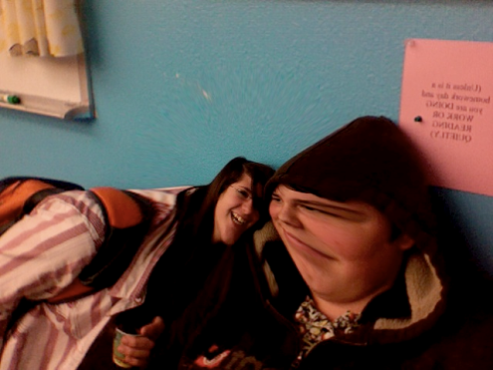
Identifying Students
Students who enter 9th grade with a “drop-out marker” (Jerald, 2006):
Poor classroom behavior
Failing English and / or math
Students identified as lacking organizational skills
Target 9th graders
With and without IEPs
Appropriate academic placement
Read Right, Math Foundations, etc.

Slide 66
Basic Components
Academic and Support
Organizational/ Study Skills
Homework Completion
Social Support
Goal Setting
Social behaviors that impact academic achievement
Tracking Progress
Academic
CICO
Connections between:
Students ➔HS-BEP ➔ Content teachers

Slide 67
Organization / Study Skills: HS-BEP Foundation
Planner
Notebook
Graduation plan
Goal setting
Tracking progress
Test taking
Study skills

Slide 68
September 2, 2009 Today’s goals: 1. Demonstrate active listening 2. Complete at least 1 missing assignment
D.E.T. / Warm-up: Write a story recounting what you did this morning up to get prepared for school, starting with the moment your eyes opened and ending when you walked out the front door. Be descriptive
Lecture with note taking: How to be an active listener
Practice and Evaluate: Tell the story of your morning to a partner, then evaluate their listening skills
Planner Popcorn
Set homework goal
Homework
Exit write: Name an active listening skill that comes easily to you, and one you need to work hard at
Notes:
Modify this slide for SOPBS

Slide 69
Measuring Outcomes
Gauging climate through student behavior
Office referrals
Classroom discipline (teacher detention, hallway conferences, etc.)
Pre and post surveys completed by students
HS-BEP grades
Content area grades
Attendance
Teacher feedback
Surveys (Survey Monkey)
“Check-in” emails
SWIS and CICO data

Slide 70
Key Components
Alignment with Small Learning Communities
Communication with 9-10 Teachers
Staff knowledgeable about HS-BEP class
Strong Universal PBIS system
Tiered supports
Administrative team support
Data for decision making
Collaboration with other schools / programs
On site Professional Development
HS-BEP staff
Content area staff

Slide 72
Data from ‘08-’09 School Year

Slide 73
Academic Engagement Data, Participants
Notes:
CICO Embedded in HS-BEP class
Routines in HS-BEP mimic CICO cycle:
Individual check-ins with teacher during each class
Review of student goals
Adult follow-up on academic tasks
Frequent updates sent home

Slide 74
Academic Engagement Data, Composites

Slide 76
Exit Activity: Continuum Audit
Identify the current supports available with your school for students with at-risk behaviors:
Advisory
Freshman Seminar
Reading / math supports
Can you clearly identify the continuum?
Do all students have access?
What conversation, questions, concerns can you take back to your team?
Be prepared to share.

Slide 77
Thank You!
Thank you for coming to Chicago to take part in the Leadership Forum.
Thank you for participating in our session!
Jessica Swain-Bradway
jswainbr@uoregon.edu
Elizabeth Mitchell
emitch@springfield.k12.il.us

Slide 78
Contact information
Elizabeth Mitchell
emitch@springfield.k12.il.us
Springfield High School
101 S. Lewis
Springfield, Illinois 62704
Springfield Public Schools

