Slide 1
Considerations for Mathematics Intervention

Slide 2
Contact Information
Sarah Powell, Ph.D
The University of Texas at Austin
srpowell@austin.utexas.edu
@sarahpowellphd
119

Slide 3
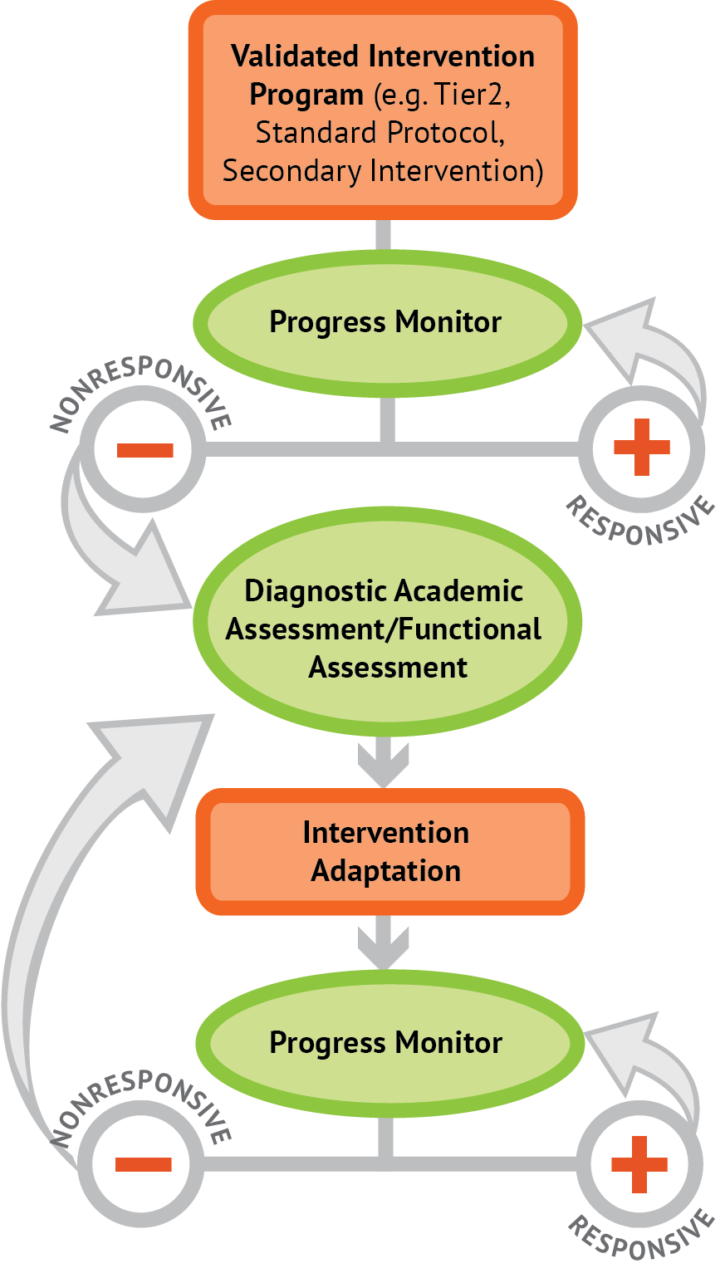
Intervention: Occurs frequently and with intensity
Assessment: Formative
Assessment: Diagnostic
Intervention adaptation: Content, dosage, explicit instruction, attention to transfer
Assessment: Formative

Slide 4
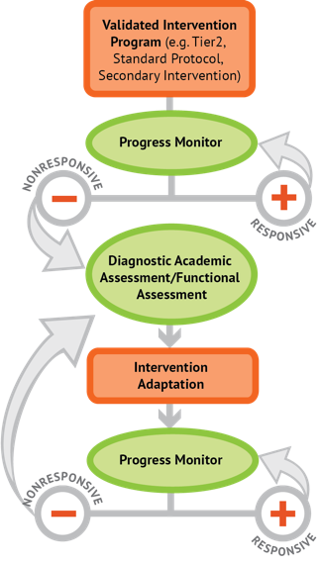
Instructional Platform
INSTRUCTIONAL DELIVERY
Explicit instruction
Multiple representations
Concise language
INSTRUCTIONAL STRATEGIES
Fluency building
Problem solving instruction
Motivation component

Slide 5
Explicit Instruction
Modeling
Practice
Clear Explanation
Guided
Practice
Planned
Examples
Independent Practice
Supporting Practices
Asking the right questions
Eliciting frequent responses
Providing immediate specific feedback
Maintaining a brisk pace

Slide 7
Goal and importance
“Today, we are learning about division. This is important because sometimes you have to share objects or things with your friends.”
Modeling
Practice
Clear Explanation
Guided
Practice
We Do
Planned
Examples
Independent Practice
“Let’s continue working with our three-dimensional shapes and volume. Understanding volume and calculating volume helps with measuring capacity.”
You Do
Supporting Practices
Asking the right questions
Eliciting frequent responses
Providing immediate specific feedback
Maintaining a brisk pace
Copyright 2018 Sarah R. Powell, Ph.D.

Slide 8
Goal and importance
Model steps
Modeling
Practice
Clear Explanation
Guided
Practice
“To solve 26 plus 79, I first decide about the operation. Do I add, subtract, multiply or divide?”
We Do
Planned
Examples
Independent Practice
“The plus sign tells me to add. So, I’ll add 26 plus 79. I’ll use the partial sums strategy. First, I add 20 plus 70. What’s 20 plus 70?”
You Do
Supporting Practices
“20 plus 70 is 90. I write 90 right here.”
Asking the right questions
Eliciting frequent responses
Providing immediate specific feedback
Maintaining a brisk pace
“Then I add 6 plus 7. What’s 6 plus 7?”
“6 plus 7 is 13. So, I write 13 here.”
“Finally, we add the partial sums: 90 and 13. 90 plus 13 is 103. So, 26 plus 79 equals 103.”
Copyright 2018 Sarah R. Powell, Ph.D.

Slide 9
Goal and importance
Model steps
Modeling
Practice
Clear Explanation
Concise language
Guided
Practice
We Do
Planned
Examples
Independent Practice
“To solve 26 plus 79, I first decide about the operation. Do I add, subtract, multiply, or divide?”
You Do
“The plus sign tells me to add. So, I’ll add 26 plus 79. I’ll use the partial sums strategy. First, I add 20 plus 70. What’s 20 plus 70?”
Supporting Practices
Asking the right questions
Eliciting frequent responses
Providing immediate specific feedback
Maintaining a brisk pace
“20 plus 70 is 90. I write 90 right here under the equal line.”
“Then I add 6 plus 7. What’s 6 plus 7?”
“6 plus 7 is 13. So, I write 13 here.”
“Finally, we add the partial sums: 90 and 13. 90 plus 13 is 103. So, 26 plus 79 equals 103.”
Copyright 2018 Sarah R. Powell, Ph.D.

Slide 10
Examples
“Today, we are learning about division. This is important because sometimes you have to share objects or things with your friends.”
Modeling
Practice
Clear Explanation
Guided
Practice
24 / 6
We Do
35 $)$ 5
28 $÷$ 7
Planned
Examples
Independent Practice
You Do
Supporting Practices
Asking the right questions
Eliciting frequent responses
Providing immediate specific feedback
Maintaining a brisk pace
Copyright 2018 Sarah R. Powell, Ph.D.

Slide 11
Examples
“Today, we are learning about division. This is important because sometimes you have to share objects or things with your friends.”
Modeling
Practice
Clear Explanation
Guided
Practice
24 / 6
We Do
35 $)$ 5
28 $÷$ 7
Planned
Examples
Independent Practice
You Do
With non-examples
Supporting Practices
Asking the right questions
Eliciting frequent responses
Providing immediate specific feedback
Maintaining a brisk pace
32 $÷$ 8
42 $÷$ 7
25 $−$ 5
Copyright 2018 Sarah R. Powell, Ph.D.

Slide 12
Explicit Instruction
Modeling
Practice
Clear Explanation
Guided
Practice
Planned
Examples
Independent Practice
Supporting Practices
Asking the right questions
Eliciting frequent responses
Providing immediate specific feedback
Maintaining a brisk pace
Copyright 2018 Sarah R. Powell, Ph.D.

Slide 13
I Do
Modeling
Practice
Clear Explanation
Guided
Practice
Planned
Examples
Independent Practice
Supporting Practices
Asking the right questions
Eliciting frequent responses
Providing immediate specific feedback
Maintaining a brisk pace
Copyright 2018 Sarah R. Powell, Ph.D.

Slide 14
Teacher and student practice together
I Do
Modeling
Practice
Clear Explanation
Guided
Practice
Planned
Examples
Independent Practice
Supporting Practices
Asking the right questions
Eliciting frequent responses
Providing immediate specific feedback
Maintaining a brisk pace
Copyright 2018 Sarah R. Powell, Ph.D.

Slide 15
Teacher and student practice together
I Do
Student practices with teacher support
Modeling
Practice
Clear Explanation
Guided
Practice
Planned
Examples
Independent Practice
Supporting Practices
Asking the right questions
Eliciting frequent responses
Providing immediate specific feedback
Maintaining a brisk pace
Copyright 2018 Sarah R. Powell, Ph.D.

Slide 16
Explicit Instruction
Modeling
Practice
Clear Explanation
Guided
Practice
Planned
Examples
Independent Practice
Supporting Practices
Asking the right questions
Eliciting frequent responses
Providing immediate specific feedback
Maintaining a brisk pace
Copyright 2018 Sarah R. Powell, Ph.D.

Slide 17
I Do
Modeling
Practice
Clear Explanation
Guided
Practice
We Do
Planned
Examples
Independent Practice
You Do
Supporting Practices
Asking the right questions
Eliciting frequent responses
Providing immediate specific feedback
Maintaining a brisk pace
Copyright 2018 Sarah R. Powell, Ph.D.

Slide 18
I Do
Modeling
Practice
Clear Explanation
Guided
Practice
Low-level and high-level
We Do
Planned
Examples
Independent Practice
You Do
“What is 7 times 9?”
“Which shape has 6 sides?”
Supporting Practices
“What do you do when you see a word problem?”
Asking the right questions
Eliciting frequent responses
Providing immediate specific feedback
Maintaining a brisk pace
“Why do you have to regroup?”
“How would you solve this problem?”
“Why do you have to use zero pairs?”
Copyright 2018 Sarah R. Powell, Ph.D.

Slide 19
I Do
Modeling
Practice
Clear Explanation
Guided
Practice
Low-level and high-level
We Do
Planned
Examples
Independent Practice
You Do
Classwide, individual, partner, write on paper, write on whiteboard, thumbs up, etc.
Supporting Practices
Asking the right questions
Eliciting frequent responses
Providing immediate specific feedback
Maintaining a brisk pace
“Turn and discuss the formula for perimeter with your partner.”
“Write the multiplication problem on your whiteboard.”
“In your math journal, draw a picture to help you remember to term parallelogram.”
Copyright 2018 Sarah R. Powell, Ph.D.

Slide 20
I Do
Modeling
Practice
Clear Explanation
Guided
Practice
Low-level and high-level
We Do
Planned
Examples
Independent Practice
You Do
Classwide, individual, partner, write on paper, write on whiteboard, thumbs up, etc.
Supporting Practices
Asking the right questions
Eliciting frequent responses
Providing immediate specific feedback
Maintaining a brisk pace
Affirmative and corrective
“Good work using your word-problem attack strategy.”
“Let’s look at that again. Tell me how you added in the hundreds column.”
Copyright 2018 Sarah R. Powell, Ph.D.

Slide 21
I Do
Modeling
Practice
Clear Explanation
Guided
Practice
Low-level and high-level
We Do
Planned
Examples
Independent Practice
You Do
Classwide, individual, partner, write on paper, write on whiteboard, thumbs up, etc.
Supporting Practices
Asking the right questions
Eliciting frequent responses
Providing immediate specific feedback
Maintaining a brisk pace
Affirmative and corrective
Planned and organized
Copyright 2018 Sarah R. Powell, Ph.D.

Slide 22
Modeling
Practice
Supporting Practices
Introduction of material
Review of material
Modeling
Practice
Modeling
Practice
Supporting Practices
Supporting Practices

Slide 23
How do you use explicit instruction within intensive intervention?
Model steps using concise language
Provide guided practice opportunities
Provide independent practice opportunities
Use supporting practices during modeling and practice
Ask the right questions
Elicit frequent responses
Provide feedback
Be planned and organized

Slide 24
Multiple Representations
Abstract
Representational
Concrete

Slide 25
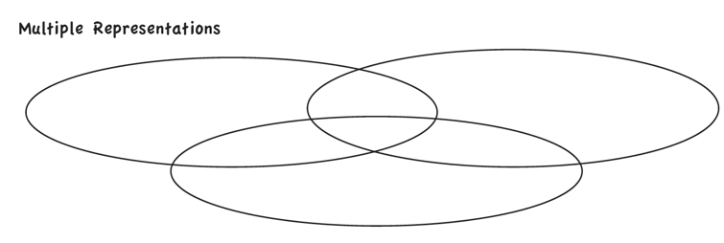

Slide 26
Abstract
Representational
Concrete
Three-dimensional objects

Slide 27
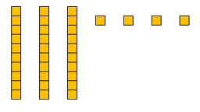
Abstract
Representational
Concrete
Two-dimensional images

Slide 28
Abstract
Representational
Concrete
Numerals and symbols
2 + 8 = 10
34 = 3 tens and 4 ones
x – 6 = 8
4,179
+ 569

Slide 29
How should multiple representations be used within intensive intervention?
Use three-dimensional concrete materials to teach concepts and procedures
Use two-dimensional representations to teach concepts and procedures
Ensure students understand mathematics with numbers and symbols (i.e., the abstract)

Slide 30
Focus on Language
precise
concise

Slide 31
Language of Mathematics
Technical terms
Subtechnical terms
Symbolic terms
General terms
trapezoid
rhombus
numerator
addend
subtract
base
degrees
cube
plane
arc
plus
zero
twelve
dollars
and
above
measure
answer
longest
outside

Slide 32
Instead of…
Say…
“And the last one is 10.”
“8, 9, 10. We’ll stop counting there but we could count more.”
“What number is in the tens place?”
“What digit is in the tens place?”
“Six hundred and forty-eight”
“Six hundred forty-eight”
“Bigger number and smaller number”
“Number that is greater and the number that is less”
Hughes et al. (2016)

Slide 33
Instead of…
Say…
“Numbers in the fraction”
“This fraction is one number.”
“Top number and bottom number”
“Numerator and denominator”
“Reduce”
“Find an equivalent fraction”
“One point two nine”
“One and twenty-nine hundredths”
Hughes et al. (2016)

Slide 34
Instead of…
Say…
“Corner”
“Angle”
“Flips, slides, and turns”
“Reflections, translations, and rotations”
“Box or ball
“Cube or sphere”
“Long hand and short hand”
“Minute hand and hour hand”
Hughes et al. (2016)

Slide 35
precise
“The denominator is the number of equal parts that make the whole.”
“A difference problem is two amounts compared for the difference.”
“To show the fraction, look at the denominator. A denominator of 5 means I need to break the whole into 5 equal parts.”
concise
“To use partial sums, add the hundreds, then add the tens, then add the ones. Finally, add all the partial sums.”

Slide 37
How do you attend to language within intensive intervention?
Understand why formal mathematical language is important
Plan for mathematical language to be precise
Plan for mathematical language to be concise

Slide 38
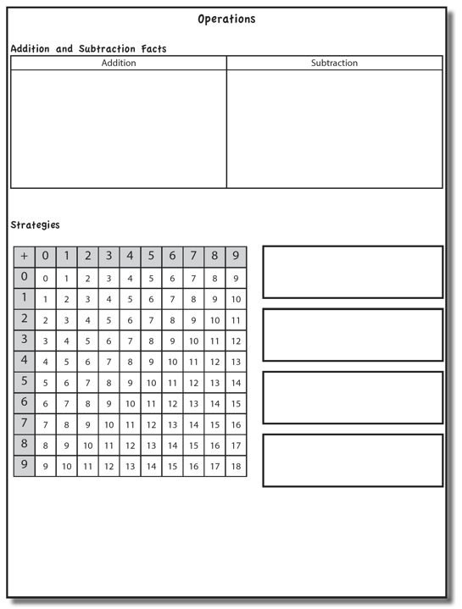

Slide 39
Addition Facts
100 addition basic facts
Single-digit addends sum to a single- or double-digit number
5 (addend)
+ 4 (addend)
9 (sum)

Slide 40
Three-Step Approach
Understand the Concepts
Learn and use Strategies
Build Fluency

Slide 41
Addition: Part-Part-Whole (Total)
Count one set, count another set, put sets together, count sum
2 + 3 = 5

Slide 42
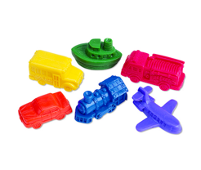
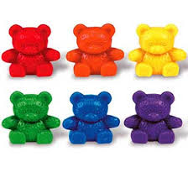
Addition: Part-Part-Whole (Total)
4 + 5 = __
3 + 7 = __
Teach this problem to a student.
Explicit instruction
Multiple representations
Concise language

Slide 43
Addition: Join (Change Increase)
Start with a set, add the other set, count sum
2 + 3 = 5

Slide 44
Addition: Join (Change Increase)
8 + 3 = __
5 + 6 = __
Teach this problem to a student.
Explicit instruction
Multiple representations
Concise language

Slide 45
Why is it important to understand addition in two separate ways?

Slide 46
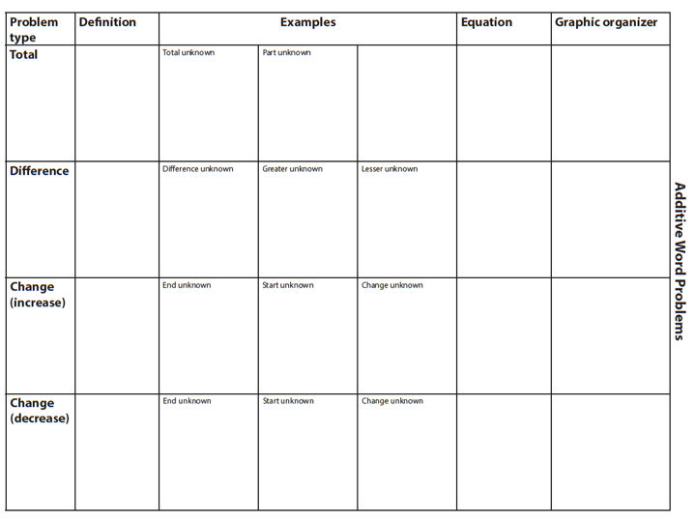

Slide 47
Total
Parts put together into a total
Jin saw 4 cardinals and 5 blue jays. How many birds did Jin see?
4 + 5 = ?
Jin saw 9 birds. If 4 of the birds were cardinals, how many were blue jays?
4 + ? = 9
Jin saw 9 birds. 5 of the birds were blue jays, how many were cardinals?
5 + ? = 9

Slide 48
Change
An amount that increases or decreases
Mara had $4. Then she earned $3 for cleaning her room. How much money does Mara have now?
4 + 3 = ?
Mara has $4. Then she earned money for cleaning her room. Now Mara has $7. How much money did she earn?
4 + ? = 7
Mara had some money. Then she made $3 for cleaning her room. Now she has $7. How much money did Mara start with?
? + 3 = 7

Slide 49
Part-Part-Whole Versus Join
Determine a word problem for each schema.
3 + 9 = __
7 + 4 = __
Explicit instruction
Multiple representations
Concise language

Slide 50
Subtraction Facts
100 subtraction basic facts
Subtrahend and difference are single-digit numbers and minuend is single- or double-digit number
16 (minuend)
– 8 (subtrahend)
8 (difference)

Slide 51
Three-Step Approach
Understand the Concepts
Learn and use Strategies
Build Fluency

Slide 52
Subtraction: Separate (Change Decrease)
Start with a set, take away from that set, count difference
5 – 3 = 2

Slide 53
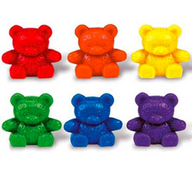
Subtraction: Separate (Change Decrease)
11 – 6 = __
13 – 7 = __
Teach this problem to a student.
Explicit instruction
Multiple representations
Concise language

Slide 54
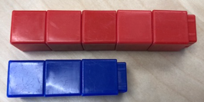
Subtraction: Compare (Difference)
Compare two sets, count difference
5 – 3 = 2

Slide 55
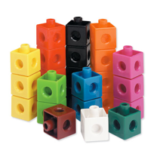
Subtraction: Compare (Difference)
10 – 7 = __
11 – 3 = __
Teach this problem to a student.
Explicit instruction
Multiple representations
Concise language

Slide 56
Why is it important to understand subtraction in two separate ways?

Slide 58
Difference
Greater and less amounts compared for a difference
Brad has 9 apples. Caroline has 4 apples. How many more apples does Brad have? (How many fewer does Caroline have?)
9 – 4 = ?
Brad has 5 more apples than Caroline. If Caroline has 4 apples, how many does Brad have?
? – 4 = 5
Caroline has 5 fewer apples than Brad. Brad has 9 apples. How many apples does Caroline have?
9 – ? = 5

Slide 59
Change
An amount that increases or decreases
Aishwarya had 9 cookies. Then she ate 2 of the cookies. How many cookies does Aishwarya have now?
9 – 2 = ?
Aishwarya had 9 cookies. She ate some of the cookies. Now, she has 7 cookies. How many cookies did Aishwarya eat?
9 – ? = 7
Aishwarya had some cookies. Then, she ate 2 of the cookies. Now she has 7 cookies left. How many cookies did Aishwarya have to start with?
? – 2 = 7

Slide 60
Separate Versus Compare
9 – 5 = __
8 – 3 = __
Determine a word problem for each schema.
Explicit instruction
Multiple representations
Concise language

Slide 61
Concepts Instruction

Slide 62
Grouping of Facts
Easier facts (0-9), then more difficult facts (10-18)
Fact families
3 + 5; 5 + 3; 8 – 3; 8 – 5
Combinations of
0 + 5; 1 + 4; 2 + 3; 3 + 2; 4 + 1; 5 + 0
5 – 0; 5 – 1; 5 – 2; 5 – 3; 5 – 4; 5 – 5
What are other ways to group addition and subtraction facts?

Slide 63
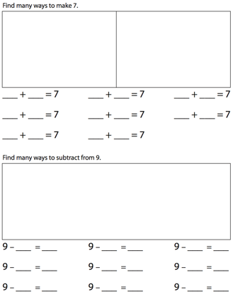
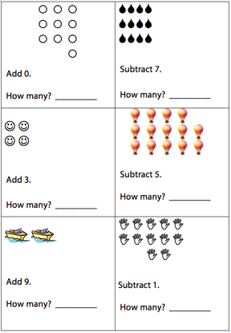
Instruction
Tell stories with storyboards
Explicit instruction
Ten Frames

Slide 64
Instruction
Must provide instruction on signs
Minus sign is em-dash (e.g., 6 – 3) instead of en-dash (e.g., 6 - 3)
Mix practice of addition and subtraction
Missing number/symbols activities help with conceptual understanding
3 + __ = 8 __ – 3 = 6

Slide 65
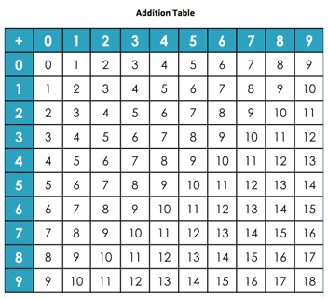
Strategies
Teach “rules” about facts
Teach counting strategies

Slide 66
Zero Facts
Adding any number by zero is equal to the number itself
Identity Property of Addition
Facts remaining: 100 – 19 = 81
+ | 0 | 1 | 2 | 3 | 4 | 5 | 6 | 7 | 8 | 9
0 | 0 | 1 | 2 | 3 | 4 | 5 | 6 | 7 | 8 | 9
1 | 1 | 2 | 3 | 4 | 5 | 6 | 7 | 8 | 9 | 10
2 | 2 | 3 | 4 | 5 | 6 | 7 | 8 | 9 | 10 | 11
3 | 3 | 4 | 5 | 6 | 7 | 8 | 9 | 10 | 11 | 12
4 | 4 | 5 | 6 | 7 | 8 | 9 | 10 | 11 | 12 | 13
5 | 5 | 6 | 7 | 8 | 9 | 10 | 11 | 12 | 13 | 14
6 | 6 | 7 | 8 | 9 | 10 | 11 | 12 | 13 | 14 | 15
7 | 7 | 8 | 9 | 10 | 11 | 12 | 13 | 14 | 15 | 16
8 | 8 | 9 | 10 | 11 | 12 | 13 | 14 | 15 | 16 | 17
9 | 9 | 10 | 11 | 12 | 13 | 14 | 15 | 16 | 17 | 18

Slide 67
One More Than
Next Number Fact
Corresponds with “One Less Than” for subtraction
Facts remaining: 81 – 17 = 64
+ | 0 | 1 | 2 | 3 | 4 | 5 | 6 | 7 | 8 | 9
0 | 0 | 1 | 2 | 3 | 4 | 5 | 6 | 7 | 8 | 9
1 | 1 | 2 | 3 | 4 | 5 | 6 | 7 | 8 | 9 | 10
2 | 2 | 3 | 4 | 5 | 6 | 7 | 8 | 9 | 10 | 11
3 | 3 | 4 | 5 | 6 | 7 | 8 | 9 | 10 | 11 | 12
4 | 4 | 5 | 6 | 7 | 8 | 9 | 10 | 11 | 12 | 13
5 | 5 | 6 | 7 | 8 | 9 | 10 | 11 | 12 | 13 | 14
6 | 6 | 7 | 8 | 9 | 10 | 11 | 12 | 13 | 14 | 15
7 | 7 | 8 | 9 | 10 | 11 | 12 | 13 | 14 | 15 | 16
8 | 8 | 9 | 10 | 11 | 12 | 13 | 14 | 15 | 16 | 17
9 | 9 | 10 | 11 | 12 | 13 | 14 | 15 | 16 | 17 | 18

Slide 68
Two More Than
Skip One Fact or skip count by two
Corresponds with “Two Less Than” for subtraction
Facts remaining: 64 – 15 = 49
+ | 0 | 1 | 2 | 3 | 4 | 5 | 6 | 7 | 8 | 9
0 | 0 | 1 | 2 | 3 | 4 | 5 | 6 | 7 | 8 | 9
1 | 1 | 2 | 3 | 4 | 5 | 6 | 7 | 8 | 9 | 10
2 | 2 | 3 | 4 | 5 | 6 | 7 | 8 | 9 | 10 | 11
3 | 3 | 4 | 5 | 6 | 7 | 8 | 9 | 10 | 11 | 12
4 | 4 | 5 | 6 | 7 | 8 | 9 | 10 | 11 | 12 | 13
5 | 5 | 6 | 7 | 8 | 9 | 10 | 11 | 12 | 13 | 14
6 | 6 | 7 | 8 | 9 | 10 | 11 | 12 | 13 | 14 | 15
7 | 7 | 8 | 9 | 10 | 11 | 12 | 13 | 14 | 15 | 16
8 | 8 | 9 | 10 | 11 | 12 | 13 | 14 | 15 | 16 | 17
9 | 9 | 10 | 11 | 12 | 13 | 14 | 15 | 16 | 17 | 18

Slide 69
Doubles
A number added to itself
Facts remaining: 49 – 7 = 42
+ | 0 | 1 | 2 | 3 | 4 | 5 | 6 | 7 | 8 | 9
0 | 0 | 1 | 2 | 3 | 4 | 5 | 6 | 7 | 8 | 9
1 | 1 | 2 | 3 | 4 | 5 | 6 | 7 | 8 | 9 | 10
2 | 2 | 3 | 4 | 5 | 6 | 7 | 8 | 9 | 10 | 11
3 | 3 | 4 | 5 | 6 | 7 | 8 | 9 | 10 | 11 | 12
4 | 4 | 5 | 6 | 7 | 8 | 9 | 10 | 11 | 12 | 13
5 | 5 | 6 | 7 | 8 | 9 | 10 | 11 | 12 | 13 | 14
6 | 6 | 7 | 8 | 9 | 10 | 11 | 12 | 13 | 14 | 15
7 | 7 | 8 | 9 | 10 | 11 | 12 | 13 | 14 | 15 | 16
8 | 8 | 9 | 10 | 11 | 12 | 13 | 14 | 15 | 16 | 17
9 | 9 | 10 | 11 | 12 | 13 | 14 | 15 | 16 | 17 | 18

Slide 70
Near Doubles
Doubles plus one or doubles minus one
Facts remaining: 42 – 12 = 30
Not always helpful
for students
with MD
+ | 0 | 1 | 2 | 3 | 4 | 5 | 6 | 7 | 8 | 9
0 | 0 | 1 | 2 | 3 | 4 | 5 | 6 | 7 | 8 | 9
1 | 1 | 2 | 3 | 4 | 5 | 6 | 7 | 8 | 9 | 10
2 | 2 | 3 | 4 | 5 | 6 | 7 | 8 | 9 | 10 | 11
3 | 3 | 4 | 5 | 6 | 7 | 8 | 9 | 10 | 11 | 12
4 | 4 | 5 | 6 | 7 | 8 | 9 | 10 | 11 | 12 | 13
5 | 5 | 6 | 7 | 8 | 9 | 10 | 11 | 12 | 13 | 14
6 | 6 | 7 | 8 | 9 | 10 | 11 | 12 | 13 | 14 | 15
7 | 7 | 8 | 9 | 10 | 11 | 12 | 13 | 14 | 15 | 16
8 | 8 | 9 | 10 | 11 | 12 | 13 | 14 | 15 | 16 | 17
9 | 9 | 10 | 11 | 12 | 13 | 14 | 15 | 16 | 17 | 18

Slide 71
Make Ten
One addend is 8 or 9, making it easy to “make ten”
Facts remaining: 30 – 18 = 12
Not always helpful
for students
with MD
+ | 0 | 1 | 2 | 3 | 4 | 5 | 6 | 7 | 8 | 9
0 | 0 | 1 | 2 | 3 | 4 | 5 | 6 | 7 | 8 | 9
1 | 1 | 2 | 3 | 4 | 5 | 6 | 7 | 8 | 9 | 10
2 | 2 | 3 | 4 | 5 | 6 | 7 | 8 | 9 | 10 | 11
3 | 3 | 4 | 5 | 6 | 7 | 8 | 9 | 10 | 11 | 12
4 | 4 | 5 | 6 | 7 | 8 | 9 | 10 | 11 | 12 | 13
5 | 5 | 6 | 7 | 8 | 9 | 10 | 11 | 12 | 13 | 14
6 | 6 | 7 | 8 | 9 | 10 | 11 | 12 | 13 | 14 | 15
7 | 7 | 8 | 9 | 10 | 11 | 12 | 13 | 14 | 15 | 16
8 | 8 | 9 | 10 | 11 | 12 | 13 | 14 | 15 | 16 | 17
9 | 9 | 10 | 11 | 12 | 13 | 14 | 15 | 16 | 17 | 18

Slide 72
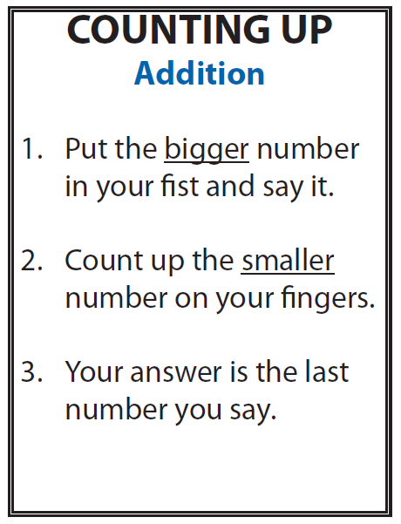
Counting Strategies

Slide 73
Fluency

Slide 74
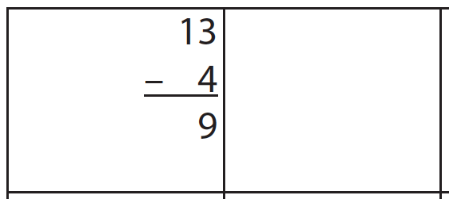
Fluency: Cover, Copy, Compare
Student is presented with worksheet of problems
Usually 10 problems for practice
1. Read fact and COVER it
2. COPY fact answer
3. Uncover and COMPARE answers
13
- 4
9

Slide 75
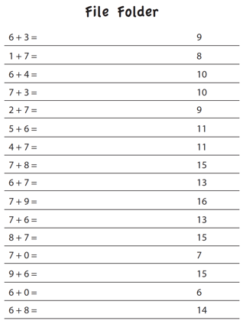
Fluency: File Folders
Create a file folder (with answers)
Student fills in answers and checks by unfolding folder
9
8
10
10
9
11

Slide 76
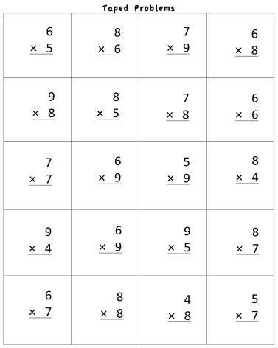
Fluency: Taped Problems
Create a worksheet of 12-24 problems
Make a recording
Read the problem
Pause (1-5 seconds)
Share the answer
Student listens
Student tries to “beat the tape”

Slide 77
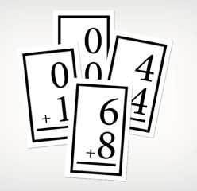
Fluency: Constant Time Delay
Typically used with a small number of related facts
1. Present card for 3 seconds
2. Acknowledge correct answer or state correct answer and have student repeat it

Slide 78
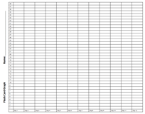
Fluency: Flash Cards
Start with a small set of flash cards. As students demonstrate mastery, add in a few more cards at a time.

Slide 79
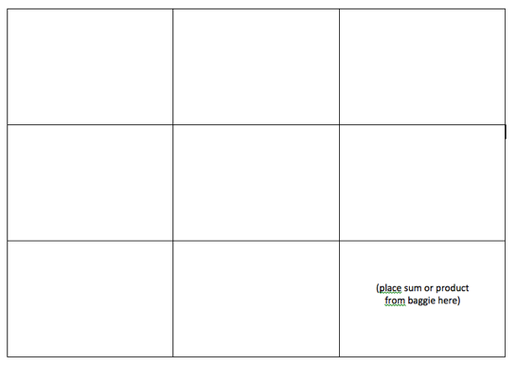
Fluency: Magic Squares
4
5
12
8
6
1
3
3
6

Slide 80
Fluency: Wrap-Ups

Slide 81
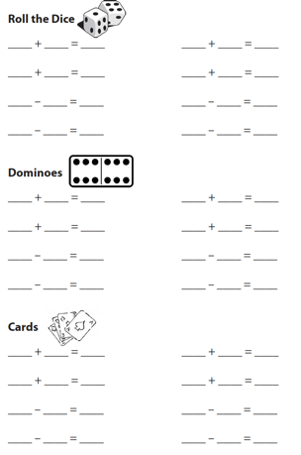
Fluency: Cards, Dice, Dominoes
Roll dice
Select dominoes
Deal cards

Slide 82
Fluency: Games
Mobi
Smath

Slide 83
Fluency: Technology

Slide 84
Fluency
What are other ways to build fluency with addition and subtraction?

Slide 85
Computation

Slide 86
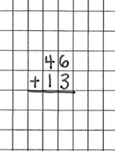
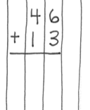
Notation Matters
Work on vertical presentation

Slide 87
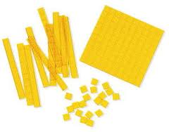
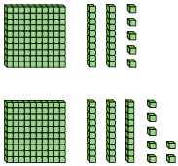
Addition and Subtraction
Focus on place value

Slide 88
Addition and Subtraction
Introduce regrouping/trading/exchanging after mastery of problems without regrouping
10 ones for 1 ten
10 tens for 1 hundred
1 ten for 10 ones
1 hundred for 10 tens
Regroup
Trade
Exchange
Carry
Addition
Regroup
Trade
Exchange
Borrow
Subtraction

Slide 89
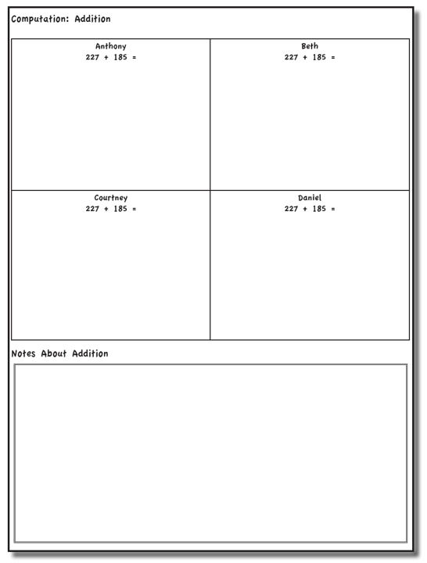

Slide 90
Addition Strategies
Anthony
Beth
Courtney
Daniel

Slide 91
Anthony
Traditional
Work right to left (start in ones column)

Slide 92
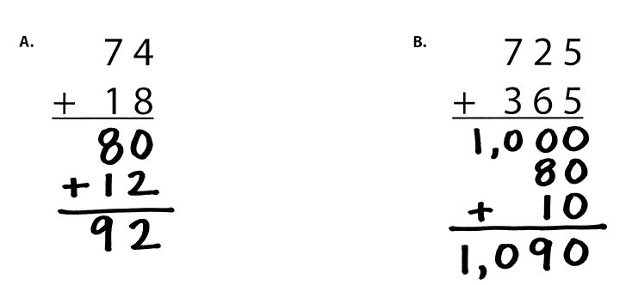
Beth
Partial Sums
Work left to right

Slide 93
Courtney
Opposite Change
Round one number to nearest ten
Amount added is subtracted from other number

Slide 94
Daniel
Column Addition
Work left to right

Slide 95
Teach a grade-level addition problem.
Explicit instruction
Multiple representations
Concise language

Slide 96
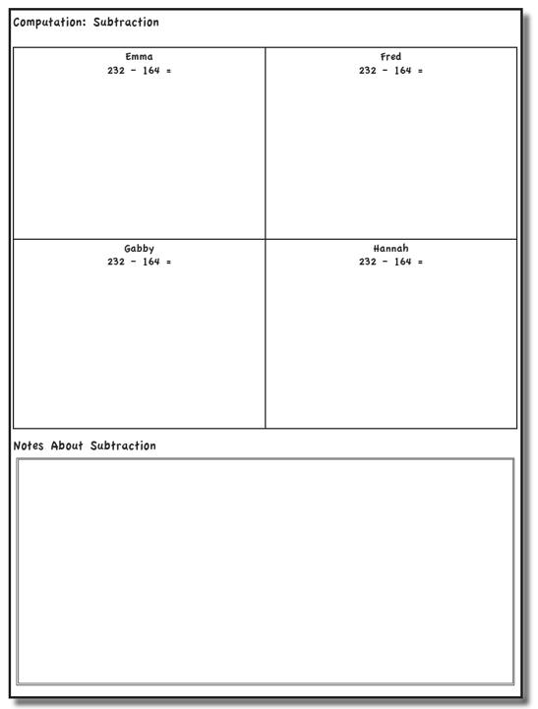

Slide 97
Subtraction Strategies
Emma
Fred
Gabby
Hannah

Slide 98
Emma
Traditional Method
Work right to left (start in ones column)

Slide 99
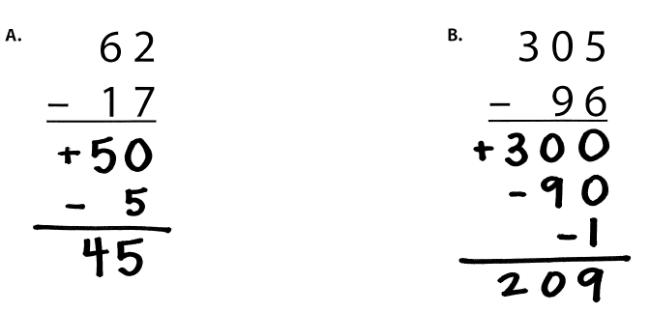
Fred
Partial Differences
Work left to right

Slide 100
Gabby
Same Change
Change subtrahend to end in 0

Slide 101
Hannah
Add-Up

Slide 102
Teach a grade-level subtraction problem.
Explicit instruction
Multiple representations
Concise language

Slide 103
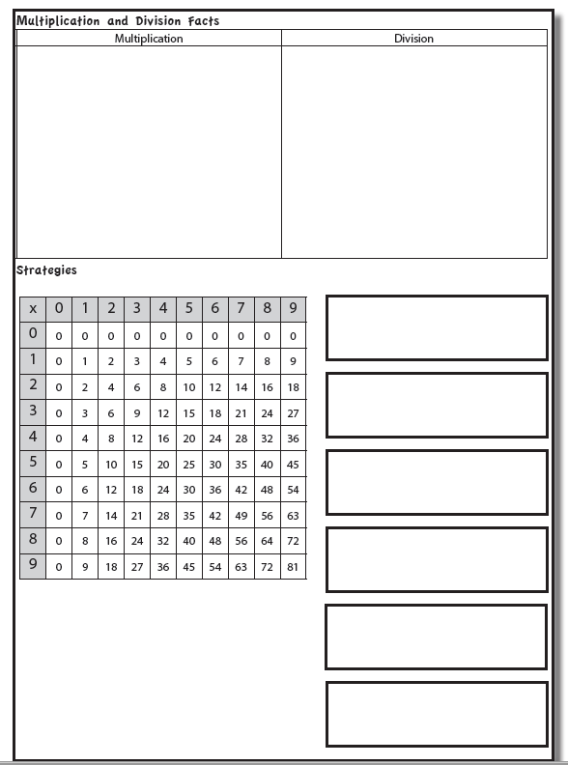

Slide 104
Multiplication

Slide 105
Multiplication Facts
100 multiplication basic facts
Multiplication of single-digit factors results in a single- or double-digit product
2 (factor)
× 3 (factor)
6 (product)

Slide 106
Three-Step Approach
Understand the Concepts
Learn and use Strategies
Build Fluency

Slide 107
Multiplication: Equal Groups
Show the groups, show the amount for each group, count product
3 × 2 = 6

Slide 108
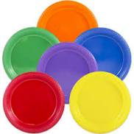
Multiplication: Equal Groups
5 × 3 = __
2 × 5 = __
Teach this problem to a student.
Explicit instruction
Multiple representations
Concise language

Slide 109
Multiplication: Comparison
Show a set, then multiply the set
3 × 2 = 6

Slide 110
Multiplication: Comparison
6 × 3 = __
4 × 5 = __
Teach this problem to a student.
Explicit instruction
Multiple representations
Concise language

Slide 111
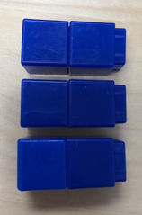
Multiplication: Array/Area
Make the array, count product
3 × 2 = 6

Slide 112
Multiplication: Array/Area
3 × 4 = __
2 × 5 = __
Teach this problem to a student.
Explicit instruction
Multiple representations
Concise language

Slide 113
Why is it important to understand multiplication in different ways?

Slide 114
Equal Groups
Groups multiplied by number in each group for a product
Mark has 2 bags of apples. There are 6 apples in each bag. How many apples does Mark have altogether?
2 × 6 = ?
Mark has 12 apples. He wants to share them equally among his 2 friends. How many apples will each friend receive?
2 × ? = 12
Mark has 12 apples. He put them into bags containing 6 apples each. How many bags did Mark use?
? × 6 = 12

Slide 115
Comparison
Set multiplied by a number of times for a product
Jill picked 6 apples. Mark picked 2 times as many apples as Jill. How many apples did Mark pick?
6 × 2 = ?

Slide 116
Multiplication: Combinations
Match each in a set with the other set
3 × 2 = 6

Slide 117
Division

Slide 118
Division Facts
90 division basic facts
Divisor and quotient are single-digit numbers and dividend is single- or double-digit number
8 ÷ 4 = 2
(dividend) (divisor) (quotient)

Slide 119
Three-Step Approach
Understand the Concepts
Learn and use Strategies
Build Fluency

Slide 120
Division: Equal Groups (Partitive Division)
Show the dividend, divide equally among divisor, count quotient
6 ÷ 3 = 2

Slide 121
Division: Partitive Division
12 ÷ 4 = __
15 ÷ 3 = __
Teach this problem to a student.
Explicit instruction
Multiple representations
Concise language

Slide 122
Division: Equal Groups (Measurement Division)
Show the dividend, make groups of the divisor, count groups
6 ÷ 3 = 2

Slide 123
Division: Measurement Division
10 ÷ 5 = __
9 ÷ 3 = __
Teach this problem to a student.
Explicit instruction
Multiple representations
Concise language

Slide 124
Why is it important to understand division in different ways?

Slide 125
Equal Groups
Groups multiplied by number in each group for a product
Mark has 2 bags of apples. There are 6 apples in each bag. How many apples does Mark have altogether?
2 × 6 = ?
Mark has 12 apples. He wants to share them equally among his 2 friends. How many apples will each friend receive?
2 × ? = 12
Mark has 12 apples. He put them into bags containing 6 apples each. How many bags did Mark use?
? × 6 = 12

Slide 126
Concepts Instruction

Slide 127
Instruction
Tell stories with storyboards
Explicit instruction
Books

Slide 128
Instruction
Must provide instruction on signs
Multiplication sign (×) is NOT an x or X
Division sign can be:
Obelus: ÷
Vinculum/fraction bar:
Slash/virgule/solidus: ⁄
Long division symbol/long division bracket:

Slide 129
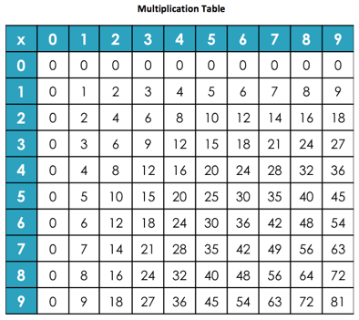
Strategies
Properties
Teach “rules” about facts
Teach strategies

Slide 130
Zeroes
Multiplying any number by zero is zero
Facts remaining: 100 – 19 = 81
x | 0 | 1 | 2 | 3 | 4 | 5 | 6 | 7 | 8 | 9
0 | 0 | 0 | 0 | 0 | 0 | 0 | 0 | 0 | 0 | 0
1 | 0 | 1 | 2 | 3 | 4 | 5 | 6 | 7 | 8 | 9
2 | 0 | 2 | 4 | 6 | 8 | 10 | 12 | 14 | 16 | 18
3 | 0 | 3 | 6 | 9 | 12 | 15 | 18 | 21 | 24 | 27
4 | 0 | 4 | 8 | 12 | 16 | 20 | 24 | 28 | 32 | 36
5 | 0 | 5 | 10 | 15 | 20 | 25 | 30 | 35 | 40 | 45
6 | 0 | 6 | 12 | 18 | 24 | 30 | 36 | 42 | 48 | 54
7 | 0 | 7 | 14 | 21 | 28 | 35 | 42 | 49 | 56 | 63
8 | 0 | 8 | 16 | 24 | 32 | 40 | 48 | 56 | 64 | 72
9 | 0 | 9 | 18 | 27 | 36 | 45 | 54 | 63 | 72 | 81

Slide 131
Ones
Multiplying any number by one is equal to that number
Facts remaining: 81 – 17 = 64
x | 0 | 1 | 2 | 3 | 4 | 5 | 6 | 7 | 8 | 9
0 | 0 | 0 | 0 | 0 | 0 | 0 | 0 | 0 | 0 | 0
1 | 0 | 1 | 2 | 3 | 4 | 5 | 6 | 7 | 8 | 9
2 | 0 | 2 | 4 | 6 | 8 | 10 | 12 | 14 | 16 | 18
3 | 0 | 3 | 6 | 9 | 12 | 15 | 18 | 21 | 24 | 27
4 | 0 | 4 | 8 | 12 | 16 | 20 | 24 | 28 | 32 | 36
5 | 0 | 5 | 10 | 15 | 20 | 25 | 30 | 35 | 40 | 45
6 | 0 | 6 | 12 | 18 | 24 | 30 | 36 | 42 | 48 | 54
7 | 0 | 7 | 14 | 21 | 28 | 35 | 42 | 49 | 56 | 63
8 | 0 | 8 | 16 | 24 | 32 | 40 | 48 | 56 | 64 | 72
9 | 0 | 9 | 18 | 27 | 36 | 45 | 54 | 63 | 72 | 81

Slide 132
Twos
Skip counting strategy helps students find the multiples of two
Facts remaining: 64 – 15 = 49
x | 0 | 1 | 2 | 3 | 4 | 5 | 6 | 7 | 8 | 9
0 | 0 | 0 | 0 | 0 | 0 | 0 | 0 | 0 | 0 | 0
1 | 0 | 1 | 2 | 3 | 4 | 5 | 6 | 7 | 8 | 9
2 | 0 | 2 | 4 | 6 | 8 | 10 | 12 | 14 | 16 | 18
3 | 0 | 3 | 6 | 9 | 12 | 15 | 18 | 21 | 24 | 27
4 | 0 | 4 | 8 | 12 | 16 | 20 | 24 | 28 | 32 | 36
5 | 0 | 5 | 10 | 15 | 20 | 25 | 30 | 35 | 40 | 45
6 | 0 | 6 | 12 | 18 | 24 | 30 | 36 | 42 | 48 | 54
7 | 0 | 7 | 14 | 21 | 28 | 35 | 42 | 49 | 56 | 63
8 | 0 | 8 | 16 | 24 | 32 | 40 | 48 | 56 | 64 | 72
9 | 0 | 9 | 18 | 27 | 36 | 45 | 54 | 63 | 72 | 81

Slide 133
Fives
Skip counting strategy helps students find the multiples of five
Facts remaining: 49 – 13 = 36
x | 0 | 1 | 2 | 3 | 4 | 5 | 6 | 7 | 8 | 9
0 | 0 | 0 | 0 | 0 | 0 | 0 | 0 | 0 | 0 | 0
1 | 0 | 1 | 2 | 3 | 4 | 5 | 6 | 7 | 8 | 9
2 | 0 | 2 | 4 | 6 | 8 | 10 | 12 | 14 | 16 | 18
3 | 0 | 3 | 6 | 9 | 12 | 15 | 18 | 21 | 24 | 27
4 | 0 | 4 | 8 | 12 | 16 | 20 | 24 | 28 | 32 | 36
5 | 0 | 5 | 10 | 15 | 20 | 25 | 30 | 35 | 40 | 45
6 | 0 | 6 | 12 | 18 | 24 | 30 | 36 | 42 | 48 | 54
7 | 0 | 7 | 14 | 21 | 28 | 35 | 42 | 49 | 56 | 63
8 | 0 | 8 | 16 | 24 | 32 | 40 | 48 | 56 | 64 | 72
9 | 0 | 9 | 18 | 27 | 36 | 45 | 54 | 63 | 72 | 81

Slide 134
Nines
Patterns in Nines facts
Sum of digits in product
Patterns in ones and tens place of product
One less than second factor, then subtract from 9
Finger strategy
Facts remaining: 36 – 11 = 25
x | 0 | 1 | 2 | 3 | 4 | 5 | 6 | 7 | 8 | 9
0 | 0 | 0 | 0 | 0 | 0 | 0 | 0 | 0 | 0 | 0
1 | 0 | 1 | 2 | 3 | 4 | 5 | 6 | 7 | 8 | 9
2 | 0 | 2 | 4 | 6 | 8 | 10 | 12 | 14 | 16 | 18
3 | 0 | 3 | 6 | 9 | 12 | 15 | 18 | 21 | 24 | 27
4 | 0 | 4 | 8 | 12 | 16 | 20 | 24 | 28 | 32 | 36
5 | 0 | 5 | 10 | 15 | 20 | 25 | 30 | 35 | 40 | 45
6 | 0 | 6 | 12 | 18 | 24 | 30 | 36 | 42 | 48 | 54
7 | 0 | 7 | 14 | 21 | 28 | 35 | 42 | 49 | 56 | 63
8 | 0 | 8 | 16 | 24 | 32 | 40 | 48 | 56 | 64 | 72
9 | 0 | 9 | 18 | 27 | 36 | 45 | 54 | 63 | 72 | 81

Slide 135
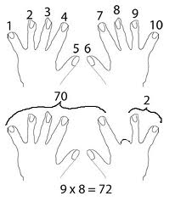
Nines

Slide 136
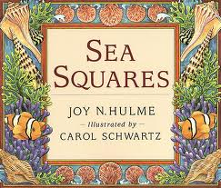
Squares
9 square numbers
Only one factor to remember
Facts remaining:
25 – 5 = 20
x | 0 | 1 | 2 | 3 | 4 | 5 | 6 | 7 | 8 | 9
0 | 0 | 0 | 0 | 0 | 0 | 0 | 0 | 0 | 0 | 0
1 | 0 | 1 | 2 | 3 | 4 | 5 | 6 | 7 | 8 | 9
2 | 0 | 2 | 4 | 6 | 8 | 10 | 12 | 14 | 16 | 18
3 | 0 | 3 | 6 | 9 | 12 | 15 | 18 | 21 | 24 | 27
4 | 0 | 4 | 8 | 12 | 16 | 20 | 24 | 28 | 32 | 36
5 | 0 | 5 | 10 | 15 | 20 | 25 | 30 | 35 | 40 | 45
6 | 0 | 6 | 12 | 18 | 24 | 30 | 36 | 42 | 48 | 54
7 | 0 | 7 | 14 | 21 | 28 | 35 | 42 | 49 | 56 | 63
8 | 0 | 8 | 16 | 24 | 32 | 40 | 48 | 56 | 64 | 72
9 | 0 | 9 | 18 | 27 | 36 | 45 | 54 | 63 | 72 | 81

Slide 137
Commutative Property
“Turn-around” strategy
Commutative Property
Numbers can be multiplied in any order and get the same result
x | 0 | 1 | 2 | 3 | 4 | 5 | 6 | 7 | 8 | 9
0 | 0 | 0 | 0 | 0 | 0 | 0 | 0 | 0 | 0 | 0
1 | 0 | 1 | 2 | 3 | 4 | 5 | 6 | 7 | 8 | 9
2 | 0 | 2 | 4 | 6 | 8 | 10 | 12 | 14 | 16 | 18
3 | 0 | 3 | 6 | 9 | 12 | 15 | 18 | 21 | 24 | 27
4 | 0 | 4 | 8 | 12 | 16 | 20 | 24 | 28 | 32 | 36
5 | 0 | 5 | 10 | 15 | 20 | 25 | 30 | 35 | 40 | 45
6 | 0 | 6 | 12 | 18 | 24 | 30 | 36 | 42 | 48 | 54
7 | 0 | 7 | 14 | 21 | 28 | 35 | 42 | 49 | 56 | 63
8 | 0 | 8 | 16 | 24 | 32 | 40 | 48 | 56 | 64 | 72
9 | 0 | 9 | 18 | 27 | 36 | 45 | 54 | 63 | 72 | 81

Slide 138
Fluency

Slide 139
Computation

Slide 141
Multiplication Strategies
Markus
Nate
Olivia
Patrice

Slide 142
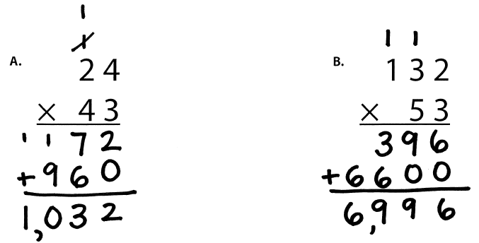
Markus
Traditional
Work right to left (start in ones column)

Slide 143
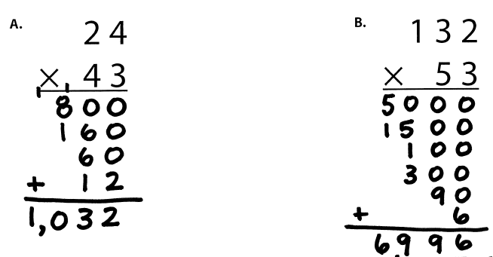
Nate
Partial Products

Slide 144
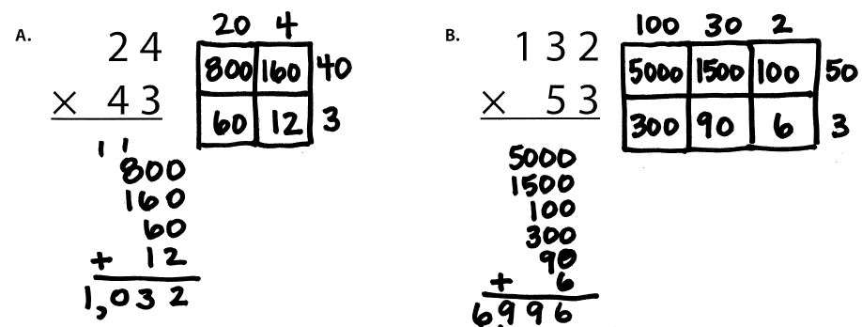
Olivia
Area

Slide 145
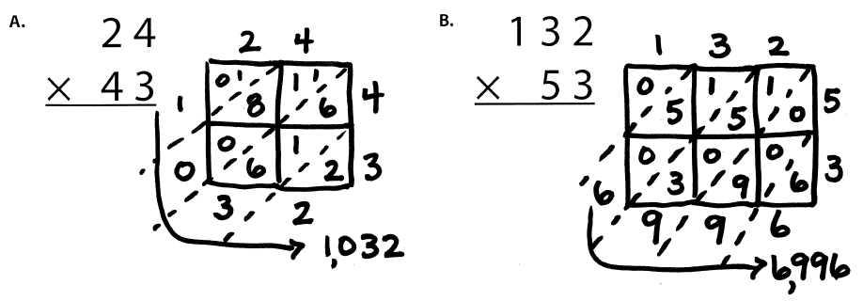
Patrice
Lattice Method (383 × 27)

Slide 146
Teach a grade-level multiplication problem.
Explicit instruction
Multiple representations
Concise language

Slide 148
Division Strategies
Roscoe
Samuel
Tony
Ula

Slide 149
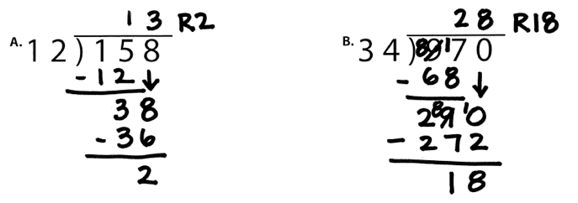
Roscoe
Traditional Method
Work Left to Right
“Does McDonald’s Sell CheeseBurgers?”
“Daddy, Mother, Sister, Brother”
Divide
Multiply
Subtract
Compare
Bring down
Notes:
1. Yellow handouts: Multiplication and division

Slide 150
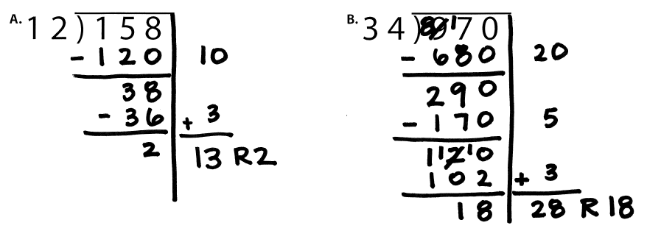
Samuel
Partial Quotients

Slide 151
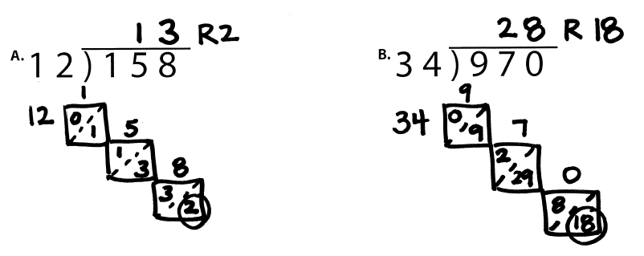
Tony
Lattice Division

Slide 152
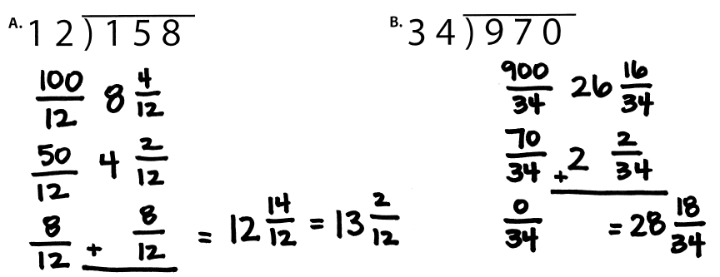
Ula
Division as Fractions

Slide 153
Teach a grade-level division problem.
Explicit instruction
Multiple representations
Concise language

Slide 154
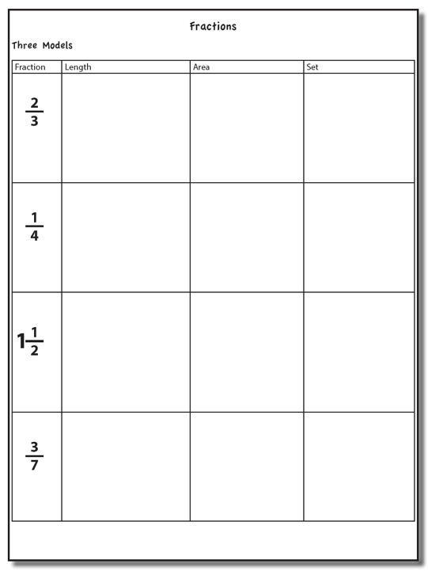
Fraction Concepts

Slide 155
Important Fraction Vocabulary
Whole
Unit
Equal parts
Fraction
Proper fraction
Improper fraction
Mixed number
Numerator
Denominator
Greatest common factor
Least common multiple (or denominator)

Slide 156
Fraction Models
Length
Area
Set

Slide 157
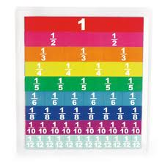
Length/Measurement
Fractions are appropriated by length

Slide 158
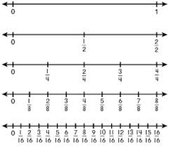
Length/Measurement

Slide 159
Length/Measurement

Slide 160
Area/Region
Shapes divided into equal sections

Slide 161
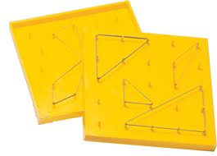
Area/Region
Shapes divided into equal sections

Slide 162
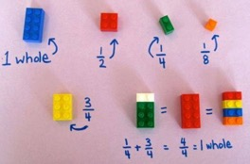
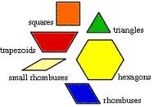
Area/Region

Slide 163
Set/Discrete
Individual shapes match the fraction

Slide 164
Set/Discrete

Slide 165
Select a fraction and teach the fraction using all three models.
Explicit instruction
Multiple representations
Concise language

Slide 166
Proper Fractions
Fractions less than 1
Numerator is less than denominator

Slide 167
Improper Fractions
Fractions equal to or greater than 1
Numerator is equal to or greater than denominator

Slide 168
Mixed Numbers
A mix of a whole number and a fraction

Slide 169
Equivalent Fractions

Slide 170
Comparing Fractions

Slide 171
Ordering Fractions
Compare to benchmark fractions

Slide 172
Select and teach a fraction concept.
Explicit instruction
Multiple representations
Concise language

Slide 173
Fraction Computation

Slide 174
Addition

Slide 175
Addition

Slide 176
Addition

Slide 177
Explicit instruction
Multiple representations
Concise language

Slide 178
Addition

Slide 179
Addition
2: 2, 4, 6, 8, 10
4: 4, 8, 12, 16, 20

Slide 180
Addition

Slide 181
Explicit instruction
Multiple representations
Concise language

Slide 182
Subtraction

Slide 183
Subtraction

Slide 184
Explicit instruction
Multiple representations
Concise language

Slide 185
Subtraction
Take away from this set
This is for reference

Slide 186
Explicit instruction
Multiple representations
Concise language

Slide 187
Multiplication
Multiplication
Interpret multiplication sign as “of”
2/3 of 3/4

Slide 188
Multiplication
Show
One-half of four-fourths

Slide 189
Multiplication
Show
One-half of two-fourths

Slide 190
Multiplication
Show
One-half of one-fourth
One-half of one-fourth

Slide 191
Multiplication
Show
One-half of three-fourths

Slide 192
Multiplication
Show
One-half of one-fourth
One-half of one-fourth
One-half of one-fourth

Slide 193
Multiplication
Show

Slide 194
Multiplication
Length
“Two-thirds of three-fourths”

Slide 195
Multiplication
Area
“Two-thirds of three-fourths”

Slide 196
Multiplication
Set
“Two-thirds of three-fourths”

Slide 197
Multiplication
Choose one of the multiplication problems and design intensive instruction related to the topic.
Explicit instruction
Multiple representations
Concise language

Slide 198
Division
Division
“How many sets of the second fraction fit into the first fraction?”

Slide 199
Multiplication
Show
1 set of one-third
2 sets of one-third
3 sets of one-third

Slide 200
Multiplication
Show
1 set of one-third
2 sets of one-third

Slide 201
Multiplication
Show
1 set of one-half
Two-thirds set of one-half

Slide 202
Division
Show

Slide 203
Division
Length
“How many sets of 1/3 can be made with 1 and ½?”

Slide 204
Division
Area
“How many sets of 1/3 can be made with 1 and ½?”
1
3
4
2
1/2 of 1/3

Slide 205
Division
Set
“How many sets of 1/3 can be made with 1 and ½?”

Slide 206
Division
Choose one of the division problems and design intensive instruction related to the topic.
Explicit instruction
Multiple representations
Concise language

Slide 207
Focus on a decimal concept. Design intensive intervention for that concept.
Explicit instruction
Multiple representations
Concise language

Slide 208
Instructional Platform
INSTRUCTIONAL DELIVERY
Explicit instruction
Multiple representations
Concise language
INSTRUCTIONAL STRATEGIES
Fluency building
Problem solving instruction
Motivation component

Slide 209
How would you teach this problem?
What do students need to know to solve this problem?
What might cause difficulty for students?

Slide 210
Problem Solving Difficulties
Reading problems
Understanding vocabulary
Identifying relevant information
Ignoring irrelevant information
Interpreting charts and graphs
Identifying appropriate operation(s)
Performing the computation(s)

Slide 211
Reading problems
Understanding vocabulary
Identifying relevant information
Ignoring irrelevant information
Interpreting charts and graphs
PARCC third-grade release item (2015)
Identifying appropriate operation(s)
Performing the computation(s)

Slide 213
Don’t tie key words to operations
Teach word-problem schemas
Have an attack strategy

Slide 215
Kasey made $42, and Mandy made $37. How much money did they make in all?
Kasey and Mandy made $79 in all. If Kasey made $42, how much money did Mandy make?
Kasey mowed 12 lawns on Monday. Then, she mowed 10 more on Tuesday. How many lawns has Kasey mowed?
Kasey mowed 22 lawns and Mandy mowed 7 lawns. How many more lawns did Kasey mow than Mandy?

Slide 216
Becky has $70 more than Perla. If Becky has $120, how much money does Perla have?
Becky has $70 more than Perla. If Perla has $50, how much money does Becky have?
Becky had 9 dinosaurs and then her sister took away 4 of them. How many dinosaurs does Becky have now?
Becky had some dinosaurs and then her sister took away 4 of them. Now Becky has 5 dinosaurs. How many dinosaurs did she start with?

Slide 217
Matt baked 18 cookies. His brother baked twice as many. How many cookies did his brother bake?
Matt’s brother baked twice as many cookies as Matt. If Matt’s brother baked 36 cookies, how many did Matt bake?
Reece has 7 bags with 3 apples in each bag. How many apples does Reece have?
Reece had 21 apples and placed 3 apples each in several bags. How many bags does Reece need?

Slide 218
Rachel wants to share 36 brownies with 6 friends. How many cookies will each friend receive?
Rachel shared brownies with 6 friends. Each friend ate 6 brownies. How many brownies did Rachel have to start with?
Brent made 12 cupcakes. His brother made half as many cupcakes. How many cupcakes did Brent’s brother bake?
Brent made 12 cupcakes. He cut each cupcake into half. How many pieces of cupcake does Brent have?

Slide 219
Michelle made 17 paper airplanes. Dante made 24 paper airplanes. How many airplanes did they make altogether?
Michelle and Dante made 41 paper airplanes altogether. If Dante made 24 paper airplanes, how many did Michelle make?
Michelle made 4 paper airplanes using 2 pieces of paper for each airplane. How much paper did Michelle use altogether?
Dante and Michelle made 40 paper airplanes altogether. Dante made 24 of the paper airplanes. If Michelle gave 7 of her paper airplanes to her friend Nicole, how many planes does Michelle have now?

Slide 220
Students need to understand key words. But, key words should not be directly tied to operations.

Slide 222
Identify a key word. Write a problem where the key word “works.” Write a problem where the key word doesn’t ”work.”

Slide 223
Don’t tie key words to operations
Teach word-problem schemas
Have an attack strategy

Slide 224
For every word problem
Regardless of problem type, students need an attack strategy for working through the problem
This strategy should work for any problem type
Routine Word Problems
Instructional Word Problems

Slide 226
RIDGES
Read the problem.
I know statement.
Draw a picture.
Goal statement.
Equation development.
Solve the equation.
RIDE
Read the problem.
Identify the relevant information.
Determine the operation and unit for the answer.
Enter the correct numbers and calculate, then check the answer.

Slide 230
SIGNS
Survey questions
Identify key words
Graphically draw problem
Note operations
Solve and check
SOLVE
Study the problem.
Organize the facts.
Line up the plan.
Verify the plan with computation.
Examine the answer.

Slide 231
R-CUBES
Read the problem.
Circle key numbers.
Underline the question.
Box action words.
Evaluate steps.
Solve and check.

Slide 233
Don’t tie key words to operations
Teach word-problem schemas
Have an attack strategy

Slide 234
Additive Schemas

Slide 235
Instruction Using Schemas
A schema refers to the structure of the word problem
Total
Difference
Change

Slide 237
Total
Parts put together into a total
Emily saw 4 cardinals and 5 blue jays. How many birds did Emily see?
4 + 5 = ?
Emily saw 9 birds. If 4 of the birds were cardinals, how many were blue jays?
4 + ? = 9
Emily saw 9 birds. 5 of the birds were blue jays, how many were cardinals?
5 + ? = 9

Slide 238
Total
P1 + P2 = T
Fuchs et al. (2008); Griffin & Jitendra (2009)

Slide 239
Total

Slide 240
Total

Slide 241
Total
✔
✔
✔
P1 + P2 = T
U
P
S
✔
✔
28
+
24
=
?
✔
✔
28 + 24 = 52
X = 52 cookies
Grade 3 Smarter Balanced

Slide 242
Total
“Are parts put together for a total?”

Slide 243
Total
✔
✔
12
11
+ 1
12
12
- 11
1
✔
U
P
S
✔
✔
11
?
✔
✔
? = 1 millimeter
Grade 2 IXL

Slide 245
Difference
Greater and less amounts compared for a difference
Shinead has 9 apples. Amanda has 4 apples. How many more apples does Shinead have? (How many fewer?)
9 – 4 = ?
Shinead has 5 more apples than Amanda. If Amanda has 4 apples, how many does Shinead have?
? – 4 = 5
Amanda has 5 fewer apples than Shinead. Shinead has 9 apples. How many apples does Amanda have?
9 – ? = 5

Slide 246
Difference
G – L = D
Fuchs et al. (2008); Griffin & Jitendra (2009)

Slide 247
Difference

Slide 248
Difference
✔
✔
G – L = D
✔
U
P
S
✔
✔
107
-
68
=
B
107
68
68
+ ?
107
✔
✔
107 – 68 = 39
B = 39 more beads
Grade 3 Smarter Balanced

Slide 249
Total
“Are parts put together for a total?”
Difference
“Are amounts compared for a difference?”

Slide 250
Difference

Slide 252
Change
An amount that increases or decreases
Shannah had $4. Then she earned $3 for cleaning her room. How much money does Shannah have now?
4 + 3 = ?
Shannah has $4. Then she earned money for cleaning her room. Now Shannah has $7. How much money did she earn?
4 + ? = 7
Shannah had some money. Then she made $3 for cleaning her room. Now she has $7. How much money did Shannah start with?
? + 3 = 7

Slide 253
Change
ST +/– C = E
(change)
(begin)
(end)
Fuchs et al. (2008); Griffin & Jitendra (2009)

Slide 254
Change

Slide 255
Change
✔
A bus had 13 passengers. At the next stop, more passengers got on the bus. Now, there are 28 passengers. How many passengers got on the bus?
✔
✔
U
P
S
✔
ST + C = E
✔
13
+
?
=
28
✔
28
- 13
✔
13
+ ?
28
13 + 15 = 28
? = 15 passengers

Slide 256
Total
“Are parts put together for a total?”
Difference
“Are amounts compared for a difference?”
Change
“Does an amount increase or decrease?”

Slide 257
Change
An amount that increases or decreases
Reece baked 9 cookies. Then, she ate 2 of the cookies. How many cookies does Reece have now?
9 – 2 = ?
Reece baked 9 cookies. Then, she ate some of the cookies. Now, she has 7 cookies. How many cookies did Reece eat?
9 – ? = 7
Reece baked some cookies. She ate 2 of the cookies and has 7 cookies left. How many cookies did Reece bake?
? – 2 = 7

Slide 258
Change
ST +/– C = E
(change)
(begin)
(end)
Fuchs et al. (2008); Griffin & Jitendra (2009)

Slide 259
Change

Slide 261
Total

Slide 262
Change

Slide 263
Difference

Slide 264
Total
P1 + P2 + P3 = T

Slide 265
Change
ST – C + C = E

Slide 266
Let’s Review
What’s a Total problem?
What’s a Difference problem?
What’s a Change problem?

Slide 267
Schema Quiz Time!

Slide 268
Difference
Grade 3 STAAR

Slide 269
Total
Grade 5 Smarter Balanced

Slide 270
Change
Grade 4 Smarted Balanced

Slide 271
Don’t describe using key words or operations
Teach word-problem schemas
Have an attack strategy

Slide 272
Multiplicative Schemas

Slide 274
Equal Groups
Groups multiplied by number in each group for a product
Mark has 2 bags of apples. There are 6 apples in each bag. How many apples does Mark have altogether?
2 × 6 = ?
Mark has 12 apples. He wants to share them equally among his 2 friends. How many apples will each friend receive?
2 × ? = 12
Mark has 12 apples. He put them into bags containing 6 apples each. How many bags did Mark use?
? × 6 = 12

Slide 275
Equal Groups
G × N = P

Slide 277
✔
✔
✔
G x N = P
U
P
S
✔
✔
x
=
6
25
?
✔
✔
6 x 25 = 150
? = 150 cherries

Slide 278
Equal Groups
“Are there groups with an equal number in each group?”

Slide 279
Equal Groups
✔
✔
✔
U
P
S
✔
✔
?
4
24
✔
✔
? x 4 = 24
4
4
Grade 3 STAAR
? = 6 packs

Slide 280
Comparison
Set multiplied by a number of times for a product
Jill picked 6 apples. Mark picked 2 times as many apples as Jill. How many apples did Mark pick?
6 × 2 = ?
Mark picked 12 apples. He picked 2 times as many apples as Jill. How many apples did Jill pick?
? × 2 = 12
Mark picked 12 apples, and Jill picked 6 apples. How many times as many apples did Mark pick as Jill did?
6 × ? = 12

Slide 281
Comparison
S × T = P

Slide 283
Comparison
✔
U
P
S
✔
6
2
?
✔
✔
✔
Grade 4 Smarter Balanced
? = 12 DVDs

Slide 284
Equal Groups
“Are there groups with an equal number in each group?”
Comparison
“Is a set compared a number of times?”

Slide 285
Ratios/Proportions
Description of relationships among quantities
Xin et al. (2005)

Slide 287
Ratios/Proportions
✔
✔
✔
✔
U
P
S
✔
✔
176
?
? = 110 slices
✔
✔
8
5

Slide 289
Ratios/Proportions

Slide 290
Equal Groups
“Are there groups with an equal number in each group?”
Comparison
“Is a set compared a number of times?”
Ratios/Proportions
“Are there relationships among quantities - if this, then this?”

Slide 291
Equal Groups

Slide 292
Ratios/Proportions

Slide 293
Comparison
Grade 4 Smarter Balanced

Slide 294
Let’s Review
What’s an Equal Groups problem?
What’s a Comparison problem?
What’s a Ratios/Proportions problem?

Slide 295
Schema Quiz Time!

Slide 296
Ratios/Proportions
Grade 6 Smarter Balanced

Slide 297
Equal Groups
Grade 4 PARCC

Slide 298
Comparison
Grade 4 Smarter Balanced

Slide 299
Schemas
Total
Difference
Change
Equal Groups
Comparison
Ratios/Proportions

Slide 300
Don’t describe using key words or operations
Teach word-problem schemas
Have an attack strategy

Slide 301
How do you incorporate effective problem-solving strategies within intensive intervention?
Don’t use key words tied to operations
Do teach students an attack strategy
Do teach students schemas
Do explicitly teach problem solving
Do provide problem-solving instruction regularly (i.e., several times a week)
Do practice schemas that students will encounter regularly

Slide 302
Instructional Platform
INSTRUCTIONAL DELIVERY
Explicit instruction
Multiple representations
Concise language
INSTRUCTIONAL STRATEGIES
Fluency building
Problem solving instruction
Motivation component

Slide 303
Motivation Component
on task
keep attention
regulate behavior

Slide 304
How do you incorporate a motivational component within intensive intervention?
Utilize a motivational component, when necessary

Slide 305
Instructional Platform
INSTRUCTIONAL DELIVERY
Explicit instruction
Multiple representations
Concise language
INSTRUCTIONAL STRATEGIES
Fluency building
Problem solving instruction
Motivation component

Slide 306
Contact Information
Sarah Powell, Ph.D.
The University of Texas at Austin
srpowell@austin.utexas.edu
@sarahpowellphd
119

