Slide 1
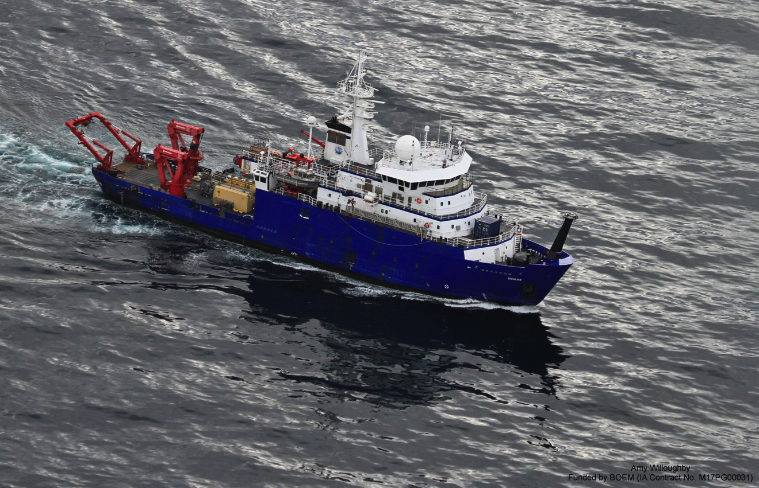
BEAUFORT SHELF BREAK ECOLOGY – PLANKTON, FISH, AND BELUGAS
Carin Ashjian (WHOI), Chief Scientist and Project Leader
carin@whoi.edu
508-289-3457

Slide 2
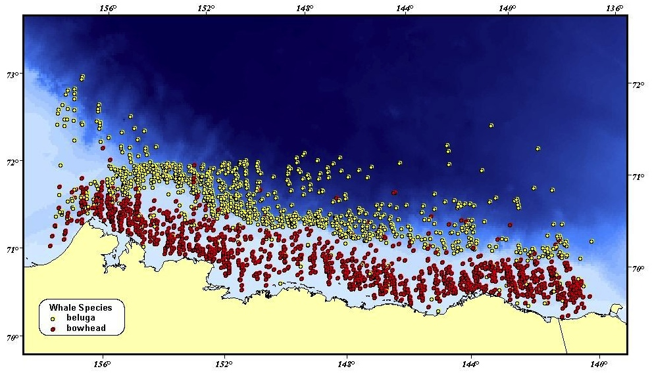
Why are beluga whales often found at the transition from shallow to deep water (shelf break) in the Beaufort Sea?
Bowhead (red) and beluga (yellow) whale
sightings from aerial surveys (S. Moore)

Slide 3
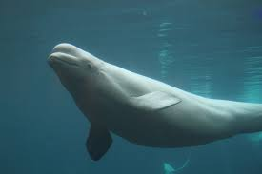
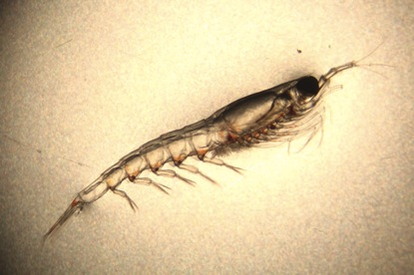
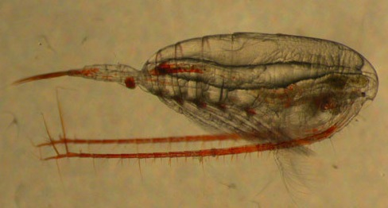
We think belugas are seen at the shelf break because high numbers of their arctic cod prey are there
The food chain we want to study:
Plankton
(Krill, Copepods)
Arctic Cod
Belugas
Images not to scale
The mechanism:
Winds from the east followed by low winds concentrates copepod and krill prey that attracts Arctic cod to feed. The cod then are present in high numbers so that belugas can easily find them

Slide 4
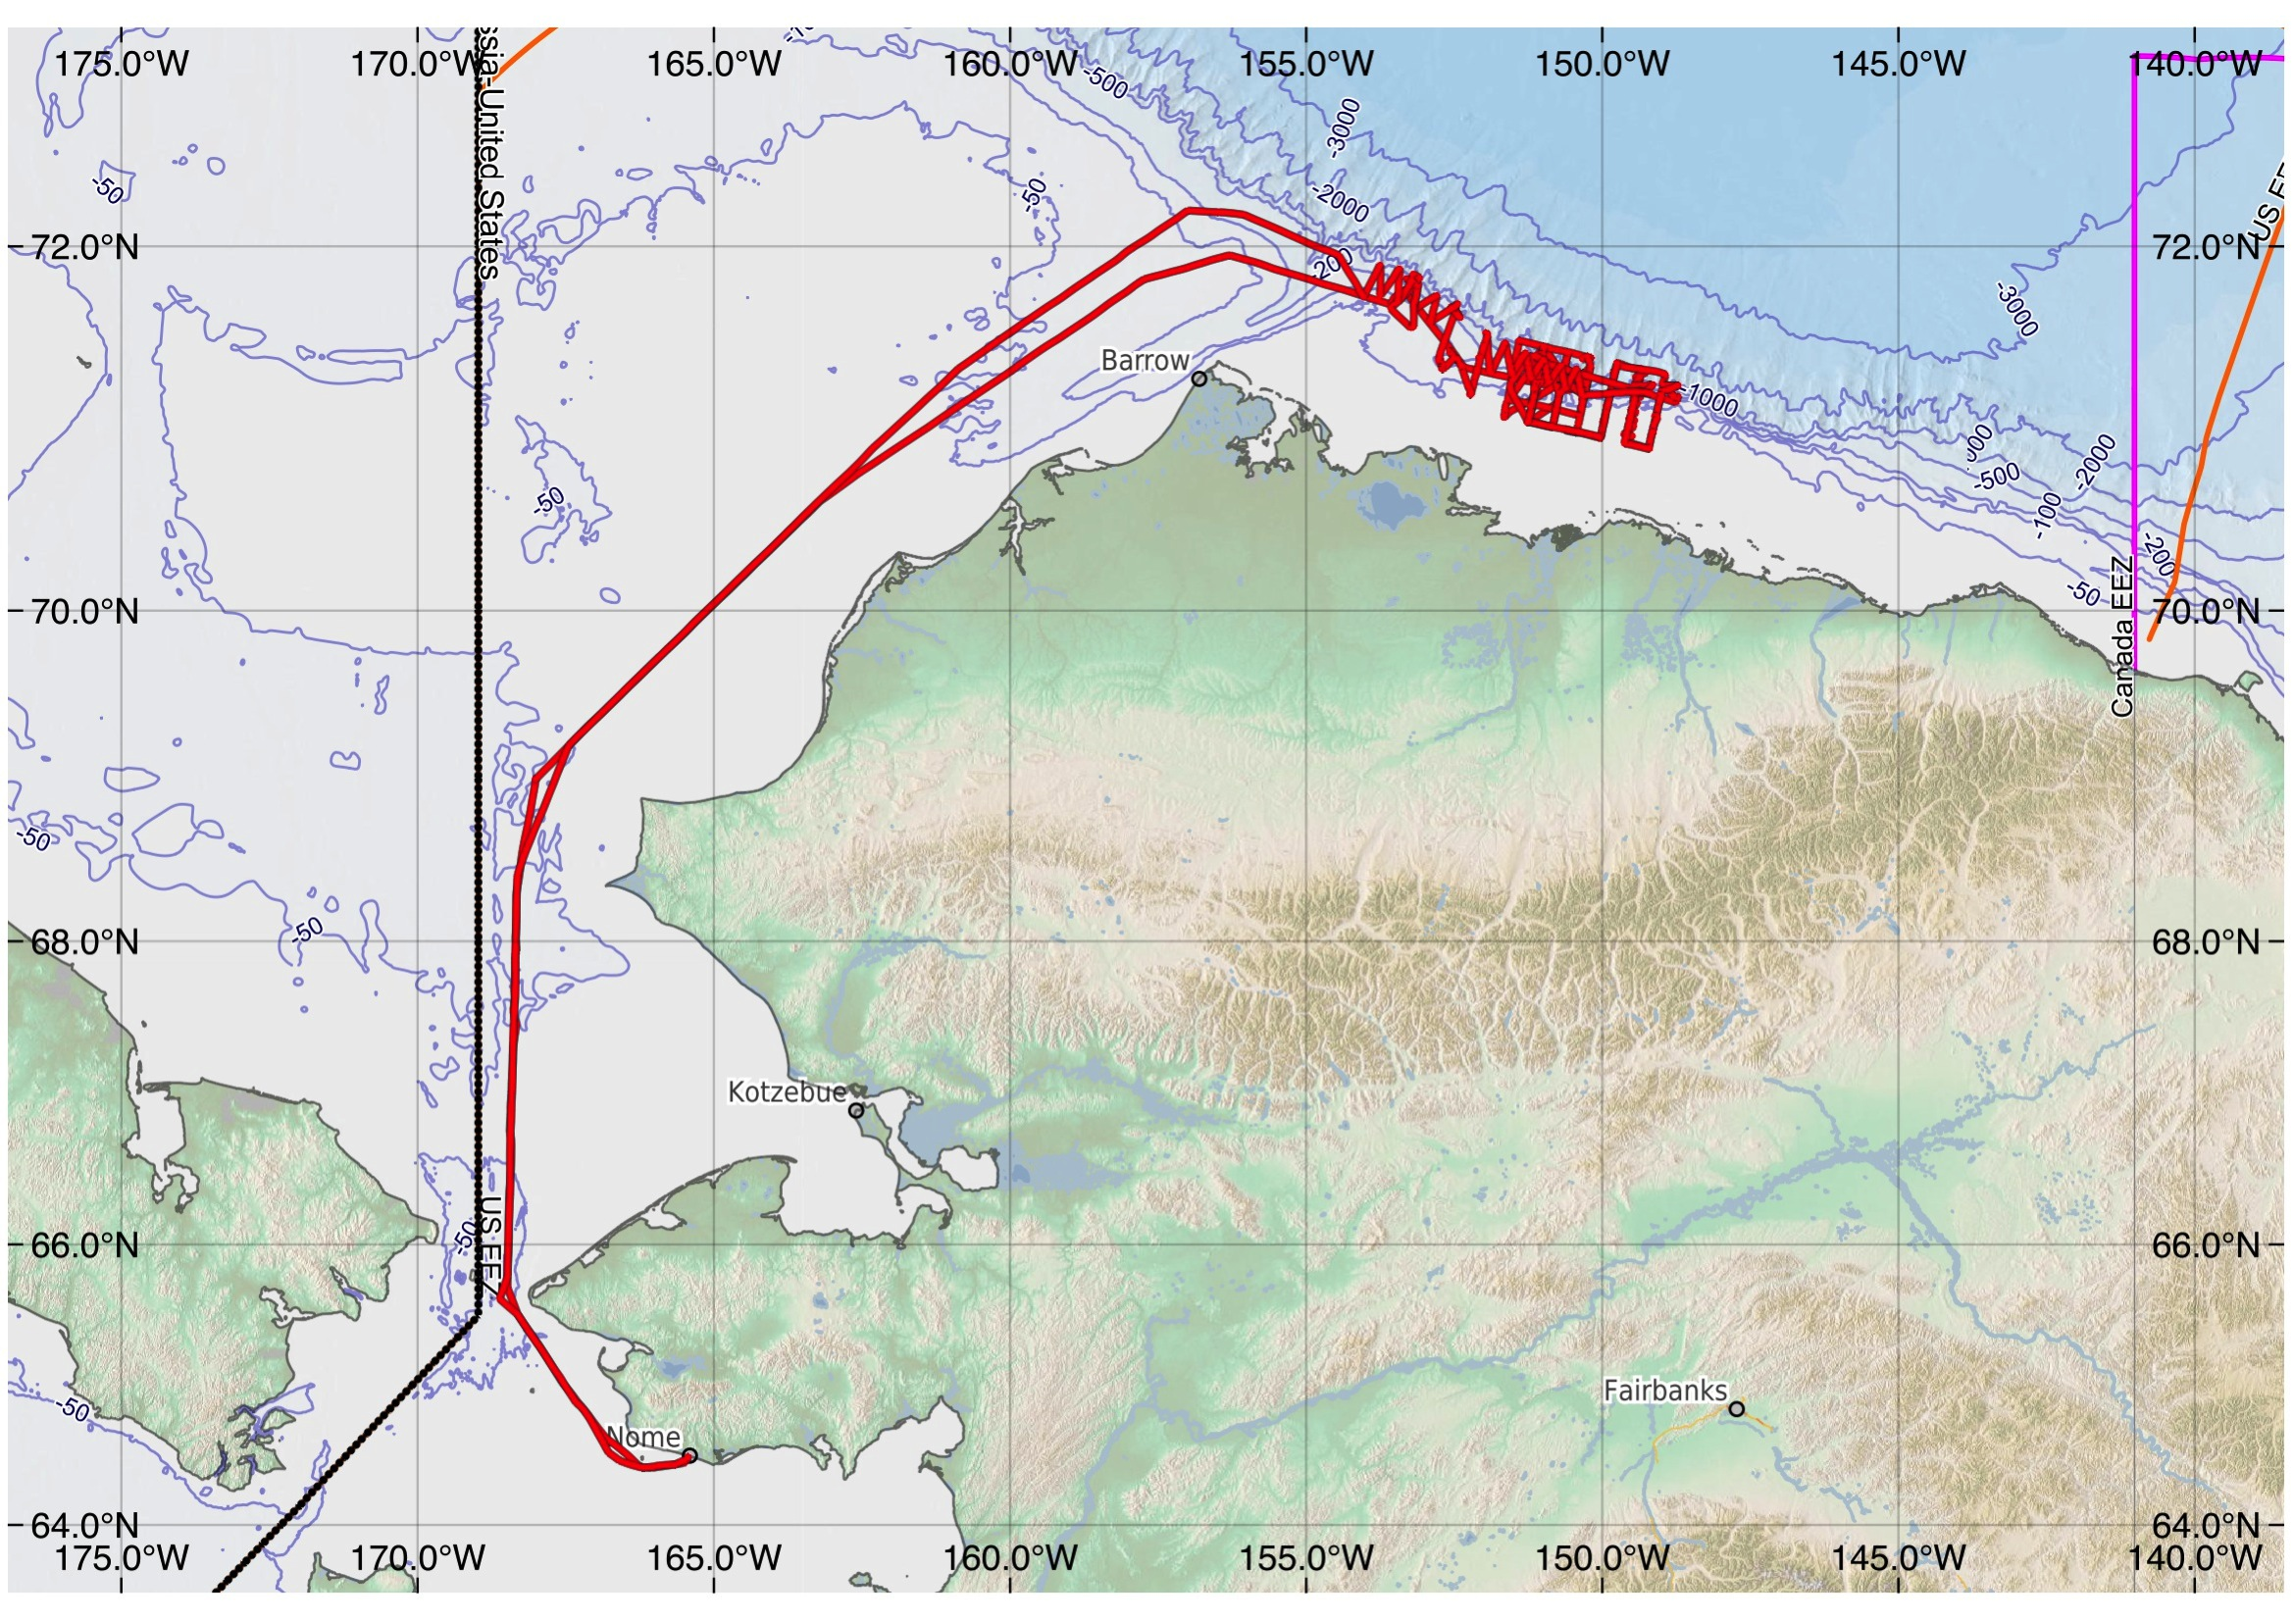
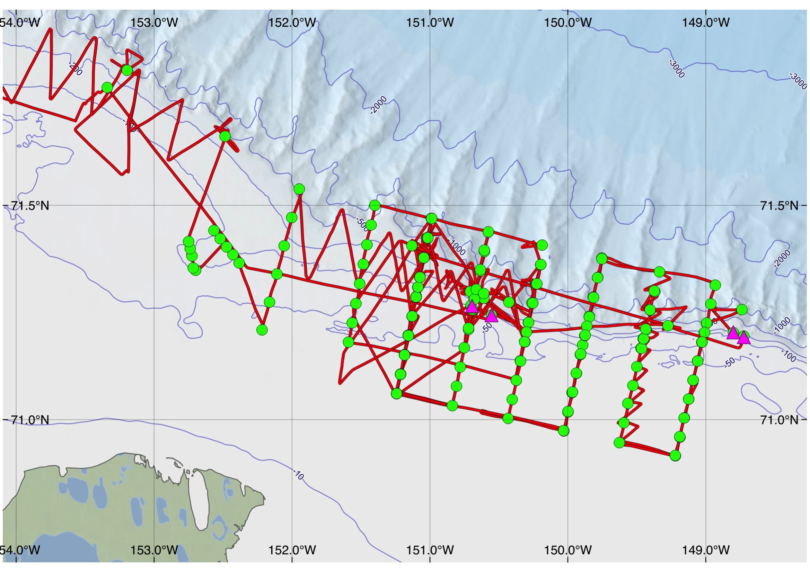
2017 CRUISE TRACK AND SAMPLING LOCATIONS
August 25 – September 18, 2017
Pt. Barrow
84 miles
Kaktovik
120 miles
Cape Halkett
Colville River Delta
30 miles
Cross Island
35 miles
Maps by Steve Roberts
2900 nautical miles or
3300 statutory miles

Slide 5
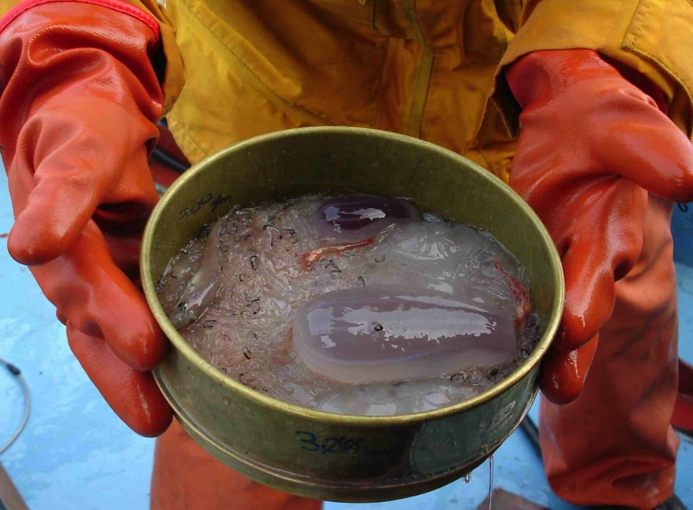
What we measure or sample
Water temperature and salinity, water currents
Plankton numbers, type (copepods, krill), location in water
Fish numbers, type, location in water
What the fish have been eating
Nutritional value of their plankton prey
Marine mammal and bird numbers

Slide 6
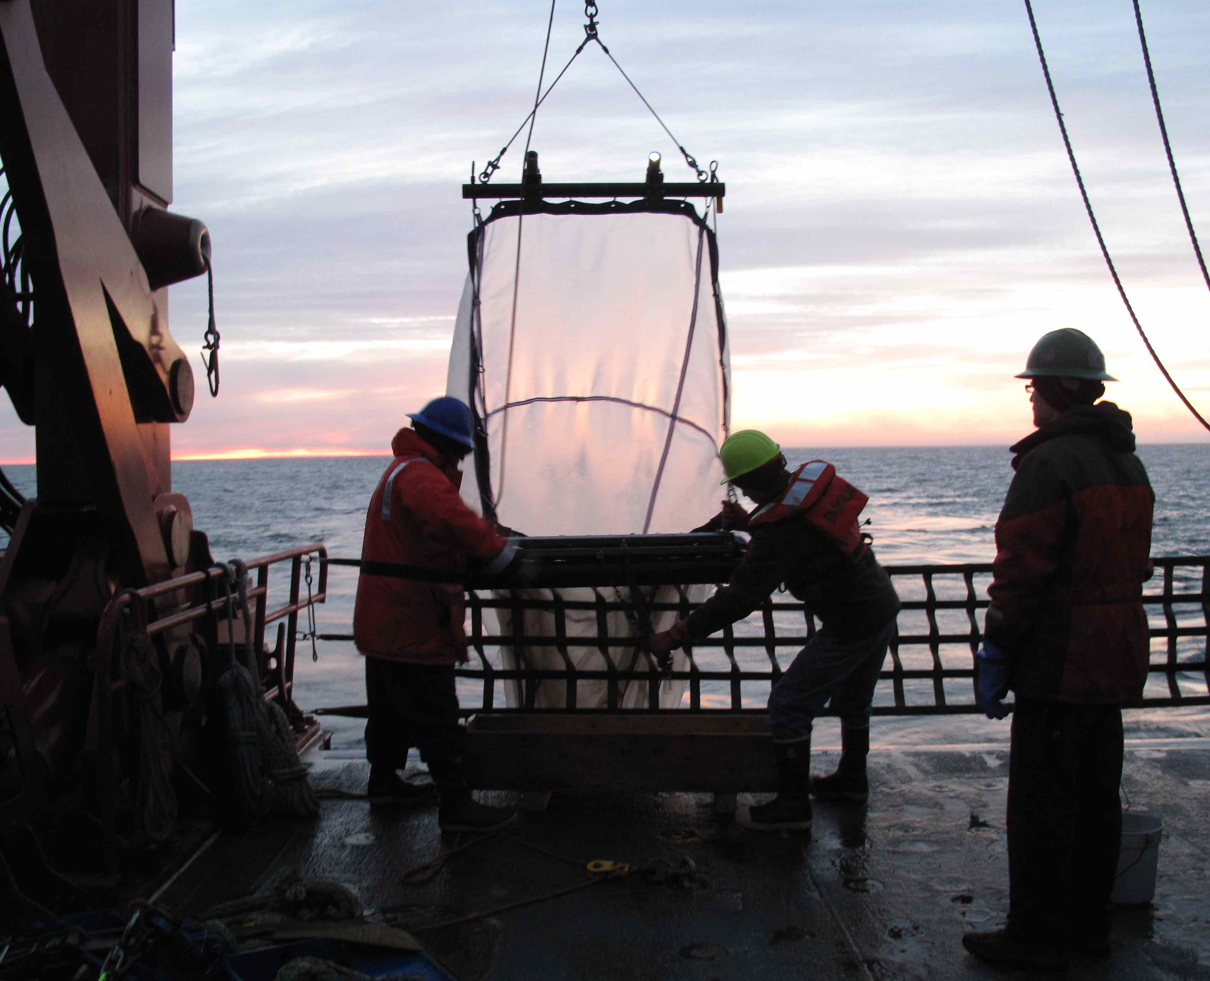
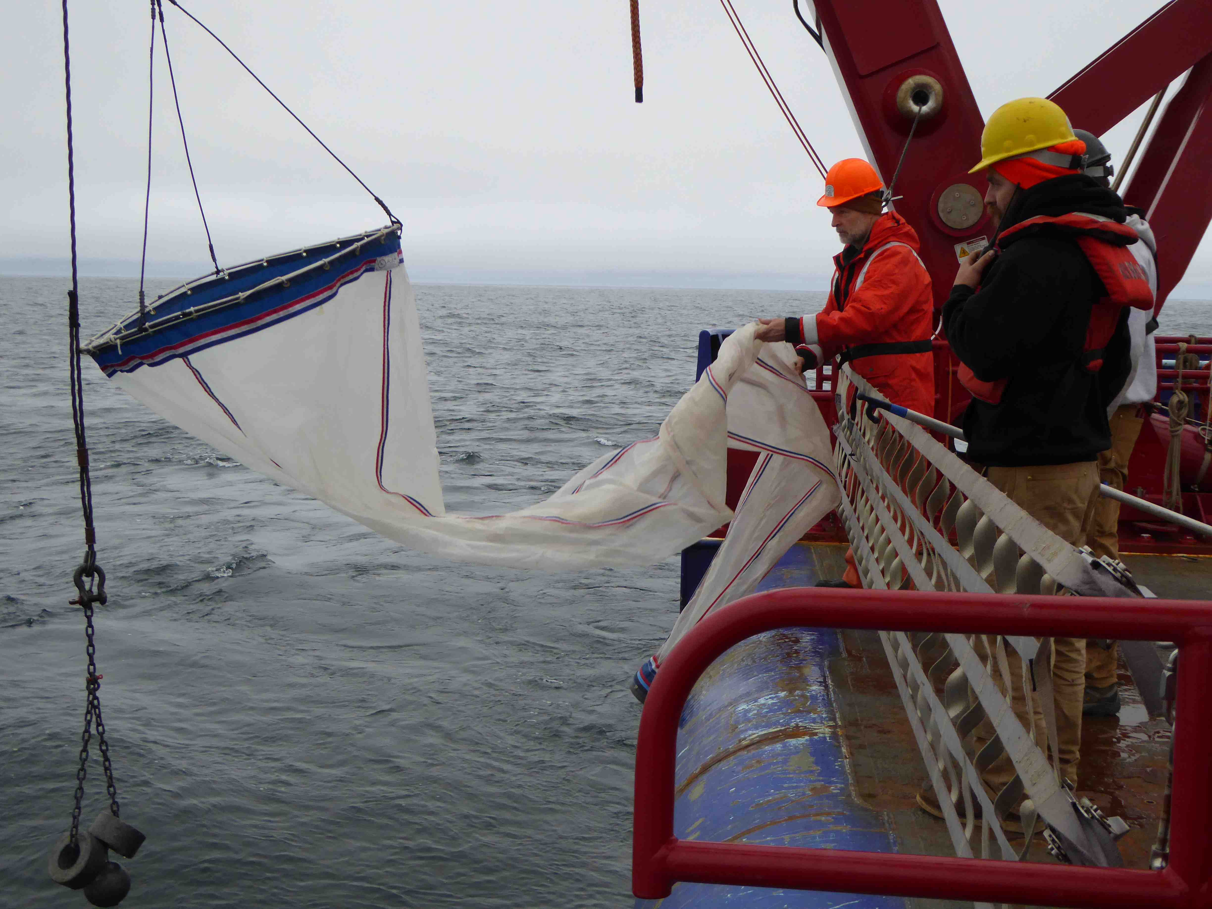
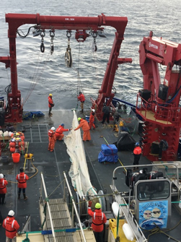
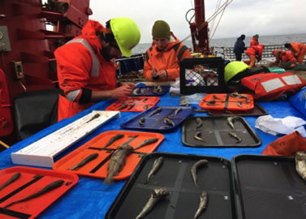
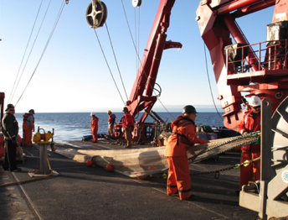
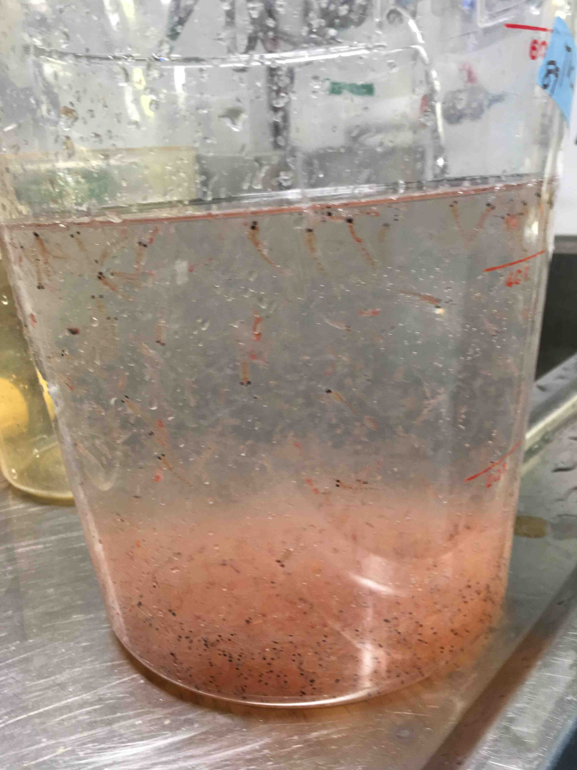
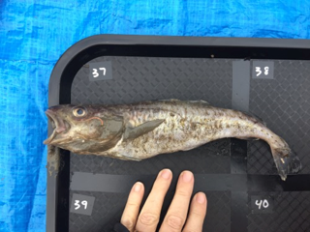
ACTIVITIES
Activity | Number
Sampling Locations | 184
Bongo Tows | 37
CTD Casts | 184
Fish Trawls | 16
Mooring Deployments | 4
Ring Nets | 4
Slocum Glider Recovery | 1
Tucker Trawls | 69

Slide 7
Findings (Preliminary)
Upwelling was seen across the shelf break during winds from the east
Offshore zooplankton were brought onto the shallow shelf during upwelling and then drained off the shelf when upwelling stopped. These zooplankton provide food on the shelf for both Arctic cod and, if dense enough, bowhead whales
More larval Arctic cod were caught during upwelling.
A dense patch of Arctic cod was seen near the sea floor at ~ 820’ depth along the slope. This could be the beluga prey patch!

Slide 8
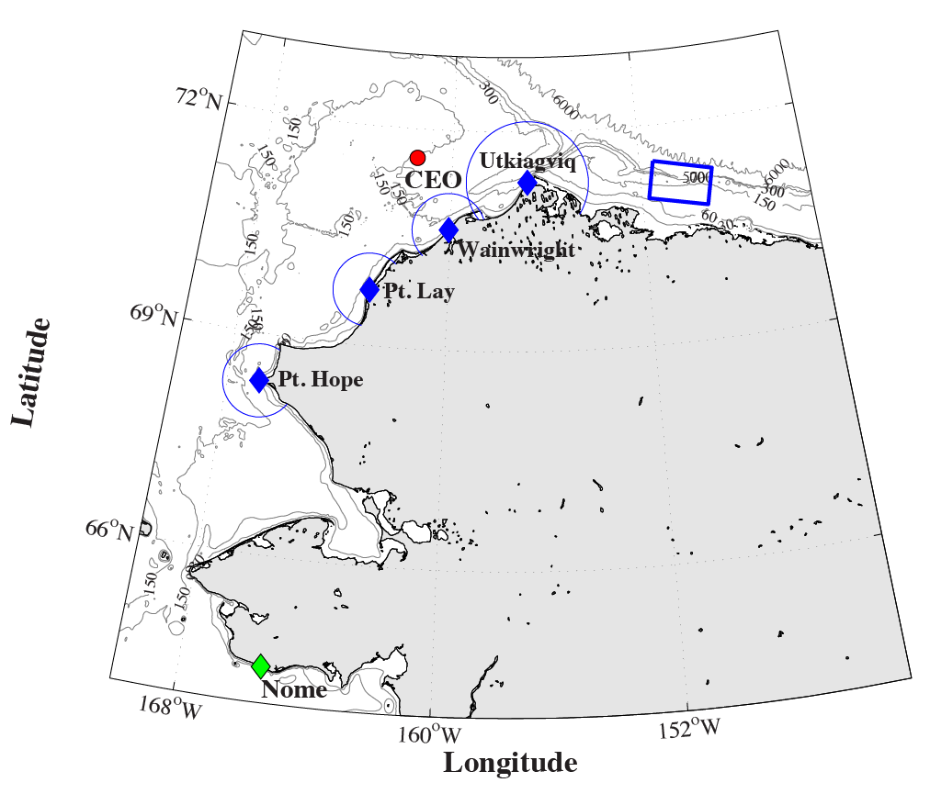
Plans for 2018 Cruise: Aug. 3 – 27, Nome to Nome
Nominal Cruise Track
Likely Sampling Locations
August 3: Leave Nome, Alaska
August 3–5 : Transit through Chukchi Sea
~August 5: Service moorings at Chukchi Ecosystem Observatory (CEO)
~August 5-6: Transit through Beaufort Sea
August 6–24: Work along Beaufort Shelf Break in study area
August 24–27: Transit back to Nome
August 27: Arrive in Nome
Timeline

Slide 9
Communication Plans
Community observer on board during cruise
Daily email updates to interested people and groups from Chief Scientist reporting on ship location, what we have been seeing, weather, and plans
Facebook, Twitter, and Instagram posts by journalism graduate student
One-pagers before and after cruise
Visits to communities and AEWC post-cruises to describe results
Visits to classrooms during these visits
Straightforward project report describing results
Participation of K12 teachers

Slide 10
How to find us
Carin Ashjian, Project Leader and Chief Scientist:
carin@whoi.edu
508-289-3457 (office phone)

