Slide 1
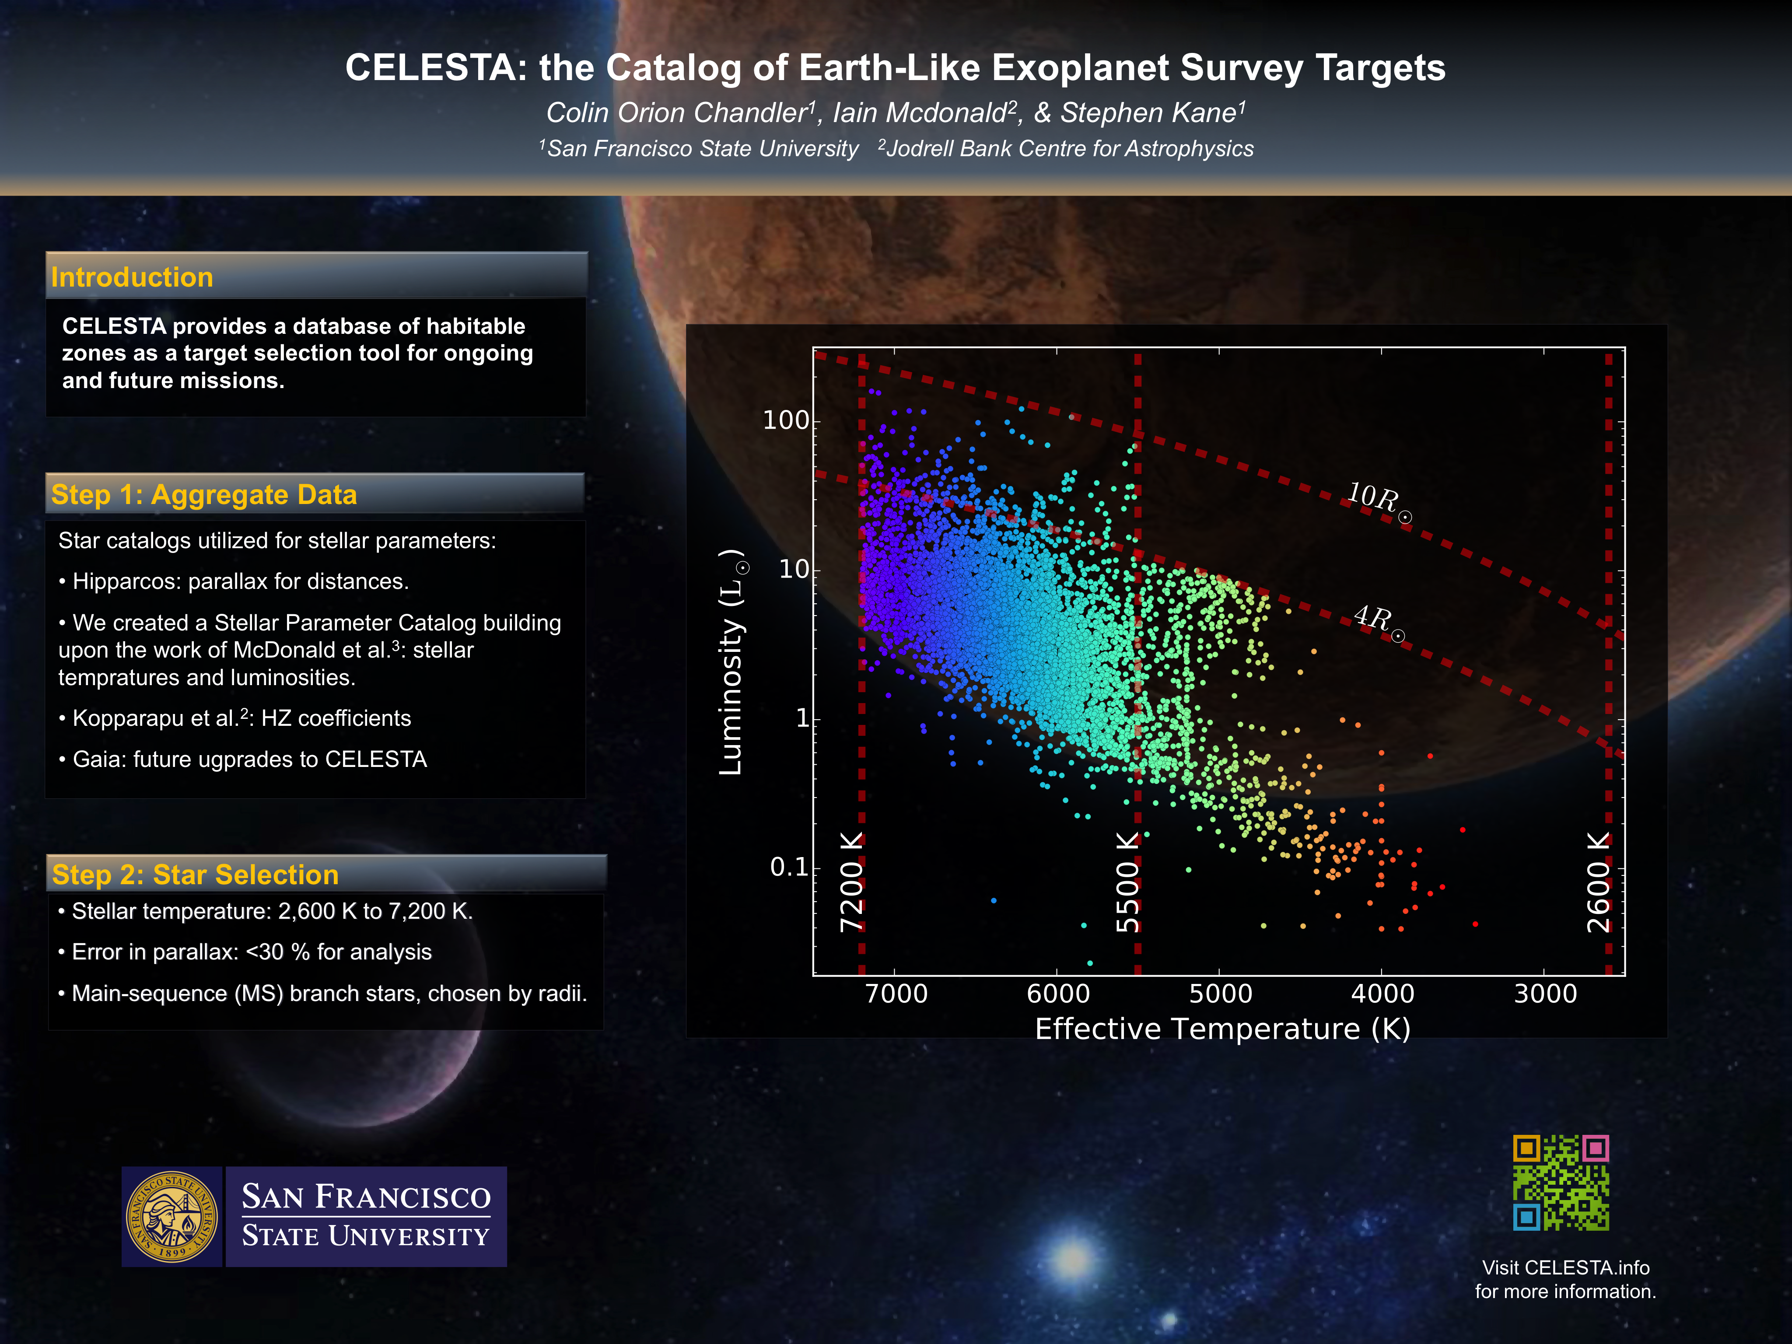

Slide 2
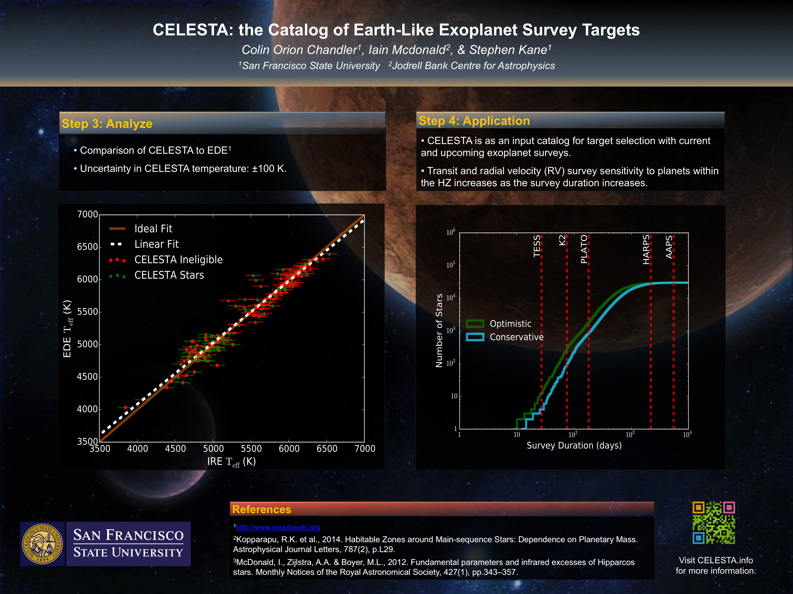

Slide 3
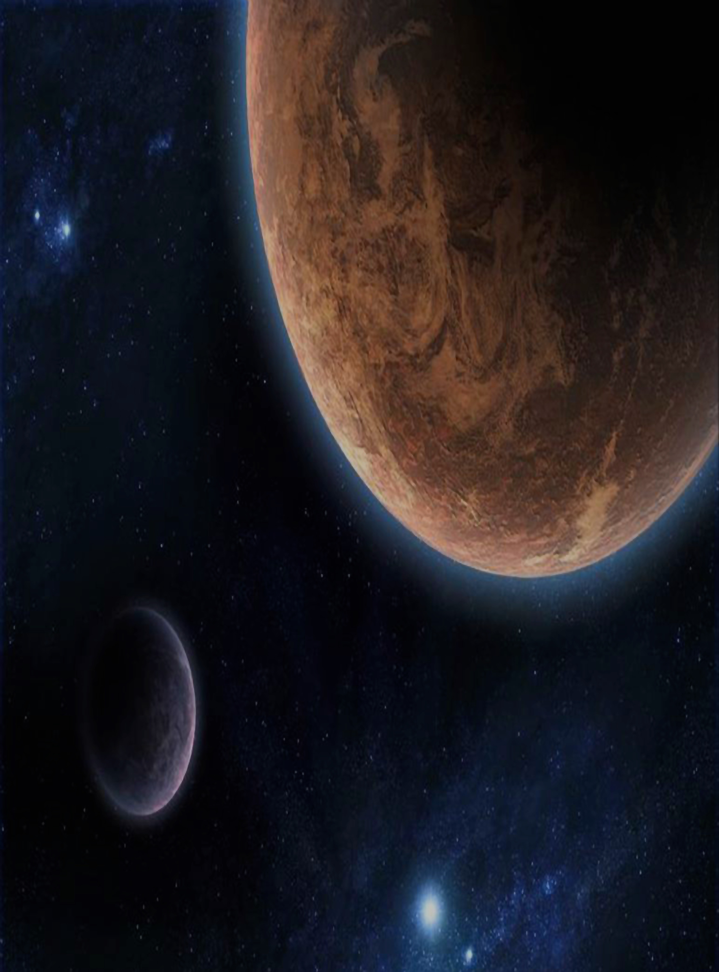

CELESTA: the Catalog of Earth-Like Exoplanet Survey Targets
Colin Orion Chandler¹, Iain Mcdonald², & Stephen Kane¹
¹San Francisco State University ²Jodrell Bank Centre for Astrophysics
Next Step: Online Presence
• Framework for interactive analysis • Vectors = unlimited resolution • Can update data automatically
References
¹http://www.exoplanets.org
²Kopparapu, R.K. et al., 2014. Habitable Zones around Main-sequence Stars: Dependence on Planetary Mass. Astrophysical Journal Letters, 787(2), p.L29.
³McDonald, I., Zijlstra, A.A. & Boyer, M.L., 2012. Fundamental parameters and infrared excesses of Hipparcos stars. Monthly Notices of the Royal Astronomical Society, 427(1), pp.343–357.
Visit CELESTA.info for more information.

Slide 4
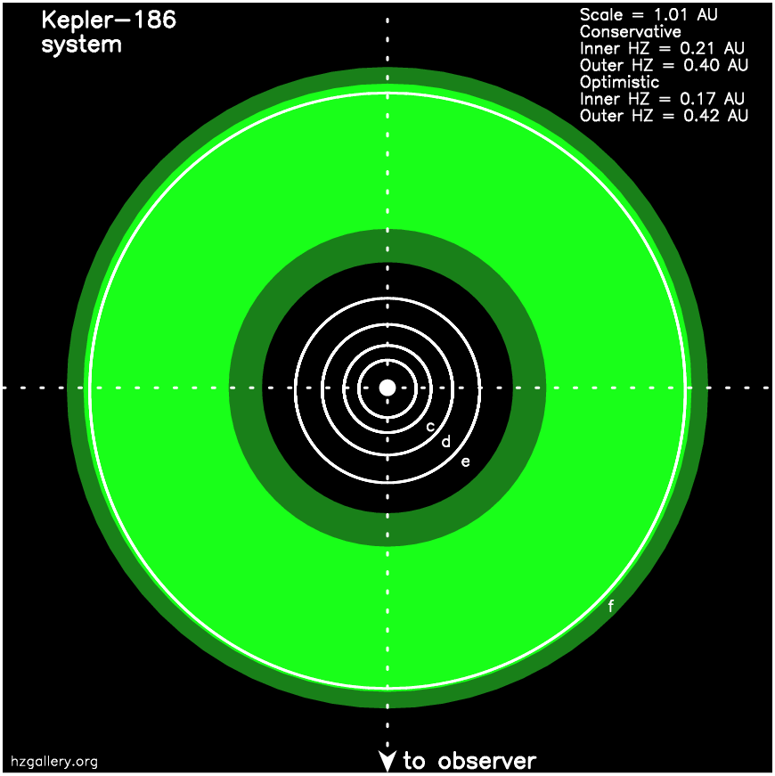
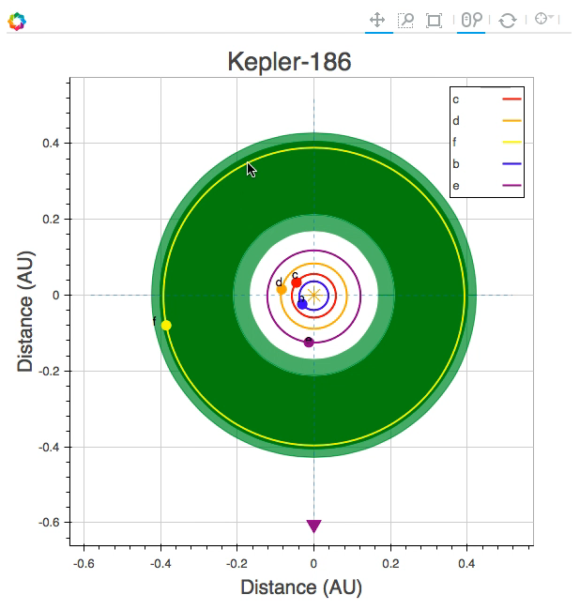
The Habitable Zone Gallery
Stephen Kane¹, Dawn Gelino², Colin Orion Chandler¹
¹San Francisco State University ²NASA/Caltech
Static Image
Interactive Environment
• Kepler-186 from the Habitable Zone Gallery¹
• Image format: PNG
• Kepler-186 with interaction
• Standalone HTML file requires no special software.
• Entire gallery of HTML files generated in < 2 minutes.
References
¹http://hzgallery.org
Visit CELESTA.info for more information.

Slide 5
The Habitable Zone Gallery
Stephen Kane¹, Dawn Gelino², Colin Orion Chandler¹
¹San Francisco State University ²NASA/Caltech
Static Image
Interactive Environment
• Kepler-186 from the Habitable Zone Gallery¹
• Image format: PNG
• Kepler-186 with interaction
• Standalone HTML file requires no special software.
• Entire gallery of HTML files generated in < 2 minutes.
References
¹http://hzgallery.org
Visit CELESTA.info for more information.

Slide 6

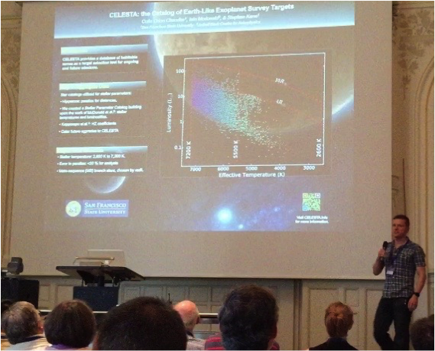
Conclusions
Research Experience
Tips
• Critical Thinking
• Scientific Writing
• Navigating the Peer-Review Process
• LaTeX Manuscript Creation
• Scientific Poster Creation & Presentation
• Scientific Collaboration
• Constructive Critisism
• Conference Participation
• Citation & Article Management
• Python (and Fortran 77) Coding
• How to navigate the Travel Reimbursement process
• … and so much more!
• Visit all of the professors in your major
• List whose work you are interested in
• Look up papers by both the professors and their students
• Go to PAC, talk to people that work with those professors
• Start in the summer – before “Hell Semester”
• Quit your job – “ain’t nobody [in P&A] got time for that!”
• Follow up and follow through!
• Get credit for your Fall/Spring efforts, everyone benefits!
• Attend a conference or workshop – local ones exist!
• Apply for scholarships – you’ll learn what you are “missing”
• Maintain a CV – those empty fields can be filled someday!
Visit CELESTA.info for more information.

