Slide 1
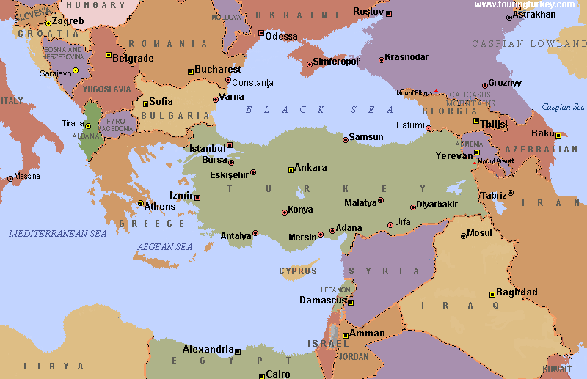
The Mid-east Today

Slide 2
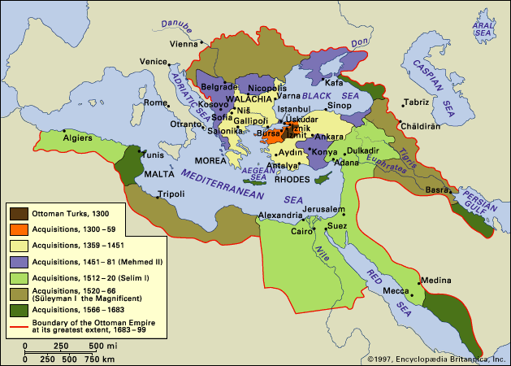
Ottoman Empire: Expansion
6

Slide 3
Ottoman Territorial Losses, 1878-1913
7

Slide 4
Sykes-Picot-Sazonov

Slide 5
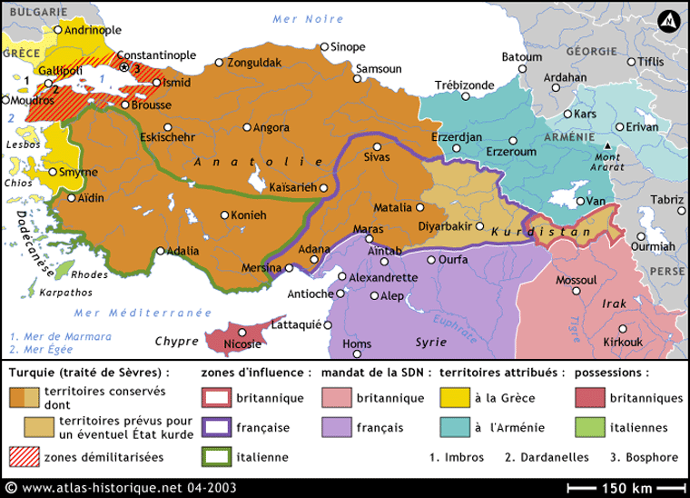
Treaty of Sèvres, 1920
8

Slide 6
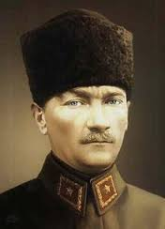
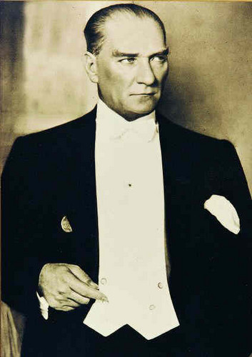
Mustafa Kemal Atatürk

Slide 8
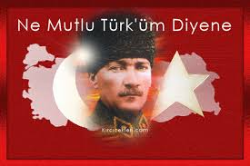
Slogan: “What joy it is to say I am a Turk”

Slide 9
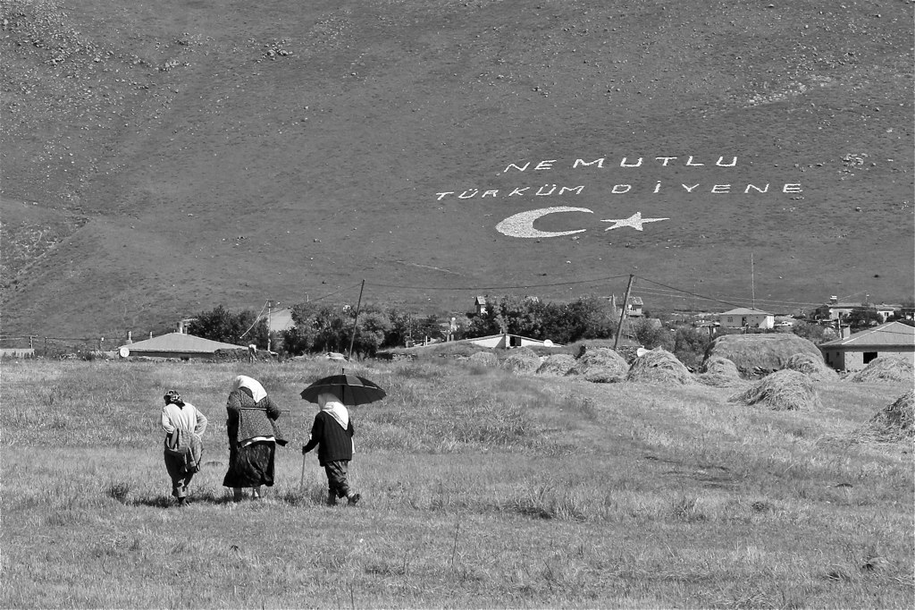
Slogan with star and crescent on hillside

Slide 10
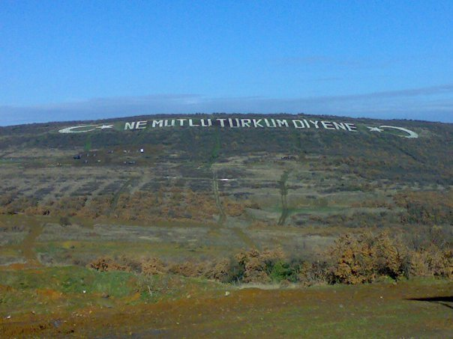
Slogan: The homeland is indivisible

Slide 11
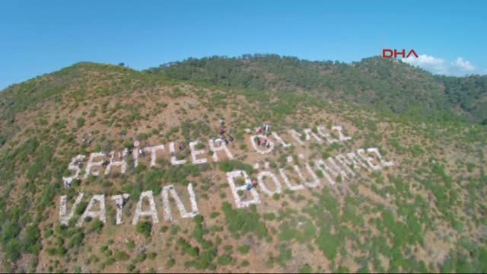

Slide 12
The Kurds: An Overview

Slide 13
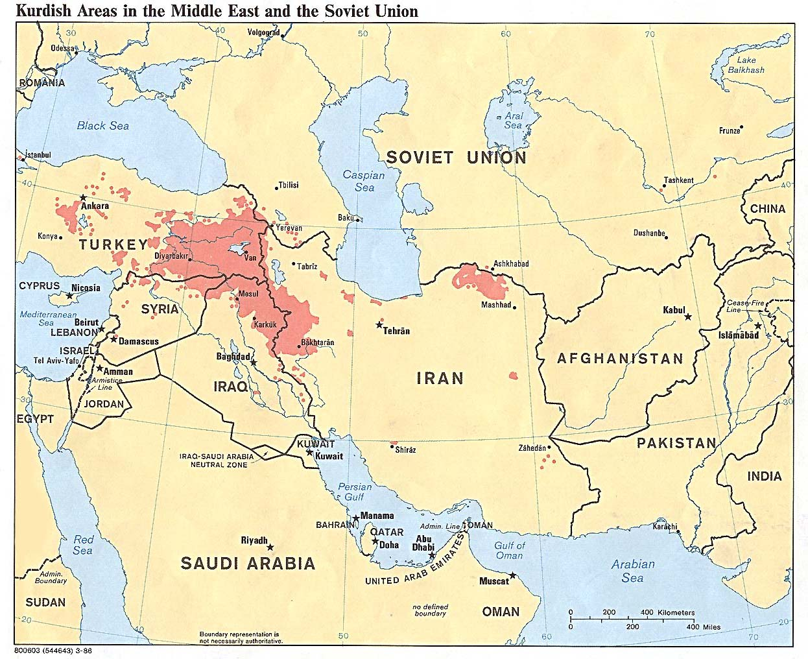
11

Slide 14
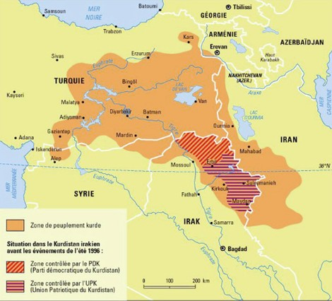
Detail – Map of Kurdish Areas

Slide 15
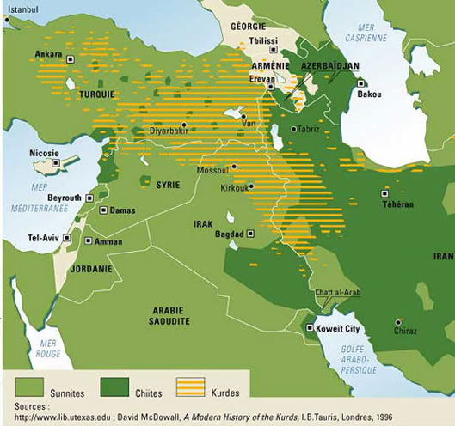
Kurds in the Middle East
12

Slide 16
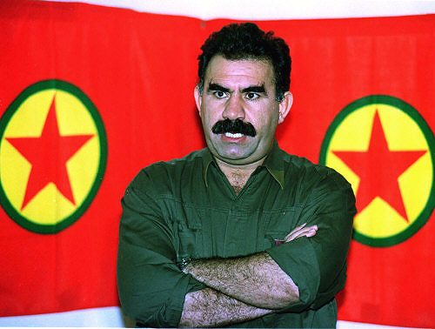
Abdullan Öcalan
Kurdistan Workers Party

Slide 17
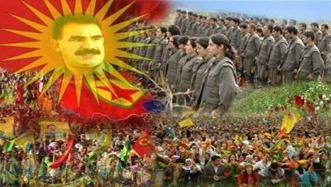
Collage: Headshot of Ocalan, military formation, popular demonstration

Slide 18
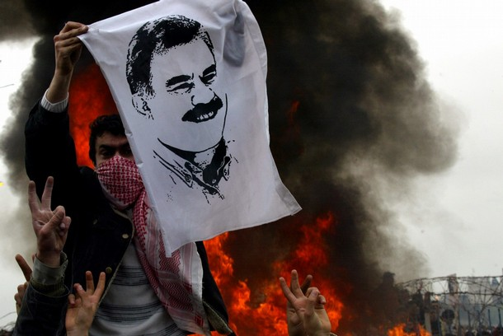
Photos: children; protester waving flag with image of Ocalan

Slide 19
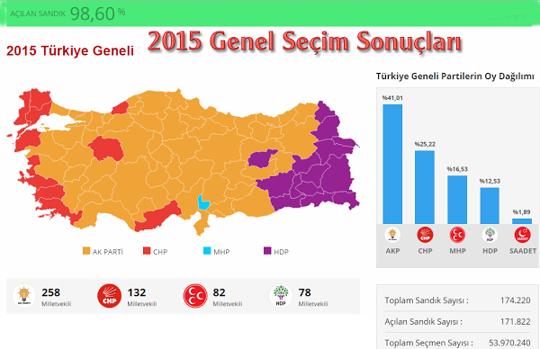
Map showing enclaves of AKP, CHP, MHP, HDP. SAADET in Turkey
13

Slide 20
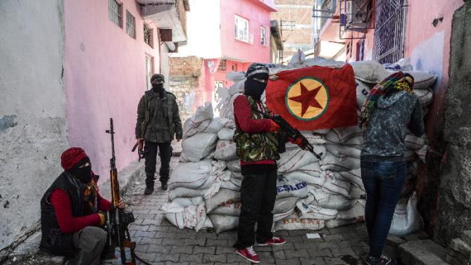
PKK in Diyarbakir, 2015

Slide 21
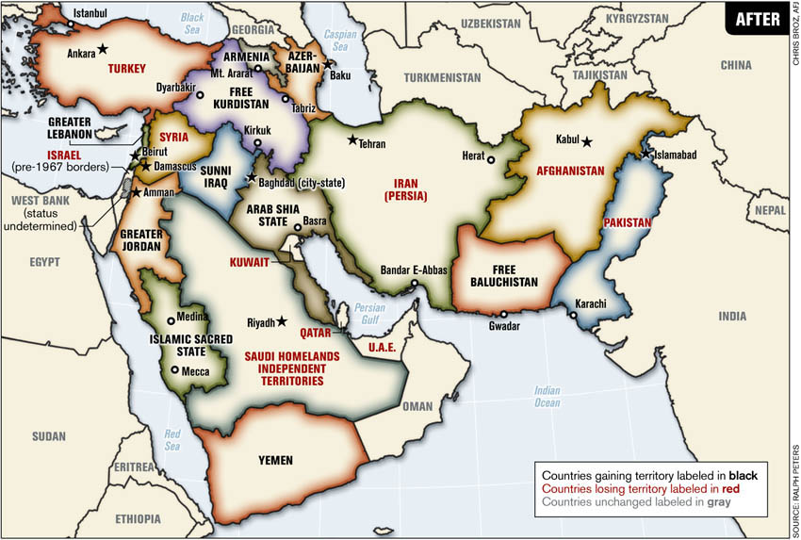

Slide 22
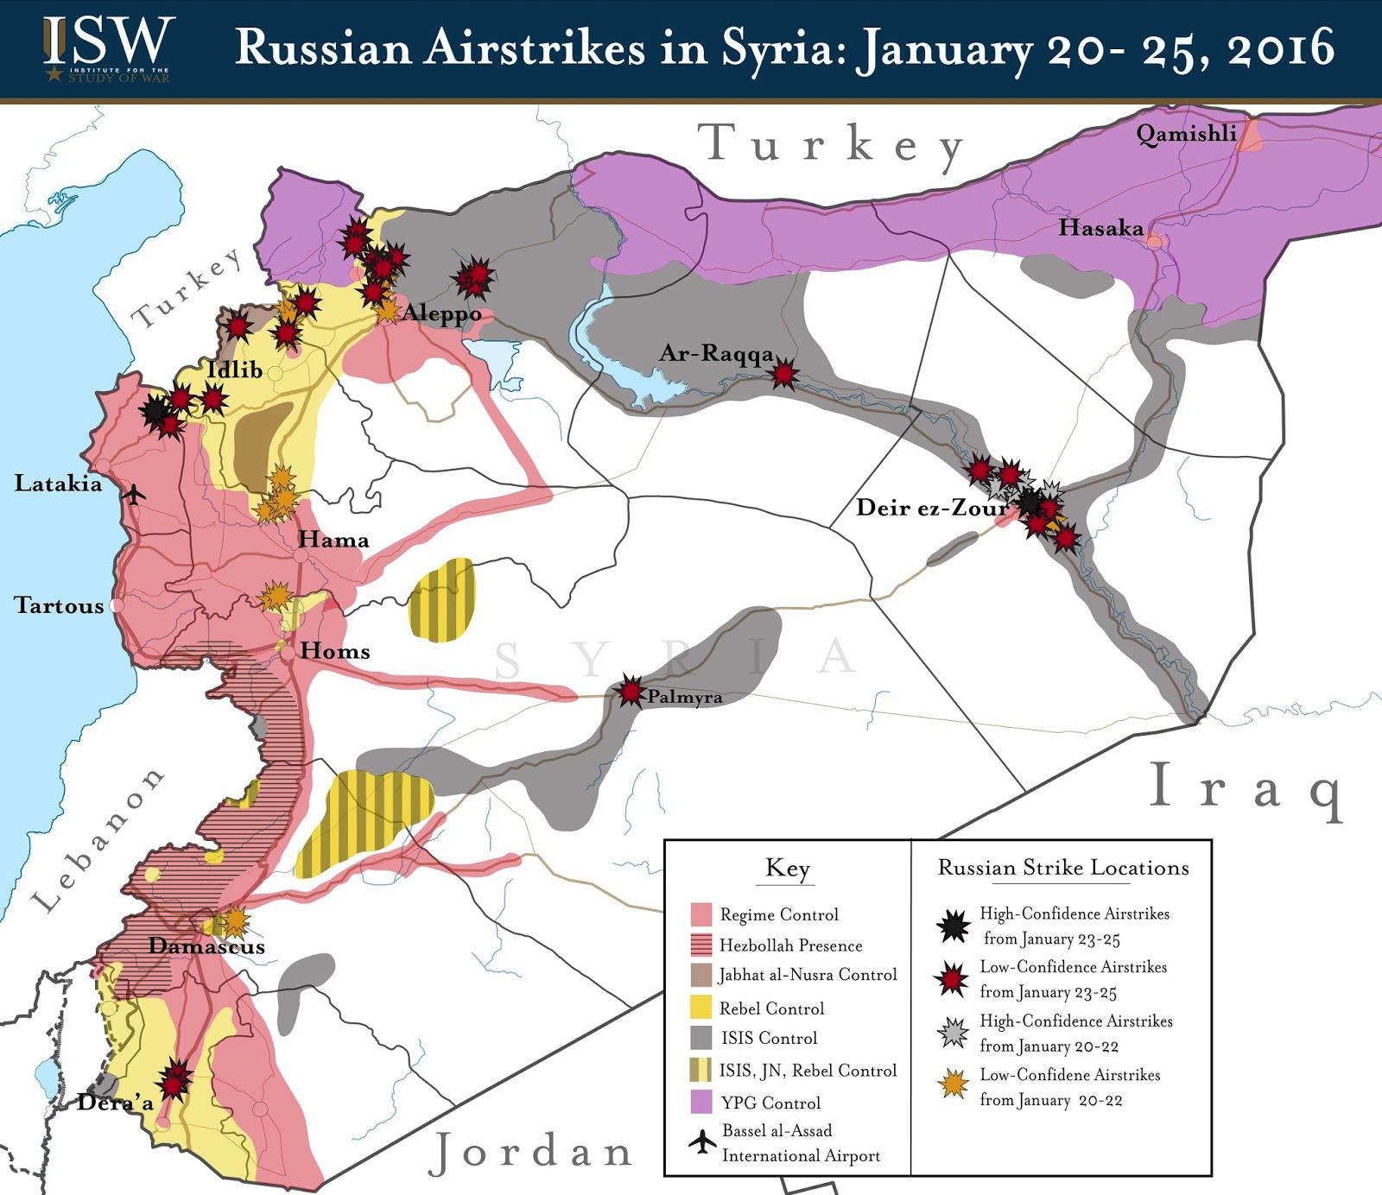

Slide 23
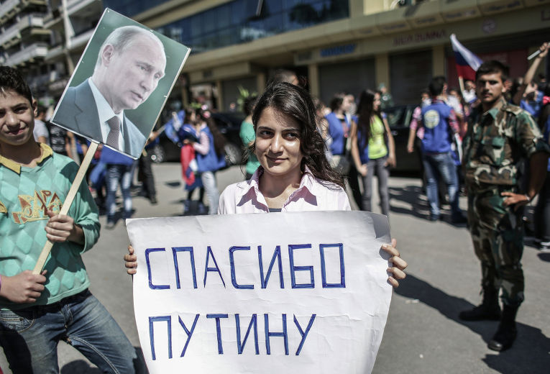
Demonstrators with portrait of Putin and sign

