Slide 1
Congress
Pt.2
By Devyn & Giera

Slide 2
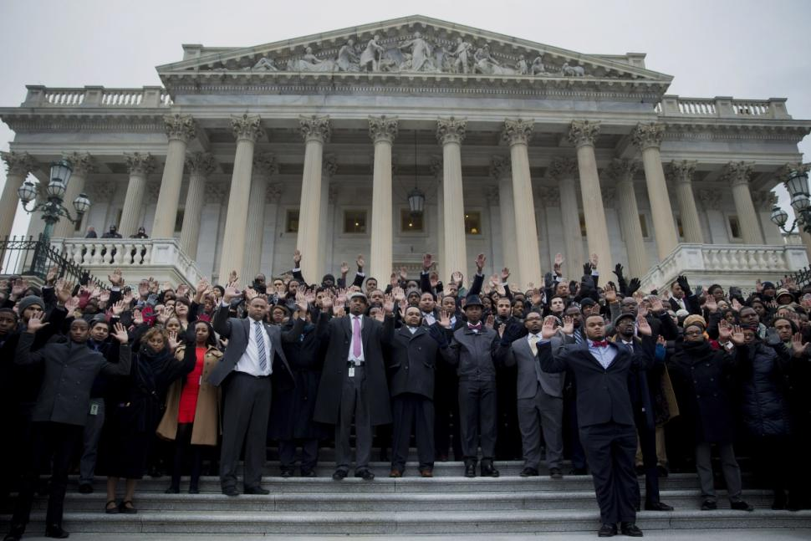
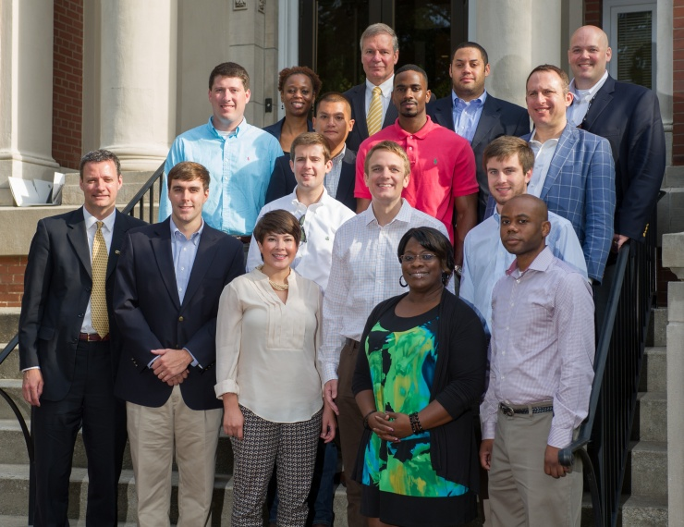
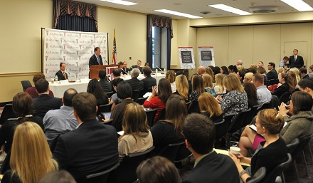
Staffs and Specialized Offices
In 1900, House members had no staffers, and Senators maybe had 1
By 1979, House members averaged 16, and Senators averaged 36
There are over 10,000 people on the personal staffs of members of Congress, 3,000 people on Congressional Committees, and yet another 3,000 on Congressional research agencies.

Slide 3
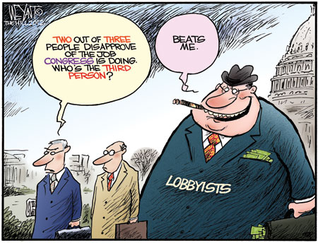
Tasks of Staff Members
Help constituents solve issues, aka help for re-election
Help their Congressmen balance all of their Committees
Finding and selling policies to their Congressmen
Deal with Lobbyists (see above bullet)
Act as negotiators with other staffers
Many titles such as;
Caseworker
Communications Directory/ Press Secretary
Legislative Director
Chief of Staff, etc

Slide 4
Staff Agencies
What they are: A set of staff agencies that work for Congress as a whole, with the knowledge equivalent to what the President’s beliefs are.
Examples:
- The Congressional Research Science (CRS), part of the Library of Congress, party neutral, employs about 900.
- The General Accountability Office (GAO), investigates policies, head appointed by Pres. for 15 yr terms, employs 5,000
- The Congressional Budget Office (CBO), advises Congress on likely impacts of different spendings & attempts to estimate future economic trends

Slide 5
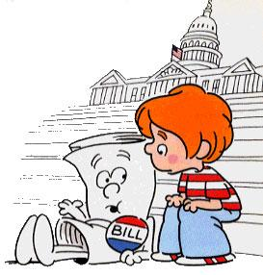
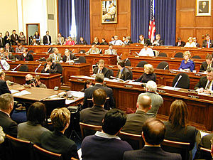
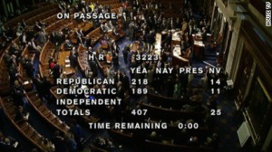
How a Bill Becomes Law
Introducing a Bill. Any member of Congress may do so. In the House you must hand it to a clerk, in Senate, announce bill to Presiding Officer.
Study by Committees. A bill is referred to a committee for consideration by either the Speaker of the House or the Presiding Officer.
Floor Debate. If the bill makes it past a committee, it is sent to the floor to be debated. The Committee of the Whole decides the final shape/outcome.
.Voting. Voice vote: members shouting ‘aye’ or ‘no.’ Division vote: members standing and being counted. Roll-call vote: names recorded of who voted which way.
*Where the President would Veto*
Legislative Productivity: the law is set in place and enforced, in whatever way deems fit.

Slide 6
Resolutions
Although Congress can pass bills, they can also pass Resolutions.
Simple: Used to establish operating rules
Concurrent: Settle Housekeeping and procedures that affect both houses
Joint: Requires approval by both houses and a presidential signature. Closest to a law this way.

Slide 7
How We Compare
The U.S has a total of 535 members of Congress, meaning one representative for every 561,000 citizens.
The British Parliament has 1300+ members, meaning one representative for every 46,000 citizens.
Sweden’s legislature has nearly 350 members, meaning one for every 28,600 citizens.
Buuut, we have State legislatures (about 7,300), which evens things out a tad bit more.

Slide 8
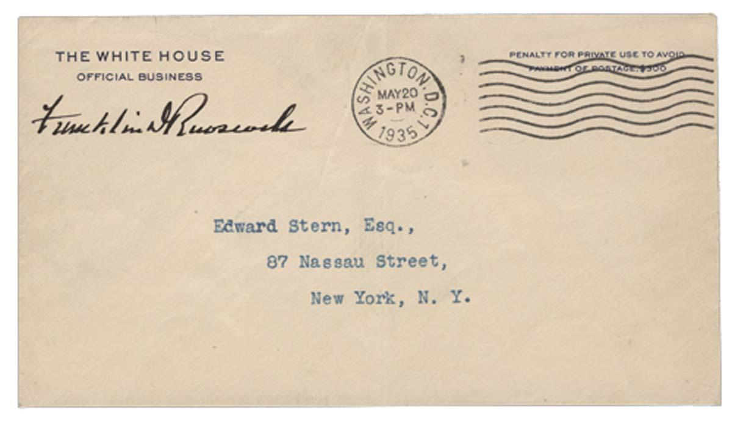
Reforming Congress
Most citizens are only vaguely familiar with the rules and procedures of Congress, but most believe it is overstaffed and self-indulgent. Citizens want better representation.
As a result, there is more pork-barrel legislation-- bills that give tangible benefits to constituents in hopes of their vote.
Members of Congress are allowed to send items in the mail free of charge, known as franking privilege.
For years, Congress exempted itself from many of the laws it passed. As public criticism grew and confidence in the government declined, the 104th Congress passed a law stating that Congress must obey laws such as civil rights, family leave, etc

