Slide 1
Explore-Engage-Pursue
E.E.P
DR
EAAS
DR
EAAS

Slide 2
Dreams
Your Dreams are the Key for Your Life's Journey. It is the engine that moves and motivates you. It creates your passion. Fulfilling your dreams defines your success. We need you to explore, engage and pursue your dreams. All it takes is for you to A.S.K. "What IF I followed my Dream?"

Slide 3
What is E.E.P?
E.E.P stands for Exploring, Engaging and
Pursuing. We believe when it comes to an individual wanting to follow their dreams that these three elements are key. It is philosophy that drives one to action.

Slide 4
Exploring
To explore means to Examine or Evaluate an option or possibility. You must continue to look at all the things that you can and want to be. Take the word can’t out of your vocabulary. You have the ability to be what you want to be. But you must explore first.

Slide 5
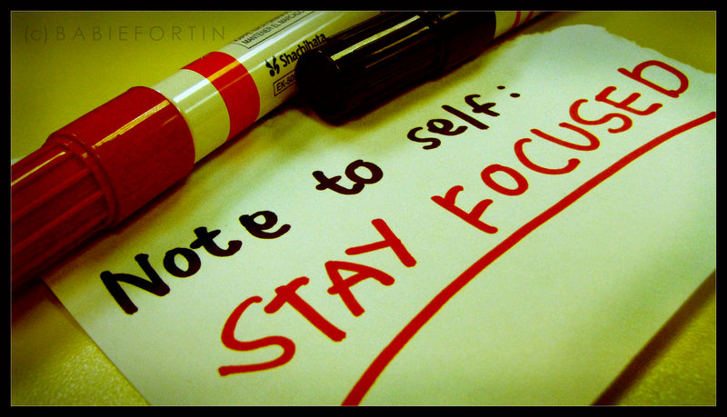
Engaging
To engage means to Participate or Become Involved. You have to constantly be a part of your dreams. No one else can dream for you or truly tell you what your desires are. You must work each day towards your dream by learning, doing and preparing. Just exploring does not move you forward in your dream, you have to be involved and focused. It is a commitment!!!!

Slide 6
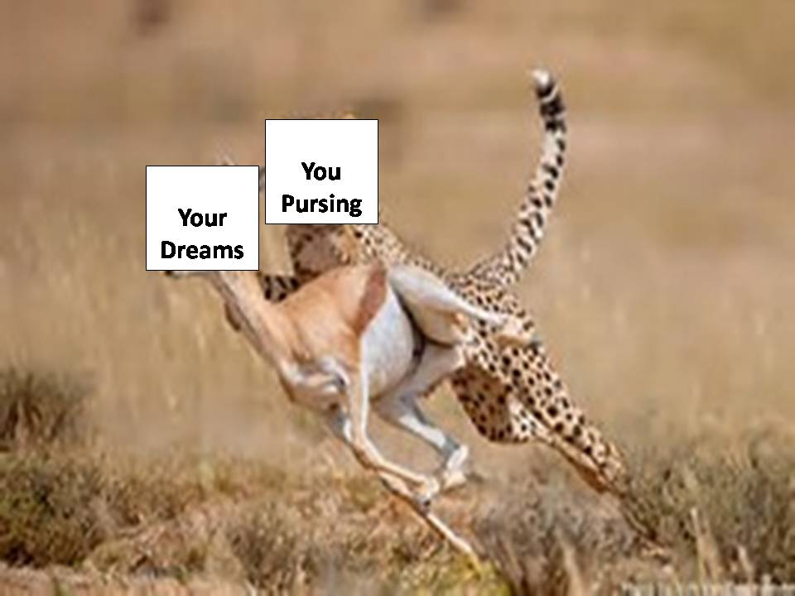
Pursuing
To pursue means to follow. It is following in a manner that the whole purpose is to capture or get what you are following. It starts with a mindset that leads to action. When you are pursing your dreams, you have laid down the ground work by engaging and exploring and now it is time to capture.

Slide 7
So, Where do I start?
We have developed some great tools for you to use to help you get started and all you have to do is download them for you own use (at no cost). Just follow the links below.
The Dream Form – This form is designed to help you think about your dream and dig deeper into understanding them . https://www.whatifjustask.com/eep.html
The A.S.K. Worksheet – This form is designed to help you ask the question what if I dreamed to be a ….. It also helps you seek the answers within yourself and utilize your resources and it helps you to know and believe in your abilities to realize your dream. https://www.whatifjustask.com/eep.html

