Slide 1
Updates in Fall Prevention
Cynthia J. Brown, M.D., MSPH, FACP
Vice‐Chair for Faculty and Staff Development, Department of Medicine
Professor and Director, Division of Gerontology, Geriatrics, and Palliative Care
Integrative Center for Aging Research
University of Alabama at Birmingham

Slide 2
Objectives
After completion of this lecture, the participant will be able to:
Describe the scope of the problem of falls among older adults
State risk factors that contribute to trauma in older adults that fall
Analyze available evidence regarding fall prevention methods

Slide 3
Defining a Fall
The Kellogg International Work Group defined a fall as:
An event which results in a person coming to rest inadvertently on the ground or other lower level and other than as a consequence of the following:
  Sustaining a violent blow;
  Loss of consciousness;
  Sudden onset of paralysis as occurs with a stroke; or
  An epileptic seizure
The prevention of falls in later life. A report of the Kellogg International Work Group on the Prevention of Falls by the Elderly. Dan Med Bull. 1987 Apr;34 Suppl 4:1-24.

Slide 4
Defining a Fall
A Cochrane Review found most commonly used research definition was:
Unintentionally coming to rest on ground, floor, or other lower level; excludes coming to rest against furniture, wall, or other structure.
Buchner et al. Frailty and Injuries: Cooperative Studies of Intervention Techniques trials, J Am Geriatr Soc 1993

Slide 5
Defining a Fall
Qualitative study of 477 older adults, average age was 70 (SD=8, range 55–92) years
Asked: ‘‘How would you describe or define a fall?’’
Most commonly, seniors included motor control (slip, trip, stumble), followed by loss of balance, injury, and obstacles.
KEY POINT: Seniors associated falls with antecedents and consequences, whereas research studies focus mainly on description of event.

Slide 6
Determining the Scope of the Problem

Slide 7
WHO, The Injury Chart Book, 2002

Slide 8
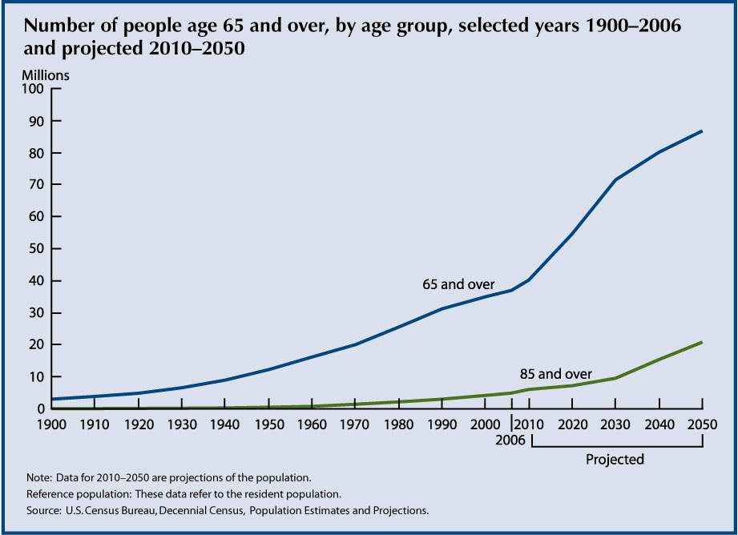
The Population
Baby Boomers started turning 65
in 2011

Slide 9
Falls Incidence: Community
One-third of community-dwelling persons
age > 65 years, fall each year;
Less than half talk to healthcare provider
̴ 50% of cases, falls recurrent
Rates increase
  With age
  During the month after hospital discharge

Slide 10
Falls Morbidity: Community
In next 17 seconds, an older adult will be treated in hospital ED for fall related injuries.
10-15% of falls result in injury requiring medical attention
Leading cause of injury-related visits to EDs in US
In 2011, 2.4 million nonfatal fall injuries treated in emergency departments.

Slide 11
~ 3 million

Slide 12
Injuries Associated with Falls:
Spinal Cord Injury
Average age at injury has moved from 29 years in 1970's to 42 years in 2015.
Distribution of causes of SCI have changed drastically since 2010.

Slide 13
Injuries Associated with Falls:
Spinal Cord Injury (SCI)
Traumatic spinal cord injury after age 65 most often caused by a fall (41.5%).
Incidence much higher than previously shown.
Selvarajah S, et al. J Neurotrauma 2014;31:228–238

Slide 14
Injuries Associated with Falls:
Spinal Cord Injury (SCI)
Older adults have higher adjusted odds of adverse outcomes:
Mortality in ED (AOR = 4.4; 95% CI: 1.1–16.6),
Mortality during hospitalization (AOR = 5.9; 95% CI:4.7–7.4)
Discharged to chronic care (AOR = 3.7; 95% CI: 3.0–4.5).

Slide 15
Injuries Associated with Falls:
Traumatic Brain Injury (TBI)
Falls leading cause of TBI (40%) in US
Falls cause 81% of all TBIs among adults aged 65 years and older.
Highest rates of TBI-related hospitalization and death seen in adults ≥ 75 years
  Hospitalization: 339 per 100,000
  Death: 57 per 100,000
In every age group, TBI rates are higher for males than for females

Slide 16
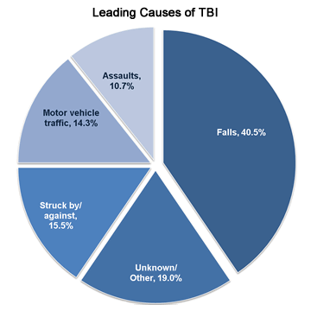
http://www.cdc.gov/traumaticbraininjury/get_the_facts.html

Slide 17
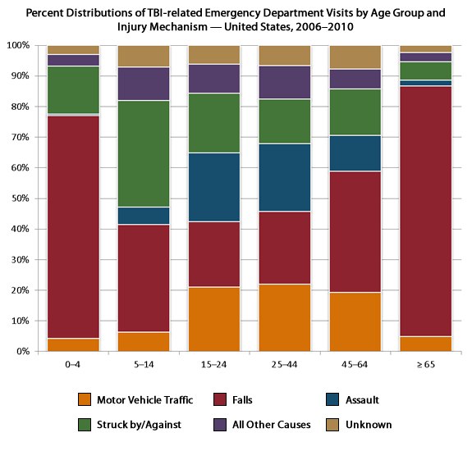
TBI Related ED Visits
http://www.cdc.gov/traumaticbraininjury/data/dist_ed.html

Slide 18
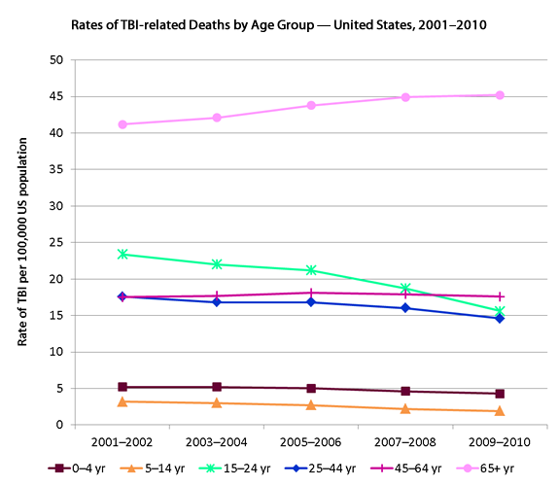
TBI-Related Deaths by Age Group
http://www.cdc.gov/traumaticbraininjury/data/rates_deaths_byage.html

Slide 19
Injuries Associated with Falls:
Hip Fracture
In 2010, 258,000 hospital admissions among older adults.
By 2030, projected to reach 289,000, a 12% increase.
More than 95% caused by falling, most often by falling sideways onto the hip.
Women sustain three-quarters of all hip fractures.
White women are more likely to sustain hip fractures than are African-American or Asian women.
People ≥ 85 are 10 to 15 times more likely to sustain hip fractures than are those aged 60 to 65.

Slide 20
Injuries Associated with Falls:
Hip Fracture
One in three adults who lived independently before hip fracture remains in a nursing home for at least a year after injury.
A large proportion of fall deaths due to complications following a hip fracture; 20% die within a year of injury

Slide 21
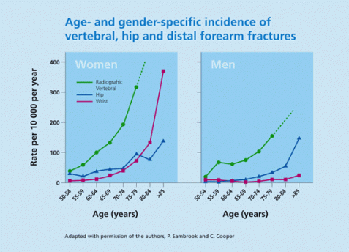

Slide 23
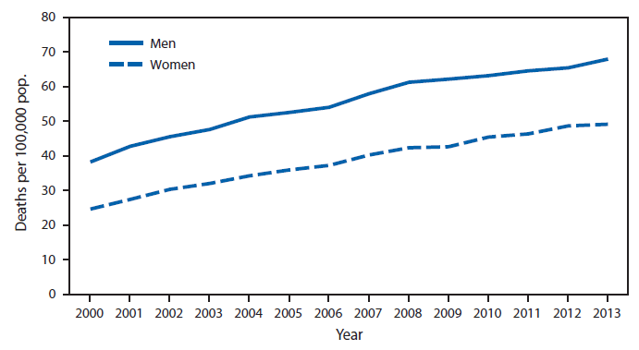
Death Rates from Unintentional Falls Among Older Adults
http://www.cdc.gov/mmwr/preview/mmwrhtml/mm6416a12.htm

Slide 24
Falls Cost: Community
Direct medical costs: $34 billion (2013) with about 78% being reimbursed by Medicare
Breakdown of direct medical costs:
  Inpatient hospitalizations: 65%
  Medical office visits: 10%
  Home health care: 10%
  Hospital outpatient visits: 8%
  Emergency room visits: 7%
  Prescription drugs: 1%
Notes:
Direct costs are what patients and insurance companies pay for treating fall-related injuries. These costs include fees for hospital and nursing home care, doctors and other professional services, rehabilitation, community-based services, use of medical equipment, prescription drugs, changes made to the home, and insurance processing.

Slide 25
Falls Cost: Community
Among community-dwelling older adults, fall-related injury one of 20 most expensive medical conditions.
On average, hospitalization cost for fall injury $30,000.
Total cost increased with age and higher among women.
Direct Medical Costs | 2012 | 2015
Fatal Injuries | $616.5 million | $637.5 million
Non-fatal Injuries | $30.3 billion | $31.3 billion
Burns EB, Stevens JA, Lee RL. The direct costs of fatal and non-fatal falls among older adults—United States. J Safety Res 2016:58.

Slide 26
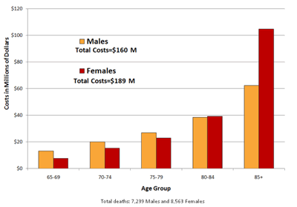
Falls Cost: Community

Slide 27
In 2000, 78% of fall deaths, and 79% of total costs, due to TBI and injuries to lower extremities.
Injuries to internal organs responsible for 28% of fall deaths and accounted for 29% of costs.
Fractures most common and costly nonfatal injuries.
Just over one-third of nonfatal injuries were fractures, but accounted for 61% of total nonfatal costs—or $12 billion.

Slide 28
Falls Cost: Community
Doesn’t account for long-term effects of injuries such as
  disability
  dependence on others
  lost time from work and household duties
  and reduced quality of life

Slide 29
Fall Risk Factors : Community
Focus of most fall research
Falls in community-dwelling older adults tend to be multifactorial in nature
As number of risk factors increases, so does risk of falls

Slide 30
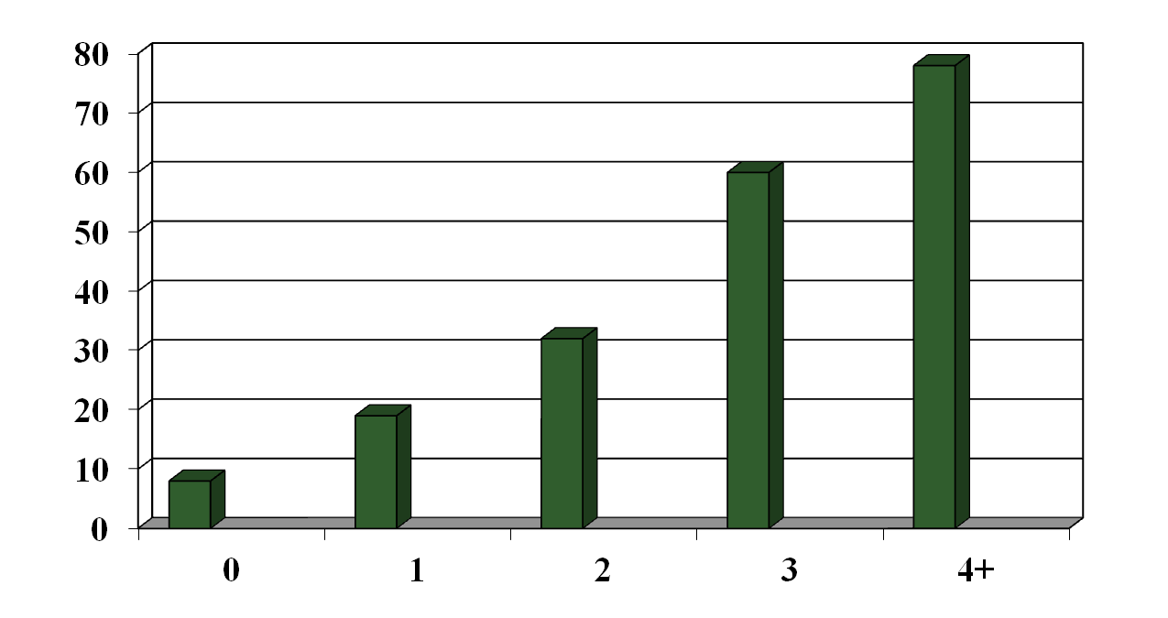
Occurrence of Falls According to Number of Risk Factors
78%
8%
Number of Risk Factors
Tinetti, 1988

Slide 31
Most Common Risk Factors
Risk factor Significant/total Mean RR-OR Range
Muscle weakness | 10/11 | 4.4 | 1.5-10.3
History of falls | 12/13 | 3.0 | 1.7-7.0
Gait deficit | 10/12 | 2.9 | 1.3-5.6
Balance deficit | 8/11 | 2.9 | 1.6-5.4
Use asst device | 6/12 | 2.6 | 1.2-4.6
Visual deficit | 6/12 | 2.5 | 1.6-3.5
Arthritis | 3/7 | 2.4 | 1.9-2.9
Cognitive impairment | 4/11 | 1.8 | 1.0-2.3
AGS Guidelines, 2011

Slide 32
Medications and Falls
Psychotropics, any: RR 1.73 (1.52-1.97)
  Neuroleptics: 1.50 (1.25-1.79)
  Sedative/hypnotics: 1.54 (1.40-1.70)
  Antidepressants: 1.66 (1.40-1.95)
  Benzodiazepines: 1.48 (1.23-1.77)
Diuretics: 1.08 (1.02-1.16)
Anti-arrhythmics (Ia) : 1.59 (1.02-2.48)
Digoxin: 1.22 (1.05-1.42)
Notes:
Medication use has also been examined with the following results.

Slide 33
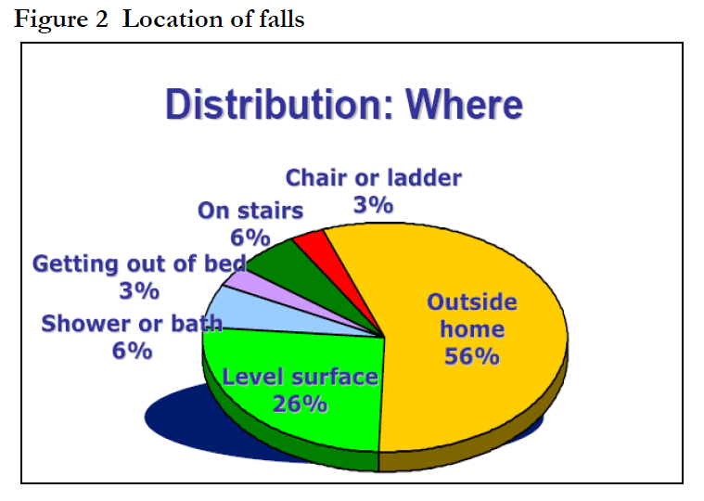
Global Report of Fall Prevention Epidemiology of Falls

Slide 34
Single-intervention Strategies
  Community based balance or strengthening exercise program (Tai chi)
    Estimated risk reduction 29-49%
  Professionally supervised balance and gait training and muscle strengthening exercise
    Estimated risk reduction 14-27%
  Gradual discontinuation of psychotropic medications
    Estimated risk reduction 39%
  Modification of home hazards after hospital discharge
    Estimated risk reduction 19%

Slide 35
Multifactorial Risk Assessment with Targeted Management
Estimated risk reduction 25-39%
Successful components include:
  Review and possible reduction of medications
  Balance and gait training, muscle-strengthening exercise
  Evaluation of postural blood pressure
  Home-hazard modifications

Slide 36
Recommended Interventions
Level of Evidence
Multifactorial assessment of risk factors and management of risk factors identified
Adaptation/Modification of home environment
Exercise, particularly balance, strength, and gait training
Withdrawal/Minimization of psychoactive medications
Withdrawal/Minimization of other medications
Management of postural hypotension
Management of foot problems and footwear
[A]
[A]
[A]
[B]
[C]
[C]
[C]

Slide 37
Cataract Surgery
In older women in whom cataract surgery is indicated, surgery should be expedited as it decreases risk of falling [B]

Slide 38
Vitamin D Supplementation
Vitamin D supplementation ≥ 800 IU for those with proven Vitamin D deficiency. [A]
Vitamin D supplements > 800 IE for those with suspected deficiency or who are otherwise at increased risk of falls. [B]

Slide 39
Do Hip Protectors Work?
Cochrane Analysis:
  Pooled data from 11 nursing home trials
    Marginal evidence of reduction in hip fracture incidence (RR 0.77, 95% CI 0.62-0.97)
  Pooled data from 3 RCT with 5135 community-dwelling participants
    Showed no reduction in hip fracture incidence
    (RR 1.16, 95% CI 0.85-1.59)
  Compliance remains a major issue
Parker MJ Cochrane Data Syst Rev 2005

Slide 40
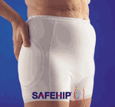
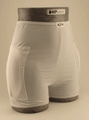
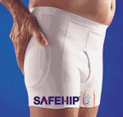
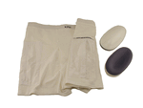
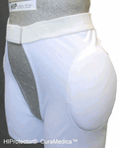
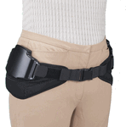
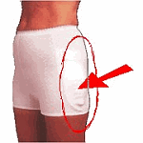
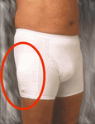
Hip Protectors – Examples
Safehip
KPH
CuraMedica
HipGuard
HIPS

Slide 41
Effect of Dissemination of Evidence in Reducing Injuries from Falls
Study done in Connecticut.
Compared rate of falls with need for medical attention in two areas of CT.
Goal was dissemination of fall prevention information
Tinetti ME et al. NEJM 2008

Slide 42
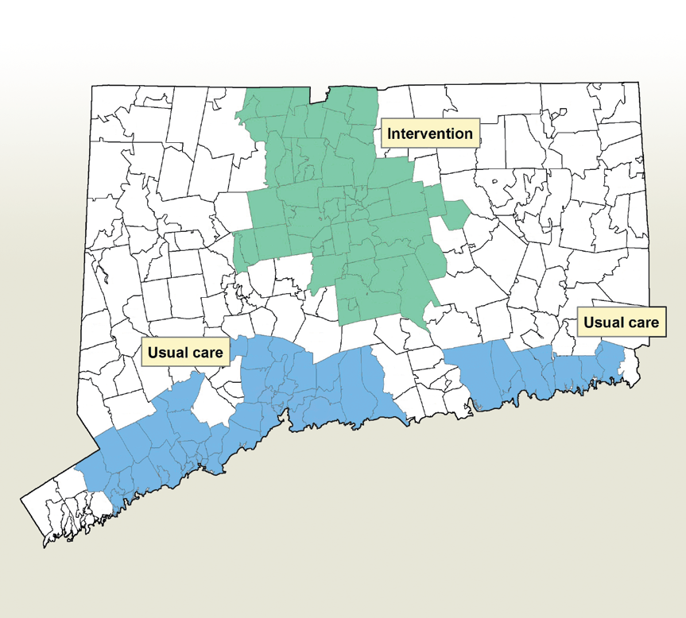
Connecticut Collaborative for Fall Prevention (CCFP)

Slide 43
Practice-Change Intervention
Team used well accepted practice-change interventions including:
  Media attention (television, radio, and newspaper)
  Seminars
  Web sites (e.g., www.fallprevention.org)
  Posters, brochures, educational materials for patients
  Advertising on buses to increase awareness
  Enlistment of opinion leaders to influence colleagues
  Visits (outreach) to explain evidence-based fall-related practices, provide materials, and demonstrate how to incorporate fall prevention into their practices.

Slide 44
Serious Injury Reduction
Before interventions, adjusted rates of serious fall-related injuries (per 1000 person-years):
  31.2 in usual-care region
  31.9 in the intervention region
During evaluation period, adjusted rates were
  31.4 in usual-care region
  28.6 in intervention region
Adjusted rate ratio, 0.91; (95% Bayesian credibility interval, 0.88 to 0.94).

Slide 45
Use of Medical Services
Between pre-intervention period and evaluation period, rate of fall-related use of medical services
  Increased from 68.1 to 83.3 per 1000 person-years in the usual-care region
  Increased from 70.7 to 74.2 in the intervention region
Adjusted rate ratio 0.89; (95% credibility interval, 0.86 to 0.92).

Slide 46
Results
During the evaluation period:
  Adjusted rate of serious fall-related injuries in intervention region 9% lower than usual-care region.
  Adjusted rate of fall-related use of medical services was 11% lower.
Differences persisted beyond intervention and evaluation periods.

Slide 47
Cost Translation
The 11% relative reduction in use of fall-related medical services translated to approximately 1800 fewer ED visits or hospital admissions.
Potential savings of > $21 million in health care costs based on average acute care cost of $12,000 per event.

Slide 48
WHO Fall Prevention Model
WHO Global Report on Falls Prevention in Older Age, 2007

Slide 49


STEADI: Stopping Elderly Accidents, Deaths & Injuries
Sponsored by CDC
http://www.cdc.gov/homeandrecreationalsafety/Falls/steadi/about.html

Slide 50
STEADI Toolkit
http://www.cdc.gov/homeandrecreationalsafety/Falls/steadi/about.html

Slide 51
Summary
Falls especially among older adults clearly a public health problem
Risk factors well described
Interventions developed and tested
Major challenge remains in implementation and dissemination on local, national and global level

