Slide 1

John Eschenberg
Washington River Protection Solutions
September 12, 2019

Slide 2
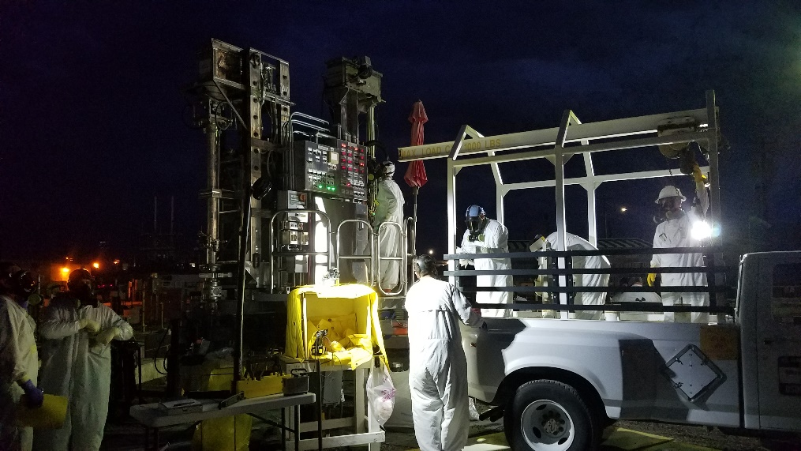
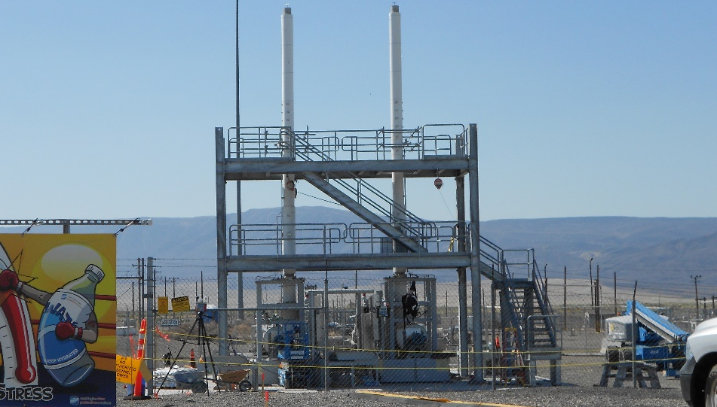
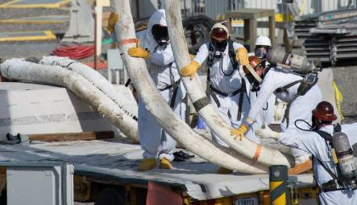
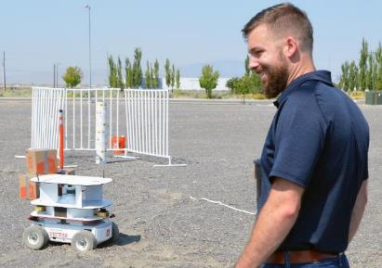
Proven Performance
Risk Reduction
Infrastructure Improvement
Advanced Tech &
Digital Transformation
Accelerated Operations
Notes:
Since assuming the TOC in 2008, WRPS has worked tirelessly to successfully advance DOE’s high-level waste cleanup mission.
Our 11-year record of performance speaks for itself. Through our strategic management plan, we’ve delivered on the promises outlined a decade ago… increasing tank farms systems efficiency and reliability, reducing risk to workers, and bringing value to our DOE customer by exceeding contractual obligations and expectations.
1. We dramatically reduced environmental and public risk
Removed 1.3 M gallons from SSTs, completing all retrievals in C Farm. Transferred over 50Mgal of liquid waste from aging single-shell tanks to more robust double-shell tanks without incident.
2. We vastly improved infrastructure, paving the way for faster, future cleanup
Upgraded facilities/infrastructure, including ventilation systems and evaporator efficiency to support future WTP operations.
3. We accelerated efforts to achieve a 24/7 approach to waste disposition
Boosted pace of operations to support the direct feed of low-activity waste to the Waste Treatment Plant. To begin treating waste as soon as practicable, DOE developed a sequenced approach that would treat LAW first by sending it from tank farms directly to WTP.
4. We modernized tank operations with innovation and technology
Moved from a clipboard operation with obsolete hardware to consolidation, wireless infrastructure and digital transformation.

