Slide 1

Drug Therapy in Cancer Care:
Looking at the Advances of the Last Year
Rowena (Moe) Schwartz, PharmD, BCOP
University of Cincinnati
James L. Winkle College of Pharmacy

Slide 2
Disclosures
Consultant Merck (re: biosimilars)

Slide 3
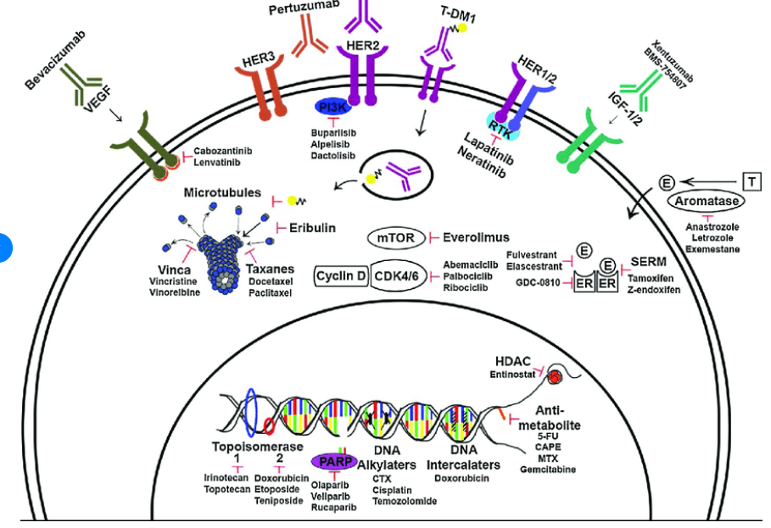
Once upon a time chemotherapy was the foundation of systemic cancer treatment…

Slide 4
Oncology New Drug Approvals from the FDA
(September 2019- August 2020*)
September:
Apalutamide (Erleada)
November:
Zanubrutinib (Brukinsa)
December:
Enfortumab vedotin-ejfv (Padcev)
Fam-trastuzumab deruxtecan-nxki (Enertu)
January:
Avapritinib (Ayvakit)
Tazemetostat (Tazverik)
March:
Isatuximab irfc (Sarclisa)
April:
Luspatercept-aamt (Reblozyl)
Selumetinib (Koselugo)
Tucatinib (Tukysa)
Pemigatinib (Pemazyre)
Sacituzumab govitecan-hziy (Trodely)
May:
Capmatinib (Tabrecta)
Selpercatinib (Retevmo)
Ripretinib (Qinlock)
June:
Lurbinectedin (Zepzelca)
July
Decitabine and cedazuridine (Inqovi)
Brexucabtagene autoleucel (Tecartus)
Tafasitamab-cxix (Monjuvi)
August
Belantamab mafodotin-blmf (Blenrep)
* as of August 31, 2020

Slide 5
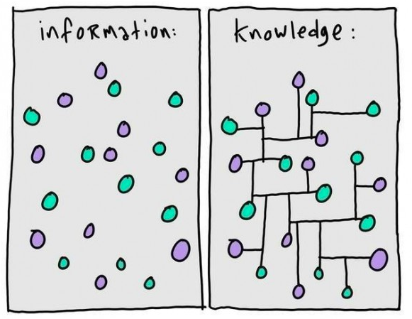
My goal for today….

Slide 6
Learning Objectives
After attending this session, the participant will be able to:
Describe the role of new* targets for drug therapy in the treatment of cancer.
Outline the evolution of new drug therapy(s) in the treatment of cancer.
Discuss the important patient and caregiver education required for some of the new drug therapies discussed today.
Given a patient scenario, identify important considerations for the use of the drug therapies discussed today.
*new = within the last year

Slide 7
The Evolution of Drug Therapy in Cancer: Identification of New Targets for Treatment
Rationale for drug development directed at new targets:
  Some genetic changes in a cancer result in the encoding of proteins that are required for survival and/or proliferation of the cancer cell.
  Drugs that block the function for these proteins can trigger apoptosis and result in tumor regression.
Challenges involved in creating these “targeted” drug therapies:
  Lack of efficacy in individual patients
  Development of resistance
  Dose-limiting toxicities of the targeted drug
  Off-target toxicity may be a mechanism of action of drug in clinical trials

Slide 8
The Evolution of Drug Therapy in Cancer 2020
Optimize Targeting Cancer
Identifying new drug targets for cancer(s).
Expanding applications of available drugs directed at specific targets in cancer.
Determining the optimal approach to use targeted therapy in treatment of select cancers.
Developing new strategies to deliver drug to patients.
Notes:
My goals for today are to…broadly…

Slide 9
New Targets for Cancer Therapy

Slide 10
Fibroblast Growth Factor Receptor (FGFR)

Slide 11
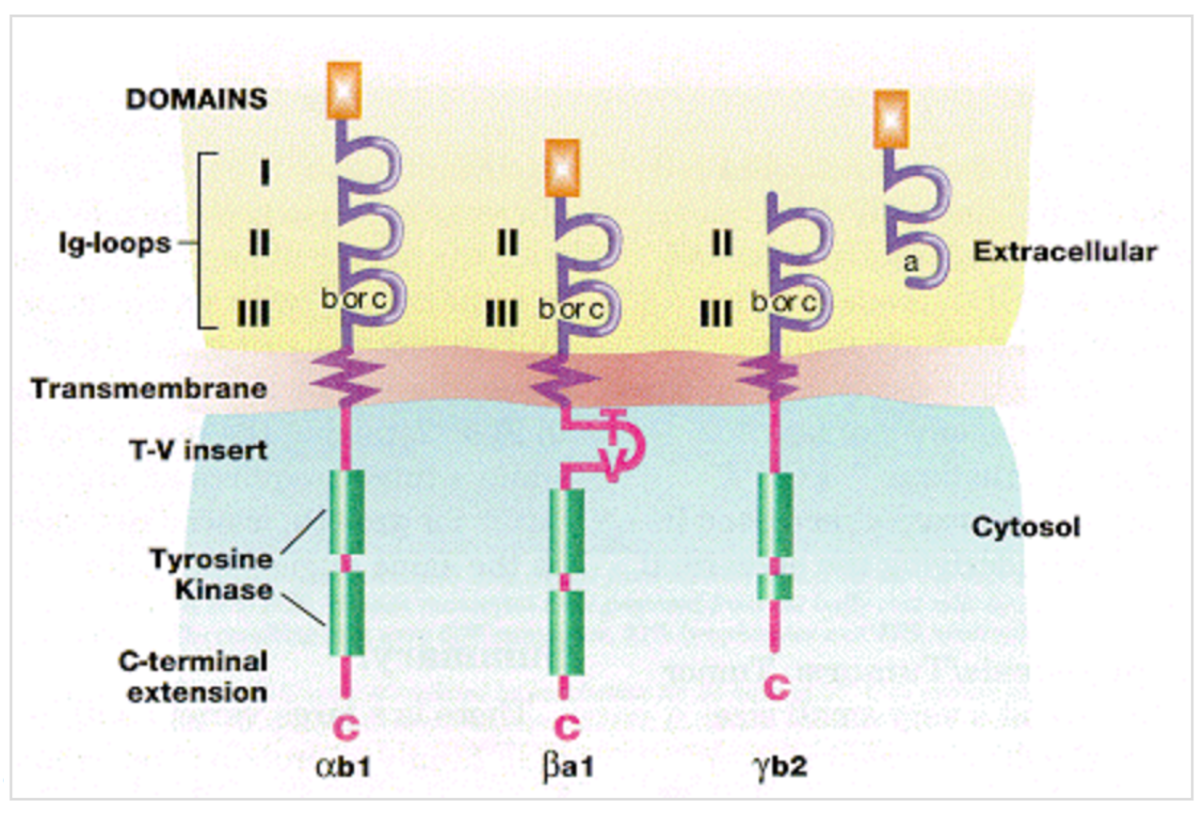
Fibroblast Growth Factor Receptor

Slide 12
Erdafitinib (Balversa)
Mechanism(s) of action:
Oral pan-FGFR inhibitor that binds to FGFR1, 2, 3 and 4.
Binds to RET, CSF-1 receptor (CSF-1R), PDGFRα and β, FLT4, KIT and VEGFR2
Current indication:
Treatment of adults with locally advanced or metastatic urothelial carcinoma that have susceptible FGFR3 or FGFR2 genetic alterations and have progressed during or following at least one line of therapy.
Dose:
Erdafitinib 8 mg (2 x 4 mg ) once daily with a dose increase to 9 mg (3x 3mg tablets) once daily based on serum phosphate levels and tolerability at 14 -21 days.

Slide 13
Erdafitinib: Phase II Trial in Urothelial Cancer
Methods:
  Open, label, phase II trial of patients with locally advanced and unresectable or metastatic urothelial carcinoma with prespecified FGFR alterations.
  Patient has a history of disease progression during or after at least one course of chemotherapy or within 12 months after neoadjuvant or adjuvant chemotherapy.
  Dose selection phase: intermittent dosing or continuous dosing
Treatment:
  Erdafitinib 8 mg PO daily → potential to escalate to 9 mg PO daily
Outcomes:
  Primary endpoints: ORR
  Secondary endpoints: PFS, DOR, OS

Slide 14
Erdafitinib: Phase II Trial in Urothelial Cancer
Response (per investigator assessment) | Number of Response (n=99 patients in selected regimen group) | Rate of Response (95% CI)
Any objective response | 40 | 40% (31 -50)
complete response | 3 | 3%
partial response | 37 | 37%
Stable disease | 39 | 39%
Progressive Disease | 18 | 18%
Response according to genetic alterations
FGFR3 mutation (n=74) | 36 | 49 (37 – 60)
FGFR2/3 fusion (n=25) | 4 | 16 (2-30)

Slide 15
Erdafitinib: Warnings and Precautions
FGFR Inhibitors:
Ocular disorders including central serous retinopathy/retinal pigment epithelial detachment.
  - Ophthalmological examinations during the first 4 months, then q 3 months
Hyperphosphatemia
  76% of patients with median onset of 20 days in clinical trials
  MOA: inhibition of FGF23 binding to receptor resulting in increased serum levels of FGF23, vitamin D and phosphate
  Management: phosphate binding agents.
Embryo-fetal toxicities
Nishina T, et al. Invest New Drug 2018;36:424

Slide 16
Erdafitinib: Consideration for Practice
Mechanism for action:
  Confirm presence of FGFR genetic alterations in tumor prior to initiation.
  Potential application beyond current indications?
Optimize strategies for use:
  Oral drug therapy
  Anticipate, manage and education about toxicities
    Warning and precautions
    Patient specific issues
  Drug-drug interactions
  Dose of drug (and potential planned titration).

Slide 17
MET Kinase
MET – mesenchymal-epithelial transition factor

Slide 18
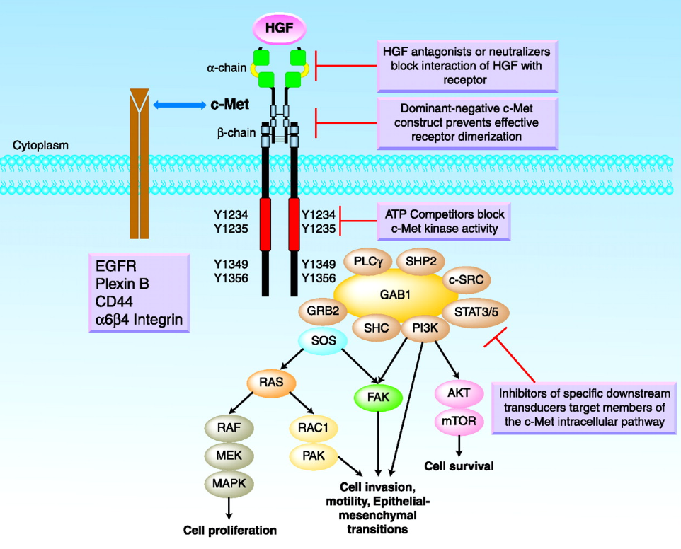
MET Signaling Pathway
Elder JP, et al. Clinical Cancer Res 2009;15:7

Slide 19
Capmatinib
Highly selective, potent, small molecule MET inhibitor
  Blocks MET phosphorylation → downstream effects
  Reverse the effects of MET activation on EFGR and HER-3 pathways
Single agent:
  clinical trials in advanced NSCLC with MET exon 14 skipping mutations and high MET amplification
Combination therapy:
  Combination with EGFR inhibitor therapy in EGFR-mutant NSCLC with MET based acquired resistance to previous EGFR inhibitors
Vansteenkiste JF, et al. Expert Rev Anticancer Thera 2019;19:8:659.

Slide 20
Capmatinib (Tabrecta)
Mechanism of Action:
  kinase inhibitor that targets MET
Current Indication:
  Treatment of adult patients with metastatic non-small cell lung cancer whose tumors have a mutation that leads to MET exon 14 skipping
Dose:
  Capmatinib 400 mg PO BID with or without food

Slide 21
Capmatinib: GEOMETRY mono-1 trial
Methods:
  Phase II single arm, multicenter, international study (multi-cohort)
  Patients with EGFT-wt, ALK-wt, advanced/metastatic NSCLC with mutation that leads to MET exon 14 skipping
Treatment:
  Capmatinib 400 mg PO twice daily until disease progression or unacceptable toxicity
Endpoints:
  Primary: ORR
  Secondary: DOR, PFS, OS, safety

Slide 22
Capmatinib: GEOMETRY mono-1 trial
Efficacy Parameters | Treatment-Naïve Patients (N=28) | Previously Treated Patients (N=69)
Overall Response Rates | 68% | 41%
CR | 4% | 0
Duration of Reponses
Median months | 12.6 | 9.7
DOR > 12 months | 47% | 32%
Tabrecta (Capmatinib) package insert. Novartis Pharm Corps. Accessed 7.2020

Slide 23
Capmatinib: GEOMETRY mono-1 trial
Peripheral edema (49%)
Nausea (43%) when taken on an empty stomach
Vomiting (28%) when taken on an empty stomach.
Fatigue
Permanent discontinuation due to AE occurred in 16%
Dose interruptions due to AE occurred in 54%
Dose reductions due to AE occurred in 23%

Slide 24
Capmatinib: Warning and Precautions
Interstitial lung disease/pneumonitis
Hepatotoxicity
Risk of photosensitivity
Embryo-fetal toxicity

Slide 25
RET

Slide 26
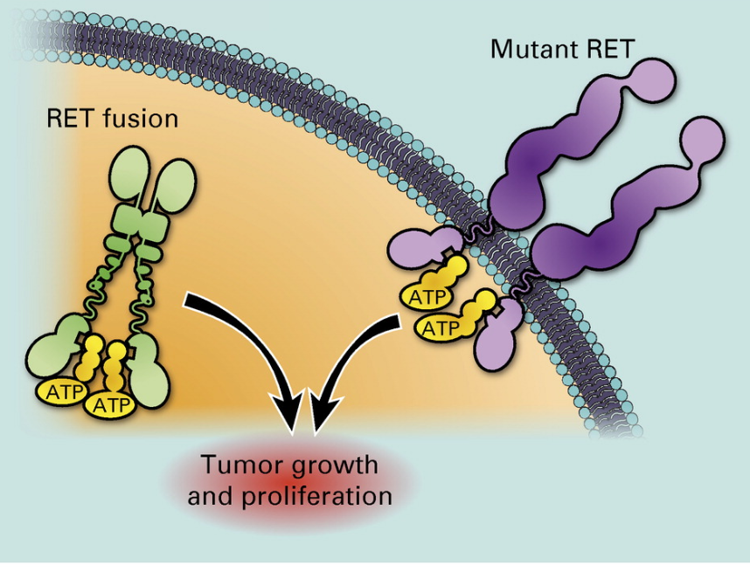
Targeting RET-Dependent Cancers
Subbiah V, et al. JCO 2020;38:11;1209

Slide 27
Selpercatinib (Retevmo)
Mechanism of Action:
  inhibited wild-type RET and multiple mutated RET isoforms
  Inhibition of VEGFR1 and VEGFR3
  Inhibited FGFR 1, 2, and 3
Indication
  Metastatic RET fusion-positive NSCLC
  RET mutant medullary thyroid cancer
  RET fusion-positive thyroid cancers
Dose:
  < 50 kg: 120 mg PO BID
  50 kg or greater: 160 mg PO BID

Slide 28
Selpercatinib: LIBRETTO-001
Methods:
  Phase I/2, open-label study designed to evaluate safety, tolerability, kinetics and anti-tumor activity of selpercatinib (LOXO-292) administered orally in patients with advanced solid tumors
  Phase I (dose escalation) and Phase 2 (dose expansion)
Endpoints:
  Phase I → maximum tolerated dose
  Phase II → ORR

Slide 29
Selpercatinib: LIBRETTO-001
Efficacy Results: Lung Cancer
Efficacy Criteria | Metastatic RET Fusion-positive NSCLC (Previously treated with platinum chemotherapy) (n=105)
Overall Response Rate (95% CI) | 64% (54%,73%)
CR | 1.9%
PR | 62%
Duration of Response
Median Months (95%) | 17.5 (12, NE)
DOR > 6 months | 81%
RETEVMO package insert. Eli Lilly. Accessed 7.2020

Slide 30
Selpercatinib: LIBRETTO-001
Efficacy Results: Lung Cancer
Efficacy Criteria | Metastatic RET Fusion-positive NSCLC (Treatment-Naïve) (n=39)
Overall Response Rate (95% CI) | 85% (70%,94%)
CR | 0
PR | 85%
Duration of Response
Median Months (95%) | Not estimable
DOR > 6 months | 58%
RETEVMO package insert. Eli Lilly. Accessed 7.2020

Slide 31
Selpercatinib: LIBRETTO-001
Efficacy Results: Medullary Thyroid Cancer
Efficacy Criteria | RET-Mutant Medullary Thyroid Cancer (Previously treated with cabozantinib or vandetanib) (n=55)
Overall Response Rate (95% CI) | 69% (55%,81%)
CR | 9 %
PR | 60%
Duration of Response
Median Months (95%) | Not estimable
DOR > 6 months | 76%
RETEVMO package insert. Accessed 7.2020

Slide 32
Selpercatinib: LIBRETTO-001
Efficacy Results: Medullary Thyroid Cancer
Efficacy Criteria | RET-Mutant Medullary Thyroid Cancer (Cabozantinib or vandetanib naive) (n=55)
Overall Response Rate (95% CI) | 73% (62%,82%)
CR | 11 %
PR | 61%
Duration of Response
Median Months (95%) | 22 (NE, NE)
DOR > 6 months | 61%
RETEVMO package insert. Eli Lily. Accessed 7.2020

Slide 33
Selpercatinib: LIBRETTO-001
Efficacy Results: Thyroid Cancer
Efficacy Criteria | RET Fusion-Positive Thyroid Cancer (prior treatment) (n=19) | RET Fusion-Positive Thyroid Cancer (systemic treatment naive) (n=9)
Overall Response Rate (95% CI) | 79% (54%,94%) | 100% (63%, 100%)
CR | 5 % | 12.5%
PR | 74% | 88%
Duration of Response
Median Months (95%) | 18 (7.6, NE) | Not estimable
DOR > 6 months | 87% | 75%
RETEVMO package insert. Eli Lily.Accessed 7.2020

Slide 34
Selpercatinib: Warning and Precautions
Hepatotoxicity
Hypertension
QT interval prolongation
Hemorrhagic events
Hypersensitivity
Impaired wound healing
Embryo-fetal toxicity

Slide 35
The Evolution of Drug Therapy in Cancer 2020
Optimize Targeting Cancer
Identifying new drug targets for cancer(s).
Expanding applications of available drugs directed at specific targets in cancer.
Determining the optimal approach to use targeted therapy in treatment of select cancers.
Developing new strategies to deliver drug to patients.

Slide 36
Exportin 1 (XPO1)

Slide 37
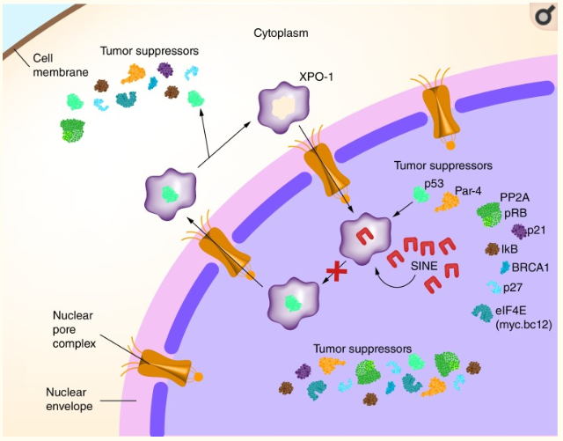
Selective Inhibitors of Nuclear Export (SINE)
Talati C et al. In J Hematol Oncol. 2018;7(30):IJH04.8;7

Slide 38
Selinexor (Xpovio)
Mechanism of Action:
Blocks exportin 1 (XPO1), which reversibly inhibits nuclear export of tumor suppressor proteins, growth regulators, and mRNA of oncogenic proteins
Initial indication at marketing in July 2019:
Combination with dexamethasone for treatment of adults with relapsed or refractory multiple myeloma who have received ≥4 prior treatments (refractory to ≥2 proteasome inhibitors, 2 IMIDs and an anti CD38 monoclonal antibody).
Starting dose
Selinexor 80 mg (4 x 20 mg) PO on days 1 and 3 of each week.
Given with dexamethasone

Slide 39
Selinexor (+ dexamethasone): STORM Trial
Methods:
  Phase 2b, open-label single arm, multicenter study
  Patients with myeloma who had prior exposure to bortezomib, carfilzomib, lenalidomide, pomalidomide, daratumumab and an alkylating agent.
  Triple-refractory disease defined as disease refractory to at least one proteasome inhibitor, one IMID, and daratumumab.
Treatment:
  Selinexor 80mg PO + dexamethasone 20 mg days (day 1 and 3) weekly in 4 week cycles
    ondansetron prophylaxis for nausea
Outcomes:
  Primary endpoint: OR
  Secondary endpoint: DOR, clinical benefit, PFS, OS

Slide 40
Selinexor (+dexamethasone): STORM Trial
 | Patients included in analysis | Patient with partial response or better | Patients with minimal response or better
Total | 122 | 26% | 39%
High risk cytogenetics | 65 | 18% | 37%
Overall response was defined as partial response (≥50% reduction in serum level of myeloma protein) or better.
Clinical benefit was defined as minimal response (≥25% to < 50% reduction in serum level of protein).

Slide 41
Selinexor (+dexamethasone): STORM Trial
Toxicity | Grade 1 or 2 | Grade 3 | Grade 4 | Total
Thrombocytopenia | 15% | 25% | 33% | 90%
Anemia | 24% | 43% | 1% | 67%
Neutropenia | 19% | 18% | 3% | 40%
Fatigue | 48% | 25% | 0 | 73%
Nausea | 62% | 10% | 0 | 72%
Diarrhea | 38% | 7% | 0 | 46%
Other common adverse effects included decreased appetite, decreased weight, hyponatremia, dyspnea, and upper airway infections.

Slide 42
Selinexor
Mechanism of Action
Blocks exportin 1 (XPO1), which reversibly inhibits nuclear export of tumor suppressor proteins, growth regulators, and mRNA of oncogenic proteins
Current indications
Myeloma: Combination with dexamethasone for treatment of adults with relapsed or refractory multiple myeloma who have received ≥4 prior treatments (refractory to ≥2 proteasome inhibitors, 2 IMIDs and an anti CD38 monoclonal antibody).
DLBCL: Treatment of adult patients with relapsed or refractor DLBCL, including DLBCL arising from follicular lymphoma, after at least 2 lines of systemic therapy. (June 2020)
Starting dose
Selinexor 80 mg (4 x 20 mg) PO on days 1 and 3 of each week.

Slide 43
Selinexor: SADAL Phase 2b
Methods:
  Multicenter, multinational, open-label, phase 2b study
  Patients 18 y/o or older with pathologically confirmed DLBCL who had received 2-5 lines of previous therapies, and progressed after or were not candidates for autologous stem cell transplantation
Treatment:
  Selinexor 60 mg PO on days 1 and 3 weekly until disease progression or unacceptable toxicity
  Initially study included both 60 mg and 100 mg twice weekly dose, but 100 mg dose was discontinued in the protocol in 2017
Results:
  ORR was 28% (12% CR, 17% PR) in 127 patients receiving 60 mg dose
Kalakonda N, et al. Lancet Haematol 2020;7(7): e511-522.

Slide 44
Selinexor: Warnings and Precautions
Thrombocytopenia
  leading cause of dose modifications
Neutropenia and serious infections
Gastrointestinal toxicities including nausea, vomiting, diarrhea, anorexia, weight loss.
Hyponatremia
  correct sodium levels for concurrent hyperglycemia
  Optimize hydration
Neurologic toxicities
  Manage concomitant medications.

Slide 45
The Evolution of Drug Therapy in Cancer 2020
Optimize Targeting Cancer
Identifying new drug targets for cancer(s).
Expanding applications of available drugs directed at specific targets in cancer.
Determining the optimal approach to use targeted therapy in treatment of select cancers.
Developing new strategies to deliver drug to patients.

Slide 46
Optimization of Targets for Cancer Treatment

Slide 47
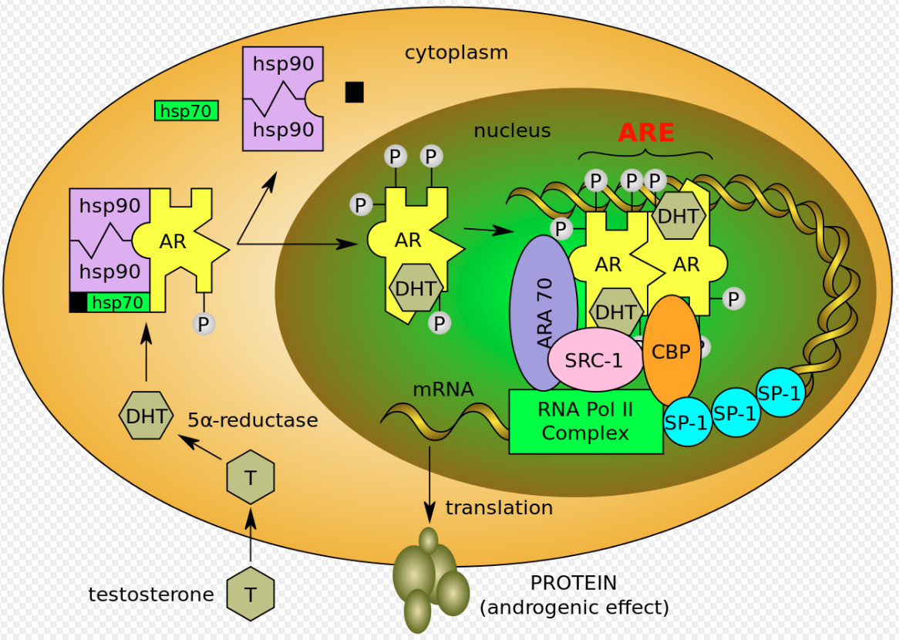
Androgen Receptor

Slide 48
Target: Androgen Receptor
 | Bicalutamide | Enzalutamide | Apalutamide | Darolutamide
Androgen receptor inhibition | Yes (partial agonist) | Full antagonist | Full antagonist | Full antagonist
Inhibition of nuclear translocation | No | Yes | Yes | Yes
Increase in serum testosterone levels | Yes | Yes | Yes | No
Penetration of BBB | Negligible | Yes | Yes | Negligible

Slide 49
Darolutamide (Nubeqa)
Methods:
  Randomized, double-blind, placebo-controlled, phase III trial
  Nonmetastatic castration-resistant prostate cancer with PSA doubling time of ≤ 10 months
Treatment:
  Darolutamide 600 mg PO + ADT
Outcomes:
  Primary endpoint: metastasis-free survival
  Secondary endpoint: OS, pain reduction, time to first symptomatic skeletal event, time to first cytotoxic chemotherapy
  Exploratory endpoints: PFS, time to cancer-related invasive procedure, PSA response, deterioration of PS, QOL

Slide 50
Darolutamide: Phase III
Non-metastatic Castration-Resistant Prostate Cancer
Endpoint | Darolutamide (n=955) | Placebo (n=544) | Hazard Ratio 95% CI | P value
Metastatic free survival (MFS) | 40.4 months | 18.4 months | 0.41 (0.34-0.51 | P<0.0001
Overall survival (OS) | data not mature at time of publication
Progression free survival (PFS) | 36.8 months | 14.8 months | 0.38 (0.32-0.45) | P<0.001

Slide 51
Darolutamide Clinical Practice
Indication:
Treatment of men with non-metastatic castration-resistant prostate cancer (nmCRPC).
Dose:
The recommended dose of is 600 mg (two 300 mg film-coated tablets) taken orally, twice daily, equivalent to a total daily dose of 1200 mg.
Patients receiving darolutamide should also receive a gonadotropin-releasing hormone (GnRH) analog concurrently or should have had a bilateral orchiectomy.

Slide 52
Comparison of Antiandrogens: Indications*
Drug Name | Indications
Apalutamide (Erleada) | Metastatic castration-sensitive prostate cancer Non-metastatic castration-resistant prostate cancer
Darolutamide (Nubeqa) | Non-metastatic castration-resistant prostate cancer
Enzalutamide (Xtandi) | Castration-resistant prostate cancer Metastatic castration-sensitive prostate cancer
* As of July 31, 2020

Slide 53
Bruton’s Tyrosine Kinase Signaling Pathway

Slide 54
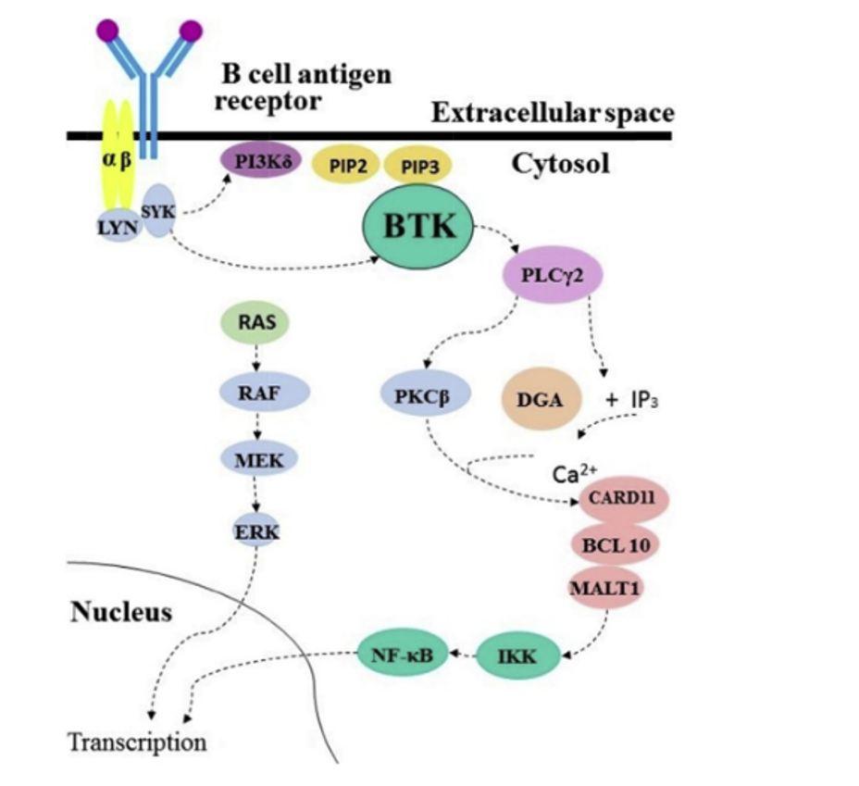
Bruton’s Tyrosine Kinase (BTK) Signaling Pathway

Slide 55
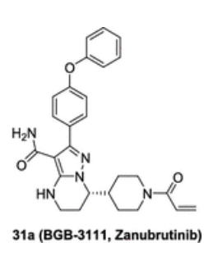
The Development of Zanubrutinib
More selective BTK inhibitor
Improved oral absorption
Better target occupancy

Slide 56
Zanubrutinib (Brukinsa)
Indication:
Adult patients with mantle cell lymphoma (MCL) who have received at least one prior therapy
This indication is approved under accelerated approval based on overall response rate. Continued approval for this indication may be contingent upon verification and description of clinical benefit in a confirmatory trial.
Dose:
160 mg taken orally twice daily or 320 mg taken orally once daily until disease progression or unacceptable toxicity.
Advise patients to swallow capsules whole with water. Advise patients not to open, break, or chew the capsules. If a dose of is missed, it should be taken as soon as possible on the same day with a return to the normal schedule the following day.

Slide 57
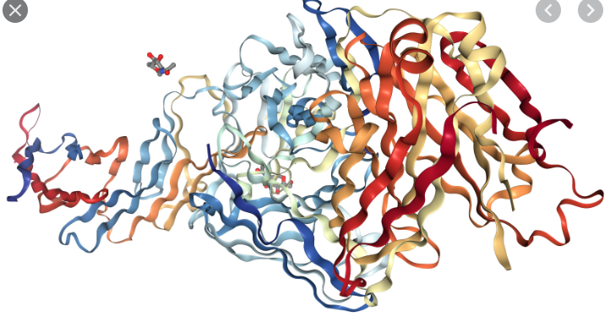
Target: CD19

Slide 58
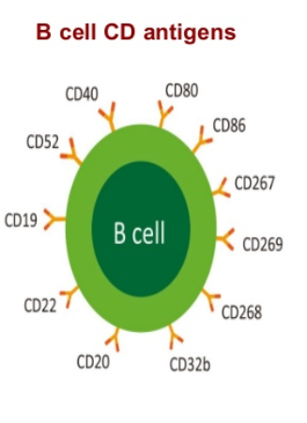
CD19
CD19 is broadly expressed across B cell malignances
  Enhances B-cell receptor signaling and cell proliferation

Slide 59
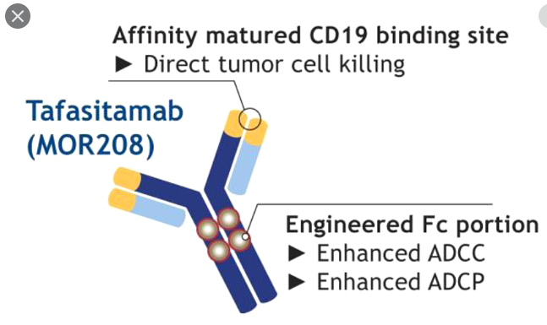
Tafasitamab (Monjuvi)
Fc-enhanced, humanized, anti-CD19 monoclonal antibody
Leukemia 2013;27:1595.

Slide 60
Tafasitamab-cxix (Monjuvi)
Mechanism of action:
  CD19-directed cytolytic antibody
Indication:
  Treatment for adults with relapsed or refractory diffuse large B-cell lymphoma no otherwise specified, including DLBCL arising from low grade lymphoma, and who are not eligible for autologous stem cell transplant
Adverse effects (≥ 20%):
  Neutropenia, anemia, thrombocytopenia
  Diarrhea
  Cough
  Pyrexia
  Peripheral edema

Slide 61
Tafasitamab: The L-MIND Clinical Trial
Method:
  Phase 2 multicenter, prospective, single-arm study (n=81)
Treatment:
  Tafasitamab-cxix 12 mg/kg IV + lenalidomide 25 mg PO daily x 21 days every 28 days x 12 cycles → tafasitamab-cxix as monotherapy
Results:
  ORR (in 71 patients): 55% (CR 37%, PR 18%)
  Median DOR: 21.7 months (range: 0, 24 months)

Slide 62
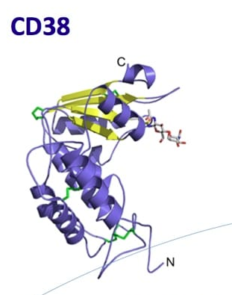
CD38

Slide 63
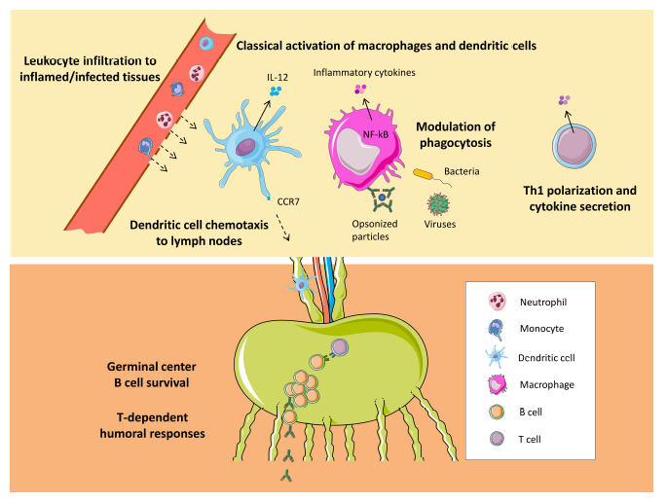
Immunological Roles of CD38 in Infection
Glaria E, et al. Cells 2020;9:228

Slide 64
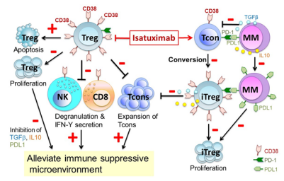
Isatuximav-irfc
Tai YT, et al. Oncotarget 2017;8:112166

Slide 65
Isatuximab-irfc (Sarclisa)
Mechanism of action:
  CD38-directed cytolytic antibody
Indication:
  Treatment for adults with relapsed or refractory multiple myeloma who have received at least 2 prior therapies including lenalidomide and a proteasome inhibitor (in combination with pomalidomide and dexamethasone
Dose:
  10 mg/kg IV infusion every week for 4 weeks → every 2 weeks in combination with pomalidomide and dexamethasone until disease progression or unacceptable toxicities.
  Premedications with dexamethasone, acetaminophen, H2 antagonists, and diphenhydramine.
Adverse effects (≥ 20%):
  Neutropenia
  Infusion related reactions
  Diarrhea
  Infections including pneumonia and upper respiratory tract infections

Slide 66
Isatuximab-irfc (Sarclisa): ICARIA-MM
Methods:
  Randomized, multicenter, open-label, phase III study
  Adults with relapsed and refractory multiple myeloma who had at least 2 LOT (including IMID and proteasome inhibitor)
  Randomized 1:1
Treatment:
  Istauximab 10 mg/kg IV Day 1,8,15,22 (cycle 1) then Day 1 and 15 (cycle 2+) + pomalidomide 4 mg PO day 1-21 + dexamethasone 40 mg (20mg) PO days 1,8,15,22
  Pomalidomide 4 mg PO day 1-21 + dexamethasone 40 mg (20mg) PO days 1,8,15,22
Outcomes:
  Primary endpoint: PFS

Slide 67
Isatuximab-irfc (Sarclisa): ICARIA-MM
Response Best Overall Response | isatuximab + pomalidomide + dexamethasone (n=154) | pomalidomide + dexamethasone (n=153)
CR | 5% | 1%
Stringent CR | 0 | <1%
Very good partial response | 27% | 7%
PR | 29% | 27%
Minimal response | 7% | 11%
Stable disease | 21% | 29%

Slide 68
Isatuximab-irfc (Sarclisa)
Warnings and Precautions (per package insert):
  Infusion related reactions
  Neutropenia
  Second primary malignancies
  Embryo-fetal toxicity
  Laboratory test interference
    Interference with serological testing (indirect antiglobulin test)
    Interference with serum protein electrophoresis and immunofixation

Slide 69
Evolution of Antibody-Drug Conjugates (ADC)

Slide 70
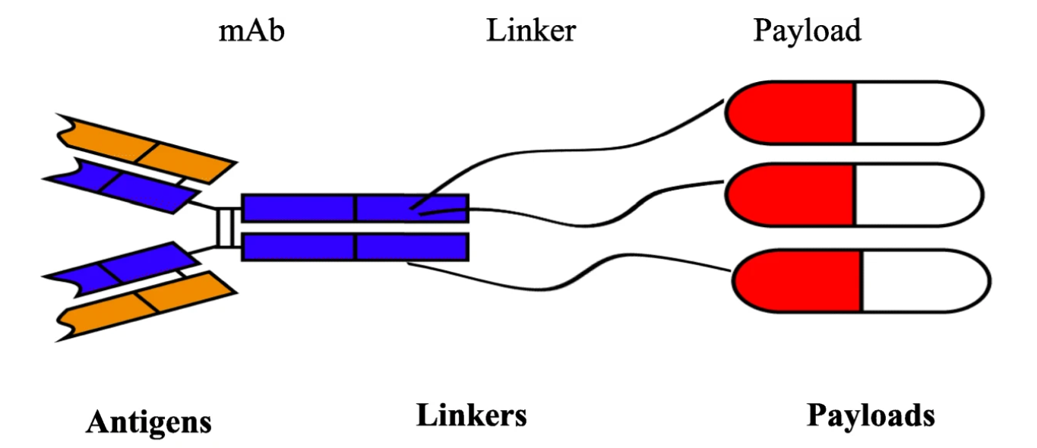
The Evolution of the Monoclonal Antibody:
Antibody-Drug Conjugates (ADC)
Yu B et al. J Hematol Oncol. 2019;12:94.

Slide 71
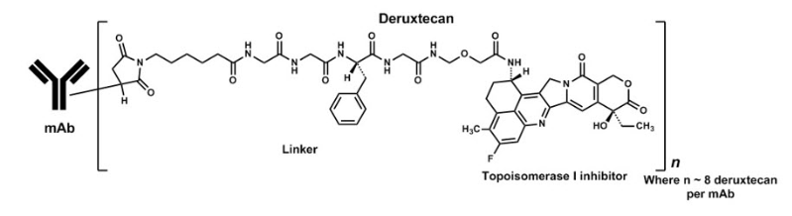
Fam-trastuzumab deruxtecan-nxki

Slide 72
Fam-trastuzumab deruxtecan-nxki
Description
HER2-directed antibody and topoisomerase inhibitor conjugate.
  Humanized anti-HER IgG1 mAb
  Deruxtecan (a topoisomerase inhibitor)
  Tetrapetide-based cleavable linker
Indication:
Treatment of adult patients with unresectable or metastatic HER2 positive breast cancer who have received two or more prior anti-HER2 based regimens in the metastatic setting.

Slide 73
Enfortumab vedotin-ejfv (Padcev)
Description:
Antibody drug conjugate including a monoclonal antibody targeting nectin-4 linked to MMAE
  Fully human anti-Nectin-4 IgG1 kappa mAb (AGS-22C3)
  MMAE
  Protease-cleavable linker
Indication:
Treatment of adults with locally advanced or metastatic urothelial cancer who have previously received a PD-1 or PDL-1 inhibitor, a platinum-containing chemotherapy.

Slide 74
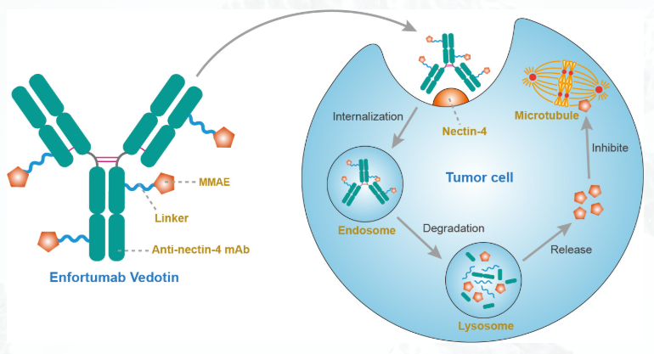
Enfortumab vedotin-ejfv (Padcev)

Slide 75
Enfortumab vedotin-ejfv
Response in Urothelial Cancer (UC)
Clinical Trial (publication) | Phase | Patient Number | ORR | CR
EV-101 (Rosenberg, 2019) | I | N=112 (mUC) | 42% | 4.5%
Japanese Trial (Takahasi, 2019) | I | N=24 | 35% | -
EV-103 | I | N=45 | 71% | 13%
EV-201 (Rosenberg, 2019) | II | N=125 | 44% | 12%

Slide 76
Enfortumab vedontin-ejfu: Urothelial Cancer
Methods:
  Global, phase II, single arm study in patients with locally advanced or metastatic urothelial carcinoma following cisplatin and immunce checkpoint inhibitor (anti PD-1/PD-L1)
Treatment:
  enfortumab vedotin 1.25 mg/kg IV on days 1, 8, 15 or every 28 days
Outcomes:
  Primary endpoint: ORR (RECIST v1.1)
  Secondary endpoint: DOR, PFS, OS, safety, tolerability.
Rosenberg JE, et al. J Clin Onc 2019;37:2592-2600.

Slide 77
Enfortumab vedontin-ejfu: Urothelial Cancer
Response | Number (%) N = 125
Objective response rate (ORR) | 55 (44%)
Best overall response:
CR | 15 (12%)
PR | 40 (32%)
Stable disease | 35 (28%)
Progressive disease | 23 (18%)
Not evaluable | 12 (10%)
Rosenberg JE, et al. J Clin Onc 2019;37:2592-2600.

Slide 78
Enfortumab vedotin-ejfv (Padcev)
Warnings and Precautions:
Hyperglycemia (including diabetic ketoacidosis)
Peripheral neuropathy
Ocular disorders
Skin reactions including maculopapular rash and pruritus
Infusion site skin and soft tissue reactions with extravasation

Slide 79
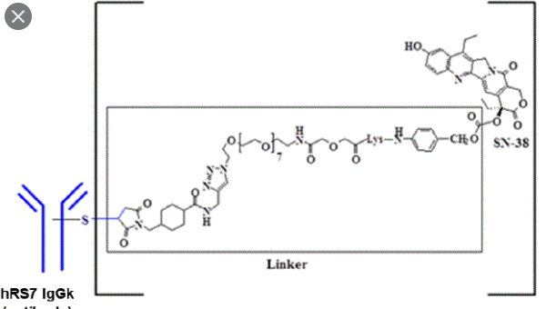
Sacituzumab govitecan-hziy
Description:
Trop-2 directed antibody and topoisomerase inhibitor conjugate.
  Humanized mAB that binds to Trop-2 (trophoblast cell surface antigen)
  Govitecan (a topoisomerase inhibitor (SN-38))
  Hydrolysable linker (CL2A)
Indication:
Treatment of adult patients with metastatic triple-negative breast cancer who have received at least two prior therapies for metastatic disease.

Slide 80
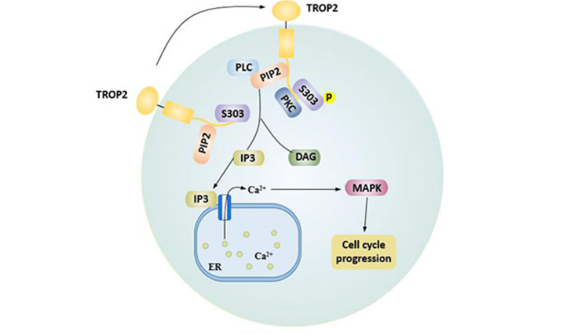
Targeting Trop-2: Beyond TNBC

Slide 81
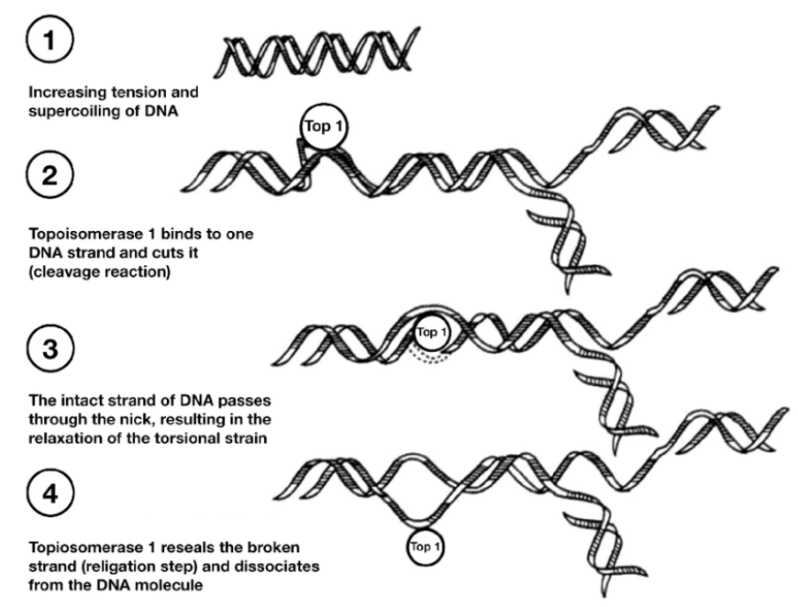
Payload: SN-38
SN-38 is the active metabolite of topoisomerase I inhibitor, and more potent than irinotecan (parent compound).

Slide 82
Sacituzumab govitecan-hziy:
Phase 1/2 Clinical Trial
Methods:
Multicenter trial of patient with advanced epithelial cancers
Treatment:
Single agent sacituzumab govitecan IV on Day 1 and 8 of each 21 days cycle
  108 patients with TNBC received 10 mg/kg
Efficacy reported in clinical trial for patients with metastatic TNBC:
Complete response 2.8%
ORR: 33.3 % (95% CI, 24.6-43.1)
Clinical benefit rate: 45.4 % (95% CI, 35.8-55.2)
Median DOR: 7.7 months (95% CI, 4.9-10.8)
Bardia A, et al. N Engl J Med. 2019:380(8):741-751.

Slide 83
Sacituzumab govitecan:TROPiCS-02
Methods:
  Open-label, randomized, multicenter Phase III
  Patients with metastatic or locally advanced inoperable HR+, HER2- metastatic breast cancer who had progressed on at least 2 (no more than 4) prior chemotherapy randomized to sacituzumab govitecan vs treatment of physician’s choice
Endpoints:
Primary: PFS, ORR
Secondary: OS, DOR, safety
Exploratory: Biomarkers, QOL
Rugo HS, et al. Future Oncol 2020; 16:12:705-715

Slide 84
TROPiCS-02: Phase III Study
Sacituzumab govitecan
10 mg/kg IV days 1 and 8 every 21 days
Patients with MBC who are HR+/HER- and have progressed:
At least 1 endocrine therapy, taxane, and CDK4/6 inhibitor
At least 2, no more than 4, lines of chemotherapy in metastatic setting
1:1
Treatment of Physician’s Choice (TPC)
(capecitabine, vinorelbine, gemcitabine or eribulin)

Slide 85
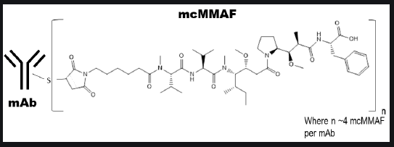
Belantamab mafodotin-blmf (Blenrep)
Description:
B-cell maturation antigen (BCMA) directed antibody and mictrotubule inhibitor conjugate.
  A humanized antagonistic anti BCMA antibody with afucosuylated Fc
  Linker (protease-resistant maleimidocaproyl)
  MMAF (microtubule inhibitor)
Indication:
Treatment of adult patients with relapsed or refractory multiple myeloma who have received at least 4 prior therapies including an antin-CD38 monoclonal antibody, a proteasome inhibitor, and an IMID.

Slide 86
Belantamab mafodotin (DREAMM-2)
Methods:
  Open-label, two arm, phase II study
  Adults with relapsed or refractory myeloma with disease progression after three or more lines of therapy and who were refractory to IMIDS and proteasome inhibitors and refractory or intolerant to and anti CD38 monoclonal antibody
  Centrally assigned 1:1 (stratified )
Treatment:
  Belantamab mafodotin 2.5 mg/kg IV infusion every 3 weeks
  Belantamab mafodotin 3.4 mg/kg IV infusion every 3 weeks
Results:
  ORR
    N = 97 treated at 2.5 mg /kg dose: 31% ORR (97.5% CI 20.8 – 42.6)
    N= 99 treated at 3.4 mg /kg dose: 34% ORR (97.5% CI 23.9 – 44)
  Safety:
    Keratopathy
    Thrombocytopenia, anemia
Lonial S, et al. Lancet 2020; 21:207

Slide 87
Belantamab mafodotin-blmf (Blenrep)
Warnings and Precautions:
Thrombocytopenia
Infusion-related reactions
Embryo-fetal toxicity
Most common toxicities (≥ 20%)
Keratopathy (corneal epithelium change on eye exam)
Decreased visual acuity, blurred vision
Nausea
Pyrexia
Fatigue
Infusion related reactions.

Slide 88
The Evolution of Drug Therapy in Cancer 2020
Optimize Targeting Cancer
Identifying new drug targets for cancer(s).
Expanding applications of available drugs directed at specific targets in cancer.
Determining the optimal approach to use targeted therapy in treatment of select cancers.
Developing new strategies to deliver drug to patients.

Slide 89
Decitabine and Cedazuridine (INQOVI)
Mechanism of action:
Decitabine: nucleoside metabolic inhibitor (hypomethylating agent)
Cedazuridine: cytidine deaminase inhibitor
Indication:
Treatment of adult patients with MDS, including previously treated and untreated, de novo and secondary MDS with the following FAB subtypes
  Refractory anemia
  Refractory anemia with ringed sideroblasts
  Refractory anemia with excess blasts
  Chronic myelomonocytic leukemia
Dose:
The combination product is taken PO daily x 5 every 28 days

Slide 90
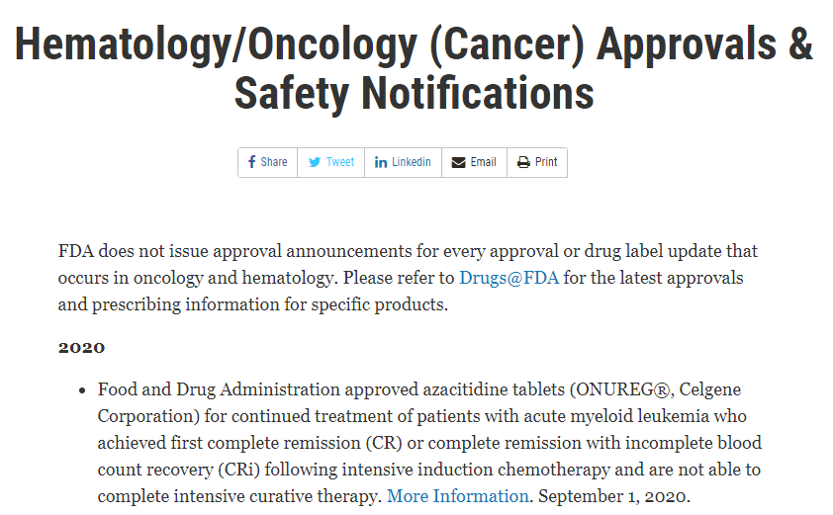

Slide 91
Pertuzumab, trastuzumab, hyaluronidase-zzxf (PHESGO)
Mechanism:
Indications:
  Early breast cancer in combination with chemotherapy
    Neoadjuvant treatment of adults with HER+ locally advanced, inflammatory, or early stage breast cancer as part of complete regimen
    Adjuvant treatment of adult patients with HER+ early breast cancer at high risk of recurrence
  Metastatic breast cancer
    In combination with docetaxel for the treatment of adult patients with HER+ metastatic breast cancer who have not received prior anti-HER2 therapy or chemotherapy of metastatic disease.

Slide 92
Pertuzumab, trastuzumab, hyaluronidase-zzxf (PHESGO)
Dose | Strength | Administration
Initial Dose | 1200 mg pertuzumab 600 mg trastuzumab 30000 units hyaluronidase (in 15 mL) | Administer subcutaneously in the thigh over approximately 8 minutes
Maintenance Dose (q 3 weeks) | 600 mg pertuzumab 600 mg trastuzumab 20000 units hyaluronidase (in 10 mL) | Administer subcutaneously in the thigh over approximately 5 minutes (every 3 weeks)
PHESGO is for subcutaneous use only (thigh). Do NOT administer intravenously.
PHESGO has different dosage and administration instructions than the intravenous pertuzumab, intravenous trastuzumab and subcutaneous trastuzumab.

Slide 93
Questions?

