Slide 1
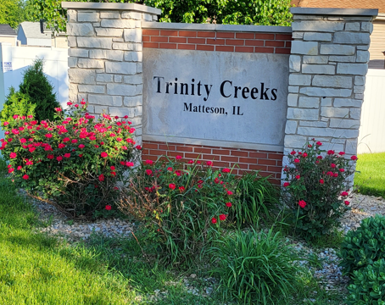
Trinity Creeks
HOA General Meeting
12-17-2025
7:00pm-8:00pm
Zoom Meeting

Slide 2
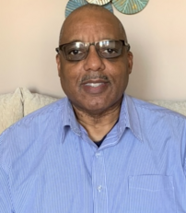
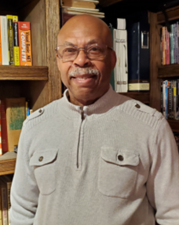


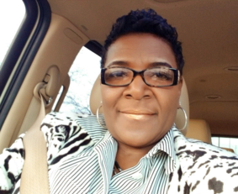
2025 Trinity Creeks HOA Board Members
Willie Johnson
President
708-267-2008
Kevin Richard
Treasurer
708-355-1609
Melody Seaton
Director
773-550-1681
Victoria Hill
Secretary
773-576-7736
Regina Brown
Director
773-368-8186
Patrick Peterson
Director
312-388-9661
Notes:
If there’s an emergency
Have a question

Slide 3

Trinity Creeks Homeowners Association
General Meeting
December 17, 2025
Agenda
Welcome Willie Johnson
2026 HOA Board Nominations Willie Johnson
Capital Improvements Melody Seaton
Squatters in Trinity Creeks Willie Johnson
Financial Update Kevin Richard
Beautification Willie Johnson
2025 Year-in-Review Willie Johnson
Question & Answer Willie Johnson

Slide 4
Trinity Creeks Homeowners Association
General Meeting
December 17, 2025
Agenda
Welcome Willie Johnson
2026 HOA Board Nominations Willie Johnson
  Nominations were mailed to all residents by Cambridge Management and are due by December 23 via email or U.S. mail.
Capital Improvements Melody Seaton
  Residents may vote with the Village of Matteson on capital improvements in the neighborhood. Information was mailed; contact Melody if you need additional details.
Squatters in Trinity Creeks Willie Johnson
  Willie contacted the homeowners of 1021 Amlin Terrace regarding their squatters. No update has been provided yet. The owners are working to remove them and will follow up within two days. If legal action is not filed within 60 days, the HOA may terminate the rental agreement and restrict future rentals.
Financial Update Kevin Richard
  Assessment collections are the highest in several years. Kevin reviewed the year’s income and expenses. Expenses included the purchase of tents and a shed to support HOA events and park resources.
Beautification Willie Johnson
  Thanks to Patrick Peterson and Marice Hill for decorating the monument sign for Christmas. HOA funds were used for weed maintenance, flowers, and continued maintenance by R&J.
2025 Review/Accomplishments Willie Johnson
  New park
  Garage Sale
  Block Party
  Walking committee formed
  Monument upgrades
  Improve assessment collection

Slide 5
Trinity Creeks Homeowners Association
General Meeting
December 17, 2025
Agenda
Question & Answer/Open Discussion Willie Johnson
Wetlands
The wetlands were scheduled to be cleared of weeds and overgrowth years ago; however, this work has not yet been completed. The Board is continuing efforts to have the work done and may need additional support from residents by sending letters to the Village to help expedite the process. Diane suggested reaching out to the Water Reclamation District for assistance and offered to draft a letter. Kevin also contacted the Water Reclamation District and was informed that the wetlands are not within their scope of responsibility. The Board is exploring other options, including working with Cook County, and will provide updates at a later date.
Park Area / Extra Lots
The Village is currently working with the HOA to determine how to utilize the extra lots near the park in a way that avoids Trinity Creeks having property tax liability. If the HOA were to take ownership of the park, there would be potential liability concerns that would need to be addressed.
Roads & Sidewalks
Newbury Lane has multiple potholes. The Village has hired a contractor to repair the streets after winter. Several sidewalks throughout the neighborhood are uneven or cracked. Residents are encouraged to write letters to the Mayor or include the Mayor as a cc when reporting these concerns to the current Public Works Superintendent Gordon Hardin.
Cyber Optic Program
Kevin spoke with the organization responsible for the cyber optic work and was informed that they will cover the cost of any damage caused by their wiring installation.
Holiday Check-In Campaign
Diane shared information about a Holiday Check-In campaign supported by the Village of Matteson and Rich Township. The initiative encourages neighbors to check in on one another during the holiday season, as some individuals may be struggling and could benefit from added support. Willie encouraged us to continue looking out for one another year-round.
Neighborhood Update
The neighbor next to Judson (Mr. Greer) is in the process of moving.
Board Elections & By-Laws
Smitty suggested considering a staggered Board election process to ensure continuity through overlapping terms. Implementing this change may require an update to the HOA By-Laws. Due to a lack of volunteers in past elections, some Board members have served longer than the terms currently outlined in the By-Laws.

Slide 6
Thank you
Community is not just where we live; it's where we belong, where we connect, and where we thrive together!

Slide 7
Trinity Creeks Homeowners Association Mission Statement
The mission of the Trinity Creeks Homeowners Association is to promote a resident friendly neighborhood, where residents enjoy an enhanced quality of life, and assures that the value of their homes will be protected. Through the administration of the Declaration of Covenants and applicable local ordinances, the Homeowners Association seeks to collaborate with its members now and in the future toward common goals.
Declaration of Covenants, Conditions and Restrictions – Trinity Creeks Subdivision Matteson, IL
Article V, 5b
Purpose and Use of Assessments: All assessments levied by the Board shall be for the purpose of insuring high standards of maintenance, repair and replacement of the entrance signage monument and adjoining landscaping. Such purposes and uses of such assessment shall include (but are not limited to) the costs of the Association of all legal, insurance, repair, replacement, maintenance and other charges by this Declaration of Covenants, Conditions and Restrictions, or that the Board of Directors of the Association shall determine to be necessary or desirable to meet the primary purpose of the Association.

