Slide 1
Fishing Pole Pack & Paddle
(Winter 2024)
President’s Paddle
Reflecting on this past year, we have a lot to be proud of, with a particular highlight being the significant achievement of purchasing Allen's Creek. This milestone stands as a pivotal moment for FFV, symbolizing not only growth and commitment but also providing a solid foundation for our future endeavors. A heartfelt thanks goes out to Bill Tanger for spearheading this project and all the others who played a role in making this possible. As we celebrate this achievement, I find myself reminiscing about those individuals before us who, through their vision and efforts, set things in motion, paving the way for the successes we enjoy today. Their contributions weave an integral part of the rich tapestry that defines the history of the Float Fishermen of Virginia.
Thanks to all who attended the winter meeting! As we eagerly anticipate the warmer months and the adventures that await us on the water, check out the exciting lineup of events and activities at the end of this newsletter.
Looking forward to seeing everyone at the Memorial Day float, don’t forget to bring a new friend and pay your dues! Please reach out anytime with ideas, questions, etc.
Until then, stay adventurous, stay connected, and I'll see you on the river!
---- Erica Goode
FFV State Officers
President: Erica Goode
Ericagoode10@gmail.com
Vice Presidents:
Tony Adams: antonadams@comcast.net
Bill Duncan: wduncan311@yahoo.com
Herb Coleman: herb@clachanproperties.com:
Bill Tanger: riverdancer1943@gmail.com
Secretary: Lauren Jacobs
lorenjacobs@yahoo.com
State Treasurer: Mitch Sims
mitchsims@yahoo.com
*Chapter Treasurers, please e-mail deposit amounts to Bryon, each time you deposit in State Account.*
Membership Chair: Ginnie Peck
**Chapter Treasurers, please e-mail updated membership info to Ginnie @:
ffvbusiness@gmail.com
Newsletter Editor: Gabby Safley
gabby.safley@gmail.com
Webmaster: Traci Martin
traci.martin1970@gmail.com
Conservation Chair: Bill Tanger
riverdancer1943@gmail.com
Annual Dues: Due January each year
$20.00 per Individual or per Family (spouse & children 0-18)
Individual chapters may have additional annual dues.
Contact your CHAPTER Treasurer to pay dues
Please, DO NOT send dues to Membership Chair or State Treasurer
Chapter Treasurers:
George Dickel Chapter: Ginnie Peck
dickels.treasurer@gmail.com
Randy Carter Chapter: Ed Galloway
ewgalloway@verizon.net
Roanoke Valley Chapter: Bill Tanger
billtanger@verizon.net
Scotts Creek Chapter: Rick Mattox
rickmattoxrva@outlook,com
Steve Keller Chapter: Larry Born
larry.born@yahoo.com

Slide 2
December 2, 2023 Meeting Minutes Provided by: Rick Mattox
Call to order: Erica Goode
Erica called the meeting to order at 11:01am.
Secretary Report (Approve minutes): Loren Jacobs
Ginnie motioned to approve minutes. Motioned, seconded, and approved.
Treasurer’s Report: Mitch Sims
Checking account balance: $11,442
Two CDs: $8,640
Total: $20,082
Currently looking into expenses. Year to date, we are in the red by $880. Mitch indicated that river tax is not covering expenses for Labor Day and Memorial Day meetings. It was indicated that river tax is intended to off-set some of the cost as opposed to financing the total cost of the meetings. Do we continue to have live music? Do we raise dues? Looking into changing current investments. Decision to table dues increase until next year was made in order to determine if the change in investments can cover current deficiency.
Possible investment changes:
Move money from checking to money market
Shopping new CD options
Mitch will email officers with results
Aluminum Collection
$880 has been raised so far to fund the kids float
Keep collecting those cans
Thanks to Andy and Katherine!
Membership Report: Ginnie Peck
Total paid membership: 141
Looking into using Zelle to allow easier dues payments and an electronic option
Membership Report: Ginnie Peck Cont.
Setting up a Venmo or QR code for river tax to allow for both cash and cashless options.
Chapter treasurers please use and submit the official spreadsheet
Newsletter Report: Gabby Safley
Gabby is not here but will hopefully continue. Thanks Gabby!
(Thanks y’all! –GLS)
Webmaster Report: Traci Martin
If you have photos or information that needs to be changed on the website email or text Traci.
Conservation Chair Report: Bill Tanger
Legislative Session ends in February
FORVA has No Tires In The River Legislation: Expensive landfill fees cause tires to be dumped in Virginia rivers. The bill proposes that if you sell tires in this (VA) state, you have to be willing to take them back at no cost. Talk to your county supervisor to see if we can get the bill on the legislative agenda.
Use the following link to determine your legislator: https://Whosmy.virginiageneralassembly.gov
Sign up for the Bay Journal – Free online
FFV Foundation Report: Bill Tanger
Allen’s Creek (Amhurst County)
Volunteers hauled away 5 tons of trash
Currently working on getting a plan in place to decide if the house on the property is worth rehabbing.

Slide 3
December 2, 2023 Meeting Minutes Provided by: Rick Mattox
Trip Schedule:
Dickel Spring Fling: 4/19-4/21
R5 Cajun Weekend: 4/46-4/28
Memorial Weekend: 5/24-5/27
-Location: Slate
-Port-o-johns: (2)Ginnie)
-Dinner: Mike McEwen will be cooking a delicious BBQ dinner.
-A $10 individual and $20 for family donation will be taken up for those eating. Feel free to bring a side
-Band will be determined based on budget remaining after porta potty rental
-Budget: $500
Kids Float: 6/8
Labor Day Weekend: 8/30-9/2
-Location: Solitude
-Port-o-johns: 3
-Band: Band will be determined based on budget remaining after porta potty rental
-Budget: $500
Dickel Bash: 10/11-10/13
Winter Meeting: 12/7 11:00am
- Location: Slate
- $100 to owners of Slate and Solitude
as a curtesy for allowing us to use
their property.
Old Business: N/A
New Business: N/A
Adjourn: Rick motioned to adjourn, motion accpted

Slide 4
Our Friend Wright Ellis Submission from: Bill Powell
One of the long-time members of R-5, Wright Ellis, has passed on the afternoon of January 21, 2024.
Wright always was cheerful and great to be around. According to the club records, he had been a member of the Randy Carter Chapter. Of Float Fishermen of Virginia since 1993.
We will miss him.
Details on a memorial service have not been made yet.
-------------------------------------------------------------------------------------------------
As of January 21, 2024 there is no official obituary to include in the Newsletter. - GLS

Slide 5
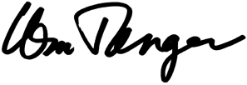
Currents and Eddies Courtesy of Bill Tanger January 11, 2024
Craigs Creek: Fighting a lawsuit against the state of Virginia that attempts to stop navigation on the creek. Could set a statewide precedent. Have created Friends of Craigs Creek, with membership now at 165. FFV has filed an amicus brief supporting our efforts. Trial coming up Monday, February 12, in Craig County Courthouse.
James River - Allens Creek: New access created by FFV and FORVA. Now share ownership of a critical access to the James. No other access for 20 miles upstream. Need volunteers. ---- FFV & FORVA
James River Balcony Falls Take-out (Amherst County): FORVA is working to find a political jurisdiction willing to partner on access development. Possible Amherst County. ---- Bill Tanger, FFV
Roanoke River – Niagara Dam Relicensing (Roanoke County): Working on recreational access issues along the river. APCO not very helpful. ---- Bill Tanger, Ro River Blueway Committee
Blackwater River (Franklin County): Improving our 6-acre access on the Blackwater River at Round Hill Road in Franklin County. Just put in a parking lot, gate, ramp, and power poles with solar lights. Kiosk and VDOT erosion control underway. ---- Bill Tanger, Creek Freaks
Big Otter River (Bedford County): Working on possible blueway access sites; Bedford County is supportive but no funds. ---- Bill Tanger & Tom Phillips
New River – Price Park (Montgomery County): Improving a 50-acre park along Stroubles Creek in Montgomery County.
---- Randi Lemmon and Bill Tanger
Blackwater River (Franklin county): New access on the Blackwater Riverr at Rt 122 under development for a parking lot and an access ramp. Need volunteers to cut and clear brush. ---- Bill Tanger, FFV; Pat & Ray Williams; Creek Freaks of Franklin County
Roanoke River (Salem City): Tucker Lane stormwater issue (Roanoke River). May be filing suit against City of Salem to get corrective action.
Statewide: Working on No Tires in the River bill to end incentives for people to throw tires in the river rather than pay landfill fees. Contact me if interested in helping. We need letters to legislators. Senator Chris Head is sponsor of the bill. Delegate Sam Rasoul is a co-patron.
FFV – Currents – Projects – 1-11-24

Slide 6
Craigs Creek Court Report of January 5, 2024 Courtesy of Bill Tanger
Attending the hearing for Friends: Bill Tanger, Terry Grimes, Barry Mobley, Ned Savage, Deb Hedrick, Mr. Pillis and Ms. Pillis.
Attending for the Lemons: Steven and Tucker Lemon and Ray Ferris
The legal battle over Craigs Creek use continues.
The Lemons attempted to add new evidence to the record refuting the judge’s decision at the last hearing that Craigs Creek was in the eastern half of Botetourt County. Craigs Creek flows east of the continental divide (in the Appalachians) and into the James River, Chesapeake Bay and Atlantic. Water west of the divide flows west into the New, Ohio and Mississippi and on into the Gulf of Mexico.
After much discussion and some contentious argument, the judge reiterated his decision that Craigs Creek is in the eastern watershed of Botetourt County. This is a good move by the judge.
The second issue was over the question of whether Craigs Creek has been used as a commons, and what date that use began. Judge Branscom ruled that the burden of proof as to whether the creek was used as a commons would be on VMRC. He said the Lemons did not have to prove that it was not used as a commons, putting the burden the state’s attorney, Rosalie Fessier.
I believe such proof is available and that we should prevail. In any case the judge put off addressing that issue until the trial. The trial is now slated for Monday, February 12 and 13 in Craig County. Start time is 9:30 am.
An interesting issue arose over the amicus brief that FORVA filed in support of the VMRC position. The Lemons objected to the court accepting the brief and claimed it was not “certified” properly. This can be fixed, if true. The Lemons also stated that there were facts that were incorrect but did not specify which ones. Judge Branscom ruled that would be addressed at the trial.
This is the first time the Lemons seemed to be aware of the amicus briefs. There are three: one done by Botetourt County, one done by the Float Fishermen of Va, and the most recent one done by FORVA. Evidently the amicus briefs are starting to have an impact.
I am proposing, if we can raise the money, to do a fourth amicus from Craig County. The county does not have the funds so we would need to raise them. I am guessing about $8,000 in attorney fees. Please let me know your thoughts on this.
Please put the trial date on your calendars. At this deciding event, your presence matters.
---- Bill Tanger (exhausted, but still kicking)

Slide 7
Allens Creek Rehab Report Courtesy of Bill Tanger & Howard Kirkland January 13, 2024
Hello river people:
On Saturday, Jan 13, Howard Kirkland and I spent a lovely day at Allens Creek. Sunny, 50 some degrees, dry and very pleasant.
The best news is that we electrical detectives found some missing wire connections and we now have a light in all five rooms downstairs! We now can see better and can use power tools.
We will be testing some new equipment that can track wiring behind the wall. Kind of like a stud sensor, but not. This should allow more accurate detective work
Outside in front we tore up some of the collapsed concrete walkway that was directing water into the basement. The best solution for this looks like removing the dirt near the wall, putting in some waterproofing materials and then putting in some French drains to run any rainwater away from the house. We shall see.
The basement was wet from the rain, but when dry we should clean out the dirt to expose the floor. We suspect there is a concrete floor that has been covered with dirt over the years. Originally the homeowners lived in the basement while they built the house. It had a basement stove at one time.
Anyway, it was a very productive day at Allens Creek.
Next scheduled work expedition will be Saturday, January 27. Start time 10:00am.
Weather depending.
---- Bill Tanger & Howard Kirkland
Allens CK – Rehab Report – 1-13-2024

Slide 8
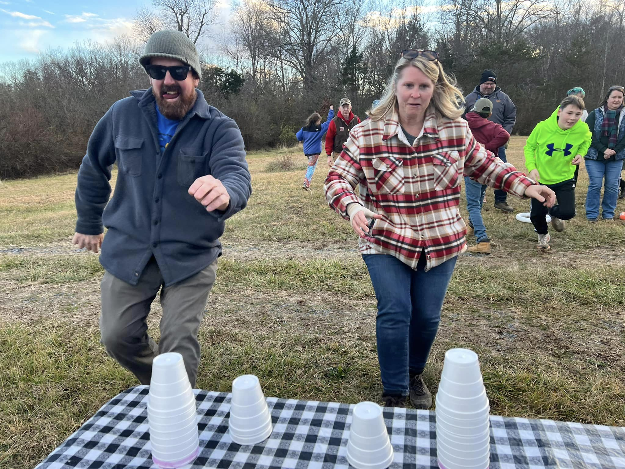
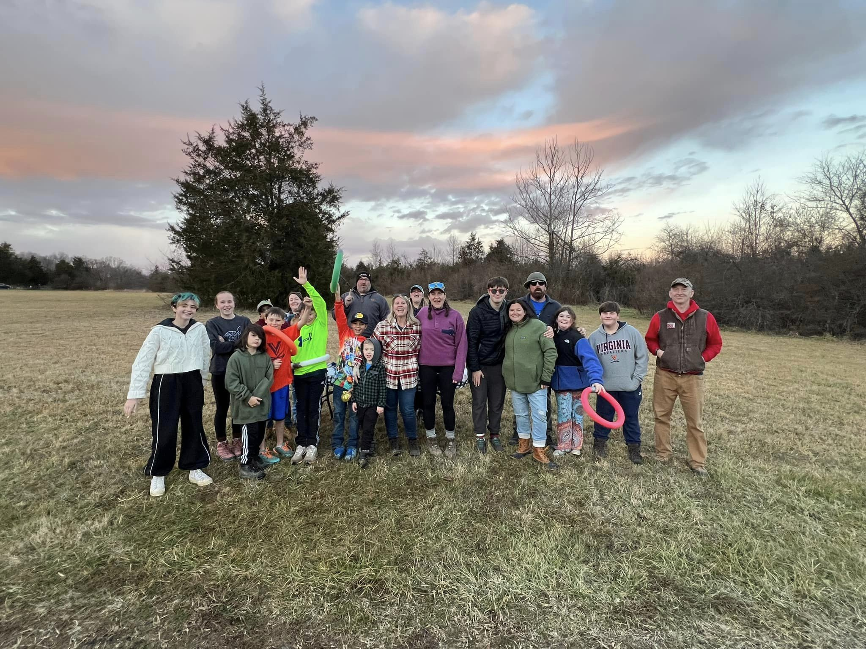
A Float Family Courtesy of our FFV Members
New Years Eve Camping Fun – Amanda Reeve
New Years Eve Camping Fun – Amanda Reeve

Slide 9
2024 FFV Event Schedule
Event/Location: Date:
Dickel Spring Fling April 19-21st , 2024
R5 Cajun Weekend April 26-28th, 2024
Location: R5
Memorial Weekend (Meeting at 9:00am) May 24th-27th, 2024
Location: Slate
Kids Float: June 8th, 2024
Location: Warren Ferry to Hattons Ferry
Labor Day Weekend (Meeting at 9:00am) Aug. 30th-Sept. 2nd, 2024
Location: Solitude
Dickle Bash Oct. 11-13th, 2024
Location: Slate
Winter Meeting (11:00am) December 7, 2024
Location: Slate

Slide 10
Editor’s Note
The opinions expressed in FPP&P are those of the author’s and not necessarily those of FFV or its members. The editor is responsible for editing the content of the newsletter and its construction. Members are responsible for providing content. Please send submissions to the editor via email attachment. The following formats are preferred: Word, RFT, and/or JPEG. The newsletter goes out quarterly: Feb 1, May 1, August 1, Nov 1. All Submissions MUST be received by the 15th of the preceding month.
If you receive this newsletter via US Mail, we do not have a current email address for you. Contact your local treasurer or the Membership Chair to update your information.
FFV Membership Chair
794 Farrar Bridge Lane
Shipman, VA 22971

