Slide 1
Build Your Pitch
Linda@PullanConsulting.com
www.PullanConsulting.com

Slide 2
Build Your Pitch
1. Consider the Audience
2. Know the partnering process
3. Partner’s questions
4. Build forms of the pitch
5. Make it easy

Slide 3
The Audience- diverse, possibly hidden
Audience
1st - an assistant
doing triage by key words only
2nd – BD
a generalist
3rd – a researcher
with deep understanding
4th – diverse
team members

Slide 4
Process
Partnering process- starts with defining value
Understand
Outreach
Listen & Evaluate
Deal Concept
Diligence
Negotiate
Deliver
Refine, reiterate
Define value, content
Find partners that FIT

Slide 5
For Partnering Meetings- aim for followup
Process
During Partnering Meeting
After Partnering Meeting
Followup
2nd non-con meeting, Questions
CDA confidential deck
Deal concept, diligence,
Etc.
Posting
Invite
Deck
Send deck
With keywords
Tailored to profile

Slide 6
Partnering Process: A numbers game
Process

Slide 7
Partner Questions to be answered
Questions
Is this a strategic fit for us? What is it?
Therapeutic, diagnostic, platform, IP?
Disease, stage, mechanism, molecule type, risk profile?
Why this one? How is it differentiated?
[What are the risks and when can they be addressed?]
What is the path to revenues?

Slide 8
Build different forms of pitch
forms
Invite – an elevator pitch
Posting – a one pager
Non-con deck
#1 tool
Confidential deck
Deeper

Slide 9
The invite – elevator pitch Aim= get a meeting Short! Specific Is it a strategic fit? What is special about this one?
forms

Slide 10
The posting – a one pager on each asset
forms
Aim= get a meeting
Title- What is it? Can they judge its strategic fit?
What is special about this one? What is its potential
What is the path to revenues?
What data do you have? Stage? IP?
What are you seeking?
Contact information

Slide 13
The non-confidential deck for VCs WHO & HOW
forms
Problem
Solution
Business model – who pays, distributes
What’s special? Differentiation?
Team – track record
Traction –progress
Financial projections
Use of funds

Slide 14
Make it Easy
easy
Deck should speak without you
First slide - Why should I care? What should I watch for?
Slide titles as take-away messages – a flip thru summary
Clear away clutter
Fewer words, more space
Every graph has its own take-away
Use circles, arrows to call attention
Summary of key items – what they should remember
Share as a PDF (under 5 Mbytes- compress pictures)

Slide 15
A VC deck- example

Slide 24
Skipped some science slides

Slide 26
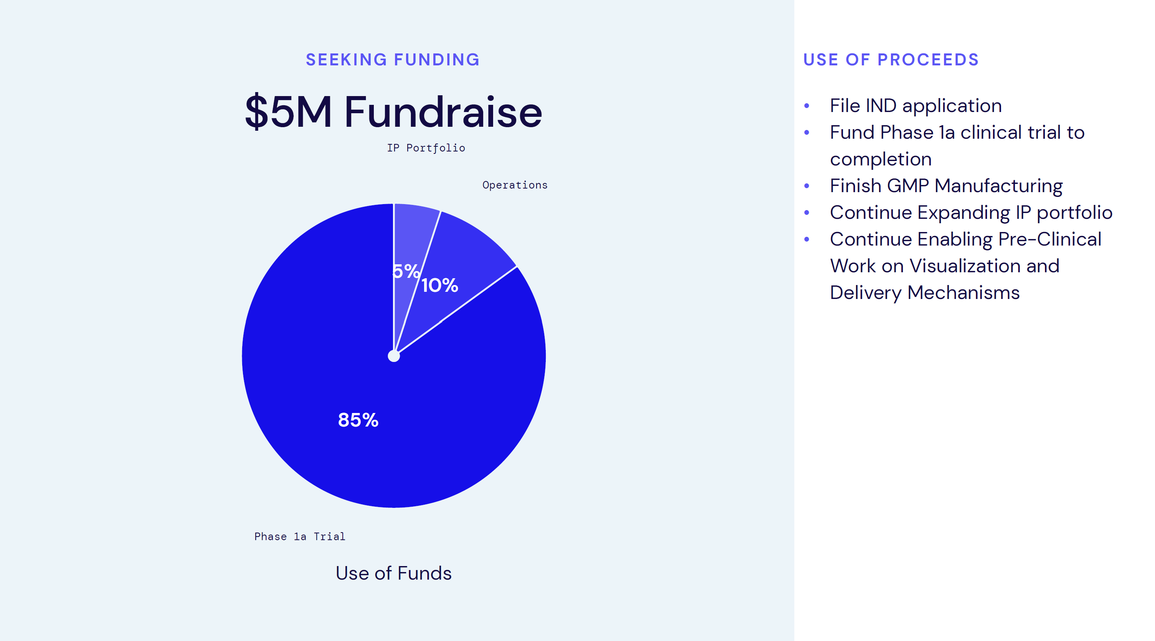

Slide 27
Partnering Decks

Slide 28
The non-confidential deck for partners WHAT
forms
Aim = get the next meeting
Summary – what’s special about this one? Does it fit?
Problem
Solution- Potential
Data for differentiation
Path to revenues- think about the market
Summary – key points
Contact information

Slide 29
How much in the non-confidential deck?
forms
ONE FOCUS
Enough to decide on FIT
Enough for What’s special about this one?
CLARITY
Address the “elephant in the room” risks
Don’t label it “confidential” or “proprietary” without a CDA = “REJECT!”
What should be kept confidential?
Not yet filed IP
Not yet published
Truly enabling – structures, manufacturing, trade secrets
BUT Include biology results

Slide 30
Make it easy for them find the next one
Easy

Slide 31
Style Tips for Non-Con Deck
First slide is KEY- Why this one?
Last slide should be take-aways – a few bullets
Avoid jargon and abbreviation
1 or 2 figures per slide
Every figure has its own caption – the conclusion
Nothing that is irrelevant
Never say “I know this is too small”
Slide numbers
Your contact

Slide 32
First slides- examples

Slide 36
The Team- examples

Slide 40
Data slides- examples

Slide 46
Other slides- examples

Slide 52
Summary- examples

Slide 57
Remember
Give them enough to decide fit
Show them what is special about this one/differentiation!
Make it easy

