Slide 1
Integration of Liquid Waste processing systems
September 12, 2019
Tom Foster
President and Project Manager

Slide 2
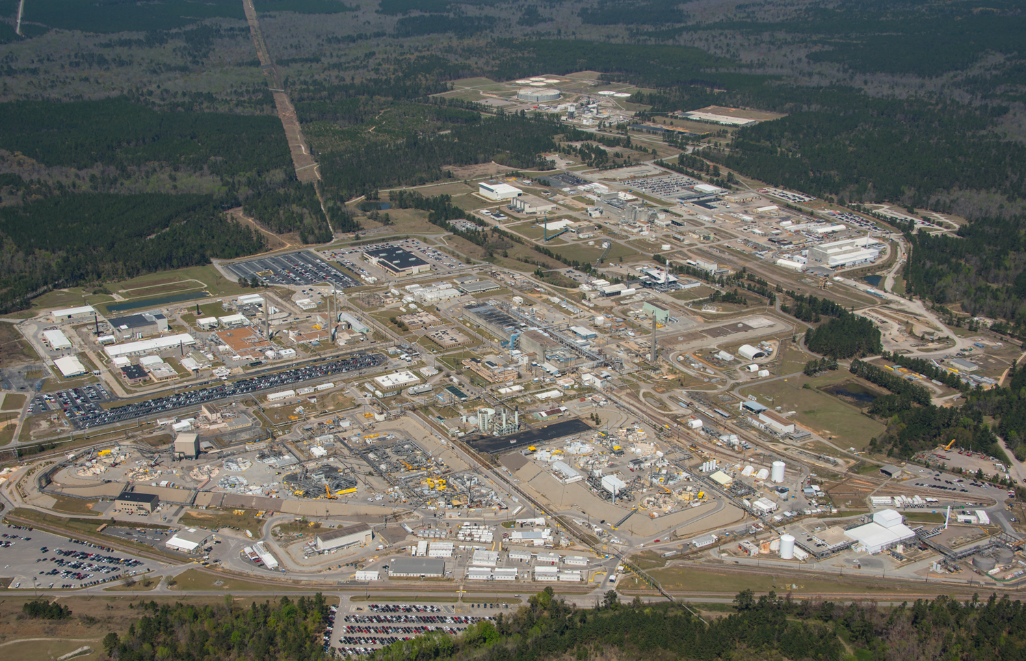
Integrated Liquid Waste System
Saltstone Disposal Units
Saltstone Processing Facility
Salt Waste Processing Facility
Defense Waste Processing Facility
H Canyon
Low Point Pump Pit
Modular Caustic Side Solvent Extraction Unit
Blend Tank 21
Actinide Removal Process
Tank 49 SWPF Feed

Slide 3












SRS Liquid Waste Program Dependencies
HLW Sludge Batch Feed Preparation
HLW Sludge Bulk Waste Removal
H-Canyon
HLW Evaporation
HLW Tank Closure
Glass Waste Storage
DWPF Canisters
Effluent Treatment Project (ETP)
HLW Tank Cleaning
HLW Salt Waste Removal & Batch Feed Preparation
LLW (Saltstone)
Tank Closure Cesium Removal
ARP/MCU
Saltstone Disposal Units (SDU)
SWPF

