Slide 1


What is the right
Business Structure for You?

Slide 2
What is the right
Business Structure for You?
The type of business structure you choose determines many components of your business, including day-to-day operations, how much you pay in taxes, and the paperwork you must file. You should choose a business structure that gives you the right balance of benefits and protection.
Each type of small business structure treats tax liability differently. Some businesses are taxed at the personal income level or are double-taxed at both the business and personal income levels. Read on to learn the various types of business structures to see which is the best fit for your small business.

Slide 3
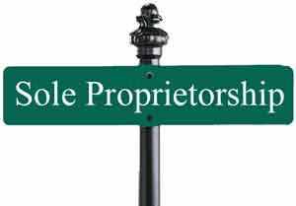
Sole Proprietorship
The most common business structure type is a sole proprietorship. A sole proprietorship is owned and operated by one person, a sole proprietor. A sole proprietorship is a good option if you are looking to have complete control of your business.
Sole proprietorships do not produce a separate business entity. Your business assets and liabilities are not separate. Sole proprietors include both their business expenses and personal income on their personal tax return.
Sole proprietors are liable for the business’s liabilities, debt, and losses. If your business goes into debt, your personal assets may be at risk.
Partnerships

Slide 4

Partnerships
A partnership is a business that two or more individuals own and operate together. Partnerships can be considered either general partnerships or limited partnerships.

Slide 5

General Partnership
A general partnership is owned by two or more people. In general partnerships, the partners manage the business and assume responsibility for the partnership’s debts. Partners have equal shares of all profits and losses.
General partnerships allow partners to work as co-owners. Consider creating a partnership agreement to lay out the specific shares for each partner if you plan on starting a general partnership.
Profits in general partnerships are only taxed at the personal income level.

Slide 6
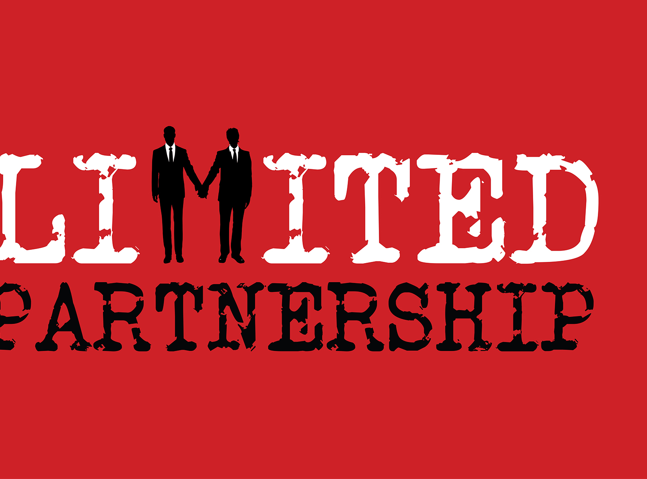
Limited Partnership
A limited partnership has both general and limited partners. You need at least one general and one limited partner to start a limited partnership.
Limited partners only serve as investors for the business and typically have no business decision rights. General partners own and operate the business while assuming liabilities for the partnership. As a general partner, you have control and responsibility. Limited partners get ownership without taking on the responsibility and risks.

Slide 7

Corporation
A corporation, or C Corp, is separate from its owners. Laws treat corporations as independent legal entities.
Corporations provide you with the strongest protection from personal liability. However, corporations are more complicated than other business structures. A corporation structure is a good option if you plan to expand your business and add shareholders.
Corporations require extensive recordkeeping and reporting. You are required to comply with more regulations and tax requirements.
Corporations are double-taxed. Double taxation occurs when you pay income taxes twice on the same source of earned income. In the case of corporations, the company is taxed as a business entity and each shareholder’s personal income is taxed.

Slide 8

S Corporation
An S corporation, or S Corp, is a type of corporation where profits and losses are passed through directly to the owner’s personal income without being subject to corporate tax rates.
Shareholders must be U.S. citizens. An S Corp can’t have more than 100 shareholders.
Only the owners, or shareholders, of the business are taxed. You can avoid double taxation by electing to operate as an S Corp through the IRS.

Slide 9
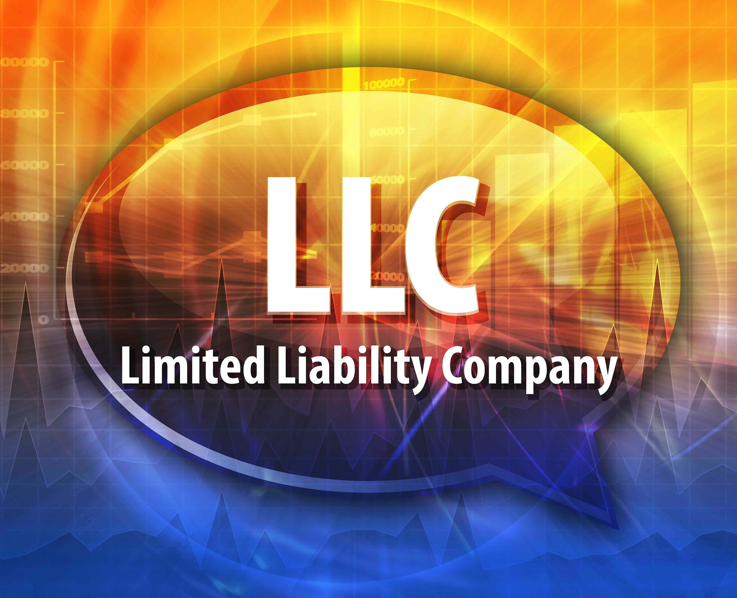
Limited Liability Company
A limited liability company (LLC) lets you take advantage of the sole proprietorship, corporation, and partnership business structures.
LLCs are flexible business structures. Your LLC separates business and personal liabilities. All owners have shared tax responsibilities.
An LLC provides you with liability protection, like corporations, without double taxation. Your business avoids double corporate taxation since you can pass through taxes to the personal income level.
Unlike other business structures, owners in LLCs are not liable for their business’s debts.
In many states, LLCs have a limited life. Your state may require you to dissolve or reform your LLC if someone joins or leaves. Each state treats LLCs differently, so tax liabilities vary depending on location. Check with your state for specific LLC regulations.

