Slide 1
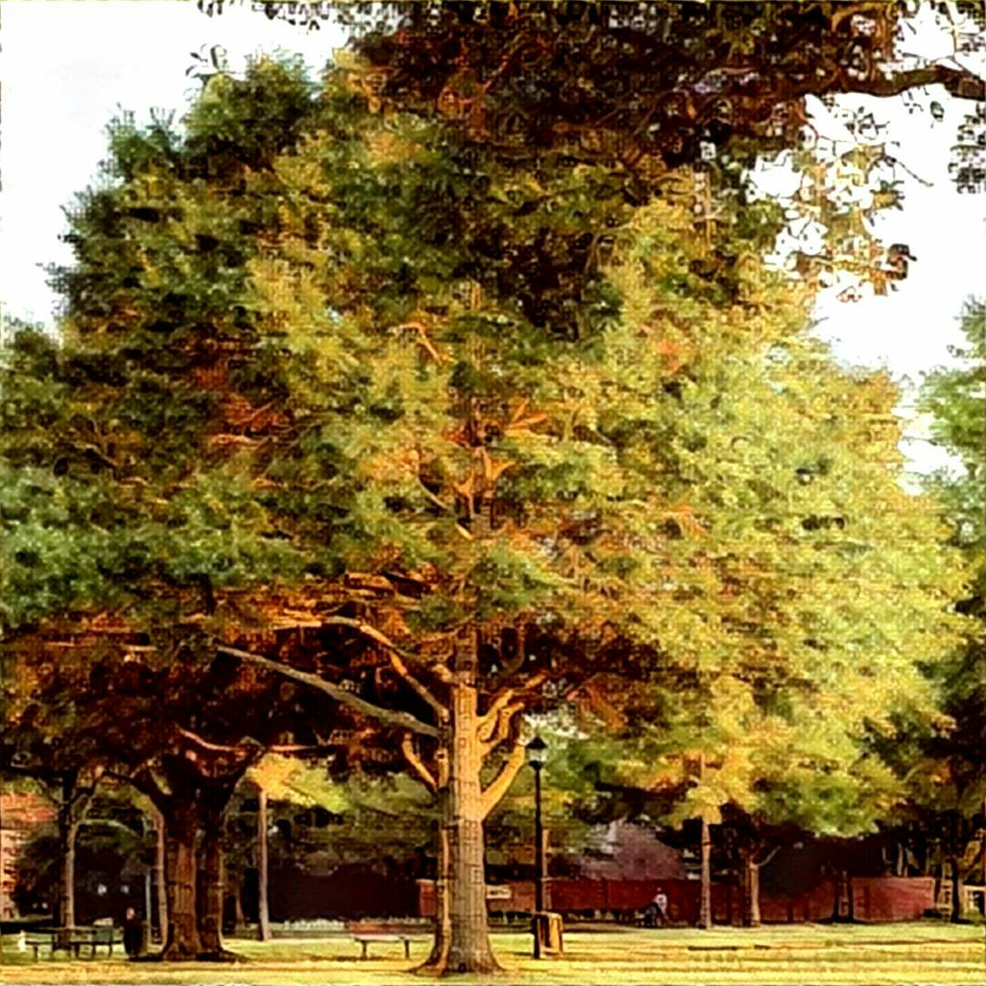
SOUTHWYCK CAI ANNUAL MEETING – JANUARY 09, 2025 www.SouthwyckTexas.com
Introduction of the current board of directors and reading of the minutes from last annual
meeting – KATHY DOOLEY
Election of Directors – JOHN FISHER
  Introduction of known candidates - Vanessa Williams – Kevin Shaw – Homer Franklin
  Floor nomination?
Master and boards responsibilities – RICK NELSON
State of the Association – VANESSA WILLIAMS
How you can participate – HELEN BILYEU
2025 Possible Projects – KEVIN SHAW
Budget 2025 – KATHY DOOLEY
Q&A While votes counted – JOHN FISHER
** Please keep comments down to no more than 2 minutes.
Election Results – KATHY DOOLEY
DOOR PRIZE – HELEN BILYEU

Slide 2
SOUTHWYCK CAI ANNUAL MEETING – JANUARY 09, 2025
WWW.SOUTHWYCKTEXAS.COM
Welcome & Introduction – KATHY DOOLEY
  Community Manager – Kathy Dooley
  President – Vanessa Williams (2024)
  V. President – Helen Bilyeu (2026)
  Secretary – John Fisher (2025)
  Treasurer – Rick Nelson (2026)
  Director – Kevin Shaw (2024)
  Attorney – Trisha Farine with Daughtry & Farine, P.C.
  All positions hold equal voting weight at our meetings.

Slide 3
SOUTHWYCK CAI ANNUAL MEETING – JANUARY 09, 2025
WWW.SOUTHWYCKTEXAS.COM
Election of Directors – JOHN FISHER
  Homer Franklin
  Vanessa Williams (incumbent)
  Kevin Shaw (incumbent)

Slide 4
SOUTHWYCK CAI ANNUAL MEETING – JANUARY 09, 2025
WWW.SOUTHWYCKTEXAS.COM
Master and boards’ responsibilities – RICK NELSON
  Collection of assessments. Distribution of each section’s
  portion of the assessments which are set by the Sections and Master
  each year. Interest on the section’s late payments is given
  to the appropriate section.
  Landscape maintenance, including but not limited to mowing,
  edging, blowing, plantings, mulching, pest control, irrigation
  system, and watering of 18 entrances and 2 parks.
  All costs associated with the lighting & irrigation for all 18
  entrances and our 2 parks.
  Tree trimming.
  Repair/replacement of all perimeter fences along a major road.

Slide 5
SOUTHWYCK CAI ANNUAL MEETING – JANUARY 09, 2025
WWW.SOUTHWYCKTEXAS.COM
Master and boards’ responsibilities (continued) – RICK NELSON
  Park equipment including play structures, sunshades, picnic tables, benches, swings,
  water fountains & foot washing station, volleyball court,
  sand box, trash cans and doggy stations in our 2 parks.
  Upkeep of the lake & fountain - cost sharing with Silverlake.
  Maintenance of covered structures and the 2 patio structures
  at our 2 parks.
  Power washing of entrances, fences, play equipment, patios/pavilions
  and graffiti removal.
  Casualty insurance for master and sections at no charge to sections.
  Directors and officer's liability insurance for the master board.

Slide 6
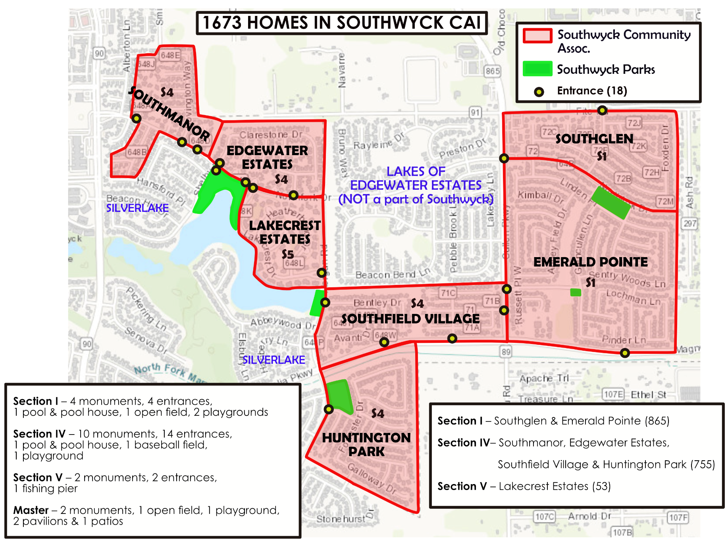
SOUTHWYCK CAI ANNUAL MEETING – JANUARY 09, 2025
WWW.SOUTHWYCKTEXAS.COM

Slide 7
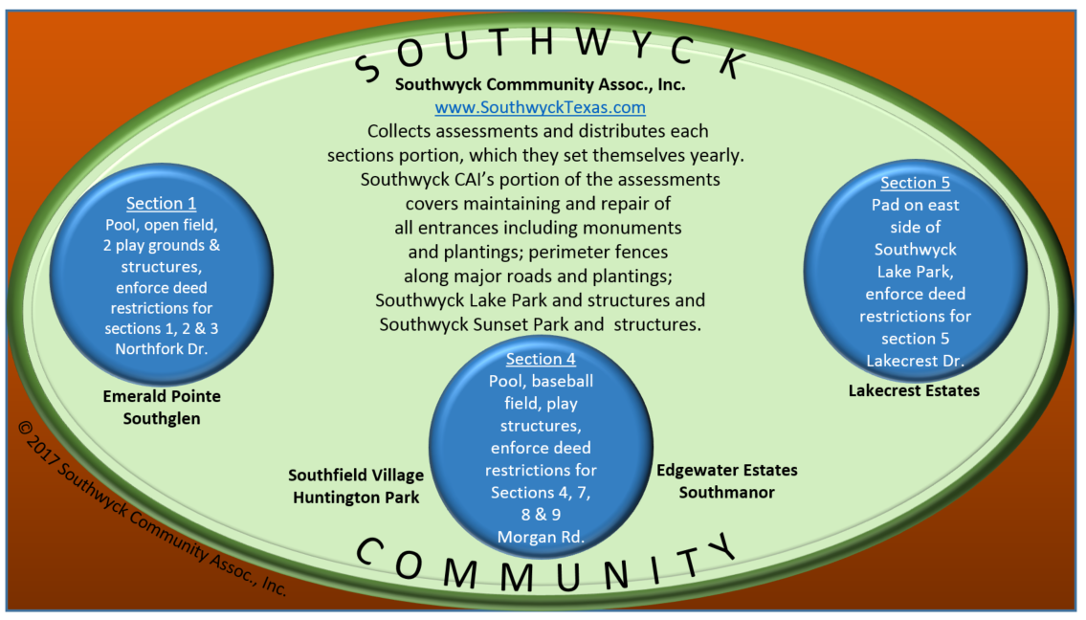
SOUTHWYCK CAI ANNUAL MEETING – JANUARY 09, 2025
WWW.SOUTHWYCKTEXAS.COM

Slide 8
SOUTHWYCK CAI ANNUAL MEETING – JANUARY 09, 2025
WWW.SOUTHWYCKTEXAS.COM
State of the Association – VANESSA WILLIAMS
  Southwyck CAI hosted an All-Boards Meeting in April, and Section 4 hosted the October meeting. These gatherings are invaluable opportunities for all the board members and property managers, who can attend, to connect, exchange ideas, address questions, and share vendor recommendations. They also provide a platform for learning new strategies and fostering collaboration across the community.
  Freeze, summer drought and hurricane repairs and replacements. Removal of dead plants & trees, downed fences repaired, and shade sails removed.
  The sidewalk on Morgan from Northfork to Lakecrest was replaced and ground graded so that the water flows off the curb and does not stand on the sidewalk anymore.
  We had Brick Restoration (BRI) do an assessment of all the brick walls and columns and give us an evaluation on those that need to be repaired.

Slide 9
SOUTHWYCK CAI ANNUAL MEETING – JANUARY 09, 2025
WWW.SOUTHWYCKTEXAS.COM
State of the Association (continued) – VANESSA WILLIAMS
  Added Unauthorized parking signs created for Southwyck Lake Park. We have had issues the last several years with unauthorized cars at the park conducting business.
  Quarterly power washing of all play equipment and picnic tables in both of our parks.
  Additional tree trimming on our property. Trimmed to make sure trees were
  off fences, roofs, light poles and shade structures.
  Minor repair of swing, swing bench & play structure at Southwyck Lake Park and Southwyck Sunset Park.
  Southwyck CAI has noticed that there are bulkhead repairs needed for the lake at Southwyck Lake Park. We are trying to determine who is responsible for these repairs for our portion of the lake.

Slide 10
SOUTHWYCK CAI ANNUAL MEETING – JANUARY 09, 2025
WWW.SOUTHWYCKTEXAS.COM
State of the Association (continued) – VANESSA WILLIAMS
  Crepe Myrtles were cut down from the uncovered pavilion area near Northfork and Lakecrest to alleviate any more damage to the bulkhead at Southwyck Lake Park.
  Continued displaying of Patriotic flags, maintained by Boy Scouts Troop 446.
  Website kept up-to-date and relevant.
  Finalized our 2022 & 2023 audits from external auditor.

Slide 11
SOUTHWYCK CAI ANNUAL MEETING – JANUARY 09, 2025
WWW.SOUTHWYCKTEXAS.COM
State of the Association (continued) – VANESSA WILLIAMS
  Board discussed and agreed on a 10% assessment increase. Our last assessment increase was 8% in 2018. The increase will be seen on your July 2025 assessment invoice since we bill assessments in arears.
Assessment increase:
Rising costs of services and maintenance necessary to maintain our community’s aesthetics and property values.
Underfunding leads to neglected amenities and declining curb appeal, which could hurt everyone’s investment.
Delaying maintenance costs will lead to higher costs in the future, which only causes more financial challenges later.
Our last assessment increase was 2018 with 8% increase.

Slide 12
SOUTHWYCK CAI ANNUAL MEETING – JANUARY 09, 2025
WWW.SOUTHWYCKTEXAS.COM
How you can participate in our association – HELEN BILYEU
Community Events – What kind of community events would you like to see us try? We are looking for low cost/no cost events that are community-oriented gathering and not the “Disney World” experience. If you have ideas, please email us at directors@SouthwyckTexas.
Projects – throughout the year we have projects that we work on where we would like homeowner input. If you are willing to help, please let us know by emailing us at directors@SouthwyckTexas. When a project comes up where we need input, we’ll contact you.
Report – vandalism or damage to our property, malfunction of lights at our parks, fountains in lake, drinking fountain, irrigation leaks and such by emailing to directors@SouthwyckTexas.com or contacting Kathy Dooley, kathy.@cmsisolutions.com, 281-480-2563.
Southwyck Community Association believes that running a successful association requires teamwork. We are looking for input/help from our homeowners. If you are looking for a way to make a difference in our community, please consider volunteering. The Southwyck CAI board reserves the right to approve all volunteers.

Slide 13
SOUTHWYCK CAI ANNUAL MEETING – JANUARY 09, 2025
WWW.SOUTHWYCKTEXAS.COM
2025 – Possible Projects – KEVIN SHAW
(Order is not order of priority)
  Continue revolving power washing program for entrances
  and brick walls.
  Continue working on brick fence repairs.
  Playground equipment repairs.

Slide 14
SOUTHWYCK CAI ANNUAL MEETING – JANUARY 09, 2025
WWW.SOUTHWYCKTEXAS.COM
Budget 2025 – Kathy Dooley

Slide 15
SOUTHWYCK CAI ANNUAL MEETING – JANUARY 09, 2025
WWW.SOUTHWYCKTEXAS.COM
Q&A while votes are counted – JOHN FISHER
Election Results – KATHY DOOLEY
Door prizes – HELEN BILYEU
Reminders:
  Board meetings are
1st Thursday of every month at 6:30 PM via Zoom.
Southwyck CAI’s next meeting February 6.
  Check our website for updates & make sure you sign up for eblasts.
  We need volunteers for short time periods throughout the year.
  Email directors@SouthwyckTexas.com if you would like to help.
PLEASE GET INVOLVED with your community associations
either at the section level and/or master level. We both need your input
and it helps you stay informed on what your association is doing.

Slide 16
SOUTHWYCK CAI ANNUAL MEETING – JANUARY 09, 2025
WWW.SOUTHWYCKTEXAS.COM
The Southwyck CAI board thanks you for attending our annual meeting!
We challenge homeowners to try to attend at least a few of our monthly meetings
a year or at the least stay informed by checking out website, www.SouthwyckTexas.com.
The first 30 minutes of each meeting is allocated for homeowner input. Our next
board meeting is Thursday, February 6 at 6:30 pm.
If you have questions about Southwyck CAI, please email us at directors@SouthwyckTexas.com
and we will try to answer any question you have quickly.
Thanks again for attending!

