Slide 1
So My Job has Ended, Now What? Don’t Panic!!
z

Slide 2
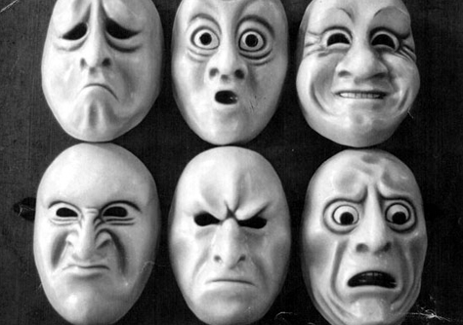
I lost My Job
z
Losing a job is an emotional thing to happen. These emotion can range from fear, anger, disbelief, shock and relief. Whatever the emotion is do not panic about it.

Slide 3
A Gift
z
The good news is that, for most people have the ability to bounce back has become in a way that makes losing a job one of the greatest gifts to receive. Whether you decide to look for a new job in the same business, start your own venture, go part time or decide to retire (if old enough), the way in which you approach this next ‘chapter’ of your life is all you really can control.

Slide 4
So Here Are Some Tips To Get You Prepared – Be Positive
z
Sometime this easier said than done. However studies have shown that negative thinking brings one down, You attitude can determine how you approach your new chapter of life. Remember the job did not define who are.

Slide 5
Tips Continued - Guard Against Haste
z
But stay calm. Firstly, a job loss is not a dreaded contagious disease, a crime, or a sin – it’s only a phase. And importantly, it doesn’t necessarily reflect badly on ‘your’ abilities and potential as a professional. So don’t panic and take any hasty financial decisions out of desperation.
Your boss and company were forced to take a practical decision to restrict costs and boost incomes and now, SO MUST YOU!
Finally don’t bad mouth your former employer. As enticing as it maybe it only reflects bad on you.
Also ask yourself do you need some time off before seeking your next opportunity so you can unwind from any stress.

Slide 6
Tips Continued – Revamp Your Resume
z
You will hear a lot on this subject. Revamping does not mean to totally change your resume in a way that it does not reflect who you really are. Revamping means to ensure it is updated with any of the skills that you picked up at the job you are leaving. It is not uncommon for individuals to have not updated their resume while they are working. Also look to ensure that your resume is tailored to the opportunity that you may be seeking. There are plenty of professional that can help you with this however you controls the substance of your resume.

Slide 7
Tips Continued – Network
z
Tap into your networks to help you look out for and assess potential opportunities. That old saying – the more the merrier- the more of your colleagues helping you in a positive way then the better the outcome may turnout. Remember your network cannot help if they don’t know what you want. Also ensure that your social media (LinkedIn, Facebook, etc.) profiles are up to date and relevant to your interest.

Slide 8
Tips Continued – Strive for A Positive Interview
z
As we stated earlier, you have probably went through an emotional rollercoaster and may be in a panic. Being in a panic will affect your ability to think positively and put your best efforts forward. Be confident and sell your brand in a positive way. Remember you are not the only person to ever lose a job and it is not some badge of shame.
And as stated earlier the interview is about you and not your former employer so guard your words in effort to not make them look bad.

Slide 9
Tips Continued –Starting A Business
If you chose for your next adventure to be out of the job market and doing something for yourself then the same things apply.
Understand what you want to do and have the capabilities to do
Take your time and do all of your do diligence regarding the opportunity
Network with others who have made such a decision or are currently doing what you are interested in

Slide 10
Tips Continued - Change

