Slide 1
Empowerment
A key component in realizing your dreams

Slide 2
What is empowerment?
Empowerment is the process of becoming stronger and more confident, especially in controlling one's life and claiming one's rights.

Slide 3
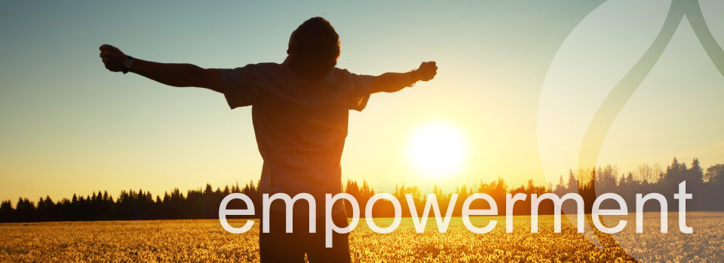
Is Empowerment given or developed?
Empowerment can be given or developed by ones own self desire. Normally no one looks to empower another unless they see or believe that the person is one who can accept the task, responsibility and accountability. So although the answer is both the real underlying answer is that it developed within oneself.

Slide 4
How can one empower Themselves?
If we go back to the definition of empowerment, we stated that it is the process of becoming stronger and more confident, especially in controlling one's life and claiming one's rights. This means one has to have a desire and focus within to improve themselves in a manner that the responsibility and accountability belongs to them.

Slide 5
4 Things
Here are four things we believe can help you begin the empowerment process:
Focus
Imagination
Make A to do List
Garner Your Natural Talent

Slide 6
FOCUS
A key component to one empowering themselves is focus. Here we are speaking of the word as a noun. Focus means the center of interest or activity. You must become the center of interest for what you desire. All though others can help, but it is important that you have a true understanding that it is about you improving you.

Slide 7
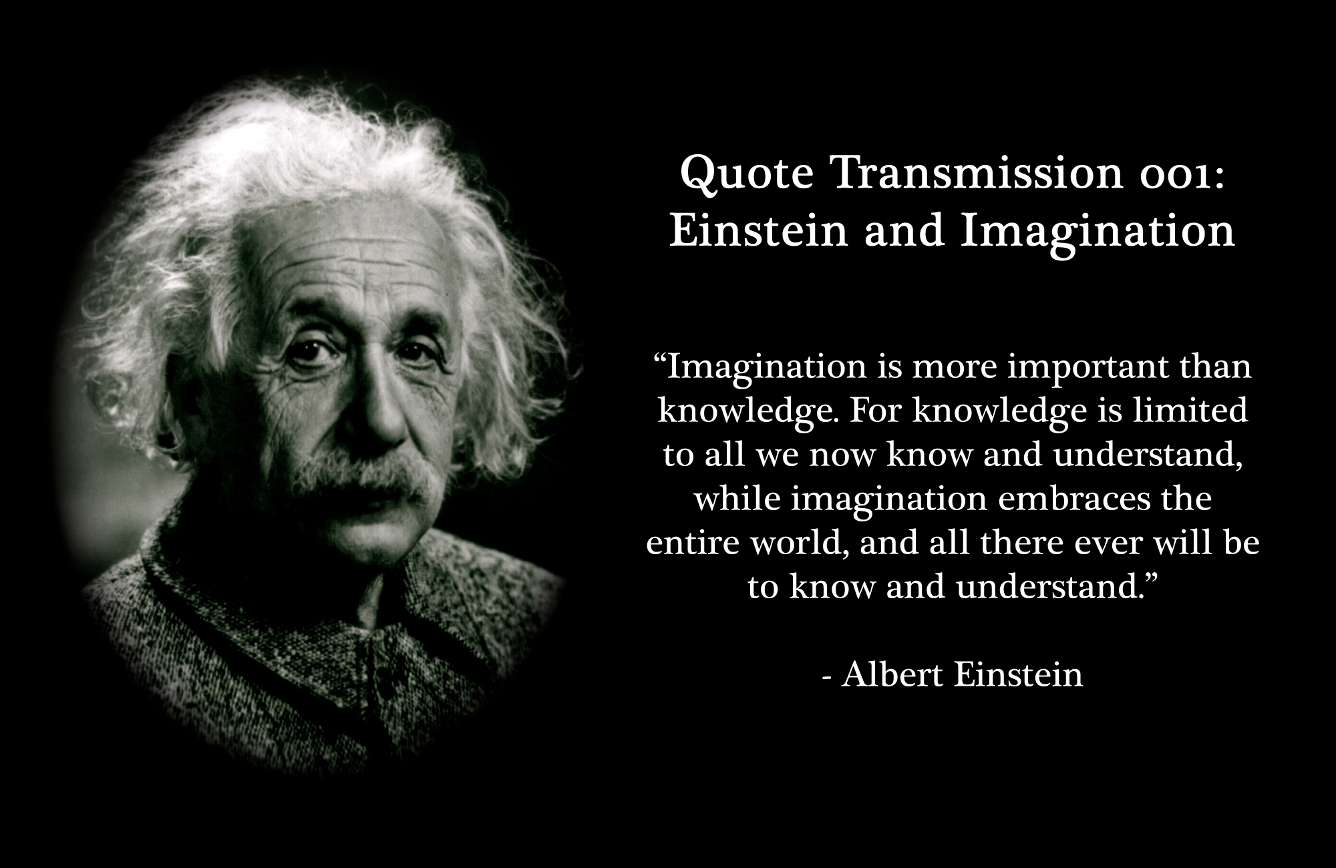
Imagination
Your imagination can take you to great heights. All our lives we have been told to imagine the best, something good or something that we can achieve even though it may seem unachievable. If you imagine that each day you are becoming more stronger and confident in controlling the success that you imagine then there is a greater chance of it happening.

Slide 8
Make a to do list
This can be one of the most effective tools in helping you hold yourself responsible and accountable for improving you and achieving your goals. Writing down what we want to achieve and putting together milestones on when we want to achieve them helps to give us focus. That old saying out of sight out of mind is true. We need to ensure that are following our plan of action.

Slide 9
Garner Your Natural Talent
No one knows you better than you. You know your strengths and weaknesses. You know what you are good at and what you are not. Take inventory (write them down) and began to work on those things that are just natural to you. This is your comfort zone. We need you to truly harness the power of those things that you are good at. Also do a gap assessment as you look at those things you may not be good at. Look to improve on those that compliment or can improve those things that you are naturally good it. Doing these things we continue to help build your confidence in you and empower you to make the best you that you can.

Slide 10
https://bbv2m-brothersbrooksvision2missionllc

