Slide 1

Mr. McSymphony™’s
Sponsored by “The Steinway Society of Riverside”
The life
Of a
Symphony Orchestra
1
A Mr.McSymphony™ Program
©2015 all right reserved

Slide 2
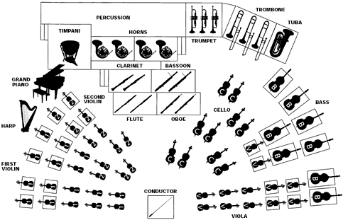
Instrument Locations
2

Slide 3
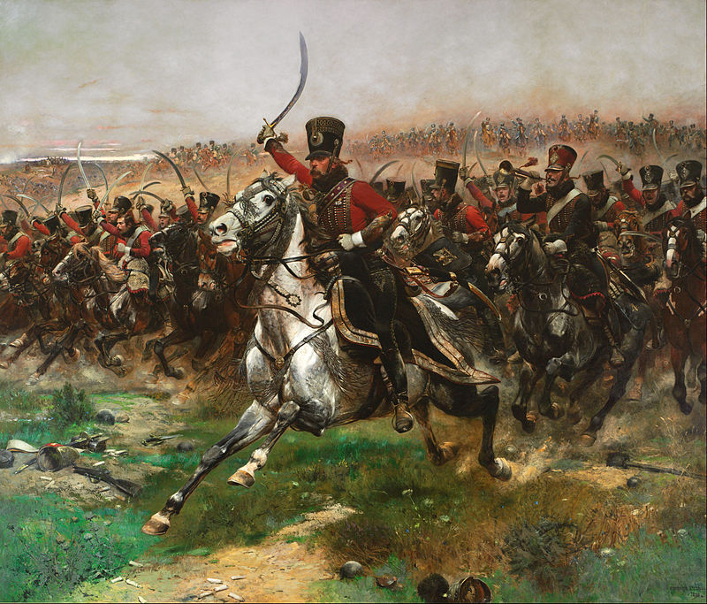
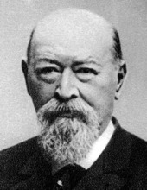
THE ORCHESTRA
“The Light Cavalry Overture”
3

Slide 4
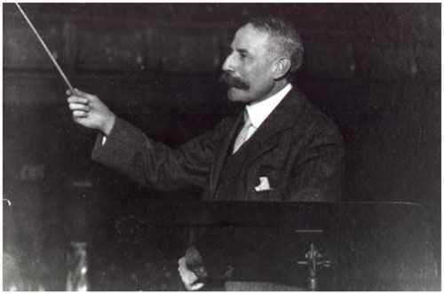

GRADUATION MUSIC
EDWARD ELGAR
“Pomp & Circumstance”
4

Slide 5
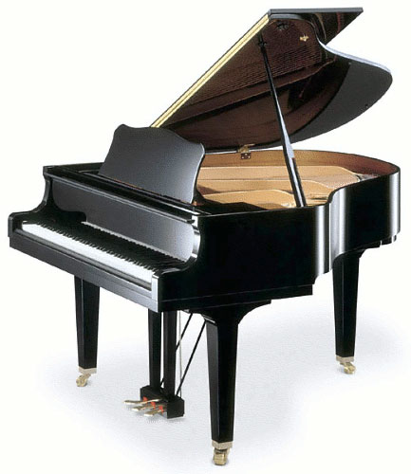
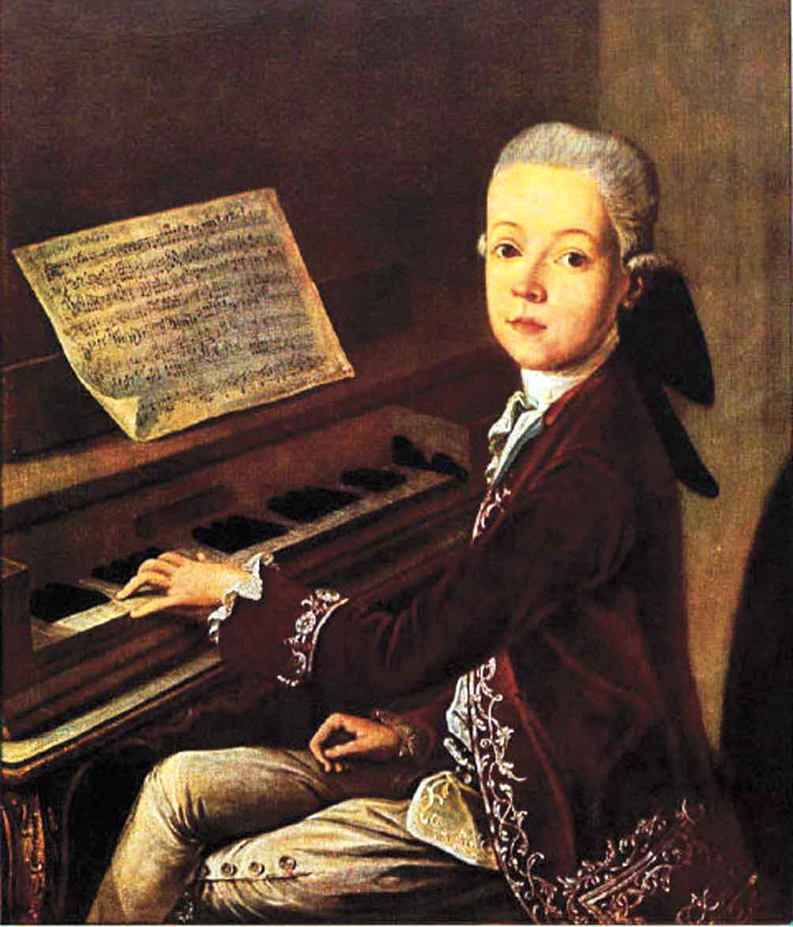
PIANO CONCERTO
Wolfgang Amadeus Mozart
5

Slide 6
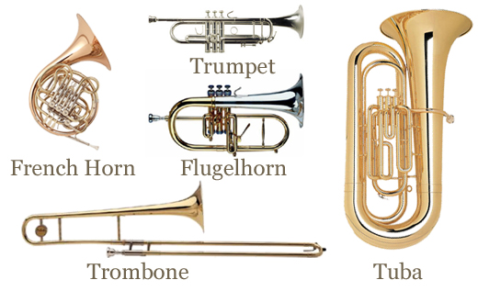
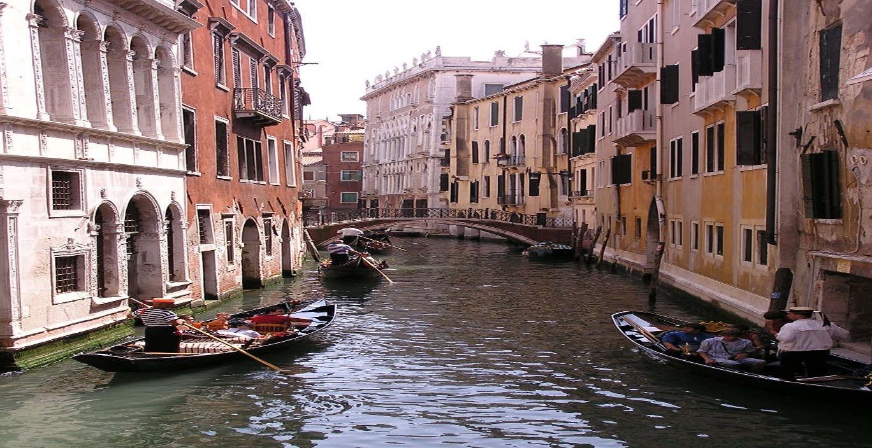
HORN INSTRUMENTS
“Italian Caprice” by
Pyotr Tchaikovsky
6
A street Canal in Venice, Italy

Slide 7
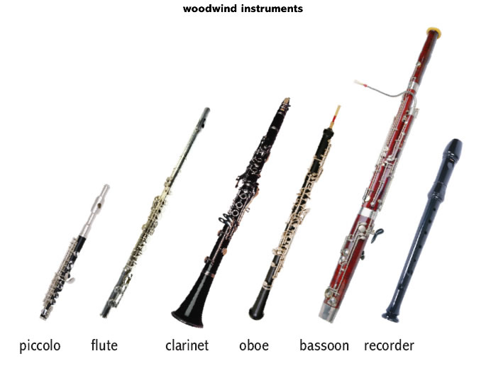
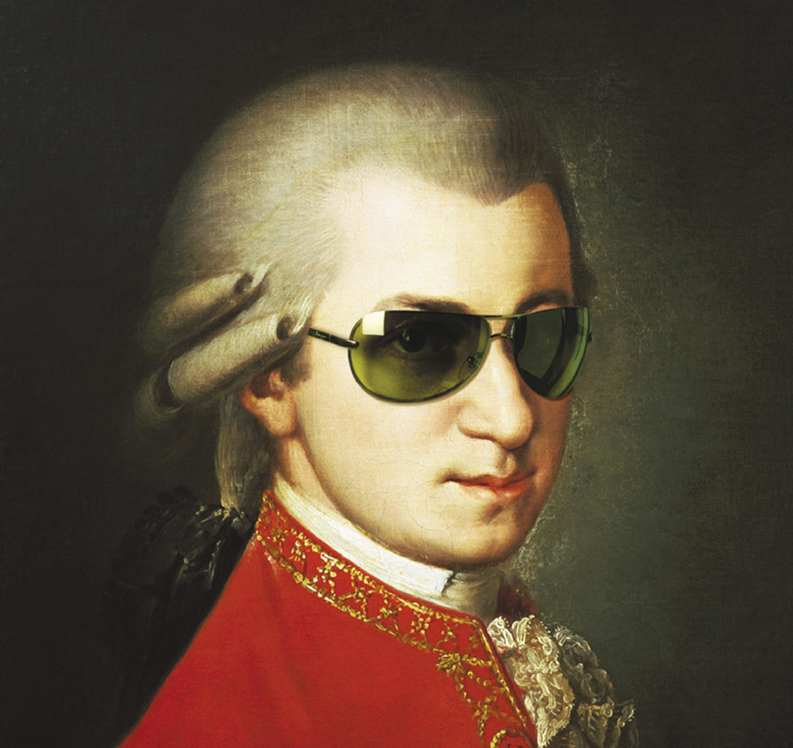
Listen for the Woodwind instrument
Mozart- a Cool Dude
7

Slide 8
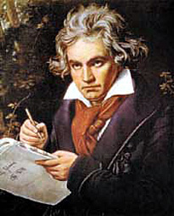
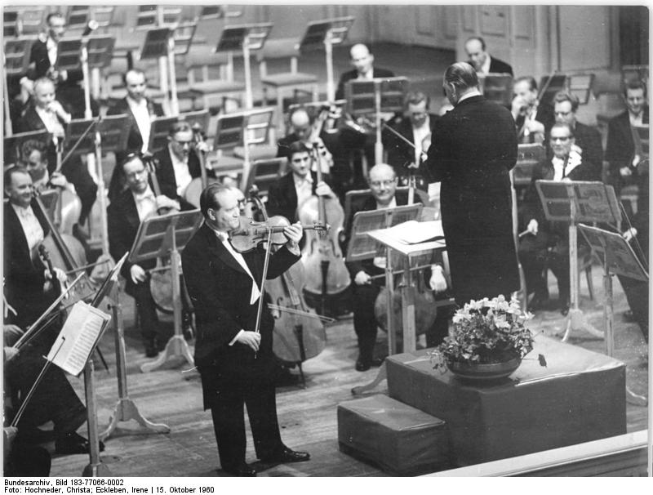
A Violin Concerto by
Ludwig von Beethoven
Concerto- a soloist accompanied by an orchestra
8

Slide 9
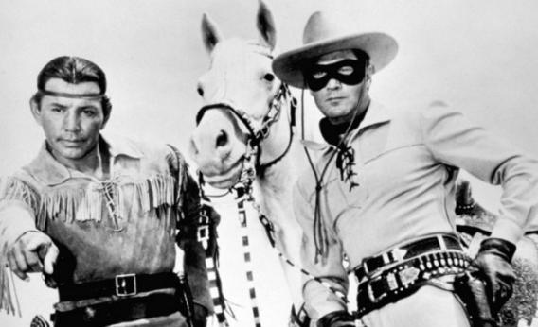
“William Tell Overture” by
Gioacchino Rossini
WHO IS THAT MASKMAN WITH HIS COMPANION AND HORSE”?
9

Slide 10
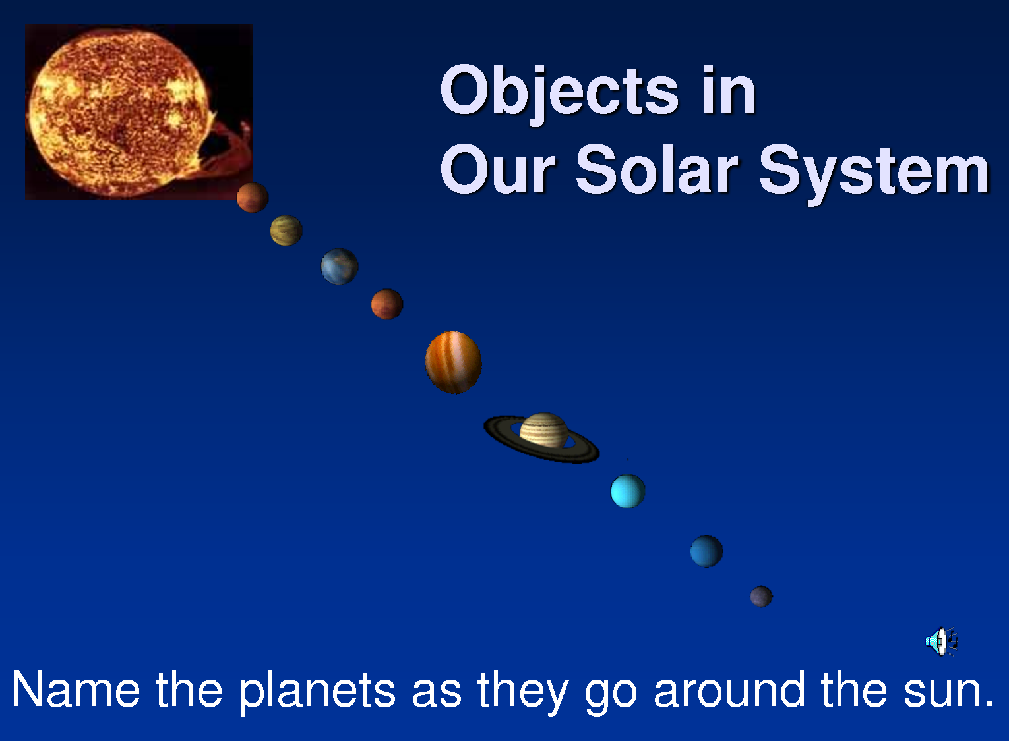
“The New World Symphony #9” by
Antonio Dvorak
10

Slide 11

“Symphony #5” by
Ludwig van Beethoven
AND THEN THERE WAS BEETHOVEN
With his five famous barks!
11

Slide 12
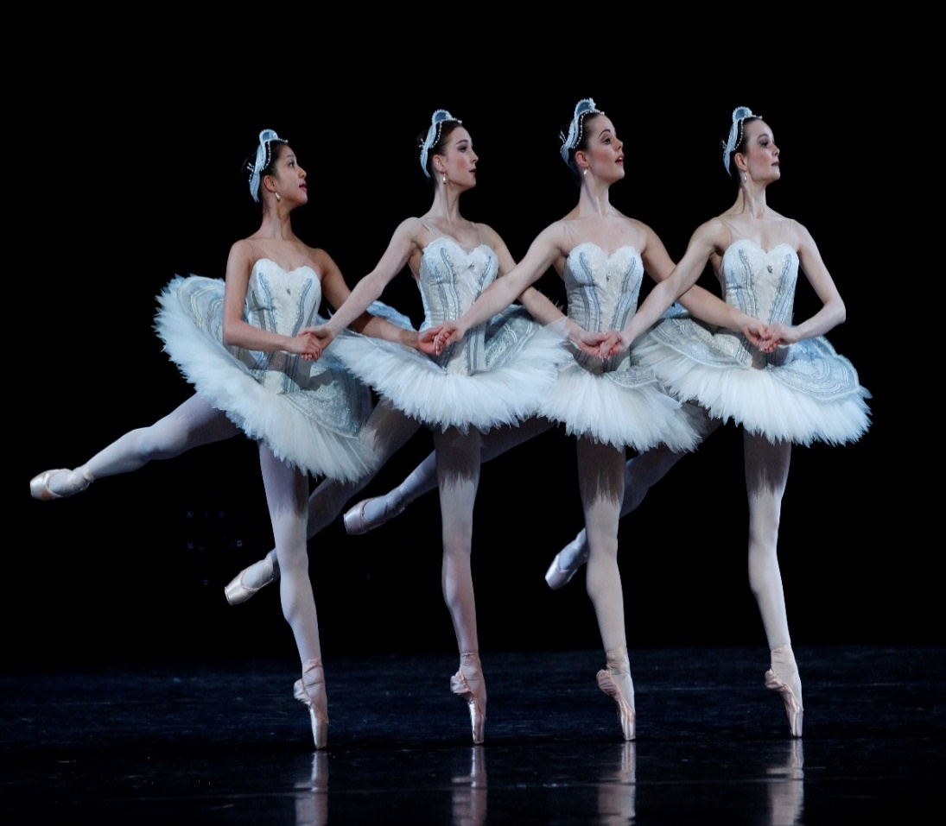
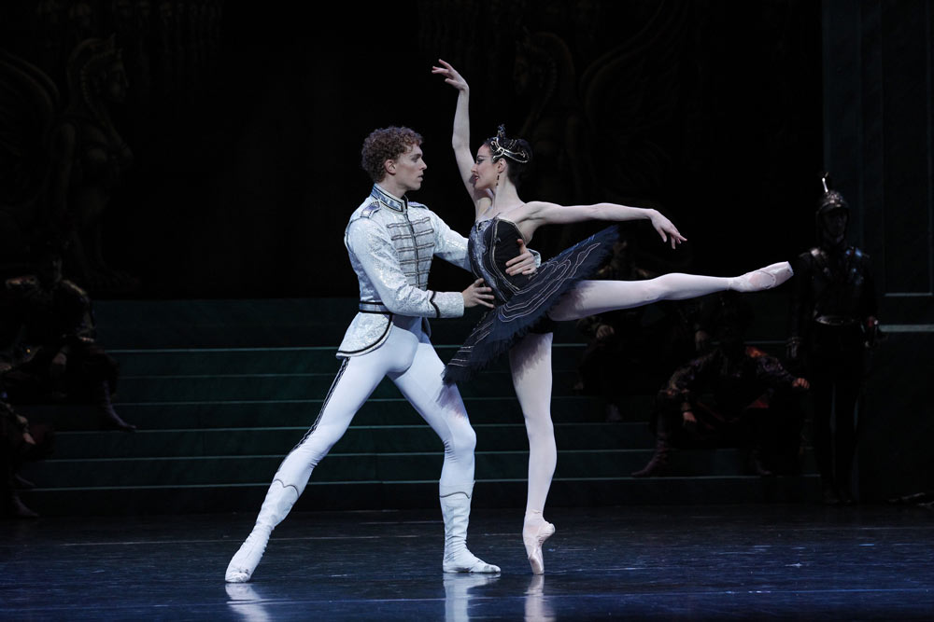
“Dance of the Swans” by
Piotr Tchaikovsky
‘Swan Lake Ballet”
12

Slide 13
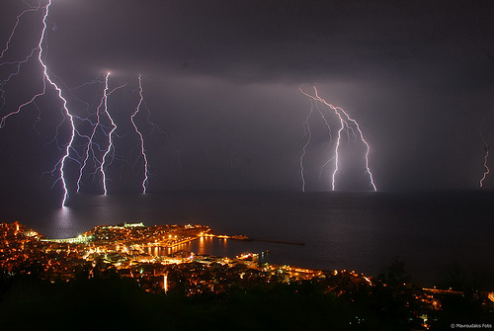
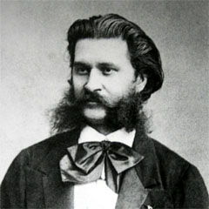
“Thunder and Lighting Polka” by
Johann Strauss II
13

Slide 14
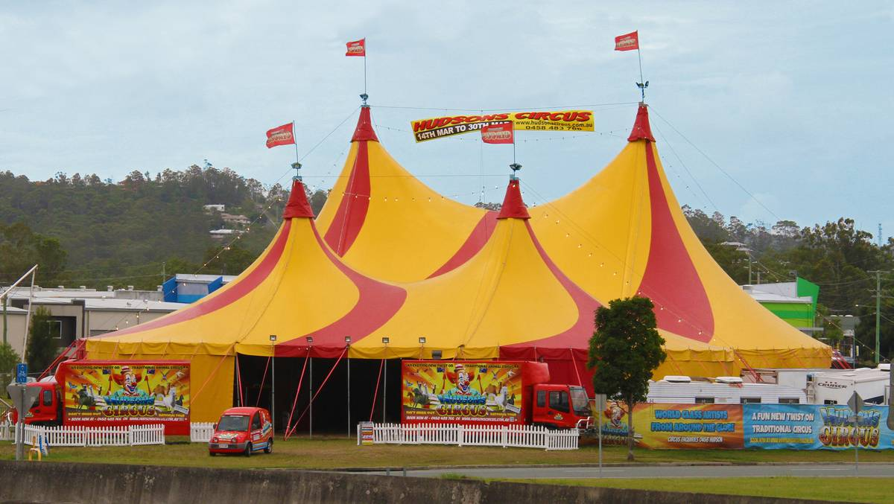
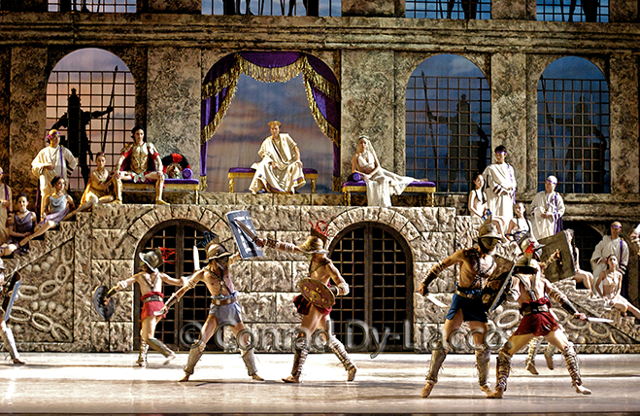
“Entry of the Gladiators” by
Julius Fucik
THE BIG TOP
Gladiators in the Roman Coliseum
14

Slide 15
THE END
15

