Slide 1
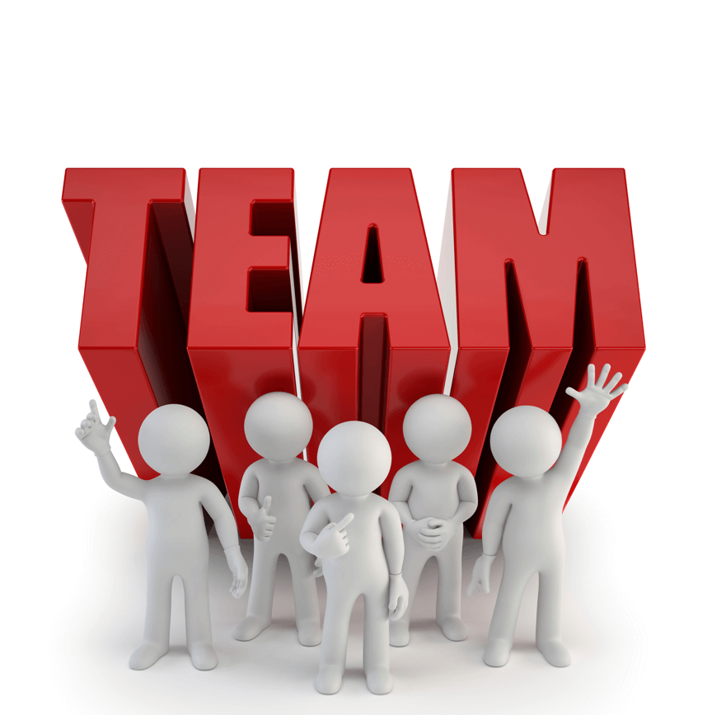
Characteristics Needed to be a good team member

Slide 2
What is a team?
A team is a group of individuals working together to achieve a goal
The key finding in the above definition is “working Together”. In order for individuals to work together there has to be some cohesiveness and common qualities that foster working together.
In the work Environment team work is critical to organization success.
Here is a look at some key qualities that were outlined by Ronald E Riggio Ph.D. in is article regarding good team members.

Slide 3
Honest and Straightforward
A good team member is up front. He/she doesn’t play games, or lead others on. You can count on a good team member to tell you what’s what, regardless of whether it is good news or bad news.

Slide 4
Shares the Load
A good team member does his or her fair share of the work. There is a sense of equity and fairness in the good team member. A sense of equity is critically important for team members’ collective motivation.

Slide 5
Reliable
The good team member can be counted on. She or he meets deadlines and is on time.

Slide 6
Fair
A good team member takes appropriate credit, but would never think of taking credit for someone else’s work.

Slide 7
Complements Others’ Skills
An important characteristic of effective work teams is the shared capacity. Every member has areas of strength and some weak spots. A good team member provides some unique skills and/or knowledge that move the team forward.

Slide 8
Good Communication Skills
Teamwork is social, so good team members need to be skilled, and tactful, communicators

Slide 9
Positive Attitude
No one would ever follow a pessimistic leader, and the same goes for team members. A positive, “can-do” attitude is critical for the good team member.

Slide 10
You Are the key dynamic to a team
The characteristics mentioned earlier are not an exhaustive list of all characteristics but it is good start. Remember understanding how you are as it relates to your attributes and what you are brining to a team is key. It is also important that you understand the team that you may be a part of and the attributes within the team.

Slide 11
BBV2M-BrothersBrooksVision2MissionLLC.com
BBV2MLLC@gmail.com

