Slide 2
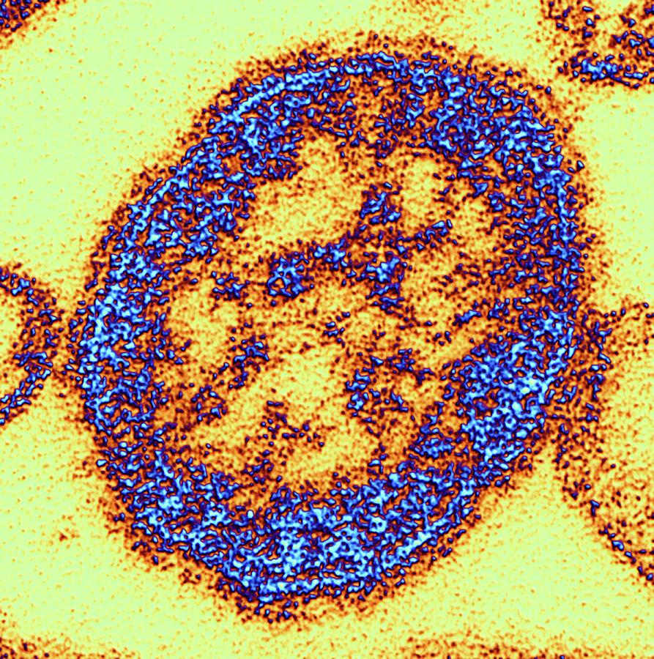
Measles
Measles Review
U.S. Measles Vaccine History
CDC Measles Vaccination Recommendations
Measles Resources Available for Clinicians

Slide 3
Objectives
At the end of the presentation you will be able to:
Identify vaccine resources
Understand the history of measles
Understand the current status of measles
Know where to obtain measles information

Slide 4
Overview
Measles Review
U.S. Measles Vaccine History
CDC Measles Vaccination Recommendations
Measles Resources Available for Clinicians
Slides from the Centers for Disease Control and Prevention (CDC), Clinical Outreach and Communication Activity (COCA),Measles 2019: Situational Update, Clinical Guidance, and Vaccine Recommendations

Slide 5
Measles Review
Transmission
Signs and Symptoms
Complications
Disease Burden

Slide 10
Measles-current events
Ban of unvaccinated kids from public areas
Cases and outbreaks
Non-Medical Exemptions
Highest populations of anivaxxers

Slide 11
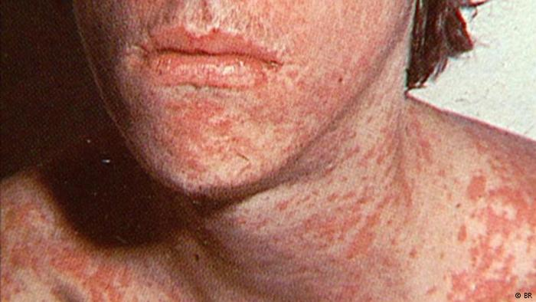
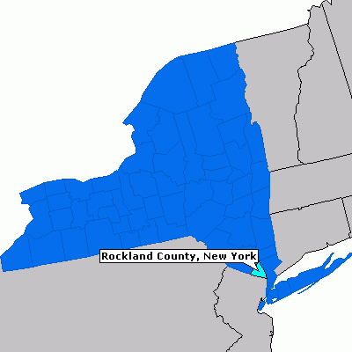
BREAKING NEWS (CNN) 9:57 AM ET, Wed March 27, 2019
NY county bans unvaccinated kids from public areas!
Unvaccinated people under age 18 are banned from public places in Rockland County, New York, as of midnight Wednesday, according to John Lyon, director of strategic communications for County Executive Ed Day. Day announced the order Tuesday.
The declaration is an effort to contain an outbreak of measles that began in October; 153 cases have been confirmed in the county

Slide 12
Recent Infections in Brooklyn and Queens
As of March 27, 2019, there have been 214 confirmed cases of measles in Brooklyn and Queens since October. Most of these cases have involved members of the Orthodox Jewish community.
The initial child with measles was unvaccinated and acquired measles on a visit to Israel, where a large outbreak of the disease is occurring. Since then, there have been additional people from Brooklyn and Queens who were unvaccinated and acquired measles while in Israel. People who did not travel were also infected in Brooklyn or Rockland County.
The neighborhoods that are affected include:
Brooklyn
Bensonhurst: 1 confirmed measles case (no new cases since November 2018)
Borough Park: 47 confirmed measles cases (1 additional case in the past week)
Brighton Beach: 1 travel-related case
Midwood/Marine Park: 3 confirmed measles cases (1 additional case in the past week)
Williamsburg: 161 confirmed measles cases (31 additional cases in the past week)
Queens
Flushing: 1 travel-related case
If you plan to travel to Israel, protect yourself and your family against measles and get vaccinated with the measles-mumps-rubella (MMR) vaccine at least two weeks in advance of your trip. If you have traveled to Israel and you have a fever, cough, red eyes, runny nose and body rash, contact your doctor. You should call your doctor before going to their office to prevent exposing other people to measles.

Slide 13
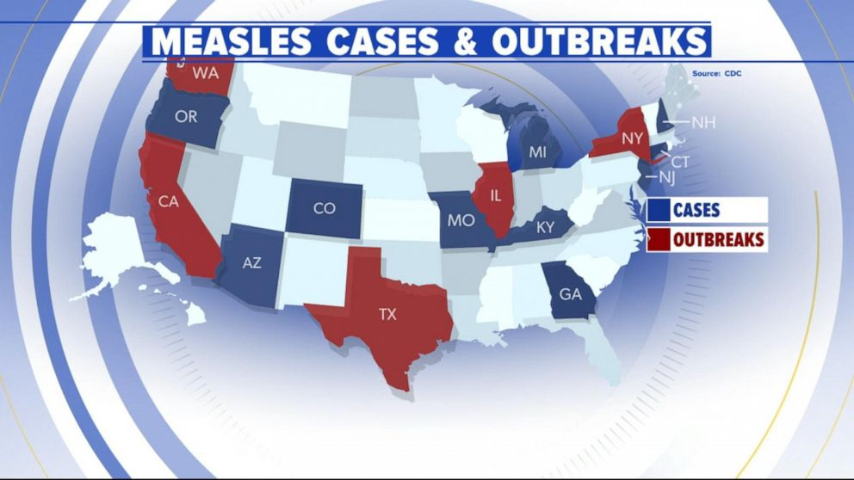
Measles cases and outbreaks
Measles outbreak in Washington State
Measles in Washington has spread and health officials urge immunization. The Washington State Department of Health reminds people to take precautions to help stop the spread of measles.
BOSTON (AP) — Public health officials in Boston are warning of a possible measles exposure after an individual with a confirmed case of the disease traveled from New York City to Boston and then to New Hampshire.
Health officials said the possible exposure occurred Tuesday when the individual boarded a 4 p.m. Greyhound bus from New York to Boston before taking a 10 p.m. Boston Express Bus from Logan International Airport to Manchester, New Hampshire.
Officials said anyone on the buses or at the South Station bus terminal in Boston between 8:30 p.m. and midnight could have been exposed and could become ill between March 3 and March 19 — up to 21 days following a potential exposure.
2019 has just started, but we already have reports of measles cases and exposures in at least 368 people in 18 states, including Arizona (1), California (8), Colorado (1), Connecticut (3), Georgia (3), Hawaii (2), Kentucky (1), Illinois (5), Kentucky (1), Michigan (22), Missouri (1), Nevada (1), New Hampshire (1), New Jersey (4), New York (227), Oregon (10), Texas (14), and Washington (73).
The Texas Department of State Health Services (DSHS) has confirmed 14 measles cases in Texas this year. DSHS is urging health care providers to consider measles when diagnosing patients because early identification, along with immunization, is key to preventing measles from spreading.
.
The last large outbreak of measles in California was associated with Disneyland and occurred from December 2014-April 2015, when at least 131 California residents were infected with measles; the outbreak also infected residents of six other states, Mexico, and Canada.
In 2019, one outbreak of three cases linked to a patient with international travel has been reported in California. As of March 22, 2019, seven confirmed measles cases, including the three outbreak-associated cases, have been reported in the following jurisdictions.

Slide 14
Non-Medical State Exemptions

Slide 15
Highest population of antivaxxers

Slide 17
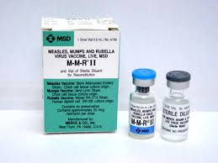
Measles Vaccine
Measles Vaccine
U.S. History

Slide 18
Notes:
Second dose was recommended in 1989

Slide 20
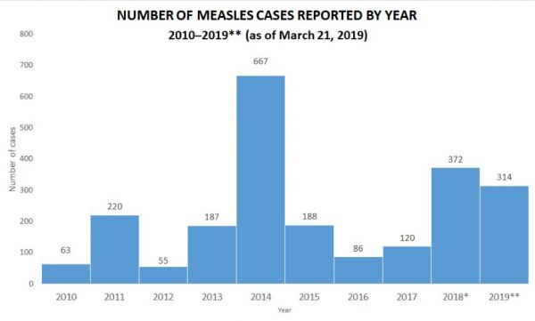

Slide 21
Measles Incidence Rate per Million (2017-12 and 2018-11): World Health Organization

Slide 22
Measles case distribution by month and WHO Region (2015-2019)
65000
WPR
60000
SEAR
EUR
55000
EMR
AMR
50000
AFR
45000
40000
35000
Measles cases (Lab+Epi+Clinical)
30000
25000
20000
15000
10000
5000
0
2015-01
2015-02
2015-03
2015-04
2015-05
2015-06
2015-07
2015-08
2015-09
2015-10
2015-11
2015-12
2016-01
2016-02
2016-03
2016-04
2016-05
2016-06
2016-07
2016-08
2016-09
2016-10
2016-11
2016-12
2017-01
2017-02
2017-03
2017-04
2017-05
2017-06
2017-07
2017-08
2017-09
2017-10
2017-11
2017-12
2018-01
2018-02
2018-03
2018-04
2018-05
2018-06
2018-07
2018-08
2018-09
2018-10
2018-11
2018-12
2019-01
2019-02
2019-03
Month of onset
Notes: Based on data received 2019-03 - Data Source: IVB Database - This is surveillance data, hence for the last month(s), the data may be incomplete.

Slide 23
Measles Vaccine
Recommendations

Slide 26
Measles vaccine
Resources

Slide 27
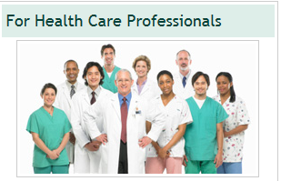
IZ Resources
CDC Immunization Schedules
Birth-18 Years
Catch-up
Adult
Footnotes
Presumptive Evidence of Immunity

Slide 28
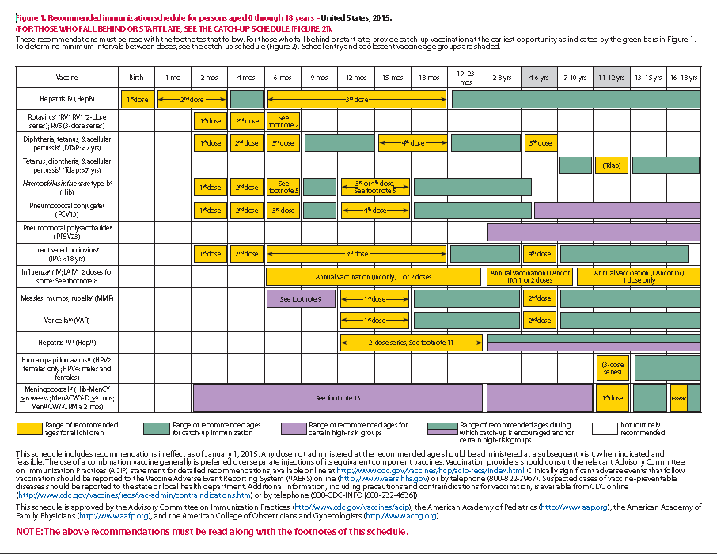

Slide 29
Measles, mumps, and rubella (MMR) vaccine. (Minimum age: 12 months for routine vaccination)
Routine vaccination:
Administer a 2-dose series of MMR vaccine at ages 12 through 15 months and 4 through 6 years. The second dose may be administered before age 4 years, provided at least 4 weeks have elapsed since the first dose.
Administer 1 dose of MMR vaccine to infants aged 6 through 11 months before departure from the United States for international travel. These children should be revaccinated with 2 doses of MMR vaccine, the first at age 12 through 15 months (12 months if the child remains in an area where disease risk is high), and the second dose at least 4 weeks later.
Administer 2 doses of MMR vaccine to children aged 12 months and older before departure from the United States for international travel. The first dose should be administered on or after age 12 months and the second dose at least 4 weeks later.
Catch-up vaccination:
Ensure that all school-aged children and adolescents have had 2 doses of MMR vaccine; the minimum interval between the 2 doses is 4 weeks.

Slide 30
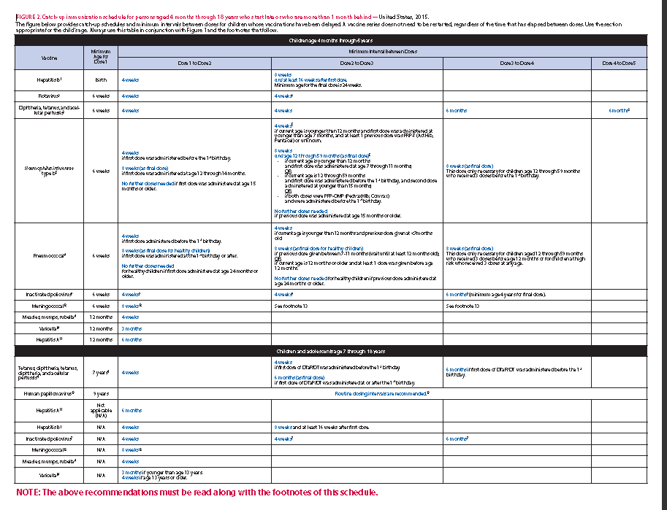

Slide 31
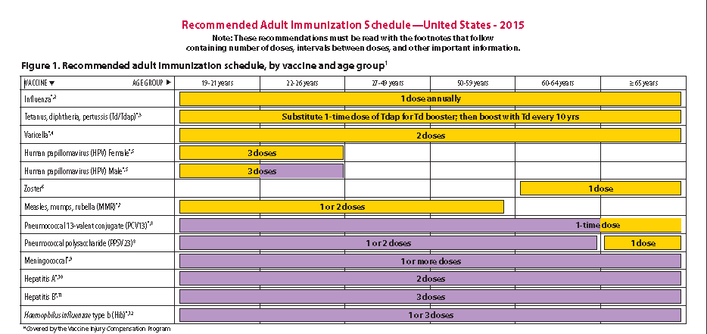

Slide 32
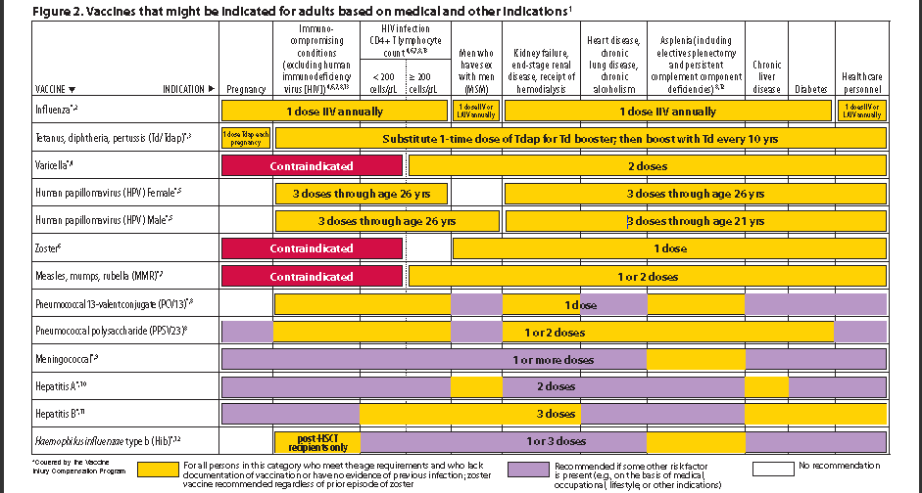

Slide 33
7. Measles, mumps, rubella (MMR) vaccination
Adults born before 1957 are generally considered immune to measles and mumps. All adults born in 1957 or later should have documentation of 1 or more doses of MMR vaccine unless they have a medical contraindication to the vaccine or laboratory evidence of immunity to each of the three diseases. Documentation of provider-diagnosed disease is not considered acceptable evidence of immunity for measles, mumps, or rubella.
Measles component:
A routine second dose of MMR vaccine, administered a minimum of 28 days after the first dose, is recommended for adults who:
are students in postsecondary educational institutions,
work in a health care facility, or
plan to travel internationally.
Persons who received inactivated (killed) measles vaccine or measles vaccine of unknown type during 1963–1967 should be revaccinated with 2 doses of MMR vaccine.

Slide 34
Healthcare Personnel
People who work in healthcare settings should have documented evidence of immunity to measles according to the Advisory Committee on Immunization Practices (ACIP).
Refer to “Immunization of Health-Care Personnel: Recommendations of the Advisory Committee on Immunization Practices” (www.cdc.gov/mmwr/pdf/rr/rr6007.pdf).

Slide 36
Measles Resources
CDC Measles for Healthcare Professionals
http://www.cdc.gov/measles/hcp/index.html#immunity
CDC Website
http://www.cdc.gov/measles/vaccination.html
Immunization Schedule
http://www.cdc.gov/vaccines/schedules/hcp/index.html

Slide 37
Questions from the Field
I had a lady call and say her geriatric doctor recommended a dose of MMR vaccine. She had one in 1972, but she is traveling to Arizona where they have cases.
Are there any recommendations related to measles and MMR's for folks born 1957-1971?

Slide 38
Answer
Dr. Michael Roizen, MD
Internist
If you were born after 1956 and do not know for sure if you were vaccinated for mumps, measles and rubella (MMR), you should probably get an MMR immunization. Check with your doctor. Even if you know you've had one, if you work in settings where large groups of individuals (particularly young adults) congregate, such as schools and universities, you might want to consider getting a second one. If you were born before 1956 and never received an MMR vaccination, do not worry, as virtually everyone born before 1956 would have been exposed to these diseases and would have built up a natural immunity. The MMR vaccine is one of the safest and most effective vaccines we have, with an effectiveness of well over 90 percent.

Slide 39
Questions ?
Thank You

