Slide 1
BUILDING AN OPERATIONAL RAILROAD CROSSING
BRIAN W. SHERON, MMR

Slide 2
ROADWAYS FREQUENTLY CROSS RAILROAD TRACKS AT GRADE, AND REQUIRE WARNING DEVICES TO ALERT MOTORISTS AND PEDESTRIANS TO APPROACHING TRAINS
PRIOR TO THE FIRST QUARTER OF THE 20TH CENTURY, ROADWAY CROSSINGS WERE PROTECTED BY FLAGMEN STATIONED AT THE CROSSING
AFTER THE FIRST QUARTER OF THE 20TH CENTURY, AUTOMATIC CROSSING GATES BEGAN TO BE INSTALLED

Slide 3
DEPENDING UPON THE AMOUNT OF RAILROAD TRAFFIC AT A ROADWAY CROSSING, A CROSSING CAN HAVE:
A SIMPLE CROSSBUCK WARNING
A CROSSBUCK WITH FLASHING LIGHTS AND A BELL
A CROSSBUCK WITH FLASHING LIGHTS AND A BELL AND GATES THAT AUTOMATICALLY LOWER ACROSS THE ROADWAY BEFORE THE TRAIN ARRIVES

Slide 4
THE OBJECTIVE OF THIS CLINIC IS TO SHOW HOW INSTALLING AUTOMATIC, OPERATING CROSSBUCKS AND CROSSING GATES ON A LAYOUT IS NOT THAT DIFFICULT
THERE ARE MANY GRADE CROSSING COMPONENTS AVAILABLE ON THE MARKET
THIS CLINIC DOES NOT NECESSARILY IDENTIFY EVERYTHING THAT IS AVAILABLE
AS WITH ANY ASPECT OF YOUR LAYOUT, IT IS RECOMMENDED THAT YOU SEARCH AND SEE WHAT IS AVAILABLE THAT BEST SUITS YOUR PARTICULAR NEEDS AND BUDGET

Slide 5
TYPICAL MODERN CROSSBUCK, FLASHER, AND GATE AT A GRADE CROSSING IN BUCKEYSTOWN, MD

Slide 6
Four Elements of a Grade Crossing
CROSSBUCK FLASHERS
CROSSING GATES
CROSSING BELL
DETECTION AND ACTIVATION CIRCUIT

Slide 7
TWO OPTIONS
PURCHASE AN INTEGRAL SYSTEM
BUY SEPARATE COMPONENTS AND COMBINE THEM

Slide 8
INTEGRAL SYSTEMS
THE EASIEST WAY TO INSTALL AN OPERATIONAL GRADE CROSSING IS WITH AN INTGEGRAL SYSTEM THAT CONTAINS ALL THE COMPONENTS (DETECTORS, FLASHING CROSSBUCKS, BELL, GATES)
SEVERAL COMPANIES MAKE INTEGRAL SYSTEMS
TYCO, LIFE-LIKE, BACHMANN
Z-STUFF FOR TRAINS
WALTHERS
MODEL TRAIN TECHNOLOGY

Slide 9
THIS IS THE SIMPLEST, LEAST EXPENSIVE, AND LEAST REALISTIC SYSTEM

Slide 10
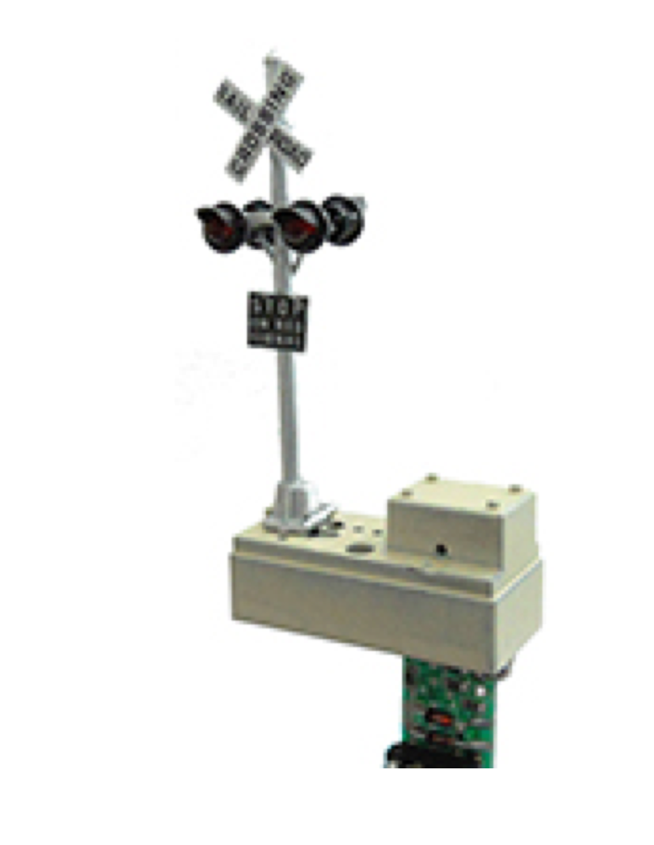
Z-STUFF FOR TRAINS MAKES AN INTEGRAL GRADE CROSSING SYSTEM
OPERATIONAL CROSSBUCK FLASHERS AND DETECTORS
AVAILBILITY OF COMBINATION COSSBUCK FLASHERS WWITH OPERATING GATES UNCERTAIN

Slide 11
WALTHERS GRADE CROSSING CONTROLLER
CAN ONLY BE USED WITH DC-POWERED LAYOUTS
CANNOT BE USED WITH DCC
USES OPTICAL SENSORS
CONNECTS TO CORNERSTONE GRADE CROSSING FLASHERS

Slide 12
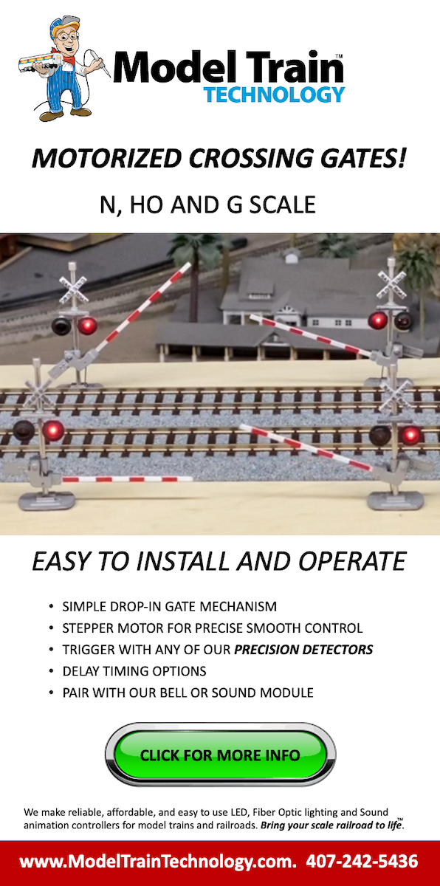
MODEL TRAIN TECHNOLOGY RECENTLY INTRODUCED MOTORIZED CROSSING GATES THAT ARE RELATIVELY EASY TO INSTALL

Slide 13
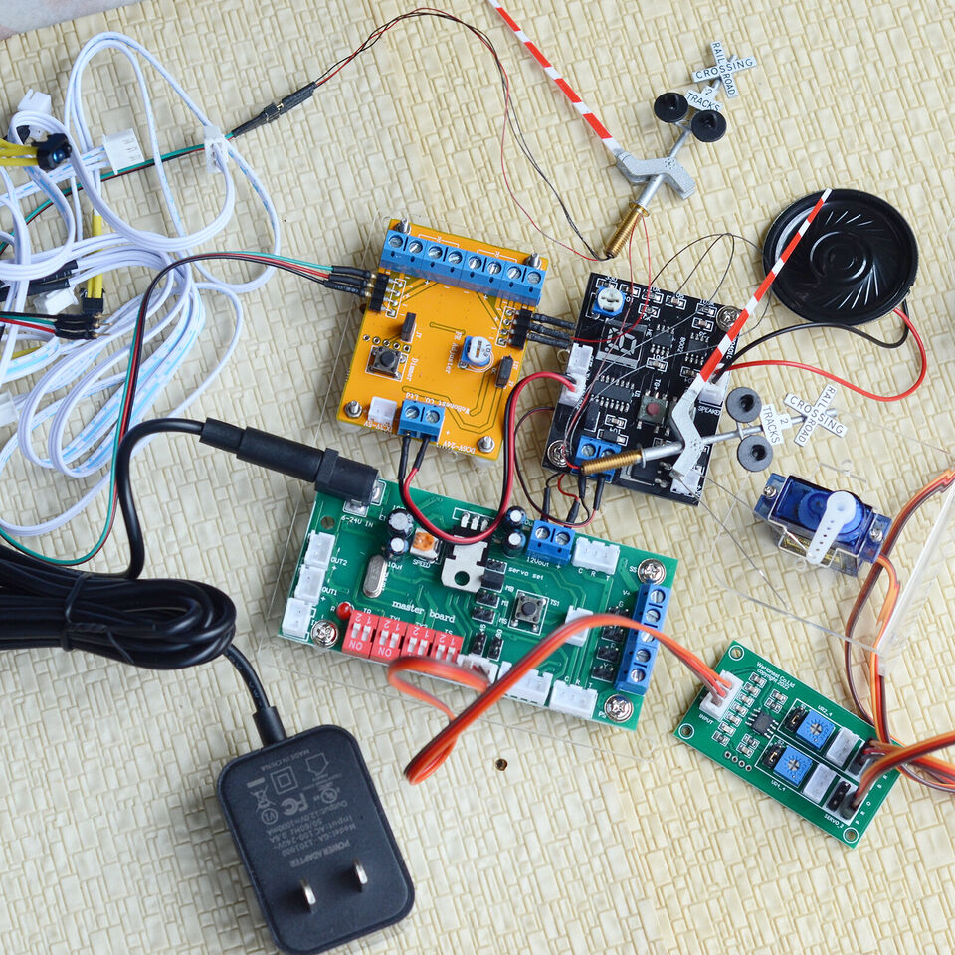
INTEGRAL SYSTEM WWITH DETECTORS, SERVO MOTORS, ACTIVATION CIRCUITS AN CROSSING GATES AND FLASHERS AVAILABLE FOR $100

Slide 14
CONSTRUCTING AN OPERATIONAL GRADE CROSSING FROM SEPARATE COMPONENTS
1.) CROSSBUCK FLASHERS
MOST GRADE CROSSINGS HAVE THE GATES AND CROSSBUCK FLASHERS CONSTRUCTED AS AN INTEGRAL UNIT
HOWEVER, GATES CAN BE SEPARATE FROM CROSSBUCK FLASHERS
SEVERAL MANUFACTURERS INCLUDE A FLASHER CIRCUIT WITH THEIR CROSSBUCKS
APPLY VOLTAGE (USUALLY 12VDC) TO THE CIRCUIT AND THE CROSSBUCK FLASHERS WILL FLASH
HOWEVER, UNLESS YOU CONNECT THEM TO A TRAIN DETECTION CIRCUIT THAT WILL AUTOMATICALLY ACTIVE THEM, THEY CAN ONLY BE ACTIVATED MANUALLY.

Slide 15
TYPICAL INEXPENSIVE ($11.99) CROSSING FLASHER WITH FLASHER CIRCUIT FOUND ON EBAY

Slide 16
2.) CROSSING GATES
SEVERAL CROSSING GATES WITH FLASHERS ARE AVAILABLE ON EBAY
NJ INTERNATIONAL MAKES A REALISTIC COMBINATION OPERATING CROSSBUCK AND GATE
AVAILABILITY IS UNCERTAIN BUT IT APPEARS THEY ARE STILL BEING MANUFACTURED
TOMAR ALSO MAKES AN OPERATIONAL CROSSBUCK WITH CROSSING GATE
AVAILABILITY IS ALSO UNCERTAIN

Slide 17
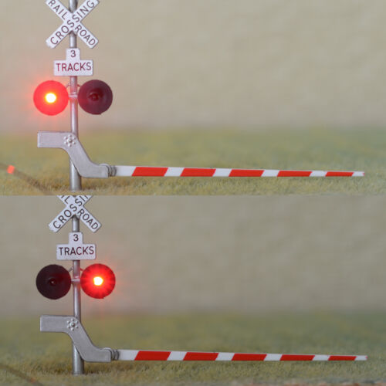
TWO CROSSING GATES AVAILABLE ON EBAY FOR $20

Slide 18
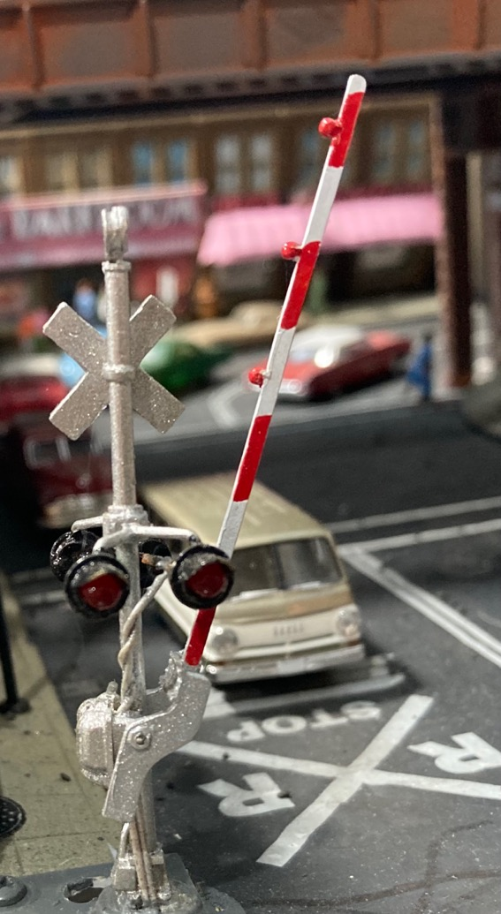
NJ INTERNATIONAL CROSSING GATE
GATE ARM IS ACTIVATED BY ROD CONNECTED NEAR THE PIVOT THAT EXTENDS TO BELOW THE LAYOUT

Slide 19
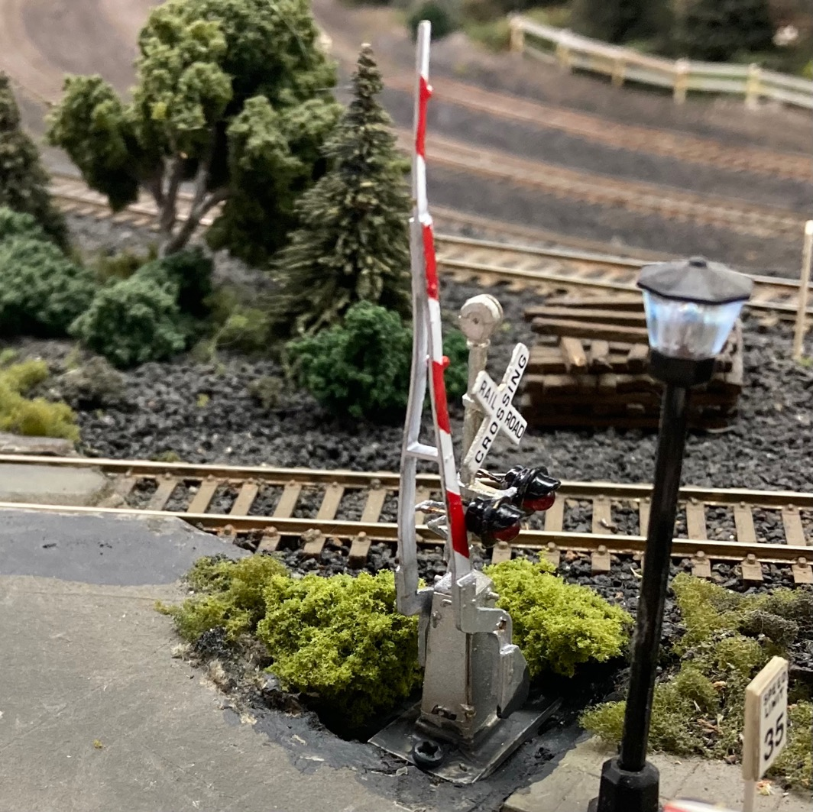
ANOTHER NJ INTERNATIONAL COMBINATION CROSSBUCK AND CROSSING GATE

Slide 20
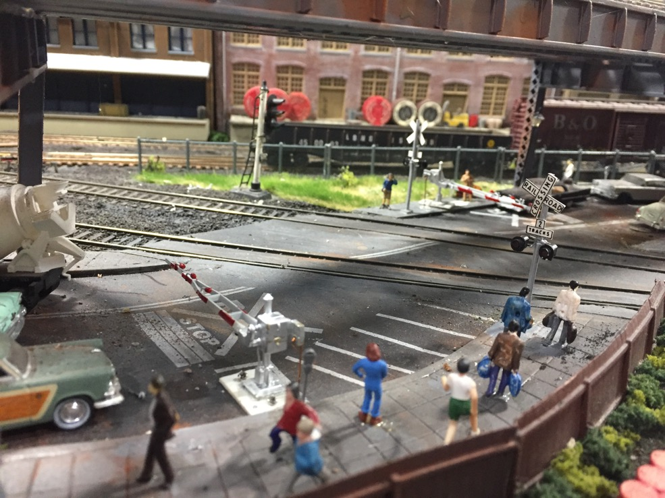
NJ INTERNATIONAL CROSSING GATES BEING USED WITH SEPARATE BERKSHIRE JUNCTION CROSSBUCK FLASHERS

Slide 21
HOW ELSE CAN I MAKE A COMBINATION CROSSBUCK FLASHER AND CROSSING GATE?
USE THE GATE ARM FROM AN INEXPENSIVE CROSSING GATE SYSTEM SUCH AS TYCO, BACHMANN, LIFE-LIKE AND AN OPERATIONAL CROSSBUCK FROM ANOTHER MANUFACTURER
REMOVE THE GATE ARM AND CUT OFF THE PIVOT MECHANISM FROM THE TYCO, ETC., SYSTEM
FILE A SEMICIRCULAR RECESS IN THE PIVOT MECHANISM YOU REMOVED THAT IS THE SAME DIAMETER AS THE CROSSBUCK POST.
GLUE THE PIVOT MECHANISM ONTO THE OPERATIONAL CROSSBUCK POST
RE-ATTACH THE GATE ARM

Slide 23
OPERATIONAL CROSSBUCK WITH PIVOT MECHANISM FROM TYCO CROSSBUCK GLUED TO POST

Slide 24
TWO OPERATIONAL CROSSBUCKS WITH TYCO GATE ARMS ATTACHED
CROSSBUCK ON LEFT IS FROM TYCO SYSTEM WITH RED LEDS MOUNTED IN THE LIGHT LOCATIONS
CROSSBUCK ON THE RIGHT IS A BERKSHIRE JUNCTION CROSSBUCK
NOTE DIFFERENCE IN SCALE!
THIN BRASS ROD IS MOUNTED ON THE END OF THE GATE AND USED TO MOVE THE GATE UP AND DOWN

Slide 25
TYCO, BACHMANN, LIFE-LIKE CROSSING GATES CAN BE KITBASHED ONTO MORE REALISTICALLY SCALED CROSSBUCK FLASHERS, EVEN IF THEY ARE TO BE NON-OPERATIONAL
THE GATES ARE NOT PERFECTLY SCALED, BUT ARE REASONABLE
SOME MODELERS MAY PREFER TO SCRATCH-BUILD THEIR GATES
POSSIBLE THESE DAYS WITH 3D PRINTERS
I MOUNTED GATES ON BERKSHIRE JUNCTION OPERATING CROSSBUCKS

Slide 27
OPERATING THE GATES
TO REALISTICALLY RAISE AND LOWER A CROSSING GATE, A MOTORIZED TURNOUT CONTROLLER OR SERVO MOTOR IS BEST
MOVES IN BOTH DIRECTIONS
MOTION IS REALISTICALLY SLOW
MOTION NEEDS TO BE VERTICALLY UP AND DOWN
TORTOISE SWITCH MACHINES ARE WELL-SUITED FOR DRIVING A CROSSING GATE
NEED TO ADD A REMOTE TORTOISE MOUNT SO SWITCH MACHINE MOTION IS VERTICALLY UP AND DOWN

Slide 28
CIRCUITRON TORTOISE SWITCH MACHINE

Slide 29
TORTOISE SWITCH MACHINE ATTACHED TO A REMOTE TORTOISE MOUNT

Slide 30
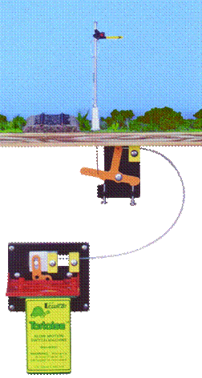
TORTOISE SWITCH MACHINE WITH REMOTE SIGNAL ACTIVATOR
REMOTE SIGNAL ACTIVATOR IS INTENDED FOR USE WITH SEMAPHORES AND CROSSING GATES
ALLOWS FOR MORE CONTROL OVER THE LENGTH OF VERTICAL THROW
MAY NOT BE NECESSARY FOR CROSSING GATES

Slide 31
MOUNTING THE TORTOISE MACHINE
USING 3/4” PINE, I MADE AN L-SHAPED MOUNT FOR THE TORTOISE MACHINE

Slide 32
BEFORE INSTALLING THE TORTOISE MACHINE ON THE MOUNTING BLOCK, MEASURE THE DISTANCE THE CROSSING GATE ACTUATOR ROD HAS TO TRAVEL IN ORDER TO MOVE THE CROSSING GATE FROM THE UP TO THE DOWN POSITION
ADJUST THE PIVOT ARM ON THE TORTOISE MACHINE SO THE THROW DISTANCE OF THE TORTOISE MACHINE IS THE SAME
THIS WILL USUALLY MEAN POSITIONING THE TORTOISE PIVOT ARM FOR THE SHORTEST THROW POSSIBLE

Slide 33
TORTOISE MACHINE WITH REMOTE MOUNT IS THEN ATTACHED TO THE L-SHAPED MOUNT

Slide 34
MOUNT THE CROSSING GATE ON THE LAYOUT AND DRILL A HOLE SO THE ACTUATOR ROD AND CROSSBUCK FLASHER WIRES PASS THROUGH TO THE UNDERSIDE OF THE LAYOUT
FASTEN THE MOUNTING BLOCK WITH THE TORTOISE MACHINE TO THE UNDERSIDE OF THE LAYOUT SO THE ACTUATOR ROD IS ALIGNED WITH THE TORTOISE MACHINE ROD GUIDE AND ROD CLAMP

Slide 35
SLIDE ACTUATOR ROD THROUGH TOP GUIDE AND CLAMP
CUT OFF EXCESS LENGTH OF ROD SO IT DOES NOT INTERFERE WITH WITH TORTOISE PIVOT MECHANISM
WITH ROD IN THE TOP GUIDE AND CLAMPED, TEST THE TORTOISE MACHINE TO MAKE SURE GATES GO ALL THE WAY UP AND DOWN
ADJUST ACTUATOR ROD AS NECESSARY

Slide 36
YOU MAY HAVE TO MODIFY YOUR TORTOISE MACHINE MOUNT TO CIRCUMVENT ANY UNDER-THE-BENCHWORK OBSTACLES!

Slide 37
GATES UP

Slide 38
AND GATES DOWN

Slide 39
DETECTION SYSTEMS TO ACTIVATE THE CROSSBUCK FLASHERS, CROSSING GATES, AND BELL
SO FAR , WE HAVE BRIEFLY DISCUSSED:
AVAILABILITY OF COMPLETE SYSTEMS
CROSSBUCK FLASHERS
CROSSING GATES
CROSSING GATE DRIVES
NEXT WE WILL DISCUSS DETECTION AND ACTIVATION SYSTEMS

Slide 40
DETECTION AND ACTIVATION SYSTEMS
SEVERAL COMPANIES MAKE ELECTRONIC SYSTEMS THAT WILL AUTOMATICALLY ACTIVATE CROSSBUCK FLASHERS, CROSSING GATES, AND CROSSING BELLS WHEN A TRAIN APPROACHES A GRADE CROSSING
BASICALLY THREE WAYS TO DETECT WHEN A TRAIN APPROACHES A GRADE CROSSING:
PHOTOCELL
INFRARED EMITTER AND DETECTOR
CURRENT DETECTOR

Slide 41
PHOTOCELL
PHOTOCELLS USUALLY MOUNT BETWEEN THE RAILS AND ARE EMBEDDED IN THE TIES
A PHOTOCELL IS A RESISTOR THAT CHANGES RESISTANCE DEPENDING UPON THE AMOUNT OF LIGHT INCIDENT UPON IT
THE ENERGY OF THE PHOTONS (LIGHT) HITTING THE PHOTOCELL FREES ELECTRONS TO FLOW THROUGH THE PHOTOCELL MATERIAL, DECREASING ITS RESISTANCE
ELECTRONIC CIRCUITS DETECT THIS DECREASED RESISTANCE TO TRIGGER CIRCUITS THAT ACTIVATE FLASHERS, GATE MOTORS, ETC.
PHOTOCELL-ACTIVATED CIRCUITS REQUIRE ROOM LIGHTING
CANNOT BE USED IN A DARKENED ROOM

Slide 42
CURRENT DETECTION
TRAIN IS DETECTED WHEN A FLOW OF ELECTRIC CURRENT ACROSS THE RAILS IS DETECTED
DETECTED CURRENT FLOW IS USED TO ACTIVATE CIRCUIT TO OPERATE FLASHERS, GATES, ETC.
REQUIRES SECTION(S) OF TRACK IN VICINITY OF GRADE CROSSING TO BE ISOLATED
ALSO REQUIRES METAL WHEELS WITH RESISTORS ON ROLLING STOCK TO BE DETECTED

Slide 43
INFRARED EMITTER AND DETECTORS
INFRARED LIGHT IS LIGHT THAT IS ABOVE THE VISIBLE SPECTRUM
WE USE INFRARED LIGHT EVERYDAY (E.G., TV REMOTES)
DEPENDING UPON THE PLACEMENT OF THE EMITTER AND DETECTOR, A TRAIN CAN BE DETECTED IF EITHER THE INFRARED BEAM BETWEEN THE EMITTER AND DETECTOR IS BROKEN OR COMPLETED

Slide 44
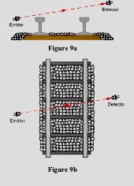
INFRARED EMITTER AND DETECTOR IN ACROSS-THE-TRACK CONFIGURATION
WHEN TRAIN PASSES BETWEEN EMITTER AND DETECTOR, IT BLOCKS THE INFRARED BEAM AND THE DETECTOR STOPS DETECTING THE EMITTER BEAM

Slide 45
THE TRICK IS TO DISGUISE THE EMITTER AND DETECTOR
HIDE THEM IN FOLIAGE
HIDE THEM IN TRACKSIDE STRUCTURES

Slide 50
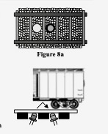
INFRARED EMITTER AND DETECTOR IN BETWEEN-THE-RAILS CONFIGURATION
WHEN TRAIN PASSES OVER THE EMITTER, INFRARED BEAM IS REFLECTED OFF OF BOTTOM OF ENGINE OR CAR TO THE DETECTOR

Slide 51
HOLES DRILLED IN TRACK FOR MOUNTING INFRARED EMITTER AND DETECTOR BETWEEN THE RAILS

Slide 52
INFRARED EMITTER AND DETECTOR MOUNTED BETWEEN THE RAILS
EMITTER IS AT TOP, DETECTOR IS AT THE BOTTOM

Slide 53
WHO MAKES DETECTION SYSTEMS THAT WILL OPERATE FLASHERS, GATES, AND BELLS?
CIRCUITRON
BERKSHIRE JUNCTION
Z-STUFF FOR TRAINS
ARDUINO CIRCUITS
LOGIC RAIL TECHNOLOGIES

Slide 54
CIRCUITRON
MANUFACTURES VARIETY OF DETECTION CIRCUITS TO OPERATE JUST CROSSBUCK FLASHERS AS WELL AS FLASHERS,GATES AND BELL
DT-1, 2, & 3 CIRCUITS WORK ON DC ONLY (WILL NOT WORK ON DCC)
DF-2 USES OPTICAL SENSORS AND OPERATES FLASHERS, GATES AND BELL
DF-3 USES CURRENT DETECTION AND OPERATES FLASHERS, GATES AND BELL
REQUIRES 3 ISOLATED TRACK SECTIONS AND ROLLING STOCK MUST USE METAL WHEELSETS WITH RESISTORS TO BE DETECTED
CURRENTLY DF-2 AND DF-3 ARE UNAVAILABLE

Slide 55
BERKSHIRE JUNCTION
SYSTEM USES INFRARED EMITTERS AND DETECTORS
CIRCUIT ONLY CONTROLS CROSSBUCK FLASHERS
CIRCUIT INCLUDES A RELAY THAT CAN BE USED TO DRIVE A CIRCUIT THAT WILL OPERATE GATES AND A BELL
UTILIZES INFRARED EMITTERS AND DETECTORS ON BOTH SIDES OF GRADE CROSSING
SYSTEM ACTIVATES ONLY WHEN THE INFRARED BEAM IS BROKEN
IF TRAIN IS NOT LONG ENOUGH TO BREAK INFRARED BEAM DOWNSTREAM OF GRADE CROSSING BEFORE CLEARING THE UPSTREAM BEAM, FLASHERS AND BELL WILL STOP AND GATES WILL GO UP
EMITTERS AND DETECTORS NEED TO BE PLACED CLOSE TO GRADE CROSSING OR MULTIPLE EMITTER/DETECTOR PAIRS USED

Slide 56
Z-STUFF FOR TRAINS
DZ-1010HOs NOT LISTED ON WEB PAGE PRODUCT LIST
ASSUME IT OPERATES SIMILAR TO S AND O GAUGE CROSSING GATES (OPTICAL DETECTORS)
APPEARS TO MOUNT ON A PLATFORM (NOT PROTOTYPIC)
CIRCUIT BOARD EXTENDS BELOW LAYOUT

Slide 57
ARDUINO CIRCUITS
ARDUINO IS COMPANY THAT MAKES MICROPROCESSORS YOU CAN PROGRAM
TAKES INPUTS, E.G., FROM PHOTOCELL OR INFRARED SENSOR
OUTPUTS ARE SIGNALS TO OPERATE FLASHERS, GATES

Slide 58
UTILIZES ARDUINO PROGRAMMING LANGUAGE AND SOFTWARE
YOU PROGRAM THE MICROPROCESSOR ON YOUR HOME COMPUTER
ONCE IT IS PROGRAMMED, YOU CAN DISCONNECT IT AND MOUNT IT ON YOUR LAYOUT AND CONNECT COMPONENTS TO IT

Slide 59
LOGIC RAIL TECHNOLOGIES
CIRCUIT IS CALLED GRADE CROSSING PRO/2 (GCP/2)
UTILIZES PHOTOCELLS, CURRENT DETECTION, INFRARED SENSORS PROVIDED WITH THE GCP/2 OR INFRARED SENSORS FROM ANOTHER VENDOR (E.G., IOWA SCALED ENGINEERING’S TRAINSPOTTER)
INFRARED EMITTERS AND DETECTORS CAN BE MOUNTED BETWEEN THE RAILS OR ACROSS THE RAILS
DETECTS TRAIN AND ACTIVATES FLASHERS, GATE MOTORS, AND CROSSING BELL

Slide 60
SAME CIRCUIT BOARD IS USED FOR ALL 4 DETECTOR TYPES (SWITCHES ON CIRCUIT BOARD USED TO CONFIGURE BOARD TO DETECTOR TYPE)
HAS AN OUTPUT FOR AN “END-OF-GATE” LED THAT DOESN’T FLASH
PROVIDES REALISTIC “FADING” OF CROSSBUCK FLASHER LAMPS WHEN FLASHING (CALLED TRUE LAMP2)
LATEST GCP/2 HAS GATE MOTOR OUTPUTS THAT WILL DRIVE TORTOISE SWITCH MOTORS AND SEPARATE ONES FOR SERVO MOTORS

Slide 61
CROSSING BELL
LOGIC RAIL TECHNOLOGIES HAS 3 DIFFERENT BELL TONES
CLASSIC MECHANICAL BELL
MODERN ELECTRONIC BELL
“FAST” CLASSIC MECHANICAL BELL
BELL CAN RING CONTINUOUSLY OR ONLY WHEN GATES ARE MOVING

Slide 62
GRADE CROSSING PRO/2 CIRCUIT BOARD
NOTE THAT BELL CIRCUIT PLUGS DIRECTLY INTO THE GCP/2

Slide 64
HOW IT WORKS
EASTBOUND TRAIN (LEFT TO RIGHT) ACTIVATES FLASHERS (AND BELL ) WHEN TRAIN PASSES WF
AFTER SHORT DELAY, GATE MOTORS ARE ACTIVATED AND GATES LOWER
SIGNALS CONTINUE TO FLASH, BELL RINGS, AND GATES REMAIN LOWERED EVEN IF TRAIN CLEARS WF AS LONG AS TRAIN PASSES OVER WN SENSOR WITHIN 35 SECONDS
TRAIN THEN PASSES EN SENSOR
TWO SECONDS AFTER LAST CAR CLEARS EN SENSOR, GATES WILL RAISE
THREE SECONDS LATER THE FLASHERS AND BELL STOP

Slide 65
IF TRAIN PASSES WF BUT DOES NOT REACH WN WITHIN 35 SECONDS, ASSUMPTION IS THAT TRAIN HAS REVERSED
FLASHERS AND BELL WILL STOP AND GATES WILL RAISE
SYSTEM BEHAVES THE SAME FOR A WESTBOUND TRAIN

Slide 66
WHAT IF I HAVE A MULTIPLE TRACK GRADE CROSSING?
LOGIC RAIL TECHNOLOGIES MAKES A GCP/2 EXPANDER
SENSORS IN ADDITIONAL TRACK CONNECT TO THE EXPANDER BOARD
EXPANDER BOARD CONNECTS TO MAIN BOARD (GCP/2)
ONE EXPANDER BOARD NEEDED FOR EACH ADDITIONAL TRACK

Slide 67
NOTE: IF YOU MOUNT THE EMITTERS AND DETECTORS ACROSS MULTIPLE TRACKS (RATHER THAN EMBED THEM BETWEEN THE TIES), A SINGLE GPC/2 WILL WORK AS LONG AS TWO TRAINS DO NOT ACTIVATE THE EMITTER/DETECTORS AT THE SAME TIME
SYSTEM WILL NOT FUNCTION PROTOTYPICALLY IF TWO OR MORE TRAINS ACTIVATE EMITTER/DETECTORS

Slide 68
SO HOW HARD IS IT TO HOOK ALL THIS STUFF UP?
INSTRUCTIONS FOR GCP/2 ARE VERY CLEAR AND NOT COMPLICATED
BEST TO MOUNT CIRCUIT BOARDS ON A PIECE OF PLYWOOD AND CONNECT CIRCUIT BOARD TERMINALS TO TERMINAL BLOCKS ALSO MOUNTED ON THE PLYWOOD BOARD
THIS IS BECAUSE SEVERAL OF THE CIRCUIT BOARD TERMINALS WILL REQUIRE MULTIPLE WIRES CONNECTING TO THEM
ALSO, CONNECTING WIRES TO LARGER TERMINAL BLOCKS IS EASIER THAN CONNECTING THEM TO THE CIRCUIT BOARD

Slide 69
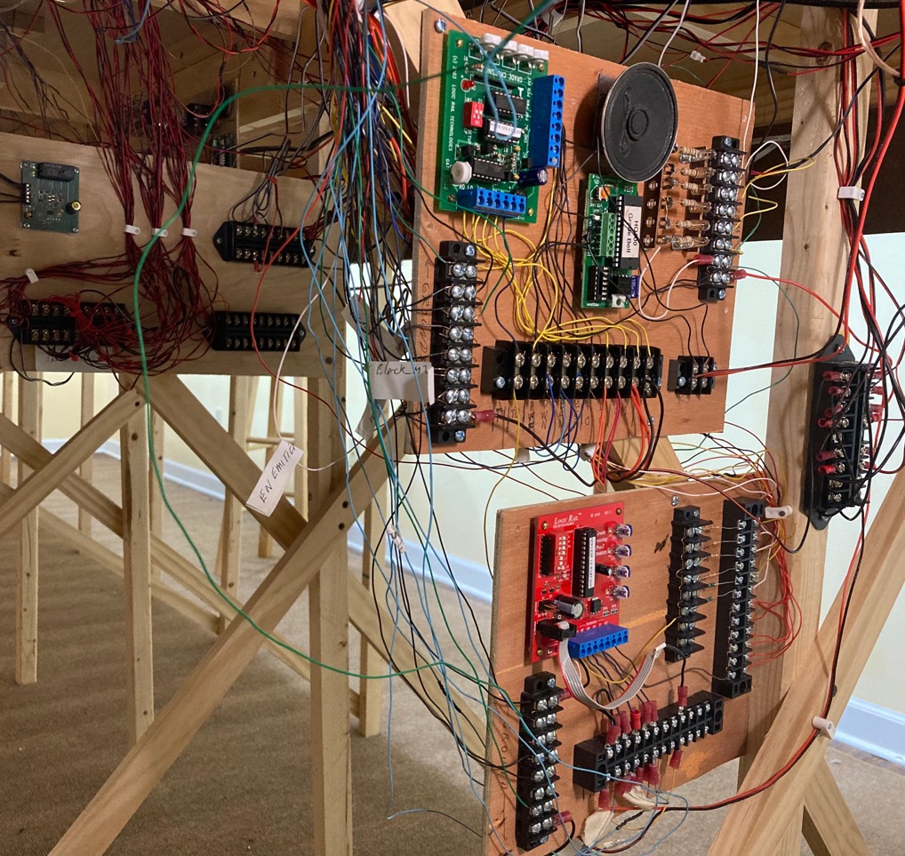
INSTALLATION OF A GCP (OLDER VERSION OF THE GCP/2) WITH BELL CIRCUIT (TOP) FOR A TWO-TRACK GRADE CROSSING
GCP/2 EXPANDER CIRCUIT BEING USED FOR SECOND TRACK (BELOW)

Slide 70
LOTS OF WIRES, BUT REMEMBER, EACH CIRCUIT BOARD HAS 4 EMITTERS AND 4 DETECTORS
32 SENSOR WIRES GOING TO 2 CIRCUIT BOARDS (16 SENSOR WIRES PER TRACK)
3 WIRES GO TO EACH CROSSBUCK FLASHER
4 WIRES GO TO 2 SWITCH MACHINES
2 WIRES GO TO THE SPEAKER
2 WIRES FOR POWER SUPPLY TO CIRCUIT BOARDS

Slide 71
SO WHAT DOES ALL THIS COST?
HO SCALE NJ INTERNATIONAL COMBINATION CROSSBUCK FLASHER AND CROSSING GATE (PAIR) ~ $50-$60
CIRCUITRON TORTOISE SWITCH MACHINES (2 NEEDED) ~ $15 EACH, $30 TOTAL
BERKSHIRE JUNCTION
INFRARED DETECTORS, CROSSBUCK FLASHERS AND CIRCUIT BOARD THAT WILL ONLY DRIVE THEIR CROSSBUCK FLASHERS (NO GATES) = $64.95
INFRARED DETECTORS, AND CIRCUIT BOARD TO DRIVE OTHER MANUFACTURERS CROSSBUCK FLASHERS (NO GATES) = $39.95

Slide 72
CIRCUITRON DF-2 CIRCUIT BOARD - NO PRICE AVAILABLE IN CATALOG (LISTED AS TBD BUT PROBABLY >$50)
Z-STUFF FOR TRAINS - 2 FLASHERS AND GATES = $152.00
ARDUINO -STARTER KIT IS ABOUT $35
MODEL TRAIN TECHNOLOGIES - COMPLETE SYSTEM IS ABOUT $380
LOGIC RAIL TECHNOLOGIES
GCP/2 (WITH PHOTOCELL DETECTORS) = $47.95
GCP/2 WITH INFRARED DETECTORS) = $59.95
GCP/2 FOR EXTERNAL DETECTORS =$39.95

Slide 73
GCP/2 EXPANDER FOR ADDITIONAL TRACKS
INFRARED SENSORS - $49.95
PHOTOCELL SENSORS -$37.95
EXTERNAL SENSORS - $29.95
CROSSING BELL CIRCUIT (3 BELL SOUNDS AVAILABLE) =$19.95
2” 8 OHM SPEAKER (FOR CROSSING BELL) =$6.00

Slide 74
LET’S TAKE LOOK AT AN OPERATIONAL GRADE CROSSING IN HO SCALE THAT USES:
NJ INTERNATIONAL COMBINATION CROSSBUCK FLASHERS AND CROSSING GATES
2 CIRCUITRON TORTOISE SWITCH MACHINES
LOGIC RAIL TECHNOLOGIES GCP/2 WITH INFRARED SENSORS

Slide 75
COST FOR A SINGLE TRACK GRADE CROSSING USING LOGIC RAIL TECNOLOGIES INFRARED SENSORS AND ACTIVATION CIRCUIT
GATES AND FLASHER ~ $60
GCP/2 INFRARED CIRCUIT ~$60
2 TORTOISE SWITCH MACHINES ~$30
CROSSING BELL ~$20
SPEAKER ~$6
TOTAL ~$176
NOTE: THIS DOES NOT INCLUDE COSTS OF WIRE, 12VDC POWER SUPPLY, TERMINAL BLOCKS, AND OTHER MISCELLANEOUS COMPONENTS.

Slide 76
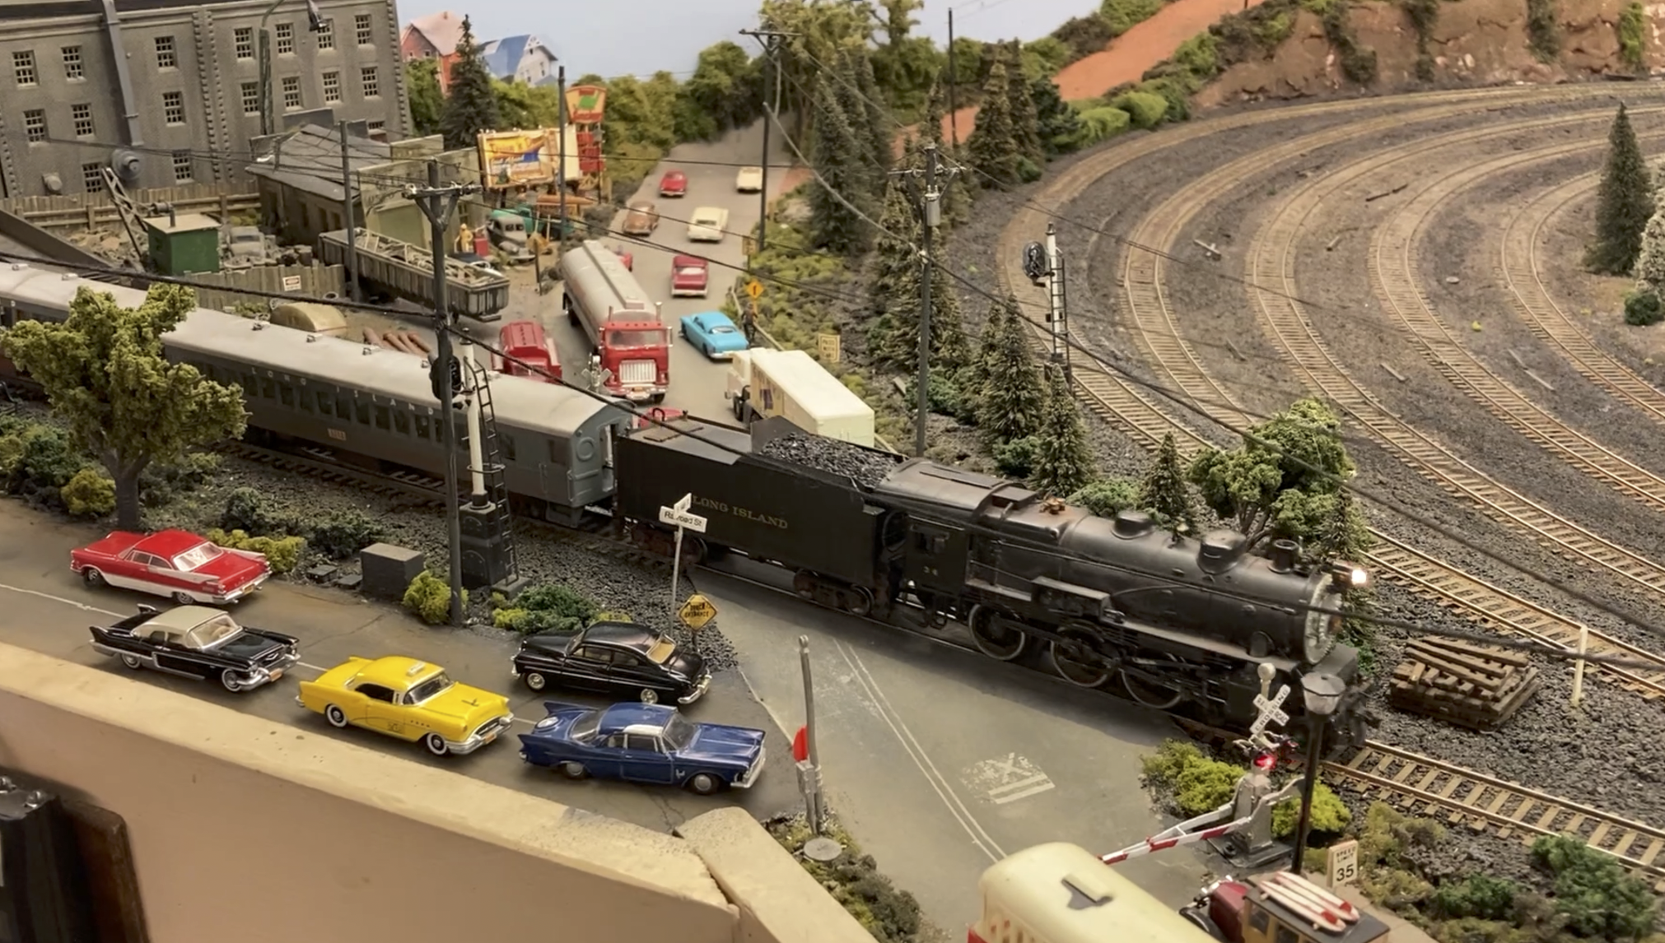

Slide 77
WHERE CAN I GET MORE INFORMATION?
NJ INTERNATIONAL - https://www.njinternational.com
BERKSHIRE JUNCTION - http://berkshirejunction.com/subdirectory/
CIRCUITRON - http://www.circuitron.com
Z-STUFF FOR TRAINS - https://www.z-stuff.net
ARDUINO - https://www.arduino.cc
LOGIC RAIL TECHNOLOGIES - https://www.logicrailtech.com
MODEL TRAIN TECHNOLOGY - www.modeltraintechnology.com

Slide 78
CONCLUSION
Automatically activated operational cross buck flashers, crossing gates, and crossing bells can add additional realism to your layout
One integral system is currently available (Model Train Technologies)
Constructing an operational system from separate components is not difficult
Research all available products regarding their capablities before deciding on a system.
I have found that Logic Rail Technologies detection and activation circuits offers the most realistic operation for the price

Slide 79
THANK YOU FOR YOUR ATTENTION
THIS CLINIC WILL BE POSTED ON THE POTOMAC DIVISION WEB SITE https://potomac-nmra.org
ANY QUESTIONS?
I CAN BE REACHED AT bwsheron@mac.com

