Slide 1
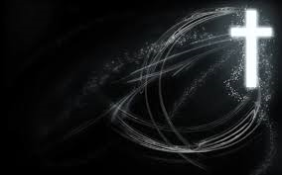
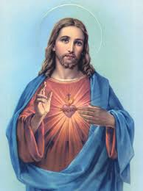
Christianity
Anu Pillai

Slide 2
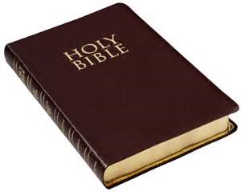
Christianity has about 2.2 billion followers worldwide. It is based on the teachings of Jesus Christ who lived in the Holy Land 2,000 years ago.
Place of Origin | Israel
Founder | Jesus of Nazareth
Sacred Text | The Bible - Old and New Testaments
Sacred Building | Church, Chapel, Cathedral
Holy Places | Jerusalem, Bethlehem, Nazareth, Lourdes (a popular place of pilgrimage), Rome, Canterbury
Major Festivals | Easter, Christmas,
Main Branches (Denominations) | Anglican, Roman Catholic, Free Churches, Orthodox, Reformed,

Slide 3
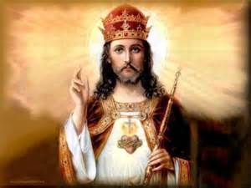
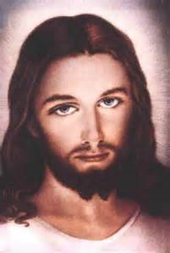
The Basics
Who is the founder of Christianity? Jesus Christ, who was crucified around A.D. 30 in Jerusalem, is the founder of Christianity.
Who is Jesus Christ? Jesus Christ is believed to be the Son of God. He came to earth to teach about love and fellowship. He represents the person that all Christians must strive to be. Jesus was a Jew who was born about 2000 years ago in Bethlehem. Jesus lived for 33 years before being crucified by the Romans.
What other names is Jesus known by? Son of God Light of the World Lamb of God The Good Shepherd.

Slide 4
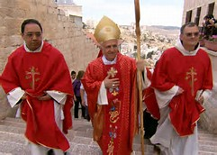
Followers
Who are Christians? Christians are people who believe that Jesus Christ is the Son of God, and who follow his teachings and those of the Christian churches that grew up after his death. Christians believe that Jesus rose from the dead and appeared to his disciples (followers) to show everyone that there is another life with one, eternal, loving God.
Why are Christians called Christians? Christians get their name from Jesus Christ who is God's son.

Slide 5
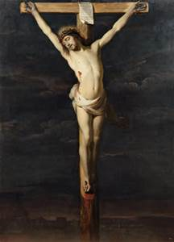
Belief
What do Christians believe?
Christians believe that Jesus Christ was the Son of God and that:
God sent his Son to earth to save humanity from the consequences of its sins
Jesus was fully human, and experienced this world in the same way as other human beings of his time
Jesus was tortured and gave his life on the Cross (At the Crucifixion)
Jesus rose from the dead on the third day after his Crucifixion (the Resurrection)
Christians believe that Jesus was the Messiah promised in the Old Testament
Christians believe that there is only one God, but that this one God consists of 3 "persons"
  God the Father
  God the Son
  The Holy Spirit
Christians believe that God made the world.

Slide 6
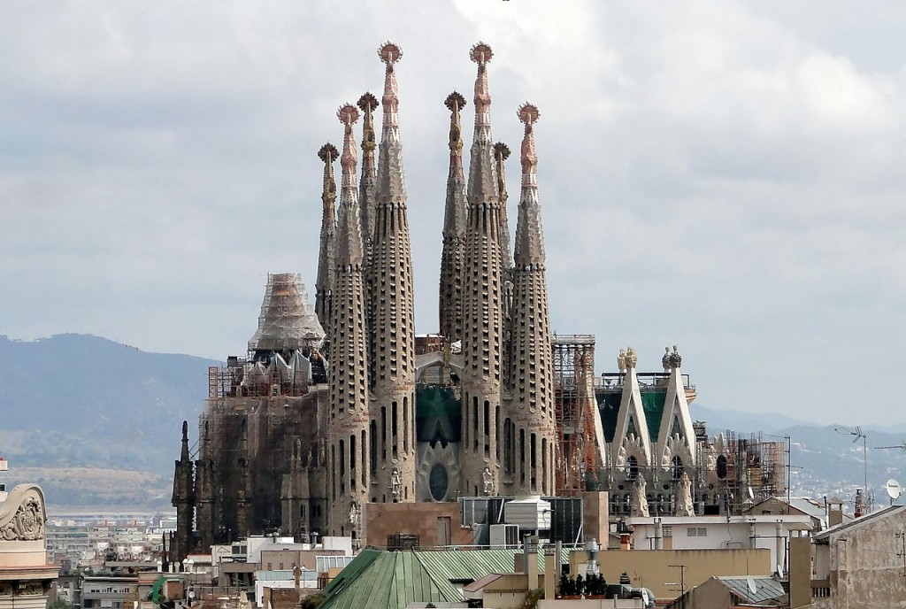
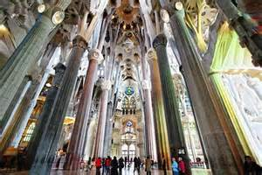
Where do Christians worship? The Christian place of worship is called a Church. They are often built in the shape of a cross with the altar facing east towards the rising sun. The Christian spiritual leaders are called priests or ministers. (vicars). What is Christian worship like? Christian worship involves praising God in music, speech, readings from scripture, prayers of various sorts, a sermon and various holy ceremonies.
Sagrada Familia, Barcelona, Spain
What is the Christian holy book called? The Bible is the Christian holy book. It is divided into the Old and New Testaments. Parts of the writing contained in the Old Testament are also sacred to Jewish and Muslim people.

Slide 7
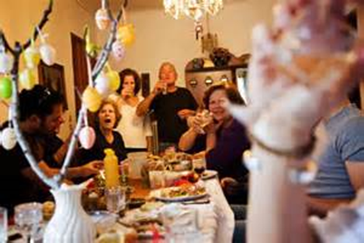
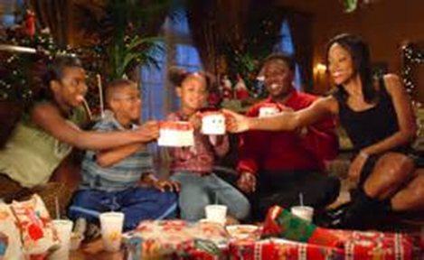
Festivals
What are the two main Christian festivals? The two main Christian festivals are Easter and Christmas. They are major milestones in the Western secular calendar. What are the most important Christian Festivals? The most important Christian festivals are: Lent, Easter and Christmas.

Slide 8



Symbols
What are the Christian symbols?
The cross is the main symbol. It reminds Christians that Jesus died on the cross to save them.
The dove is the symbol of the holy spirit and peace.
The fish symbol was created using the Greek letters which spell out ICHTHUS : Jesus Christ God's Son Saviour.
The Romans persecuted the Christians and it became dangerous for them to meet. So the Christians devised a secret code. They drew half a fish in the sand. If a person completed the fish, they knew he or she was a believer too. Under the fish sign the Christians wrote the Greek word fish.
These letters stood for: Jesus Christ God's Son Saviour

Slide 9

Similarities and Differences
Christianity
Jesus Christ
Church
Christmas
Holy bible
Buried
Hinduism
No founder
temple
Diwali
Vedas
Cremation
Pilgrimage
Statues
Pictures
Coming

Slide 10

Thanks for watching!!!!!!!
This slideshow uses information from www.ChurchYear.net

