Slide 1

DMIST
Verbal Report for Transition of Care

Slide 2
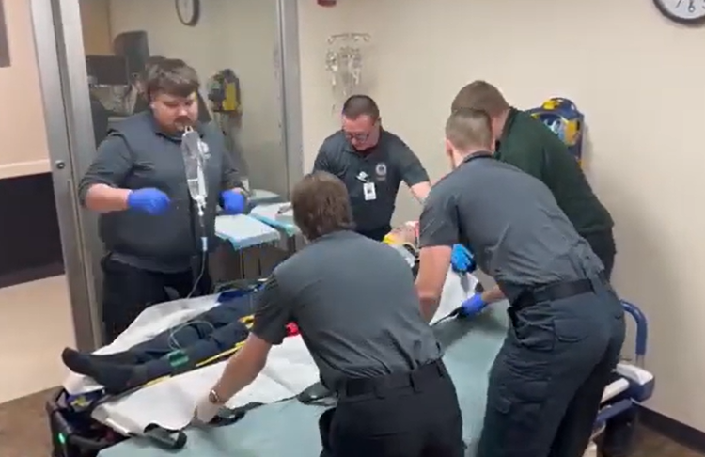

The power of communication
Notes:
Did you know that patient hand off is an extremely important time in patient care transition and one of the times most at risk for errors that can lead to patient care mistakes and poor outcomes? One recent study noted that poor communication was the sole cause of patient-safety incidents in over one in ten cases and contributed to causing incidents in one in four cases (https://doi.org/10.7326/ANNALS-24-02904)

Slide 3



DMIST
Can be used for all patient care hand-offs:
First responders to ambulance crews
BLS ambulance crews to ALS intercepts
Ambulance crews to helicopter flight crews
When delivering a patient to the hospital and giving bedside report to the ED staff or a trauma team
Notes:
Recently the Wisconsin State Trauma Advisory Council and the EMS Advisory Board approved a joint position statement on verbal reports for transition of patient care. The position statement recommends that a standardized format of hand-off report be adopted across the state to make it easier for services that transport to multiple hospitals or hand-off to different ALS intercept or helicopters.

Slide 4
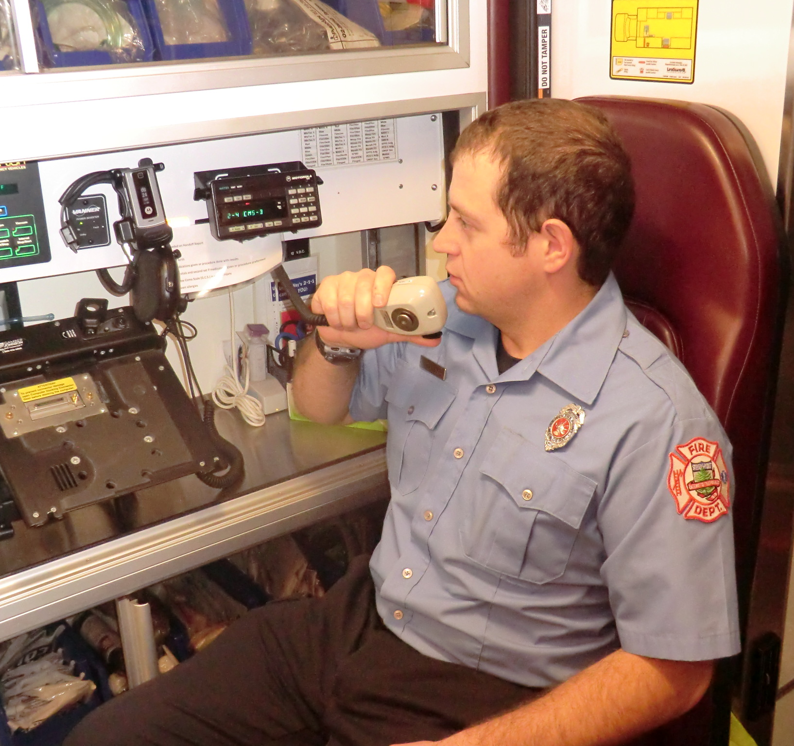
D – Demographics
M - Mechanism of injury or illness
I - Injuries or illness
S - Signs and symptoms
T - Treatments
Notes:
The position statement recommends that a standardized format of hand-off report be adopted across the state to make it easier for services that transport to multiple hospitals or hand-off to different ALS intercept or helicopters.

Slide 5

D – Demographics
M - Mechanism of injury or illness
I - Injuries or illness
S - Signs and symptoms
T - Treatments
Name
Age
Date of birth
Medical history
Medications
Blood thinners
Notes:
Demographics should include pertinent information about the patient including their name, or what they want to be called, their age, and any pertinent medical history such as use of blood thinners.

Slide 6
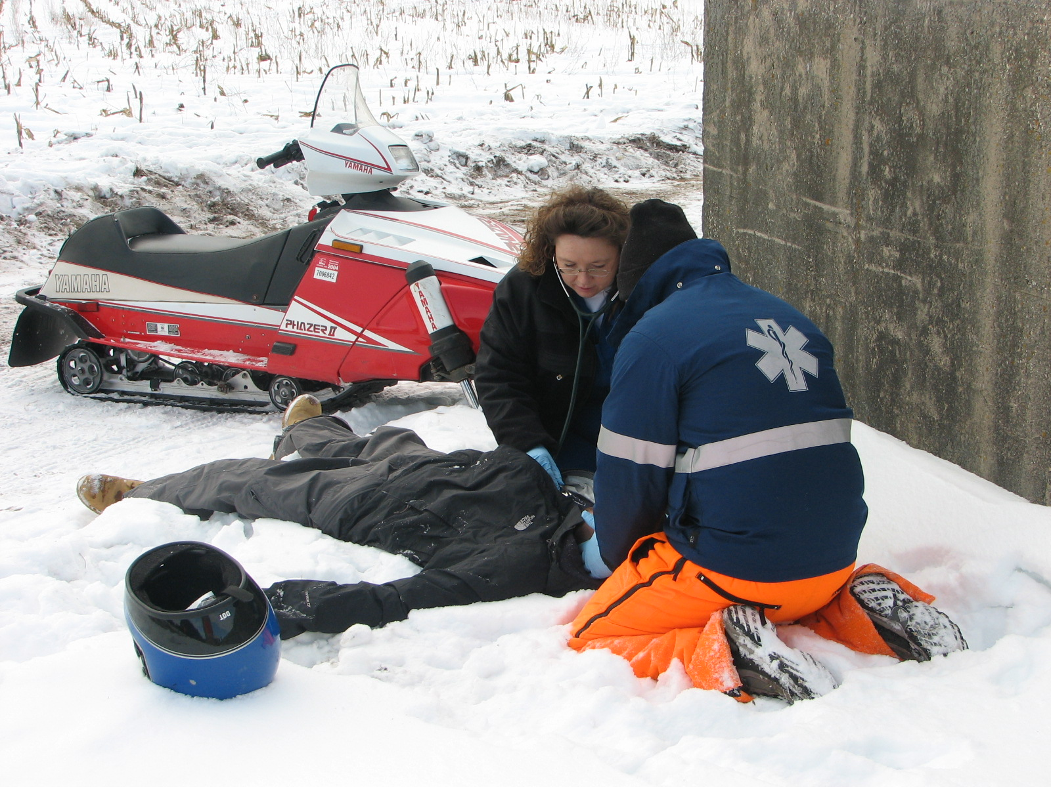
D – Demographics
M - Mechanism of injury or illness
I - Injuries or illness
S - Signs and symptoms
T - Treatments
High speed crash
Partial or complete ejection
Significant vehicle intrusion
Death of another occupant
Child not secured in a car seat
Rider separated from the vehicle (motorcycle, UTV, horse, etc.)
Pedestrian/bicycle rider thrown or run over
Fall from >10 feet
Notes:
Mechanism of injury or illness should be brief information about how the patient was injured. You don’t need to paint the entire picture here, just enough to give an idea if it was a significant injury or not. Inclusion of any MOI points from the National Guidelines for the Field Triage of Injured patients would be appropriate

Slide 7
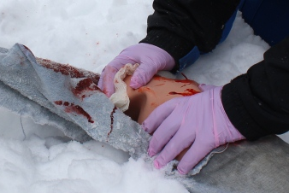
D – Demographics
M - Mechanism of injury or illness
I - Injuries or illness
S - Signs and symptoms
T - Treatments
Penetrating injuries to the head, neck, torso, & proximal extremities
Skull deformity, suspected skull fracture
Suspected spinal injury with new motor or sensory loss
Chest wall instability, deformity or suspected flail chest
Suspected pelvic fracture
Suspected fracture of two or more proximal long bones
Crushed, degloved, mangled, or pulseless extremity
Amputation proximal to wrist or ankle
Active bleeding requiring a tourniquet or wound packing with continuous pressure
Notes:
The Injury or illness section includes any injuries you have identified in your primary or secondary assessments. It would be especially important to highlight any of these critical injuries Significant pertinent negatives may also be listed here. The list of significant injury patterns from the National Guidelines for the Field Triage of Injured Patients is a great place to start but other significant injuries identified should also be reported. For medical cases this might be the illness that you are treating them for. Be sure to announce if they met STEMI or stroke alert criteria.

Slide 8
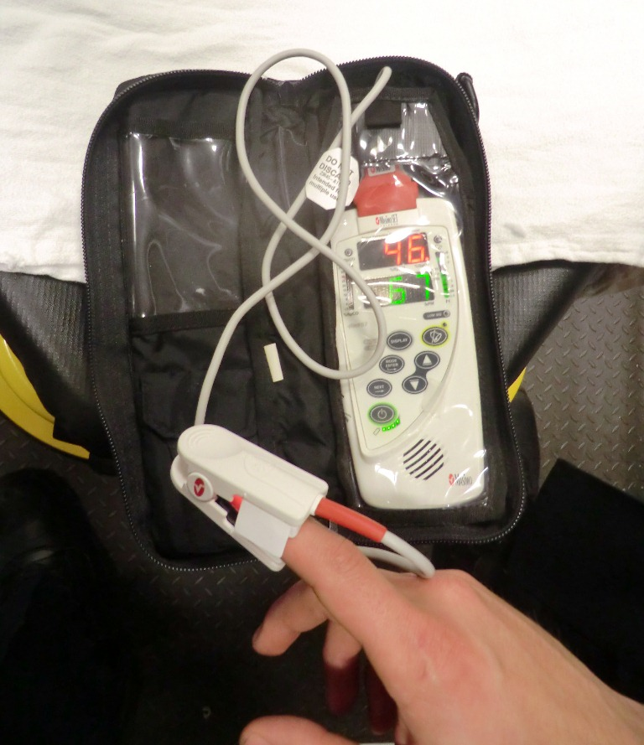
D – Demographics
M - Mechanism of injury or illness
I - Injuries or illness
S - Signs and symptoms
T - Treatments
Glasgow coma score
Blood pressure – be sure to report the lowest one you recorded if the patient is at all hypotensive
Heart rate
Respiratory rate
Pulse oximetry
Pain scale
End tidal CO2 data if it is pertinent
Blood glucose if there is an altered level of consciousness
Notes:
Report any symptoms the patient is complaining of as well as any objective data you have collected during your care. Be sure to highlight any abnormal findings.

Slide 9
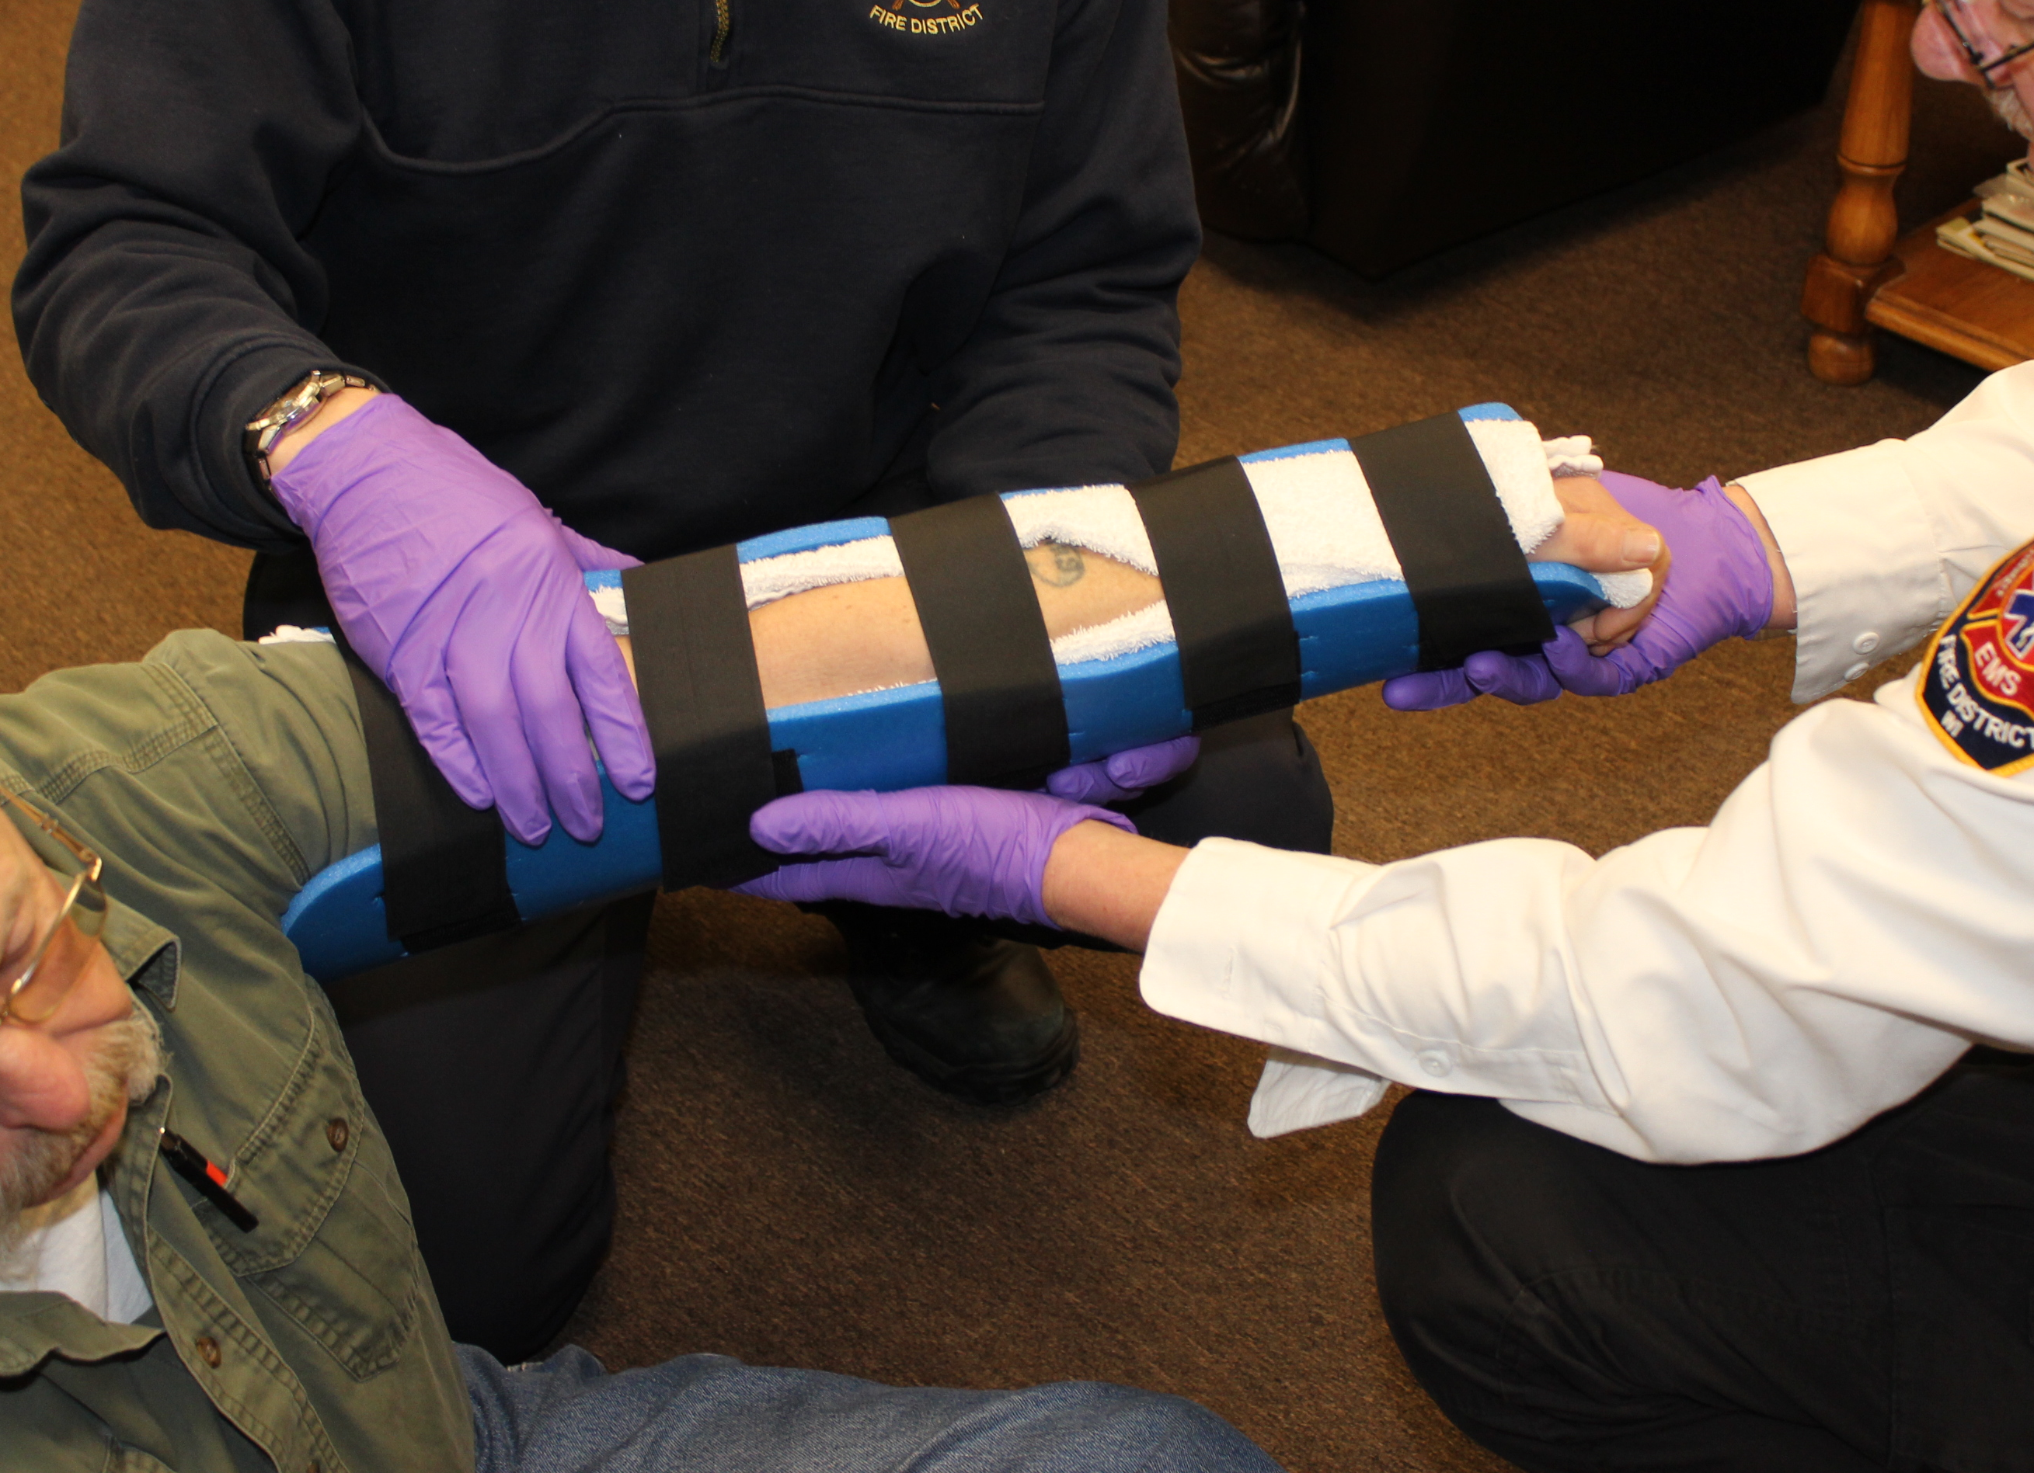
D – Demographics
M - Mechanism of injury or illness
I - Injuries or illness
S - Signs and symptoms
T - Treatments
Airway and breathing interventions
Circulation and hemorrhage control
IVs and IV fluids
Medications given
Splinting and spinal immobilization
Notes:
The treatment section is your time to report the main interventions you did during your time with the patient. If the treatment led to a significant change in the patient’s condition make note of it here.

Slide 10

Putting it all together
DMIST video created by the Wisconsin RTAC Coordinators
https://www.youtube.com/watch?v=_dUTTJA1OIA
Notes:
Consider showing this video to reinforce the learning points of this Power Point presentation.

