Slide 1

Hanford Cleanup:
Past, Present, Future
National Cleanup Workshop
Brian Vance, Hanford Site Manager
September 12, 2019

Slide 2
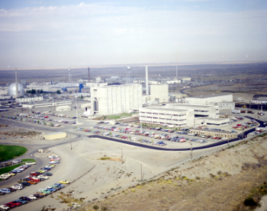
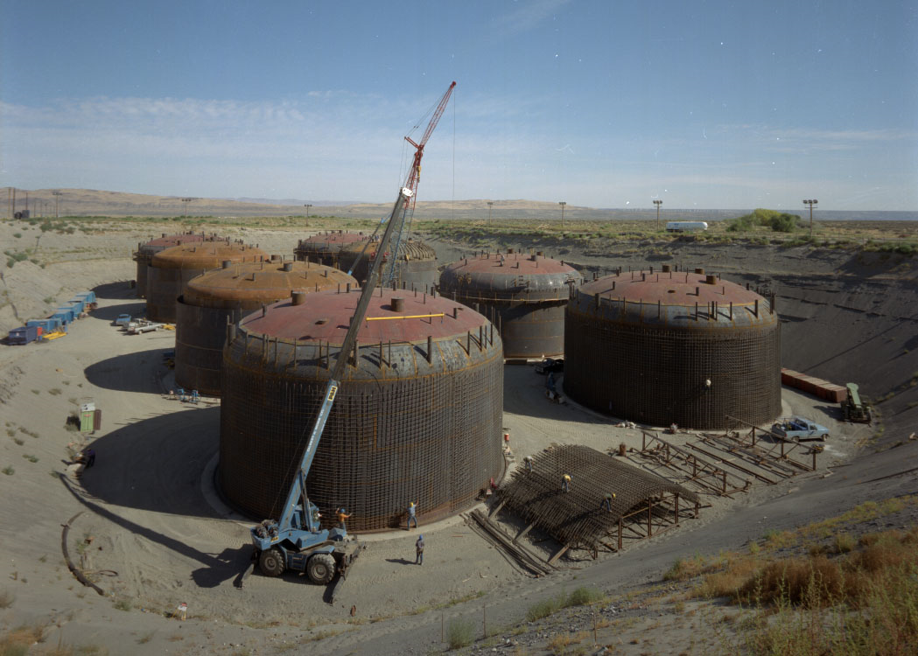
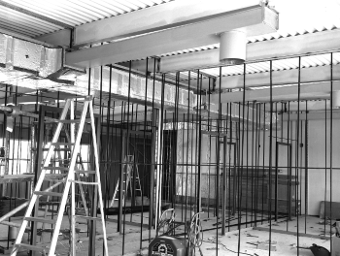
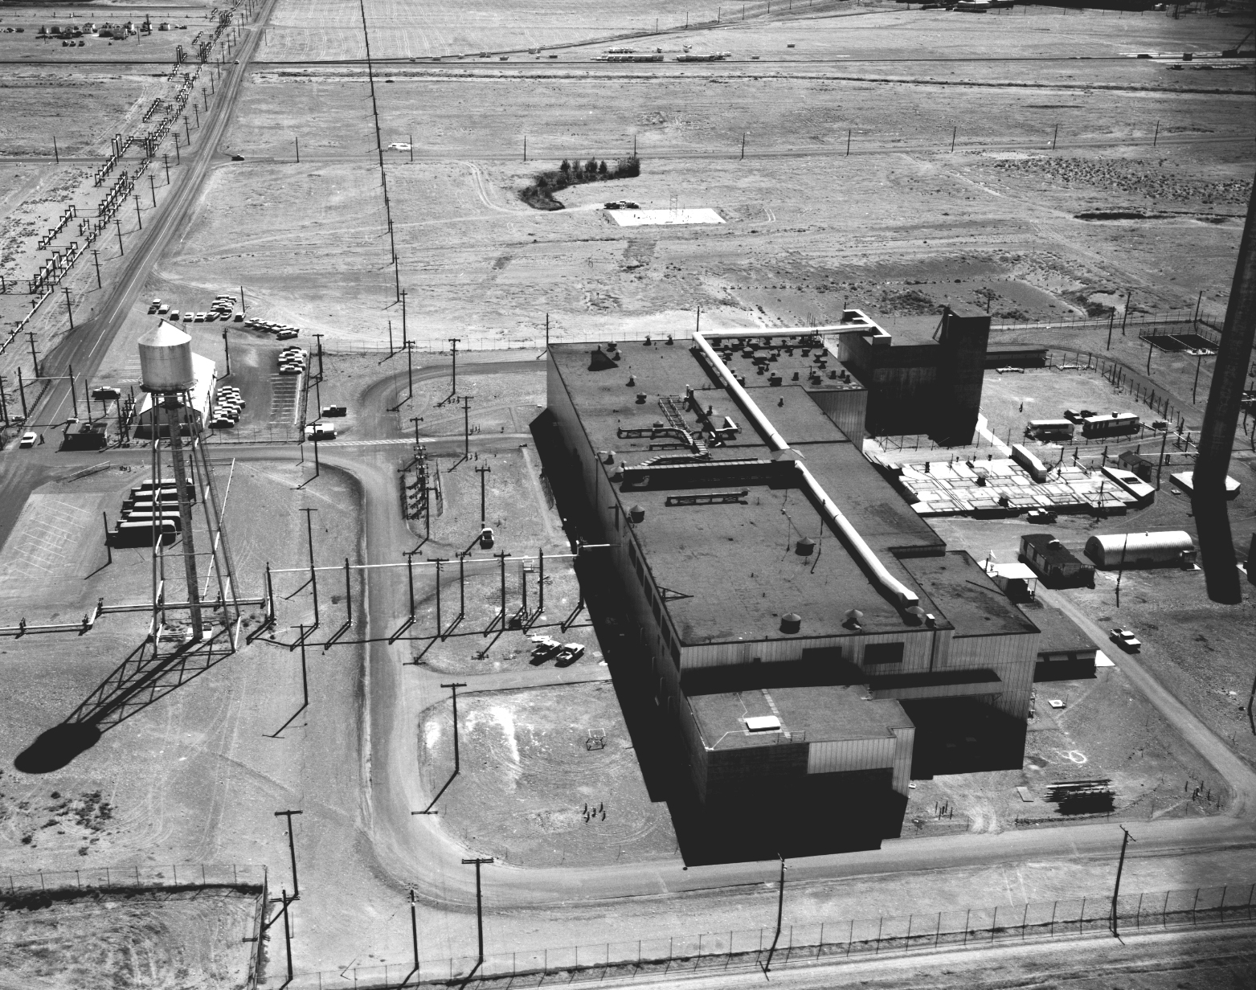
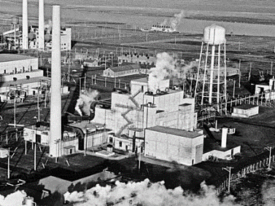
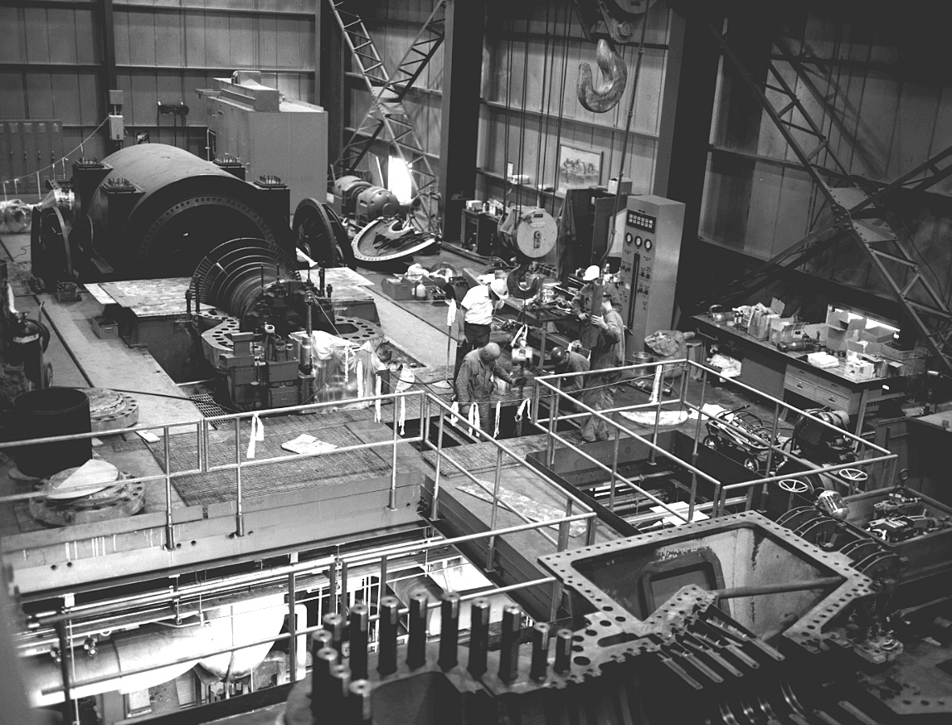
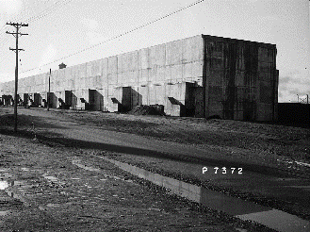
National Defense: Hanford Plutonium Production
World War II thru the Cold War Era (1944-1991)
Hanford Reactors:
B Reactor 1944-1968
D Reactor 1944-1967
F Reactor 1945-1965
H Reactor 1949-1965
DR Reactor 1950-1964
C Reactor 1952-1969
KW Reactor 1955-1970
KE Reactor 1955-1971
N Reactor 1963 -1987
Total: 74 tons plutonium
~6 tons plutonium
~68 tons plutonium

Slide 3
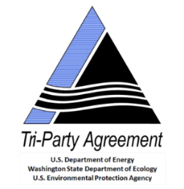
Key Regulatory Drivers
Atomic Energy Act of 1954
Comprehensive Environmental Response, Compensation, and Liability Act (CERCLA)
  Three active National Priority List (NPL) sites at Hanford – 100, 200 and 300 Areas; 1100 Area removed from list in 1996
  Facility cleanout, demolition and waste site cleanup
Resource Conservation and Recovery Act (RCRA)
  State of Washington delegated authority by EPA
  Safe storage, treatment and disposal of hazardous waste
Tri-Party Agreement (Hanford Federal Facility Agreement and Consent Order, signed in 1989)
  Agreement between DOE, State of Washington
  and EPA
  A living document that provides framework to implement and comply with regulations
Notes:
Hanford cleanup began in 1989, with an agreement between DOE, EPA, and Washington State
The Tri-Party Agreement established 161 milestones for completing cleanup.
Since then, hundreds of milestones and target dates have been added, with approximately 96 percent (1,665) completed on or ahead of schedule (Oct. 2018 stats)
After more than 25 years of cleanup, considerable progress has been made at Hanford, reducing the risk the site poses to the health and safety of workers, the public, and the environment.

Slide 4
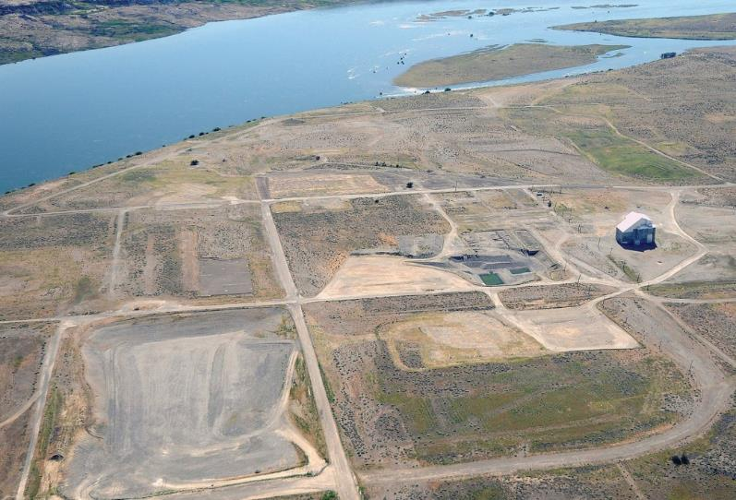
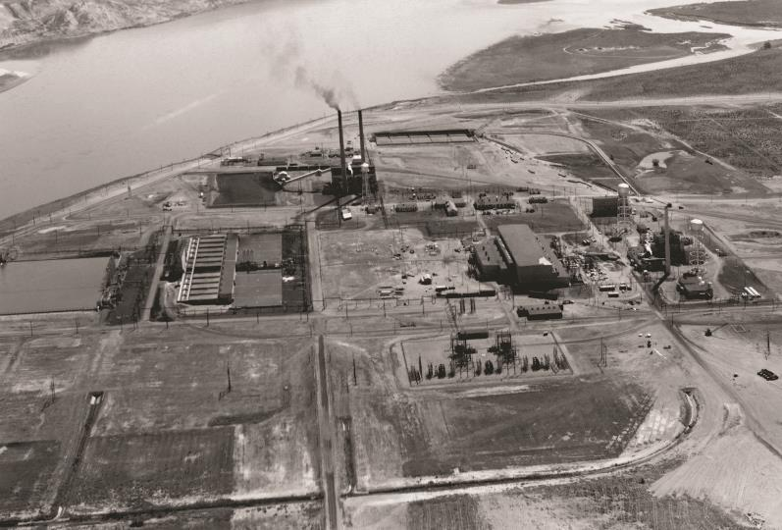
F Reactor Area: A First
During Operations
2012

Slide 5
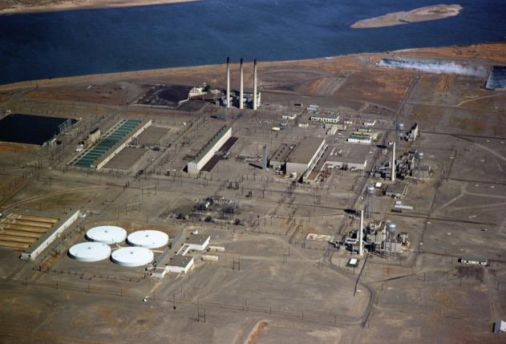
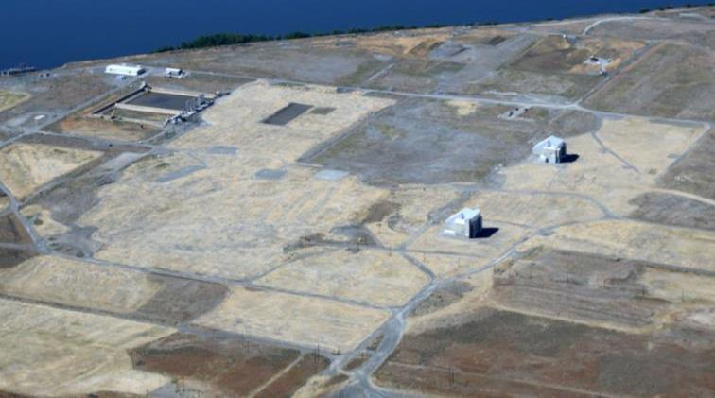
D and DR Reactor Areas
2016
During Operations
Notes:
Chromium contamination in the soils was removed by digging down to groundwater to remove the source of groundwater contamination. D Reactor’s water filter building was a very solid concrete structure that was also removed by the River Corridor contractor before backfilling and revegetation.

Slide 6
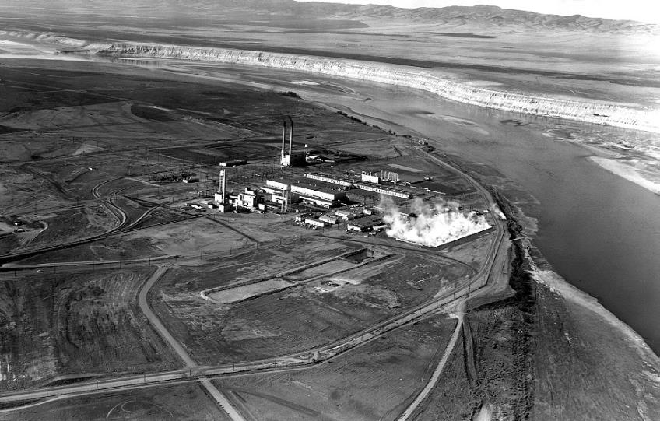
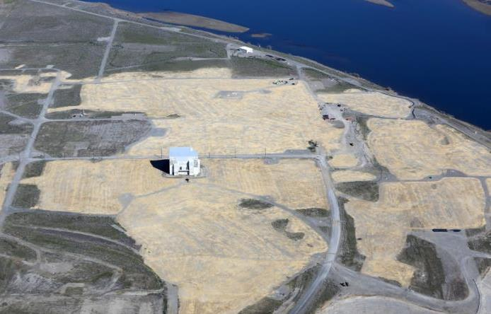
H Reactor Area
2016
During Operations

Slide 7
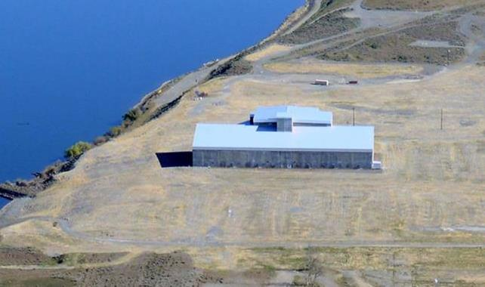
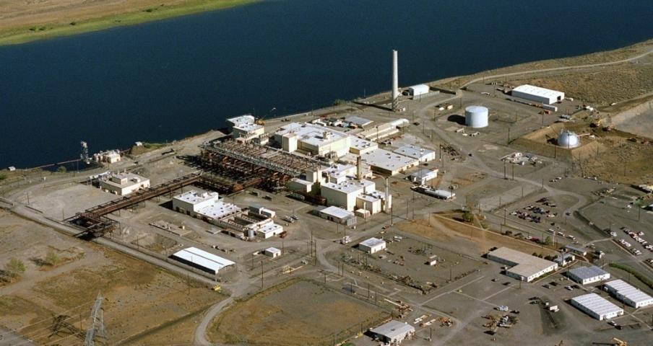
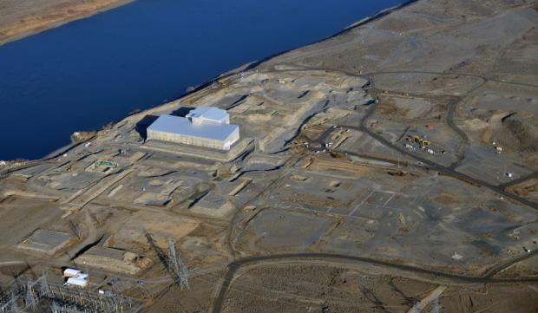
N Reactor Area
During Operations
2015
Notes:
100-N Cleanup
726,000 tons of clean material was used to backfill 98 remediated waste sites
Revegetated with more than 3,000 pounds of native bunchgrass seed, and approximately 78,000 shrub tubelings planted
Backfill left the area with more natural appearance, using contouring and boulders

Slide 8
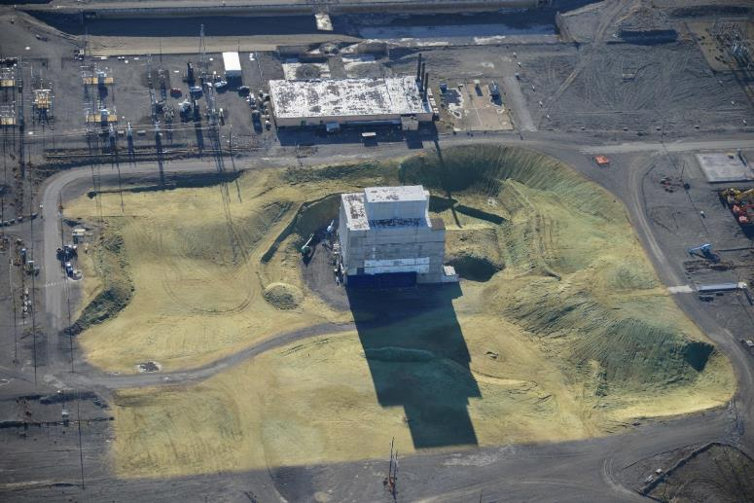
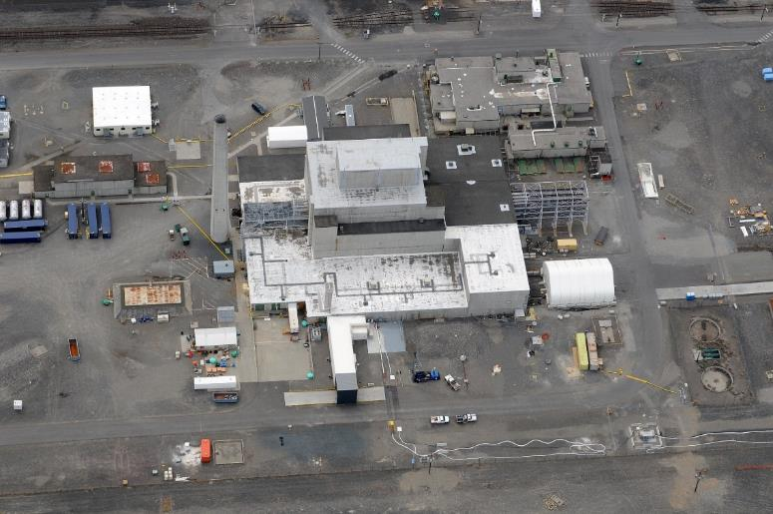
K East Reactor
2008
2012

Slide 9
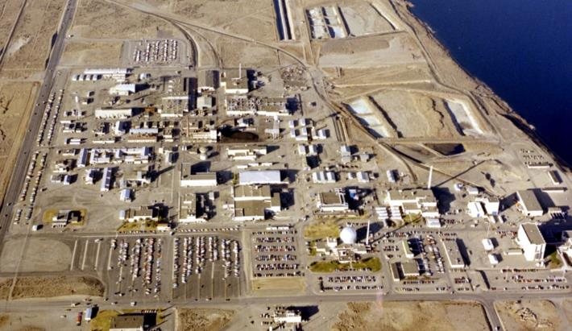
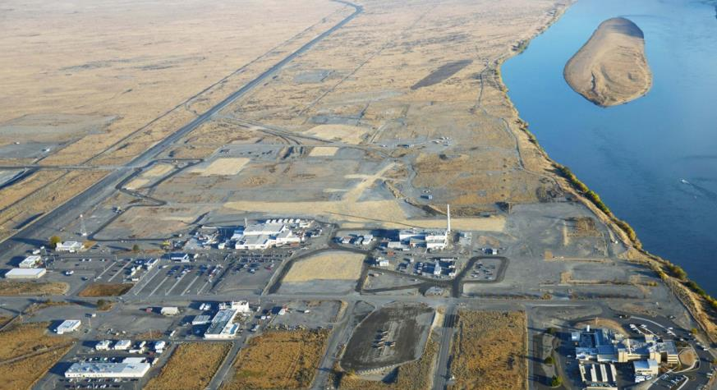
300 Area Cleanup
1977
2015
2015

