Slide 1


Scan now to
complete the pretest
Keeping Pace With Evolving Treatment Paradigms in Advanced Renal Cell Carcinoma: The Nurse’s View
Scan the QR here or on the front of your i3 Health folder to complete the pretest OR use the paper assessment included in your i3 Health folder
To scan the QR code:
FOR IPHONE:
Open the camera & focus it to QR code
Your internet browser should pop up with a link
Click the link and complete
FOR ANDROID:
Open the camera & focus it to QR code
Hold ‘Home’ button
The pretest comes visible to complete

Slide 2
Keeping Pace With Evolving Treatment Paradigms in Advanced Renal Cell Carcinoma: The Nurse’s View
Nazy Zomorodian, RNC, MSN, CUNP, CCRC
Assistant Professor, Department of Urology
David Geffen School of Medicine
University of California, Los Angeles

Slide 3
Provided by i3 Health
ACCREDITATION
i3 Health is accredited with distinction as a provider of nursing continuing professional development by the American Nurses Credentialing Center’s Commission on Accreditation.
A maximum of 1.0 contact hour may be earned by learners who successfully complete this continuing nursing education activity.
INSTRUCTIONS TO RECEIVE CREDIT
An activity evaluation form has been distributed. To claim credit, you must turn in a completed and signed evaluation form at the conclusion of the program. Your certificate of attendance will be emailed to you in approximately 2 weeks.
UNAPPROVED USE DISCLOSURE
This educational activity may contain discussion of published and/or investigational uses of agents that are not indicated by the FDA. The planners of this activity do not recommend the use of any agent outside of the labeled indications.
The opinions expressed in the educational activity are those of the faculty and do not necessarily represent the views of the planners. Please refer to the official prescribing information for each product for discussion of approved indications, contraindications, and warnings.
DISCLAIMER
The information provided at this NCPD activity is for continuing education purposes only and is not meant to substitute for the independent medical/clinical judgment of a healthcare provider relative to diagnostic and treatment options of a specific patient’s medical condition.
COMMERCIAL SUPPORT
This educational activity is supported by a medical education grant from Exelixis.

Slide 4
Disclosures
Ms. Zomorodian has no relevant financial relationships to disclose

Slide 5
Learning Objectives
Distinguish the mechanisms of action of IO agents and VEGFR TKIs in advanced renal cell carcinoma (RCC)
Differentiate the efficacy and safety profiles of IO and VEGFR TKI therapies for advanced RCC
Assess strategies to improve treatment tolerability, control adverse events, and ensure the provision of patient-centered RCC care
IO = immuno-oncology; VEGFR = vascular endothelial growth factor receptor; TKI = tyrosine kinase inhibitor.

Slide 6
Renal Cell Carcinoma
Statistics
 | Estimated New RCC Cases | Estimated RCC Deaths
2020 | 73,750 | 14,830
 | 5-Year Relative Survival
1975 | 52.3%
2000 | 64.7%
2016 | 75.2%
NCI, 2020.

Slide 7
Risk Factors
Cigarette smoking
Obesity
Hypertension
Gender (2:1 male:female ratio)
Race
Chronic kidney disease
Genetic
  Von Hippel-Lindau disease
  Hereditary papillary RCC
  Hereditary leiomyoma RCC
  Birt-Hogg-Dubé (BHD) syndrome
  Familial renal cancer
  Cowden syndrome
  Tuberous sclerosis
ACS, 2020.

Slide 8
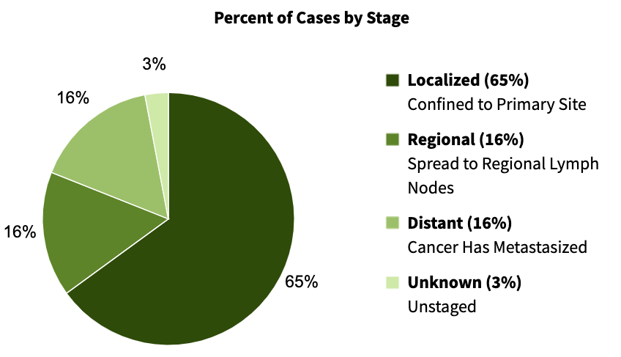
Kidney and Renal Pelvis Cancer
Stage at Diagnosis
NCI, 2020.

Slide 9
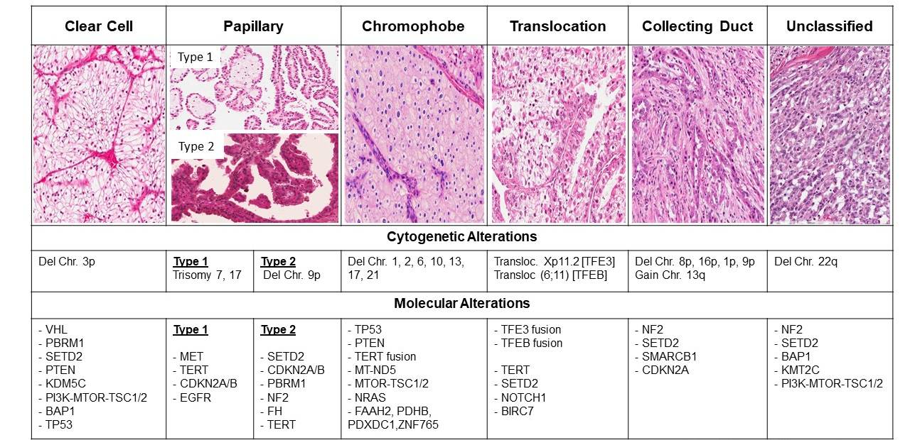
Histologic Classification of Renal Cell Carcinoma
del = deletion; chr = chromosome; VHL = Von Hippel-Lindau; transloc = translocation; EGFR = epidermal growth factor receptor.
Image courtesy of Sabrina Signoretti, MD, and Toni Choueiri, MD, Harvard Kidney Cancer Program.

Slide 10
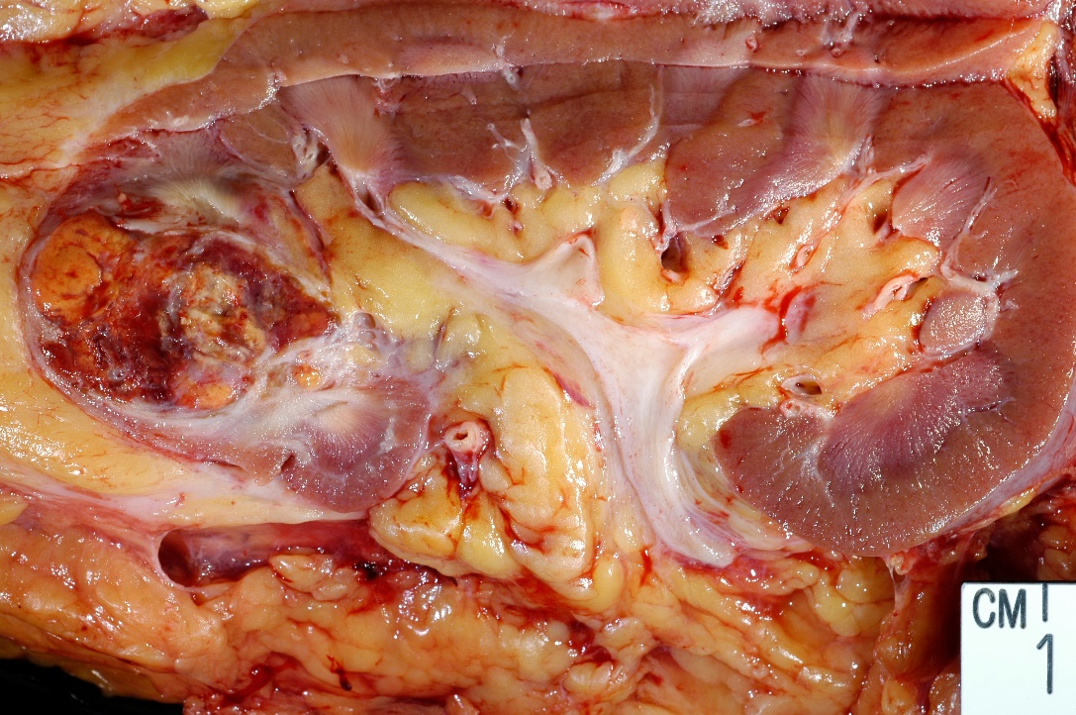
Clear Cell RCC
Highly Angiogenic Tumor
Inactivated VHL tumor suppressor gene
Degradation of HIF-1α involves binding to VHL gene
Increased expression of HIF-α
Leads to increased production of pro-angiogenic factors (VEGF and PDGF)
Increased neovascularization and metastasis
HIF = hypoxia-inducible factor; VEGF = vascular endothelial growth factor; PDGF = platelet-derived growth factor.
Image courtesy of Laura Wood, RN.
Rini & Small, 2005; Wiesener et al, 2001.

Slide 11
Sarcomatoid RCC
Histologic subtype with sarcoma-like features
  Spindle-like cells
  High cellularity
  Cellular atypia
Present as large, bulky tumors
Aggressive subtype with early distant metastasis
May be an independent predictor of poor survival
Shuch et al, 2012.

Slide 12
Renal Cell Carcinoma Staging
Clinical staging
  Based on clinical, radiologic, and biopsy information
Pathologic staging
  Based on pathologic staging at time of surgery
TNM system of staging
  T: size of tumor
  N: involvement of regional lymph nodes
  M: presence of metastatic disease
TNM = tumor, nodes, metastases.

Slide 13
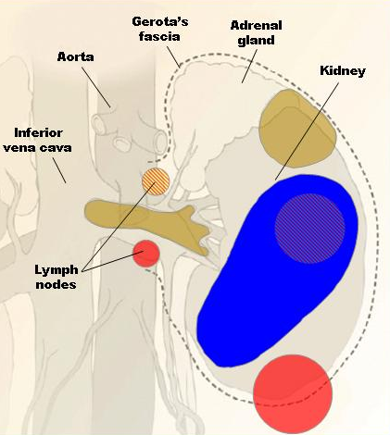
AJCC Staging: RCC
Stage 1
  Tumor <7 cm, limited to kidney
Stage 2
  Tumor >7 cm, limited to kidney
Stage 3
  Tumor in major veins or adrenal gland, tumor within Gerota’s fascia, or 1 regional lymph node involved
Stage 4
  Tumor beyond Gerota’s fascia or >1 regional lymph node involved
AJCC = American Joint Committee on Cancer.
Image courtesy of Laura Wood, RN.
NCCN, 2021.

Slide 14
Prognostic Factors
Targeted Therapy Era
Model based on 645 patients with mRCC treated with VEGF-targeted therapy
  Sunitinib (61%), sorafenib (31%), bevacizumab (8%)
Predictors for survival:
  Time from diagnosis to treatment <1 year
  Hemoglobin
  Calcium
  Performance status
  Neutrophil count
  Platelet count
mRCC = metastatic RCC.
Heng et al, 2009.

Slide 15
Case Study 1
69-year-old male presents to his PCP with recurrent mild hematuria
  Denies fever, chills
  Mild flank pain, fatigue, weight loss
  Anemia; other labs within normal limits
CT scan demonstrates
  11-cm left renal mass
  Multiple retroperitoneal lymph nodes
  No bone metastasis
PCP = primary care physician; CT = computed tomography.

Slide 16
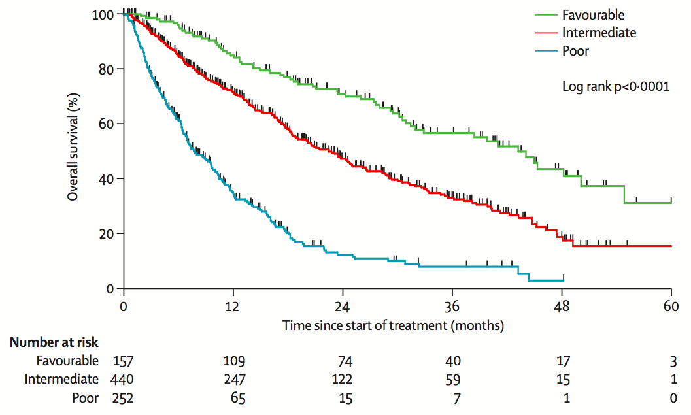





IMDC Prognostic Factors
Favorable risk
  0 risk factors
Intermediate risk
  1-2 risk factors
Poor risk
  ≥3 risk factors
IMDC = International Metastatic Renal Cell Carcinoma Database Consortium.
Heng et al, 2013; Ko et al, 2015.

Slide 17
Treatment Planning
Surgery or Systemic Therapy?
Patient presents with synchronous metastatic renal cell carcinoma
  Presence of metastatic disease at diagnosis
Histology unknown
  Do you biopsy or just do nephrectomy?
Symptomatic
  Surgery first? Systemic therapy first?

Slide 18
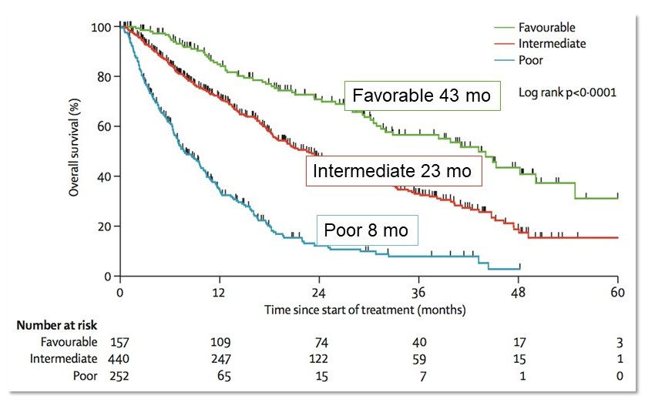
IMDC Prognostic Factors (cont.)
mo = months.
Heng et al, 2013; Ko et al, 2015.

Slide 19
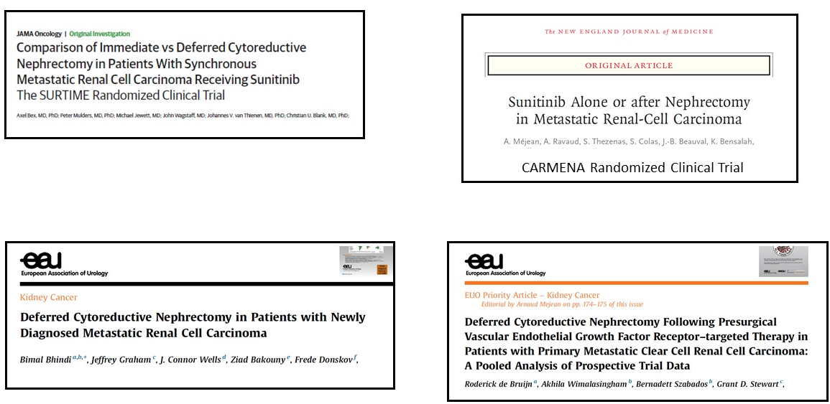
Role of Cytoreductive Nephrectomy (CN)
Bex et al, 2019; Méjean et al, 2018; Bhindi et al, 2020; de Bruijn et al, 2020.

Slide 20
Role of Cytoreductive Nephrectomy (cont.)
Upfront CN does not result in additional survival benefit for most patients
Deferred CN improved survival compared to immediate CN
Deferred CN allows identification of patients with aggressive biology or inherent resistance to VEGF TKIs
  Those unlikely to benefit from CN in the first place
Initial treatment with systemic therapy is preferred in those with MSKCC/IMDC poor-risk disease, poor KPS, and/or large-volume metastatic burden
MSKCC = Memorial Sloan Kettering Cancer Center; KPS = Karnofsky performance status.
Bex et al, 2019; Méjean et al, 2018; Bhindi et al, 2020; de Bruijn et al, 2020.

Slide 21
CN: Patient Selection Matters
Retrospective review of 608 patients undergoing cytoreductive nephrectomy
  MD Anderson Cancer Center, 2005-2017
Median follow-up: 29.4 months
Demographics
  95% ECOG 0-1
  70% single site of metastatic disease
ECOG = Eastern Cooperative Oncology Group.
McIntosh et al, 2020.

Slide 22
CN: Patient Selection Matters (cont.)
Risk factors for decreased survival
  Symptomatic at diagnosis
  Retroperitoneal and supradiaphragmatic lymphadenopathy
  Bone metastasis
  Clinical T4 disease
  Hgb < LLN
  Albumin < LLN
  LDH > ULN
  Neutrophil/lymphocyte ratio >4
Risk groups
  Low: 0-1 risk factors
  Intermediate: 2-3 risk factors
  High: ≥4 risk factors
Hgb = hemoglobin; LLN = lower limit of normal; ULN = upper limit of normal; LDH = lactate dehydrogenase.
McIntosh et al, 2020.

Slide 23
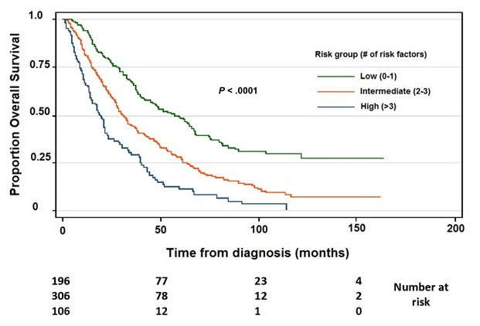
Survival Based on Risk Group
McIntosh et al, 2020.

Slide 24
CN: Patient Selection Matters (cont.)
9 pre-op risk factors for increased risk of death
3 risk groups identified to help clinicians determine risk/benefit of CN
Patients with >3 risk factors did not benefit from CN
Deferred CN remains a critical component of the management of mRCC
Randomized clinical trials comparing survival outcomes of patients treated with TKIs and/or checkpoint inhibitors
pre-op = preoperative.
McIntosh et al, 2020.

Slide 25
Case Study
Role of Supportive Care
Important component of comprehensive care
  Address disease-related symptoms
  Improve tolerability of systemic therapy
  Improve quality of life
Multidisciplinary care
  Palliative care
  Social work
  Nutritional support

Slide 26
Systemic Therapy Options
Advanced RCC
Cytokines
IFN-α
IL-2
Antiangiogenic (VEGF/VEGFR)
Bevacizumab (+IFN-α)
    Sorafenib
    Sunitinib
    Pazopanib
    Axitinib
    Cabozantinib
    Lenvatinib/everolimus
    Tivozanib
Checkpoint Inhibitors
Nivolumab
Nivolumab/ipilimumab
mTOR Inhibitors
    Temsirolimus
    Everolimus
Checkpoint Inhibitor VEGF-TKI Combinations
Pembrolizumab/axitinib
Avelumab/axitinib
Nivolumab/cabozantinib
IFN = interferon; IL = interleukin; mTOR = mammalian target of rapamycin.
NCCN, 2021.

Slide 27
Systemic Therapy Options (cont.)
Checkpoint Inhibitors
Checkpoints
  Signals that regulate the activation of T cells in the process of immune response
Necessary for regulating immune functions, including maintaining self tolerance and protecting the host from tissue damage
Carlo et al, 2016.

Slide 28
PD-1/PD-L1
PD-1 is expressed on immune cells and activated T cells
  Key regulator of T-cell activity
PD-L1 / PD-L2 are expressed on tumor cells
When PD-L1 and PD-L2 bind to the PD-1 on an activated T cell, the T cell is inactivated
PD-1/PD-L1 inhibitors block the interaction of PD-1/PD-L1 and their ligand
  The brake is OFF
  The T cell becomes activated
PD-1 = programmed cell death protein 1; PD-L1 = programmed death-ligand 1; PD-L2 = programmed death-ligand 2.
Carlo et al, 2016.

Slide 29
CTLA-4
Key inhibitory cell surface protein on the T cell (acts as a brake)
  Modulates the early phase of T-cell activation
  Interaction leads to T-cell inhibition
CTLA-4 inhibitors block the interaction of CTLA-4 and its ligand
  The brake is OFF
  Allows the T cell to attack the cancer cell
CTLA-4 = cytotoxic T-lymphocyte–associated protein 4.
Carlo et al, 2016.

Slide 30
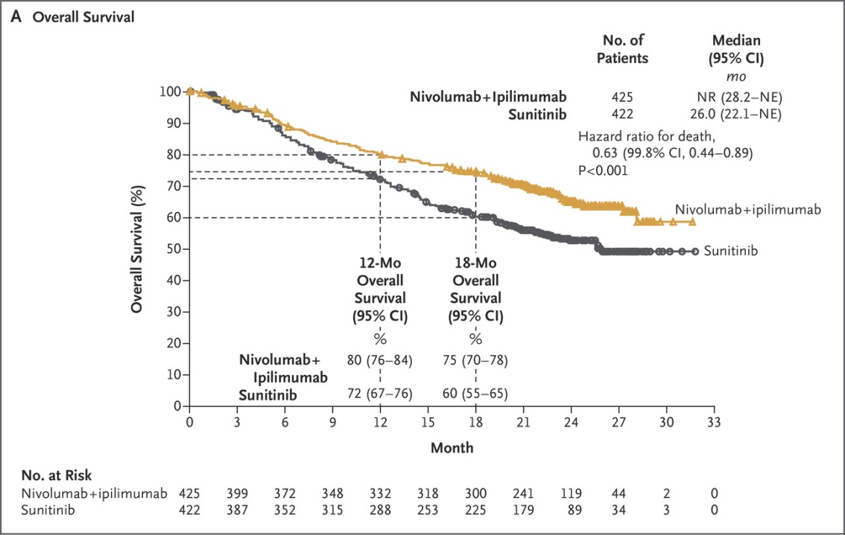
Ipilimumab/Nivolumab
First-Line Advanced RCC
No. = number; CI = confidence interval; NR = not reached; NE = not evaluable.
Motzer et al, 2018.

Slide 31
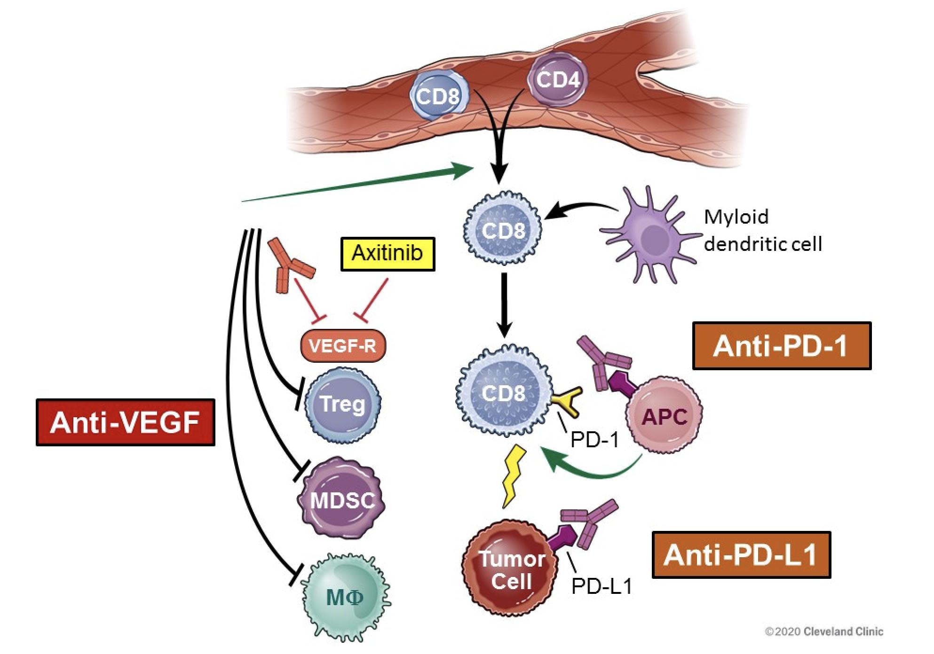
Immunotherapy
VEGF Combination Strategy
Treg = regulatory T cell; APC = antigen presenting cell; MDSC = myeloid-deprived suppressor cell.
Image courtesy of Cleveland Clinic.

Slide 32
Immunotherapy (cont.)
VEGF Inhibitor Combination Strategy
Dysfunctional angiogenic vasculature prevents extravasation of T cells through the endothelium into tumor cells and promotes immunosuppressive tumor microenvironment
VEGF/VEGFR2 axis promotes proliferation, survival, migration, and metastasis
  Inhibits dendritic cell maturation and accumulation and activation of T regulatory cells and MDSCs
  Leads to immunosuppression and tumor growth
Antiangiogenic therapy normalized tumor vasculature, leading to increased T-cell infiltration
Campesato & Merghoub, 2017; Motz & Coukos et al, 2013; Bracarda et al, 2019.

Slide 33
Immunotherapy-Based Frontline Therapy
Advanced RCC
Regimen | ORR | CR | PFS (Months) | OS
Ipilimumab/nivolumabª | 41% (P=0.001) | 11% | 9.7 (P=0.014) | NR (HR for death 0.66, P<0.0001)
Axitinib/avelumab^{b} | 52.5% | 3.8% | 13 (P=0.001) | NE
Axitinib/pembrolizumab^{c} | 60.2% (P<0.001) | 8.8% | 15.4 (P<0.0001) | NR (HR for death 0.68, P<0.001)
Cabozantinib/nivolumab | 55.7% (P<0.0001) | 8% | 16.6 (P=0.001) | NR
ªIntermediate and poor risk.
^{b}All risk groups.
^{c}ITT group.
ORR = overall response rate; CR = complete response; PFS = progression-free survival; OS = overall survival; HR = hazard ratio; ITT = intention to treat.
Motzer et al, 2019; Choueiri, Motzer et al, 2020; Plimack et al, 2020; Choueiri, Powles et al, 2020.

Slide 34
Response Based on PD-L1 Expression
 | Pembrolizumab/Axitinib vs Sunitinib (N=861) |  | Avelumab/Axitinib vs Sunitinib (N=886) |  | Nivolumab/Ipilimumab vs Sunitinib (N=1,096)
Tumor PD-L1 expression ≥1%, (%) | 60.5 |  | 63.2 |  | 24
PFS (HR, 95% CI) | PD-L1 <1 PD-L1 ≥1 | 0.87 (0.62-1.23) 0.62 (0.47-0.80) | Overall PD-L1 ≥1 | 0.69 (0.56-0.84) 0.61 (0.47-0.79) | PD-L1 <1 PD-L1 ≥1 | 1.00 (0.80-1.26) 0.46 (0.31-0.67)
OS (HR, 95% CI) | PD-L1 <1 PD-L1 ≥1 | 0.59 (0.34-1.03) 0.54 (0.35-0.84) | 0.82 (0.53-1.28) Not stratified on PD-L1 status |  | PD-L1 <1 PD-L1 ≥1 | 0.73 (0.56-0.96) 0.45 (0.29-0.71)
Avelumab/axitinib trial required PD-L1 positive status for primary end point
  PD-L1 expression evaluated as part of subgroup analyses
  PD-L1 testing was not required for other 2 trials
Conclusion: PD-L1 expression does not predict benefit or response
N = study population.
Plimack et al, 2020; Choueiri, Motzer et al, 2020; Motzer et al, 2019.

Slide 35
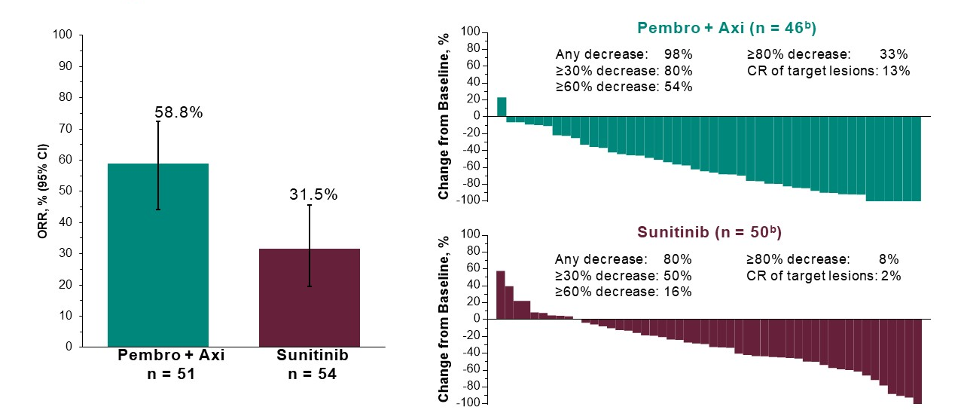
Pembrolizumab/Axitinib: KEYNOTE 426
Response: Presence of Sarcomatoid Featuresª
Data cutoff date: August 24, 2018
ªAmong the 578 participants with known status assessed by local pathology review and as indicated on the eCRF.
^{b}Patients with ≥1 measurable lesion per RECIST version 1.1 by BICR at baseline and ≥ post-baseline imaging assessment evaluable per RECIST 1.1 per BICR.
pembro = pembrolizumab; axi = axitinib; eCRF = electronic case report form; RECIST = Response Evaluation Criteria in Solid Tumors;
BICR = blinded independent central review.
Rini et al, 2019.

Slide 36
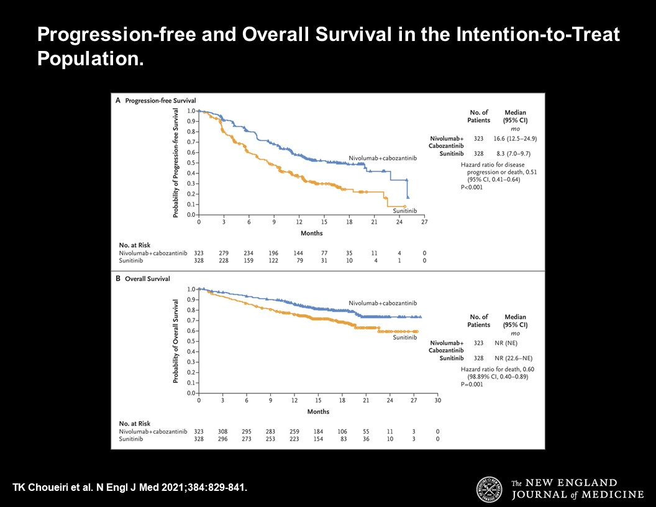
Nivolumab/Cabozantinib: Checkmate 9ER
PFS and OS in the Intent-to-Treat Population
 | Nivolumab/ cabozantinib | Sunitinib
Number of patients | 323 | 328
Median PFS (95% CI) | 16.6 (12.5-24.9) mo | 8.3 (7.0-9.7) mo
HR, PFS (95% CI) | 0.51 (0.41-0.64)
P value, PFS | <0.001
Median OS (95% CI) | NR (NE) | NR (22.6 mo-NE)
HR, OS (98.89% CI) | 0.60 (0.40-0.89)
P value, OS | 0.001
Confirmed ORR | 55.7% | 27.1%
CR | 8% | 4%
PR | 47.7% | 22.6%
Median DOR | 20.2 (17.3-NE) mo | 11.5 (8.3-18.4) mo
PR = partial response; DOR = duration of response.
Choueiri et al, 2021.

Slide 37
NCCN Guidelines
Frontline Treatment for Advanced RCC: Clear Cell Histology
Risk | Preferred | Other Recommended | Useful in Certain Situations
Favorable | Axitinib/pembrolizumab Pazopanib Sunitinib Cabozantinib/nivolumab | Ipilimumab/nivolumab Axitinib/avelumab Cabozantinib | Active surveillance Axitinib High-dose IL-2
Intermediate/poor | Ipilimumab/nivolumab Axitinib/pembrolizumab Cabozantinib Cabozantinib/nivolumab | Pazopanib Sunitinib Axitinib/avelumab | Axitinib High-dose IL-2 Temsirolimus
NCCN = National Comprehensive Cancer Network.
NCCN, 2021.

Slide 38
NCCN Guidelines (cont.)
Systemic Therapy for Non–Clear Cell RCC
Preferred | Other Recommended | Useful in Certain Situations
Clinical trial Sunitinib | Cabozantinib Everolimus Lenvatinib/everolimus | Axitinib Bevacizumab/erlotinib Nivolumab Erlotinib Pazopanib Bevacizumab/everolimus Temsirolimus
NCCN, 2021.

Slide 39
NCCN Guidelines (cont.)
Subsequent Therapy for Clear Cell RCC
Preferred | Other Recommended | Useful in Certain Situations
Cabozantinib Nivolumab Ipilimumab/nivolumab | Axitinib Lenvatinib/everolimus Axitinib/pembrolizumab Everolimus Pazopanib Sunitinib Tivozanib Axitinib/avelumab | Bevacizumab Sorafenib High-dose IL-2 Temsirolimus
NCCN, 2021.
Notes:
Subsequent therapy for clear cell histology

Slide 40
Treatment-Related Adverse Events
VEGF monotherapy
Checkpoint inhibitor monotherapy
Checkpoint inhibitor combination strategies
  Combined immunotherapy
  Immunotherapy + VEGF therapy
Will focus on class effects
It’s not about the data––it’s about clinical presentation

Slide 41
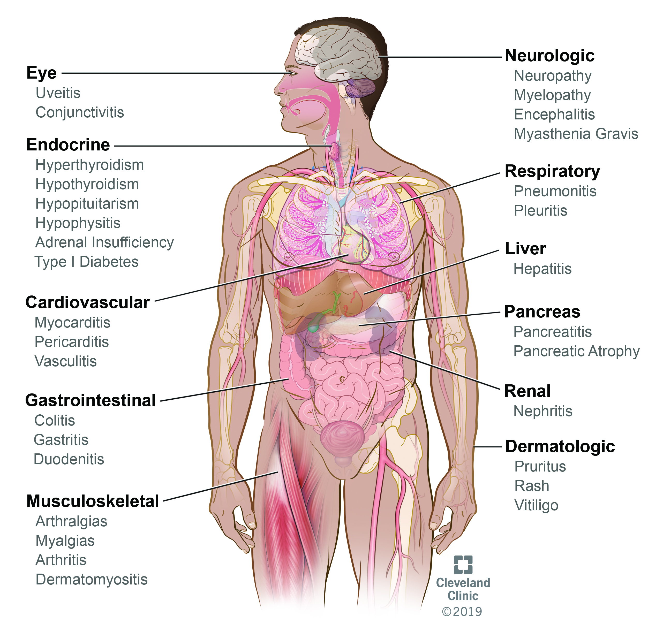
Immune-Related Adverse Events (irAEs)
Image courtesy of the Cleveland Clinic.

Slide 42
VEGF-Targeted Therapy
Adverse Events
Abdominal bloating | Hand-foot syndrome
Alopecia | Hypertension
Anorexia | Hypopigmentation of hair and skin
Arthralgias | Mucositis (mostly functional mucositis)
Diarrhea | Myalgias
Dyspepsia | QTc prolongation
Dysphonia | Rash
Fatigue | Taste changes
Flatulence | Weight loss
QTc = heart rate–corrected QT interval.
Cabometyx® prescribing information, 2020; Sutent® prescribing information, 2020;
Votrient® prescribing information, 2020.

Slide 43
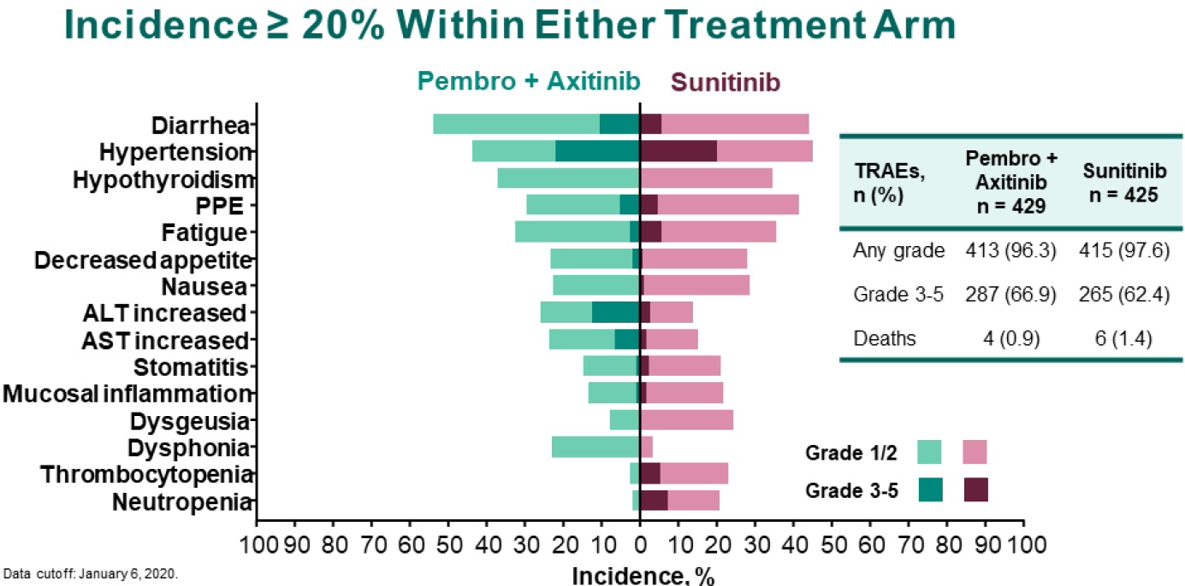
Pembrolizumab/Axitinib vs Sunitinib
Treatment-Related Adverse Events
PPE = palmar-plantar erythrodysesthesia; ALT = alanine aminotransferase; AST = aspartate aminotransferase; TRAE = treatment-related adverse event.
Plimack et al, 2020.

Slide 44
Case Study 2
58-year-old male presents to oncologist’s office
  Works full time in industrial equipment delivery
    Mild fatigue (KPS = 80)
  Partial right nephrectomy 3 years ago for clear cell RCC
  Recent CT scans demonstrate multiple retroperitoneal lymph nodes
  CT chest, bone scan, and CT brain are negative for metastatic disease
  Mild anemia, all other labs within normal limits
  Concomitant medications
    Amlodipine 10 mg for hypertension
IMDC prognostic group?

Slide 45
Case Study 2 (cont.)
3 years since nephrectomy
Works full time: industrial equipment delivery
  Mild fatigue (KPS = 80)
Mild anemia
All other labs within normal limits
Concomitant medications:
  Amlodipine 10 mg for HTN
IMDC prognostic group: intermediate group
HTN = hypertension.

Slide 46
Treatment Options
Observation
High-dose interleukin-2
Ipilimumab/nivolumab
Pembrolizumab/axitinib
Avelumab/axitinib

Slide 47
Treatment Options (cont.)
Observation
High-dose interleukin-2
Ipilimumab/nivolumab
Pembrolizumab/axitinib
Avelumab/axitinib

Slide 48
Treatment Options (cont.)
Pembrolizumab/axitinib
  Pembrolizumab 400 mg IV every 6 weeks
  Axitinib 5 mg twice daily, every 12 hours
Nursing considerations
  Prior authorization/copay costs
  Need for supportive care involvement
    Palliative medicine, social worker
  Patient and caregiver education
IV = intravenous.

Slide 49
Immune-Related Adverse Events (irAEs)
Image courtesy of the Cleveland Clinic.

Slide 50
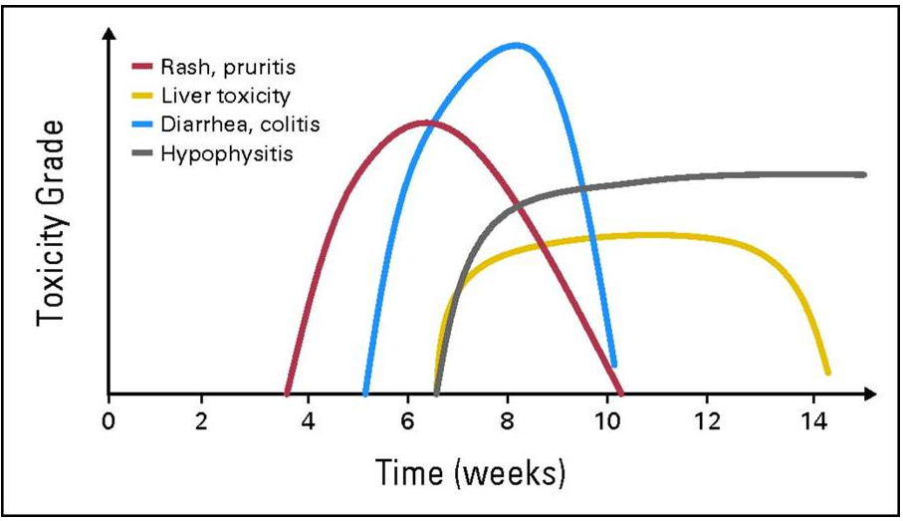
Kinetics of irAE Appearance
Weber et al, 2012.

Slide 51
Axitinib Side Effects
Diarrhea
Hypertension
Fatigue
Decreased appetite
Nausea
Dysphonia/voice changes
Hand-foot syndrome
Inlyta® prescribing information, 2020

Slide 52
Combination Therapy: Overlapping Toxicities
VEGF Targeted Therapy + Immunotherapy
VEGF-Targeted Therapy
Immunotherapy
Rash
Fatigue
Diarrhea
LFT elevations
Hypothyroidism
Anorexia
Altered mental status
Hypertension
Taste changes
Mucositis
Dyspepsia
Myelosuppression
Hand-foot syndrome
Pruritus
Myocarditis
Adrenal insufficiency
Rash
Pneumonitis
Colitis
Hepatitis
RPLS or PRES
Encephalitis
LFT = liver function test; RPLS = reversible posterior leukoencephalopathy syndrome; PRES = posterior reversible encephalopathy syndrome.
Wood & Ornstein, 2020.

Slide 53
VEGF TKIs vs Immunotherapy: Adverse Events
VEGF TKI AEs | Immunotherapy AEs
Almost guaranteed | May never occur
Dose and schedule dependent | Dose and schedule independent
Timing based on drug and schedule | Can occur anytime
May need short course of treatment to resolve | Need treatment to resolve
Type and timing of AE varies greatly
AE = adverse event.
Wood & Ornstein, 2020.

Slide 54
General Guidelines for irAE Management
Early recognition of symptoms and frequent monitoring
Establish correct diagnosis
  Presentation can be subtle
  Other causes must be ruled out
irAEs can become severe and life-threatening if diagnosis and appropriate treatment are delayed
Fecher et al, 2013.

Slide 55
Guidelines for irAE Management
ESMO guidelines
SITC guidelines
ASCO guidelines
  www.asco.org/supportive-care-guidelines
NCCN guidelines
  Management of Immunotherapy-Related Toxicities, Version 1.2020
  www.NCCN.org
ESMO = European Society for Medical Oncology; SITC = Society for Immunotherapy of Cancer; ASCO = American Society of Clinical Oncology.
Haanen et al, 2017; Puzanov et al, 2017; Brahmer et al, 2018; NCCN, 2019.

Slide 56
Goals of irAE Management
Impact of irAEs should be minimized so they do not:
  Progress and lead to poor clinical outcomes by themselves
  Lead to poor outcomes owing to premature or unnecessary treatment discontinuation
  Cause excessive or unnecessary health care utilization and costs
Hoffner et al, 2019.

Slide 57
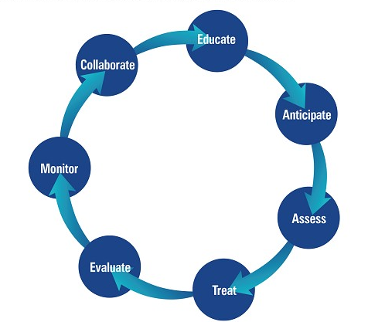
The Seven Pillars of irAE Toxicity Management
Champiat et al, 2016; Wood et al, 2018.

Slide 58
Patient Education
Education: treatment plan, mechanism of action, potential side effects
Patient instructed to call if he develops:
  Any side effects
  Rash or itching
  Fatigue
  Loose or watery stools
Patient instructed to:
  Apply moisturizer daily after his shower
  Use same moisturizer he normally uses
  Purchase loperamide
  Call his oncology nurse if he experiences more frequent bowel movements or looser consistency

Slide 59
CTCAE: Common Terminology Criteria for Adverse Events
Gastrointestinal Disorders
Adverse Event | Grade 1 | Grade 2 | Grade 3 | Grade 4 | Grade 5
Diarrhea: a disorder characterized by frequent and watery bowel movements | Increase of <4 stools per day over baseline; mild increase in ostomy output compared to baseline | Increase of 4-6 stools per day over baseline; moderate increase in ostomy output compared to baseline | Increase of ≥7 stools per day over baseline; incontinence; hospitalization indicated; severe increase in ostomy output compared to baseline; limiting self-care ADL | Life-threatening consequences; urgent intervention indicated | Death
Enterocolitis: a disorder characterized by inflammation of the small and large intestines | Asymptomatic; clinical or diagnostic observations only; intervention not indicated | Abdominal pain; mucus or blood in stool | Severe or persistent abdominal pain; fever; ileus; peritoneal signs | Life-threating consequences; urgent intervention indicated | Death
ADL = activities of daily living.
NCI, 2017.

Slide 60
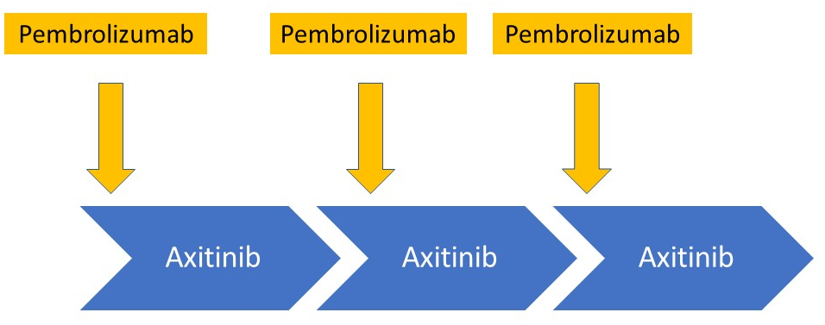
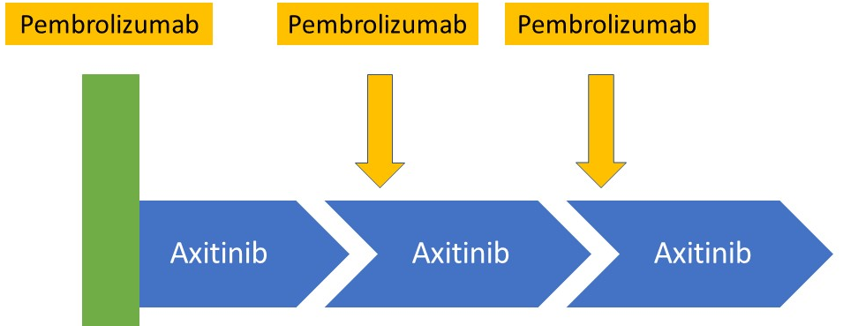
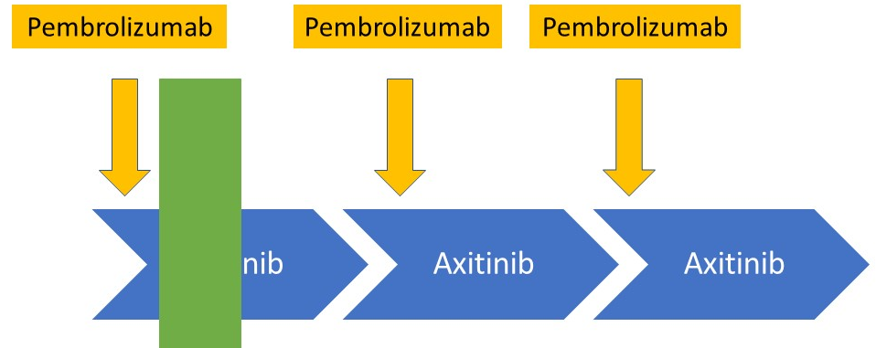
Combination Therapy: AE Management
Wood & Ornstein, 2020.

Slide 61
Improving Clinical Care
Educational needs
  Identify educational needs at ALL levels
  Identify staff to provide education
  Videotape presentations
Identify experts who are interested in irAEs
  Create a referral list
    MDs and APPs
  Multidisciplinary grand rounds
    Collaborative education
APP = advance practice provider.

Slide 62
irAE References
Esfahani K, Meti N, Miller WH, et al (2019). Adverse events associated with immune checkpoint inhibitor treatment for cancer. CMAJ, 191(2):E40-E46. DOI:10.1503/cmaj.180870
Kennedy LB & Salama AKS (2020). A review of cancer immunotherapy toxicity. CA Cancer J Clin, 70(2):86-104. DOI:10.3322/caac.21596
Postow MA, Sidlow R & Hellmann MD (2018). Immune-related adverse events associated with immune checkpoint blockade. N Engl J Med, 378(2):158-168. DOI:10.1056/NEJMra1703481
Hoffner B & Rubin KM (2019). Meeting the challenges of immune-related adverse events with optimized telephone triage and dedicated oncology acute care. J Adv Pract Oncol, 10(suppl_1):9-20. DOI:10.6004/jadpro.2019.10.2.10

Slide 63
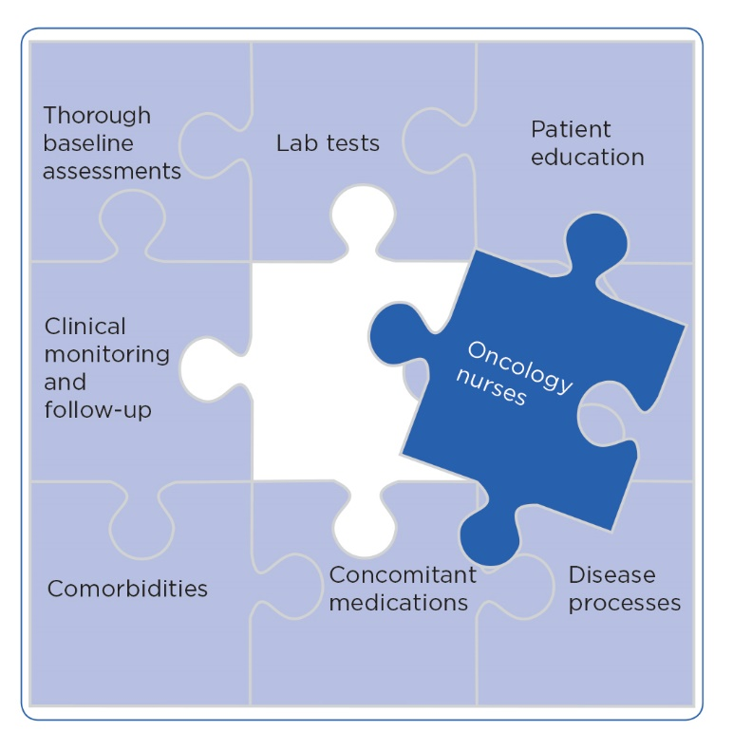
Knowledge Improves Clinical Outcomes and Quality of Life
Image adapted from Wood, 2019.

Slide 64
Key Takeaways
Patient selection is critical when considering cytoreductive nephrectomy in patients diagnosed with synchronous metastatic renal cell carcinoma
Understanding the mechanism of action for VEGF targeted therapies and checkpoint inhibitors (CPI) will assist practitioners in providing appropriate education for patients, caregivers, and clinical staff regarding combination VEGF-CPI treatment regimens
Use of evidence-based guidelines for irAE management can improve clinical outcomes

Slide 65
Scan now to complete the
posttest and evaluation
Thank you joining us!
Scan the QR here or on the front of your i3 Health folder to complete the posttest and evaluation OR use the paper assessment and paper evaluation included in your i3 Health folder
To scan the QR code:
FOR IPHONE:
Open the camera & focus it to QR code
Your internet browser should pop up with a link
Click the link and complete
FOR ANDROID:
Open the camera & focus it to QR code
Hold ‘Home’ button
The pretest comes visible to complete

Slide 66
References
American Cancer Society (2020). Risk factors for kidney cancer. Available at: https://www.cancer.org
Bex A, Mulders P, Jewett M, et al (2019). Comparison of immediate vs deferred cytoreductive nephrectomy in patients with synchronous metastatic renal cell carcinoma receiving sunitinib: the SURTIME randomized clinical trial. Jama Oncol, 5(2):164-170. DOI:10.1001/jamaoncol.2018.5543
Bhindi B, Graham J, Wells JC, et al (2020). Deferred cytoreductive nephrectomy in patients with newly diagnosed metastatic renal cell carcinoma. Eur Urol. [Epub ahead of print] DOI:10.1016/j.eururo.2020.04.038
Bracarda S, Porta C, Sabbatini R, et al (2019). Angiogenic and immunological pathways in metastatic renal cell carcinoma: a counteracting paradigm or two faces of the same medal? The GIANUS review. Crit Rev Oncol Hematol, 139:149-157. DOI:10.1016/j.critrevonc.2018.07.009
Brahmer JR, Lacchetti C, Schneider BJ, et al (2018). Management of immune-related adverse events in patients treated with immune checkpoint inhibitor therapy: American Society of Clinical Oncology Practice Guidelines. J Clin Oncol, 36(17):1714-1768. DOI:10.1200/JCO.2017.77.6385
Cabometyx® (cabozantinib) prescribing information (2020). Exelixis, Inc. Available at: https://www.cabometyx.com/downloads/CABOMETYXUSPI.pdf
Campesato LF & Merghoub T (2017). Antiangiogenic therapy and immune checkpoint blockade go hand in hand. Ann Transl Med, 5(24):497. DOI:10.21037/atm.2017.10.12
Carlo MI, Voss MH & Motzer RJ (2016). Checkpoint inhibitors and other novel immunotherapies for advanced renal cell carcinoma. Nat Rev Urol, 13(7):420-431. DOI:10.1038/nrurol.2016.103
Champiat S, Lambotte O, Barreau E, et al (2016). Management of immune checkpoint blockade dysimmune toxicities: a collaborate position paper. Ann Oncol, 27(4):559-574. DOI:10.1093/annonc/mdv623
Choueiri TK, Motzer RJ, Rini BI, et al (2020). Updated efficacy results from the JAVELIN Renal 101 trial: first-line avelumab plus axitinib versus sunitinib in patients with advanced renal cell carcinoma. Ann Oncol, 31(8):1030-1039. DOI:10.1016/j.annonc.2020.04.010
Choueiri TK, Powles T, Burotto M, et al (2020). Nivolumab + cabozantinib vs sunitinib in first-line treatment for advanced renal cell carcinoma: first results from the randomized phase III CheckMate 9ER trial. Ann Oncol (ESMO Virtual Congress Abstracts), 31(suppl_4):S1142-S1215. Abstract 6960_PR. DOI:10.1016/annonc/annonc325
Choueiri TK, Powles T, Burotto M, et al (2021). Nivolumab plus cabozantinib versus sunitinib for advanced renal-cell carcinoma. N Engl J Med, 384(9):829-841. DOI:10.1056/NEJMoa2026982
de Bruijn R, Wimalasingham A, Szabados B, et al (2020). Deferred cytoreductive nephrectomy following presurgical vascular endothelial growth factor receptor-targeted therapy in patients with primary metastatic clear cell renal cell carcinoma: a pooled analysis of prospective trial data. Eur Urol Oncol, 3(2):168-173. DOI:10.1016/j.euo.2019.12.004
Esfahani K, Meti N, Miller WH, et al (2019). Adverse events associated with immune checkpoint inhibitor treatment for cancer. CMAJ, 191(2):E40-E46. DOI:10.1503/cmaj.180870
Fecher LA, Agarwala SS, Hodi FS, et al (2013). Ipilimumab and its toxicities: a multidisciplinary approach. Oncologist, 18(6):733-743. DOI:10.1634/theoncologist.2012-0483
Haanen JBAG, Carbonnel F, Robert C, et al (2017). Management of toxicities from immunotherapy: ESMO clinical practice guidelines for diagnosis, treatment and follow-up. Ann Oncol, 28(suppl_4):iv119-iv142. DOI:10.1093/annonc/mdx225
Heng DYC, Xie W, Regan MM, et al (2009). Prognostic factors for overall survival in patients with metastatic renal cell carcinoma treated with vascular endothelial growth factor-targeted agents: results from a large, multicenter study. J Clin Oncol, 27(34):5794-5799. DOI:10.1200/JCO.2008.21.4809

Slide 67
References (cont.)
Heng DYC, Xie W, Regan MM, et al (2013). External validation and comparison with other models of the International Metastatic Renal-Cell Carcinoma Database Consortium prognostic model: a population-based study. Lancet Oncol, 14(2):141-148. DOI:10.1016/S1470-2045(12)70559-4
Hoffner B & Rubin KM (2019). Meeting the challenges of immune-related adverse events with optimized telephone triage and dedicated oncology acute care. J Adv Pract Oncol, 10(suppl_1):9-20. DOI:10.6004/jadpro.2019.10.2.10
Hoffner B, Vaughn R, Reed M, et al (2019). The advanced practice provider perspective: treating patients with immuno-oncology combination therapy across tumor types. J Adv Pract Oncol, 10(4):367-386. DOI:10.6004/jadpro.2019.10.4.5
Inlyta® (axitinib) prescribing information (2020). Pfizer Inc. Available at: http://labeling.pfizer.com/ShowLabeling.aspx?id=759
Kennedy LB & Salama AKS (2020). A review of cancer immunotherapy toxicity. CA Cancer J Clin, 70(2):86-104. DOI:10.3322/caac.21596
Ko JJ, Xie W, Kroeger N, et al (2015). The International Metastatic Renal Cell Carcinoma Database Consortium model as a prognostic tool in patients with metastatic renal cell carcinoma previously treated with first-line targeted therapy: a population-based study. Lancet Oncol, 16(3):293-300. DOI:10.1016/S1470-2045(14)71222-7
McIntosh AG, Umbreit EC, Holland LC, et al (2020). Optimizing patient selection for cytoreductive nephrectomy based on outcomes in the contemporary era of systemic therapy. Cancer, 126(17):3950-3960. DOI:10.1002/cncr.32991
Méjean A, Ravaud A, Thezenas S, et al (2018). Sunitinib alone or after nephrectomy in metastatic renal-cell carcinoma. N Engl J Med, 379(5):417-427. DOI:10.1056/NEJMoa1803675
Motz GT & Coukos G (2013). Deciphering and reversing tumor immune suppression. Immunity, 39(1):61-73. DOI:10.1016/j.immuni.2013.07.005
Motzer RJ, Rini BI, McDermott DF, et al (2019). Nivolumab plus ipilimumab versus sunitinib in first-line treatment for advanced renal cell carcinoma: extended follow-up of efficacy and safety results from a randomized, controlled, phase 3 trial. Lancet Oncol, 20(10):1370-1385. DOI:10.1016/S1470-2045(19)30413-9
Motzer RJ, Tannir NM, McDermott DF, et al (2018). Nivolumab plus ipilimumab versus sunitinib in advanced renal-cell carcinoma. N Engl J Med, 378:1277-1290. DOI:10.1056/NEJMoa1712126
National Cancer Institute (2017). Common Terminology Criteria for Adverse Events. Version 5.0. Available at: https://ctep.cancer.gov/protocolDevelopment/electronic_applications/docs/CTCAE_v5_Quick_Reference_5x7.pdf
National Comprehensive Cancer Network (2019). Clinical Practice Guidelines in Oncology: management of immunotherapy-related toxicities. Version 1.2020. Available at: http://www.nccn.org
National Comprehensive Cancer Network (2021). Clinical Practice Guidelines in Oncology: kidney cancer. Version 3.2021. Available at: https://www.nccn.org/professionals/physician_gls/pdf/kidney.pdf
National Cancer Institute Surveillance, Epidemiology, and End Results Program (2020). Cancer stat facts: kidney and renal pelvis. Available at: https://www.seer.cancer/gov
Plimack ER, Rini BI, Stus V, et al (2020). Pembrolizumab plus axitinib versus sunitinib as first-line therapy for advanced renal cell carcinoma (RCC): updated analysis of KEYNOTE-426. J Clin Oncol (ASCO Virtual Scientific Program Abstracts), 38(suppl_15). Abstract 5001. DOI:10.1200/JCO.2020.38.15_suppl.5001

Slide 68
References (cont.)
Postow MA, Sidlow R & Hellmann MD (2018). Immune-related adverse events associated with immune checkpoint blockade. N Engl J Med, 378(2):158-168. DOI:10.1056/NEJMra1703481
Puzanov I, Diab A, Abdallah K, et al (2017). Managing toxicities associated with immune checkpoint inhibitors: consensus recommendations from the Society for Immunotherapy of Cancer (SITC) Toxicity Management Working Group. J Immunother Cancer, 5(1):95. DOI:10.1186/s40425-017-0300-z
Rini BI, Plimack ER, Stus V, et al (2019). Pembrolizumab (pembro) plus axitinib (axi) versus sunitinib as first-line therapy for metastatic renal cell carcinoma (mRCC): outcomes in the combined IMDC intermediate/poor risk and sarcomatoid subgroups of the phase 3 KEYNOTE-426 study. J Clin Oncol (ASCO Annual Meeting Abstracts), 37(suppl_15). Abstract 4500. DOI:10.1200/JCO.2019.37.15_suppl.4500
Rini BI & Small EJ (2005). Biology and clinical development of vascular endothelial growth factor-targeted therapy in renal cell carcinoma. J Clin Oncol, 23(5):1028-1043. DOI:10.1200/JCO.2005.01.186
Shuch B, Bratslavsky G, Linehan WM, et al (2012). Sarcomatoid renal cell carcinoma: a comprehensive review of the biology and current treatment strategies. Oncologist, 17(1):46-54. DOI:10.1634/theoncologist.2011-0227
Sutent® (sunitinib malate) prescribing information (2020). Pfizer Inc. Available at: http://labeling.pfizer.com/showlabeling.aspx?id=607
Votrient® (pazopanib) prescribing information (2020). Novartis Pharmaceuticals Corporation. Available at: https://www.novartis.us/sites/www.novartis.us/files/votrient.pdf
Weber JS, Kähler KC & Hauschild A (2012). Management of immune-related adverse events and kinetics of response with ipilimumab. J Clin Oncol, 30(21):2691-2697. DOI:10.1200/JCO.2012.41.6750
Wiesener MS, Münchenhagen PM, Berger I, et al (2001). Constitutive activation of hypoxia-inducible genes related to overexpression of hypoxia-inducible factor-1alpha in clear cell renal carcinoma. Cancer Res, 61(13):5215-5222.
Wood LS (2018). Immune-related adverse events: advances in the management of immunotherapy treatments. ASCO-SITC Clinical Immuno-Oncology Symposium Daily News. Available at: dailynews.ascopubs.org
Wood LS (2019). Immune-related adverse events from immunotherapy: incorporating care step pathways to improve management across tumor types. J Adv Pract Oncol, 10(suppl 1):47-62. DOI:10.6004/jadpro.2019.10.2.13
Wood LS & Ornstein MC (2020). Toxicity management of front-line pembrolizumab combined with axitinib in clear cell metastatic renal cell carcinoma: a case study approach. JCO Oncol Practice, 16(suppl_2):15s-19s. DOI:10.1200/JOP.19.00647

