Slide 1
Paediatric / Youth Violence
Accident and Emergency Provision

Slide 2
St. Giles Trust
UK based charity embracing the power of lived experience in everything we do.
We are a UK wide organization working across 4 key regions and with other organizations to help us have a much bigger impact on the lives of those we help.

Slide 3
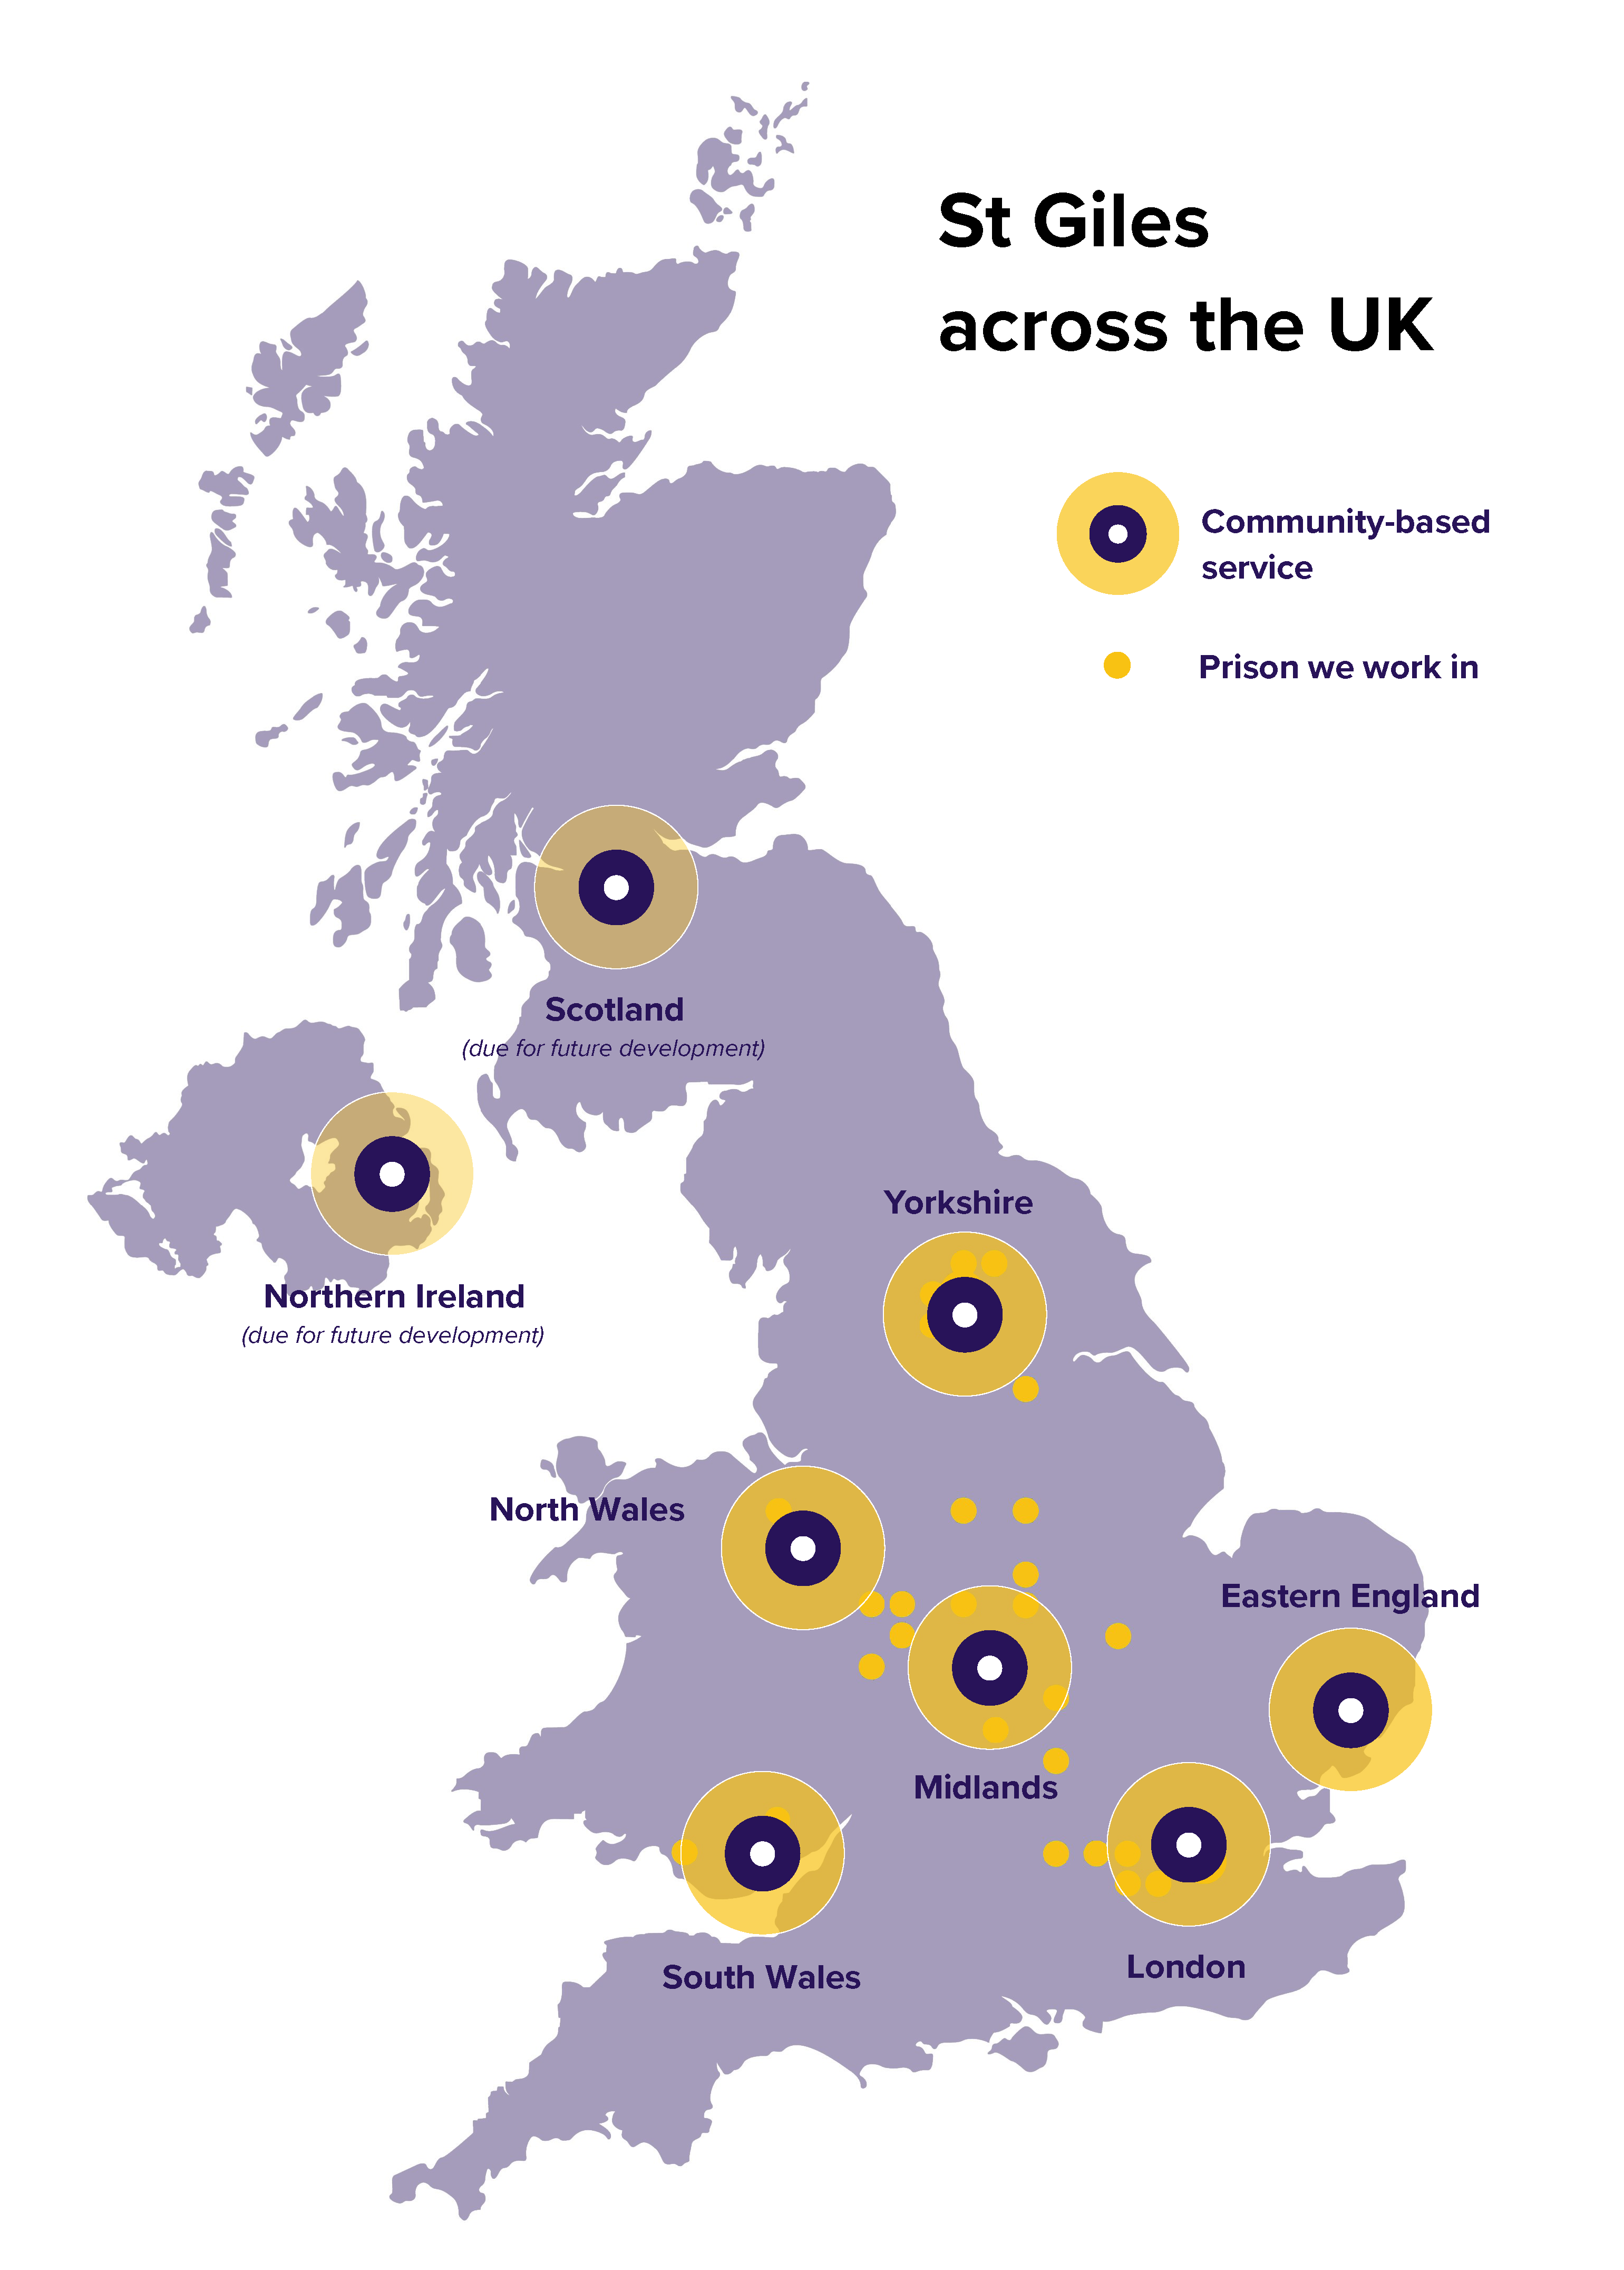
Within the Midlands:
Peer Advisor Hub
Expect Respect (Girls Project)
Gangs Young Adults Resettlement Service
County Lines
SOS+ school early intervention
Power 2 Wolverhampton
Prison Peer Advisor Programme
A&E Youth Violence Services
Missing Return Home Service

Slide 4
St Giles Hospital Projects
2004 to 2008 - Kings College Homelessness
2010 to date – Pathways (bed blocking) Project at Kings, St Thomas’, Guys and Maudsley
2015 to date – Royal London MTC
2019 to date – Coventry and Wolverhampton
2019 to date – Cardiff
2019 to date - Wakefield Hospital
2020 to date - Newham and Whittington
2021 to date – Dudley Hospital

Slide 5
The offer
Support to 11- 25 year olds
Reachable Moment
Contextual safeguarding
Multi-agency focused
1:1 Community mentoring
Debunk myths
Not time bound

Slide 6
Our staff
Lived experience
Cultural competence
Credible
Engaging
Understand Young People
Trust & respect
Positive role model
Passion
Convicted murderer Sadam Essakhil speaks on life-ruining consequences of carrying a knife - Bing video

Slide 7
The Result
Reductions in A&E, offending, gang activity/serious youth violence
Improved knowledge of consequences, health & lifestyle, confidence
Self-esteem and ability to say ‘no’
Improved family relationships
more positive leisure and sport activities

Slide 8
Case study
C.C is 16 year old boy who was referred to following a drug induced psychosis due to past trauma. C.C is a young person who grew up without a father, didn’t have a great relationship with his mother and got involved in the wrong crowd. He had previously been arrested for violence, smoking cannabis and last year three of his friends were sentenced for murder. His relationship with his mother was difficult. I started mediation sessions between mum and C.C to help them build their relationship. These sessions have helped them to have an amazing relationship and communicate effectively.

Slide 9
Outcome
I supported C.C to get a local college which had a football programme. C.C has kept out of trouble and is currently re-doing his GCSE English and Maths and working towards level 3 Extended Diploma in Sport and Exercise. We have been able to support C.C in purchasing a new laptop so that he can continue to do his college work and have paid for additional football training sessions within an academy to better his performance overall. Our intervention was timely to C.C in preventing him continuing a life of violence and poor relationship with his mother.

Slide 10
Interventions delivered
Culturally competent staff
Timely intervention at ‘Reachable Moment’
1-1 focused intervention, action planning and advocacy working with detached services
Signposting to external agencies
Presence in University Coventry & Warwickshire Emergency Department
Monday – Friday; 9AM until 5:30PM

Slide 11
Community interventions delivered
Client focused
Caseworkers with lived experience
Practical & emotional support
Go to them
Not enforcement
Challenge & debunk myths
Link to support agencies
Activity based
Safe spaces
Trauma informed
Support for family, siblings, associates
Flexible approach

Slide 12
ACTIVITY

Slide 13
Lowe It
Cunch
Strap
Food
Fam
Shook
Bando
Bare
Bait
Whip
Flippin chicken
OT
Lucy

Slide 14
Referral routes
Peter Walker
peter.walker2@uhcw.nhs.uk
M: 07770 013622
Stgiles@uhcw.nhs.uk
Bleep: 5388
Our office is based within A&E

Slide 15
Any questions?

