Slide 1

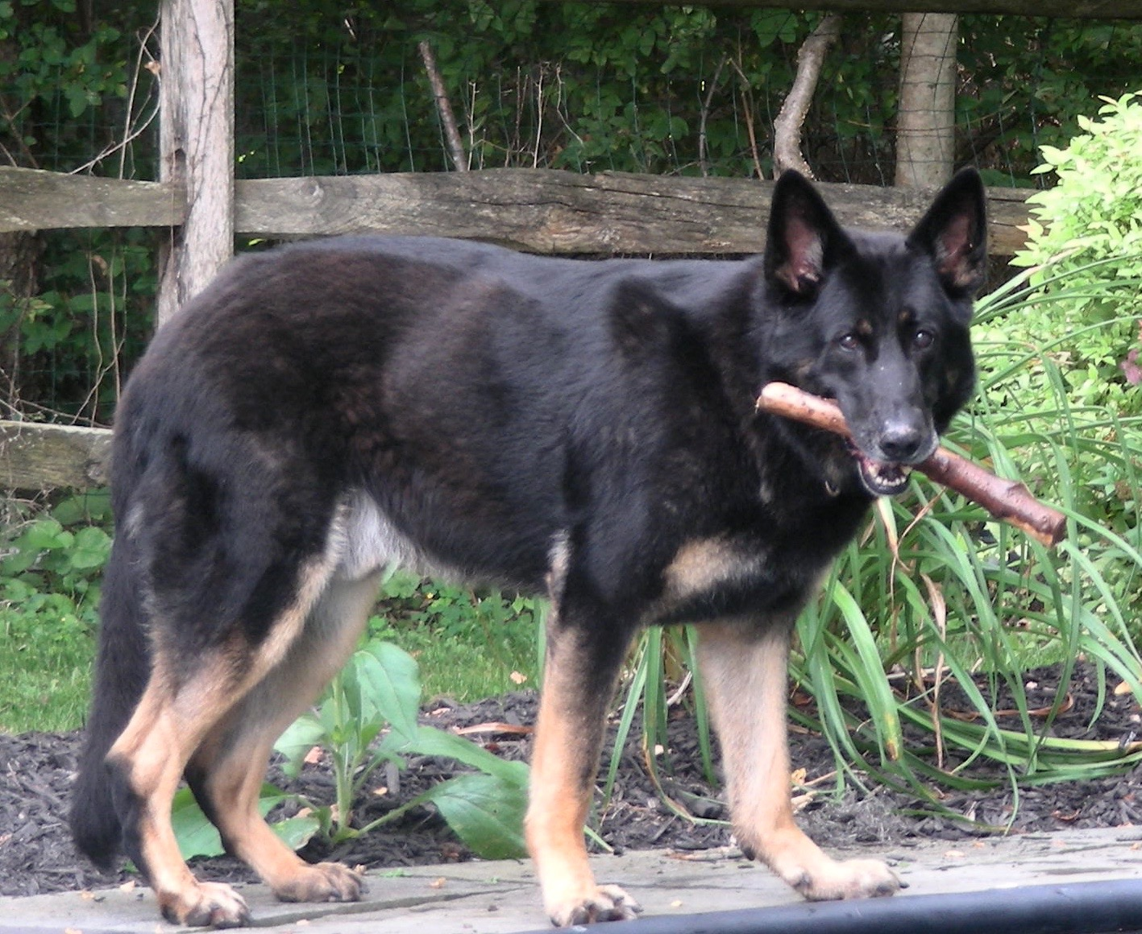
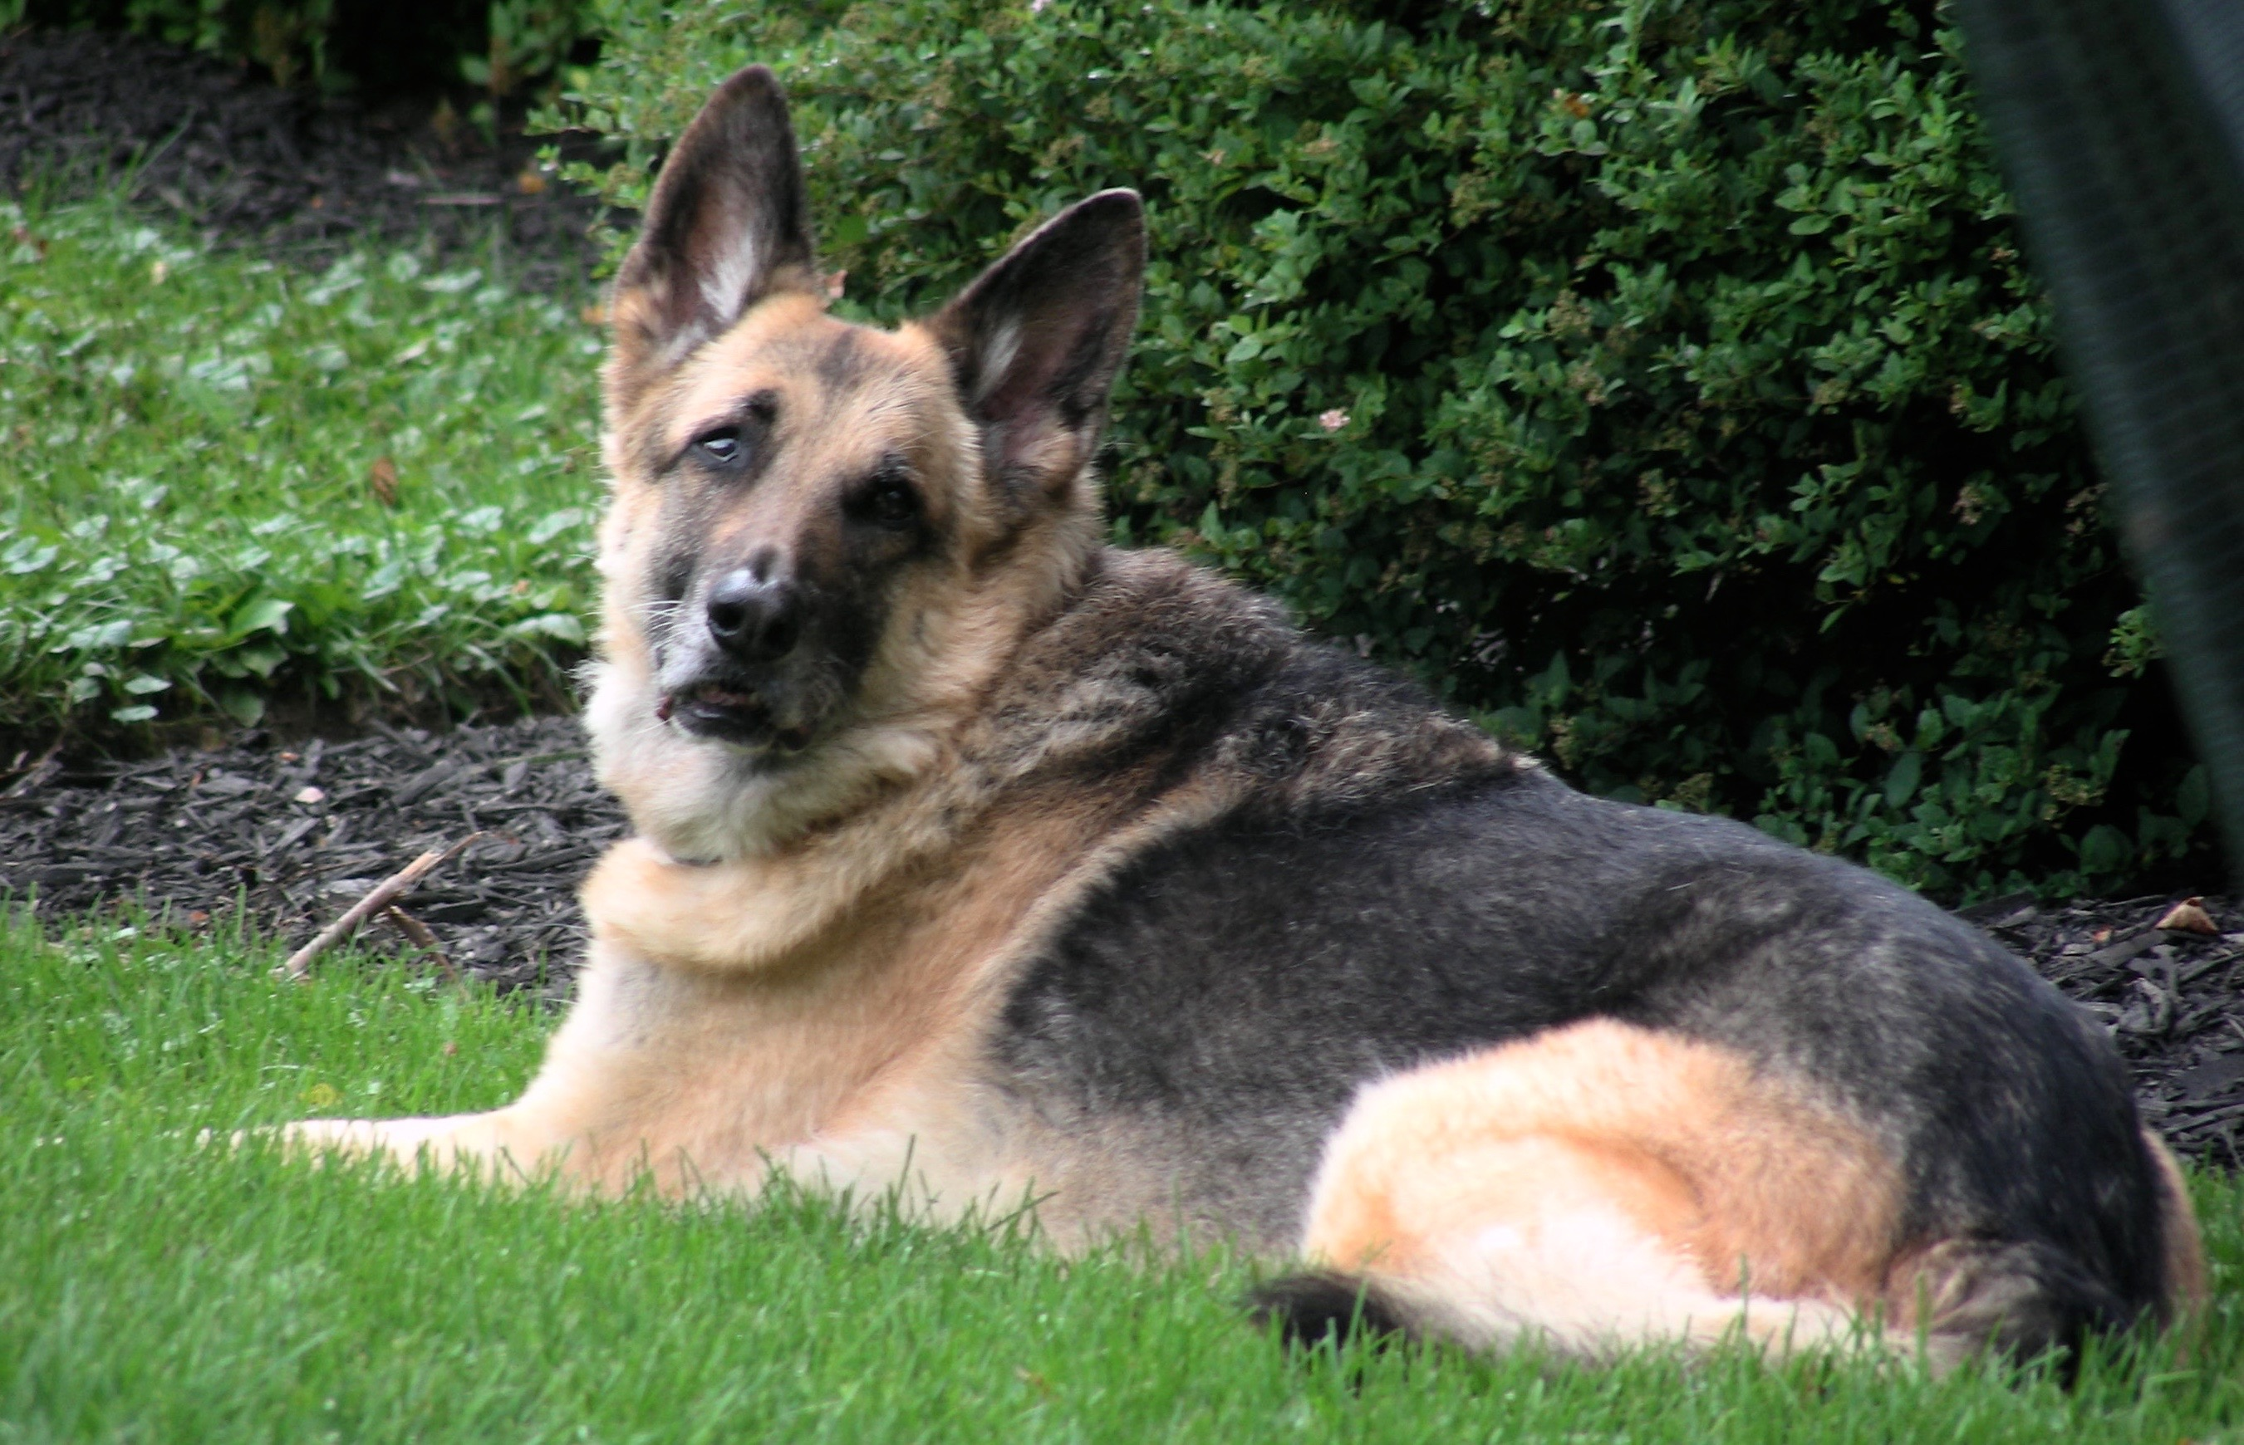
Emergency Pet Sheltering for MRC Volunteers: Level 2
Max
Sadie
Prepared and Presented by:
Lisa C. Kaufman, ATR-BC, LADC1
Behavioral Health, Emergency Preparedness Consultant
Preparedness Specialty Services

Slide 2


Acknowledgements
This training program was funded (2013) through a National Association of County & City Health Officials Capacity Building Award
The program was made possible through the collaboration between (2013) The Brockton Area Medical Reserve Corps , The City of Brockton Animal Inspector, Lisa Kaufman and the State of Massachusetts Animal Response Team

Slide 3
Collaborating Partners
2025 Partners for Update
  Deb Goodwin Handler, Berkshire County MRC Canine Support Team
  Liisa Jackson
  Regional Medical Reserve Corps Coordinator
  Lisa C. Kaufman ATR-BC, LADC1 Behavioral Health, Emergency Planning Consultant Preparedness Specialty Services
  David J. Schwarz, D. V. M. State of Massachusetts Animal Resource Team

Slide 4
Prepare, Coordinate, Educate.
Building local capacity for animal response
State of Massachusetts Animal Resource Team is a network of organizations, agencies and individuals committed to responding to the needs of the animal population in disaster situations throughout Massachusetts
SMART’s Mission: To be a key resource in Massachusetts by establishing best practices for animal emergency preparedness. Through training and education, SMART assists in the development of disaster animal response teams, both locally and regionally, in an effort to strengthen capabilities throughout the state.

Slide 5
Emergency Pet Sheltering for MRC Volunteers, Level 2
Modeled on Best Practices and Plans developed by:
  State of Massachusetts Animal Response Team (SMART)
  The Humane Society of the United States
  The Center for Disease Control: Emergency Preparedness and Response, Disaster Information for Pet Shelters

Slide 6
Why Collaborate?
Standardization of skills for the safety of the volunteers and the pets
Create a cache of volunteers who are trained with standardized, identifiable skill sets
Provide skills that are transferable/adaptable to Local plans
Training levels and skills sets are based on the SMART Pet Shelter Plan*
* http://smartma.org/wp-content/uploads/2011/09/SMART-Shelter-Manual-5-25-14-.pdf

Slide 7
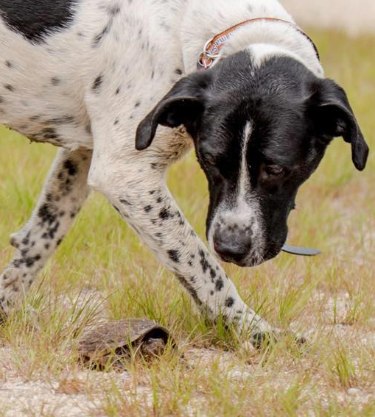
Emergency Pet Sheltering for MRC Volunteers:
Level 1: a QUICK Review
Ollie

Slide 8
Emergency/Disaster Pet Shelter Volunteer, Level 1

Slide 9

For the Safety of the Owners and their Pets, All Level 1 Volunteers are responsible for enforcing the Emergency/Disaster Pet Shelter Rules
True
False
Unsure
True

Slide 10
The ______ Act of 2006 requires state and local emergency preparedness operational plans to take into account the needs of individuals with Household Pets and Service Animals by providing on site shelter for all household animals
SHELTER
ADA
PETS
PETS
Pets Evacuation and Transportation Standards Act

Slide 11
When assisting a Pet Owner, a Level 1 Volunteer may not be in charge of a leashed or caged animal.
True
False
Unsure
True

Slide 12
Comfort, Crisis Response and Therapy Animals will remain with their owners during the day, but will be caged in the Emergency Pet Shelter at night
Depends on Local Protocols
True
False
False
& Depends on Local Protocols
What about Service Animals?

Slide 13
The SMART Emergency Pet Shelter plan and forms, and Level 1 & Level 2 trainings have been adopted Nationwide
True
False
Unsure
False

Slide 14
Training & Objectives
Level 2
To be a Level 2 Emergency Pet Shelter Volunteer you must:
  Be a credentialed member of a recognized Volunteer Organization
  Have completed NIMS 700, ICS 100 or a local Volunteer organization approved ICS training
  Have completed Emergency Pet Sheltering for MRC Volunteers: Level 1
  Learn how to assist the Owners with the care, safety and security of their Pets
  Learn the appropriate level of interactions with Owners and their Pets
  Understand the role of an Emergency/Disaster Pet Shelter Levels 1 & 2 Volunteer
  Satisfactorily complete the Level 2 training quiz

Slide 15
Please Note
All Informational Links, Downloadable Materials, and Additional Suggested Trainings have been made available at:
Emergency Pet Sheltering For Medical Reserve Corps Volunteers, Levels 1 & 2
www.mrcvolunteer.org/emergency-pet-sheltering.html

Slide 16
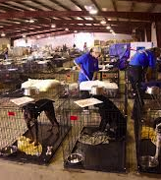
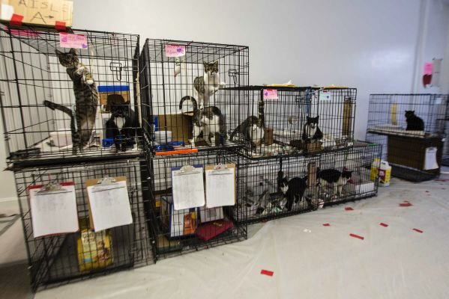
Emergency Pet Sheltering
Level 2
Trained Level 1 & 2 volunteers are needed for ALL shifts
  People & their pets arrive at shelters at all hours of the Day & Night!
Incident Command System
Job Action Sheets
  Level 1
  Level 2

Slide 17
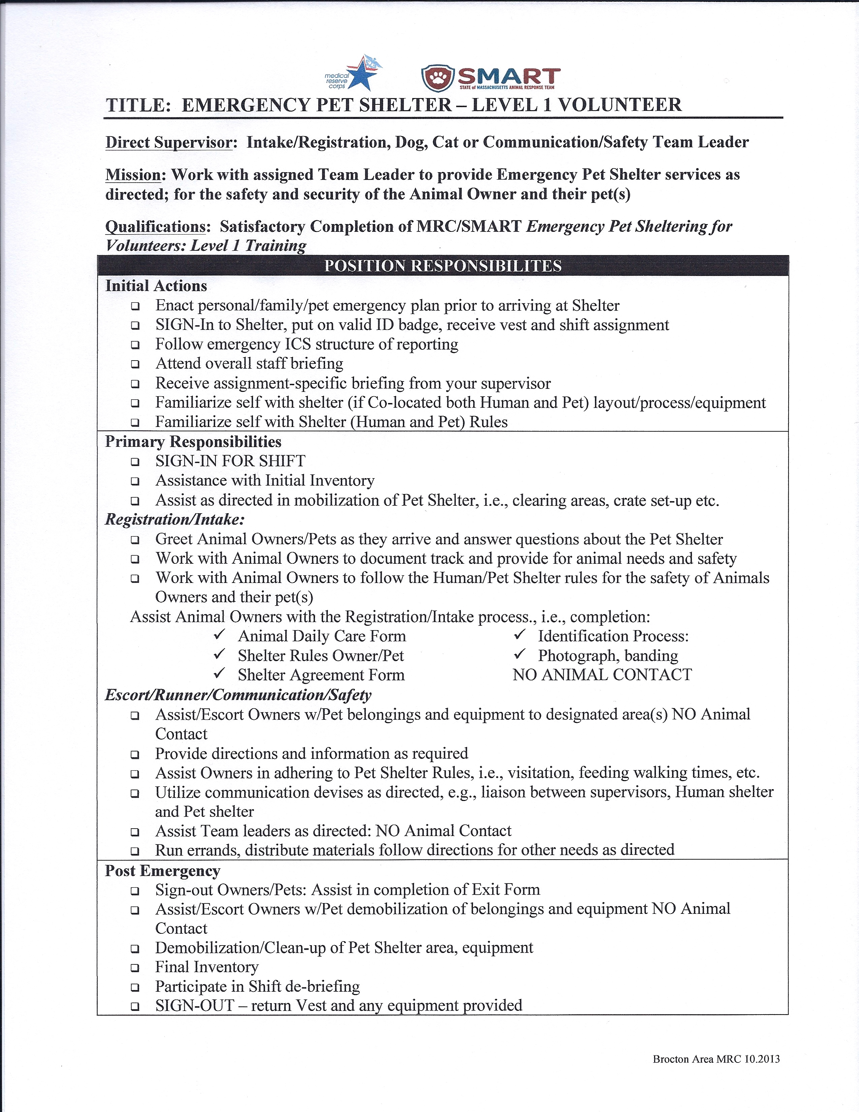
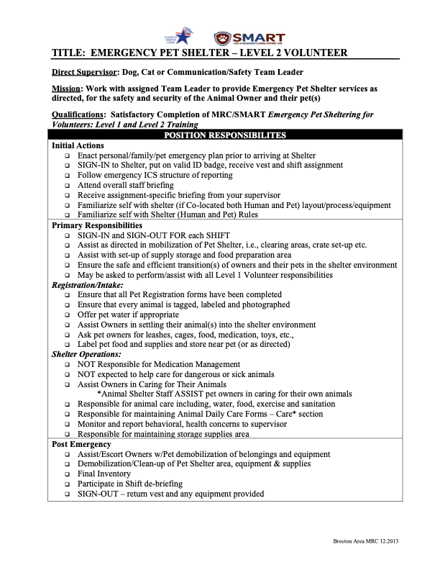
Emergency Pet Sheltering for
MRC Volunteers: Level 2
Level 2 Responsibilities
ICS & Job Action Sheets
  All of the Responsibilities of Level 1 Volunteers
  Assist in tagging and locating Animals and their equipment
  Assist Owners in caring for their Animals
  Responsible for Animal Care, Cage Maintenance & Animal Daily Care Forms
  Monitor & Report behavioral or health concerns

Slide 18
Health Risks Associated with NOT Providing Emergency Shelter for Household Pets
Psychopathologies such as grief, depression, and posttraumatic stress disorder are associated with pet abandonment during an evacuation
Health care workers may refuse to work if their animals are in danger, leaving medical facilities, and emergency shelters understaffed during crises
Zoonotic disease risk increases when pets are abandoned or left to roam, where they are more likely to encounter infected wildlife or unowned animals than they would if they were safely sheltered with their owners
Evacuation of Pets During Disasters: A Public Health Intervention to Increase Resilience
Robin Chadwin, DVM, https://www.ncbi.nlm.nih.gov/pmc/articles/PMC5551593/

Slide 19
Pets, Emergency Sheltering and Health Concerns
Anxiety around or fear of animals
  Zoophobia is the fear of animals. Some people with zoophobia fear all animals, while others are afraid of one specific animal
Allergies
  People can react to substances in animals e.g., hair, dander, saliva
  Common reactions can include, itchy eyes, stuffy nose, hives and sneezing
Zoonotic Disease
  Infectious illnesses that spread between animals, as well as between animals and humans
  Zoonotic diseases spread through contact with infected body fluids, animal bites, contaminated water and eating infected meat
Cleveland Clinic, Zoophobia: https://my.clevelandclinic.org/health/diseases/22727-zoophobia-fear-of-animals
Cleveland Clinic, Pet Allergies: https://my.clevelandclinic.org/health/diseases/17702-pet-allergies
Cleveland Clinic, Zoonotic Disease: https://my.clevelandclinic.org/health/diseases/zoonotic-diseases

Slide 20
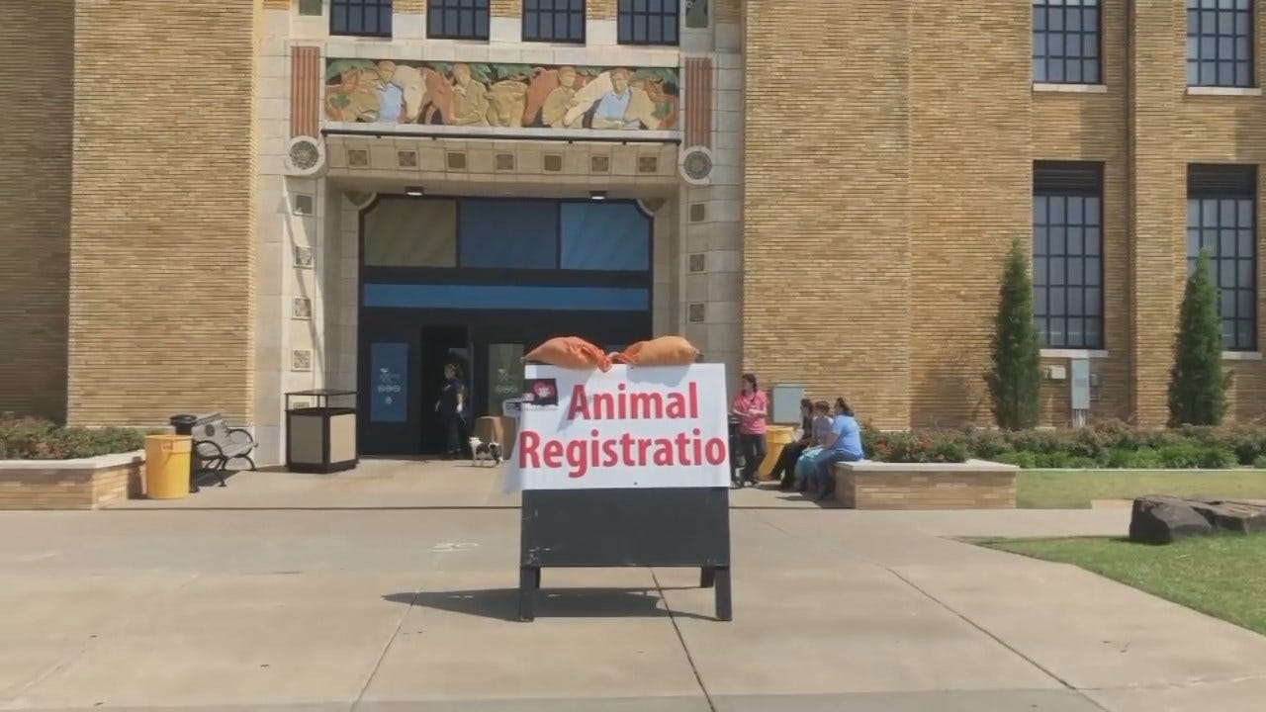
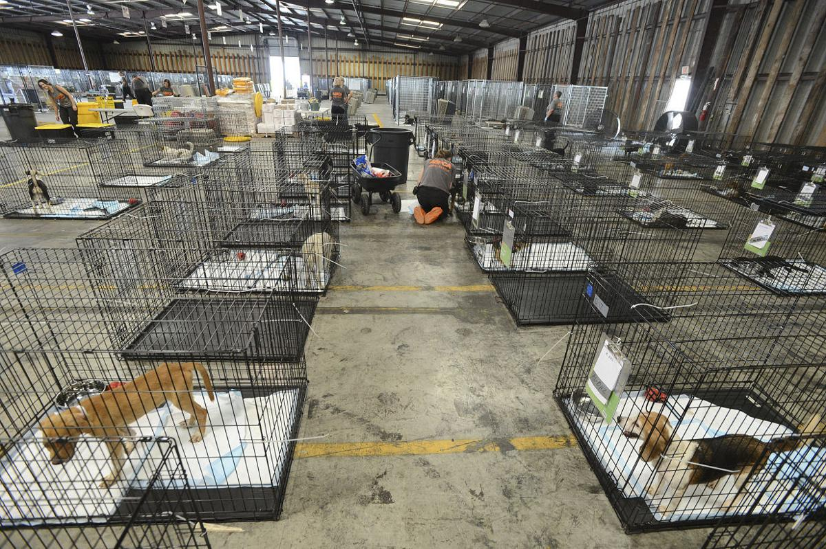
Mobilization: Set-up
Tasks will be pre-determined
    Follow ICS and the Local Plan
Just In Time Training
  Job Action Sheets
  Local Tagging, Identification Procedures
Set-up, Inspection, Organization
  Animal Accommodations
  Animal Supply/Storage Area
Supplies
  Storage & Food Preparation areas
  Inventory, Distribution
Notes:
Level 1 Slide #

Slide 21

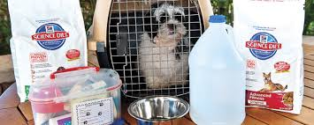

What to Expect
What kind of pets?
  Household Pets: dog, cat
  Exotic Pets: birds, reptiles, gerbils, hamsters, etc., ???
Level 1 & 2 Volunteers are NOT responsible for caring for Exotic Pets
  What is the local plan for exotics?
What will Pets & Owners be bringing with them?
  Proof of Vaccination/Medical Records
  Food, Medication, Cage, leash
  Nothing!?!?!?
Do you have a plan for your pets??

Slide 22
Level 2 Volunteer Responsibilities
All of the responsibilities of Level 1 Volunteers
Assist with set-up of supply storage and food preparation area
Ensure the safe and efficient transition(s) of owners and their pets in the shelter environment
Assist Owners in caring for their Animals
Responsible for Animal Care, Cage Maintenance & Animal Daily Care Forms
MRC Pet Shelter Volunteers are NOT expected to medicate animals
MRC Pet Shelter Volunteers are NOT expected to help care for dangerous or sick animals

Slide 23
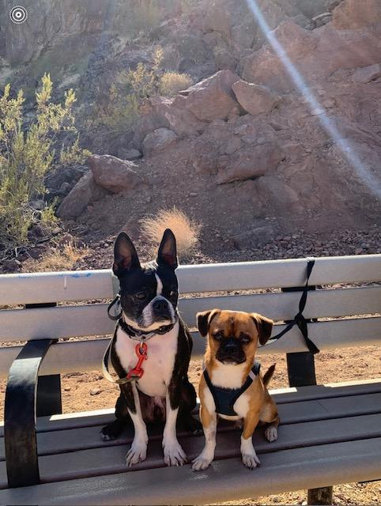
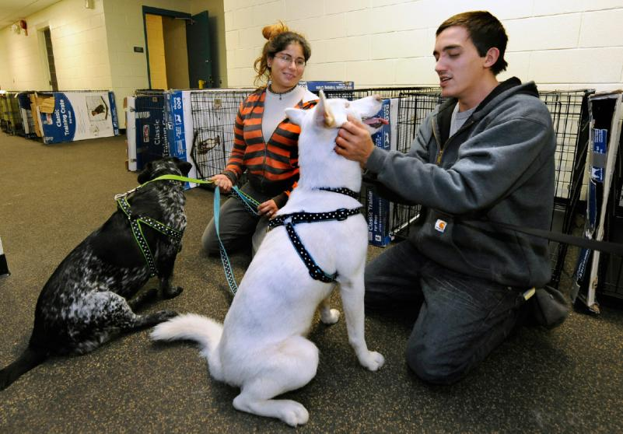
Welcoming the Pets & Owners
Always be aware of how you are communicating with Pet Owners
  Sheltering is stressful for the Owner and the Pet(s)
Ensure:
  All Forms have been completed
  All Pets & Owners are tagged and photographed*
    A match for Pet(s) and Owner ID
Gather and label all leashes, cages, food, medication, toys ?, etc.
Sammy & Churro
* Tagging procedures & methods may vary by Location, follow all Local standards

Slide 24
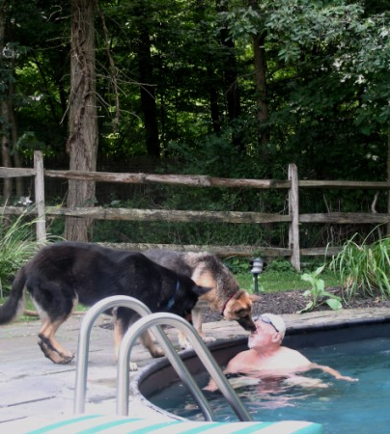

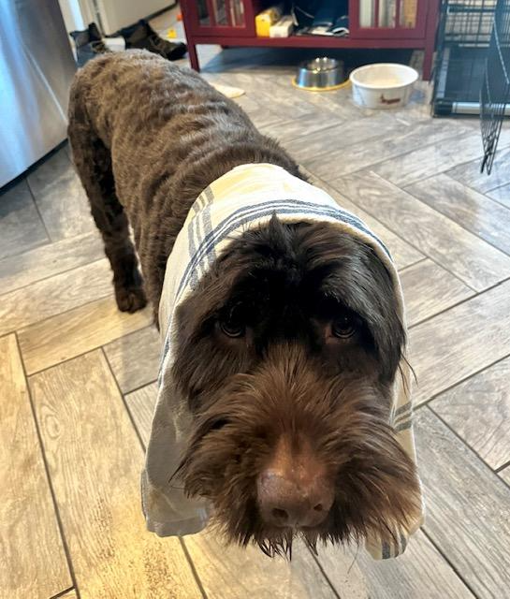
How to Greet Dogs
Max & Sadie
Oliver

Slide 25
Day-to-Day Operations
Assist Pet Owners in Caring for their Animals
    Checking owner/pet bands
    Ensure use of Owner/Pet supplies
      Provide supplemental supplies as directed
    Assist Owners/Pets in settling into environment
      Initial event as well as pre-post walking, feeding etc.
Maintain Animal Daily Care Forms *
  Cage Maintenance
Monitor and report behavioral, health concerns to supervisor
Provide ONLY Authorized Information and updates to Owners
*Forms may vary based on Local Emergency Pet Shelter Plans

Slide 26
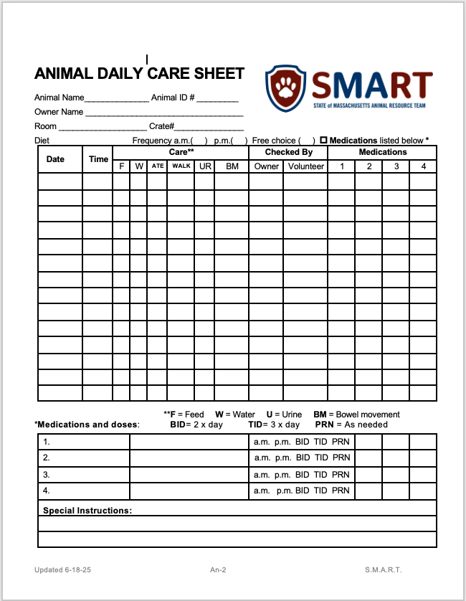
Animal Daily Care Form*
For Co-Located & Temporary Shelters
Each Pet has it’s own Daily Care Sheet
  Care Section
    Volunteer must review to make sure notation is made for each Care item
  Medications Section
    Volunteers are NOT responsible for delivering medication
    Volunteer must review to make sure all medication delivery is noted
* Forms, may vary based on Local Emergency Pet Shelter Plans

Slide 27
Animal Handling Safety Skills
In a Co-Located and Co-Habitated Emergency Pet Shelters:
  The care of the pet is mainly the responsibility of the pet owner
  The Volunteers are there to ASSIST
Animal Shelter Volunteers are NOT expected to help care for dangerous or sick animals
Good animal handling skills prevent staff, volunteers and the animal(s) from being injured
Good animal handling skills reduce stress for the animal and the owner!
Treat both the Pet Owner and the Pet(s) in a respectful manner

Slide 28
Animal Handling Do’s and Don’ts
DO:
DON’T:
Concentrate on the pet you are handling
Take a moment to assess the dog or cat you are about to interact with
  Look over the daily Animal Care Sheet
  Read any pertinent notations
Be prepared to protect yourself
Wash your hands! Before & after working with an animal
Remember the Shelter can be a stressful environment
If you are ever uncomfortable with your assignment or an animal, speak with your supervisor
Put your face directly into the face of a dog or cat
Sit on the floor while handling a dog
Attempt to handle an aggressive animal
Yell or scream at an animal
Stare a dog down
Reach into a cat crate
Provide ANY medication or medical attention

Slide 29
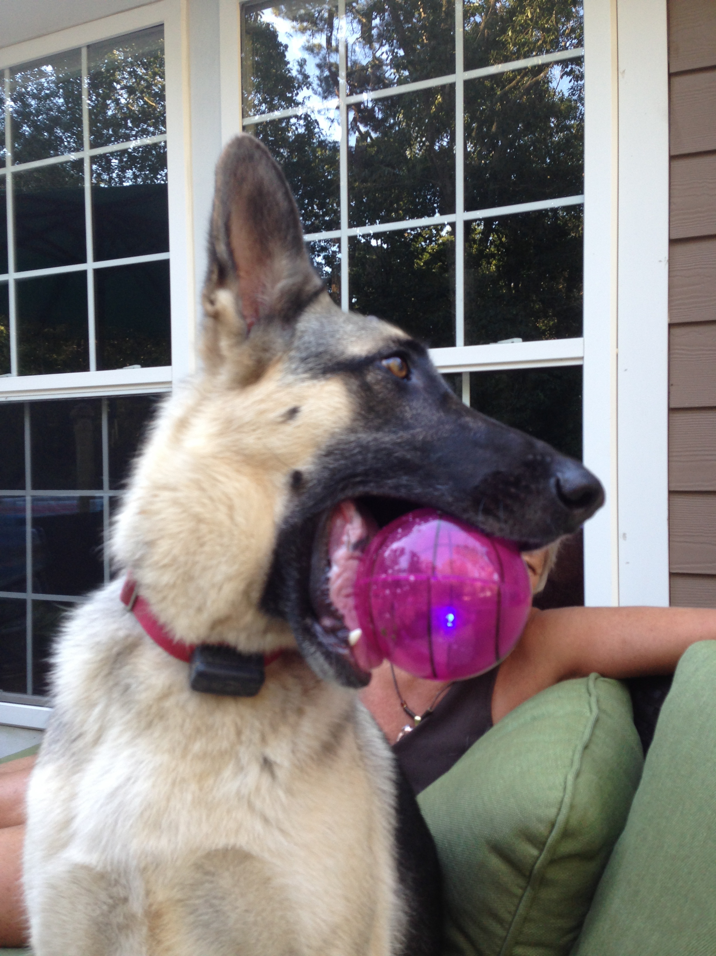
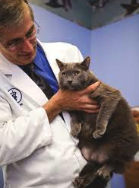


Hands-On Experience!
We strongly recommended that you get some hands-on, non-emergency experience with animals
Find out what training or volunteer opportunities are available with:
  SMART or Your local DART
  Local and Regional MRC Units
  Your Local/Regional Animal Shelter
  Your Local Veterinary Clinic
  Please document any experience(s) and share with your MRC Coordinator
Izzy
Jacky & Dove © Sofia Ludwig

Slide 30

Personal Protective Equipment
First line in Personal Protective Equipment (PPE) is:
  HANDWASHING
  Gloves may be used when handling animals, feeding and cleaning cages
  Removing gloves properly insures your health and safety, and that of the pets you are caring for
Always WASH YOUR HANDS before and after working with an animal

Slide 31
Communications
Always be aware of how you are communicating with Pet Owners and their pet(s)
  Sheltering can cause stress for the Owners & the Animals
Know your ICS
  Know who you’re reporting to - Chain of Command
Level 2 Volunteers may be asked to:
  Do anything a Level 1 Volunteer is asked to do
  Have direct communication with a pet owner
        Monitor supply needs and animal health & behavior concerns, to report to supervisor

Slide 32
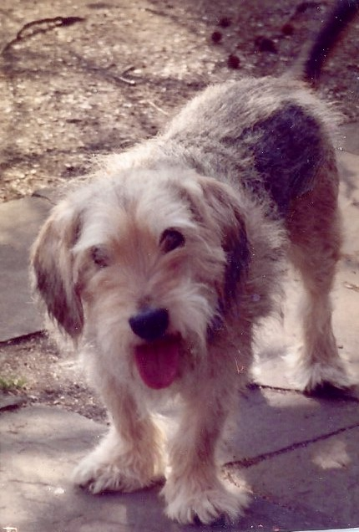
Demobilize*
Assist Owners & Pets as necessary to complete a smooth transition out of the Shelter
  Gathering all belongs
  Checking owner/pet/belongings tags
  Helping Owners in transporting their pet(s) and pet belongings out of the Shelter environment
  Breaking down the Pet Shelter
    Closing procedures
    Clean-up Pet Shelter area, equipment & supplies
      PPE
    Final Inventory
    Shift de-briefing
Jazz
*Scope, Methods and Management may differ from SMART plan and be based on Local Emergency Pet Sheltering Plans

Slide 33


LOCAL Plans
As Volunteers, we need to be ready to respond, but we first need to make sure our family is prepared and safe:
  Do you have a plan and/or a go-kit for yourself, your family and family pets?
  https://www.avma.org/sites/default/files/2023-11/aph-save-the-whole-family-pets.pdf
  Do you know where your local or regional Emergency/Disaster is?
    Do they have a plan for household pets?
      Does it include provisions for health concerns, for guests and animals?
https://www.ready.gov/pets
https://www.ready.gov/plan

Slide 34
Personal & Local Plans for Large Animals
Do you have Large animals or Livestock?
  Local Animal Emergency/Disaster Shelters plans typically do not include either
  Make sure YOU have a plan. A good resource is:
https://www.avma.org/resources/pet-owners/emergencycare/large-animals-and-livestock-disasters
Check with your local Emergency Management Agency to see what their plan(s) are

Slide 35
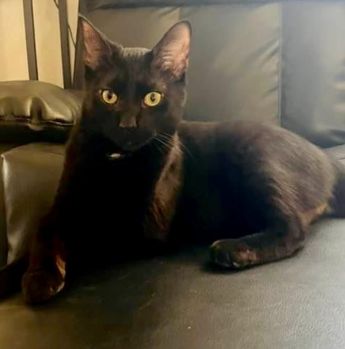
Emergency/Disaster Pet Sheltering for
Level 2 Volunteers: Review
Level 2 Responsibilities
ICS & Job Action Sheets
Level 1 & Level 2
  ALL of the Responsibilities of Level 1 Volunteers
  Assist in tagging and locating Animals and their equipment
  Assist Owners in caring for their Animals
  Responsible for Animal Care, Cage Maintenance & Animal Daily Care Forms
  Monitor & Report behavioral or health concerns
Luci

Slide 36
Resources
All Informational Links, Downloadable Materials, and Additional Suggested Trainings have been made available at:
Emergency Pet Sheltering For Medical Reserve Corps Volunteers, Level 1 & 2
www.mrcvolunteer.org/emergency-pet-sheltering.html

Slide 37
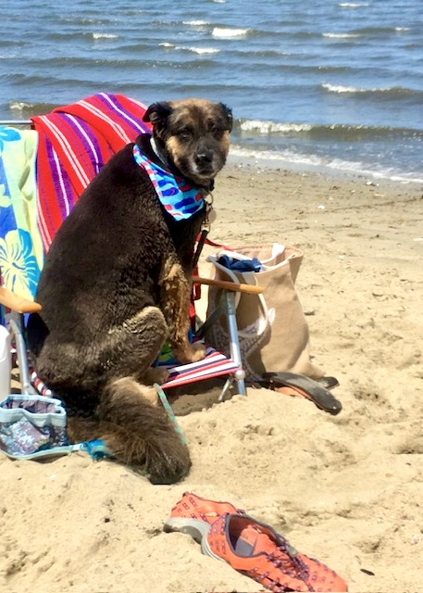


Emergency Pet Sheltering for Medical Reserve Corps Volunteers: Level 2
Certificates of Completion
Level 2 or Emergency Pet Shelter Volunteer Identification
Certificates of Completion
Level 2 or Emergency Pet Shelter Volunteer Identification
Rhody

Slide 38

Emergency Pet Sheltering for MRC Volunteers, Level 2
To Complete your Training please go to:
www.mrcvolunteer.org/emergency-pet-sheltering.html
and click on Level 2 Quiz
Once you pass, you will be directed to receive your
Level 2 Certificate of Completion

Slide 39

THANK YOU!
For Your Time and for Being a VOLUNTEER
“Some people talk to animals. Not many listen though. That's the problem”
~Winnie-the-Pooh
Author: A.A. Milne
Illustration: E.H. Shepard
Lisa C. Kaufman, ATR-BC, LADCI
Behavioral Health, Emergency Preparedness Consultant
Preparedness Specialty Services
lckaufmanpss@gmail.com

