Slide 1
Acute Ischemic Stroke Care: Updates for 2020
Angela Hays Shapshak, MD
Associate Professor of Neurology and Anesthesiology

Slide 2
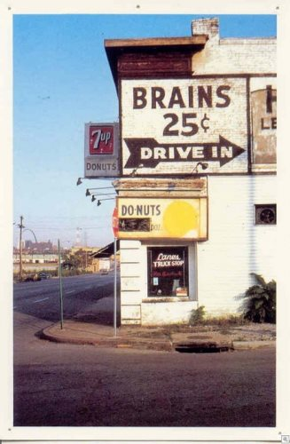
Disclosures
No financial conflicts
Research Funding:
  NIH funded trials: 1U01NS10651301A1, 1U01NS102289, 1U01NS080168-01A1
  No industry studies at this point in time
Unapproved uses:
  TNK—not FDA approved for stroke
  rtPA—not FDA approved for stroke > 3 hours after symptom onset

Slide 3
Stroke Epidemiology
Roughly 800,000 strokes every year in the US
  About one every 40 seconds
~$38.6 billion per year, direct and indirect costs
Fifth most common cause of death in the US
  Behind heart disease, cancer, trauma and lower respiratory disease
Leading cause of long term disability in adults
  Over 4 million stroke survivors in the US
Berry, Jarett D., et al. Heart Disease and Stroke Statistics--2013 Update: A Report from the American Heart Association. Circulation. 127, 2013.

Slide 4
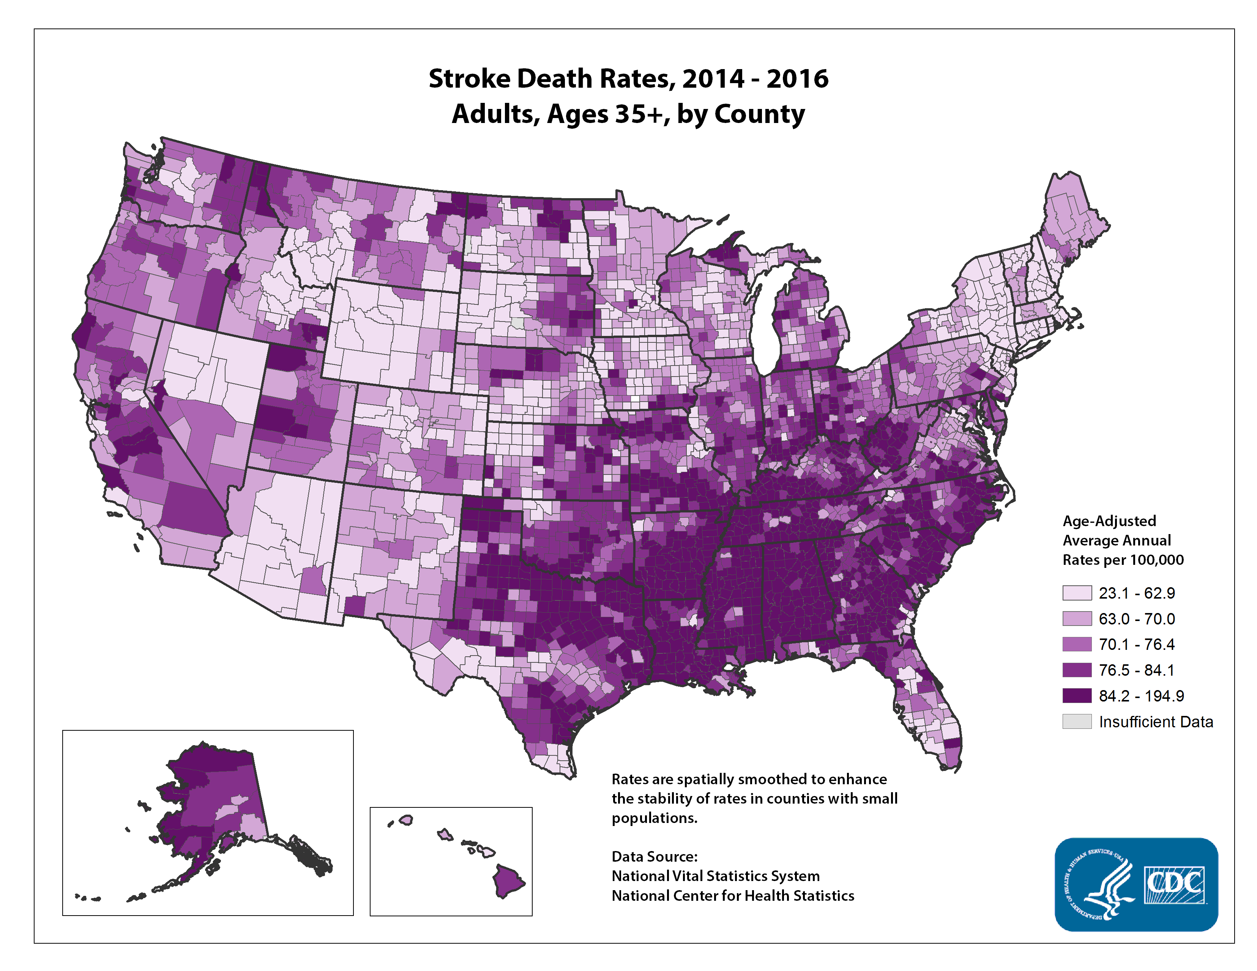

Slide 5
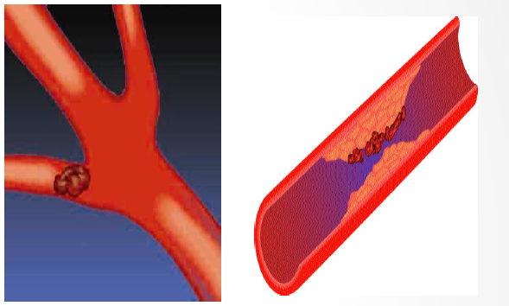
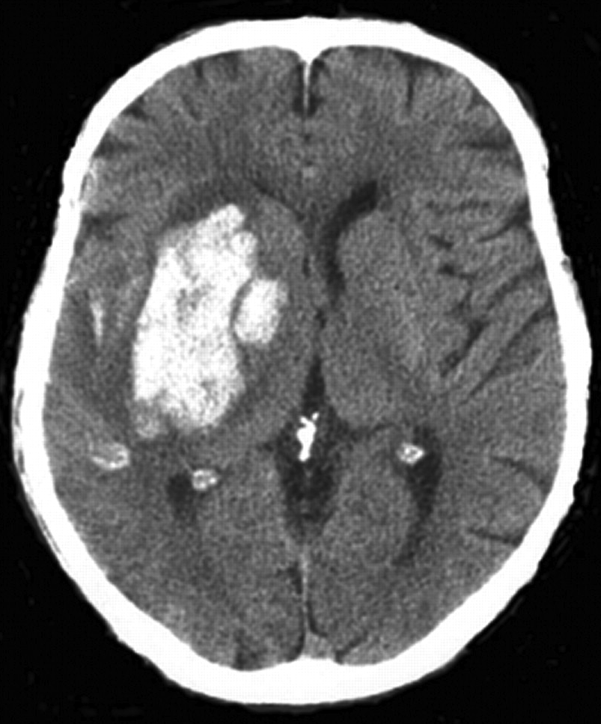
Types of Stroke
Ischemic → lack of blood flow
87% of all strokes
Hemorrhagic → ruptured vessel
13% of all strokes

Slide 6
Transient Ischemic Attack (TIA)
Warning sign for a ischemic stroke.
Stroke-like symptoms that resolve within 24h and brain MRI is negative for a stroke.
Symptoms are temporary and there is no permanent damage to the brain.
Approximately 15% of all strokes occur after a TIA with the greatest risk being within 24-48 hours of the TIA.
TIA is a medical emergency!

Slide 7
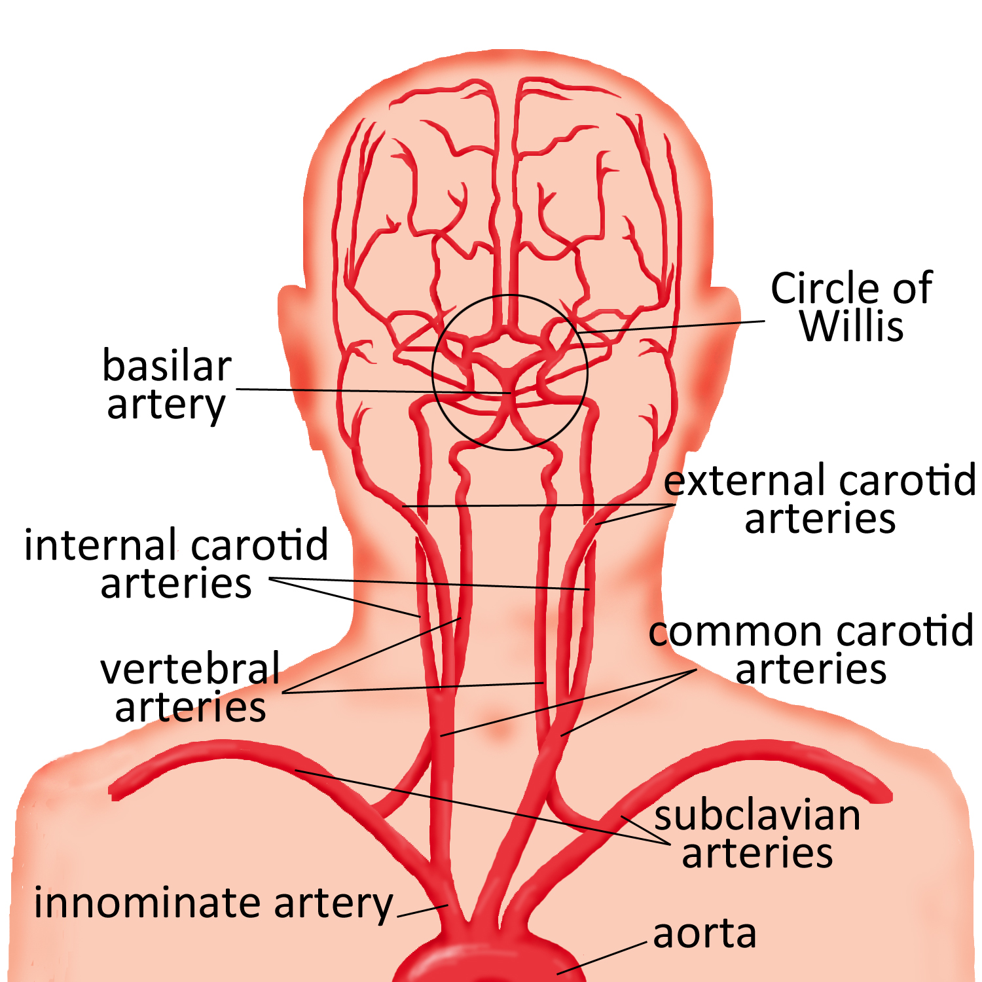
Neurovascular Anatomy

Slide 8
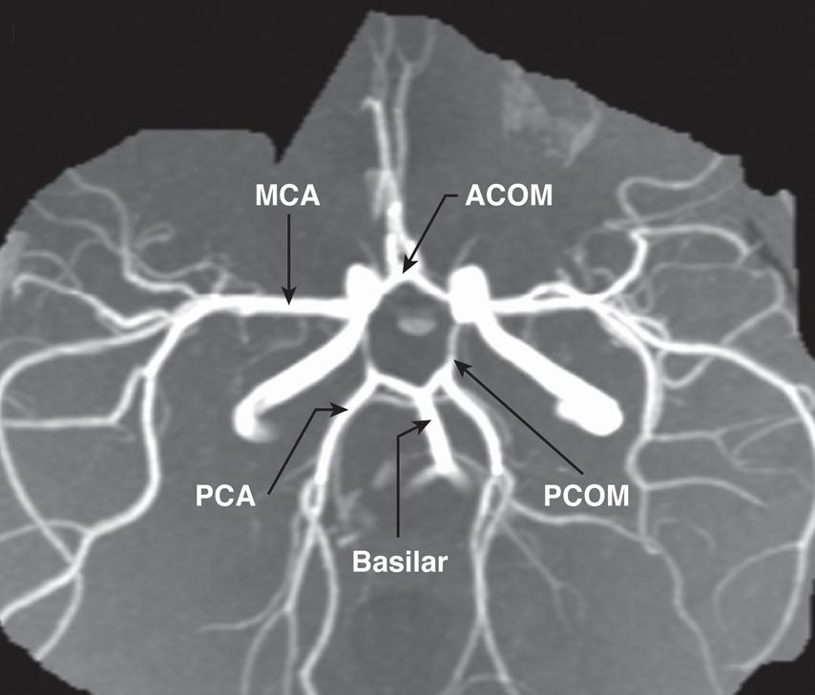
Neurovascular Anatomy
https://emedicine.medscape.com/article/1877617-overview

Slide 9
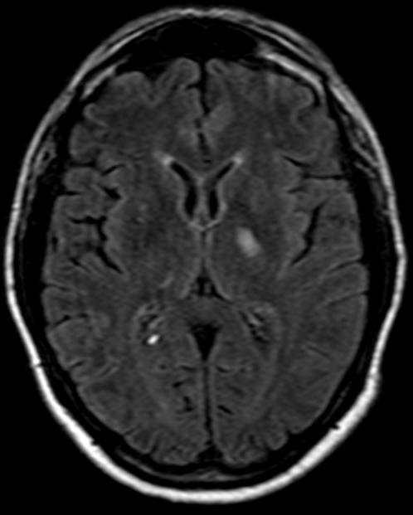
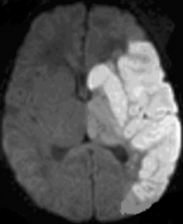
Cerebrovascular Syndromes
Small Vessel Stroke (Lacune)
Large Vessel Stroke: L MCA Occlusion
https://openi.nlm.nih.gov/detailedresult.php?img=PMC2877247_jkms-25-888-g001&req=4
http://case.edu/med/neurology/NR/LacunarInfarction%20Thalamus.htm

Slide 10
The size of the infarct depends upon both the degree and the duration of ischemia.

Slide 11
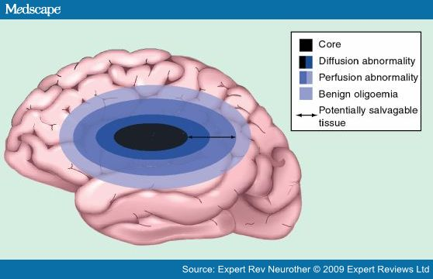
https://www.medscape.com/viewarticle/707722_4
Expert Rev Neurother. 2009;9(6):885-895.

Slide 12
Left and Right Hemisphere Stroke: Common Patterns
Dominant (Usually LEFT)
Non-Dominant (Usually RIGHT)
• Aphasia
• Right hemiparesis
• Right-sided sensory loss
• Right visual field defect
• Poor right conjugate gaze
• Dysarthria
• Difficulty reading, writing, or calculating
• Neglect of left visual field
• Extinction of left-sided stimuli
• Left hemiparesis
• Left-sided sensory loss
• Left visual field defect
• Poor left conjugate gaze
• Dysarthria
• Spatial disorientation
Adams HP et al. Circulation. 1994; 90:1588-1601

Slide 13
Brainstem Strokes
Unexplained coma/loss of consciousness (Basilar artery thrombosis/occlusion)
• Motor or sensory loss in all four limbs
• Crossed signs
• Limb or gait ataxia
• Dysarthria
• Dysconjugate gaze
• Nystagmus
• Bilateral visual field defects
Adams HP et al. Circulation. 1994; 90:1588-1601

Slide 14
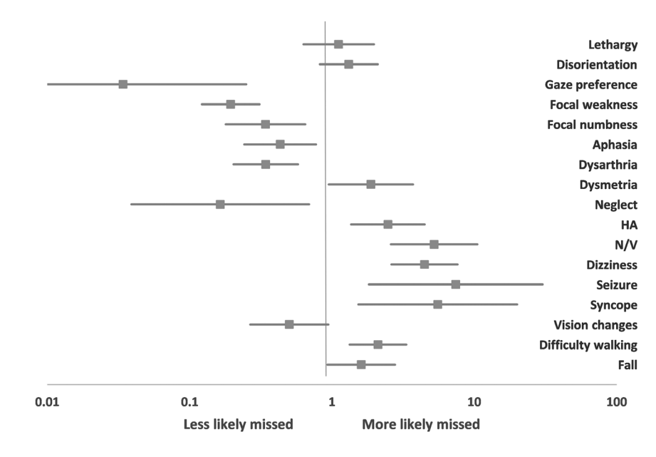
Posterior Circulation Strokes
Stroke. 2016;47:668-673

Slide 15
Causes of stroke
Clotting stroke (Ischemic)
  Heart disease (atrial fibrillation, valvular disease, cardiomyopathy, clots in the heart)
  Carotid atherosclerosis/plaques
  Intracranial atherosclerotic disease
  Small vessel disease of the brain
  Dissections
Bleeding stroke (Hemorrhagic)
  Hypertension
  Aneurysms
  AV malformations
  Trauma

Slide 16

Common Stroke Mimics
Stroke Mimics
Seizure and post-seizure paralysis (Todd’s paralysis)
Hypoglycemia
Migraine
Hypertensive Encephalopathy
Brain Tumors
Alcohol Intoxication
Drug overdose/Toxicity
Metabolic Disorders
Neuropathies (Bell’s Palsy)
Cerebral Infections
Summers, D., Leonard, A., Wentworth, D., Saver, J. L., Simpson, J., Spilker, J. A., et al. Comprehensive Overview of Nursing and Interdisciplinary Care of the Acute Ischemic Stroke Patient. American Heart Association,2911-2944, 2009

Slide 17
Risk factors
Modifiable Risk Factors | Non-modifiable Risk Factors
High Blood Pressure | Age
High Cholesterol | Gender
Diabetes | Race
Tobacco Use | Family History
Alcohol Use | Previous Stroke or TIA
Illicit Substance Use
Physical Inactivity
Obesity
Heart Disease
Atrial Fibrillation
Obstructive Sleep Apnea
http://www.strokeassociation.org/STROKEORG/AboutStroke/UnderstandingRisk/Understanding-Stroke-Risk_UCM_308539_SubHomePage.jsp

Slide 18
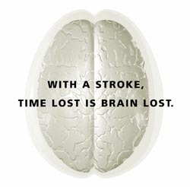
Treatment of (Hyper)Acute Stroke
Notes:
1.9 million neurons/min

Slide 19
Time is Brain!
Every second 32,000 neurons die
Every minute 1.9 million neurons die
Every hour 120 million neurons die
The goal of stroke care is to minimize brain injury and maximize the patient’s recovery.

Slide 20
AHA Recommended Initial Assessment in a Emergency Setting
Assure adequate airway
Monitor vital signs
Conduct general assessment
  Evidence of trauma to head or neck
  Cardiac Examination
Neurological Examination
  Level of consciousness
  Presence of seizure activity
  Glasgow Coma Scale/NIHSS
  Pupils: size, equality, reactivity
  Individual limb movements
Adams HP et al. Circulation. 1994; 90:1588-1601
www.strokecenter.org

Slide 21
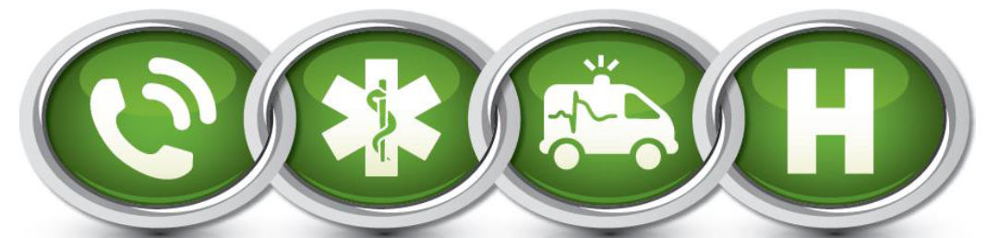
Stroke Care
Stroke Chain of Survival links actions to be taken by patients, family members, and healthcare providers to maximize stroke recovery.
http://www.strokeassociation.org/idc/groups/heart-public/@wcm/@private/@hcm/@gwtg/documents/downloadable/ucm_310253.pdf

Slide 22
Emergency Dispatch
Use of 911 system is recommended for symptoms of stroke
Many callers do not use the word “stroke”
Dispatchers should recognize the seriousness of stroke and be familiar with stroke symptoms
Strokes should be dispatched as a high priority call, send closest unit- similar to acute MI or trauma
An EMD call-receiving algorithm is recommended to ask appropriate questions to callers
https://www.acls.net/acls-suspected-stroke-algorithm.htm

Slide 23


Slide 24
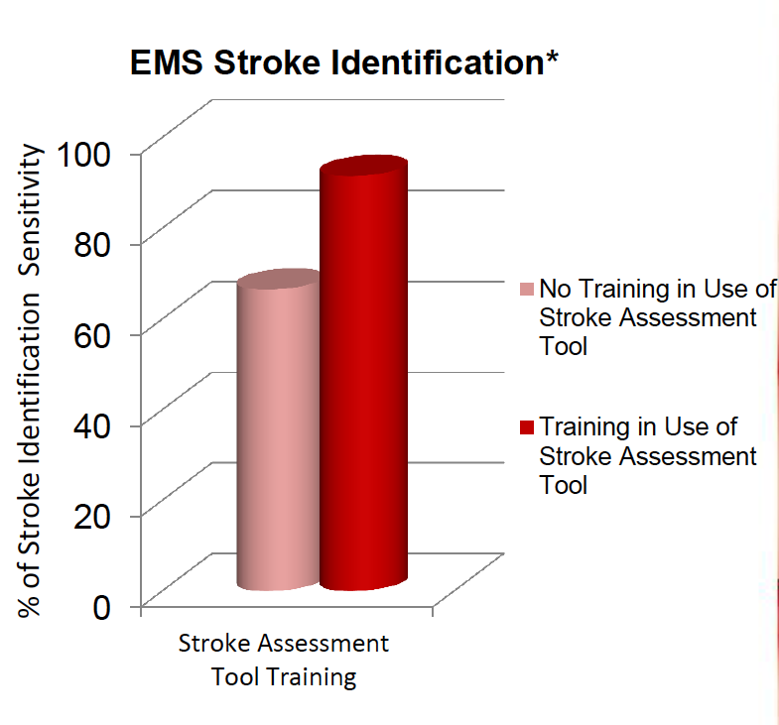
Pre-hospital Stroke Assessment
Stroke assessment tools help EMS identify a stroke quickly
Pre-hospital stroke assessment training raises accuracy of stroke identification
Paramedics demonstrated a sensitivity of 61-66% without training and 86-97% with training
Maggiore, W. A. (2012). 'Time is Brain' in Prehospital Stroke Treatment . Journal of Emergency Medical Services , 1- 9.

Slide 25
Pre-hospital Stroke Assessment
Cincinnati Prehospital Stroke Scale
Facial Droop Normal: Left and Right side of face move equally Abnormal: One side of face does not move at all
Arm Drift Normal: Both left and right arm move together or not at all Abnormal: One arm does not move equally with the other
Speech Normal: Patient uses correct words with no slurring Abnormal: Patient has slurred speech, uses inappropriate words or cannot speak
Kothari RU, Pancioli A, Liu T., Brott T., Broderick J. “Cincinnati Prehospital Stroke Scale: reproducibility and validity.” Ann Emerg Med. 1999 Apr;33(4):373-8.

Slide 26
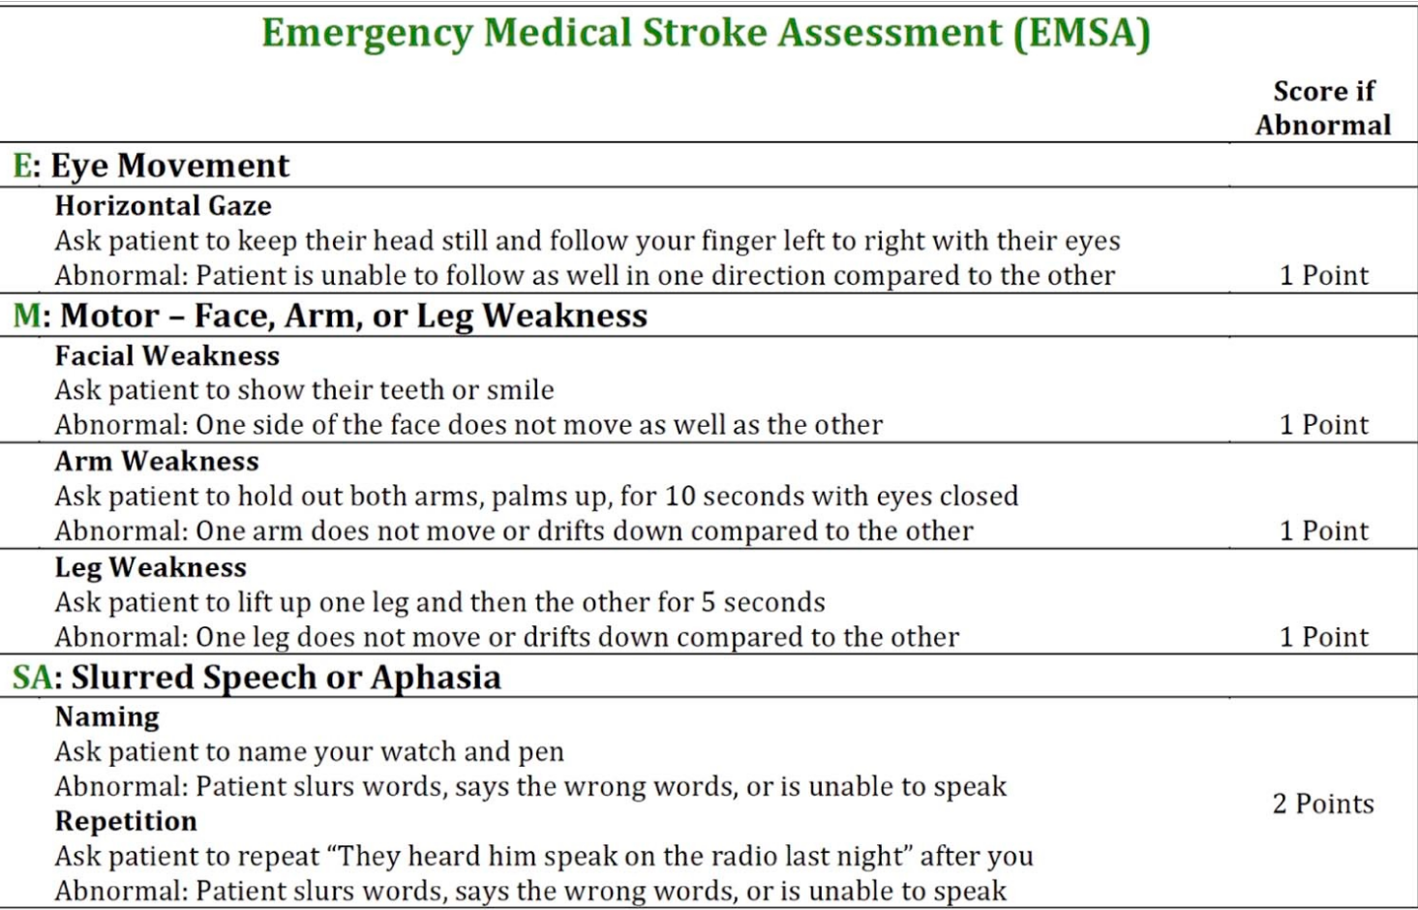
Detecting Large Vessel Occlusions
https://doi.org/10.1016/j.jstrokecerebrovasdis.2017.10.018

Slide 27
Pre-notification
EMS professionals can notify hospital staff that a stroke patient is being sent to the hospital prior to them arriving at the hospital
The sooner the patient gets to medical treatment, the greater potential for a better outcome
Shorter symptom onset to hospital arrival time
Increase in the number of patients with door-to-imaging times within 25 min
Lower onset-to-door times
Overall, pre-notification resulted in more rapid triage, evaluation, and treatment of patients with acute ischemic stroke
Lin, C. B., Peterson, et al. (2012). Emergency Medical Service Hospital Pre-Notification is Associated with Improved Evaluation and Treatment of Acute Ischemic Stroke. Journal of the American Heart Association , 1-9.

Slide 28
Prehospital Stroke Care
Minimize scene time (≤ 15 minutes)
Establish Last Known Normal time
Bring a knowledgeable friend or family member with the stroke patient

Slide 29
Ongoing Assessment en route
History from family member (SAMPLE)
S-Symptoms/ onset (When was the person last seen normal?)
A-Allergies
M-Medications-anticoagulants (warfarin), antithrombotics, insulin, antihypertensives, antiepileptics
P-Past Medical History-Hypertension, Diabetes (hypoglycemic patients may have symptoms that mimic stroke), seizures, prior stroke, aneurysms
L-Last oral intake
E-Events Prior-stroke, MI, trauma, surgery, bleeding

Slide 30
Management en route
Not recommended
Dextrose-containing fluids in nonhypoglycemic patients
Blood pressure reduction (can cause hypotension, decrease cerebral perfusion and worsen stroke) unless >220/120

Slide 31

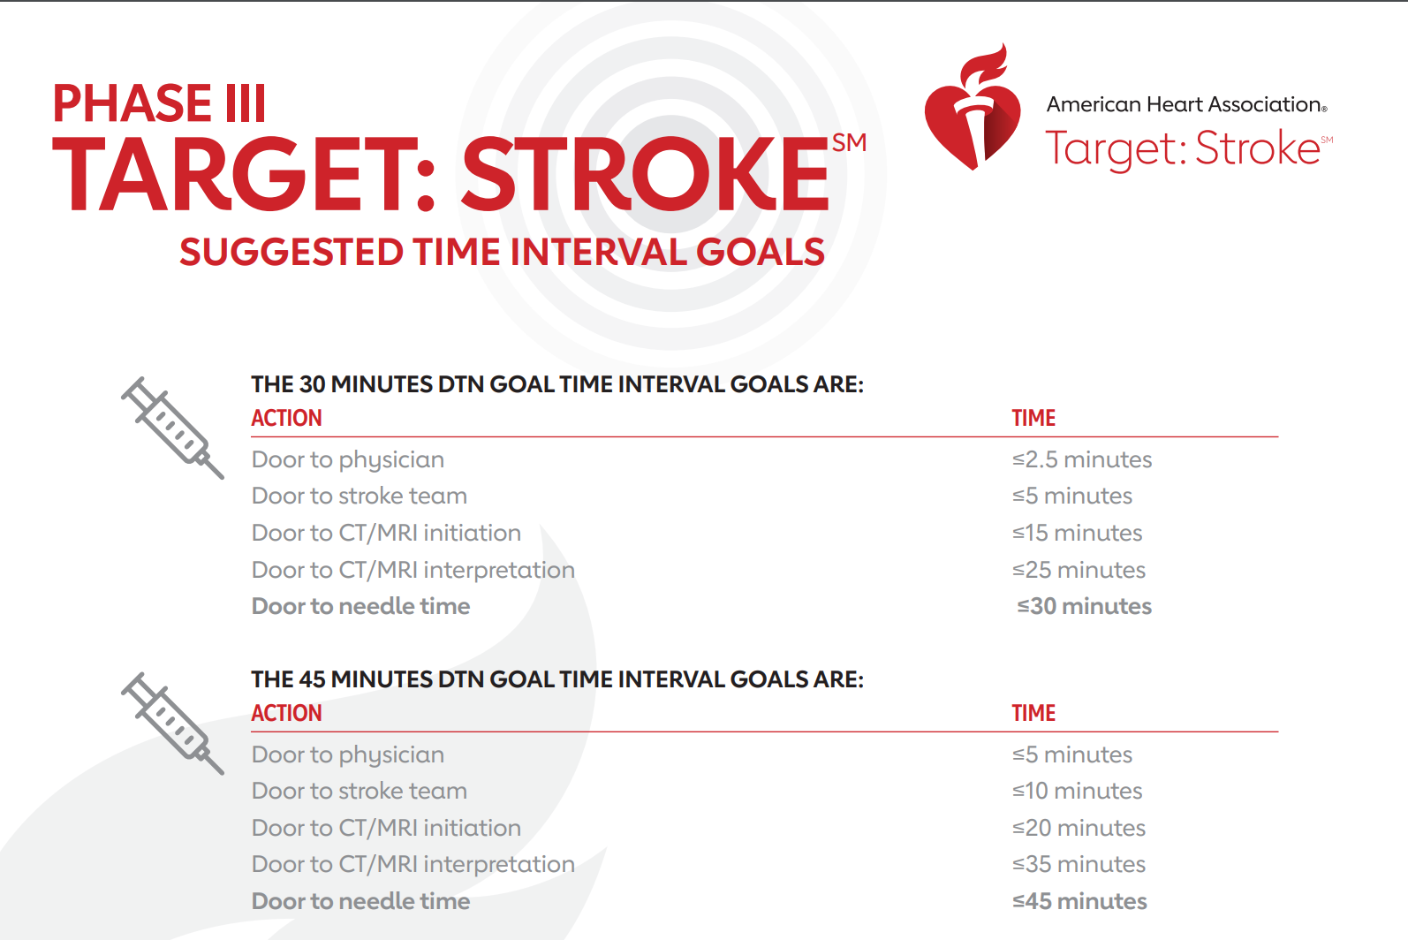
Hospital Managements: AHA Quality Metrics

Slide 32
Acute Stroke: Initial Evaluation
CT of the brain without contrast
Electrocardiogram
Chest x-ray
Hematologic studies (complete blood count, platelet count, prothrombin time, partial thromboplastin time)
  Platelet Count and Coagulation profile are not necessary prior to tPA if patient is not taking Oral anticoagulants and has no suspected bleeding disorder.
Serum electrolytes
Blood glucose
Renal and hepatic chemical analyses
National Institutes of Health Scale (NIHSS) score

Slide 33
Stroke specific interventions
Depend on Last known normal time
IV Thrombolytic Agents
Depend on advanced imaging (CTA/CTP or MRA/MRP)
Intra-arterial approaches (neurointerventional clot retrieval)

Slide 34
IV tPA (alteplase)
Last known normal time ≤ 4.5 hours
No hemorrhage on CT
Disabling neurological deficit
No contraindications to tPA
IV alteplase (tPA)
FDA approved for ≤ 3 hours of onset of symptoms
AHA/ASA approved for use between 3-4.5 h with additional exclusion criteria

Slide 35
Exclusion criteria
Significant head trauma or prior stroke in previous 3 months
Symptoms suggest subarachnoid hemorrhage
Arterial puncture at non-compressible site in previous 7 days
History of previous intracranial hemorrhage
Intracranial neoplasm, arteriovenous malformation, or aneurysm
Recent intracranial or intraspinal surgery
Elevated blood pressure (systolic >185 mm Hg or diastolic >110 mm Hg)
Active internal bleeding
Acute bleeding diathesis, including but not limited to
  Platelet count <100 000/mm3
  Heparin received within 48 hours, resulting in abnormally elevated aPTT
  greater than the upper limit of normal
  Current use of anticoagulant with INR >1.7 or PT >15 seconds
  Current use of direct thrombin inhibitors or direct factor Xa inhibitors with
  elevated sensitive laboratory tests (such as aPTT, INR, platelet count, and
  ECT; TT; or appropriate factor Xa activity assays)
Blood glucose concentration <50 mg/dL (2.7 mmol/L)
CT demonstrates multilobar infarction (hypodensity >1/3 cerebral hemisphere)

Slide 36
Relative exclusion criteria
Careful consideration and weighing of risk to benefit
Patients may receive TPA despite 1 or more relative contraindications
Consider risk to benefit of IV tPA administration carefully if any of these relative contraindications are present:
  Only minor or rapidly improving stroke symptoms (clearing spontaneously)
  Pregnancy
  Seizure at onset with postictal residual neurological impairments
  Major surgery or serious trauma within previous 14 days
  Recent gastrointestinal or urinary tract hemorrhage (within previous 21 days)
  Recent acute myocardial infarction (within previous 3 months)

Slide 37
Additional Exclusion criteria for 3-4.5 h window
  Aged >80 years
  Severe stroke (NIHSS>25)
  Taking an oral anticoagulant regardless of INR
  History of both diabetes and prior ischemic stroke

Slide 38
Does tPA kill patients?
Despite an increase in fatal intracerebral hemorrhages at 7 days (IST-3), all-cause mortality at 90 days and 6 months is not affected.
A recent meta-analysis of RCTs of IV tPA versus placebo showed:
  tPA does not impact all-cause mortality at any time point: 7 days, 30 days, 90 days, and 6 months
Emberson et al. Lancet. 2014 Nov 29;384(9958):1929-35
IST-3 collaborative group. Lancet. 2012 Aug 25;380(9843):730.
Uhrig et al. International Stroke Conference -2015

Slide 39
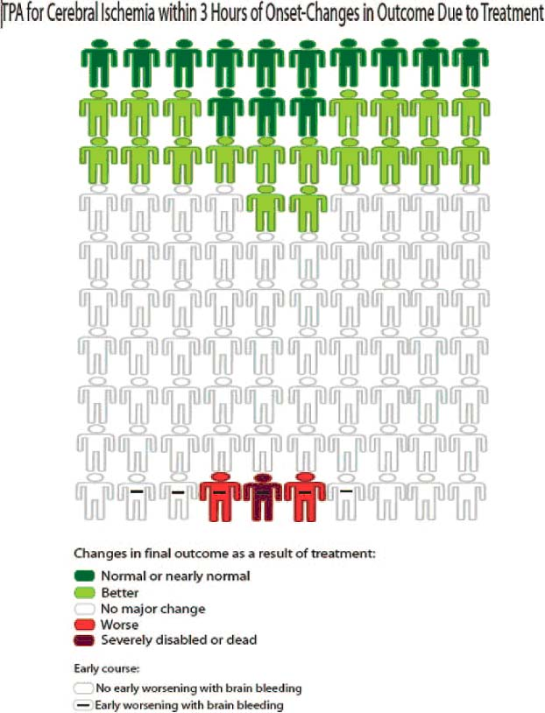
Beyond rt-PA
Stroke. 2010;41:00-00.
Notes:
NNT around 11 within the 3 hour window
Absolute 2% increase in rates of fatal ICH
Did not result in difference in mortality at 90d

Slide 40
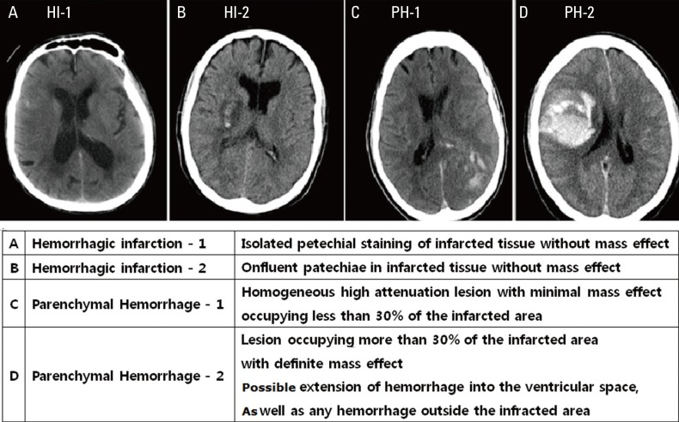
Hemorrhage After tPA
Journal of Stroke 2014;16(3):131-145.

Slide 41
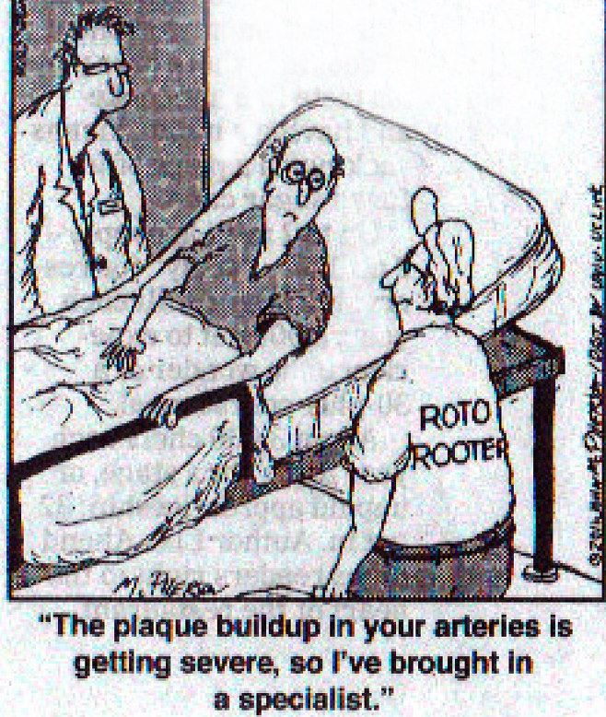
What About Endovascular?

Slide 42
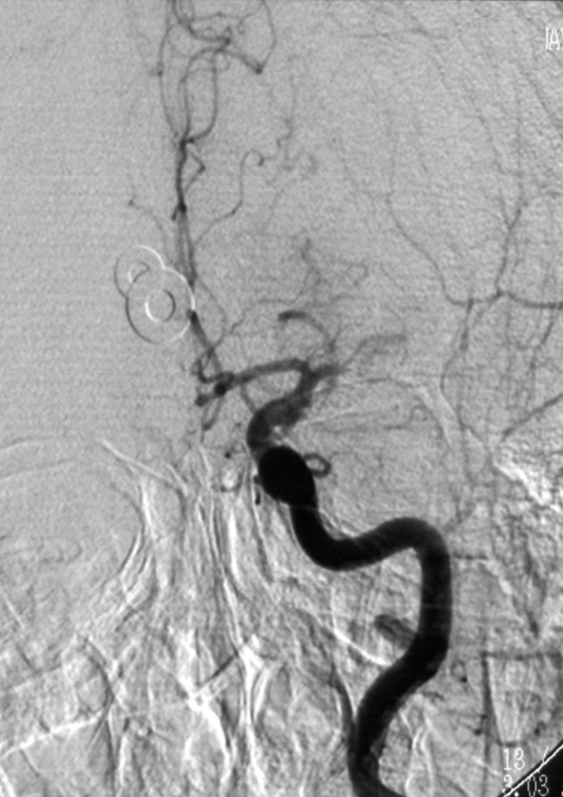
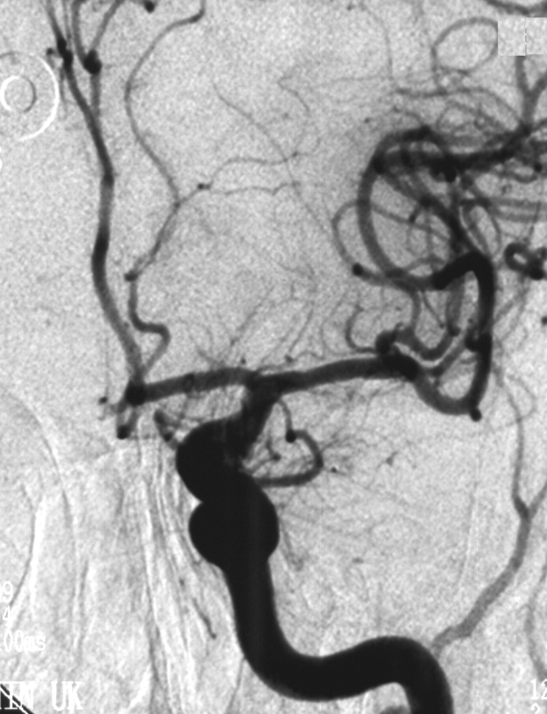
Intra-arterial Thrombolysis

Slide 43
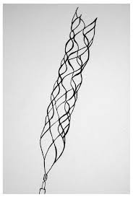
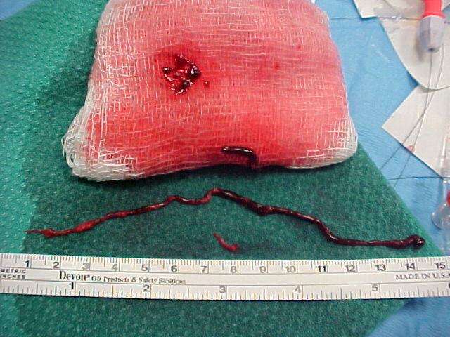
Embolectomy: Stent-Retriever
Smith et al. Stroke, July 2005

Slide 44
Time-Based Reperfusion Trials
5 trials reported in 2014-2015→ total of 1287 patients
Randomized patients with ICA or MCA occlusion to IAT vs usual care
  tPA was administered if the patient was eligible (83%)
    MR CLEAN: enrolled within 6 hours of onset
    ESCAPE: up to 12 hours, used CT and CTA
    SWIFT PRIME: within 4.5 hours (included only tPA recipients), varied imaging criteria
    REVASCAT: enrolled within 8 hours of onset, used ASPECTS score
    EXTEND IA: enrolled within 4.5 hours of onset, used perfusion imaging

Slide 45
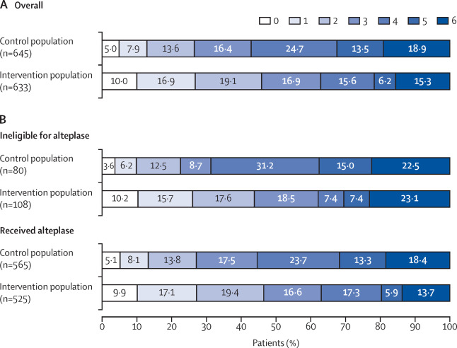
Pooled analysis
Lancet 2016; 387: 1723–31

Slide 46
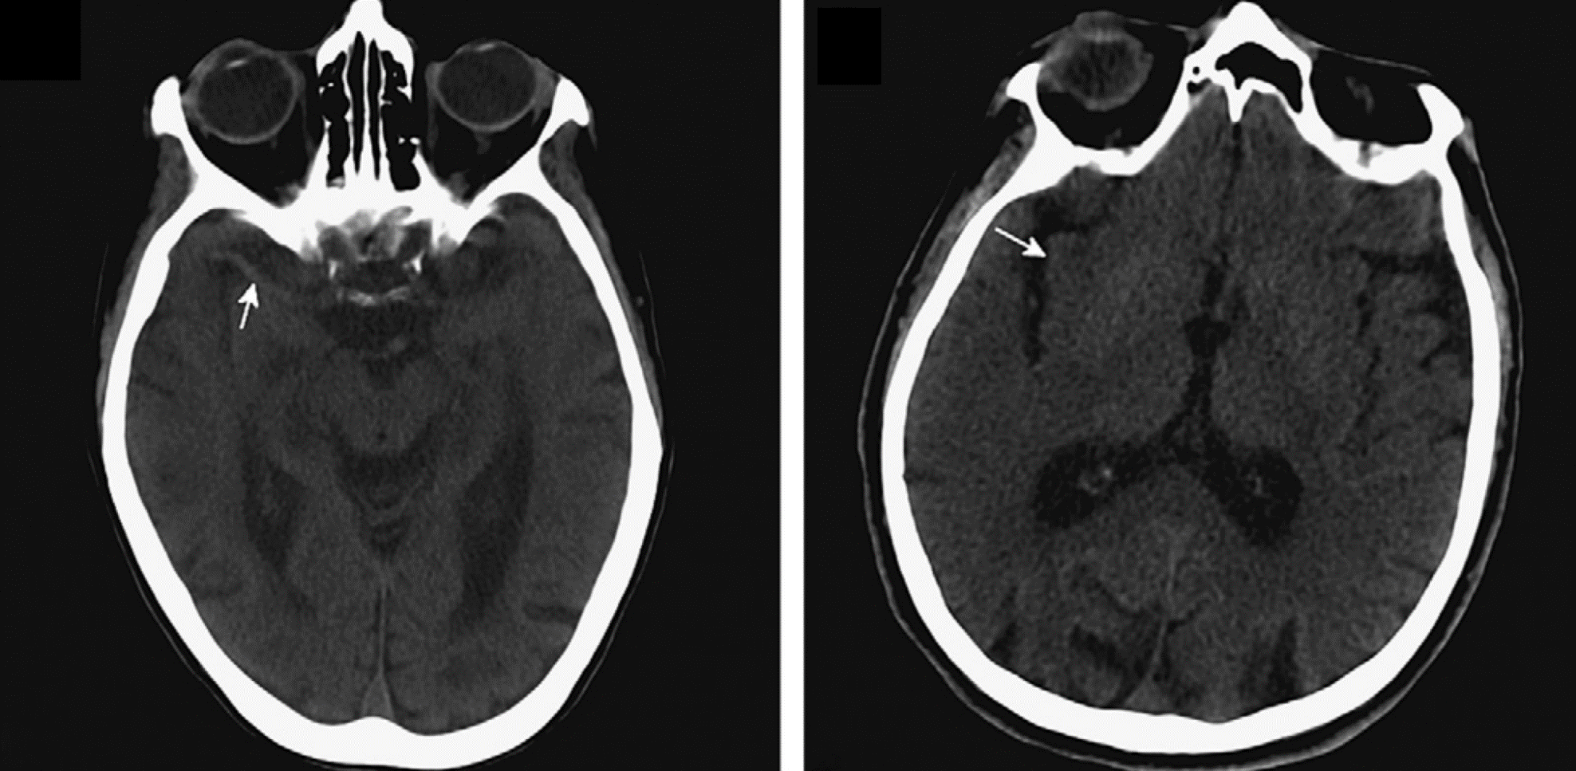
Imaging-Based Reperfusion Trials

Slide 47
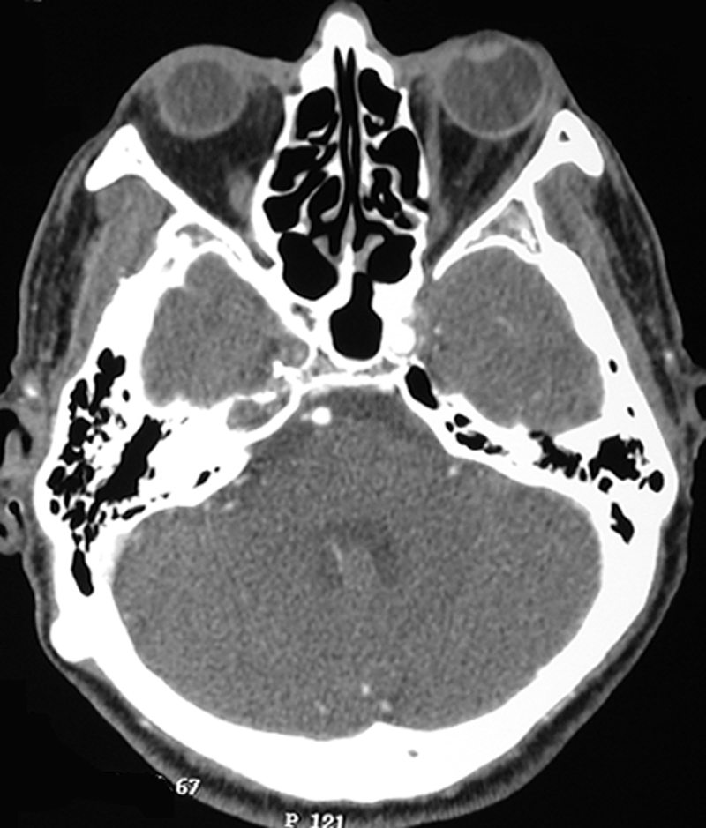
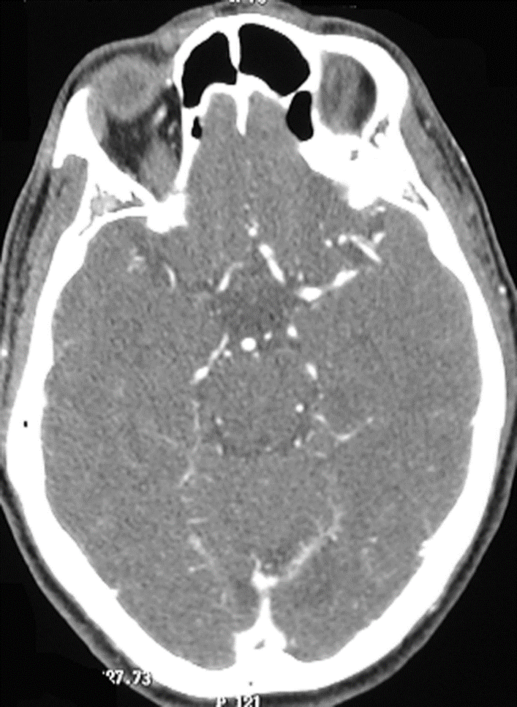
CT Angiography
CT Angiography
R ICA Occlusion
Poor R MCA flow

Slide 48




CT Perfusion
Provides an indirect measure of the metabolic state of the tissue
  Useful for identification of penumbra vs. core (ie, salvagable tissue)
INFARCT will have ↑ MTT, ↓ CBF, & ↓ CBV
TISSUE AT RISK will have ↑ MTT, ↓ CBF, & ↑ or normal CBV due to autoregulation
CBF CBV MTT Follow-Up CT
Hoeffner et. al. Cerebral perfusion CT: technique and clinical application. Radiology 2004; 231:632–644.

Slide 49
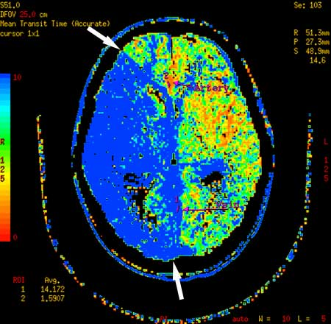
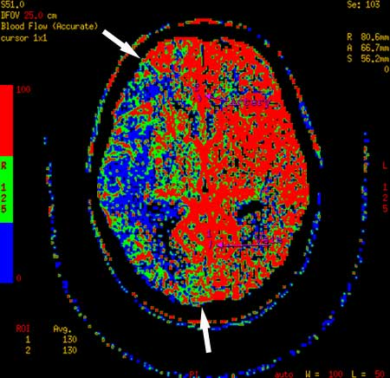
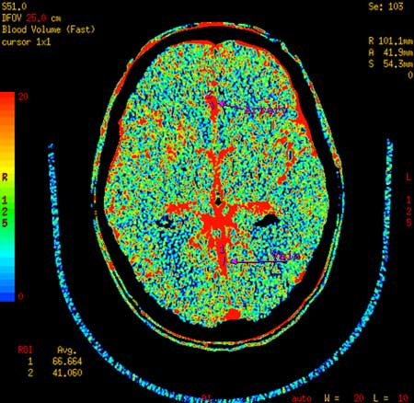
CT Perfusion
Blood Volume
(>2.5 mL/100g)
Blood Flow
( > 50 mL/100g/min)
Mean Transit Time
( < 6 sec)
http://www.neurographics.org/4/2/2/Fig1.shtml

Slide 50
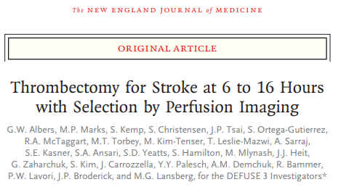
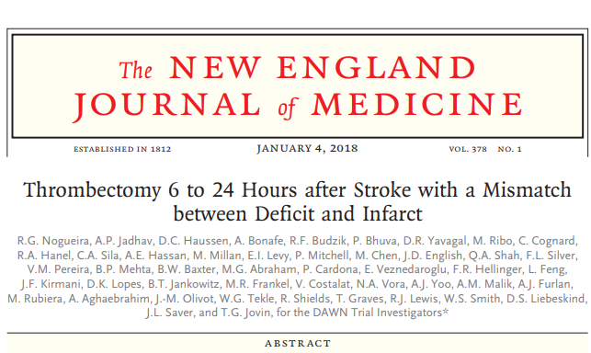
DEFUSE:
RCT, 182 patients; terminated early for efficacy (goal 476)
--used MRI or CTP
N Engl J Med 2018;378:708-18.
N Engl J Med 2018;378:11-21
DAWN:
RCT, included 206 patients
--used MRI or CTP to select

Slide 51
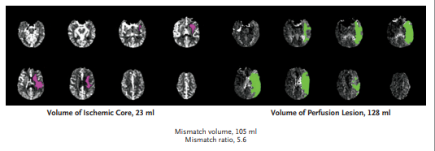

GW Albers et al. N Engl J Med 2018;378:708-718.
Example of Perfusion Imaging Showing a Disproportionately Large Region of Hypoperfusion as Compared with the Size of Early Infarction.
Eligible for randomization if:
Core infarct < 70 mL
Ratio of Penumbra: Core Infarct of >= 1.8
Absolute penumbra volume > 15 mL
Notes:
Figure 1. Example of Perfusion Imaging Showing a Disproportionately Large Region of Hypoperfusion as Compared with the Size of Early Infarction. A 59-year-old man presented with a “wake-up stroke” (having awakened with symptoms of stroke) 13 hours after he was last known to be well. The score on the National Institutes of Health Stroke Scale (NIHSS; range, 0 to 42, with higher scores indicating a greater deficit) was 23. A baseline CT perfusion scan that was obtained with the use of RAPID software shows a region of severely reduced cerebral blood flow (<30% of that in normal tissue), which represents the early infarct (ischemic core), of 23 ml (pink) and a region of perfusion delay of more than 6 seconds, which represents hypoperfused tissue, of 128 ml (green).
Vs. DAWN: NIHSS > 10, infarct volume < 50

Slide 52
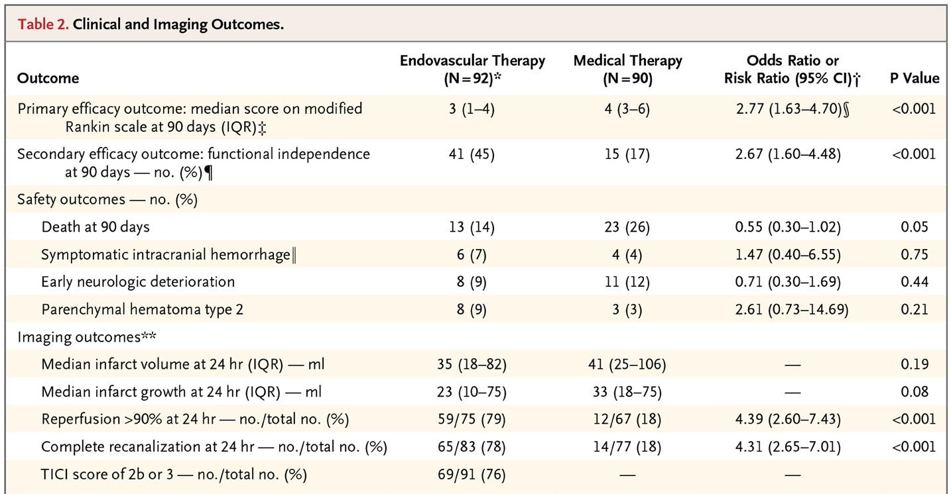
DEFUSE 3: Outcomes

Slide 53
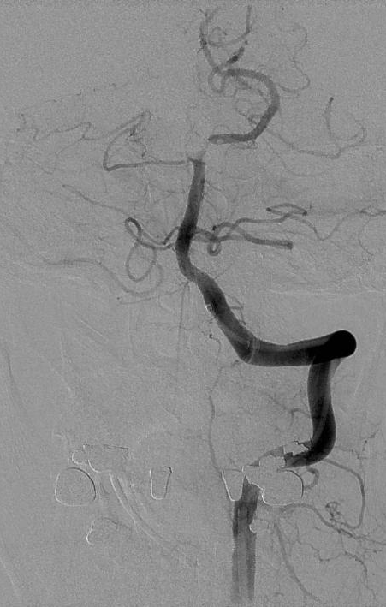
When is IAT Considered?
Acute stroke due to occlusion of a large vessel
Onset within 6 hours
OR, favorable perfusion pattern
  Small area of completed infarction
OR, acute basilar artery occlusion, regardless of imaging

Slide 54
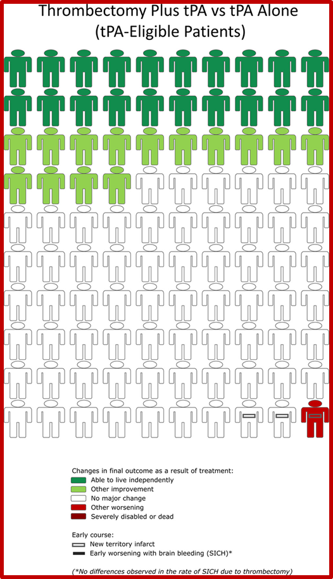
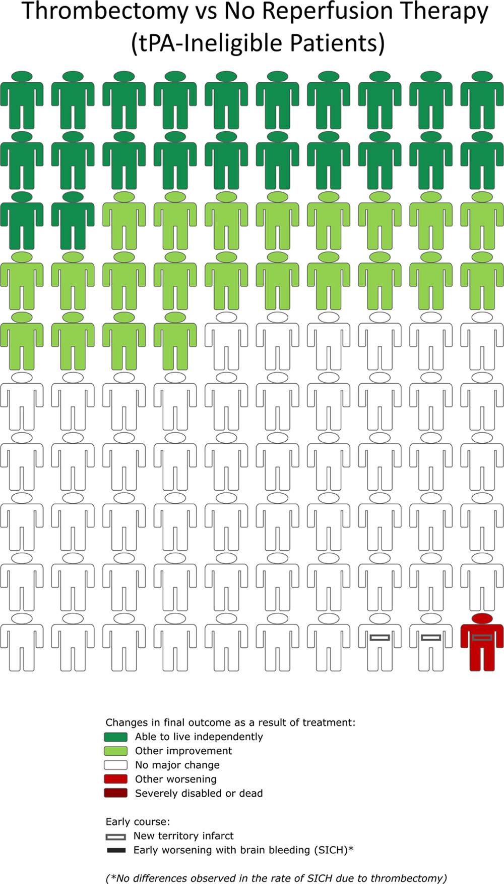
Notes:
IAT + TPA: NNT 2.8, NNH 68.9
IAT only (tpa ineligible): NNT 2.3, NNH 100

Slide 55
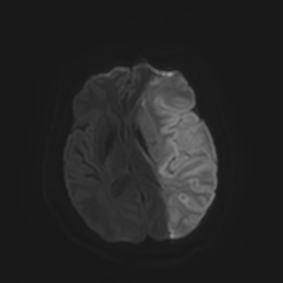
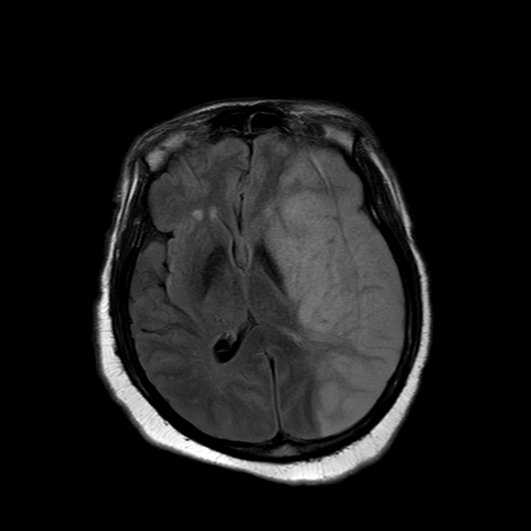
Extending the rt-PA Window
Diffusion-Weighted MRI (DWI)
Fluid-Attenuated Inversion Recovery (FLAIR)
Notes:
About 3.8% of patients receive TPA
15-32% present within 3h
40-50% of those are eligible

Slide 56
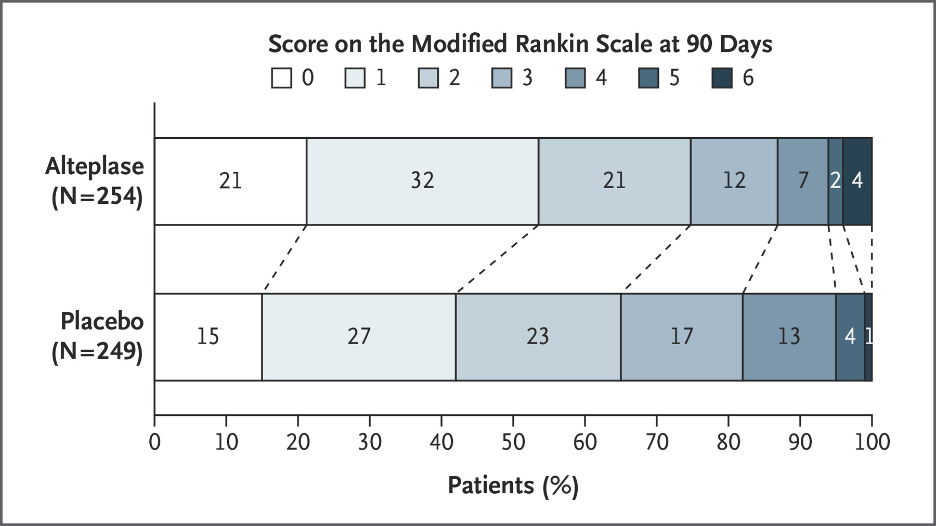
WAKE-UP Trial
N Engl J Med 2018; 379:611-622
Study of MRI-guided treatment of stroke patients with unknown time of onset
“Also excluded were patients in whom thrombectomy was planned, and those with severe stroke.”
  Majority of patients arrived within 3h of symptom recognition
503 patients randomized: Good outcome (0-1) in 53.3%, vs 41.8%, OR 1.61, p 0.02

Slide 57
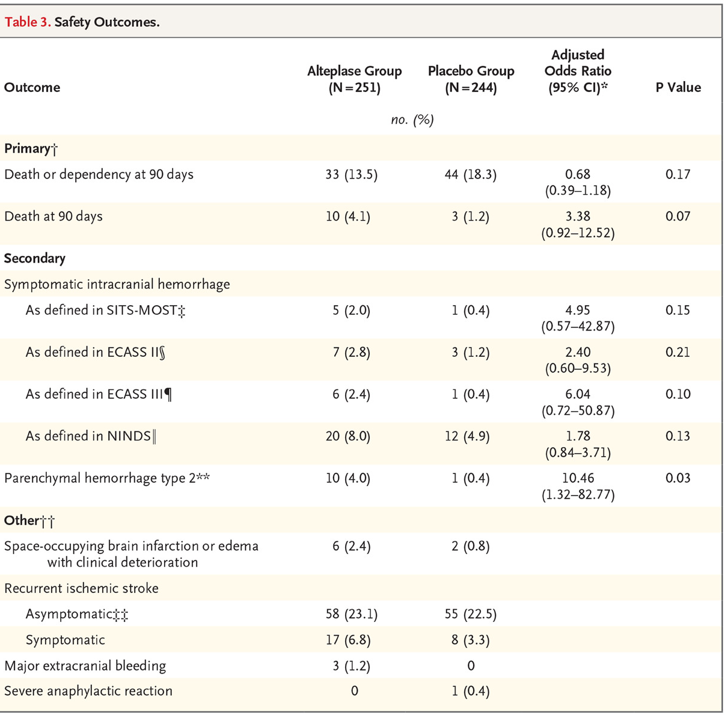
WAKE-UP Trial: Safety Data

Slide 58
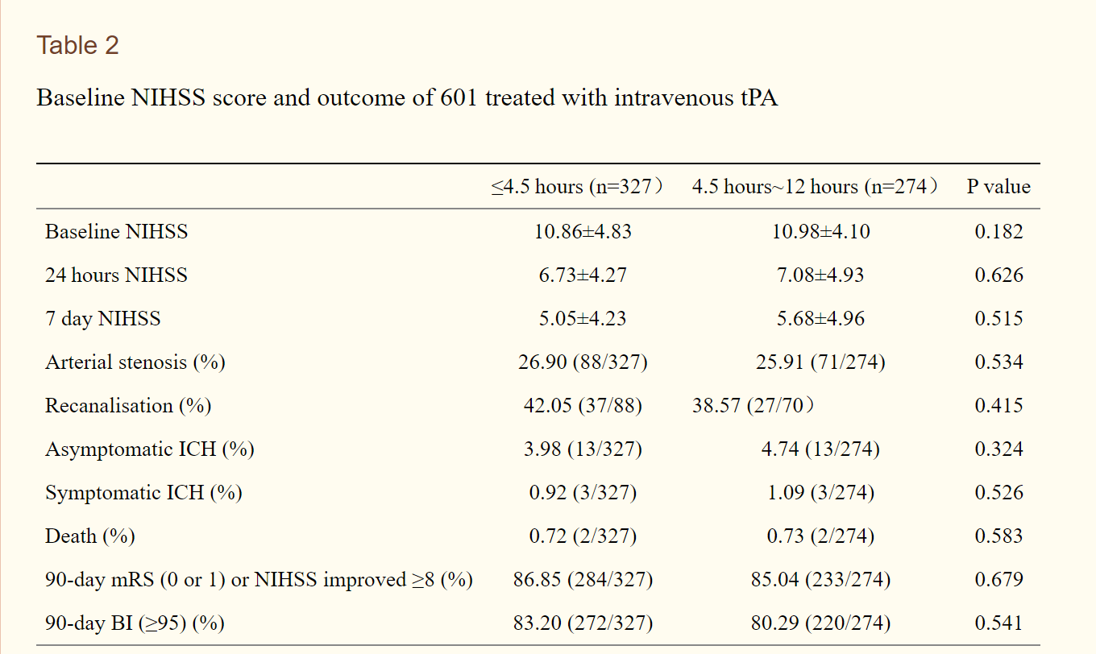
Expanding the tPA Window
Stroke Vasc Neurol. 2019 Mar; 4(1): 8–13

Slide 59
Tenecteplase
Pharmacology:
  increased fibrin specificity and prolonged half-life relative to rt-PA
  Given as a single IV bolus, as opposed to bolus + infusion
Evidence from the cardiac literature (ASSENT-2):
  indicates lower rates of systemic bleeding with TNK vs TPA
  Equivalent rates of ICH
Phase II studies: TNK 0.4 has increased ICH rates
  0.1 and 0.25 have similar efficacy and safety when compared to rt-PA
Lancet. 1999 Aug 28;354(9180):716-22. Stroke. 2019;50:2156–62.

Slide 60
TNK for AIS
NOR-TEST: Open label RTC of tPA vs. TNK (0.4 mg/kg) for AIS
  Enrolled 1000 patients, onset within 4.5 hours
  Enrolled predominantly minor strokes (average NIHSS was 5)
  Essentially no difference in outcome or rates of SAE
EXTEND-IA TNK: specifically enrolled LVO patients going to IAT
  Onset within 4.5 hours, TNK 0.25 vs TPA, n = 202
  Primary outcome: successful recanalization
Lancet Neurol. 2017 Oct;16(10):781-788.
N Engl J Med 2018; 378:1573-1582

Slide 61
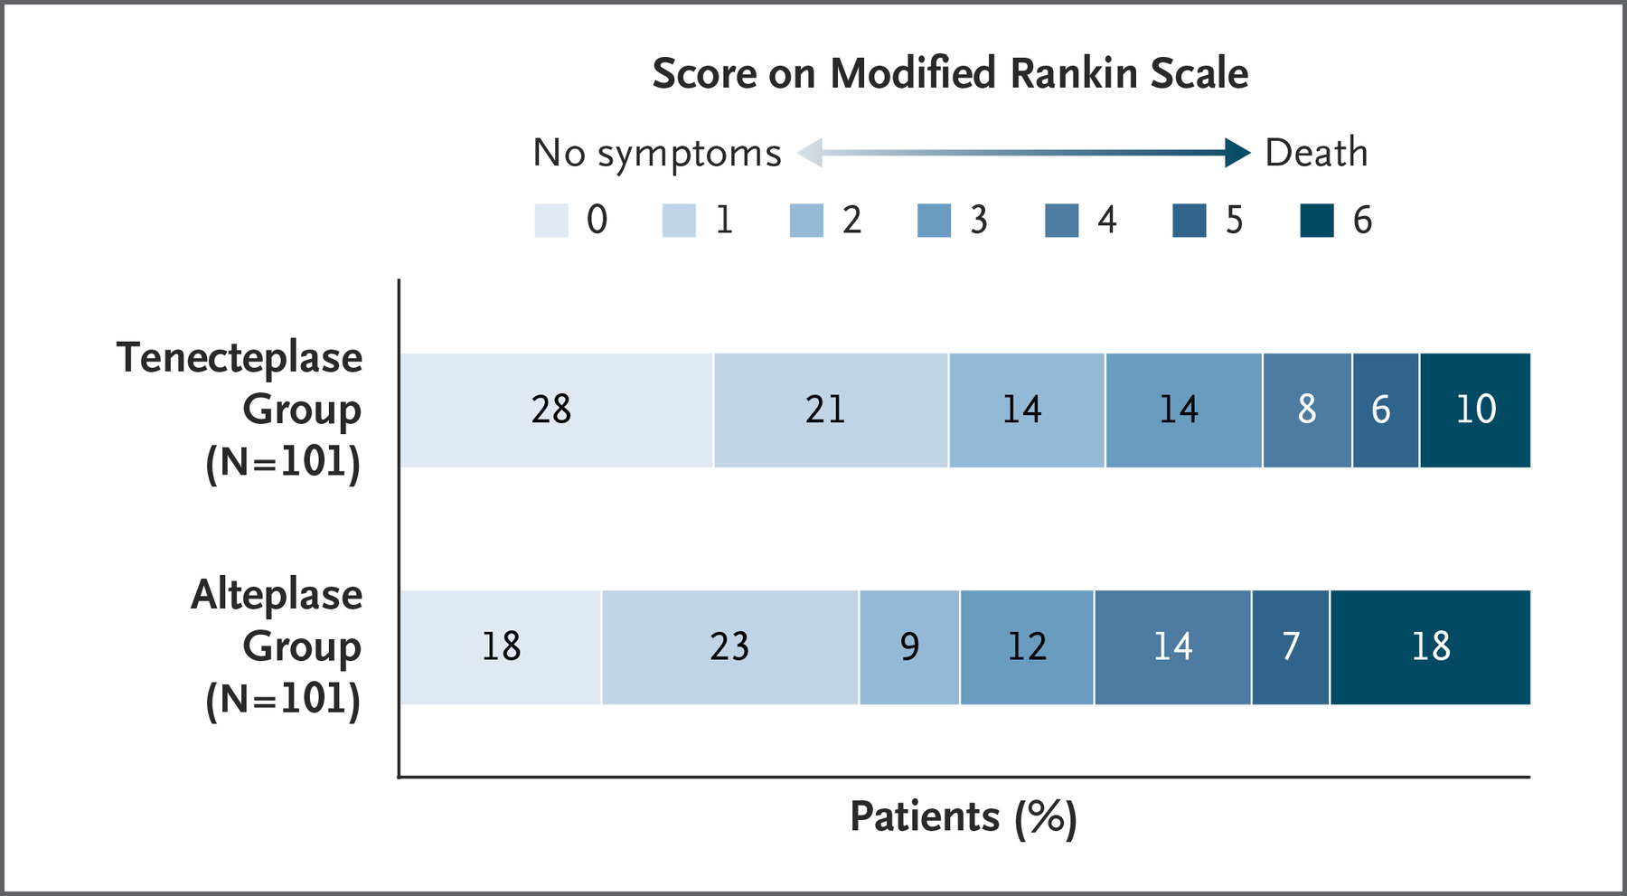
EXTEND-IA TNK: Outcomes
mRS: odds ratio, 1.7; 95% CI, 1.0 to 2.8; P=0.04
Reperfusion: odds ratio, 2.6 [95% CI, 1.1 to 5.9; P=0.02

Slide 62
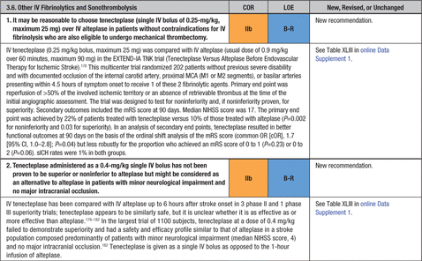
Stroke Guidelines
Stroke. 2019;50:e344–e418

Slide 63
Medical Therapy: Future Directions
TIMELESS: industry-sponsored study of image-guided thrombolysis (NCT03785678)
  Enrolling ischemic stroke patients presenting between 4.5 to 24 hours since onset
  Randomized to TNK 0.25 mg/kg vs. Placebo
MOST: Multi-arm Optimization of Stroke Thrombolysis
  Enrolling patients who receive rt-PA within 3hrs to concurrent administration of eptafibatide, argatroban or placebo
  NCT03735979

Slide 64
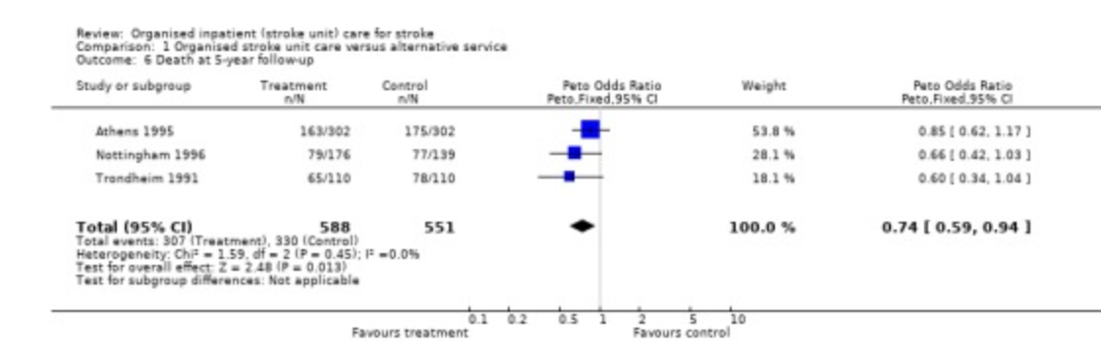
Acute Stroke Care: Beyond the ED
Cochrane Database Syst Rev. 2013 Sep; 2013(9): CD000197

Slide 65
Causes of Death
 | Stroke Unit | General Ward | Odds Ratio (95% CI)
Neurological | 9.2% | 10.3% | 0.91 (0.66-1.28)
Cardiovascular | 5.2% | 7.0% | 0.72 (0.47-1.09)
Complications of Immobility | 3.8% | 6.3% | 0.62 (0.39-0.97)
Other | 3.6% | 4.2% | 0.90 (0.53-1.15)
Stroke. Nov 1997;28(1): 2139-2144.

Slide 66
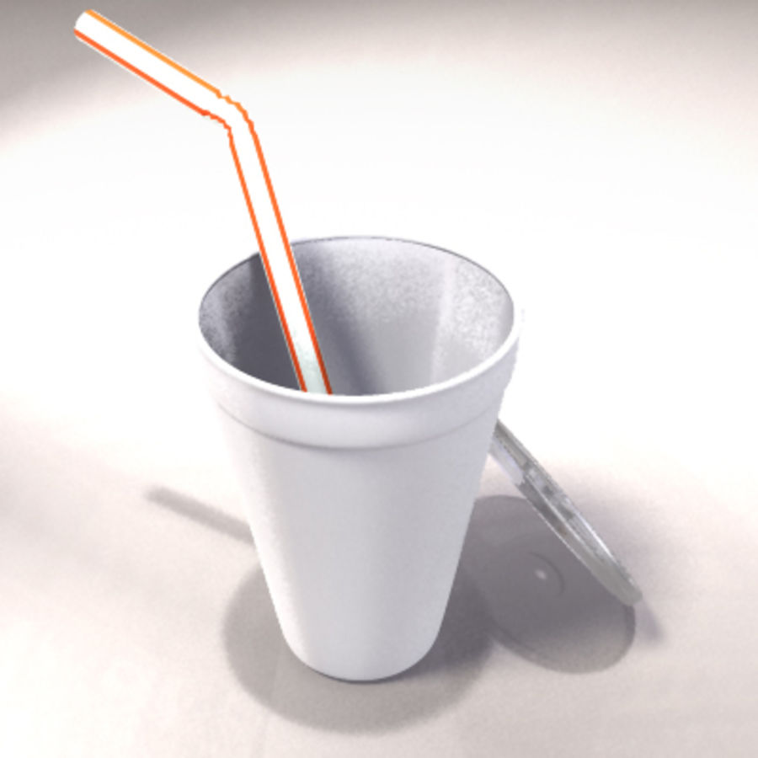
Dysphagia Screening
Incidence of dysphagia: 42-67%
  50% of patients with dysphagia develop aspiration
  1/3rd of those who aspirate develop pneumonia
Yale Swallow Screen
  Exclusion Criteria
  Brief Cognitive Screen
  -Oral Exam
Stroke. 2013;44:e24–e31
Dysphagia volume 29, pages199–203(2014)

Slide 67
Early Mobilization
Western Data: (Stroke. 2015; 46(4):1141-1146.)
  Meta-analysis of 4 trials studying PT mobilization within 24-72 hours
    Suggested earlier return to walking, improved function at 3 mo
    Did not demonstrate a mortality benefit or decreased complications
Chinese Trials: (Int J Stroke. 2014 Jun;9(4):494-502.)
  Included 5916 patients; demonstrated a statistically significant improvement in functional outcomes
    Insufficient data to comment on mortality or complication rate

Slide 68
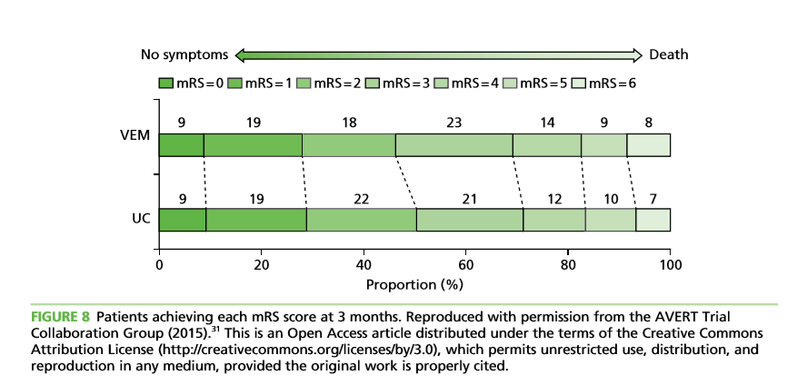
AVERT-III
N = 2104 patients
Usual care vs. Very Early Mobilization
decrease in good outcome for VEM:
  46 vs 50%, OR 0.73 {CI 0.59-0.9}, p 0.004)
Langhorne P, Wu O, Rodgers H, Ashburn A & Bernhardt J. A Very Early Rehabilitation Trial after stroke (AVERT): a Phase III, multicentre, randomised controlled trial. Health Technol Assess 2017;21(54)

Slide 69
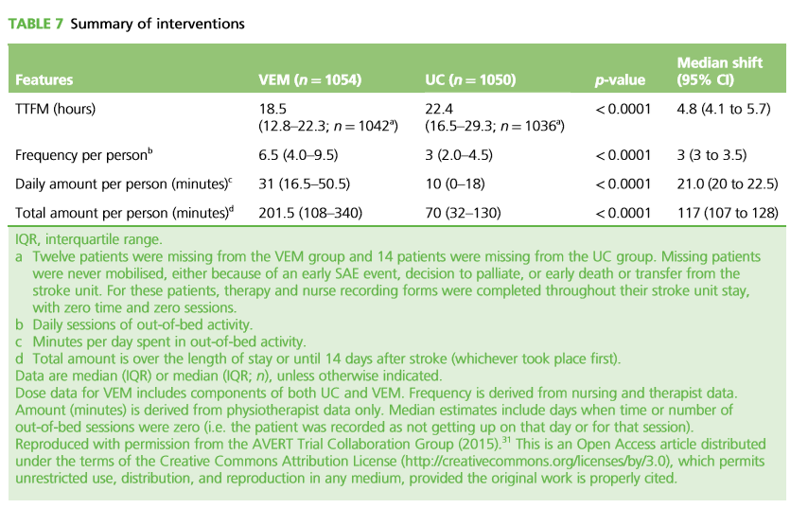

Slide 70
In Summary:
Any patient with clinical suspicion for stroke:
  If onset occurred within 4.5 hours, consider treatment with thrombolysis
If there’s clinical suspicion for large vessel occlusion:
  Determine eligibility for thrombolysis
    AND
  Consider transfer to a center with IAT capability
After admission: multidisciplinary teams including nursing, rehab, case management
Stay tuned for new developments!

Slide 71
What does UAB offer
24/7 access to board certified vascular neurologists for consultation and/or patient transfer to the UAB Mist Line (205) 934-MIST
24/7 Neurointerventionalist coverage for intra-arterial therapy (if indicated)
Dedicated Neurointensive Care Unit and Stroke Step Down
Novel experimental therapies through clinical trials

Slide 72
