Slide 1


Slide 2

Cloning in R18
Ben Jenkins – bljenkins1@waketech.edu
Notes:
Jango

Slide 3
First things first…
A huge shout out to Cinda Goff for her notes and assistance, particularly with MECU settings related to FTP parameters.
Primary Non-Cinda Sources:
  NC Community Colleges “R18 Cloning Process”
  Colleague R18 Installation Procedures
  Managing Colleague Software Environments

Slide 4
What We’ll Be Focusing On
Terminology
Cloning Steps (Data Refresh)
Mecu/Becu
Directories

Slide 5

Terminology

Slide 6
Terminology
Cloning
The creation of an application environment with the same software and data as an existing application environment.

Slide 7
Terminology
Source Application Environment
The application environment that is being cloned
(Production)
Target Application Environment
The application environment that results from cloning
(Test)

Slide 8
Terminology
Local Product Repository (LPR)
A storage area for software updates from Ellucian, customer licensing information, and your own release packages.

Slide 9
Terminology
SA Valet
The application tool that supports Datatel system administration. Datatel SA Valet administers the DMI servers on the Datatel system and runs on a Microsoft Windows machine. In Release 18, SA Valet is also the interface for the release system.

Slide 10
Terminology
DMI
Datatel Messaging Interface. A highly efficient message structure for communication between DMI Listeners and other Datatel software components.

Slide 11
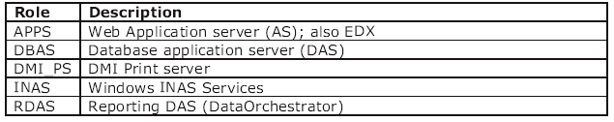
Terminology
DMI Listeners
Java based programs that interpret commands between two software components that do not have a common command set.
Functionality: security, data transformation services using XML/XSLT, thread management, Java Runtime Environment (JRE)

Slide 12
Terminology
DMI application server (APPS)
Software that provides access to the Datatel application. Most external software that interfaces with Colleague uses this Listener to exchange communications. A DMI application server has the following additional specialized functionality:
Application server for WebAdvisor, between the Web server and Colleague, and other web software.
The UniData runtime environment.
Communications hub for EDX/partner interfaces.

Slide 13
Terminology
DMI data access server (DBAS)
Software that controls access to the data in the database environment. This is the primary method for the application environment to communicate with the database environment. A Colleague installation includes a DMI data access server for the product repository database, as well as a DMI data access server in each application environment for the Colleague database.
JDBC-based extensible database interface is the DMI data access server’s additional specialized functionality.

Slide 14
Terminology
Datatel Application Server
Colleague executables, running on a UniData virtual machine (VM), and the DMI Listener, that work together to make the Colleague application run. In Release 18 architecture, the database does not reside on this server. Clients will likely have “production”, “test,” and “development” application servers.

Slide 15
Terminology
Datatel daemon
Communications software used to access DMI Listeners and to transfer files during installation. It performs functions typically performed by Telnet and FTP. The daemon is designed to work with all operating systems supported by Datatel. (Telnet and FTP are not consistent across the operating systems).

Slide 16

Directories

Slide 17
Directories
Application Environment Directories
Production, dev, test, etc
apphome
Where Colleague executables are installed- In a Unidata environment it also contains Colleague data
repository_das
Where the DMI data access server (das) for the local product repository is installed

Slide 18
Directories
datatel/coll18/coll18
Where the local product repository (lpr) is installed in a Unidata environment
das
Directory where the DMI data access server for the Colleague database is installed
svr01
Directory where the DMI app server will be installed

Slide 19
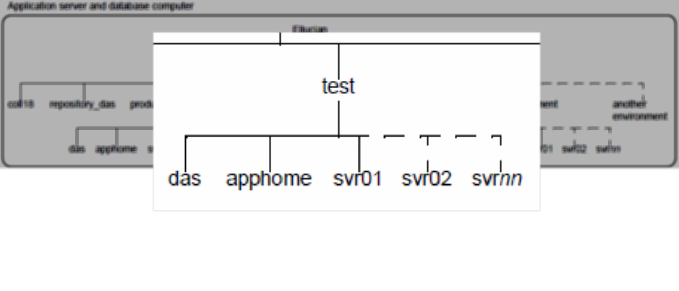
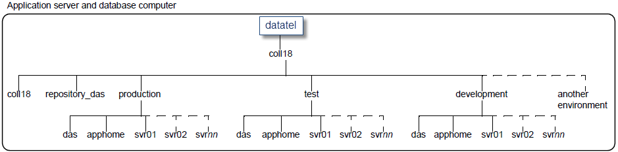
Directories

Slide 20
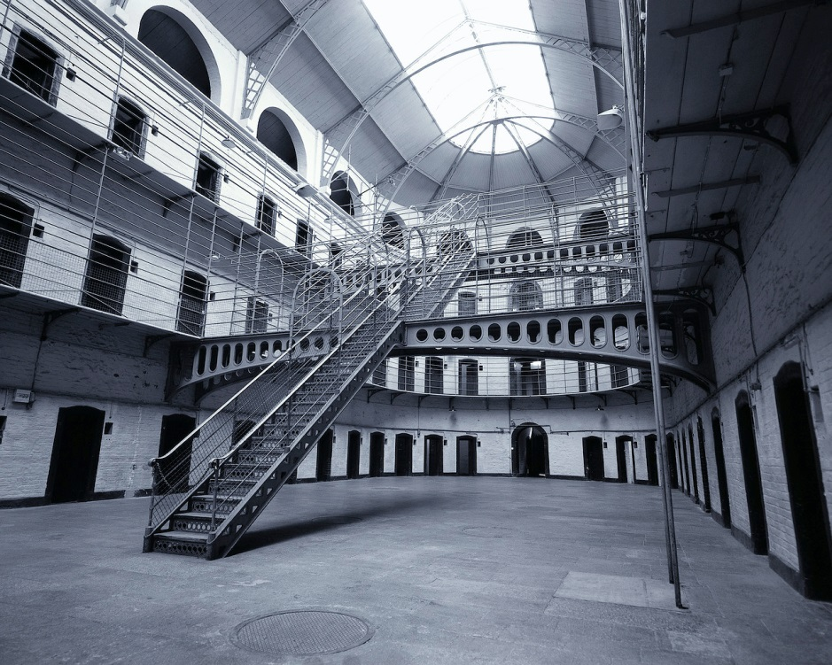
Cloning Steps

Slide 21
Cloning Steps
Record Necessary Information
Prevent User Access
Delete Target Environment
Remove Existing Application Directories/Files
Recreate the File System
Copy Directories and Files
Clone Production
Cleanup

Slide 22
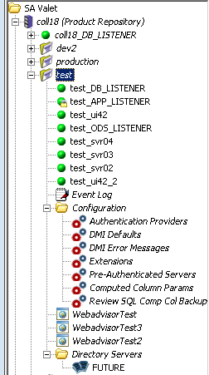
Cloning Steps
(Record Necessary Information)
SA Valet > Target Environment
Screenshots, screenshots, and more screenshots
Listeners
Authentication providers
Webadvisor servlets
Directory server info
Copy input intensive text into a notepad document for future pasting activities.

Slide 23
Cloning Steps
(Prevent User Access)
From the “R18 Cloning Process” document:
“After production directories are copied, but before the SA Valet Clone Environment Wizard is run, users will be able to login to the test environment, but will actually be redirected to the production environment due to the SQLENVINIT command in the copied LOGIN paragraph”.
We don’t want that…

Slide 24
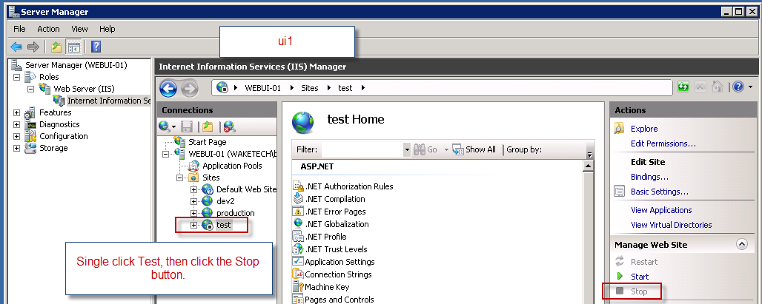
Cloning Steps
(Prevent User Access)
To disable access to test:
  Log in to your webserver.
  With the Server Manager open, Roles> Web Server> Internet Information Services
  Under connections, expand WEBUI-01, expand sites, single click test.
  Under the Actions column click the Stop button.

Slide 25
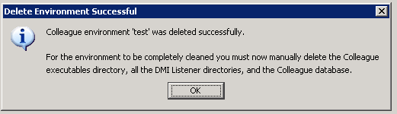
Cloning Steps
(Delete Target Environment)
  Access SA Valet and expand the coll18 environment using datatel as the username.
  Right click “test” and select Delete Application Environment from the drop-down menu.
  Answer yes to the dialogue box, if you’ve got the correct environment selected.
  Supply the datatel username and password.
  You should see:

Slide 26
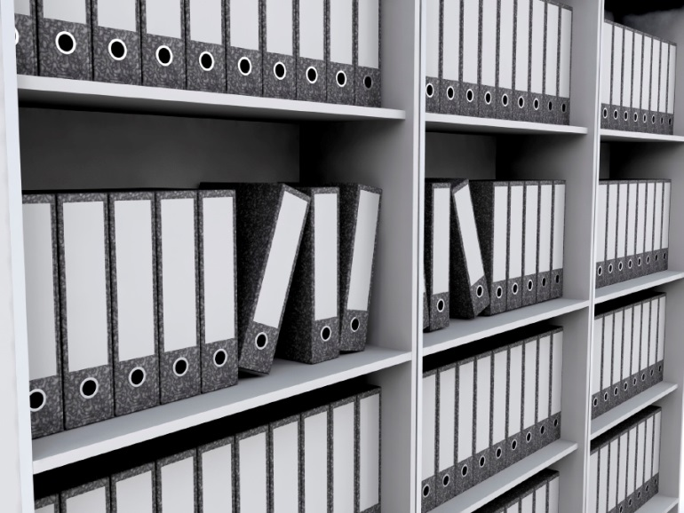
Cloning Steps
(Remove Existing Application Directories/Files)
  Wake Tech uses an IBM AIX operating system which allows us to take advantage of umount and rmfs commands.
  See the “R18 Cloning Process” document for information that may apply to your school’s OS.

Slide 27
Cloning Steps
(Recreate the File System)
  AIX also allows the use of “smitty”, the System Management Interface Tool, for file system management.
  See the “R18 Cloning Process” document for information that may apply to your school’s OS.

Slide 28
Cloning Steps
(Copy Directories and Files)
  It’s recommended that you clone using a quiet source (Production in this case) with no active users, listeners should be shut down, and patch levels should be equal in the source and target environments.

Slide 29
Cloning Steps
(Copy Directories and Files)
  Move to your newly created “test” directory and copy apphome over from “production” to the current directory.
  cp –rp /datatel/coll18/production/apphome . ***see note below
    Note: After apphome there is a space and a dot.
    The copy takes 4+ hours to complete.
  Verify the copy is accurate
    cd apphome
    ls –l | wc –l
      note the record count
    cd /datatel/coll18/production/apphome
    ls –l | wc –l
      compare the record count to the one noted above

Slide 30

Cloning Steps
(Copy Directories and Files)
  What if the totals don’t match???
  diff /datatel/coll18/production/apphome /datatel/coll18/test/apphome | grep Only
  Look for any missing files and copy them from production/apphome to test/apphome.
    Although the files above didn’t contain much, it felt better to end with an even count.

Slide 31

Cloning Steps
(Copy Directories and Files)
  Where are your WWW files?
  Some have chosen to mount these files on a RAM disk. For test you’ll probably want to copy them back to apphome.
  Then…

Slide 32
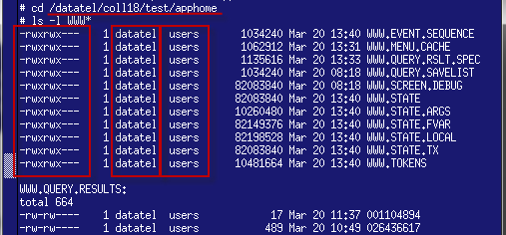
Cloning Steps
(Copy Directories and Files)
  change ownership and group to “datatel” and “users”
    chown datatel:users WWW*
  change permissions to allow for read and write
    chmod 770 WWW*

Slide 33

Cloning Steps
(Copy Directories and Files)
    Last part of the WWW files horror, I promise!!
    Log in to the Test environment in terminal mode and remove the “webfiles/” portion from line 2 of the voc entries for the WWW files listed above. The end result for each should look similar to:

Slide 34

Cloning Steps
(Clone Production)

Slide 35
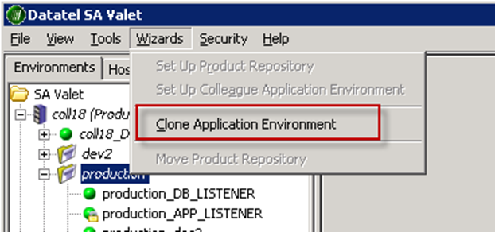
Cloning Steps
(Clone Production)
    Log in to SA Valet with the datatel user and credentials
      Assume from this point forward that, when dealing with SA Valet, unless otherwise specified the log in user will be datatel.
    Log in to the SA Valet production environment
    With the production environment selected, click the Wizards tab and Clone Application Environment.

Slide 36
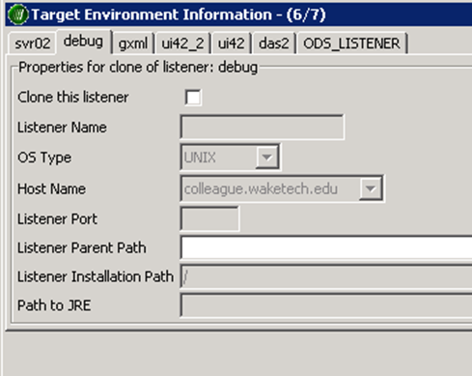
Cloning Steps
(Clone Production)
    Use the documentation you gathered at the beginning of all this to populate the information fields in the wizard.
    When you get to step 6/7, only clone listeners that existed in both test and production prior to cloning. Uncheck any you don’t need.

Slide 37
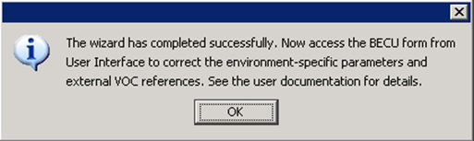
Cloning Steps
(Clone Production)
    You’ll have an opportunity to review your info at the end
    If everything looks good click “Install”
    Hopefully you’ll see:

Slide 38
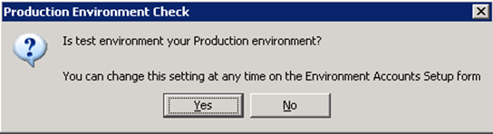
Cloning Steps
(Clone Production)
    Note: if the following message box appears at any point, choose “No”.

Slide 39
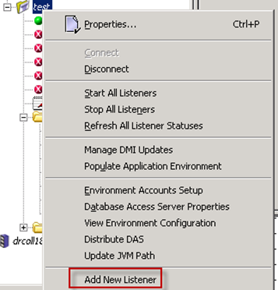
Cloning Steps
(Clone Production)
    Listeners in test that weren’t in production?
    Right click test > Add New Listener

Slide 40
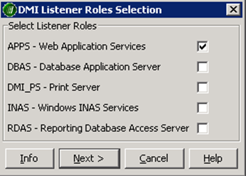
Cloning Steps
(Clone Production)
    Select a role for the listener:

Slide 41
Cloning Steps
(Clone Production)
    Provide listener info
    When the “DMI components to install” message box pops up click OK.
      The installation of these components can take 15+ minutes

Slide 42
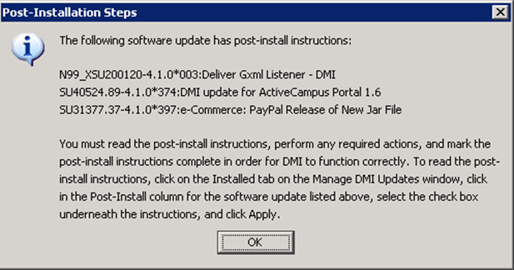
Cloning Steps
(Clone Production)
      Click OK.
      Right-click the test environment in SA Valet.
      Select Manage DMI Updates.
      Click the Installed tab.
Ensure the Post-Install steps are marked “Completed”.

Slide 43
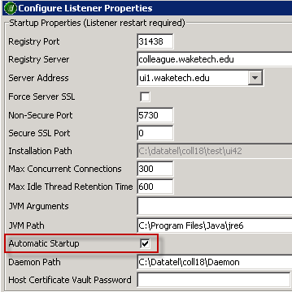
Cloning Steps
(Clone Production)
    Double click each listener in the environment, to open the Listener Properties, and toggle on Automatic Startup.

Slide 44
Cloning Steps
(Clone Production)
    Even if we don’t want the listeners to automatically start, they still need to be toggled on and saved at least once, which writes the listener name into the dmi.ini file.
    If you don’t want the datatel password to show up in plain text when a Unix ps command is run (ps –ef | grep datatel) I would suggest keeping automatic startup checked. If you check it, start it, then remove the automatic startup the password will be hidden until the next time the listener is started.
      Starting the listener with this box unchecked leaves the password visible.
    Set the Registry Server setting on the DB_LISTENER, APP_LISTENER, and each Webadvisor listener (svr02, svr03, and svr04) to “localhost”.
    R18 Cloning Process step 2.5.1.12 has info on Restore UI4.x Windows Registry Parameters

Slide 45
Cloning Steps
(Clone Production)
    Set up LDAP
      Start the app listener
      Right-click the Directory Servers folder, choose Create LDAP Server
      Input settings and priveleged user password
      Test authentication
    Create LDAP and REGISTRY authentication providers
    Manage LDAP Mappings

Slide 46
Cloning Steps
(Clone Production)
    Set up Web Server connections for WebAdvisor
    Stop/Start all listeners
    Re-enable “test” on your web server for access to UI.
      Get to the cleanup portion of things immediately. After UI is enabled you have the potential for big problems until BECU is run. **SQLENVINIT command in your login paragraph***
      Or you could edit your “test” login paragraph with a text editor before re-enabling your web server, which might not be a horrible idea.

Slide 47

Cloning Steps
(Cleanup)

Slide 48
Cloning Steps
(Cleanup)
Enable BECU access in TEST
  Log in to the test UI as Datatel
  SOD > datatel > add UT-ADMIN.PRIVILEGED
Run BECU with Environment Cleanup and Update Mode set to “Y”.
Remove UT-ADMIN.PRIVILEGED security class from the datatel user

Slide 49
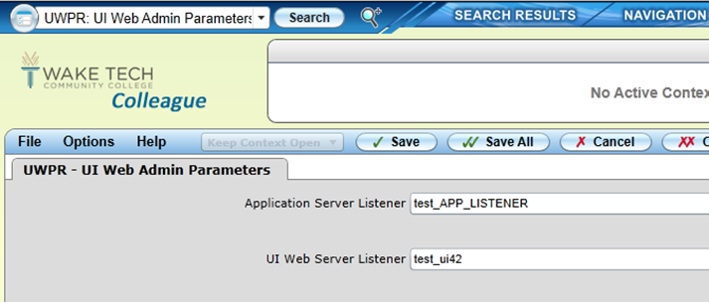
Cloning Steps
(Cleanup)
UWPR > provide server names
  If it won’t recognize the name use “…” and select from the list.

Slide 50
Cloning Steps
(Cleanup)
  At the colon prompt (if using LDAP):
    SELECT ORG.ENTITY.ENV WITH OEE.DMIDIRSERV EQ ‘<<production directory server name>>’
    MODIFY ORG.ENTITY.ENV OEE.DMIDIRSERV EQ ‘<<test directory server name’

Slide 51
Cloning Steps
(Cleanup)
  In UI, update the following if necessary:
    UT-EDIL
    EDSD
    EDQM > stop the queue/start the queue
    XNCI
    AS DATATEL > PRSC and clear the schedule
    RSPH and reset all queues
    CF-ECPR
    ECPG > Payment Gateway Definition > update with test server info

Slide 52
Cloning Steps
(Cleanup)
  UI updates continued:
    ECPA
    MTXT > NEWID > add html indicating test account
    XWMN
    UT-HLKM > XWMN
      Change link description
      Change target server path list

Slide 53

Cloning Steps
(Cleanup)
The clone is complete!!!!

Slide 54

MECU/BECU

Slide 55
MECU/BECU
Environ Cleanup Specs (MECU)
  Able to define element values to be changed when BECU is run.
  LESS CLEANUP!!!

Slide 56
MECU/BECU
How it works:
Identify a mnemonic that you would typically need to use to modify parameters after a clone.
  In this example, ECPR, e-Commerce Providers
Make note of:
  The target application(CORE)
  The name of the data element whose value we want to modify (ECOMM.HOST.ADDRESS)
  The key to the record we’ll be modifying (VERISIGN)

Slide 57
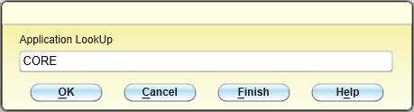
MECU/BECU
How it works (continued):
(PRODUCTION) MECU > drill down on an empty line
When prompted, provide the application we noted

Slide 58
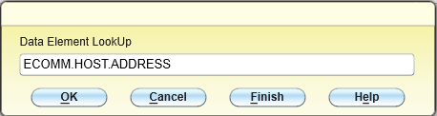
MECU/BECU
How it works (continued):
When prompted for a data element, provide it

Slide 59
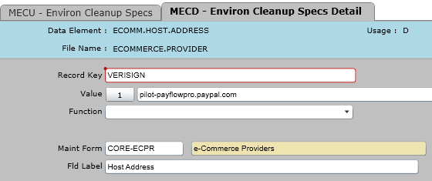
MECU/BECU
How it works (continued):
After reaching MECD, supply a key to the record you wish to modify and a value for the data element.

Slide 60
MECU/BECU
How it works (continued):
When you clone the definitions you’ve created will be copied over to the target environment.
Run BECU (IN THE TARGET ENVIRONMENT – TEST)
The values are automagically updated!!!
It’s just that easy!!

Slide 61

MECU/BECU

Slide 62
Thank you for your time!!!

