Slide 1
Oak Park Estates Neighborhood Association (OPENA) General Meeting & Program on Southern Gateway Project
Serving Oak Park Estates & Druid Hills
Better Together!
First Ever Virtual Meeting on Zoom!
May 19, 2020

Slide 2
Welcome to OPENA!
The Oak Park Estates Neighborhood Association (OPENA) provides a forum and an active support group for the residents of the Oak Park Estates and Druid Hills neighborhoods in order to make the area a safer, more attractive and a better place to live.
Any current resident of, or owner of property or a business, in a neighborhood of Oak Cliff and who has an interest in advancing the quality of life in our neighborhoods is eligible for membership.
Join OPENA at http://www.opena.org/join-us.html

Slide 3
OPENA Leadership Team:
Officers:
Tom Forsyth, President
Mary Harrison, Vice President
Beatrice Lovett, Treasurer
Richard Thomas, Secretary
Lucy Livingston, Past President
Standing Committee Chairs:
Kathy Biers, Membership
Brett Anderson, Communications
Cynthia White, Community Development
Corey Miles, Code & Crime Watch Chair
Block Captain Chairs:
Jacqulyn Peel, OPE North
Patsy Brown, OPE Southeast
Raquel Fuentes, OPE Southwest/Druid Hills
Ad hoc Committee Chairs:
Judy Pollock, Grants & Resources
Faye Williams, Programs
Carol Jackson, Publications
Carl Hays, Government Liaison
Lynn Witherspoon, Education Chair
Bernie Tjarks, Hospitality
Beautification Chair - Vacant
Social Events Chair – Vacant
New Officers in Red Type!

Slide 4
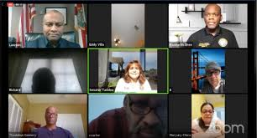
AGENDA - May 2020 OPENA General Meeting
Welcome
Prayer by Mother Emily Hylden, Vicar of St. Aug’s Oak Cliff
Pledge of Allegiance Led by Carl Hays, Gov’t Liaison
Introduction of Guests, Bernie Tjarks, Hospitality Chair
Announcements
Committee Reports:
Adoption of Minutes by Richard Thomas, Secretary
Treasurer’s Report by Beatrice Lovett, Treasurer
Membership by Kathy Birks
Grants by Judy Pollock
Code/Crime Watch by Corey Miles
DPD NPO Updates:
Sgt. Jamison Lewis, NPO Officer, Southwest Division
Program on “Southern Gateway Project”:
Ashton Strong, Project Manager, TX DOT
Katie O’Brian, Managing Director, Southern Gateway Public Green Foundation
John Reynolds, Program Manager at Dallas Park & Recreation Department

Slide 5
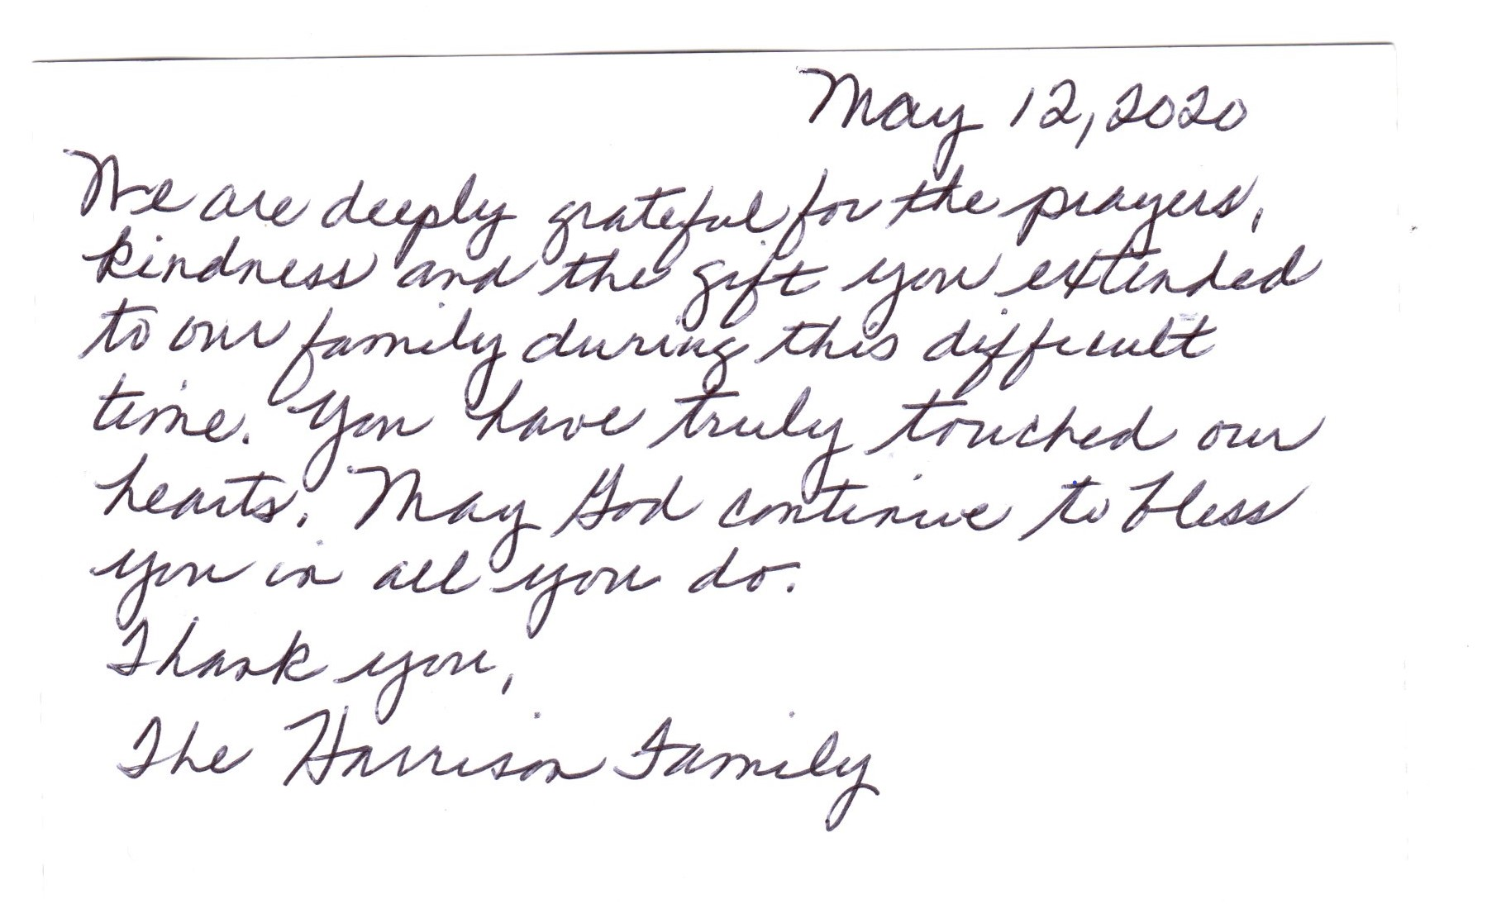
Prayers for the Harrison Family

Slide 6
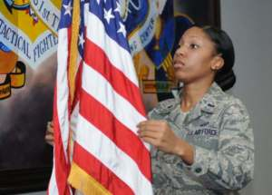
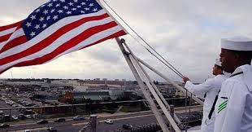
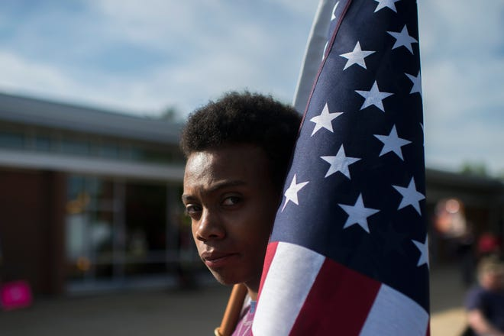

Slide 7
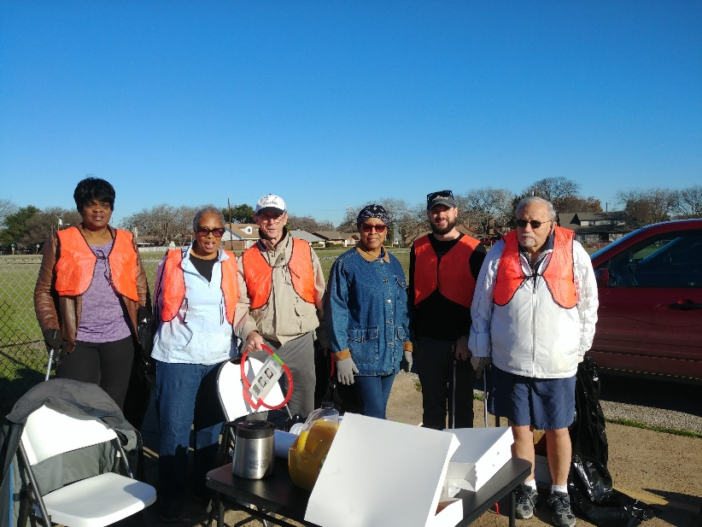
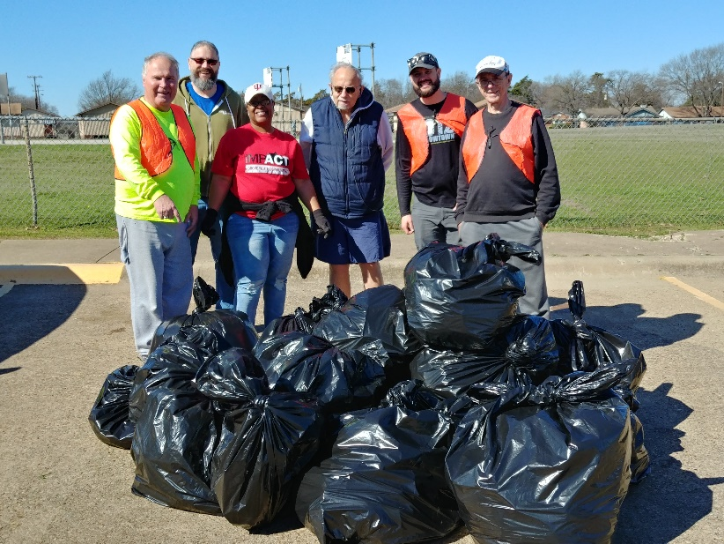
Operation Beautification in 2020
Clean up trash & litter on our major streets!
4 Dates Planned in 2020:
Sat. Feb. 8, 2020
Sat. May 9, 2020 (Cancelled due to Covid)
Sat. Aug. 8, 2020
Sat. Nov. 7, 2020
8:45 am at JW Carpenter School Teachers Parking Lot
Work from 9 am to 11:30 pm
Volunteers needed for each clean up day event!
You can plan your own clean up days!
Let us know if you need gloves, bags & pick-up tools!

Slide 8
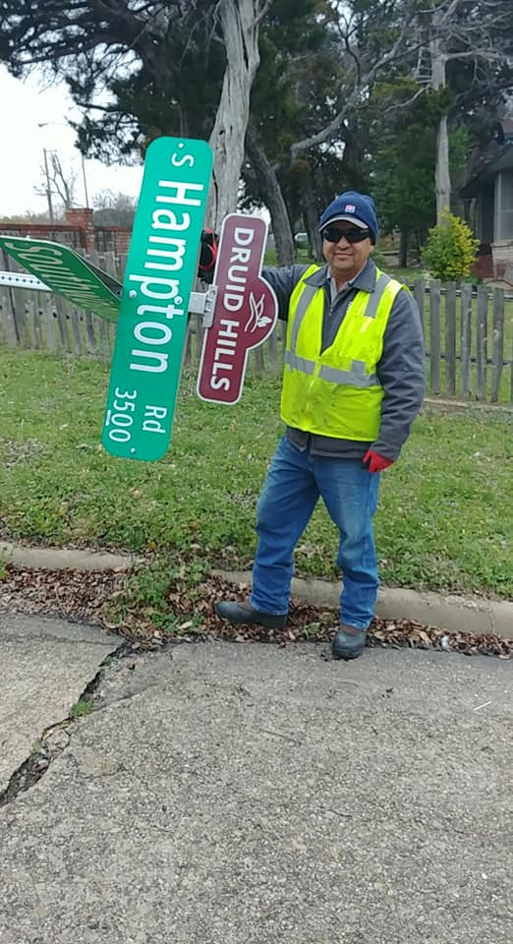
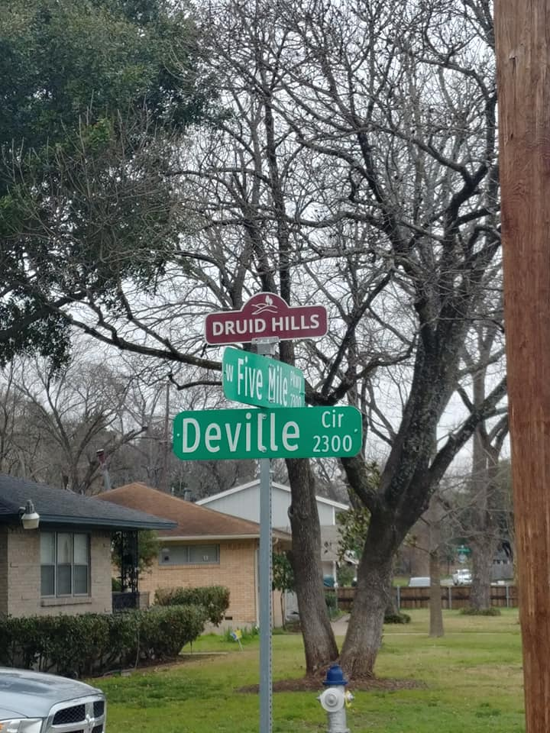
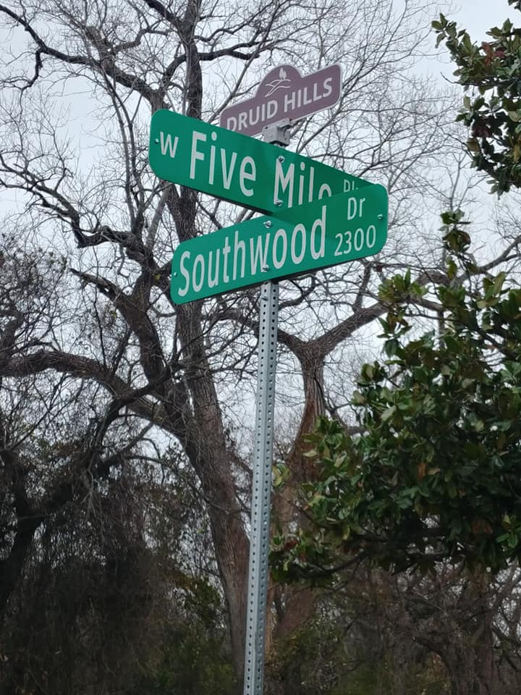
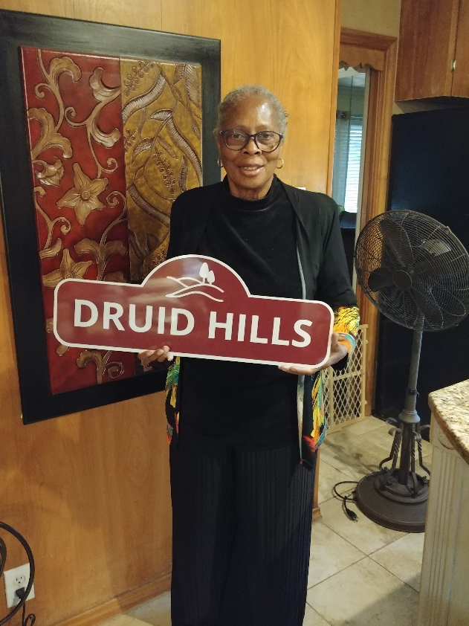
Druid Hills Sign Topper Update
First 15 Sign Toppers Installed in Feb. 2020.
Grant Submitted to HOC for Phase 2 – 15 more signs.

Slide 9
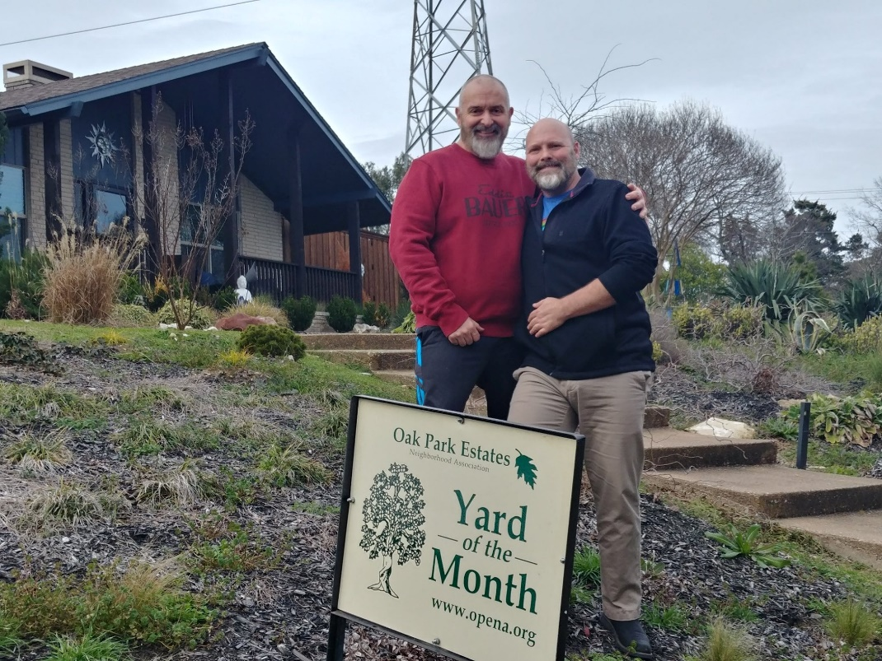
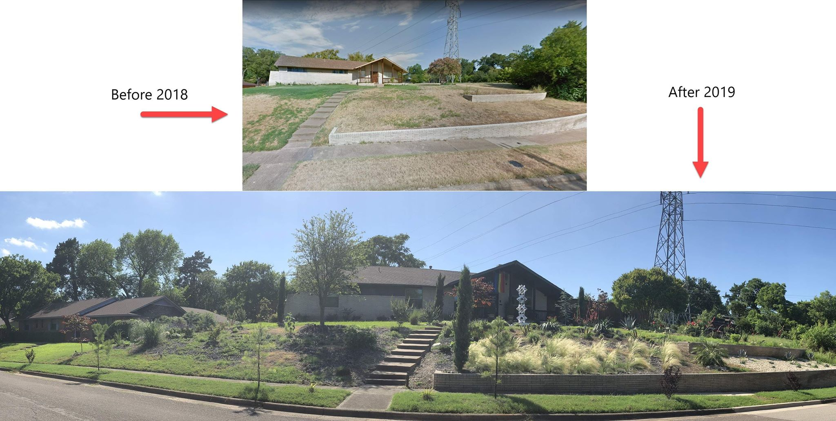
Yard of the Month – March/April
Brian Brown and Kim Seese at 3737 Cripple Creek Drive

Slide 10
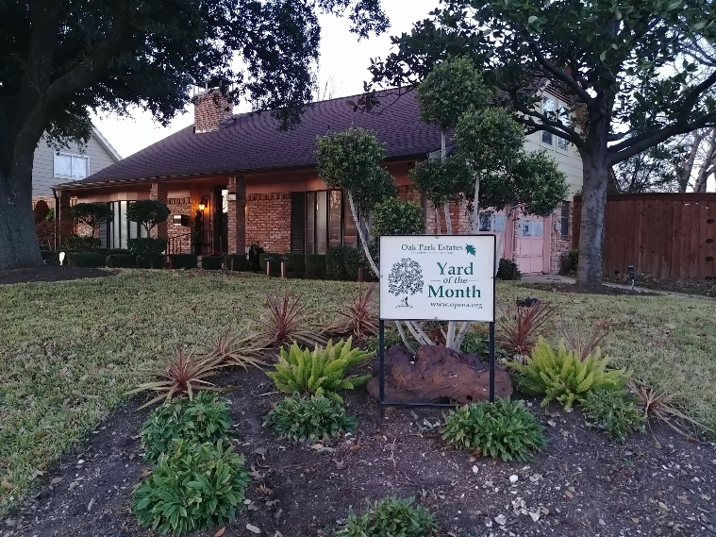
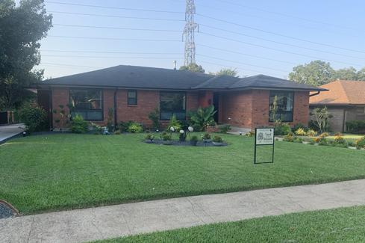
OPENA Yard of the Month Program
Program details & nominations can be
made at: http://www.opena.org/yard-of-the-month.html
Criteria:
Nice foliage & Kept Yard
Focus on beautification, originality & creativity
Combo of lawns, borders and flower beds
It’s visually appealing from the street!
Water-wise landscapes are also considered!
Be willing to have photos published

Slide 11
Oak Park Estates/Druid Hills T Shirts!
T Shirt Cost: $ 15.00 for Sizes S-XL
Std. Color: Dark Green with White Image
Custom Color: $ 5.00 extra per shirt
Each size up from XL: $2.50 Extra

Slide 12
Upcoming Meeting Reminders:
OPENA Board Meeting: Sat. June. 20 at 1:30 pm
Location: Likely by Zoom!
Next OPENA Gen’l Meeting: Tuesday, July 21 at 6:30 pm
Program: Annual Crime Watch Program
Location: TBD!

Slide 13
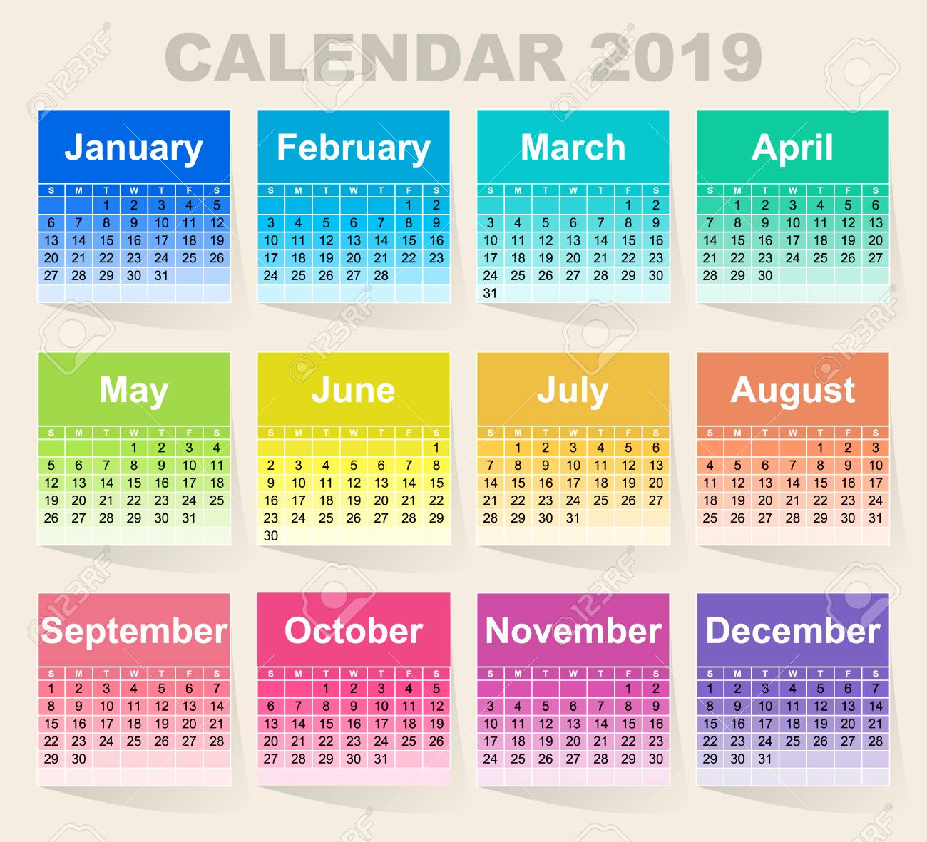
2020 Calendar

Slide 14
Meeting Minutes Richard Thomas, OPENA Secretary
General Meeting on Jan. 18, 2020
Board Meetings on Feb. 15 & Apr. 18, 20209

Slide 15
OPENA Treasurer’s Reports By Beatrice Lovett, Treasurer
Reports from 01/04/2020 to 05/19/2020

Slide 17
Membership Report – Kathy Birks
Membership Report (As of 05/15/2020):
2020 Member Total 41
2020 New Member Total 6
2019 Members Renewed in 2020 19
2018 Members Still to Renew 42
Member Attendance 1/19 27
Five (5) New & Renewing Members in May!
Alyssa and Nathaniel Strenger
Luisanna and George Hernandez
Keith Flanagan
Brett and Katie Anderson
Faye Williams

Slide 18
HOC Grant Application – Judy Pollock
Submitted on 05/15/2020
Four projects:
Phase 2 of the Druid Hills Sign Toppers Project
Becoming a 501 C3 or C4 Entity with Tax Exempt Status
Marketing of OPENA
Special Member Engagement Social Event
Total Amount of Grants: $ 4,427.62
HOC Reimbursement Amount: $ 2,656.57
OPENA Cost: $ 1,771.05

Slide 19
Neighborhood Handbook & Directory – Carol Jackson
Mission of the Oak Park Estates Neighborhood Association
Overview and History of Oak Park Estates & Druid Hills Neighborhoods
Meeting Schedule
Membership, Contact Us, OPENA Officers
City of Dallas Resources
Education Resources
Elected Officials
Local Business & Services Directory
Neighborhood Residents Directory

Slide 20
Submitting 311Requests
By Phone
Simply call 3-1-1 when inside Dallas' city limits.
You may also access Dallas 3-1-1 by calling (214) 670-3111 from any location.
Online
Visit - https://dallascrm.force.com/public/servicetypes
Mobile Application
Access your phone's app store
Download the OurDallas mobile app
City Hall On-the-Go – let us come to you!
Create a "City Hall on the Go" service request.

Slide 21
Crime Watch/NPO Update
Corey Miles, Code/Crime Watch Chair
Officer Jamison Lewis
Southwest Patrol Office
Desk: 214-670-0690
Jamison.Lewis@dallascityhall.com
Annual Crime Watch Program in July!
Dianne Edwards of Sunset Hills NA will teach us how to use Police Reporting Websites

Slide 22
Program: The Southern Gateway Project
The Highway Construction Project:
Ashton Strong, Project Manager, TX DOT
The Public Green Foundation/Deck Park:
Katie O’Brian, Managing Director, Public Green Foundation
John Reynolds, Program Manager at Dallas Park & Recreation Department

Slide 23
Special Thanks to our Sponsors!
Melissa Flanagan with Li’l Rhythms
Elijah Salazar with Peaberry Coffee
Ryan Munchrath with Ann’s Health Foods
James Fairchild with Ebby Holliday Realty
Cynthia White of W& W Business Services!

Slide 24
Questions?
Please email us at:
crimewatch@opena.org
www.opena.org

