Slide 1


Family Reunification Center Training
Strategic Emergency Education

Slide 2
Introductions…
Heather Jones
Krista Salinas

Slide 3

What is reunification?
Returning students to their families

Slide 4
Three Levels of Reunification
Normal
On Site
Off Site at a Reunification Center

Slide 5
Normal, regular school day reunification
You do reunification every day
Everyday steps that provide foundation for reunification:
  Accurate and up-to-date attendance records
  Current guardian contact and custody information
  Student health information
  Contact information for older students (their mobile numbers)

Slide 6
On Site Reunification
An event occurs, but is resolved and poses no threat to the students.
Event may result in early release or late release.
More parents than normal will probably pick up their kids.
Is it safe for walkers to walk?

Slide 7
Off Site at a Reunification Center
An ongoing event or safety issue that causes evacuation of students to another location for reunification.
  Natural disaster
  Violent event
    Ongoing investigation
    Unsafe area
Transport students to another location and then release them to their guardians.

Slide 8
Accountability & Communication
Normal
On Site
Off Site

Slide 9
Two Locations, Two Teams
Transportation
Reunification
Begins at the impacted school
Continues until all students and staff have been evacuated to reunification site
Begins at district office
Operates at reunification center
Continues until all students have gone home and all guardians have their students

Slide 10
Transportation Team: Key Activities
Assemble a master student roster, teacher roster and guest roster.
Provide safe transport of students and staff to reunification site.
Expect to be reassigned to reunification or other tasks

Slide 11
Transportation Team: Teachers
Teachers stay with their students until all students are reunited with their families.
Make note of missing students
  Bathrooms
  Library
  Late coming in from recess
Teachers with students at impacted school should be reunited when practical to do so.

Slide 12
Transportation Team: Buses
Notify bus drivers to report to bus garage
Identify bus pickup location
  In a controllable space to prevent students leaving or interference from parents or the public
  Away from media
Law enforcement may search students and staff prior to or after getting on the bus
Drop-off at reunification site
Return to event site to pick up more students as needed

Slide 13
Reunification Team: Staffing (How do we fill these positions?)
From the school where reunification is occurring:
  Counselors, office staff, facilities staff, para-educators, TAs
  Trusted parent volunteers that happen to be on site
Available staff from other schools, other district facilities

Slide 14
Reunification Team: Key Activities
Notify reunification site (if not yet done)
Notify reunification team to assemble
Prepare the reunification site
Account for incoming students
Account for outgoing students
Provide assistance to parents, law enforcement, students

Slide 15
Reunification Team: Preparation and Setup
Setup signage, tables, supplies, cone off areas in school and in parking lots
Coordinate with reunification school staff regarding impact on their normal operations, parent pickups, student movements, etc.
Ready student assembly area (auditorium, gym, etc.)
  Access to bathrooms
  Entertainment
  Snacks, drinks

Slide 16
Reunification: Go Kits
Reunification kits should be stored in multiple locations.
Contain necessary supplies, signs, forms, etc to handle the reunification process.
Include a copy of the reunification plan.

Slide 17
Reunification Team: Separate Students and Parents
In order to maintain accountability of all students you must keep the parents and guardians picking up students physically and visually separate from the students.
Only Runners/Reunifiers, with correct forms, should bring students to reunification area.
Parent Check-in
Student Assembly
Runners/Reunifiers

Slide 18
Reunification Team: Student Arrival
Check-in students as they arrive at assembly area
Three types of students:
  On the master attendance roster and at reunification site
    This is the ideal – you expected the student, you have the student
  Not on the master attendance roster, but at reunification site
    Add student to the master attendance – they were missed by attendance procedure
  On master attendance roster, but not at reunification site
    Student is missing, possibly a victim
    May have left school grounds without permission before, during, or after event
    Compare to office sign-out sheets, may have left for appointment
    Make a list of these students and share with parent check-in, District Office

Slide 19
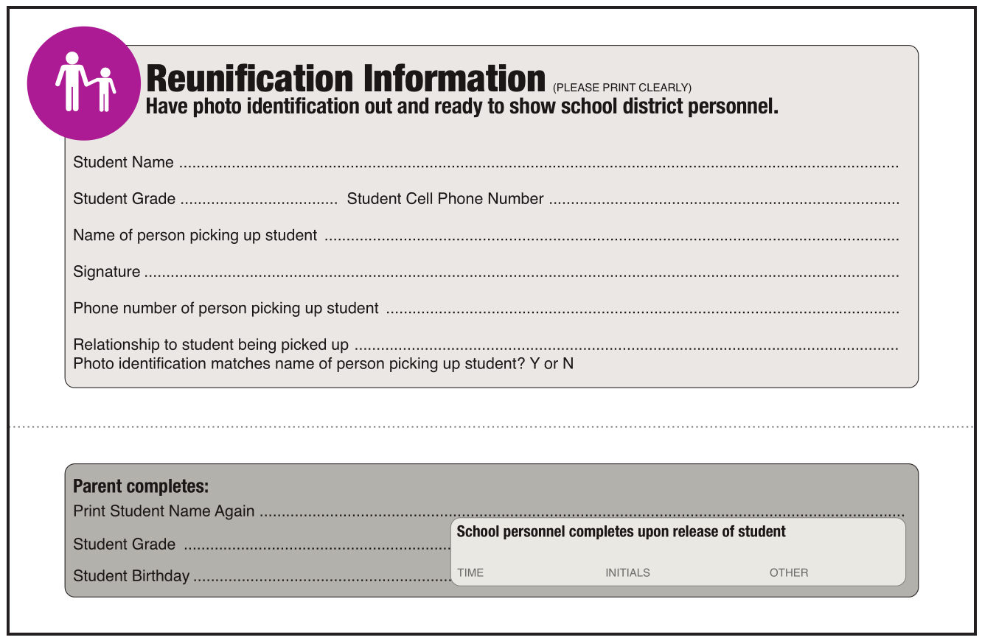
Reunification: Step 1 - Greetings
Parents arrive at reunification site
Greeters explain the process and hand out Reunification Cards (in Spanish and English)

Slide 20
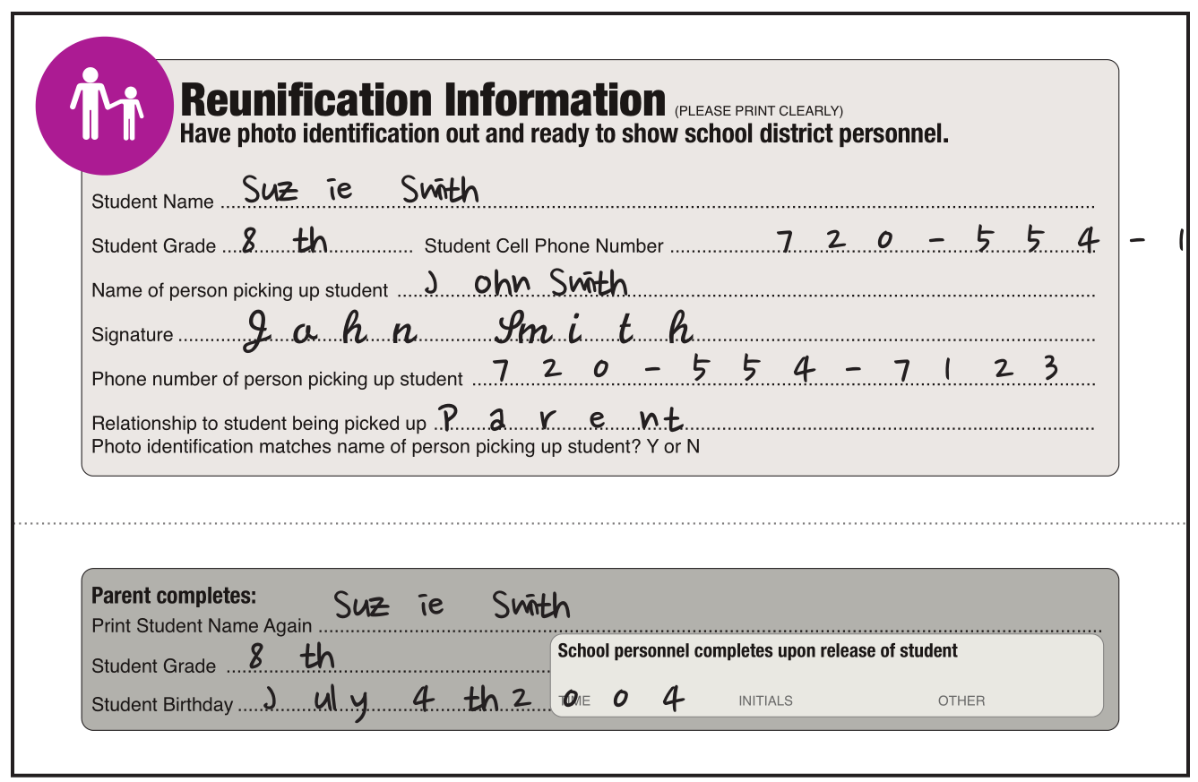
Reunification: Step 2 – Parents Fill Out Card
Parents fill in top and bottom of card (except school section)
One card per student
All cards filled completely
Parents get in line by student last name

Slide 21
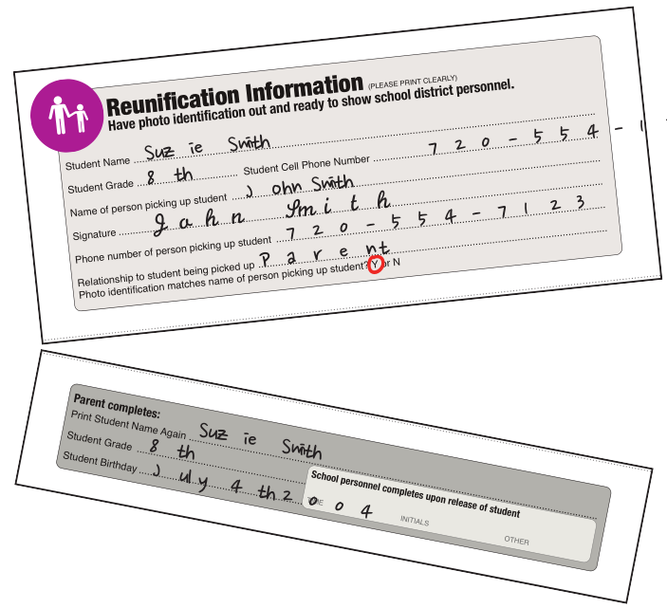
Reunification: Step 3 – Checkers Verify ID
Verify ID matches individual
Verify individual is allowed to pick up student (Parent/Guardian or emergency contacts only)
Verify that all cards are filled completely
Top is given to Parent Check-In, Bottom is returned to parent

Slide 22
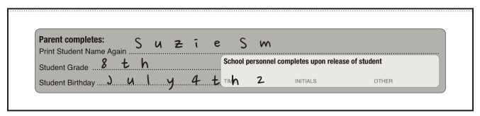
Reunification: Step 4 – Reunification Area
Parent gives bottom of form to Runer/ Reunifier
Runner / Reunifier goes to assembly area to collect student
Parent waits

Slide 23
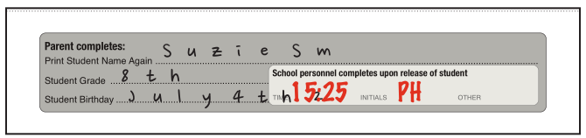
Reunification: Step 5 – Student Reunification
Runner / Reunifier brings student to parent.
Runner / Reunifier asks “Are you comfortable leaving with this person?”
If yes, note the time on the card and initial and release student to parent.
If no, alert supervisor or principal.

Slide 24
Reunification: Step 6 – Accountability
Reunifier brings bottom of card to Parent Check-In.
Parent Check-In verifies the cards against the master roster.

Slide 25
Reunification: What if?
The parent doesn’t have ID?
The student says “No they don’t feel comfortable”?
The student isn’t at reunification site?
A parent doesn’t claim their student?

Slide 26
Reunification: How to use law enforcement
Student assembly area
  Provide security against additional threats
  May be comforting to students
Greeting/Check-in Area
  Provide a sense of security
  Maintain order
  Help verify identification
Roads and Parking lot
  Traffic control
  Security

Slide 27
Reunification: Notifying parents
Notify parents about the Reunification Center once its location has been decided.
Use the script in the Reunification Plan to provide details in English and Spanish via broadcast calls.
Use social media, school website to share key details.
Expect them to show up at impacted school because their student has contacted them via mobile phone moments after the incident.

Slide 28
Reunification: Notifying parents (Sample)
This is an important message from Blank School District.
The School District is aware of the emergency situation at _____________ school.
At this time we are in the process of establishing the safety status of all students and staff.
Please listen carefully to these student-release instructions.
Parents or guardians, please go to the Family Reunification Center at ________ located at ______________ to pick up your child. Do not come to your child’s school. All students, including those who normally ride the bus, will be taken to the Designated Reunification Center and released to parents and guardians there.
Bring your photo identification with you.
School staff will check your ID against a list of individuals approved to sign out each student. This is for the safety of your child.
Thank you for your patience as we work to reunite you with your child.

Slide 29
Reunification: When to begin releasing students
Verify with law enforcement that they are ready for release
After all available students have been checked-in at the Student Assembly Area
  Prior to this point it is likely the Runner / Reunifier won’t find the student at the Assembly Area, not because they are missing, but because they have not yet arrived.
  Reduces workload for Runners / Reunifiers and stress for parents

Slide 30
Transition to Family Resource Center
After all students have been reunited with parents or guardians.
Secure location to provide information and resources to parents whose children are missing or deceased.
Provide updates on rescue and recovery efforts.
Provide emotional support. Support officers and CISM teams
Childcare for siblings.
Other services as needed.

Slide 31
Questions…

Slide 32
Let’s play a game…

